Slide 1
SPECIAL INTENSIVE REVISION
Uttar Pradesh 2026
Figures as of 10 April 2026, when the final roll was published.
Uttar Pradesh's draft roll left off 2.89 crore names, 18.7 of every 100 electors on the roll of 27 October 2025.
Women were 53.6% of the names left off and 46.8% of the roll before the revision. 21.5 of every 100 women on the roll were left off, against 16.3 of every 100 men, by the Chief Electoral Officer's rounded figures.
Urban areas lost 28.1 of every 100 electors and rural areas 15.3, by the Chief Electoral Officer's figures as the press reported them.
Lucknow left off 30.0 of every 100 electors, the most of the 75 districts, and 17 districts left off 20 or more. Lalitpur left off the fewest, 10.0.
No count by constituency was published. If each district's names left off are shared out over its seats by their electors, the share is larger than the 2022 winning margin in 377 of the 403 seats. This estimates how many seats the names left off could have decided. It cannot say which seats, or that any result changed.
After the draft, notices went to 3.26 crore electors, 26.0 of every 100 on it, and 3.5 lakh were deleted for not answering one.

Slide 2
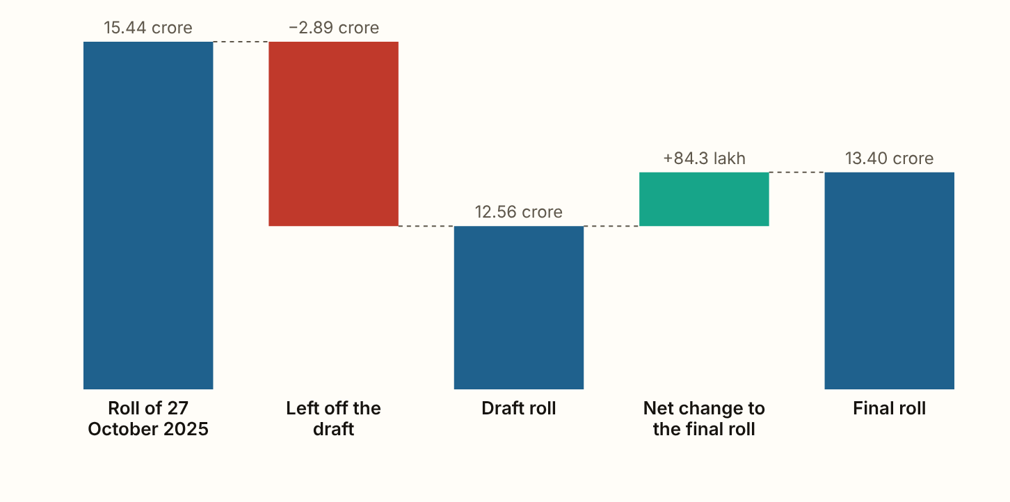
UTTAR PRADESH 2026 · The roll, step by step
The draft roll left off 2.89 crore names, 18.7 of every 100 electors.
Figures as published by the Chief Electoral Officer or the Election Commission; the method section of the report gives each source.
Notes:
The draft roll left off 2.89 crore names, 18.7 of every 100 electors. The final roll was 84.3 lakh larger than the draft, 29.2% of what the draft left off. That rise counts new voters as well as names put back, so it is the most that can have been put back. A further 8.2 lakh were deleted after the draft, as reported in the press.

Slide 3
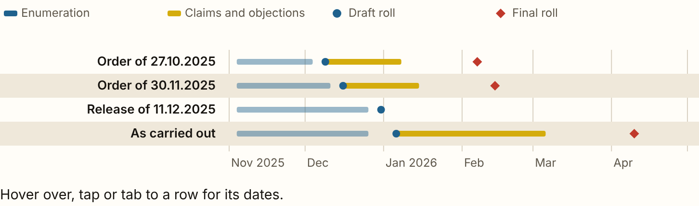
UTTAR PRADESH 2026 · When it happened
The final roll came out on 10 April 2026, 62 days after the date in the Commission's order of 27 October 2025.
Figures as published by the Chief Electoral Officer or the Election Commission; the method section of the report gives each source.
Notes:
The final roll came out on 10 April 2026, 62 days after the date in the Commission's order of 27 October 2025. The draft was published on 6 January 2026, 28 days later than that order set. Claims ran to 6 March 2026, and notices were heard until 27 March 2026.

Slide 4
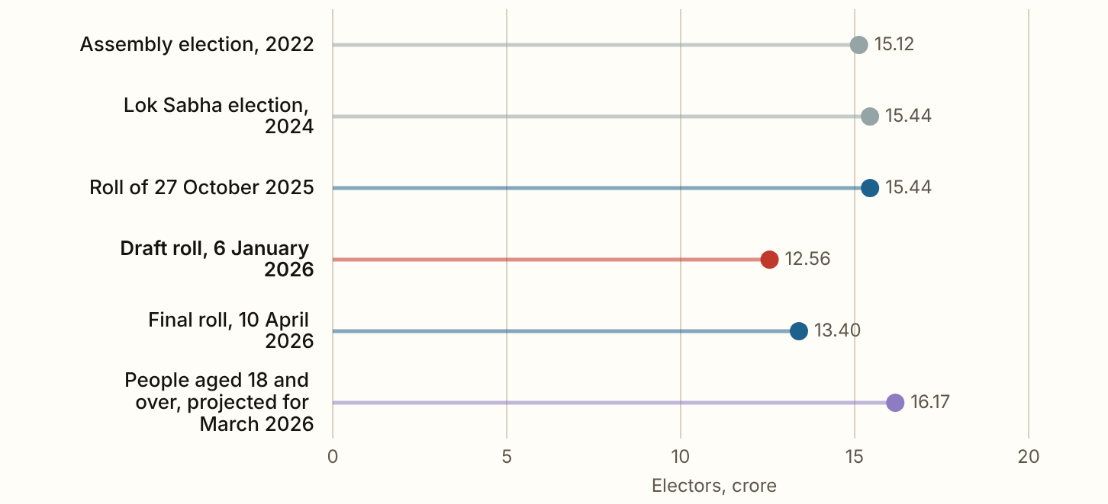
UTTAR PRADESH 2026 · The draft against earlier rolls
The final roll holds 1.73 crore fewer electors than the roll of the 2022 Assembly election, and 2.04 crore fewer than the roll of the 2024 Lok Sabha election.
Figures as published by the Chief Electoral Officer or the Election Commission; the method section of the report gives each source.
Notes:
The final roll holds 1.73 crore fewer electors than the roll of the 2022 Assembly election, and 2.04 crore fewer than the roll of the 2024 Lok Sabha election. The roll the revision started from held 95.5 electors for every 100 people of voting age. The draft held 77.7 and the final roll 82.9. The population figure is a projection, and if it is right, about 2.77 crore adults living in the state are on no roll here, some of them because they are registered in another state or are not citizens.

Slide 5
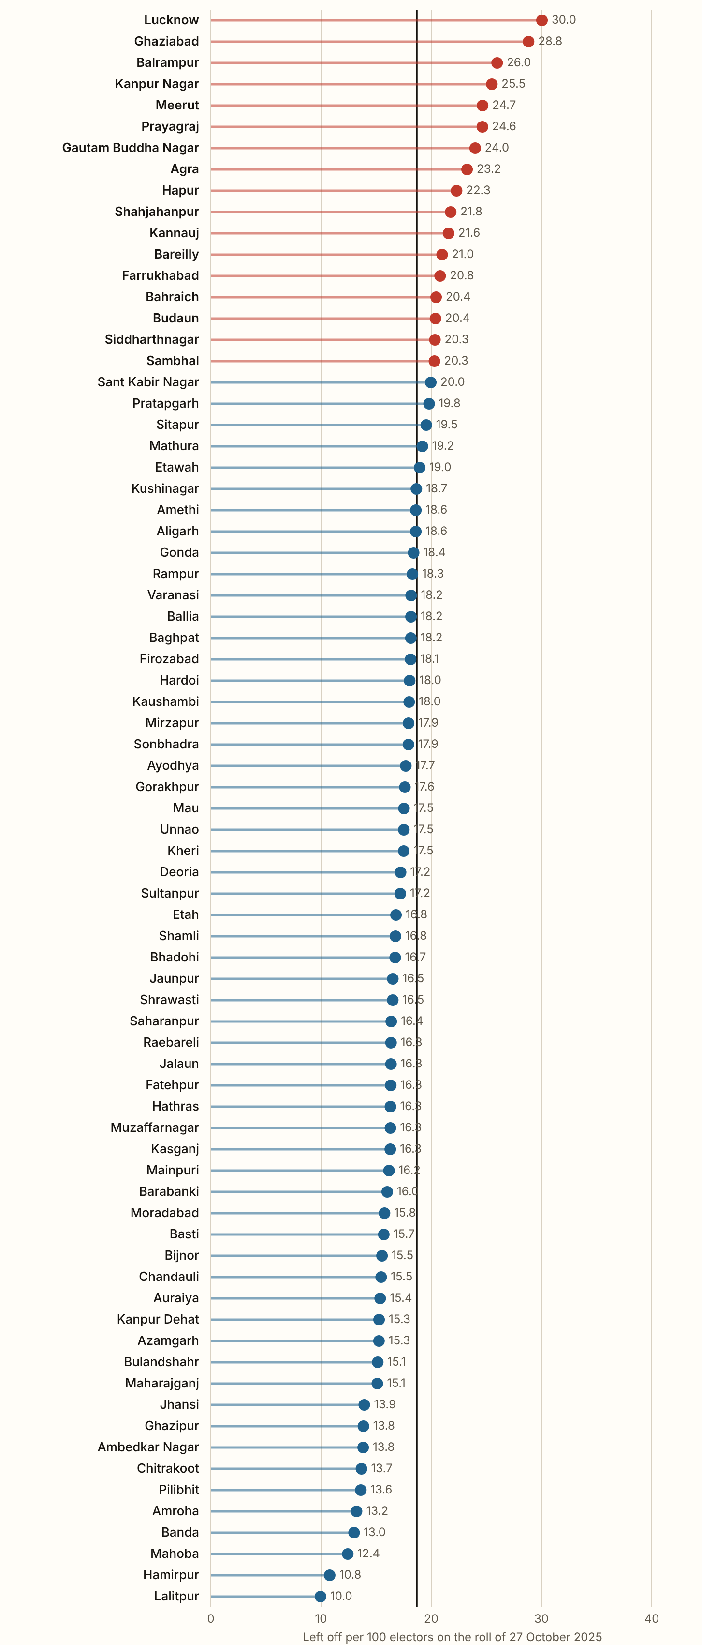
UTTAR PRADESH 2026 · Per 100 electors, by district
Lucknow left off 30.0 of every 100 electors, 12.0 lakh names, the most of any district.
Ghaziabad, Balrampur, Kanpur Nagar and Meerut come next. 17 of the 75 districts left off 20 or more per 100, against 18.7 for the state. Lalitpur left off the fewest, 10.0. The upright line on the chart marks the rate for the state as a whole.
Figures as published by the Chief Electoral Officer or the Election Commission; the method section of the report gives each source.
Notes:
Lucknow left off 30.0 of every 100 electors, 12.0 lakh names, the most of any district. Ghaziabad, Balrampur, Kanpur Nagar and Meerut come next. 17 of the 75 districts left off 20 or more per 100, against 18.7 for the state. Lalitpur left off the fewest, 10.0. The upright line on the chart marks the rate for the state as a whole.

Slide 6
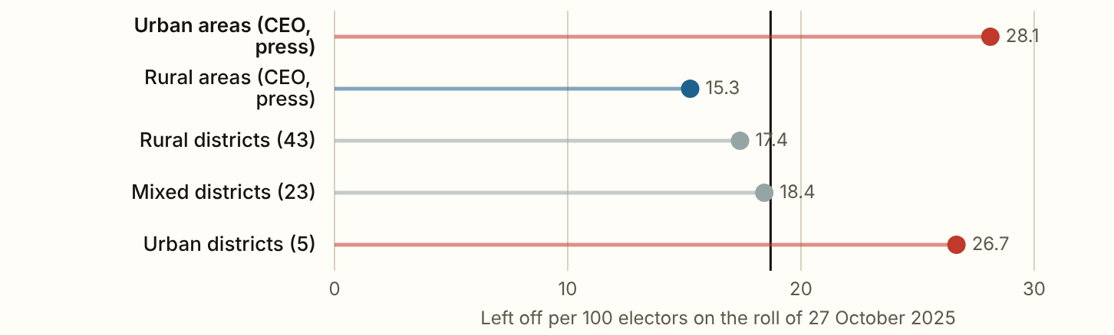
UTTAR PRADESH 2026 · Towns and villages
Urban areas lost 28.1 names for every 100 electors and rural areas 15.3.
Figures as published by the Chief Electoral Officer or the Election Commission; the method section of the report gives each source.
Notes:
Urban areas lost 28.1 names for every 100 electors and rural areas 15.3. Urban areas held 26.9% of the roll and 40.5% of the names left off, 1.17 crore of them. The five districts where most people lived in towns in 2011 lost 26.7 per 100 and the 43 most rural 17.4. The Hindustan Times printed the rural fall as 1.27 crore, but its own two rural rolls, and the 15.23% it gives, put it at 1.72 crore, which is the figure used here.

Slide 7
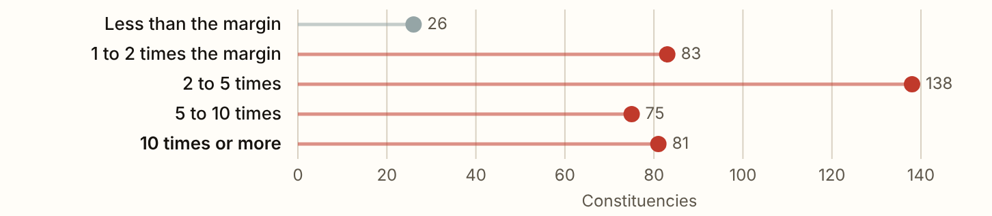
UTTAR PRADESH 2026 · Against the 2022 winning margins
On this spread, the names left off were larger than the 2022 winning margin in 377 of the 403 constituencies.
Figures as published by the Chief Electoral Officer or the Election Commission; the method section of the report gives each source.
Notes:
On this spread, the names left off were larger than the 2022 winning margin in 377 of the 403 constituencies. In the typical seat the margin was 19,684 votes and the spread puts 66,644 names left off. All 53 seats won by fewer than 5,000 votes are among them. Larger than the margin means the names left off were large enough to decide the seat. It does not mean they did, since the people left off would not all have voted, nor all for one side. Spreading the state's total over the seats without the district split, as the All India margins page does, gives 381.

Slide 8
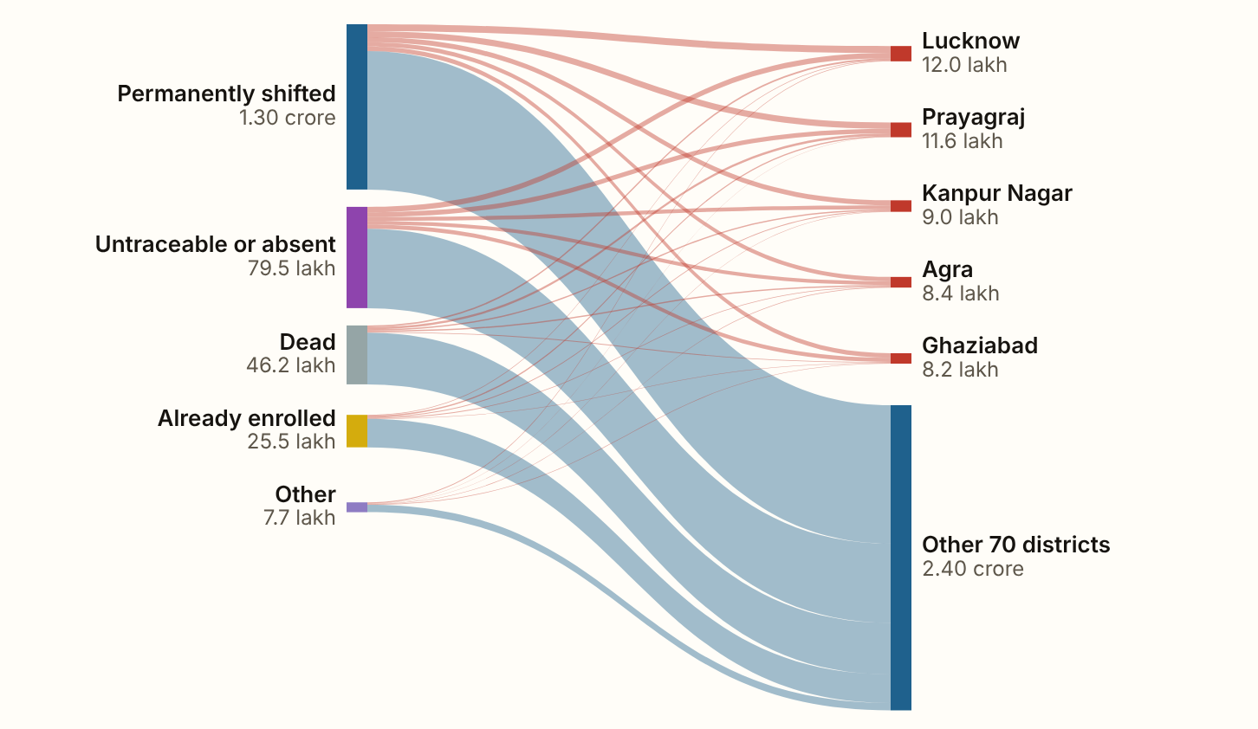
UTTAR PRADESH 2026 · The reasons
Across the state, 44.9% of the names left off were entered as permanently shifted, 27.5% as untraceable or absent and 16.0% as dead.
Figures as published by the Chief Electoral Officer or the Election Commission; the method section of the report gives each source.
Notes:
Across the state, 44.9% of the names left off were entered as permanently shifted, 27.5% as untraceable or absent and 16.0% as dead. 8.8% were entered as already enrolled elsewhere. The share entered as untraceable or absent is highest in Ghaziabad, 39.1%, and the share entered as dead in Gonda, 22.4%.

Slide 9
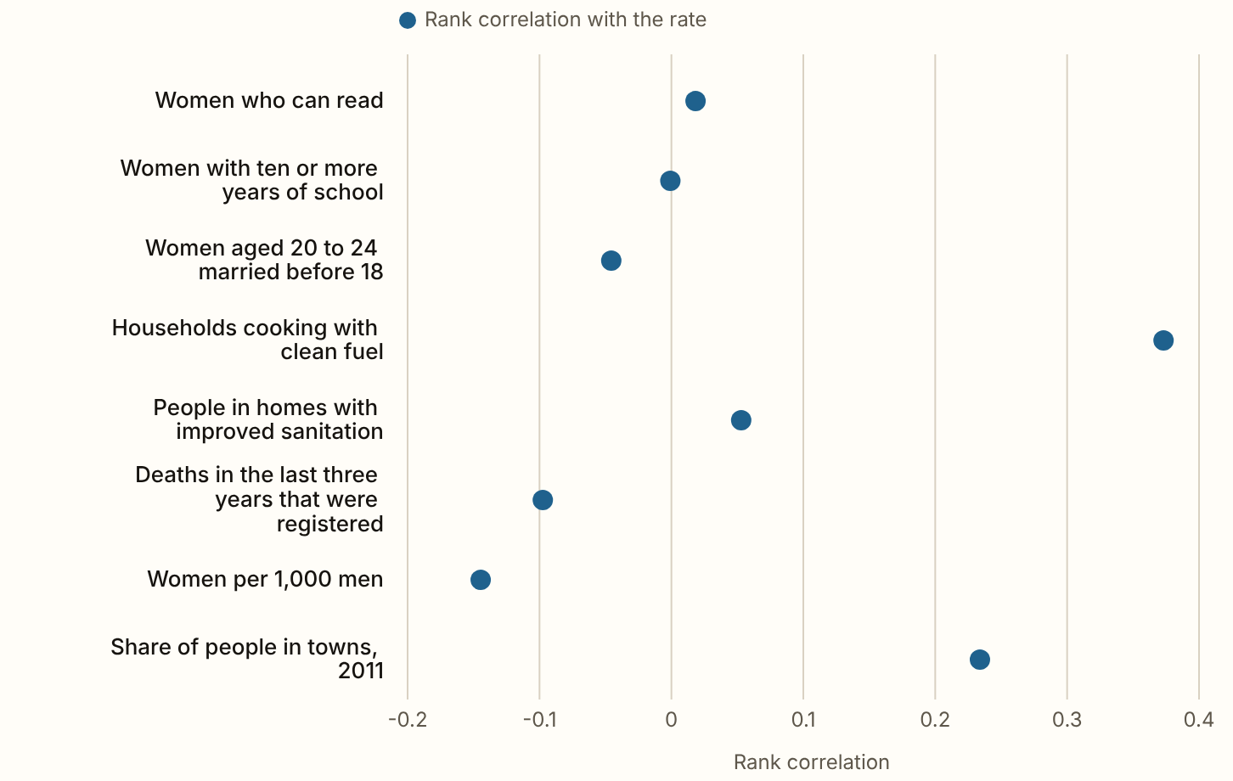
UTTAR PRADESH 2026 · District circumstances
households cooking with clean fuel (0.37) is the only circumstance clear of chance.
Figures as published by the Chief Electoral Officer or the Election Commission; the method section of the report gives each source.
Notes:
households cooking with clean fuel (0.37) is the only circumstance clear of chance. Schooling, early marriage, sanitation, registered deaths and the sex ratio show no relationship with the rate. Clean cooking fuel is most common in the towns, and the share of people in towns, 0.23 across 71 districts of 2011, sits just short of the line. The rate follows the towns more than anything about schooling or women's lives.

Slide 10
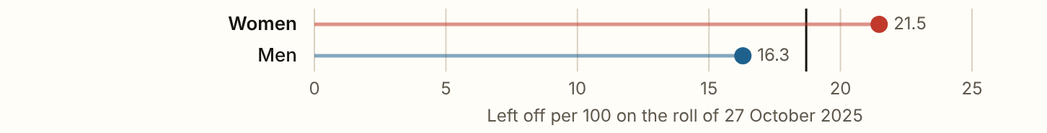
UTTAR PRADESH 2026 · Women
Women were 53.6% of the names left off and 46.8% of the roll before the revision.
Figures as published by the Chief Electoral Officer or the Election Commission; the method section of the report gives each source.
Notes:
Women were 53.6% of the names left off and 46.8% of the roll before the revision. For every 100 women on the roll, 21.5 were left off the draft, against 16.3 for every 100 men. The roll had 877 women for every 1,000 men in 2025, the draft 824 and the final roll 834. Women were 49.8% of the rise from the draft to the final roll, 50.5% of the 70.7 lakh Form 6 claims, and 41.2% of the electors whose deletion was sought in the 2.7 lakh Form 7 objections.

Slide 11
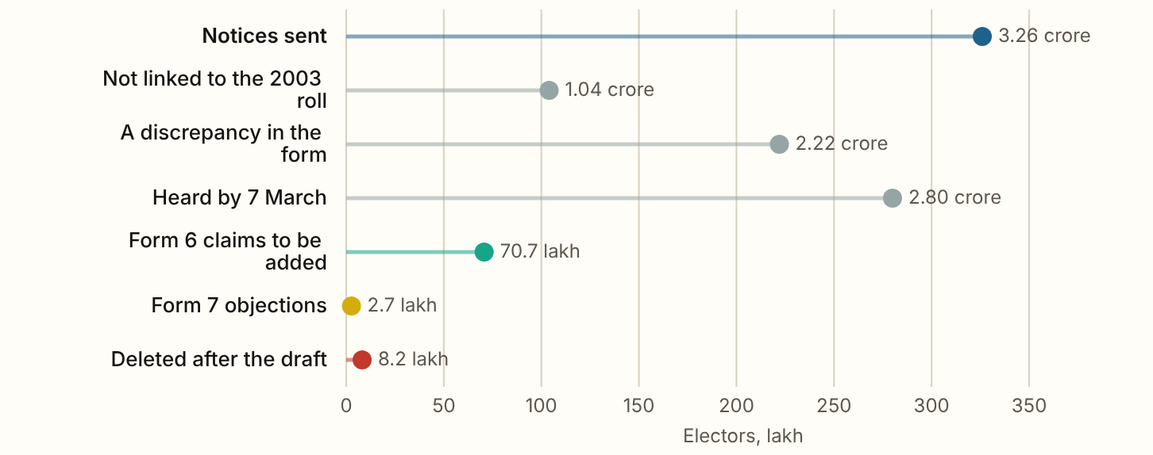
UTTAR PRADESH 2026 · After the draft
Notices went to 3.26 crore electors kept on the draft, 26.0 of every 100 on it.
Figures as published by the Chief Electoral Officer or the Election Commission; the method section of the report gives each source.
Notes:
Notices went to 3.26 crore electors kept on the draft, 26.0 of every 100 on it. 1.04 crore could not be linked to the roll of 2003 and 2.22 crore had a discrepancy the Commission's software found in their form, such as a name or a parent's name that did not match. They were heard by 8,751 assistant registration officers under 493 registration officers, about 3,725 notices for each assistant officer, or about 56 for each of them every day from 21 January to 27 March. The Hindu reported the two groups as 1.4 crore and 2.02 crore, which add to more than the 3.26 crore total, so the split the Hindustan Times reported, which adds up, is used here.

Slide 12
UTTAR PRADESH 2026
What these figures cannot show
The figures are by district only, from the Chief Electoral Officer's table as published in the press. The split by sex, by urban and rural area and the notices are the Chief Electoral Officer's figures as the press reported them, rounded to the lakh.

