Slide 1
SPECIAL INTENSIVE REVISION
Maharashtra 2026
Figures as of 31 August 2026, when the draft roll was published. The final roll is due on 16 November 2026.
Maharashtra's draft roll of 31 August 2026 left off 2.07 crore names, 21.1 of every 100 electors on the roll before the revision.
Bhiwandi East lost 49.1 of every 100 names, the most of the 288 constituencies, and in 220 of them more names were left off than the 2024 winning margin.
Thane left off 38.4 of every 100 electors, the most of the 36 districts, and Mumbai City, Mumbai Suburban, Pune and Nagpur come next. Hingoli left off the fewest, 8.8.
The five districts of Mumbai City, Mumbai Suburban, Thane, Palghar and Pune hold 29.9% of the state's roll and 48.4% of the names left off. They lost 34.2 of every 100 electors, against 15.6 in the other 31 districts.
37.1% of the names left off were entered as shifted for good, 36.5% as untraceable or absent, 16.8% as dead, 8.5% as enrolled at another place and 1.1% under another reason, by the Chief Electoral Officer's own tables.
Claims and objections run to 26 October 2026, and the final roll is due on 16 November 2026. Until it is out, nobody can say how many of the names left off will be put back.

Slide 2
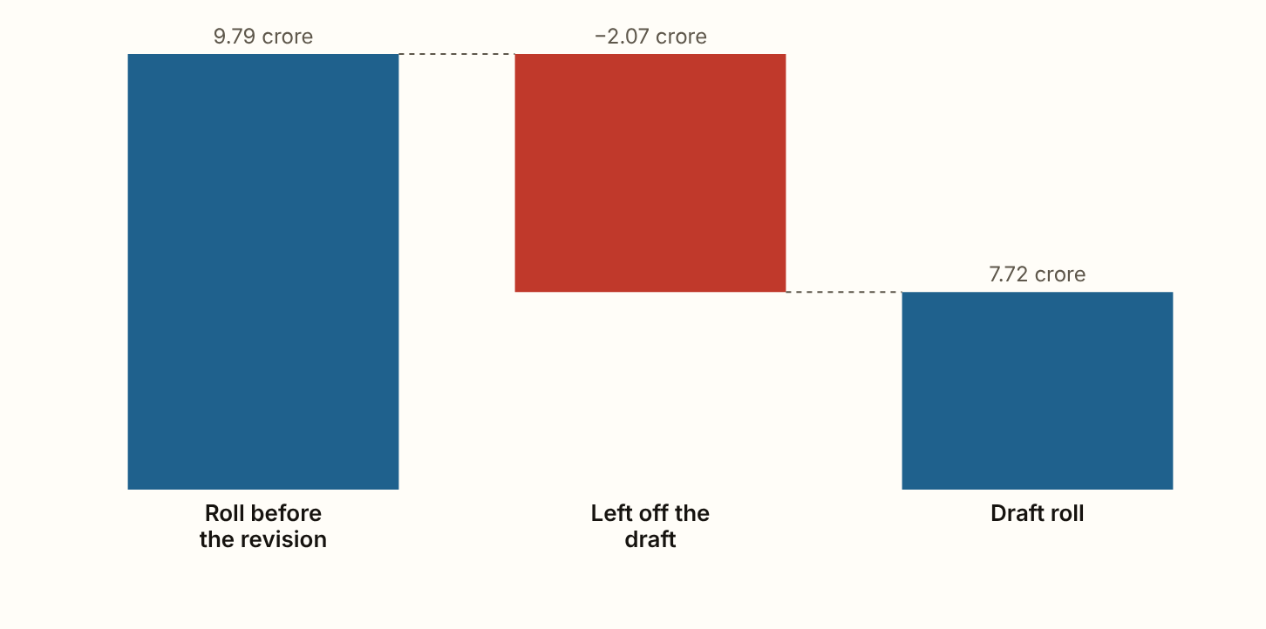
MAHARASHTRA 2026 · The roll, step by step
The draft roll left off 2.07 crore names, 21.1 of every 100 electors.
Figures as published by the Chief Electoral Officer or the Election Commission; the method section of the report gives each source.
Notes:
The draft roll left off 2.07 crore names, 21.1 of every 100 electors. The roll before the revision held 9.79 crore names and the draft holds 7.72 crore. One crore is ten million.

Slide 3
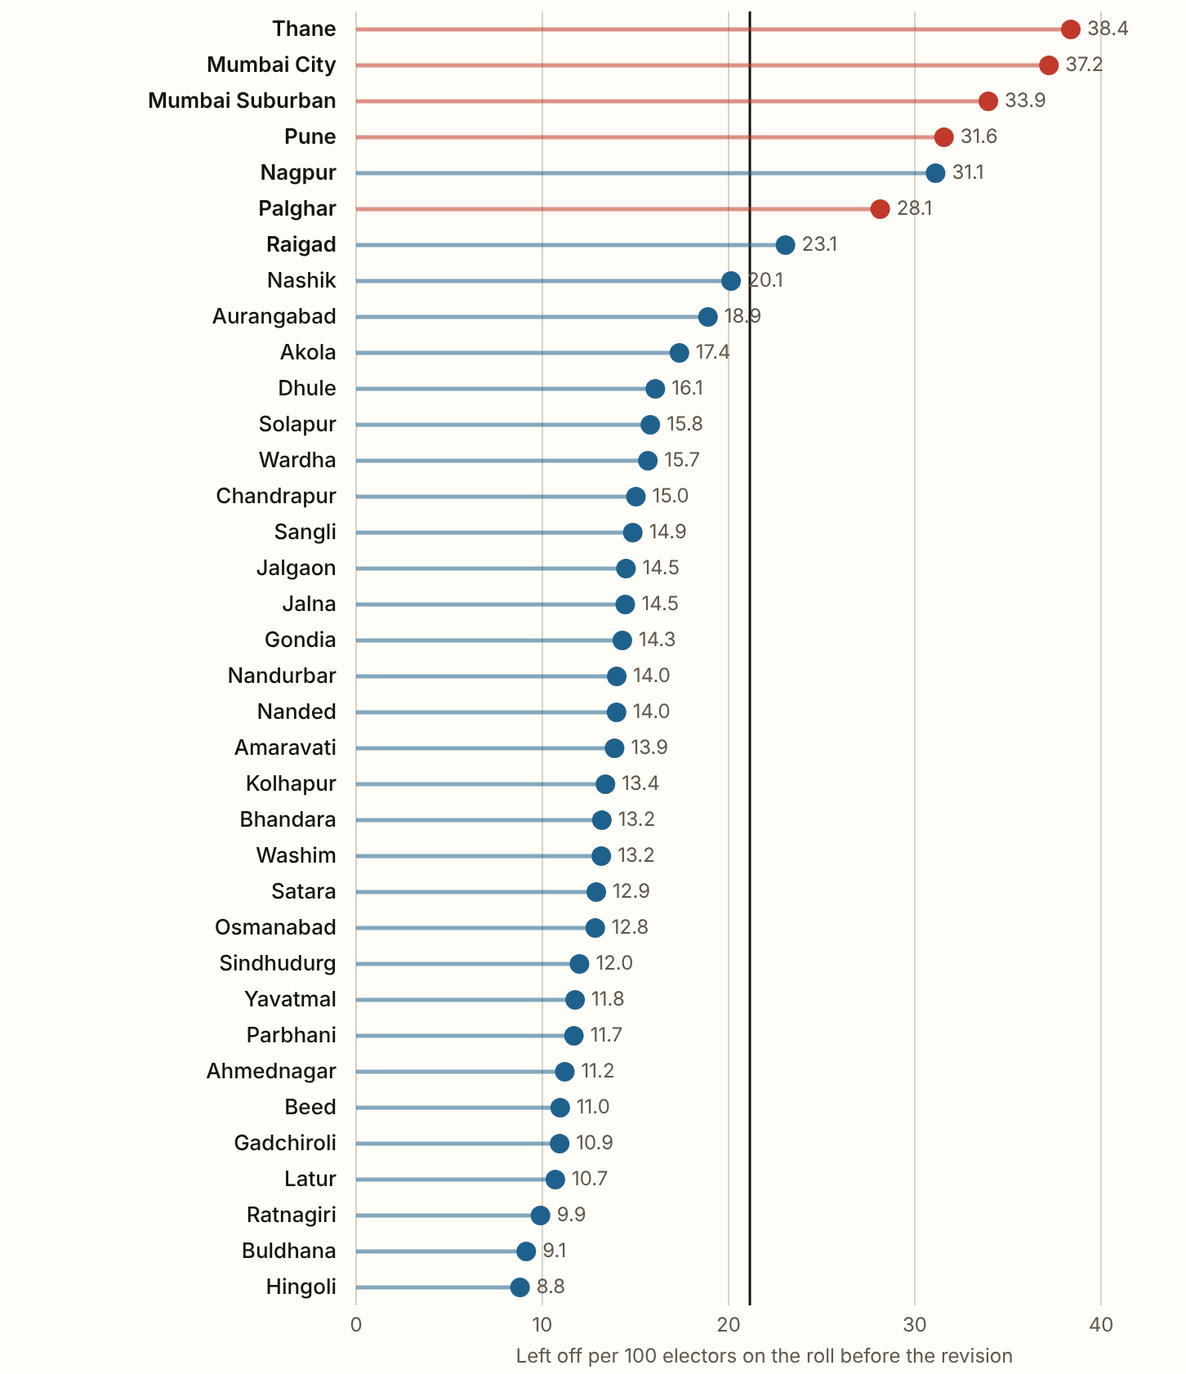
MAHARASHTRA 2026 · Per 100 electors, by district
Thane left off 38.4 of every 100 electors, the highest rate of any district, 28.6 lakh names in all.
Mumbai City, Mumbai Suburban, Pune and Nagpur come next. Outside the five city districts the highest is Nagpur, at 31.1. 7 of the 36 districts left off more than the state's 21.1, and 22 left off fewer than 15. Hingoli left off the fewest, 8.8.
Figures as published by the Chief Electoral Officer or the Election Commission; the method section of the report gives each source.
Notes:
Thane left off 38.4 of every 100 electors, the highest rate of any district, 28.6 lakh names in all. Mumbai City, Mumbai Suburban, Pune and Nagpur come next. Outside the five city districts the highest is Nagpur, at 31.1. 7 of the 36 districts left off more than the state's 21.1, and 22 left off fewer than 15. Hingoli left off the fewest, 8.8.

Slide 4
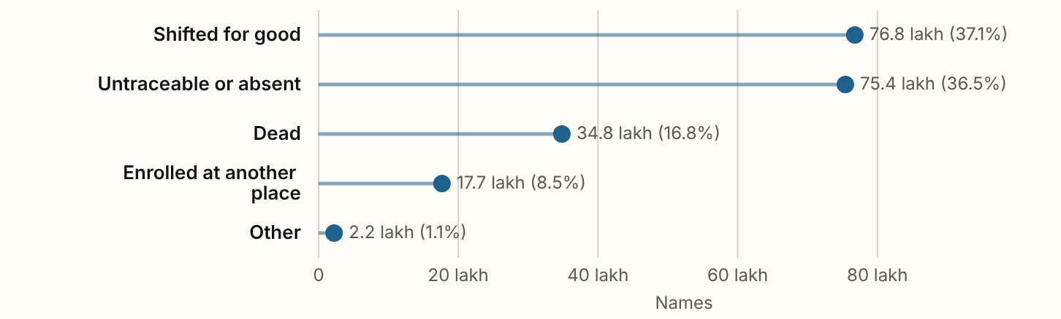
MAHARASHTRA 2026 · The reasons
37.1% of the names left off were entered as shifted for good and 36.5% as untraceable or absent, 73.6% together.
Figures as published by the Chief Electoral Officer or the Election Commission; the method section of the report gives each source.
Notes:
37.1% of the names left off were entered as shifted for good and 36.5% as untraceable or absent, 73.6% together. 16.8% were entered as dead, 8.5% as enrolled at another place and 1.1% under another reason. The five add up to the 2.07 crore left off exactly. A reason is what the officer wrote down, and nobody checked it.

Slide 5
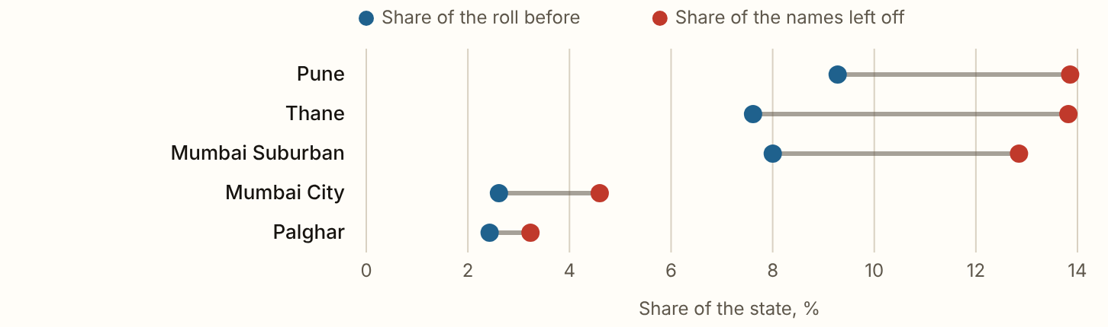
MAHARASHTRA 2026 · Mumbai and Pune
The five districts hold 29.9% of Maharashtra's roll and 48.4% of the names left off, 1.00 crore names in all.
Figures as published by the Chief Electoral Officer or the Election Commission; the method section of the report gives each source.
Notes:
The five districts hold 29.9% of Maharashtra's roll and 48.4% of the names left off, 1.00 crore names in all. They lost 34.2 of every 100 electors, against 15.6 in the other 31 districts. Each of the five lost a larger share of the names than its share of the roll. Pune and Thane together account for 27.7% of every name left off in the state.

Slide 6
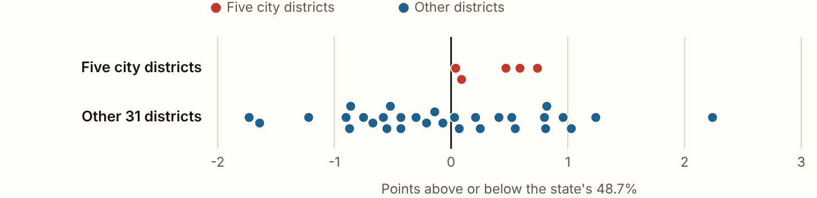
MAHARASHTRA 2026 · Women
Women are 48.7% of Maharashtra's draft roll, 3,75,72,570 women against 3,95,89,905 men and 3,087 third-gender electors.
Figures as published by the Chief Electoral Officer or the Election Commission; the method section of the report gives each source.
Notes:
Women are 48.7% of Maharashtra's draft roll, 3,75,72,570 women against 3,95,89,905 men and 3,087 third-gender electors. Their share runs from 47.0% in Beed to 50.9% in Ratnagiri. In the five city districts it is 49.0% and in the rest 48.6%. Without the roll before the revision by sex, these shares cannot show whether women were left off more often than men.

Slide 7
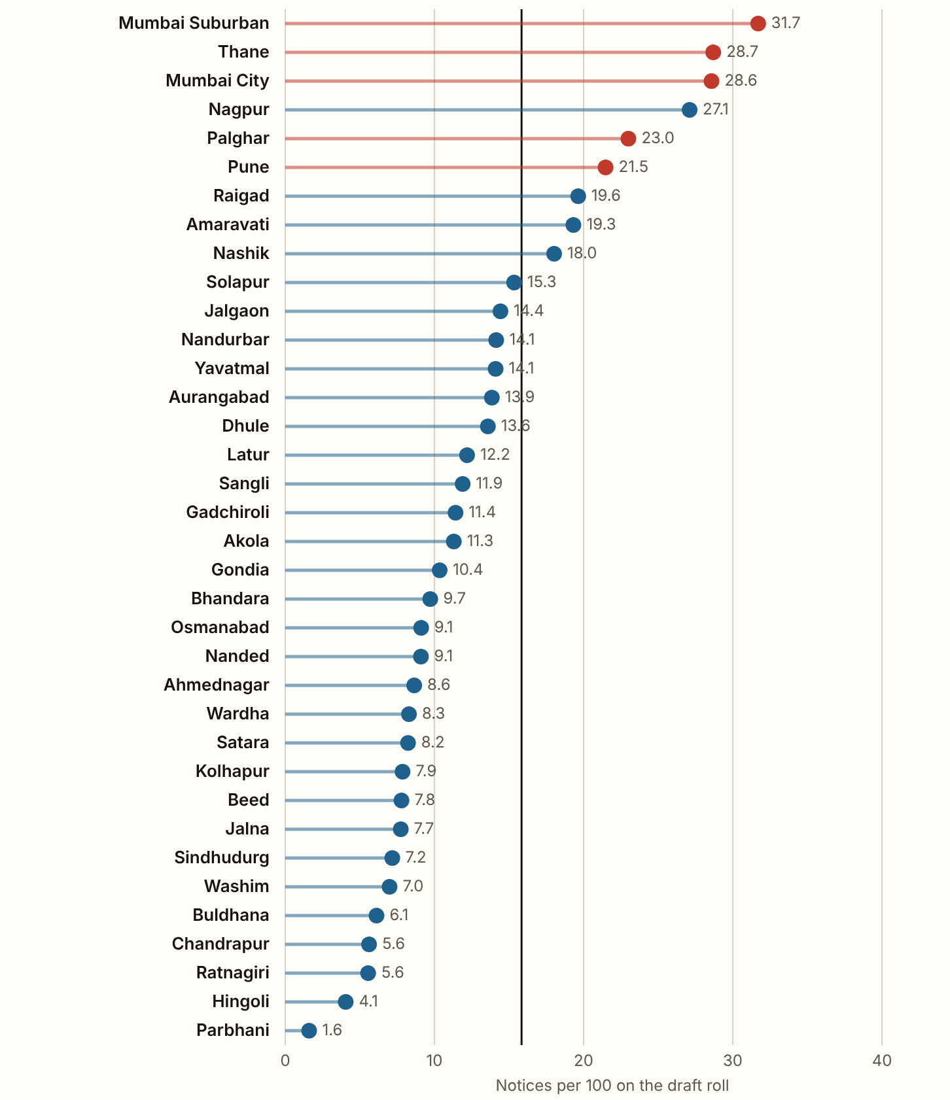
MAHARASHTRA 2026 · Notices
1.22 crore electors still on the draft roll were in line for a notice, 15.8 of every 100.
59.8 lakh could not be linked to the last intensive revision and 62.5 lakh had an anomaly in their entry. Mumbai Suburban had the most for its size, 31.7 of every 100 on its draft, and Parbhani the fewest, 1.6. Districts that left off more names also sent more notices (rank correlation 0.75). How many names have been deleted after a hearing has not been published. The counts are from the CEO's release of 4 September 2026.
Figures as published by the Chief Electoral Officer or the Election Commission; the method section of the report gives each source.
Notes:
1.22 crore electors still on the draft roll were in line for a notice, 15.8 of every 100. 59.8 lakh could not be linked to the last intensive revision and 62.5 lakh had an anomaly in their entry. Mumbai Suburban had the most for its size, 31.7 of every 100 on its draft, and Parbhani the fewest, 1.6. Districts that left off more names also sent more notices (rank correlation 0.75). How many names have been deleted after a hearing has not been published. The counts are from the CEO's release of 4 September 2026.

Slide 8
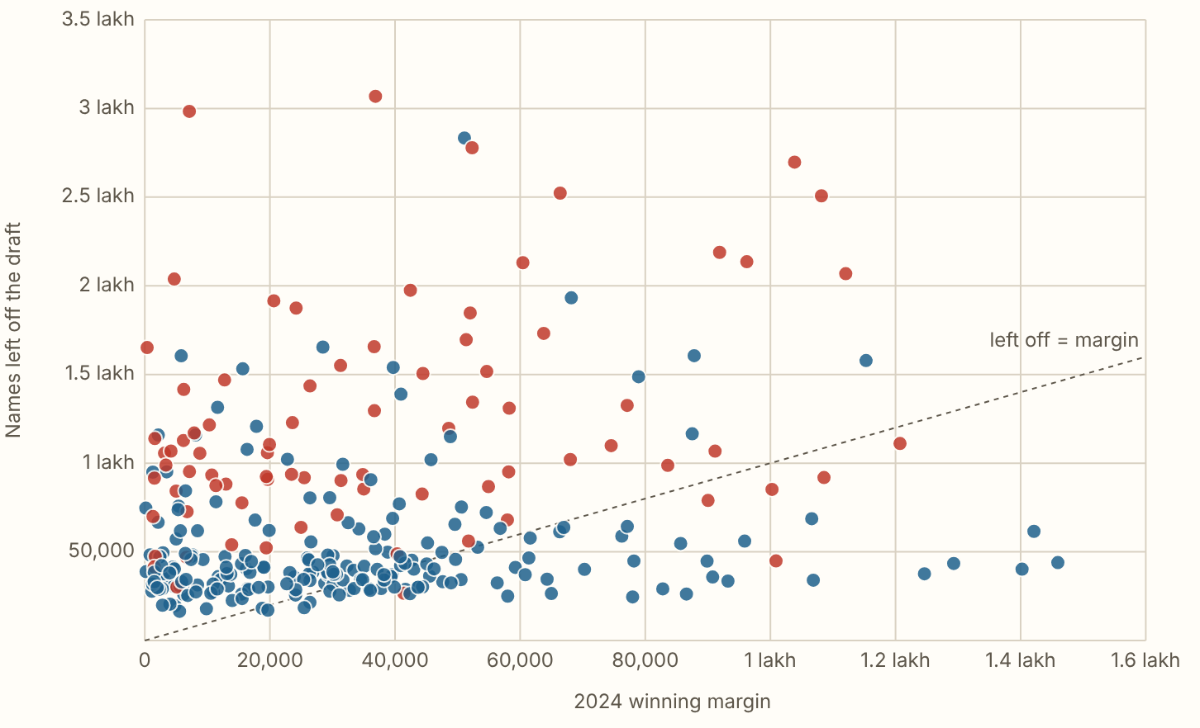
MAHARASHTRA 2026 · Against the 2024 margins
In 220 of the 288 constituencies more names were left off the draft than the 2024 winner's margin.
Figures as published by the Chief Electoral Officer or the Election Commission; the method section of the report gives each source.
Notes:
In 220 of the 288 constituencies more names were left off the draft than the 2024 winner's margin. Not everyone on a roll votes, so scaled down by each seat's 2024 turnout it is 183. By the party that won the seat in 2024, the names left off per 100 were 22.9 in the BJP's 132, 20.8 in the Shiv Sena's 57, 16.0 in the NCP's 41, 22.5 in the Shiv Sena (UBT)'s 20, 21.8 in the Congress's 16 and 20.5 in the NCP (SP)'s 10. Set against each seat's own district, the six parties run from -3.5 to 0.8 points, so most of the difference comes from where each party's seats are. Red dots are constituencies in the five city districts.

Slide 9
MAHARASHTRA 2026
What these figures cannot show
The Chief Electoral Officer published no split of the names left off by sex, and a reason is what the officer wrote down, so these pages show where names were left off and what was entered, and cannot show why.

