Slide 1
SPECIAL INTENSIVE REVISION
Rajasthan 2026
Figures as of 21 February 2026, when the final roll was published.
Rajasthan's draft roll left off 41.8 lakh names, 7.7 of every 100 electors on the roll before the revision.
After the draft 12.9 lakh were added and 2.4 lakh more deleted, so 44.3 lakh had been left off or deleted by the time of the final roll. The final roll was 10.5 lakh larger than the draft, which is at most 25.1% of what was left off.
The District Election Officers' own figures, as two newspapers printed them for 22 districts, put Jodhpur highest, with 11.2 of every 100 names left off the draft, and Barmer lowest, with 4.0.
From the 2023 election to the final roll, the roll fell most in Salumber (5.7 per 100) and grew in Balotara, Deeg, Dholpur, Jaisalmer, Phalodi and Barmer.
Women's share of the roll fell in 165 of 200 constituencies, from 48.0% in 2023 to 47.7%, and women were 55.4% of the names deleted after the draft.
In 32 of the 200 constituencies the roll fell by more than the 2023 winning margin.

Slide 2
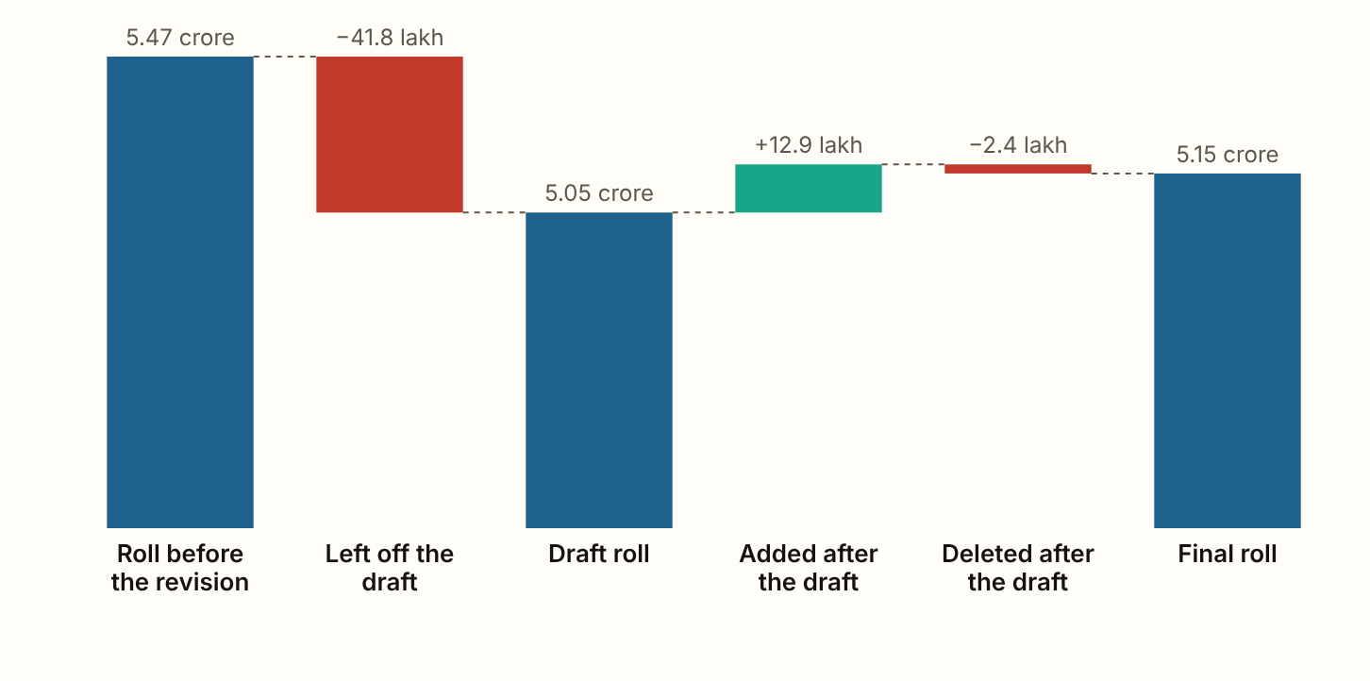
RAJASTHAN 2026 · The roll, step by step
The draft roll left off 41.8 lakh names, 7.7 of every 100 electors.
Figures as published by the Chief Electoral Officer or the Election Commission; the method section of the report gives each source.
Notes:
The draft roll left off 41.8 lakh names, 7.7 of every 100 electors. After the draft, 12.9 lakh were added and 2.4 lakh more deleted, so 44.3 lakh had been left off or deleted by the time of the final roll. The final roll was 10.5 lakh larger than the draft, 25.1% of what the draft left off. That rise counts new voters too, so it is the most that can have been put back.

Slide 3
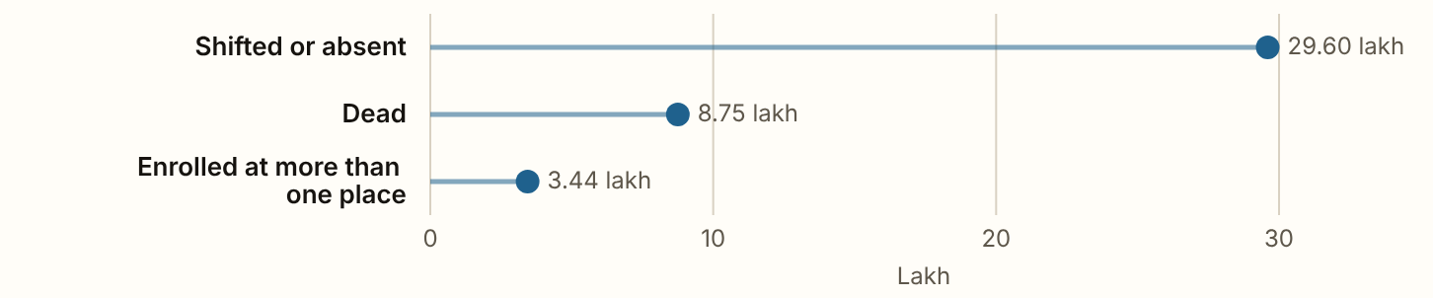
RAJASTHAN 2026 · The reasons
70.8% were entered as shifted or absent, and 20.9% as dead.
Figures as published by the Chief Electoral Officer or the Election Commission; the method section of the report gives each source.
Notes:
70.8% were entered as shifted or absent, and 20.9% as dead. The three reasons add up to 41.79 lakh, against 41.8 lakh left off. They differ because each reason was published rounded.

Slide 4
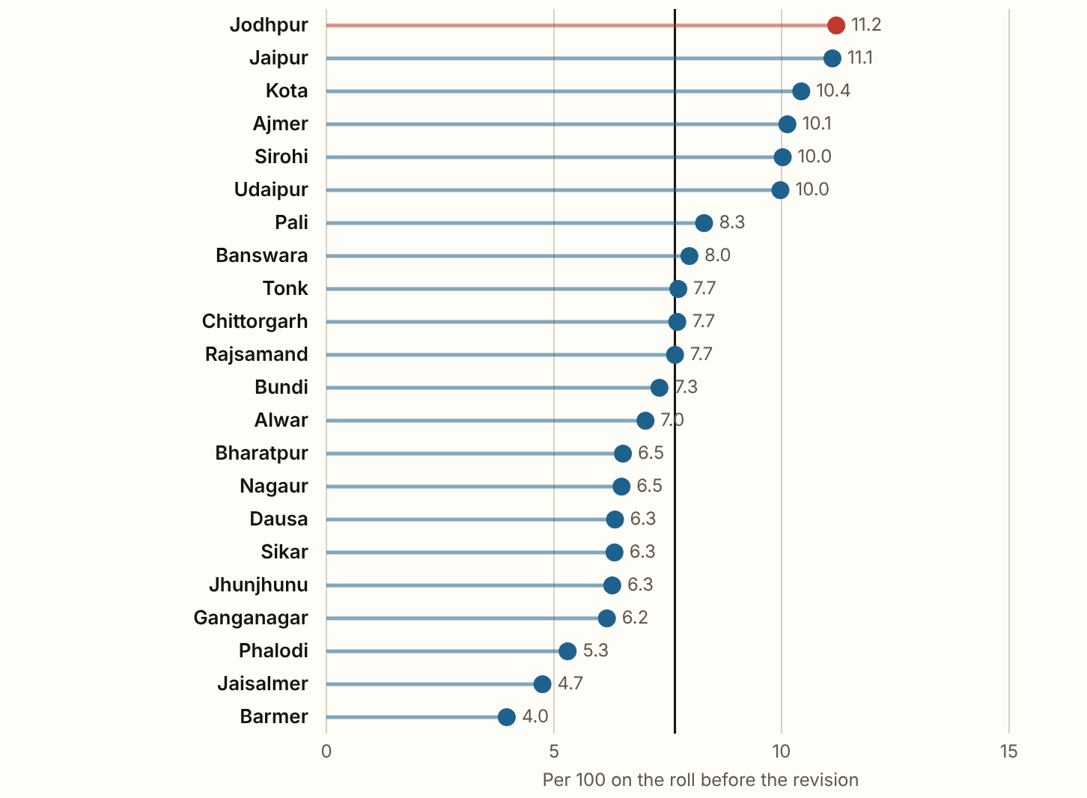
RAJASTHAN 2026 · Names left off, district by district, as the press printed them
In the 22 districts the press printed, 27.8 lakh names were left off, 66.4% of the state's 41.8 lakh.
Figures as published by the Chief Electoral Officer or the Election Commission; the method section of the report gives each source.
Notes:
In the 22 districts the press printed, 27.8 lakh names were left off, 66.4% of the state's 41.8 lakh. Jodhpur lost the most, 11.2 of every 100 on its roll, then Jaipur (11.1) and Kota (10.4). Barmer lost the fewest, 4.0. The line marks the state's 7.7. In the 20 districts that gave the five reasons, 59.6% of the names were entered as shifted for good, 21.3% as dead, 11.4% as absent and 7.1% as enrolled at more than one place. A reason is what the officer wrote down, and nobody checked it.

Slide 5
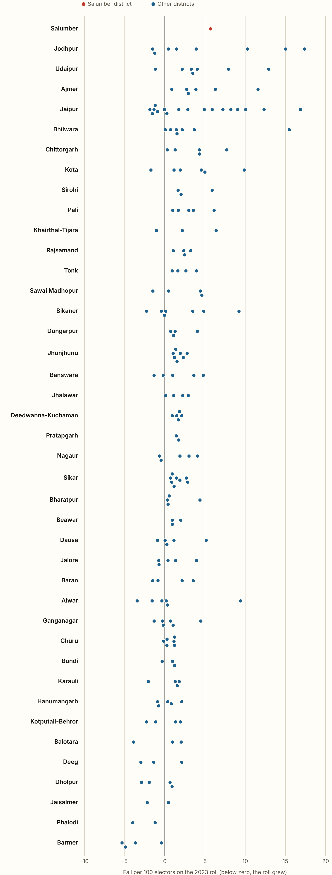
RAJASTHAN 2026 · Per 100 electors, by district
From the 2023 election to the final roll, the roll of general electors fell by 10.6 lakh, 2.0 per 100.
It fell most in Salumber (5.7 per 100), Jodhpur and Udaipur, and grew in 6 districts, Balotara, Deeg, Dholpur, Jaisalmer, Phalodi and Barmer. Across the 200 constituencies it runs from a rise of 5.3 per 100 in Gudamalani to a fall of 17.4 in Jodhpur, and 49 constituencies grew. The change takes in more than two years of new voters, deaths and moves as well as the revision.
Figures as published by the Chief Electoral Officer or the Election Commission; the method section of the report gives each source.
Notes:
From the 2023 election to the final roll, the roll of general electors fell by 10.6 lakh, 2.0 per 100. It fell most in Salumber (5.7 per 100), Jodhpur and Udaipur, and grew in 6 districts, Balotara, Deeg, Dholpur, Jaisalmer, Phalodi and Barmer. Across the 200 constituencies it runs from a rise of 5.3 per 100 in Gudamalani to a fall of 17.4 in Jodhpur, and 49 constituencies grew. The change takes in more than two years of new voters, deaths and moves as well as the revision.

Slide 6
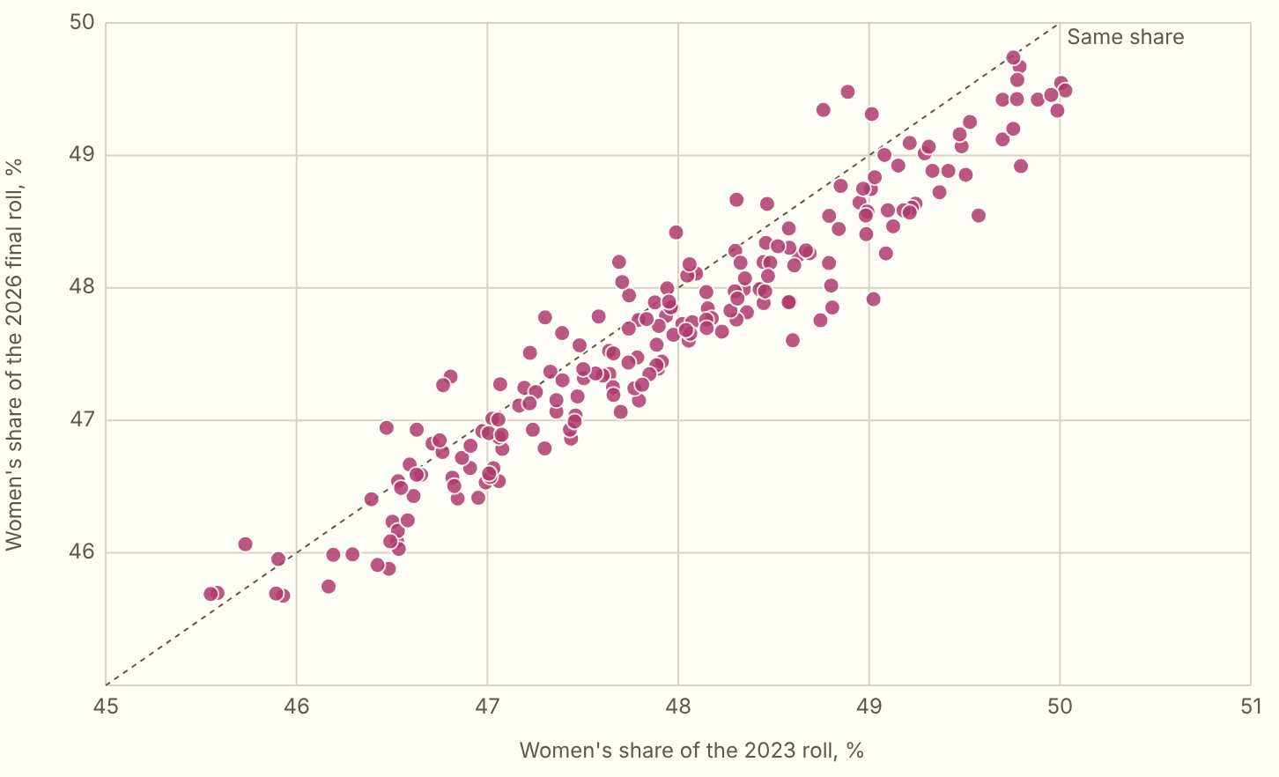
RAJASTHAN 2026 · Women
Women were 47.7% of the final roll, against 48.0% of the 2023 roll, and their share fell in 165 of the 200 constituencies.
Figures as published by the Chief Electoral Officer or the Election Commission; the method section of the report gives each source.
Notes:
Women were 47.7% of the final roll, against 48.0% of the 2023 roll, and their share fell in 165 of the 200 constituencies. Of the names deleted after the draft, women were 55.4%, and of those added 51.3%. No split by sex of the names left off has been published for the state. One district gave one. In Sirohi, by the District Election Officer's figures as Amar Ujala printed them, women were 55.7% of the 85,596 names left off, against 48.3% of the roll before the revision.

Slide 7
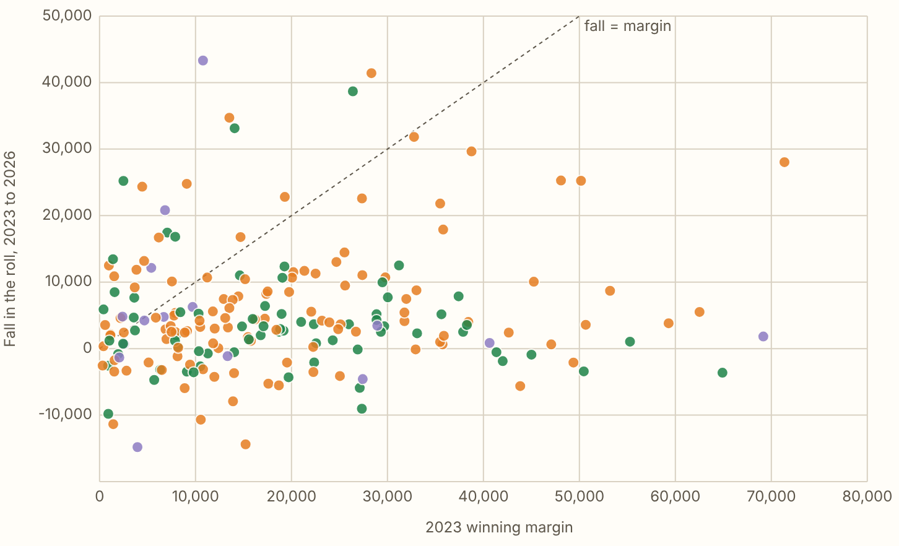
RAJASTHAN 2026 · Against the 2023 margins
In 32 of the 200 constituencies the roll fell by more than the 2023 winning margin.
Figures as published by the Chief Electoral Officer or the Election Commission; the method section of the report gives each source.
Notes:
In 32 of the 200 constituencies the roll fell by more than the 2023 winning margin. Not everyone on a roll votes, so scaled down by each seat's 2023 turnout it is 27. The roll fell by 2.3 per 100 in the BJP's 115 seats and 1.5 in the Congress's 70. Against their own districts the two are within half a point of zero (0.1 and -0.3). So most of the difference comes from where each party's seats are. Orange dots are BJP seats, green Congress and purple the rest.

Slide 8
RAJASTHAN 2026
What these figures cannot show
Below the state, the figures are the change in the roll from the 2023 election to March 2026, which takes in new voters, deaths and moves as well as the revision.

