Slide 1
SPECIAL INTENSIVE REVISION
Gujarat 2026
Figures as of 17 February 2026, when the final roll was published.
Gujarat's draft roll of 19 December 2025 left off 73.7 lakh names, 14.5 of every 100 electors on the roll before the revision.
In 98 of the 182 constituencies, more names were left off than the 2022 winning margin, and in 60 even leaving out the names entered as dead or as enrolled elsewhere.
Ahmedabad and Surat districts hold 21.9% of the state's roll and 36.7% of the names left off. They lost 24.3 of every 100 electors, against 11.8 in the other 31 districts.
Surat left off the most, 25.7 per 100, and Karanj the most of any constituency, 38.4. Dangs left off the fewest of the districts, 5.5.
The final roll of 17 February 2026 is 5.6 lakh larger than the draft, at most 7.6% of the names left off, and still 68.1 lakh smaller than the roll before the revision.

Slide 2
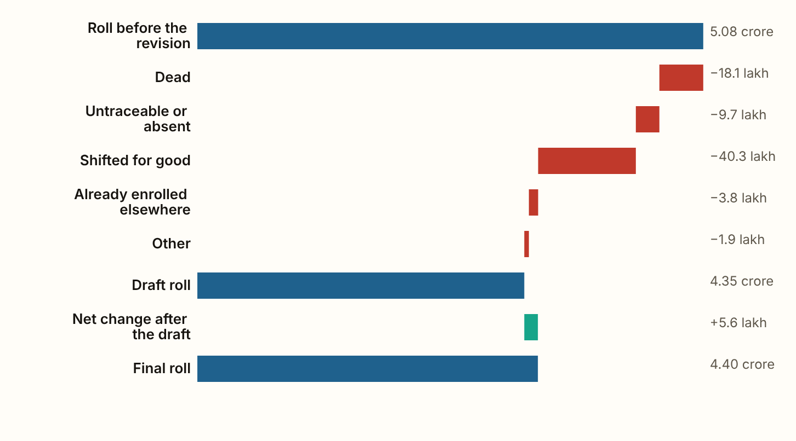
GUJARAT 2026 · The roll, step by step
The draft roll left off 73.7 lakh names, 14.5 of every 100 electors on the roll before the revision.
Figures as published by the Chief Electoral Officer or the Election Commission; the method section of the report gives each source.
Notes:
The draft roll left off 73.7 lakh names, 14.5 of every 100 electors on the roll before the revision. The roll fell from 5.08 crore names to 4.35 crore (one crore is ten million). The final roll of 17 February 2026 holds 4.40 crore. It is 5.6 lakh larger than the draft and still 68.1 lakh smaller than the roll before the revision.

Slide 3
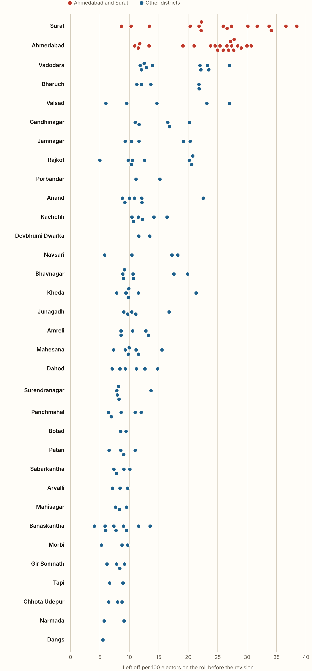
GUJARAT 2026 · Per 100 electors, by district
Surat left off 25.7 of every 100 electors and Ahmedabad 23.2, against 14.5 for the state.
Vadodara comes next, at 18.7, and Dangs left off the fewest, 5.5. Of the 182 constituencies, 23 left off 25 or more of every 100 and 70 fewer than 10. Karanj in Surat left off the most, 38.4, and Tharad in Banaskantha the fewest, 4.1.
Figures as published by the Chief Electoral Officer or the Election Commission; the method section of the report gives each source.
Notes:
Surat left off 25.7 of every 100 electors and Ahmedabad 23.2, against 14.5 for the state. Vadodara comes next, at 18.7, and Dangs left off the fewest, 5.5. Of the 182 constituencies, 23 left off 25 or more of every 100 and 70 fewer than 10. Karanj in Surat left off the most, 38.4, and Tharad in Banaskantha the fewest, 4.1.

Slide 4
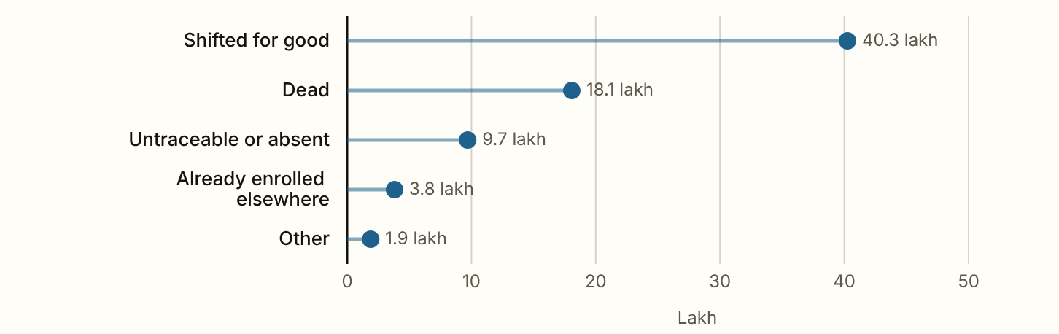
GUJARAT 2026 · The reasons
54.6% of the names left off were entered as shifted for good, 24.5% as dead and 13.2% as untraceable or absent.
Figures as published by the Chief Electoral Officer or the Election Commission; the method section of the report gives each source.
Notes:
54.6% of the names left off were entered as shifted for good, 24.5% as dead and 13.2% as untraceable or absent. 5.2% were already enrolled at another place and 2.6% were left off for some other reason. The share entered as shifted is highest in Surat, at 68.8%. Where fewer names were left off, more of them were entered as dead, up to 42.3% in Chhota Udepur. Across the 182 constituencies the rank correlation between the rate left off and the share entered as dead is -0.73. A rank correlation runs from minus 1, where one measure falls in step as the other rises, through 0, where the two are unrelated, to 1, where they rise in step.

Slide 5
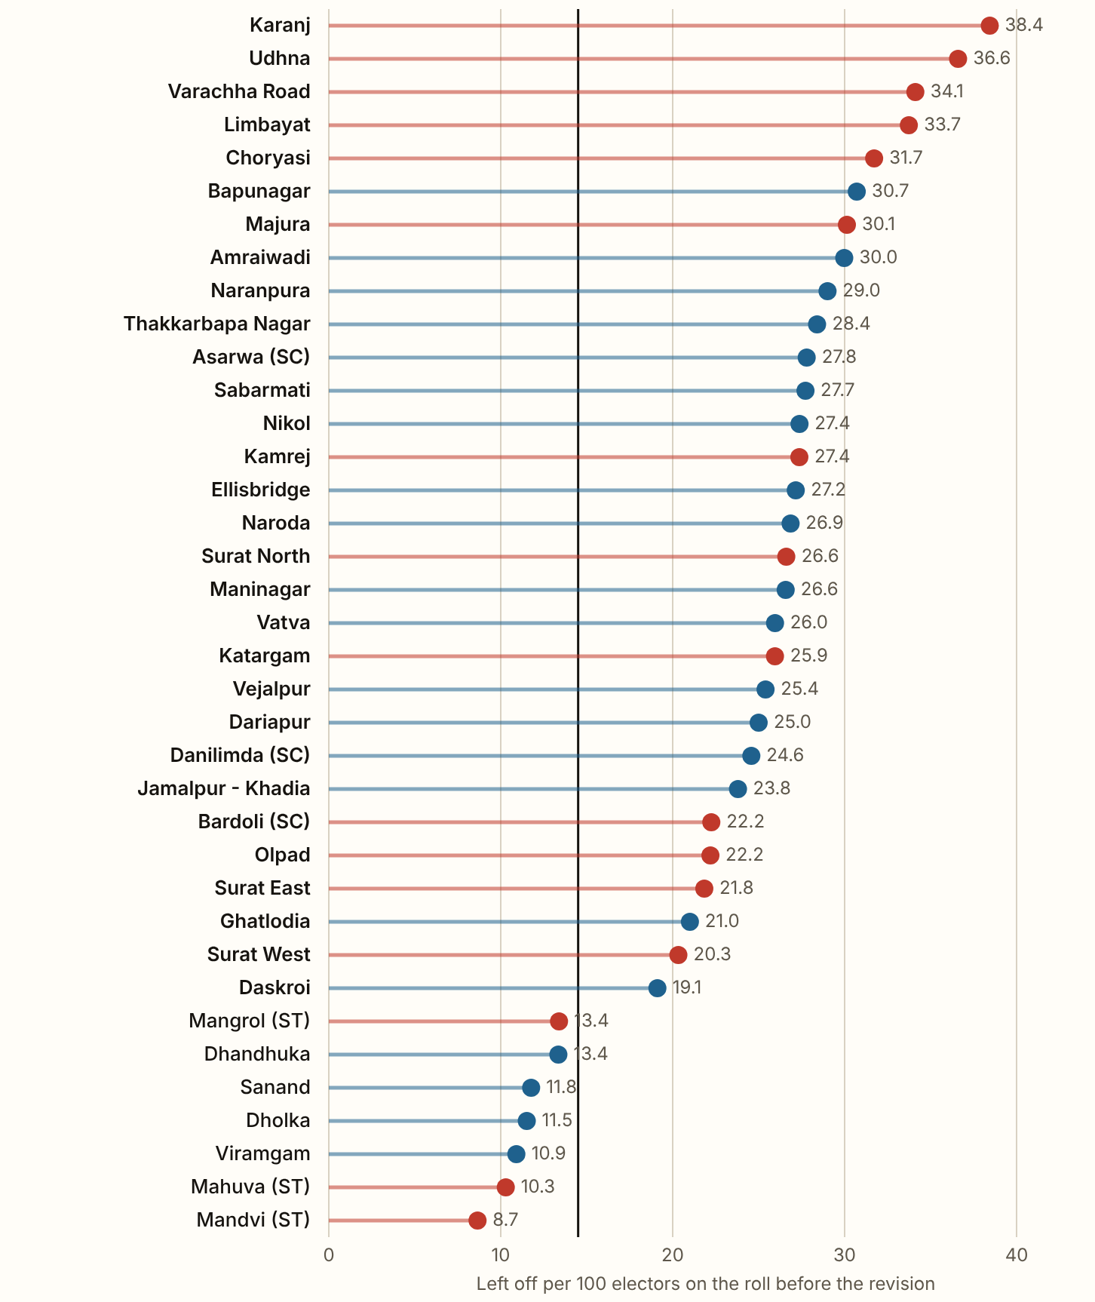
GUJARAT 2026 · Ahmedabad and Surat
Ahmedabad and Surat hold 21.9% of Gujarat's roll and 36.7% of the names left off, 27.0 lakh names in all.
Their 37 constituencies lost 24.3 of every 100 electors, against 11.8 in the rest of the state, and 30 of the 37 lost more than the state's 14.5. In the chart Surat's seats are in red and Ahmedabad's in blue. 63.8% of the two districts' names were entered as shifted for good, against 49.3% elsewhere, and 14.8% as dead, against 30.1%. In Surat district, 68.8% were entered as shifted.
Figures as published by the Chief Electoral Officer or the Election Commission; the method section of the report gives each source.
Notes:
Ahmedabad and Surat hold 21.9% of Gujarat's roll and 36.7% of the names left off, 27.0 lakh names in all. Their 37 constituencies lost 24.3 of every 100 electors, against 11.8 in the rest of the state, and 30 of the 37 lost more than the state's 14.5. In the chart Surat's seats are in red and Ahmedabad's in blue. 63.8% of the two districts' names were entered as shifted for good, against 49.3% elsewhere, and 14.8% as dead, against 30.1%. In Surat district, 68.8% were entered as shifted.

Slide 6
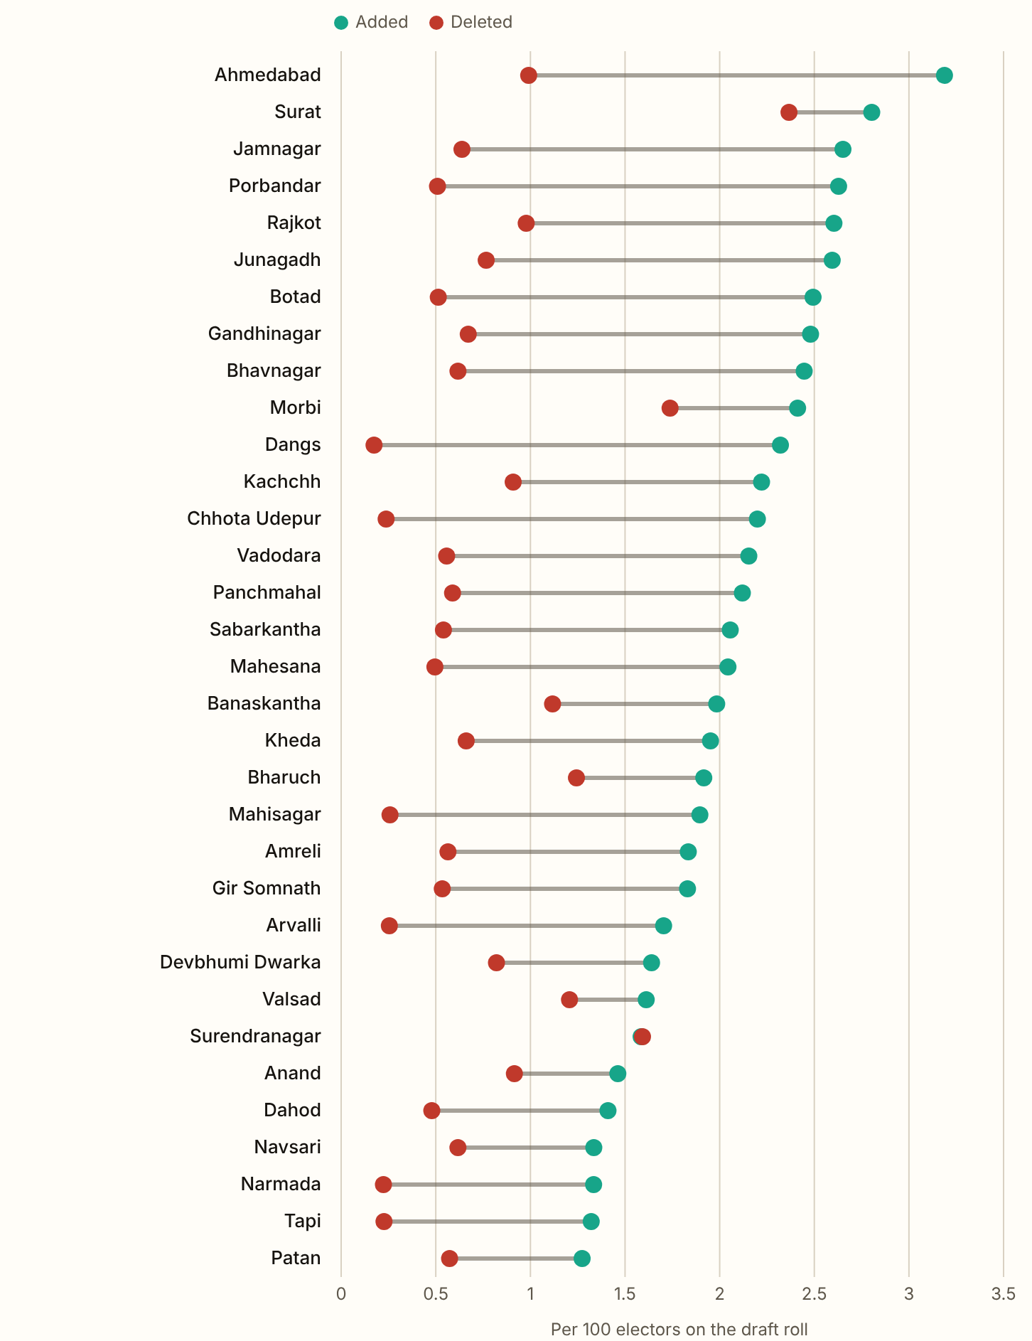
GUJARAT 2026 · After the draft
Between the draft and the final roll, 9.6 lakh names were added and 4.0 lakh deleted, a net rise of 5.6 lakh.
That is at most 7.6% of the names left off the draft, because the names added count new voters as well as names put back. The final roll is still 13.4 of every 100 electors smaller than the roll before the revision. Ahmedabad added the most for its size, 3.2 per 100 on its draft. Surat deleted the most names, 85,734, so its roll rose by 15,844 only. Surendranagar deleted more names than it added. Ahmedabad's roll is 21.5 per 100 and Surat's 25.3 per 100 smaller than before the revision.
Figures as published by the Chief Electoral Officer or the Election Commission; the method section of the report gives each source.
Notes:
Between the draft and the final roll, 9.6 lakh names were added and 4.0 lakh deleted, a net rise of 5.6 lakh. That is at most 7.6% of the names left off the draft, because the names added count new voters as well as names put back. The final roll is still 13.4 of every 100 electors smaller than the roll before the revision. Ahmedabad added the most for its size, 3.2 per 100 on its draft. Surat deleted the most names, 85,734, so its roll rose by 15,844 only. Surendranagar deleted more names than it added. Ahmedabad's roll is 21.5 per 100 and Surat's 25.3 per 100 smaller than before the revision.

Slide 7
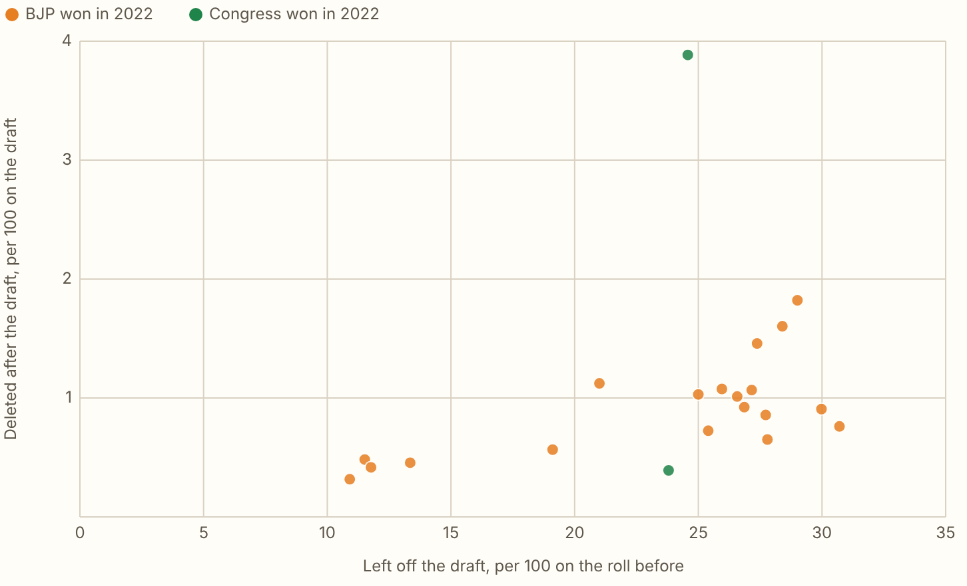
GUJARAT 2026 · Ahmedabad, seat by seat after the draft
Danilimda (SC) lost the most after the draft, 8,289 names, 3.9 for every 100 on its draft, and it is the only one of the 21 seats whose final roll is smaller than its draft.
Figures as published by the Chief Electoral Officer or the Election Commission; the method section of the report gives each source.
Notes:
Danilimda (SC) lost the most after the draft, 8,289 names, 3.9 for every 100 on its draft, and it is the only one of the 21 seats whose final roll is smaller than its draft. Across the 21, the seats that lost more names at the draft also lost more after it (rank correlation 0.51). Ghatlodia added the most, 22,094. The names added count people enrolling for the first time too, so they say little about names put back. These seat figures are from the press.

Slide 8
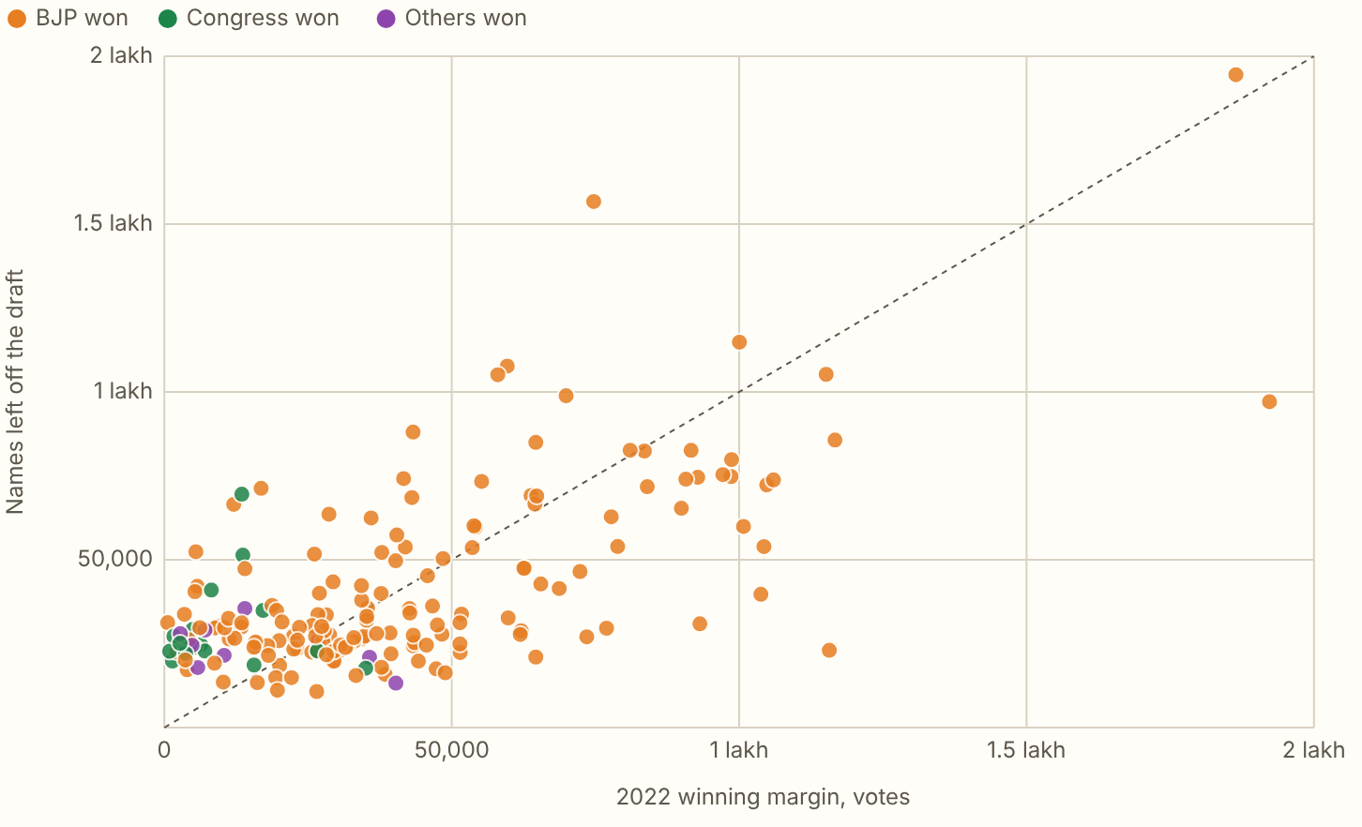
GUJARAT 2026, ELECTIONS · Names left off against the winning margin
In 98 of the 182 constituencies, more names were left off the draft roll than the 2022 winning margin.
Figures as published by the Chief Electoral Officer or the Election Commission; the method section of the report gives each source.
Notes:
In 98 of the 182 constituencies, more names were left off the draft roll than the 2022 winning margin. The seats that lost the most names were mostly not close contests. Across the 182 seats the rank correlation between the rate left off and the margin is 0.44, where 0 means the two are unrelated and 1 means they rise in step, because the city seats that lost the most were won by wide margins. Larger than the margin means large enough to decide a seat, and it says nothing about whether it would have.

Slide 9
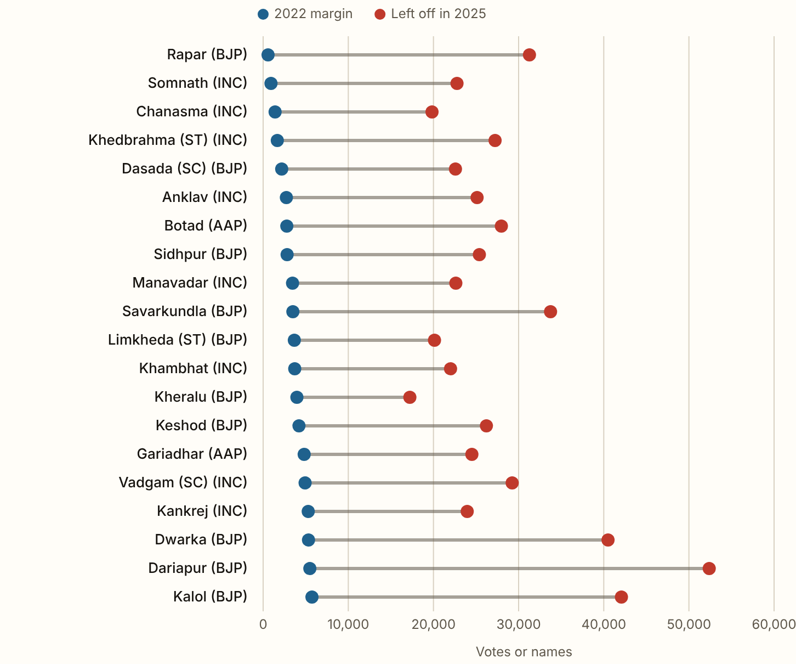
GUJARAT 2026, ELECTIONS · The closest seats
In every one of the 20 closest seats, the names left off were more than the margin.
Rapar was won by 577 votes and lost 31,274 names, and Somnath was won by 922 and lost 22,765. Of the twenty, 10 were won by the BJP, 8 were won by the Congress and 2 were won by the AAP.
Figures as published by the Chief Electoral Officer or the Election Commission; the method section of the report gives each source.
Notes:
In every one of the 20 closest seats, the names left off were more than the margin. Rapar was won by 577 votes and lost 31,274 names, and Somnath was won by 922 and lost 22,765. Of the twenty, 10 were won by the BJP, 8 were won by the Congress and 2 were won by the AAP.

Slide 10
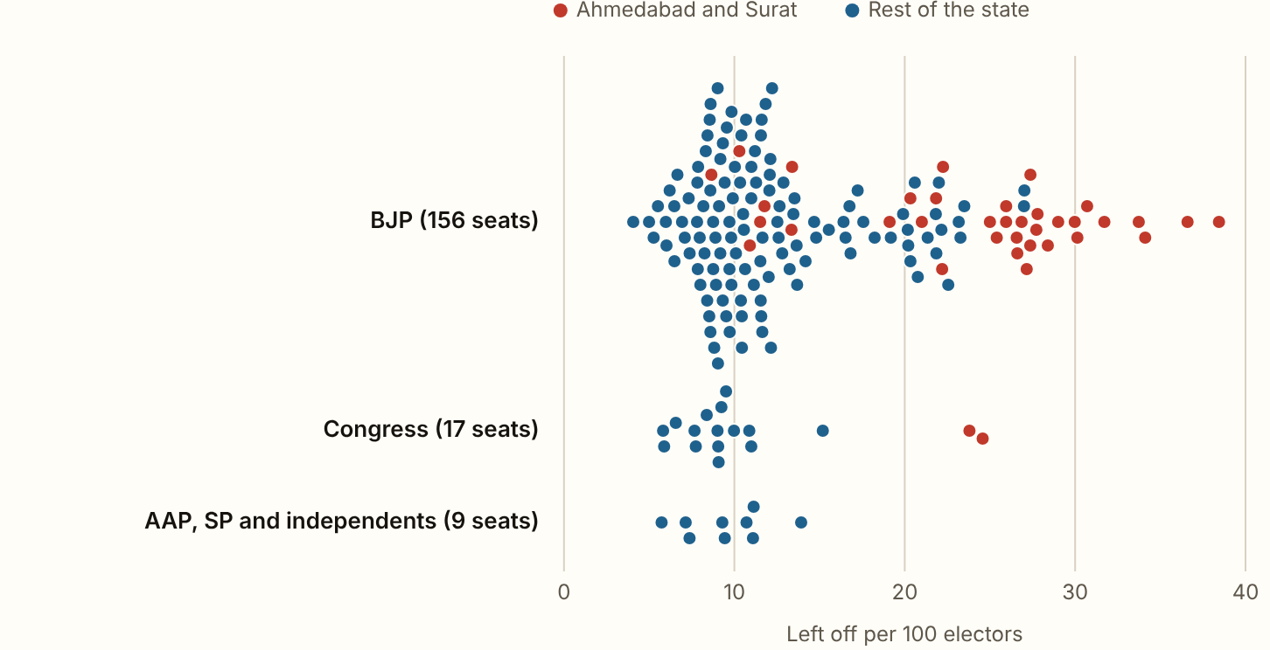
GUJARAT 2026, ELECTIONS · The names left off by the party that won
Seats the BJP won in 2022 lost 15.2 of every 100 electors, against 10.5 in the Congress's seats and 9.3 in the AAP's.
Figures as published by the Chief Electoral Officer or the Election Commission; the method section of the report gives each source.
Notes:
Seats the BJP won in 2022 lost 15.2 of every 100 electors, against 10.5 in the Congress's seats and 9.3 in the AAP's. Most of that gap is about where the seats are. The BJP won 35 of the 37 seats in Ahmedabad and Surat districts, where the most names were left off. Set against their own districts, the BJP's seats come out at +0.1, the Congress's at -0.8 and the AAP's at -1.7 per 100. The names left off were more than the margin in 77 of the BJP's 156 seats and in 15 of the Congress's 17.

Slide 11
GUJARAT 2026
What these figures cannot show
The figures are the tables of the Chief Electoral Officer (CEO), who keeps the state's rolls for the Election Commission, as published in the press. The CEO's own website carries none of them. Nothing is split by sex or age, and the final roll is by district only.

