Slide 1
SPECIAL INTENSIVE REVISION
Delhi 2026
Figures as of 31 August 2026, when the draft roll was published. The final roll is due on 4 December 2026.
Delhi's draft roll left off 47.6 lakh names, 32.8 of every 100 electors on the roll before the revision.
In 68 of the 70 constituencies, more names were left off than the 2025 winning margin.
South East district left off the most, 43.6 per 100, and Tughlakabad the most of any constituency, 47.8.
91.1% were entered as shifted, absent or other, and 5.9% as dead.
Men were left off more often than women, 35.3 per 100 men against 29.9 per 100 women, with the roll before the revision by sex as reported in the press.

Slide 2
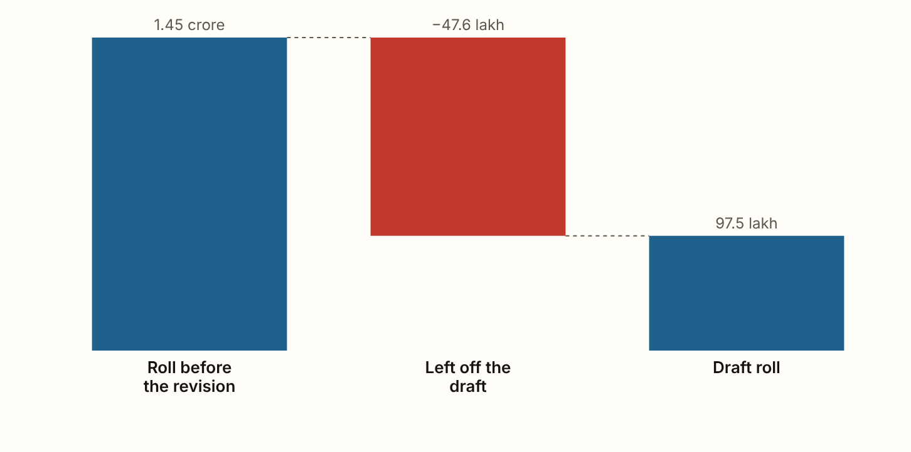
DELHI 2026 · The roll, step by step
The draft roll left off 47.6 lakh names, 32.8 of every 100 electors.
Figures as published by the Chief Electoral Officer or the Election Commission; the method section of the report gives each source.
Notes:
The draft roll left off 47.6 lakh names, 32.8 of every 100 electors. In 13 of the 70 constituencies it left off 40 or more of every 100. It ranges from 16.5 per 100 in Rohini to 47.8 in Tughlakabad.

Slide 3
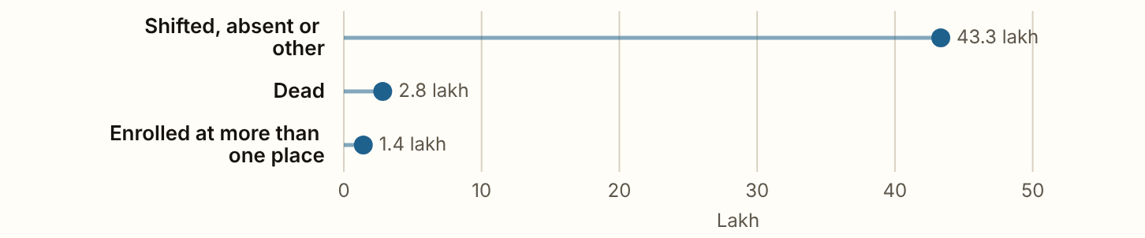
DELHI 2026 · The reasons
91.1% were entered as shifted, absent or other, 5.9% as dead and 3.0% as enrolled at more than one place.
Figures as published by the Chief Electoral Officer or the Election Commission; the method section of the report gives each source.
Notes:
91.1% were entered as shifted, absent or other, 5.9% as dead and 3.0% as enrolled at more than one place. The Chief Electoral Officer did not separate shifted from absent.

Slide 4
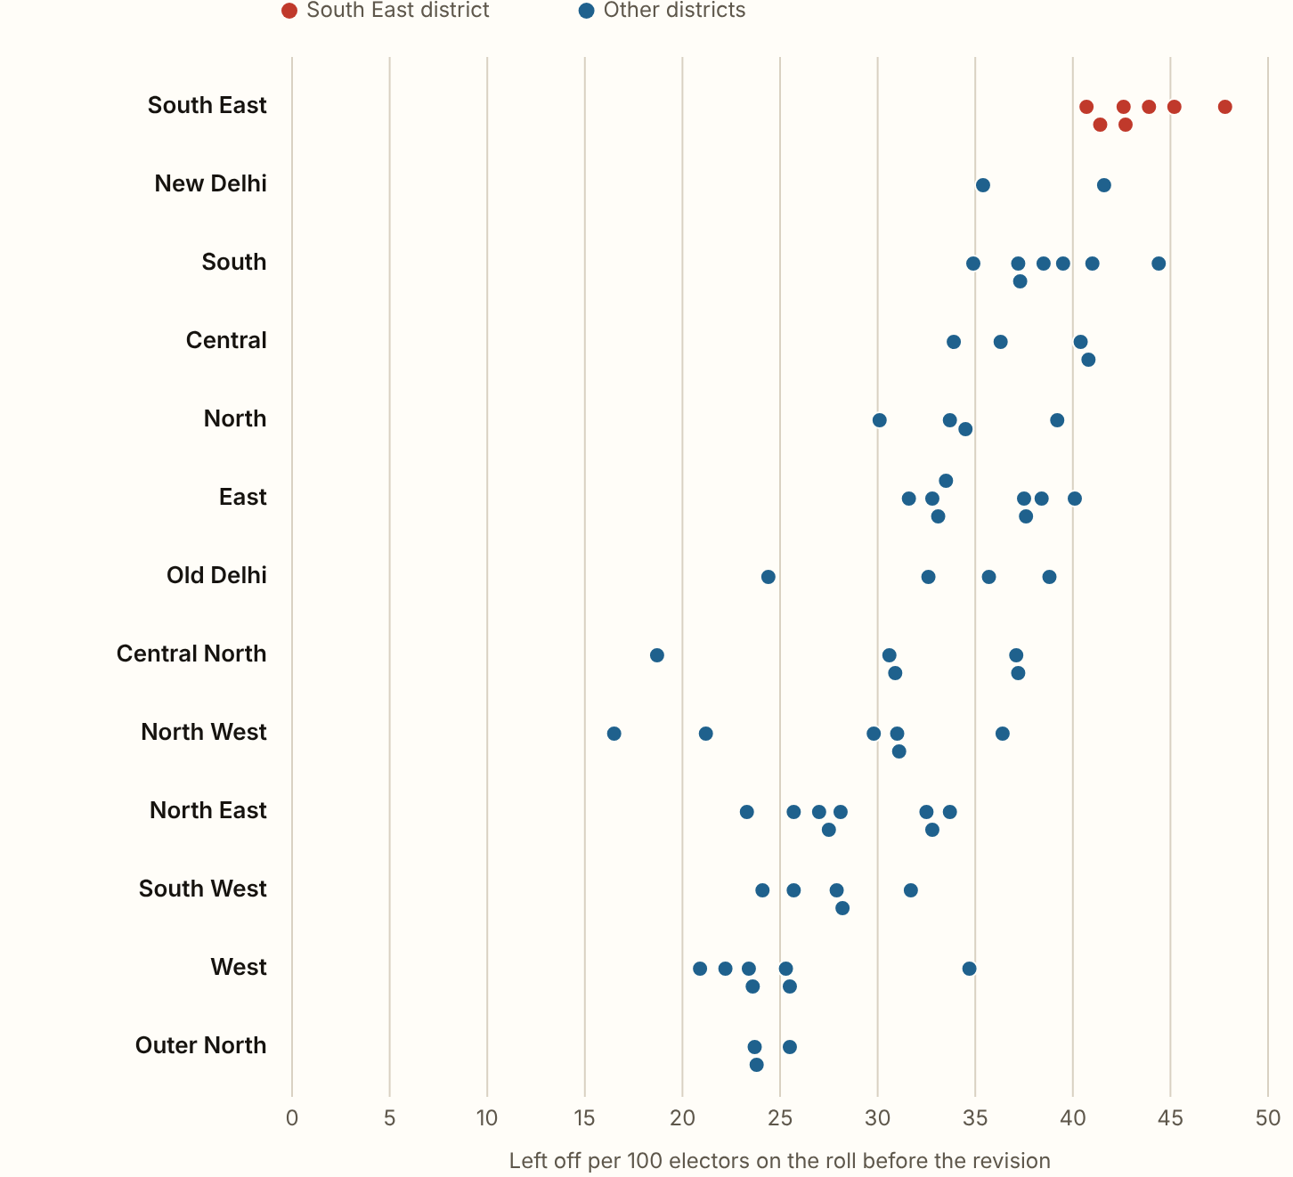
DELHI 2026 · Per 100 electors, by district
South East district left off 43.6 of every 100 electors, the most of the 13.
New Delhi and South come next, at 39.0 and 38.6. Outer North left off the fewest, 24.3.
Figures as published by the Chief Electoral Officer or the Election Commission; the method section of the report gives each source.
Notes:
South East district left off 43.6 of every 100 electors, the most of the 13. New Delhi and South come next, at 39.0 and 38.6. Outer North left off the fewest, 24.3.

Slide 5
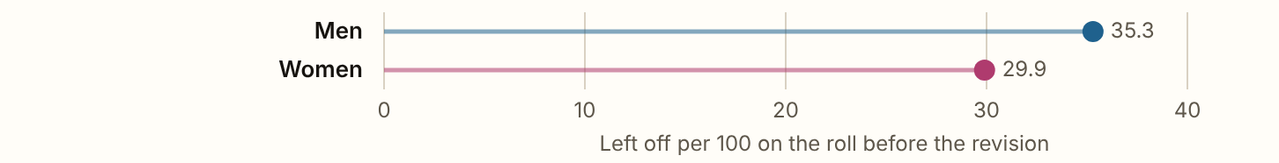
DELHI 2026 · Women
Men were left off more often than women, 35.3 of every 100 men against 29.9 of every 100 women.
Figures as published by the Chief Electoral Officer or the Election Commission; the method section of the report gives each source.
Notes:
Men were left off more often than women, 35.3 of every 100 men against 29.9 of every 100 women. Women were 46.9% of the roll before the revision and 42.8% of the names left off, so their share of the draft roll rose to 48.8%. These are state figures, with the roll before the revision by sex as reported in the press. The split by constituency was not published.

Slide 6
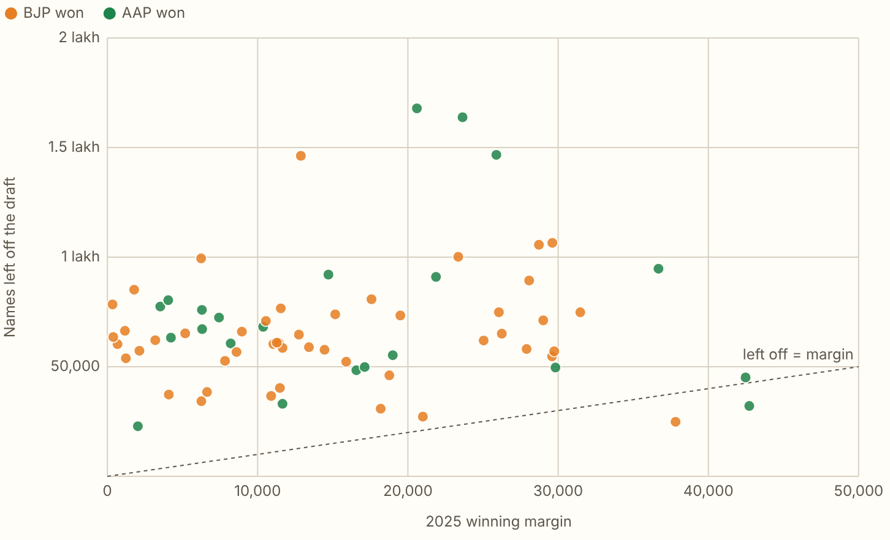
DELHI 2026 · Against the 2025 margins
In 68 of the 70 constituencies, more names were left off the draft than the 2025 winning margin.
Figures as published by the Chief Electoral Officer or the Election Commission; the method section of the report gives each source.
Notes:
In 68 of the 70 constituencies, more names were left off the draft than the 2025 winning margin. Not everyone on a roll votes, so scaled down by each seat's 2025 turnout it is 66. The exceptions are Matia Mahal and Rohini. The BJP's 48 seats lost 31.3 per 100 and the AAP's 22 lost 36.0. Against their own districts the two are -0.6 and 0.1 points. So the difference comes mostly from where each party's seats are. Larger than the margin means large enough to decide a seat, and it says nothing about whether it would have.

Slide 7
DELHI 2026
What these figures cannot show
The reasons and the split by sex are for Delhi as a whole, and there is no final roll yet.

