Slide 1
SPECIAL INTENSIVE REVISION
Every other state and union territory
Twenty states and union territories, each from its Chief Electoral Officer's published figures

Slide 2
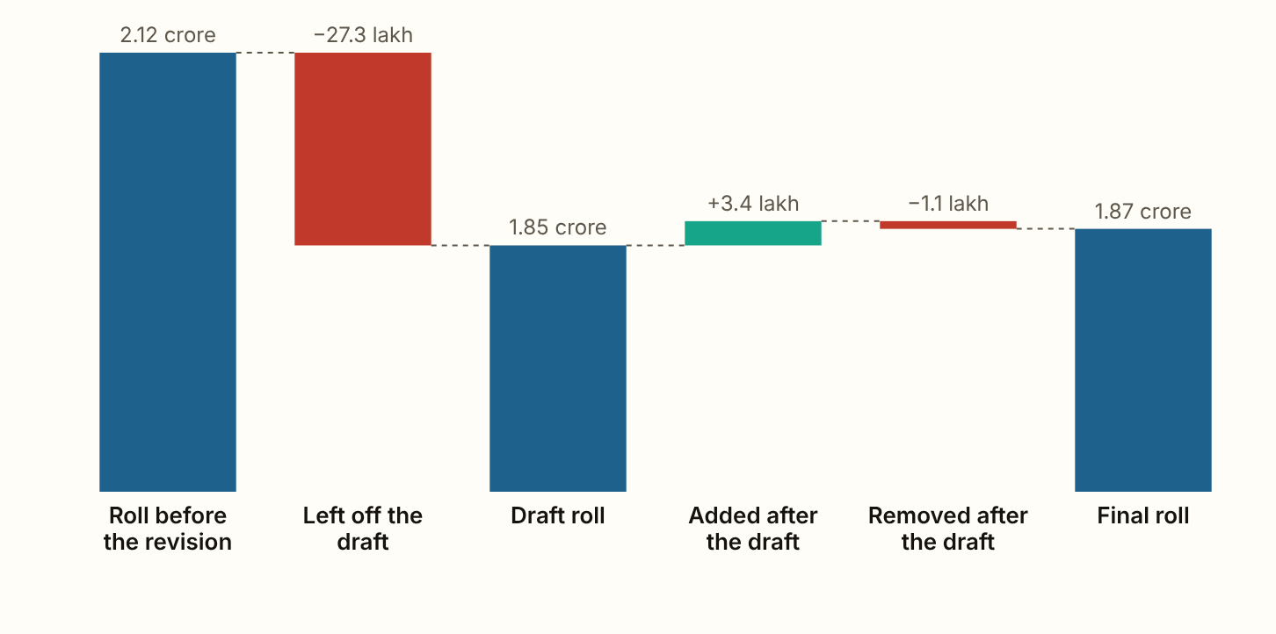
CHHATTISGARH 2026 · The roll, step by step
Chhattisgarh's draft roll of 23 December 2025 left off 27.35 lakh names, 12.9 of every 100 electors on the roll before the revision.
Figures as published by the Chief Electoral Officer or the Election Commission; the method section of the report gives each source.
Notes:
Chhattisgarh's draft roll of 23 December 2025 left off 27.35 lakh names, 12.9 of every 100 electors on the roll before the revision. 70.0% of the names left off were entered as shifted, absent or for another reason, 23.5% as dead and 6.5% as enrolled more than once. The final roll of 21 February 2026 holds 1.87 crore electors. After the draft 3.44 lakh names were added and 1.09 lakh removed, and the net rise is 8.6 for every 100 left off. It counts people enrolling for the first time, so fewer than that were put back.

Slide 3
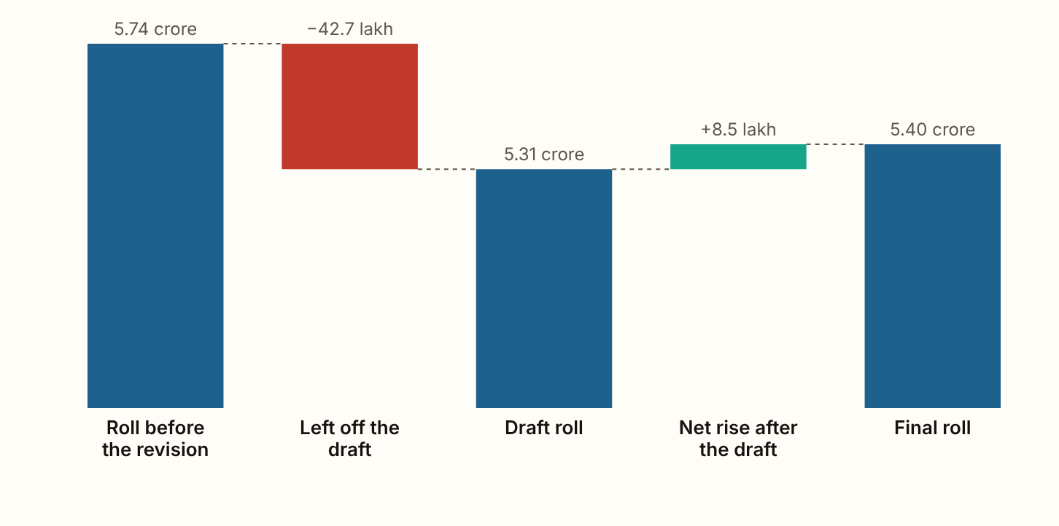
MADHYA PRADESH 2026 · The roll, step by step
Madhya Pradesh's draft roll of 23 December 2025 left off 42.74 lakh names, 7.4 of every 100 electors on the roll before the revision, as reported in the press.
Figures as published by the Chief Electoral Officer or the Election Commission; the method section of the report gives each source.
Notes:
Madhya Pradesh's draft roll of 23 December 2025 left off 42.74 lakh names, 7.4 of every 100 electors on the roll before the revision, as reported in the press. 73.7% of the names left off were entered as shifted, absent or for another reason, 19.8% as dead and 6.5% as enrolled more than once, as far as the published reasons go. The final roll of 21 February 2026 holds 5.40 crore electors, and the net rise is 19.9 for every 100 left off. It counts people enrolling for the first time, so fewer than that were put back. Women were 55.3% of the names left off and 48.8% of the roll before the revision, 8.4 of every 100 women against 6.5 of every 100 men.

Slide 4
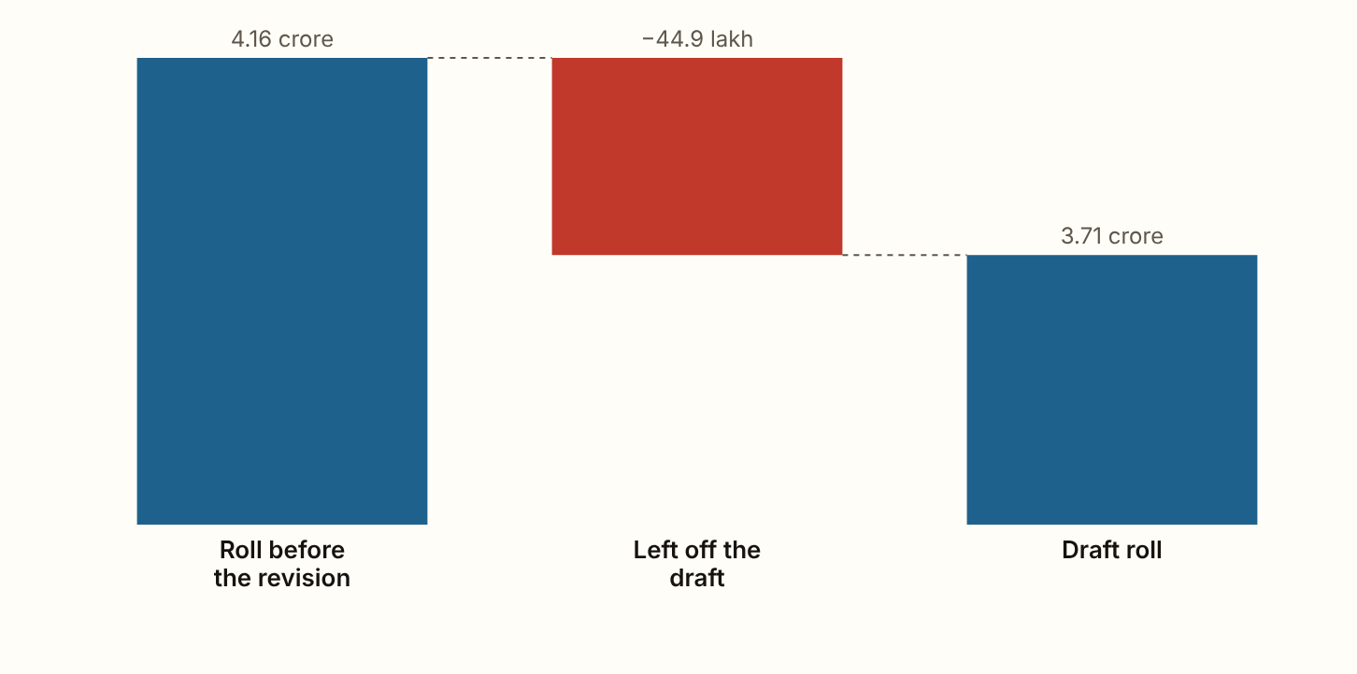
ANDHRA PRADESH 2026 · The roll, step by step
Andhra Pradesh's draft roll of 31 July 2026 left off 44.90 lakh names, 10.8 of every 100 electors on the roll before the revision.
Figures as published by the Chief Electoral Officer or the Election Commission; the method section of the report gives each source.
Notes:
Andhra Pradesh's draft roll of 31 July 2026 left off 44.90 lakh names, 10.8 of every 100 electors on the roll before the revision. 49.7% of the names left off were entered as shifted, absent or for another reason, 33.9% as dead and 16.4% as enrolled more than once. Women were 51.2% of the names left off and 51.0% of the roll before the revision, 10.8 of every 100 women against 10.7 of every 100 men.

Slide 5
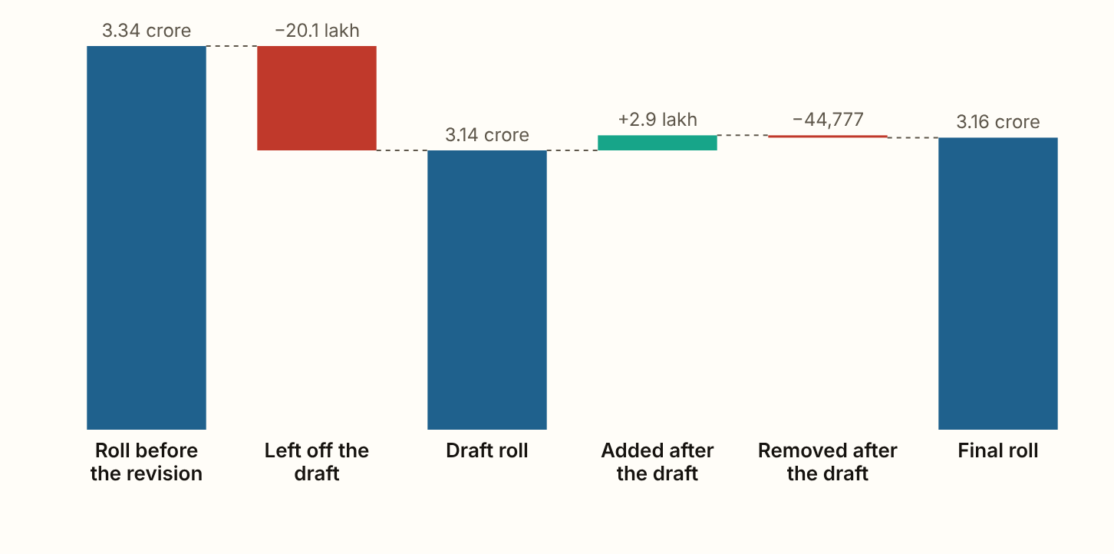
ODISHA 2026 · The roll, step by step
Odisha's draft roll of 5 July 2026 left off 20.13 lakh names, 6.0 of every 100 electors on the roll before the revision, as reported in the press.
Figures as published by the Chief Electoral Officer or the Election Commission; the method section of the report gives each source.
Notes:
Odisha's draft roll of 5 July 2026 left off 20.13 lakh names, 6.0 of every 100 electors on the roll before the revision, as reported in the press. 50.8% of the names left off were entered as shifted, absent or for another reason, 41.4% as dead and 7.9% as enrolled more than once. The final roll of 21 September 2026 holds 3.16 crore electors. After the draft 2.90 lakh names were added and 44,777 removed, and the net rise is 12.2 for every 100 left off. It counts people enrolling for the first time, so fewer than that were put back. Women were 56.9% of the names left off and 49.4% of the roll before the revision, 6.9 of every 100 women against 5.1 of every 100 men.

Slide 6
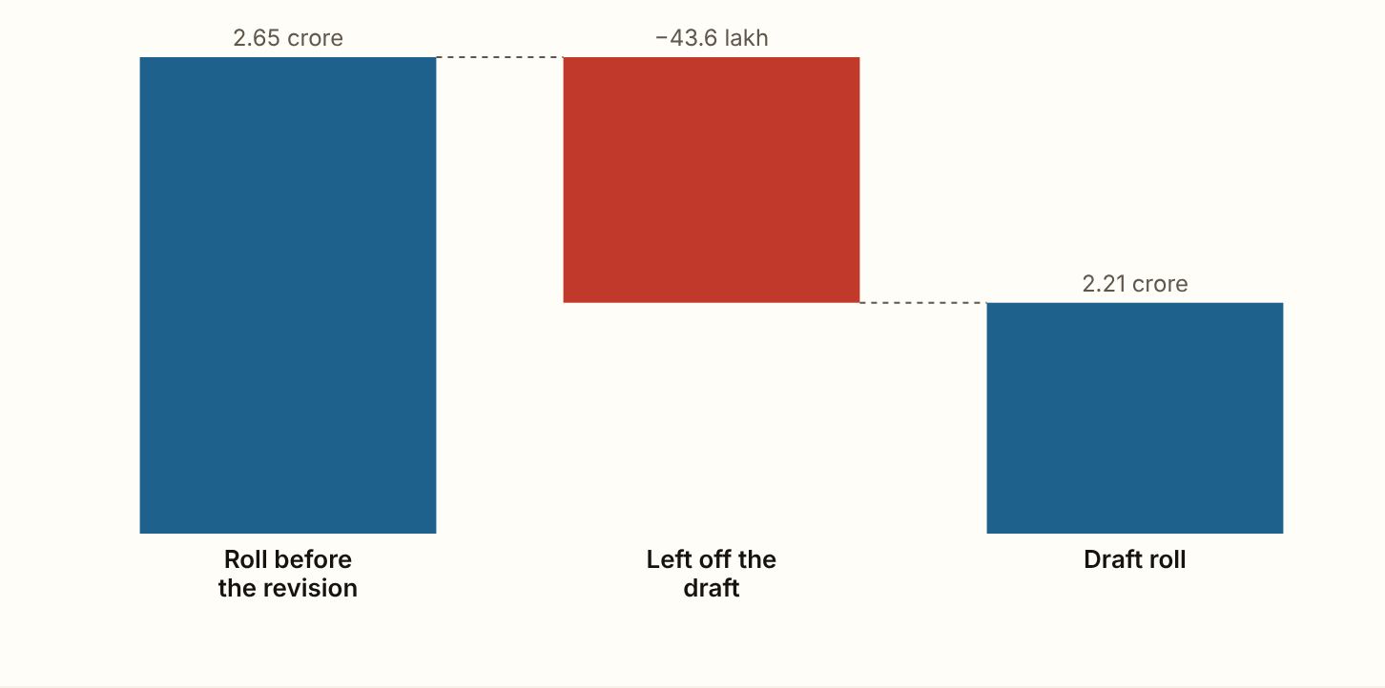
JHARKHAND 2026 · The roll, step by step
Jharkhand's draft roll of 5 August 2026 left off 43.62 lakh names, 16.5 of every 100 electors on the roll before the revision, as reported in the press.
Figures as published by the Chief Electoral Officer or the Election Commission; the method section of the report gives each source.
Notes:
Jharkhand's draft roll of 5 August 2026 left off 43.62 lakh names, 16.5 of every 100 electors on the roll before the revision, as reported in the press. 72.4% of the names left off were entered as shifted, absent or for another reason, 17.5% as dead and 10.1% as enrolled more than once.

Slide 7
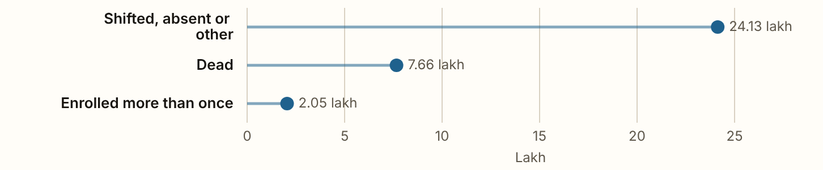
HARYANA 2026 · The reasons
Haryana's draft roll of 31 July 2026 left off 33.85 lakh names, 16.4 of every 100 electors on the roll before the revision, as the press and the state government reported.
Figures as published by the Chief Electoral Officer or the Election Commission; the method section of the report gives each source.
Notes:
Haryana's draft roll of 31 July 2026 left off 33.85 lakh names, 16.4 of every 100 electors on the roll before the revision, as the press and the state government reported. 71.3% of the names left off were entered as shifted, absent or for another reason, 22.6% as dead and 6.1% as enrolled more than once.

Slide 8
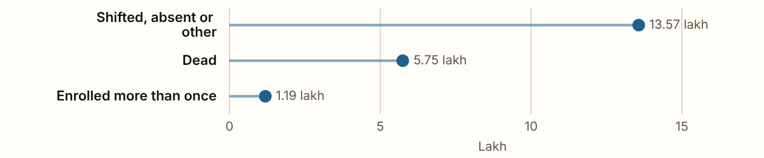
PUNJAB 2026 · The reasons
Punjab's draft roll of 13 August 2026 left off 20.67 lakh names, 9.6 of every 100 electors on the roll before the revision, as reported in the press.
Figures as published by the Chief Electoral Officer or the Election Commission; the method section of the report gives each source.
Notes:
Punjab's draft roll of 13 August 2026 left off 20.67 lakh names, 9.6 of every 100 electors on the roll before the revision, as reported in the press. 66.2% of the names left off were entered as shifted, absent or for another reason, 28.0% as dead and 5.8% as enrolled more than once, as far as the published reasons go. The final roll of 12 October 2026 holds 2.01 crore electors. Women are 48.4% of the final roll. No split of the names left off by sex was found.

Slide 9
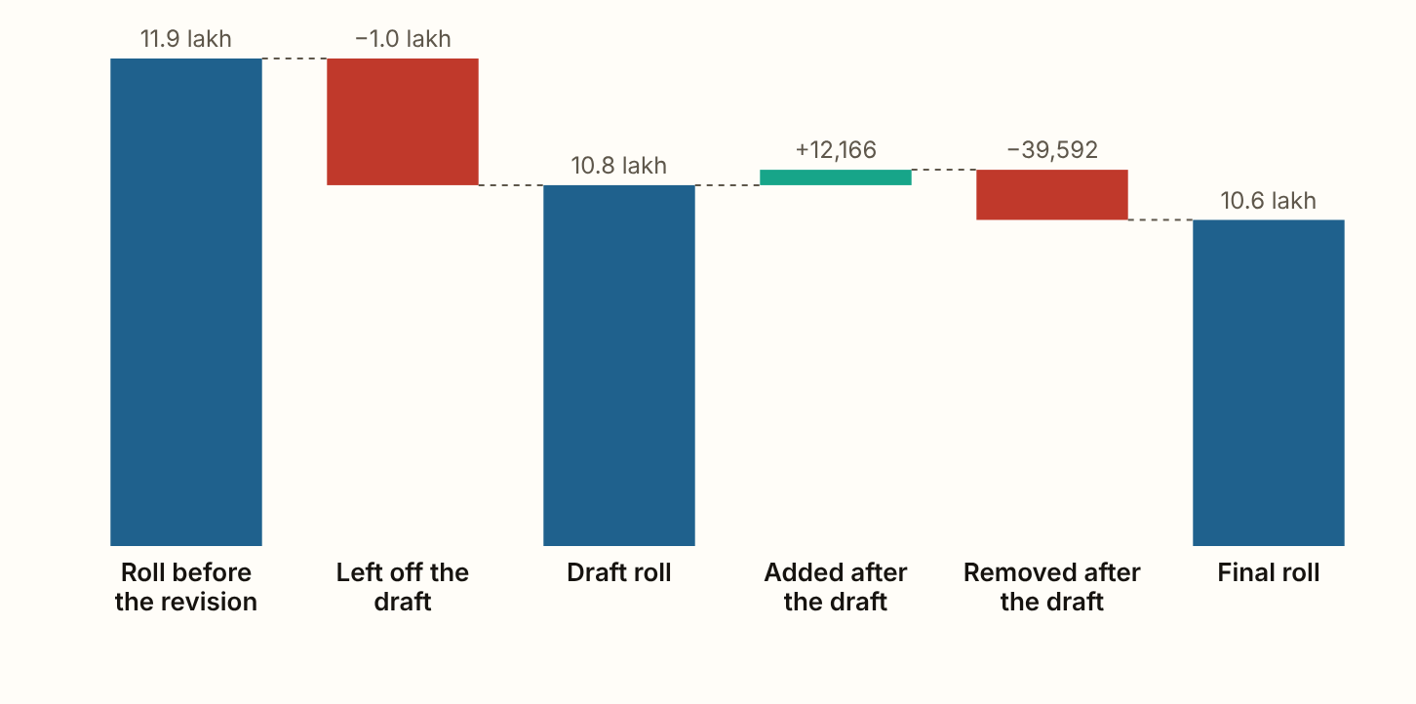
GOA 2026 · The roll, step by step
Goa's draft roll of 16 December 2025 left off 1.00 lakh names, 8.4 of every 100 electors on the roll before the revision.
Figures as published by the Chief Electoral Officer or the Election Commission; the method section of the report gives each source.
Notes:
Goa's draft roll of 16 December 2025 left off 1.00 lakh names, 8.4 of every 100 electors on the roll before the revision. 72.4% of the names left off were entered as shifted, absent or for another reason, 25.6% as dead and 2.0% as enrolled more than once. The final roll of 21 February 2026 holds 10.58 lakh electors. After the draft 12,166 names were added and 39,592 removed, so the roll fell by a further 27,426 after the draft. Women were 49.5% of the names left off and 51.6% of the roll before the revision, 8.1 of every 100 women against 8.8 of every 100 men.

Slide 10
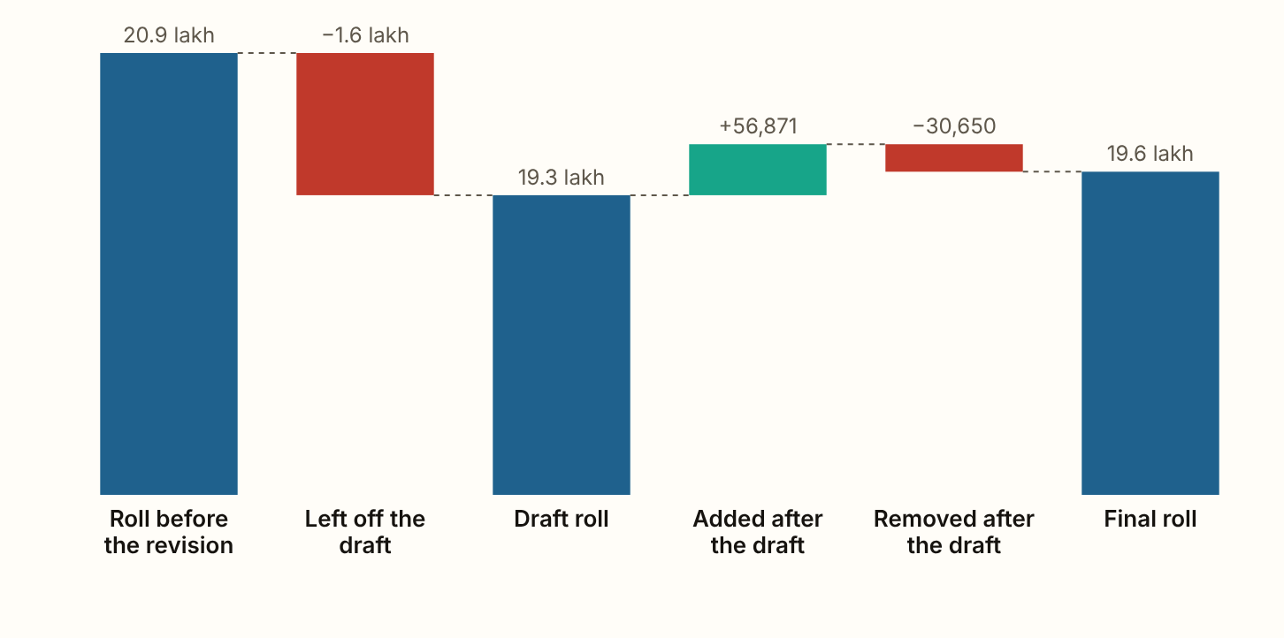
MANIPUR 2026 · The roll, step by step
Manipur's draft roll of 5 July 2026 left off 1.59 lakh names, 7.6 of every 100 electors on the roll before the revision.
Figures as published by the Chief Electoral Officer or the Election Commission; the method section of the report gives each source.
Notes:
Manipur's draft roll of 5 July 2026 left off 1.59 lakh names, 7.6 of every 100 electors on the roll before the revision. 68.2% of the names left off were entered as shifted, absent or for another reason, 27.1% as dead and 4.7% as enrolled more than once. The final roll of 6 September 2026 holds 19.61 lakh electors. After the draft 56,871 names were added and 30,650 removed, and the net rise is 16.5 for every 100 left off. It counts people enrolling for the first time, so fewer than that were put back. Women were 56.0% of the names left off and 51.7% of the roll before the revision, 8.2 of every 100 women against 6.9 of every 100 men.

Slide 11
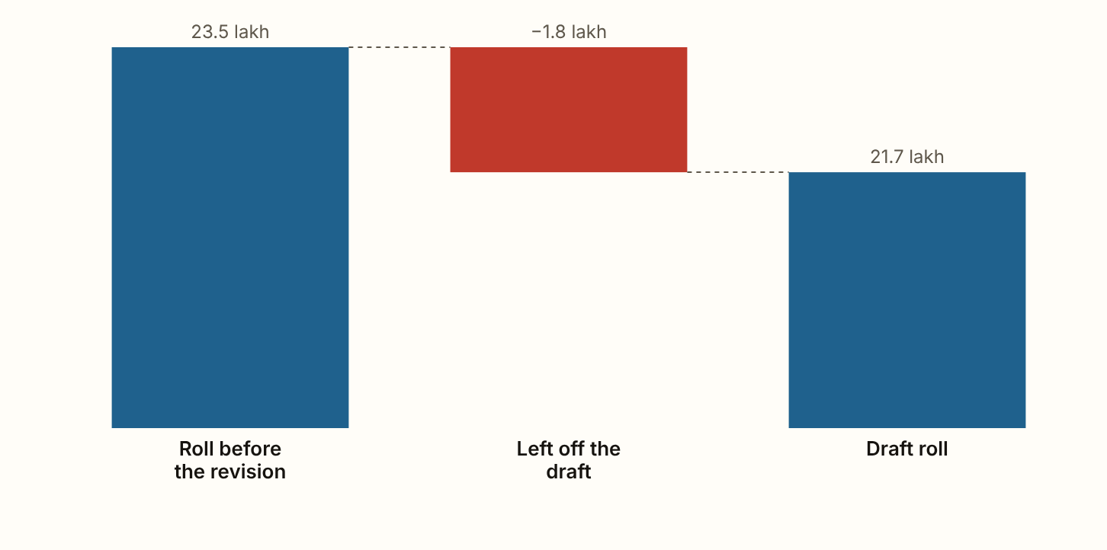
MEGHALAYA 2026 · The roll, step by step
Meghalaya's draft roll of 5 August 2026 left off 1.80 lakh names, 7.7 of every 100 electors on the roll before the revision.
Figures as published by the Chief Electoral Officer or the Election Commission; the method section of the report gives each source.
Notes:
Meghalaya's draft roll of 5 August 2026 left off 1.80 lakh names, 7.7 of every 100 electors on the roll before the revision. 51.1% of the names left off were entered as shifted, absent or for another reason, 45.2% as dead and 3.7% as enrolled more than once. Women were 41.4% of the names left off and 50.7% of the roll before the revision, 6.3 of every 100 women against 9.1 of every 100 men.

Slide 12
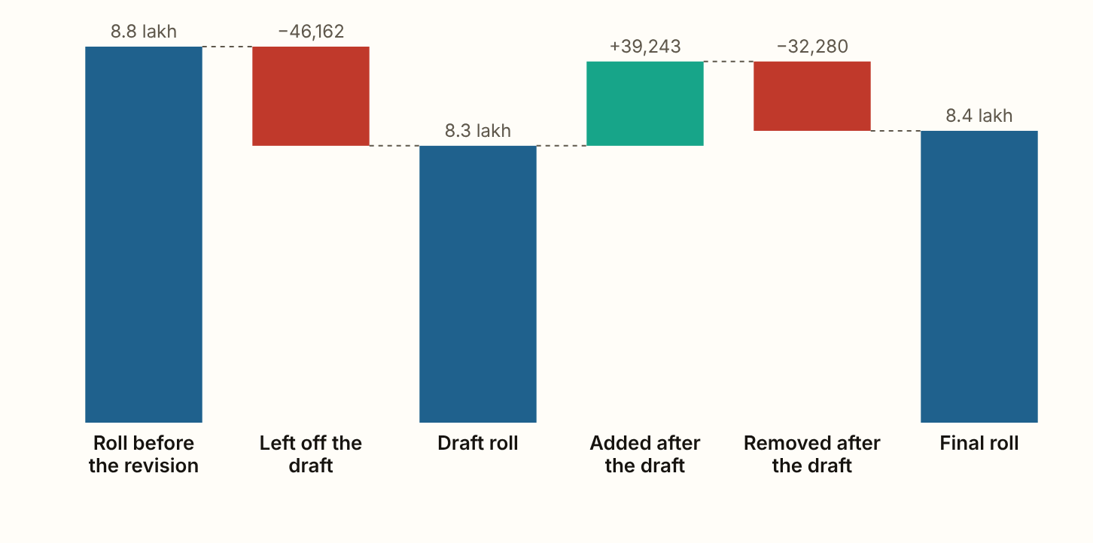
MIZORAM 2026 · The roll, step by step
Mizoram's draft roll of 4 July 2026 left off 46,162 names, 5.3 of every 100 electors on the roll before the revision.
Figures as published by the Chief Electoral Officer or the Election Commission; the method section of the report gives each source.
Notes:
Mizoram's draft roll of 4 July 2026 left off 46,162 names, 5.3 of every 100 electors on the roll before the revision. 49.0% of the names left off were entered as shifted, absent or for another reason, 46.1% as dead and 4.9% as enrolled more than once. The final roll of 7 September 2026 holds 8.36 lakh electors. After the draft 39,243 names were added and 32,280 removed, and the net rise is 15.1 for every 100 left off. It counts people enrolling for the first time, so fewer than that were put back. Women are 51.8% of the final roll. No split of the names left off by sex was found.

Slide 13
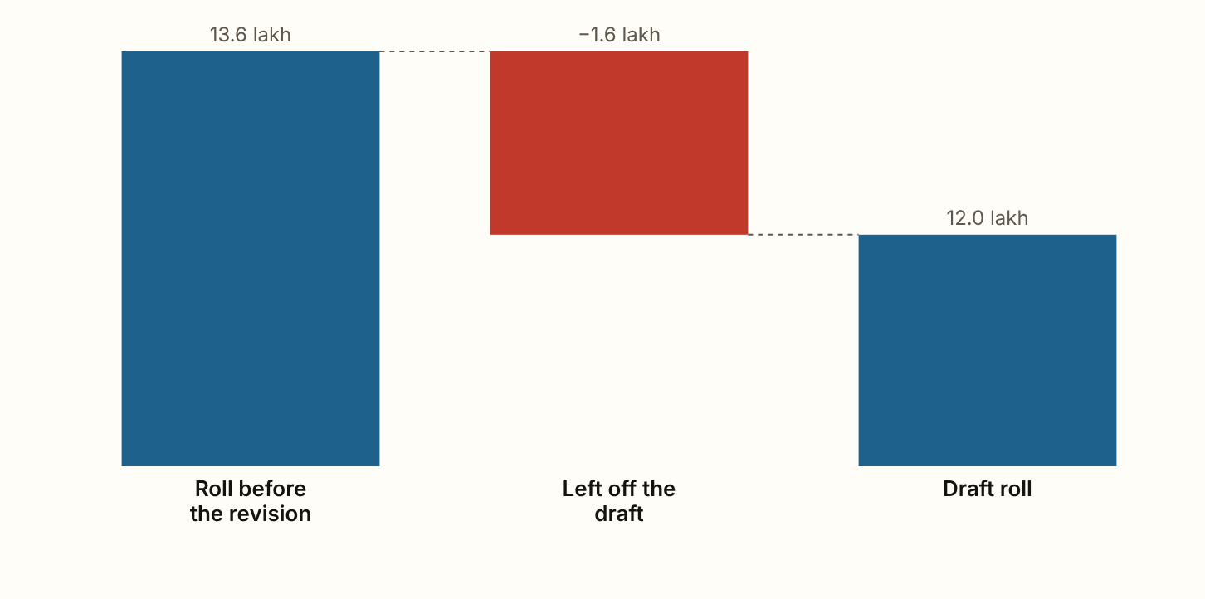
NAGALAND 2026 · The roll, step by step
Nagaland's draft roll of 20 September 2026 left off 1.58 lakh names, 11.6 of every 100 electors on the roll before the revision.
Figures as published by the Chief Electoral Officer or the Election Commission; the method section of the report gives each source.
Notes:
Nagaland's draft roll of 20 September 2026 left off 1.58 lakh names, 11.6 of every 100 electors on the roll before the revision. 78.4% of the names left off were entered as shifted, absent or for another reason, 18.3% as dead and 3.2% as enrolled more than once.

Slide 14
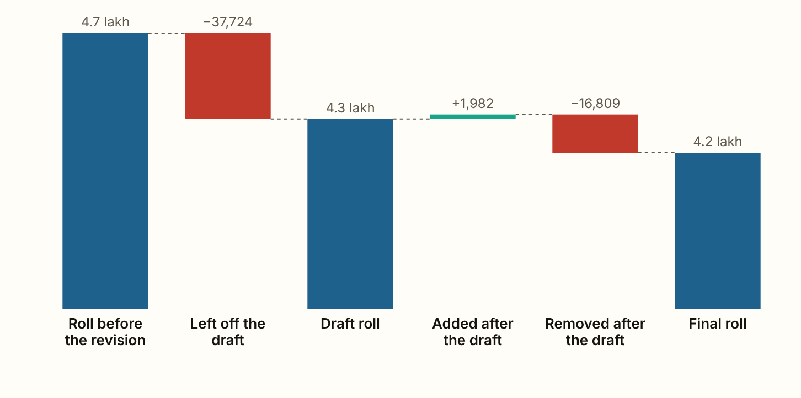
SIKKIM 2026 · The roll, step by step
Sikkim's draft roll of 5 July 2026 left off 37,724 names, 8.0 of every 100 electors on the roll before the revision.
Figures as published by the Chief Electoral Officer or the Election Commission; the method section of the report gives each source.
Notes:
Sikkim's draft roll of 5 July 2026 left off 37,724 names, 8.0 of every 100 electors on the roll before the revision. 64.9% of the names left off were entered as shifted, absent or for another reason, 28.7% as dead and 6.3% as enrolled more than once. The final roll of 6 September 2026 holds 4.18 lakh electors. After the draft 1,982 names were added and 16,809 removed, so the roll fell by a further 14,827 after the draft. Women are 49.2% of the final roll. No split of the names left off by sex was found.

Slide 15
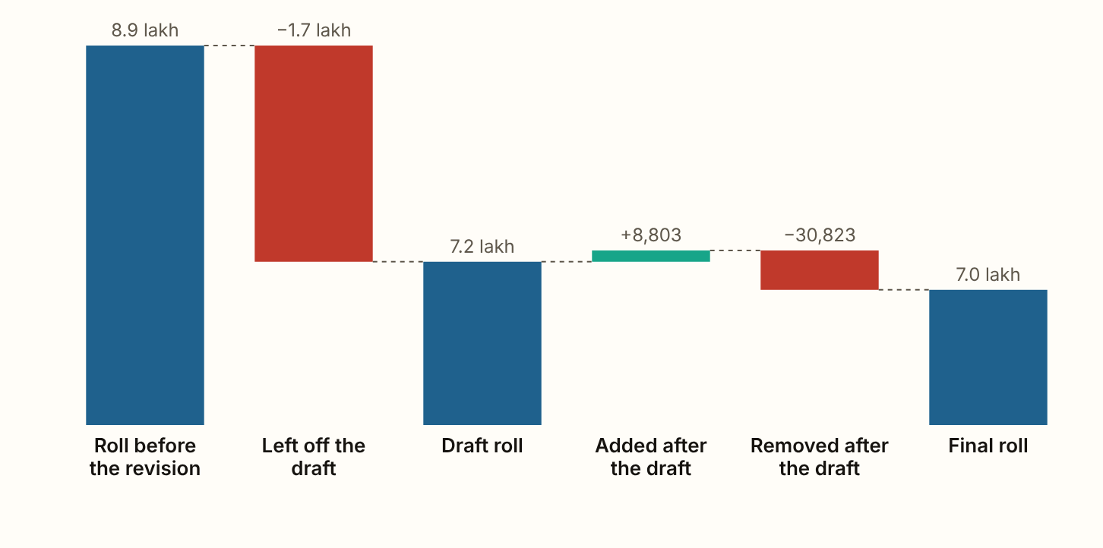
ARUNACHAL PRADESH 2026 · The roll, step by step
Arunachal Pradesh's draft roll of 21 July 2026 left off 1.69 lakh names, 19.1 of every 100 electors on the roll before the revision.
Figures as published by the Chief Electoral Officer or the Election Commission; the method section of the report gives each source.
Notes:
Arunachal Pradesh's draft roll of 21 July 2026 left off 1.69 lakh names, 19.1 of every 100 electors on the roll before the revision. 82.0% of the names left off were entered as shifted, absent or for another reason, 15.1% as dead and 2.9% as enrolled more than once. The final roll of 22 September 2026 holds 6.96 lakh electors. After the draft 8,803 names were added and 30,823 removed, so the roll fell by a further 22,020 after the draft. Women are 50.6% of the final roll. No split of the names left off by sex was found.

Slide 16
TRIPURA 2026
Overview
Tripura has not yet published a draft roll, so no count of names left off exists for it.

Slide 17
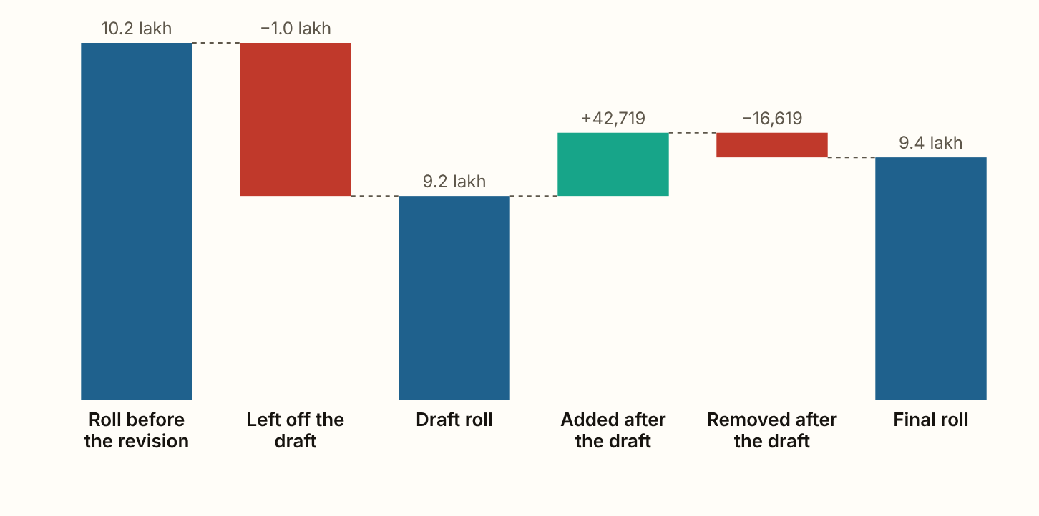
PUDUCHERRY 2026 · The roll, step by step
Puducherry's draft roll of 16 December 2025 left off 1.03 lakh names, 10.1 of every 100 electors on the roll before the revision.
Figures as published by the Chief Electoral Officer or the Election Commission; the method section of the report gives each source.
Notes:
Puducherry's draft roll of 16 December 2025 left off 1.03 lakh names, 10.1 of every 100 electors on the roll before the revision. 77.9% of the names left off were entered as shifted, absent or for another reason, 20.1% as dead and 2.0% as enrolled more than once. The final roll of 14 February 2026 holds 9.44 lakh electors. After the draft 42,719 names were added and 16,619 removed, and the net rise is 25.2 for every 100 left off. It counts people enrolling for the first time, so fewer than that were put back. Women are 53.0% of the final roll. No split of the names left off by sex was found.

Slide 18
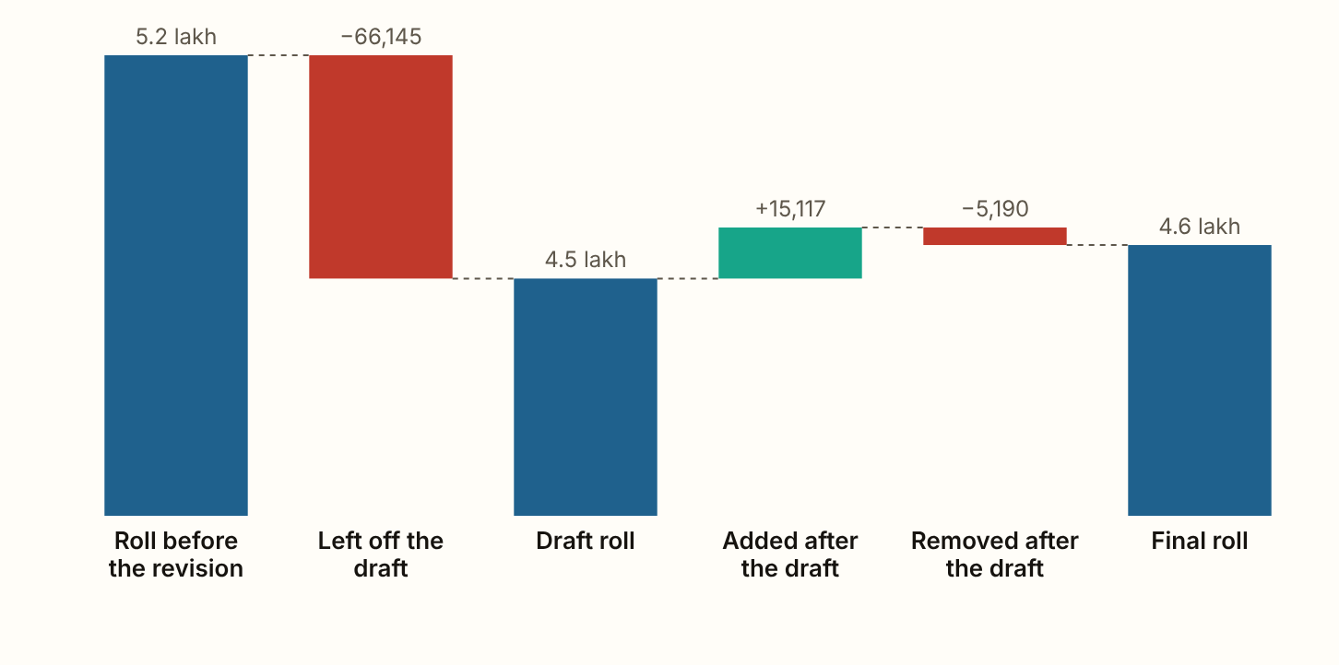
CHANDIGARH 2026 · The roll, step by step
Chandigarh's draft roll of 21 July 2026 left off 66,145 names, 12.8 of every 100 electors on the roll before the revision, as reported in the press.
Figures as published by the Chief Electoral Officer or the Election Commission; the method section of the report gives each source.
Notes:
Chandigarh's draft roll of 21 July 2026 left off 66,145 names, 12.8 of every 100 electors on the roll before the revision, as reported in the press. 90.7% of the names left off were entered as shifted, absent or for another reason, 5.3% as dead and 3.9% as enrolled more than once. The final roll of 22 September 2026 holds 4.60 lakh electors. After the draft 15,117 names were added and 5,190 removed, and the net rise is 15.0 for every 100 left off. It counts people enrolling for the first time, so fewer than that were put back. Women are 49.0% of the final roll. No split of the names left off by sex was found.

Slide 19
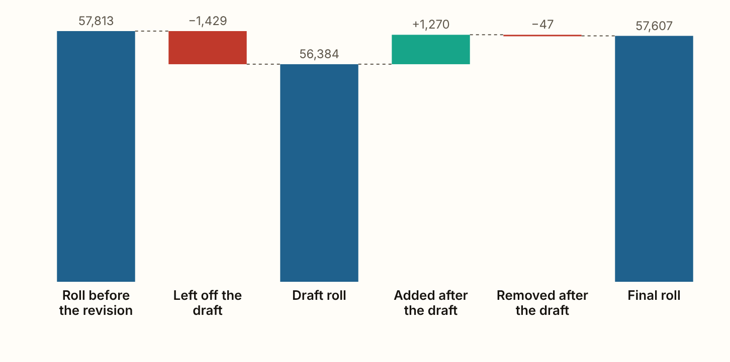
LAKSHADWEEP 2026 · The roll, step by step
Lakshadweep's draft roll of 16 December 2025 left off 1,429 names, 2.5 of every 100 electors on the roll before the revision.
Figures as published by the Chief Electoral Officer or the Election Commission; the method section of the report gives each source.
Notes:
Lakshadweep's draft roll of 16 December 2025 left off 1,429 names, 2.5 of every 100 electors on the roll before the revision. 17.6% of the names left off were entered as shifted, absent or for another reason, 49.3% as dead and 33.0% as enrolled more than once. The final roll of 14 February 2026 holds 57,607 electors. After the draft 1,270 names were added and 47 removed, and the net rise is 85.6 for every 100 left off. It counts people enrolling for the first time, so fewer than that were put back. Women are 49.3% of the final roll. No split of the names left off by sex was found.

Slide 20
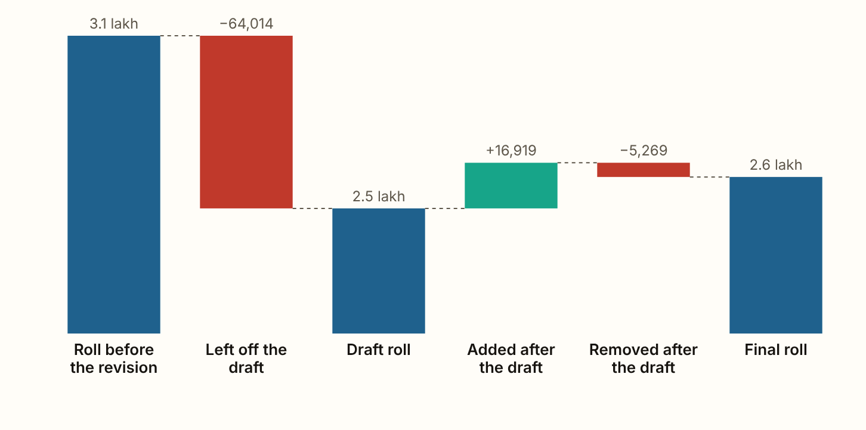
ANDAMAN AND NICOBAR ISLANDS 2026 · The roll, step by step
The Andaman and Nicobar Islands' draft roll of 23 December 2025 left off 64,014 names, 20.6 of every 100 electors on the roll before the revision, as reported in the press.
Figures as published by the Chief Electoral Officer or the Election Commission; the method section of the report gives each source.
Notes:
The Andaman and Nicobar Islands' draft roll of 23 December 2025 left off 64,014 names, 20.6 of every 100 electors on the roll before the revision, as reported in the press. 81.1% of the names left off were entered as shifted, absent or for another reason, 14.4% as dead and 4.6% as enrolled more than once. The final roll of 21 February 2026 holds 2.58 lakh electors. After the draft 16,919 names were added and 5,269 removed, and the net rise is 18.2 for every 100 left off. It counts people enrolling for the first time, so fewer than that were put back. Women are 49.5% of the final roll. No split of the names left off by sex was found.

Slide 21
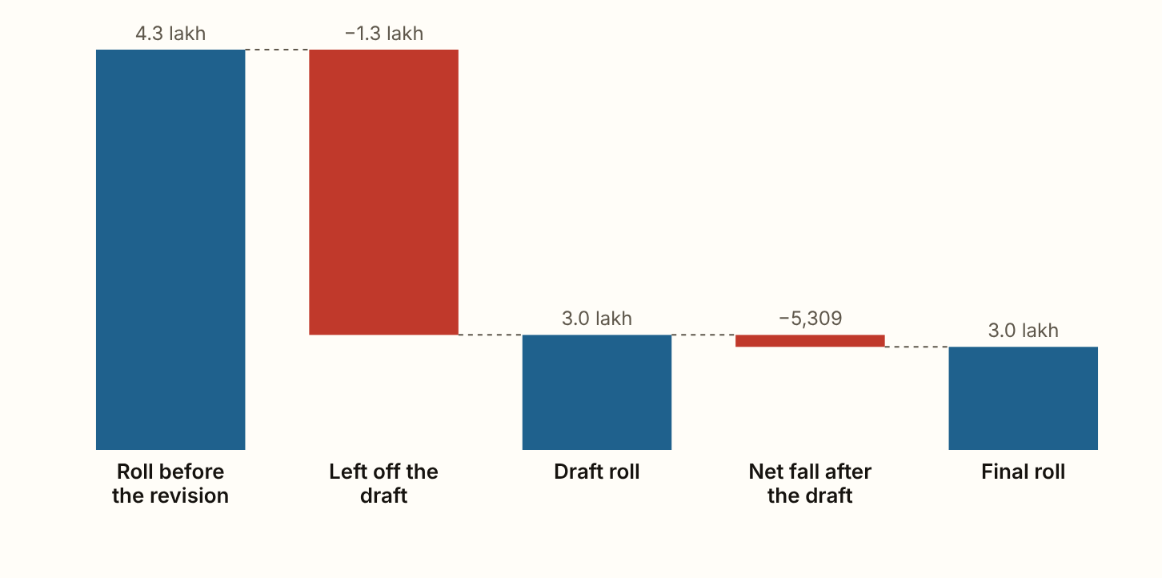
DADRA AND NAGAR HAVELI AND DAMAN AND DIU 2026 · The roll, step by step
Dadra and Nagar Haveli and Daman and Diu's draft roll of 10 July 2026 left off 1.27 lakh names, 29.6 of every 100 electors on the roll before the revision, as reported in the press.
Figures as published by the Chief Electoral Officer or the Election Commission; the method section of the report gives each source.
Notes:
Dadra and Nagar Haveli and Daman and Diu's draft roll of 10 July 2026 left off 1.27 lakh names, 29.6 of every 100 electors on the roll before the revision, as reported in the press. The final roll of 11 September 2026 holds 2.96 lakh electors. Women are 50.7% of the final roll. No split of the names left off by sex was found.

