Slide 1
SPECIAL INTENSIVE REVISION
Assam 2025-26
Figures as of 10 February 2026, when the final roll was published.
Assam had a Special Revision of its roll in 2025-26, ordered by the Election Commission on 17 November 2025, and was left out of the Special Intensive Revision. No existing elector filled an enumeration form or showed a document to stay on the roll.
10.56 lakh names were flagged for deletion with the draft roll of 27 December 2025, as dead, shifted, or entered more than once. The draft still held 2,76,490 more names than the roll of January 2025.
Between the draft and the final roll, the roll fell in 94 of the 126 constituencies and rose in 32. Women were 62.9% of the net fall, against 50.1% of the draft.
93,021 D-voters, electors whose citizenship a Foreigners Tribunal has yet to decide, were carried onto the draft unchanged and kept out of the house-to-house check.
In November 2019 the six detention centres held 970 people, 324 of them women, and 10 people held in them died in hospital between March 2019 and February 2020.

Slide 2
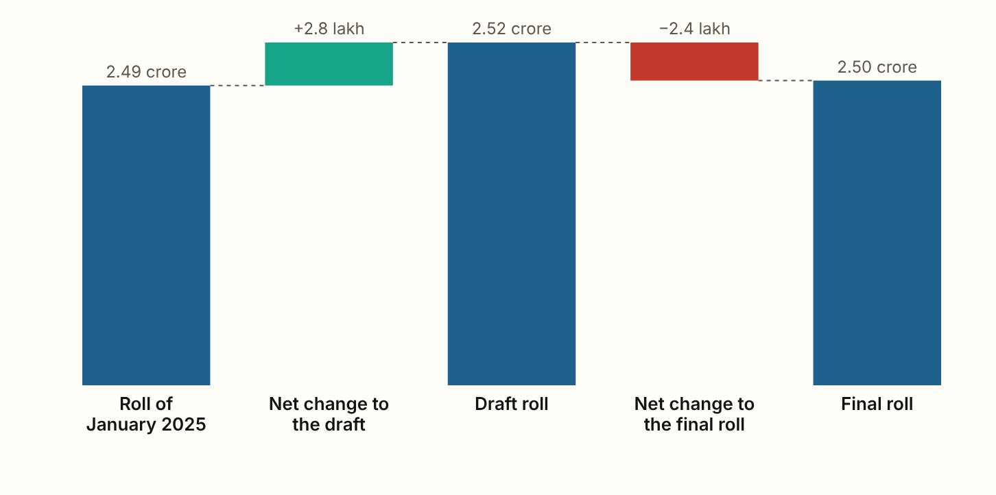
ASSAM 2025-26 · The roll, step by step
The draft roll held 2,76,490 more names than the roll of January 2025, and the final roll 2,44,636 fewer than the draft.
Figures as published by the Chief Electoral Officer or the Election Commission; the method section of the report gives each source.
Notes:
The draft roll held 2,76,490 more names than the roll of January 2025, and the final roll 2,44,636 fewer than the draft. The final roll of 2.50 crore electors is 31,854 larger than the roll of January 2025. Women are 49.99% of it. The January 2025 figure is the Chief Electoral Officer's as reported in the press, and the Commission published no count of the names added and removed in between, only the totals.

Slide 3
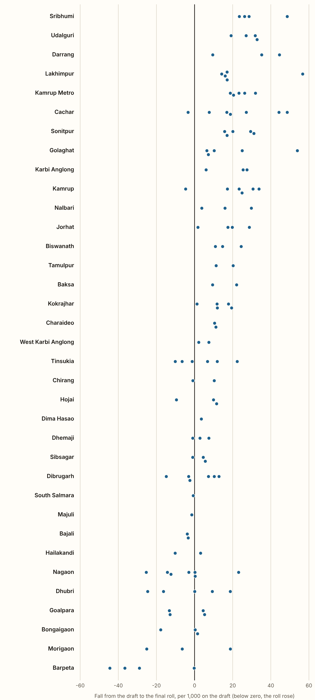
ASSAM 2025-26 · Constituency by constituency
Between the draft and the final roll, the roll fell in 94 of Assam's 126 constituencies and rose in 32.
It fell most in Lakhimpur (Lakhimpur), by 56.7 for every 1,000 on the draft, and rose most in Chenga (Barpeta), by 44.4. Every constituency's draft held more names than its final roll of February 2024, which is 8,99,664 more across the state.
Figures as published by the Chief Electoral Officer or the Election Commission; the method section of the report gives each source.
Notes:
Between the draft and the final roll, the roll fell in 94 of Assam's 126 constituencies and rose in 32. It fell most in Lakhimpur (Lakhimpur), by 56.7 for every 1,000 on the draft, and rose most in Chenga (Barpeta), by 44.4. Every constituency's draft held more names than its final roll of February 2024, which is 8,99,664 more across the state.

Slide 4
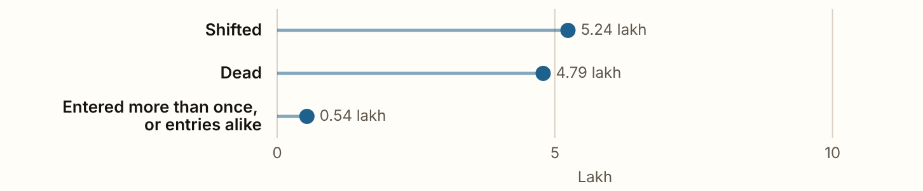
ASSAM 2025-26 · Names flagged for deletion
Names flagged for deletion
Figures as published by the Chief Electoral Officer or the Election Commission; the method section of the report gives each source.

Slide 5
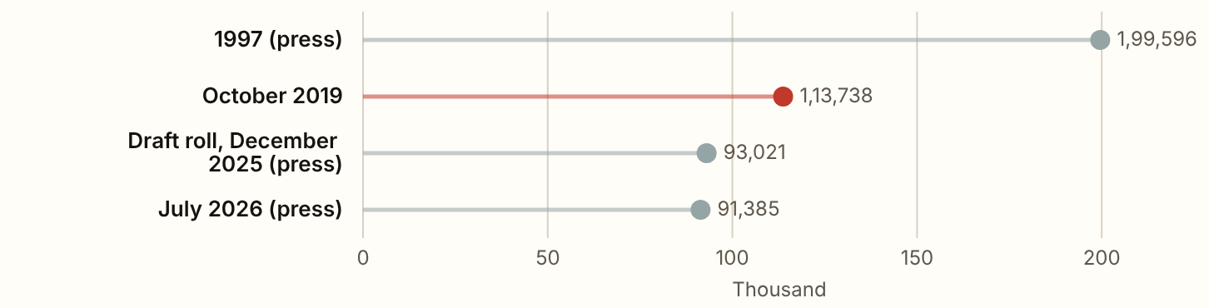
ASSAM 2025-26 · D-voters
D-voters
Figures as published by the Chief Electoral Officer or the Election Commission; the method section of the report gives each source.

Slide 6
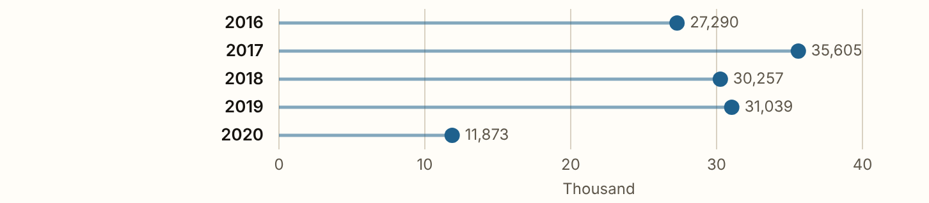
ASSAM 2025-26 · Foreigners Tribunals
Foreigners Tribunals
Figures as published by the Chief Electoral Officer or the Election Commission; the method section of the report gives each source.

Slide 7
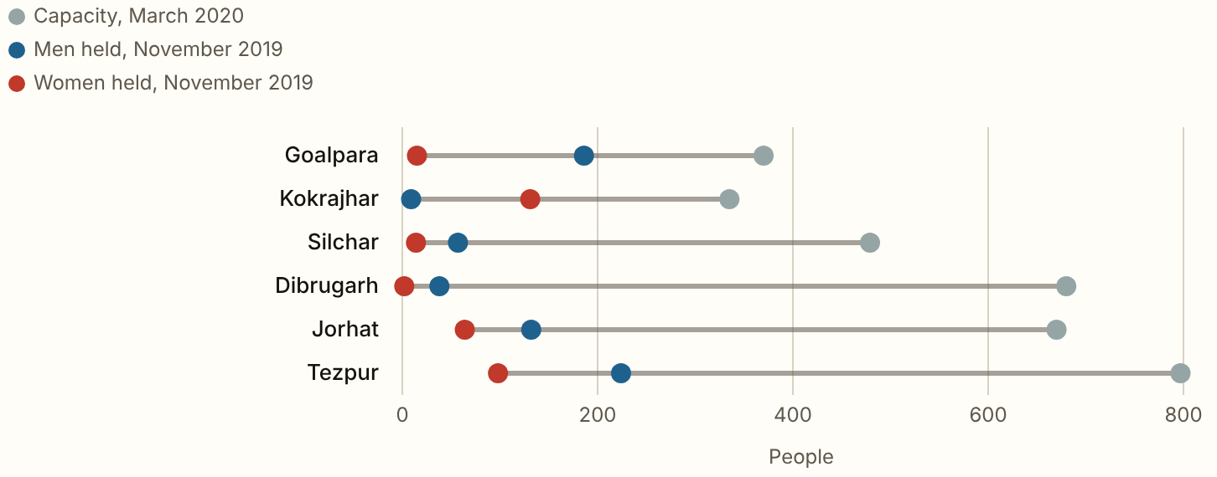
ASSAM 2025-26 · Detention centres
10 people held in Assam's detention centres died in hospital between 1 March 2019 and 29 February 2020.
Figures as published by the Chief Electoral Officer or the Election Commission; the method section of the report gives each source.
Notes:
10 people held in Assam's detention centres died in hospital between 1 March 2019 and 29 February 2020. At the end of 2019, 181 declared foreigners and 44 convicted foreigners had been held for more than three years, and 128 had been released after three years under the Supreme Court's order of 10 May 2019. 289 declared foreigners were detained in 2019. Every figure here is from the Ministry of Home Affairs' answers to the Lok Sabha, which put them on the information of the Assam government.

Slide 8
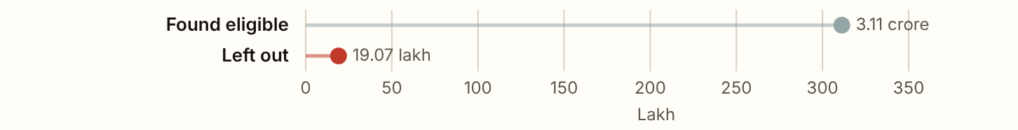
ASSAM 2025-26 · The 2019 NRC
The 2019 NRC
Figures as published by the Chief Electoral Officer or the Election Commission; the method section of the report gives each source.

Slide 9
ASSAM 2025-26
What these figures cannot show
The draft and final rolls by constituency are the Chief Electoral Officer's own tables, and the count of names flagged is the officer's as reported in the press. The constituency tables give the net change only. A reason for deletion is what the officer wrote down, and nobody checked it. The detention figures are from 2019 and 2020.

