Slide 1
SPECIAL INTENSIVE REVISION
Uttarakhand 2026
Figures as of 3 October 2026, when the final roll was published.
Uttarakhand's draft roll left off 8.27 lakh names, 10.4 of every 100 electors on the roll before the revision.
Kichha lost 18.2 of every 100 names on its roll before the revision, the most of the 70 constituencies, and Didihat 4.2, the fewest.
After the draft, 1.30 lakh names were added and 1.05 lakh removed, so the final roll of 3 October 2026 holds 25,164 more than the draft. That is 3.0 for every 100 left off.
The four plains districts held 60.9% of the roll before the revision, and account for 68.4% of the names left off the draft and 87.2% of the names removed after it.
Women were 47.8% of the draft roll and 53.0% of the names removed after it, more than their share in 63 of the 70 constituencies.

Slide 2
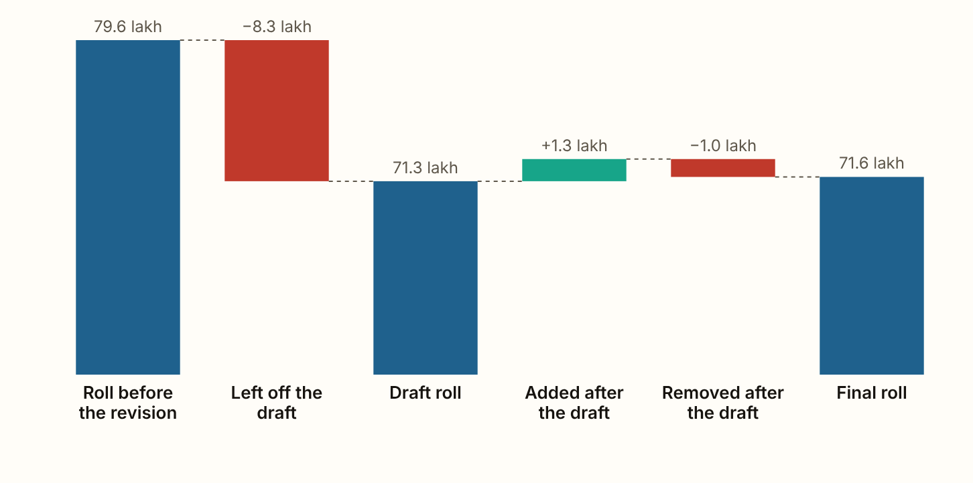
UTTARAKHAND 2026 · The roll, step by step
The draft roll left off 8.27 lakh names, 10.4 of every 100 electors, and the final roll is 8.02 lakh smaller than the roll before the revision.
Figures as published by the Chief Electoral Officer or the Election Commission; the method section of the report gives each source.
Notes:
The draft roll left off 8.27 lakh names, 10.4 of every 100 electors, and the final roll is 8.02 lakh smaller than the roll before the revision. After the draft, 1.30 lakh names were added and 1.05 lakh removed. The net rise of 25,164 is 3.0 for every 100 left off, and it counts people enrolling for the first time, so fewer than that were put back.

Slide 3
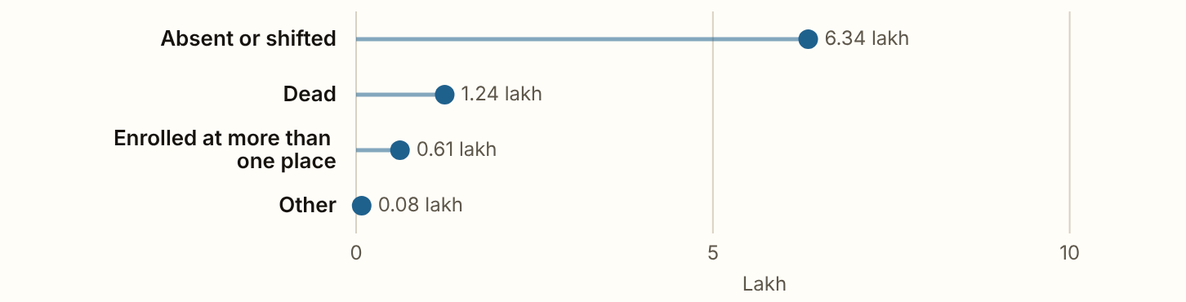
UTTARAKHAND 2026 · The reasons
76.6% were entered as absent or shifted, 15.0% as dead and 7.4% as enrolled at more than one place.
Figures as published by the Chief Electoral Officer or the Election Commission; the method section of the report gives each source.
Notes:
76.6% were entered as absent or shifted, 15.0% as dead and 7.4% as enrolled at more than one place. The Chief Electoral Officer did not separate absent from shifted, and published no split of the reasons by district or by sex.

Slide 4
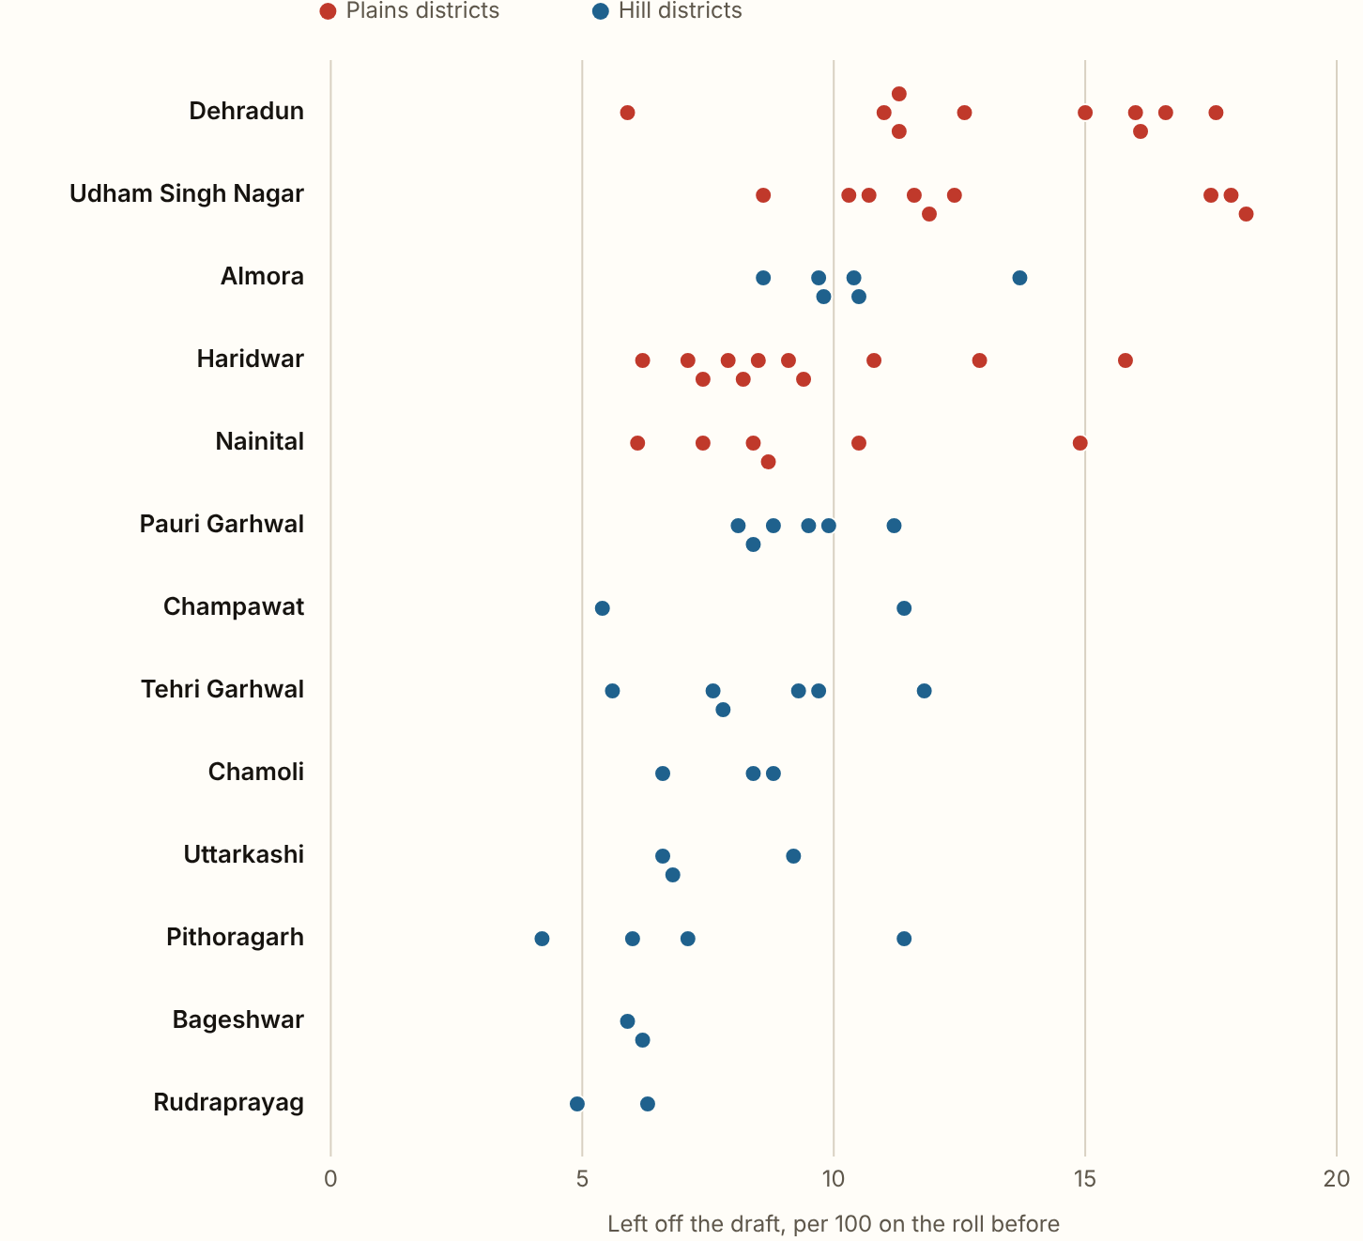
UTTARAKHAND 2026 · Names left off, constituency by constituency
Kichha lost 18.2 of every 100 names on its roll before the revision, and Bajpur (SC) 17.9. Didihat lost 4.2, the fewest.
27 of the 70 constituencies lost more than the state's 10.4. By district, Dehradun lost the most, 13.5 per 100, and Rudraprayag the fewest, 5.6. The plains districts lost 11.7 per 100 and the hill districts 8.4. The table gives no reason or sex below the state.
Figures as published by the Chief Electoral Officer or the Election Commission; the method section of the report gives each source.
Notes:
Kichha lost 18.2 of every 100 names on its roll before the revision, and Bajpur (SC) 17.9. Didihat lost 4.2, the fewest. 27 of the 70 constituencies lost more than the state's 10.4. By district, Dehradun lost the most, 13.5 per 100, and Rudraprayag the fewest, 5.6. The plains districts lost 11.7 per 100 and the hill districts 8.4. The table gives no reason or sex below the state.

Slide 5
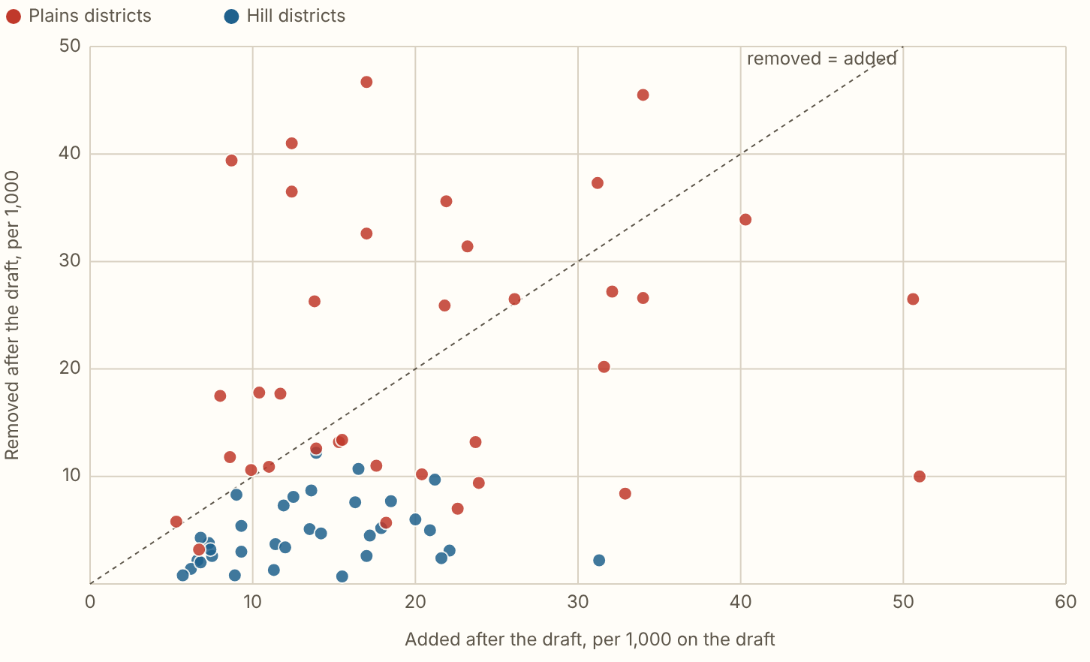
UTTARAKHAND 2026 · After the draft, constituency by constituency
In 18 of the 70 constituencies more names were removed after the draft than added, and all of them are in the plains districts.
Figures as published by the Chief Electoral Officer or the Election Commission; the method section of the report gives each source.
Notes:
In 18 of the 70 constituencies more names were removed after the draft than added, and all of them are in the plains districts. Haridwar Rural removed the most, 46.7 for every 1,000 on its draft, and Ghansali (SC) the fewest, 0.7. Across the state, 18.2 were added and 14.7 removed for every 1,000 on the draft.

Slide 6
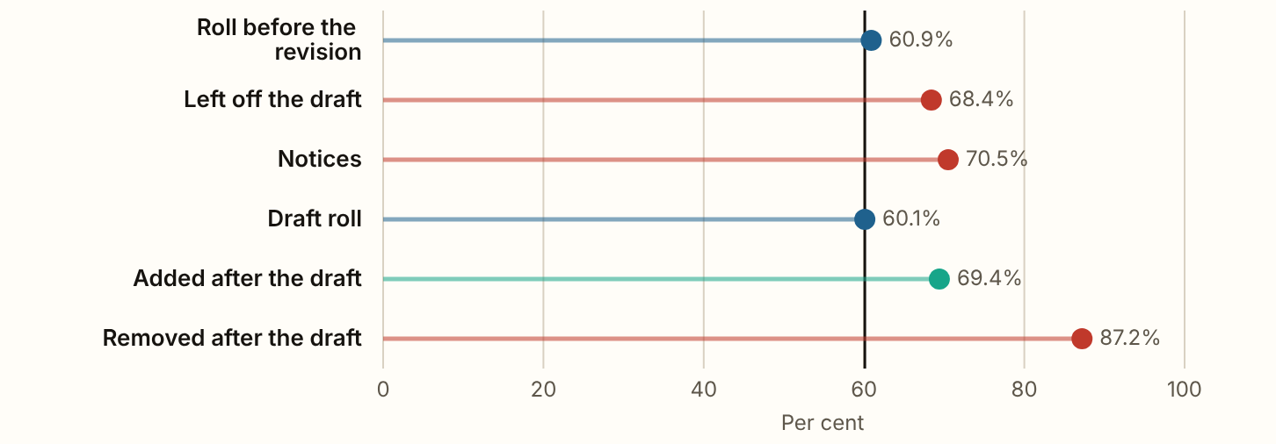
UTTARAKHAND 2026 · The plains and the hills
The plains districts held 60.9% of the roll before the revision, and account for 68.4% of the names left off the draft, 70.5% of the notices and 87.2% of the names removed after it.
Figures as published by the Chief Electoral Officer or the Election Commission; the method section of the report gives each source.
Notes:
The plains districts held 60.9% of the roll before the revision, and account for 68.4% of the names left off the draft, 70.5% of the notices and 87.2% of the names removed after it. Their share grows at every step. They removed 21.3 for every 1,000 on the draft and added 21.0, so their rolls shrank by 0.3 per 1,000. The hill districts removed 4.7 and added 13.9, and their rolls grew by 9.3 per 1,000.

Slide 7
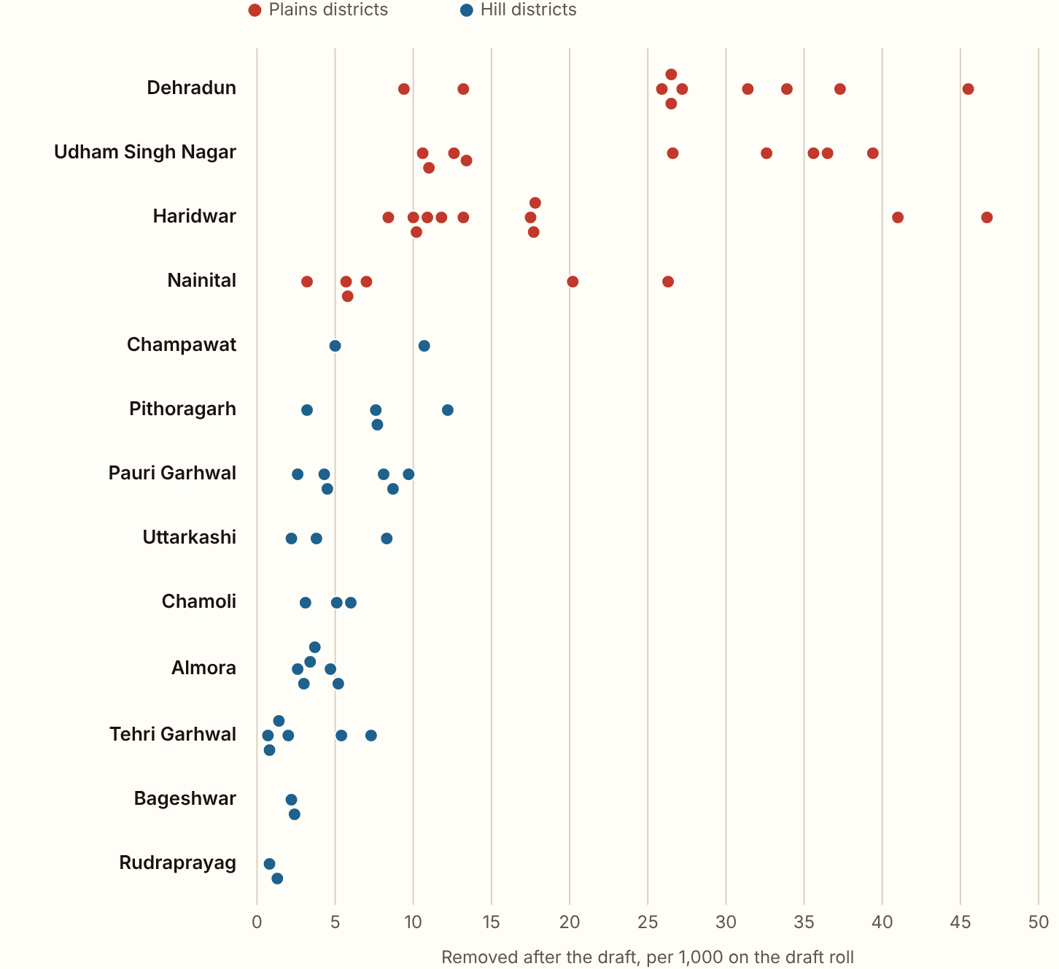
UTTARAKHAND 2026 · Per 1,000 electors, by district
Dehradun removed 26.9 for every 1,000 on its draft, the most of the 13 districts.
Udham Singh Nagar and Haridwar come next, at 24.4 and 18.6. Rudraprayag removed the fewest, 1.1.
Figures as published by the Chief Electoral Officer or the Election Commission; the method section of the report gives each source.
Notes:
Dehradun removed 26.9 for every 1,000 on its draft, the most of the 13 districts. Udham Singh Nagar and Haridwar come next, at 24.4 and 18.6. Rudraprayag removed the fewest, 1.1.

Slide 8
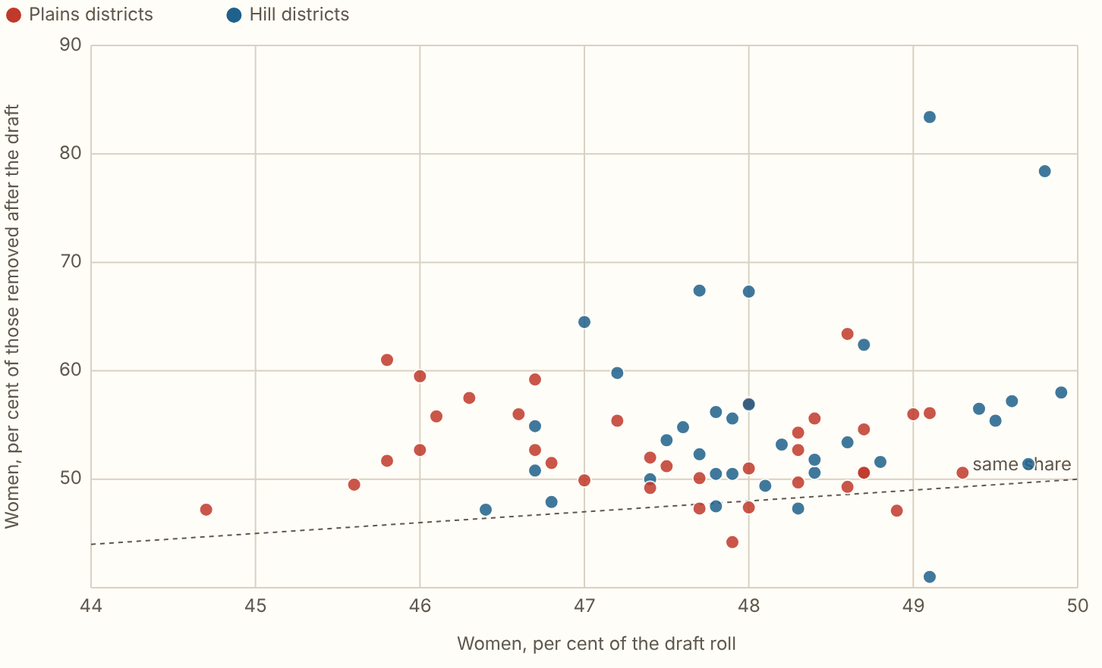
UTTARAKHAND 2026 · Women
Women were 47.8% of the draft roll and 53.0% of the names removed after it, more than their share in 63 of the 70 constituencies.
Figures as published by the Chief Electoral Officer or the Election Commission; the method section of the report gives each source.
Notes:
Women were 47.8% of the draft roll and 53.0% of the names removed after it, more than their share in 63 of the 70 constituencies. In 12 the gap is 10 points or more, among them Dharchula (83.4% of 993), Didihat (78.4% of 582), Champawat (67.4% of 989) and Deoprayag (67.3% of 104). Women were also 51.3% of the names added, and 47.8% of the final roll.

Slide 9
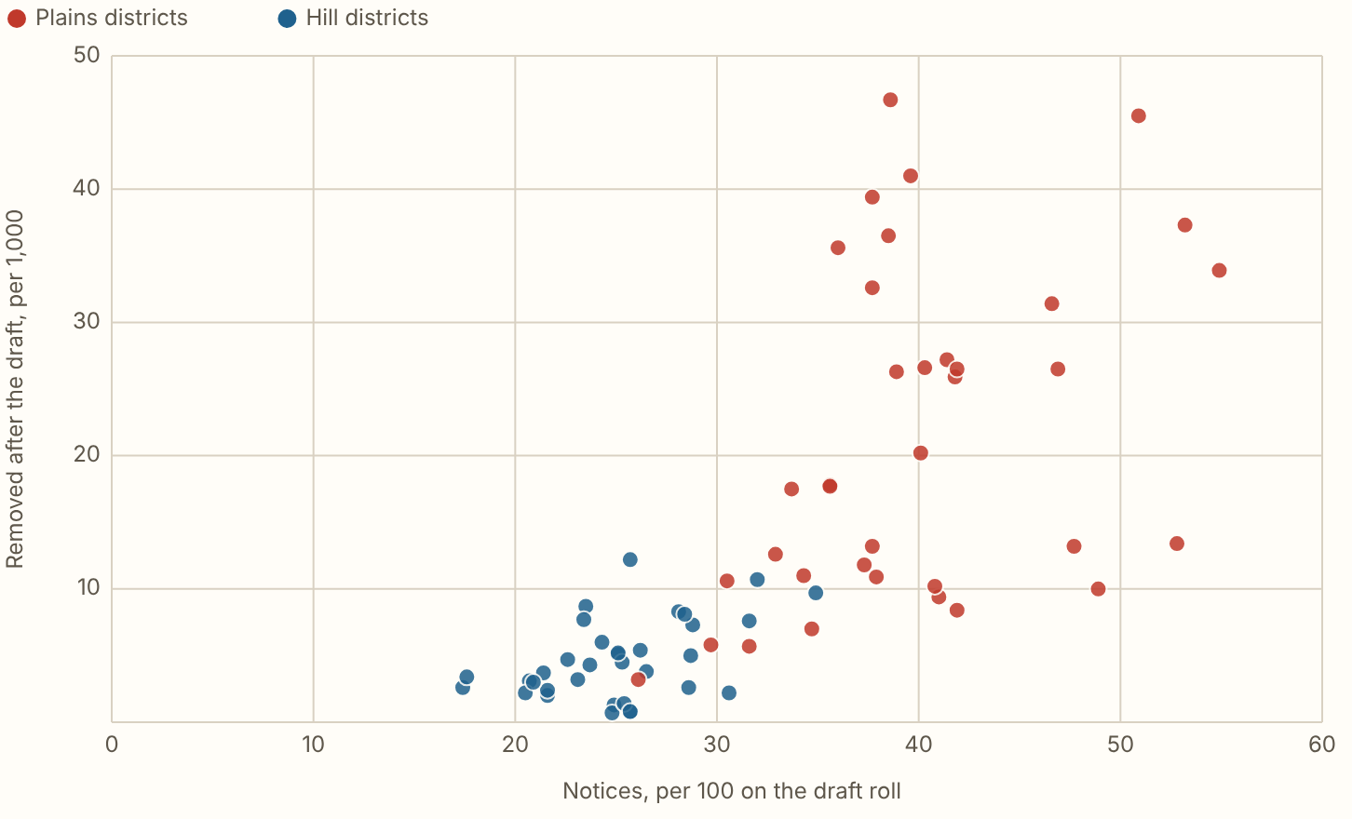
UTTARAKHAND 2026 · Notices
24.31 lakh electors on the draft, 34.1 of every 100, were in line for a notice: 5.26 lakh with no mapping to the 2003 roll and 19.04 lakh with an anomaly.
Figures as published by the Chief Electoral Officer or the Election Commission; the method section of the report gives each source.
Notes:
24.31 lakh electors on the draft, 34.1 of every 100, were in line for a notice: 5.26 lakh with no mapping to the 2003 roll and 19.04 lakh with an anomaly. The constituencies with more notices removed more names after the draft (rank correlation 0.81), and the notices tie the two counts together more closely than the names left off do (0.48). The plains districts had 40.0 notices per 100 on the draft and the hills 25.2. The table does not say how many notices were served or heard in each constituency. The Indian Express reported on 3 October, from the Chief Electoral Officer's presentation, that 97,186 of the 1,04,708 names removed after the draft were electors found ineligible after a notice, and that would explain the link. The site has not seen that presentation.

Slide 10
UTTARAKHAND 2026
What these figures cannot show
The reasons for leaving a name off, and the split by sex, were published for Uttarakhand as a whole only.

