Slide 1



MERIDIAN CLOUD
AUGUST, 2030
MERIDIAN CLOUD
WHAT'S ACTUALLY DRIVING CUSTOMER CHURN
A data-driven analysis for executive leadership. Product usage — not pricing — is the primary driver of churn. Here's what the evidence shows.
PRESENTED BY: CUSTOMER ANALYTICS TEAM

Slide 2

MERIDIAN CLOUD
AUGUST, 2030
THE BUSINESS PROBLEM
Customer churn has risen sharply over the past two quarters. Leadership believes the recent price increase is the primary cause — and is considering a full rollback to stop the bleeding.
The decision on the table: reverse the price increase to recover churned customers and prevent further attrition.
MERIDIAN CLOUD — CONFIDENTIAL

Slide 3

MERIDIAN CLOUD
AUGUST, 2030
OUR RECOMMENDATION
Product usage — not price — is the real driver of customer churn. Rolling back the price increase will not stop attrition. Investing in adoption and retention will.
Customers who actively use core features churn at a fraction of the rate of low-engagement customers, regardless of price tier.
We recommend redirecting resources toward onboarding, adoption programs, and proactive customer success — not pricing rollbacks.
MERIDIAN CLOUD — CUSTOMER CHURN ANALYSIS

Slide 4

MERIDIAN CLOUD
AUGUST, 2030
WHAT WE TESTED
To isolate the true driver of churn, we examined four variables across the full customer base. Each was tested independently before drawing conclusions.
PRICING CHANGES
PRODUCT USAGE
We analyzed whether the Q2 price increase correlated with cancellation events, controlling for contract timing and renewal cycles.
We measured active feature engagement and login frequency in the 90 days prior to churn or renewal decisions across all accounts.
SEAT UTILIZATION
SUPPORT TICKETS
We tracked the ratio of provisioned seats to actively used seats, identifying accounts where significant capacity went unused before churn.
We reviewed volume, severity, and resolution time of support interactions to assess whether unresolved friction contributed to cancellation decisions.

Slide 5
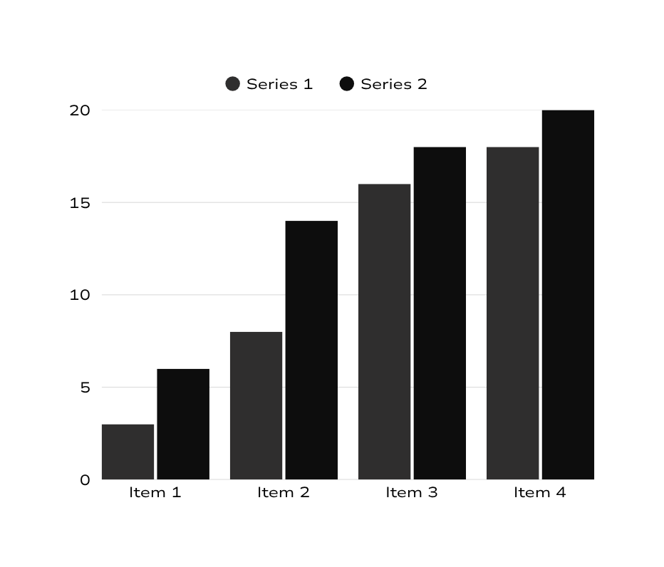
CONFIDENTIAL
MERIDIAN CLOUD
USAGE
DRIVES
CHURN
Customers in the lowest usage quartile churn at 3x the rate of highly active users. As monthly active usage rises, churn rate drops sharply and consistently.
This pattern holds across all customer segments and contract sizes. Usage is the single strongest leading indicator of churn risk — stronger than price sensitivity.
WWW.MERIDIANCLOUD.COM

Slide 6
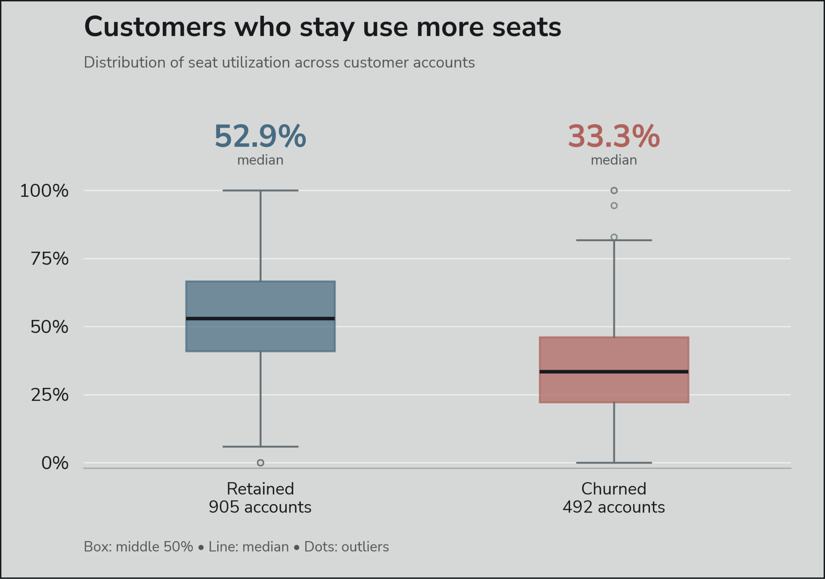
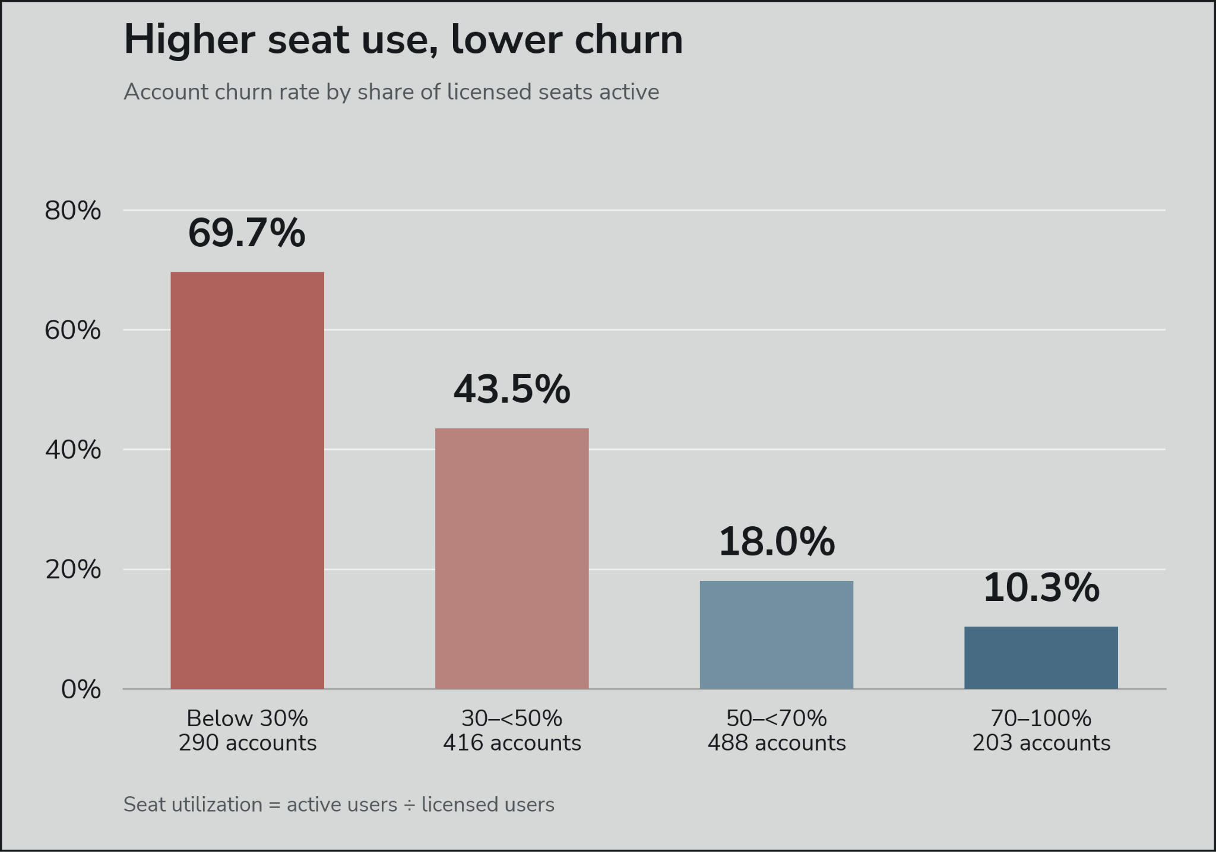
MERIDIAN CLOUD
AUGUST, 2030
SEAT UTILIZATION
Retained accounts have 52.9% median seat utilization, compared with 33.3% for churned accounts.
Churn falls from 69.7% among accounts using less than 30% of seats to 10.3% among those using at least 70%.
Low seat utilization can help flag accounts for adoption support, though it does not prove why they churn.
WWW.MERIDIANCLOUD.COM

Slide 7
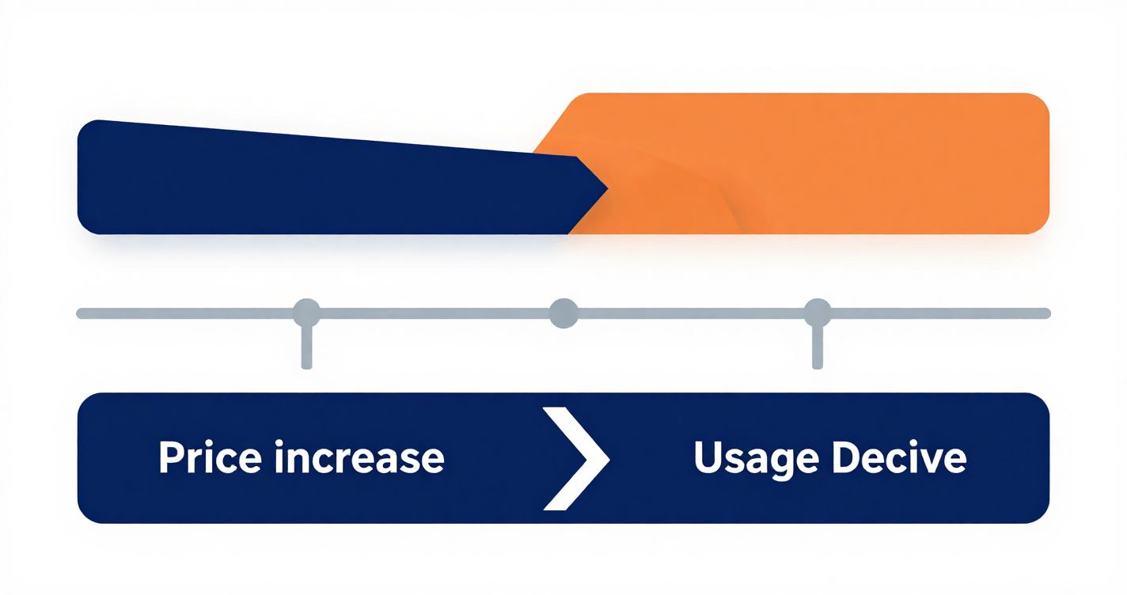
MERIDIAN CLOUD
AUGUST, 2030
WHY PRICE LOOKED RESPONSIBLE
The price increase and churn spike occurred at the same time — a compelling but misleading correlation.
Customers who churned after the price increase were already low-usage accounts. Usage decline preceded their cancellation by months. Price was the trigger, not the cause.
WWW.MERIDIANCLOUD.COM

Slide 8

MERIDIAN CLOUD
AUGUST, 2030
PATTERN HOLDS ACROSS ALL SEGMENTS
SMB Segment
High-usage SMB customers churned at 4% vs. 31% for low-usage SMBs. Price sensitivity did not explain the gap.
New Customers
Recently onboarded accounts with low feature adoption churned 3x more often — regardless of plan tier or price paid.
Tenured Customers
Even long-tenure accounts showed elevated churn risk when active usage declined over a 60-day window.
NEW (<1YR)
TENURED (2YR+)
SMB
MID-MARKET
ENTERPRISE
Mid-Market Segment
Usage depth predicted churn more reliably than contract size or billing frequency across all mid-market accounts.
Enterprise Segment
Enterprise accounts with low seat utilization churned at 18% — 4x higher than fully activated enterprise accounts.

Slide 9

MERIDIAN CLOUD
EXECUTIVE PRESENTATION
PRIORITIZE LOW-USAGE ACCOUNTS
LEADERSHIP ACTIONS
Route accounts with usage scores under 50 and seat activation rates under 50% to a dedicated retention team before their next renewal date.
INVEST IN ONBOARDING & ADOPTION
Expand guided onboarding and in-product adoption programs to increase usage and decrease future support ticket volume.
Four actions to take, each grounded in the usage and churn data reviewed across all customer segments.
DO NOT ROLL BACK PRICE INCREASE
Churn is driven by low engagement, not cost sensitivity. Reversing pricing will not solve the problem and will leave money on the table.
MONITOR & REPORT PROGRESS
Track usage, seat activation, and churn rate monthly. Report back to leadership at the quarter-mark with retention results.

Slide 10

MERIDIAN CLOUD
CONFIDENTIAL
LIMITATIONS
These findings are directionally strong but should be interpreted responsibly. Four key constraints shape what we can and cannot conclude from this analysis.
CORRELATION ≠ CAUSATION
INCOMPLETE USAGE HISTORY
Correlation between low usage and churn is robust, but this analysis cannot prove causation.
Data does not show information about specific features and use cases that may highlight strengths and weaknesses of the software itself driving churn.
POTENTIAL SEGMENT CONFOUNDING
PRICE INCREASE IS RECENT
Market needs and company size may interact with usage patterns in ways not fully understood here.
The price increase is recent so its full effect on renewal cycles may not yet be visible.

