Slide 1

Service Resilience & Contingency Analytics Suite
Team Name: MetroMind
Members: Jacob Lourie, Kunal Roy Chowdhury, Varnika Bethireddy, Vishesh Khare
Date: 12/06/2025

Slide 2
Project Background & Scope
Client: Washington Metropolitan Area Transit Authority (WMATA)
Primary Stakeholders: Operations Management, Strategic Leadership, Safety Program Office
Dataset: Service Excellence Reports, FY2019–FY2024
Analytical Focus: System performance during the COVID-19 contingency window and the subsequent recovery phase.

Slide 3

Introduction: Mission and Objectives
Ridership Recovery:
To identify service routes with the largest post – Covid ridership decline and measure their subsequent recovery rates.
To develop a forward-looking analytics framework that evaluates WMATA’s operational performance during the COVID-19 crisis and generates actionable insights to strengthen future contingency planning.
Cost Efficiency:
To assess operational costs against cost recovery rates to identify financially inefficient routes .
Weekend Service Shift: To analyze the variance in ridership and crowding between weekdays and weekends to identify routes requiring service allocation.
Stop Correlation: To evaluate on time performance and crowding levels relative to rider demographics to ensure equitable service in low-income areas.

Slide 4
Conceptual Database Design
Dimension Entities:
- Route
- Line
- StationStops
- ReportingPeriod
- timeOfWeek (implicit within RouteSummaryStat & LineSummaryStat)
Associative Entity:
ReportingPeriod (serves as the associative table linking facts to fiscal years)
Fact Entities:
RouteSummaryStat — Route-level KPIs
LineSummaryStat — Line-level performance metrics parallel to route KPIs.
LinePerformanceFact — Systemwide operational measures
“The data model consolidates performance metrics into core fact tables, supported by route, line, stop, and reporting-period dimensions. This structure ensures clean temporal alignment and provides a scalable foundation for systemwide performance analytics.”

Slide 5
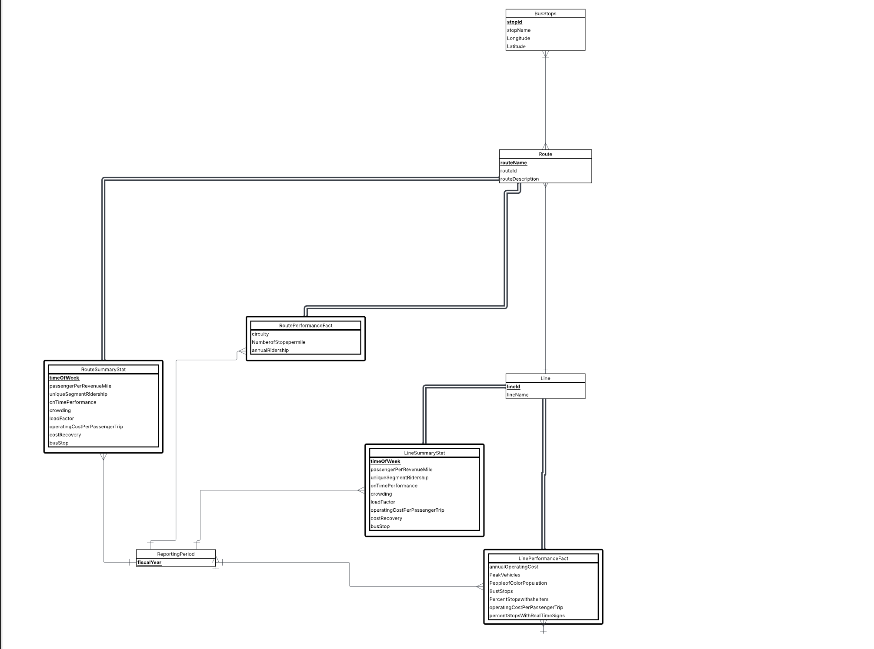
Conceptual Database Design - ERD

Slide 6

Logical Database Design
Dimension Tables
Route (routeId, routeName, routeDescription)
Line (lineId, lineName)
StationStops (stopId, stopName, longitude, latitude)
ReportingPeriod (fiscalYear)
timeOfWeek (embedded within summary tables but acts as a time dimension)
Fact & Associative Tables
Route Summary Stat
Route level KPIs: passengerPerRevenueMile, uniqueSegmentRidership, onTimePerformance,
etc…,
LineSummaryStat
LinePerformanceFact
Associative Entity:
ReportingPeriod

Slide 7
Physical Database Design
CREATE TABLE RouteSummaryFact (
routeId VARCHAR(10) NOT NULL,
fiscalYear INT NOT NULL,
timeOfWeek VARCHAR(20) NOT NULL,
passengerPerRevenueMile DECIMAL(6,2),
uniqueSegmentRidership BIGINT,
onTimePerformance DECIMAL(5,2),
…
CONSTRAINT pk_RouteSummaryStat_routeId_fiscalYear_timeOfWeek_factSequence
PRIMARY KEY (routeId, fiscalYear, timeOfWeek, factSequence),
CONSTRAINT fk_PerformanceFact_routeId_Route FOREIGN KEY (routeId)
REFERENCES Route(routeId)
ON DELETE CASCADE
ON UPDATE CASCADE,
…
);
Implementation Strategy:
Composite Keys: Employed in RouteSummaryStat to guarantee uniquely identifiable records across each route–time interval.
Foreign Key Constraints: ON DELETE CASCADE ensures seamless referential integrity by automatically removing dependent records when a route is deleted.
Data Integrity Controls: NOT NULL constraints enforced on all primary key attributes to uphold strict data completeness and reliability.

Slide 8
Business Transactions Utilized
We address two of the four strategic business questions defined for this project. The business transactions examined are:
Identifying the top 5 routes with the largest ridership decline and evaluating their recovery trajectories.
Assessing which routes, weighted by total operating costs, continue to exhibit low cost-recovery performance.

Slide 9
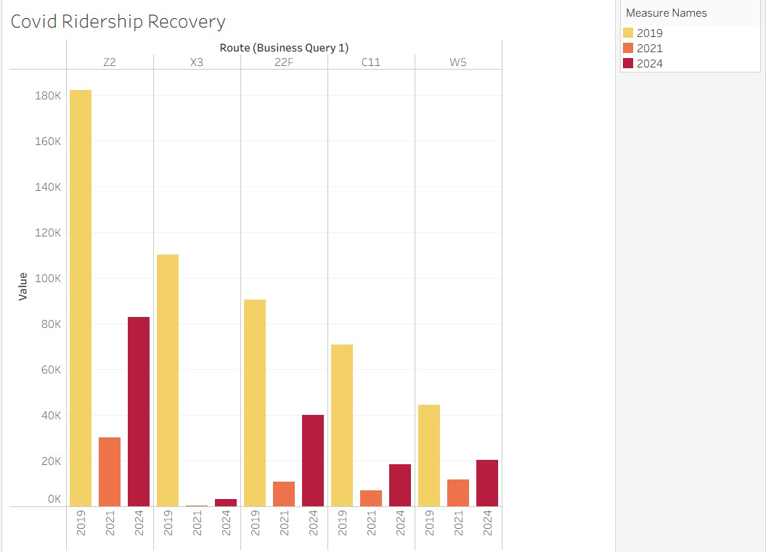
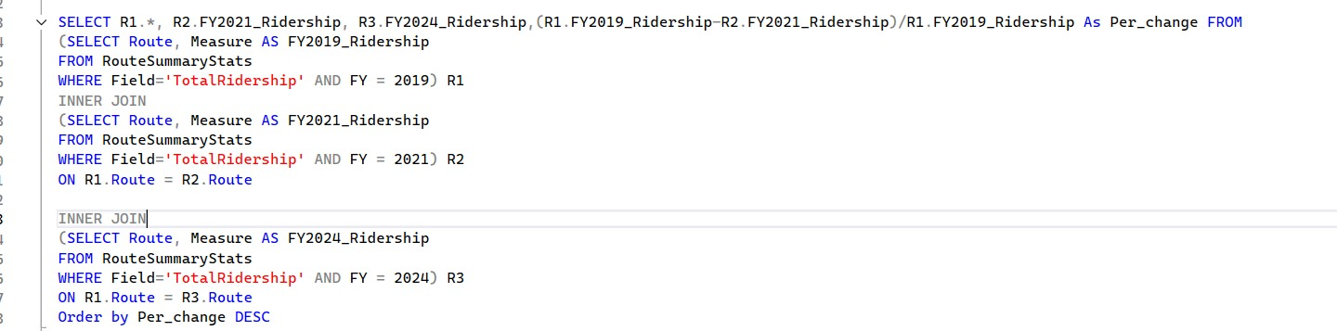
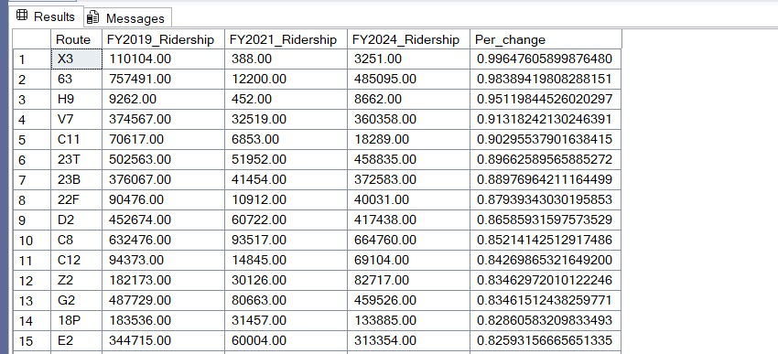
Transaction 1: Ridership Recovery
Which route riderships were affected most by Covid and how did they recover?

Slide 10

Insights & Recommendations – Ridership Recovery
Insights:
Drastic Decline: Route X3 experienced the steepest ridership drop, falling from over 100k riders in 2019 to near zero in 2021, with minimal recovery by 2024.
Stagnant Recovery: Route Z2, the highest-volume route in 2019 (~180k), has recovered to only ~80k riders by 2024—less than half of its pre-pandemic level.
Moderate Struggles: Routes 22F and C11 show similar sharp declines with only marginal improvement by FY2024.
Recommendations:
Discontinuation Analysis: Route X3 has experienced a complete loss of ridership. Absent an external long-term disruption, it should be evaluated for discontinuation to redirect resources more effectively.
Strategic Audit: Route Z2 warrants a targeted operational review. As a formerly high-volume line, underlying demand may persist but has shifted due to behavioral or modal changes. A rider survey is recommended to identify barriers to recovery.

Slide 11
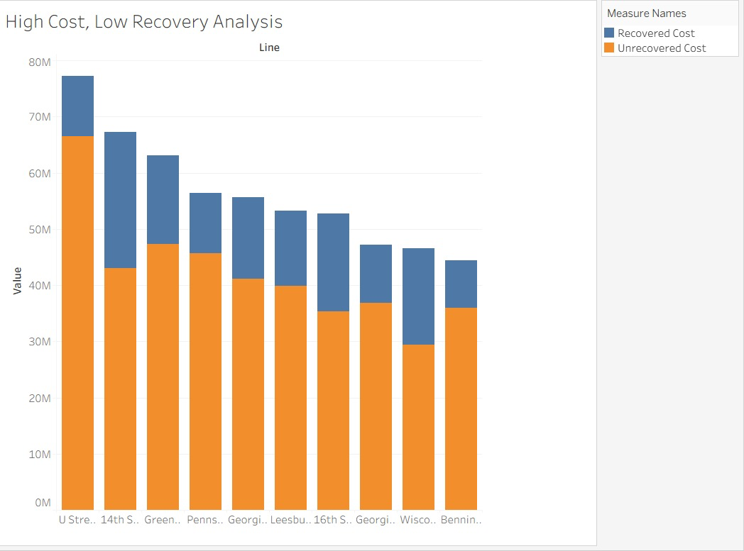
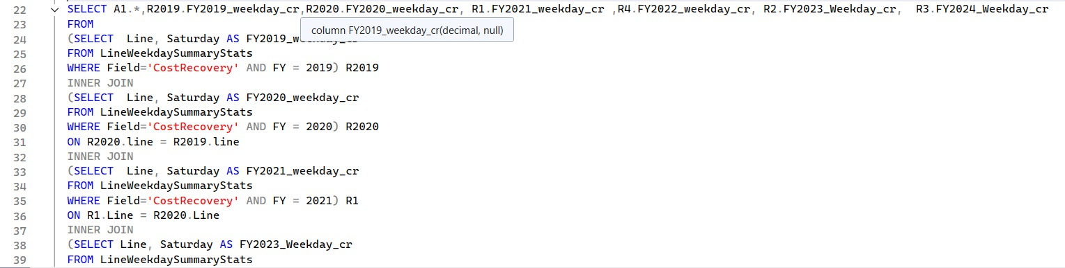
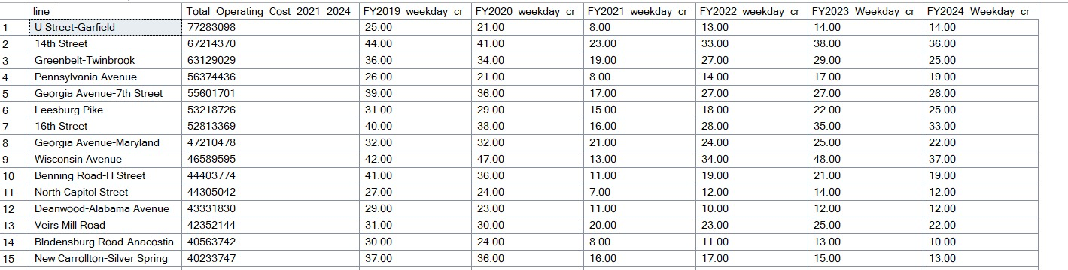
Transaction 2: Cost Efficiency and Analysis
Which routes, weighted by total operating cost, still have low rates of cost recovery?

Slide 12
Insights & Recommendations –Cost Efficiency and Analysis
Insights:
Major Financial Drain: The U Street–Garfield line incurs the highest total operating cost and the largest share of unrecovered cost, making it the least financially efficient.
Recovery Variance: Although the 14th Street line is also costly, its higher recovered-cost portion indicates stronger revenue performance relative to expenses.
Inefficient Lines: The Wisconsin Avenue and Benning Road lines exhibit disproportionately high unrecovered costs compared to their overall operating volume.
.
Recommendations:
Revenue Enforcement: For the U Street–Garfield line, conduct a focused review of fare compliance and pricing strategy. High operating costs paired with low revenue recovery may indicate fare evasion or excess off-peak service.
Service Optimization: For routes like Wisconsin Avenue, adjust off-peak frequency to reduce unrecovered costs while maintaining essential service coverage.

Slide 13
Thank You

