Slide 1

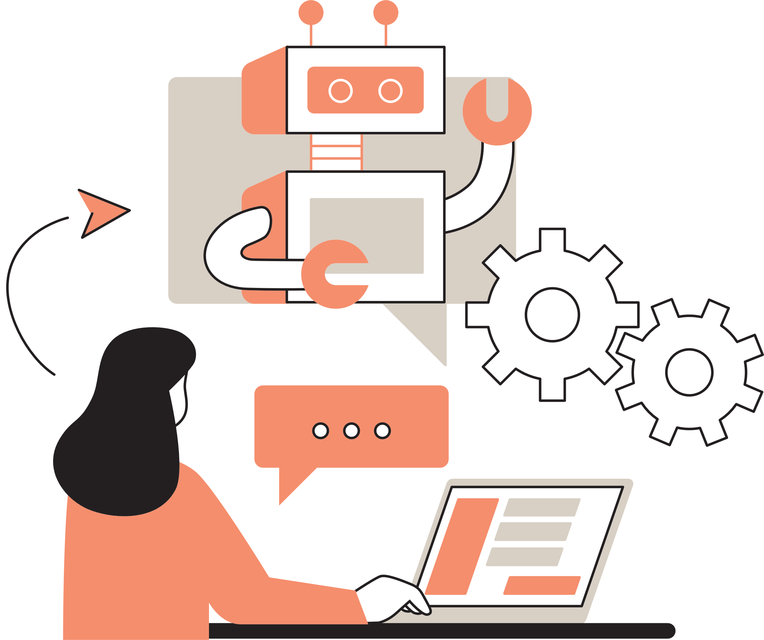
Voice chatbot
Varnika Milind Mulay (MST03-0060)

Slide 2
Table of Index
1. Project Introduction
2. What is voice chatbot?
3. Introduction to Gemini API
4. Workflow
5. Streamlit integration
6. Error Handling
7. Results
8. Future Directions
9. References
1

Slide 3
Project Introduction
Objective:
Develop a conversational chatbot leveraging Google’s Gemini AI model to create an interactive and user-friendly system.
Key Features:
Dual Response Format: Provides responses in both text and audio formats to enhance user interaction.
Advanced NLP: Utilizes Natural Language Processing (NLP) to accurately understand and respond to diverse user queries.
Chat History: Maintains and displays the chat history, allowing users to review previous conversations seamlessly.
Application:
Ideal for various use cases requiring real-time, AI-driven interactions, improving accessibility and user engagement.
2

Slide 4

Voice chatbot
Definition:
An AI-powered system that interacts with users through spoken language.
Key Components:
Speech Recognition: Converts spoken language into text.
Natural Language Processing (NLP): Understands and processes user queries.
Response Generation: Produces relevant answers based on the input.
Text-to-Speech (TTS): Converts text-based responses back into spoken language.
Common Applications:
Virtual Assistants: (e.g., Google Assistant, Siri, Alexa).
Customer Service: Automates responses to customer queries.
Accessibility: Assists users with disabilities through hands-free interaction.
3
3

Slide 5
Gemini API
WHAT IS GEMINI PRO ?
KEY FEATURES
ADVANTAGES
An advanced generative AI model by Google, optimized for natural language understanding and generation.
Part of Google's Gemini family of AI models, known for their powerful NLP capabilities [1].
Natural Language Understanding: Excels at interpreting and understanding user queries in natural language.
High-Quality Responses: Generates coherent, contextually appropriate, and human-like text responses.
Versatility: Suitable for a wide range of applications, including chatbots, content generation, and more [1].
Scalability: Handles complex queries and large-scale deployments effectively.
Integration: Easily integrates with various platforms and services using Google's API infrastructure [2].
4

Slide 6
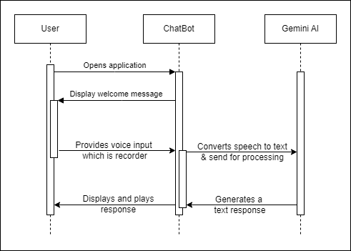
Workflow
5

Slide 7
Streamlit integration
Purpose of Streamlit:
Used as the front-end framework to build an interactive web interface for the chatbot.
Simplifies the deployment of machine learning models and AI applications with a user-friendly interface.
Key Components:
USER INTERFACE (UI)
Provides a clean, intuitive interface for users to interact with the chatbot.
Includes text input fields, chat history display, and custom styling.
SESSION MANAGEMENT
Manages user sessions and retains the chat history within the Streamlit app.
Ensures a continuous conversation flow, even when the page is refreshed.
INTEGRATION WITH GEMINI PRO
Connects the Streamlit app to Google’s Gemini Pro API for processing user queries.
Sends user input to Gemini Pro and displays the AI-generated responses in real-time [3].
6

Slide 8
Advantages of Using Streamlit:
REAL-TIME INTERACTION
Enables dynamic and real-time user interactions with the chatbot.
EASY DEPLOYMENT
Simplifies the deployment process of the AI chatbot as a web app.
CUSTOMIZATION
Allows for custom styling and layout adjustments to enhance user experience.
Working of Streamlit in this project:
USER INTERACTION
Users input their queries via a text box.
API COMMUNICATION
Streamlit sends the input to the Gemini Pro model and receives the AI-generated response.
RESPONSE DISPLAY
The chatbot's responses are displayed immediately in both text and audio formats [4].
7

Slide 9

Error handling
Importance:
Ensures the chatbot functions smoothly and provides a reliable user experience.
Prevents the application from crashing or behaving unexpectedly in case of errors.
Common Scenarios Addressed:
API Connectivity Issues:
Handles scenarios where the Gemini Pro API may be unavailable or slow to respond.
Provides user-friendly error messages or prompts to retry.
Invalid User Input:
Detects and manages cases where the user input is unclear or inappropriate.
Guides the user to rephrase or correct their input.
Session Management Errors:
Handles potential issues with maintaining chat history or session continuity.
Ensures the chat session is maintained even if there are temporary disruptions.
Unexpected Responses:
Manages situations where the AI response may be incomplete or irrelevant.
Provides fallback options or asks the user to refine their query.
8

Slide 10
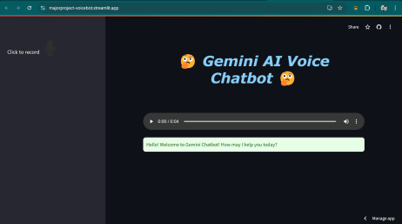
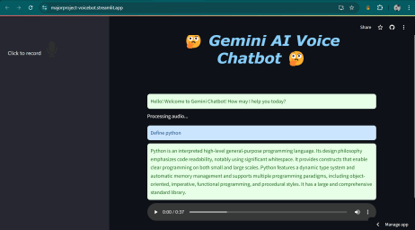
Results
Page setup of chatbot
Example of user-bot conversation
The above figure represents the page setup for the chatbot. The microphone button is present in the sidebar so that its position is fixed and users are easily able to locate and access it.
The above figure depicts an interaction between the user and the chatbot in which the user asks the bot a question and the bot responds with the answer and the recorded message.
9

Slide 11
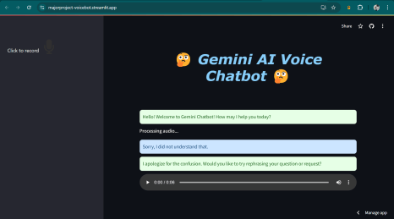
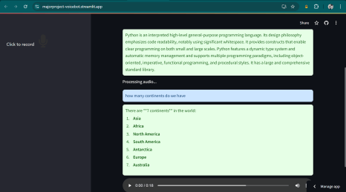
Results
Unknown message error
Follow up question by user
The above figure represents the case of Unknown message error. In this, the bot is unable to identify or analyze what the user is trying to ask due to which it responds with the message “Sorry, I did not understand”.
The above figure is a representation of a scenario in which the user asks a second question to the chatbot. It showcases the chat history and the feature of the bot to save the recorded answers temporarily for each answer.
10

Slide 12



Future directions
Expand the chatbot's capabilities to support multiple languages, making it accessible to a broader audience.
Improve the chatbot's ability to handle accents, dialects, and noisy environments.
Strengthen data protection measures to ensure user data and interactions are secure and private.
11

Slide 13
References
[1] https://www.analyticsvidhya.com/blog/2023/12/building-a-conversational-qa-chatbot-with-a-gemini-pro-free-api/
[2] https://github.com/chrismartindiaz/voice-chat-gemini
[3] https://github.com/ilhansevval/Gemini-Chatbot-Interface-with-Streamlit
[4] https://www.linkedin.com/pulse/how-create-gemini-pro-chatbot-using-python-streamlit-hafiz-m-ahmed-pxscf/
[5] https://skolo.online/course-detail/step-by-step-guide-to-building-an-ai-voice-assistant-with-streamlit-openai-111e921a222a
12

Slide 14
Thank you!
13

