Slide 1
Roshambo II – The Magical Adventure in JavaScript

Slide 2
Requierments
Creating a game mainly using JavaScript.

Slide 3
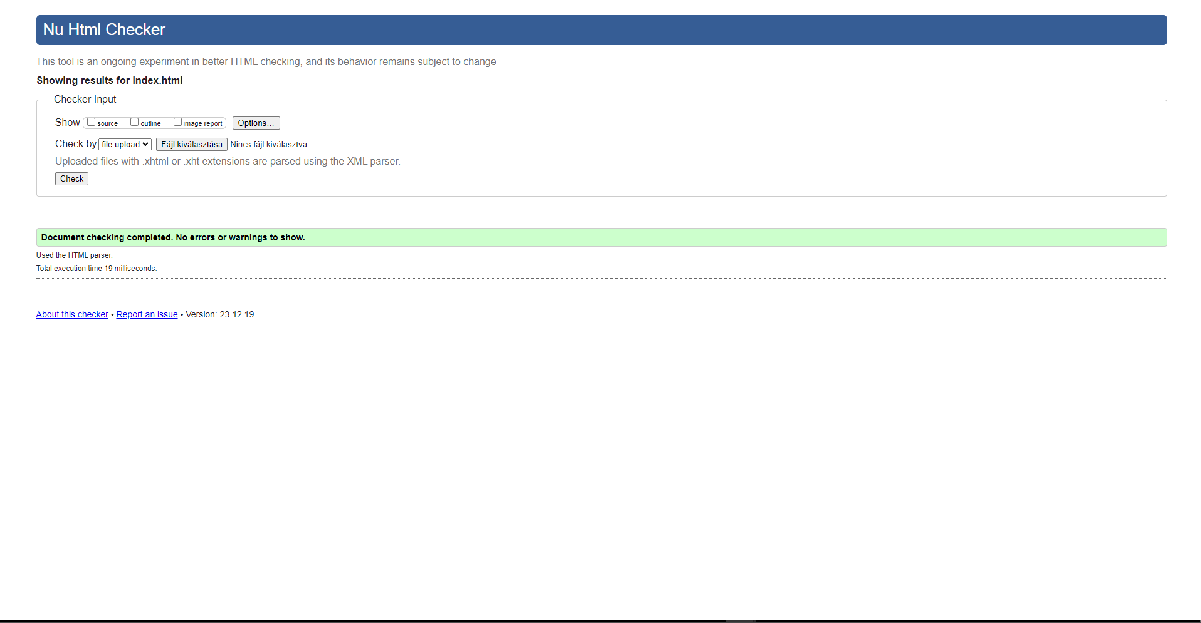
Validating - HTML
The purpose of HTML validation is to check that the structure of the website meets the requirements of the W3 Consortium.
The HTML validation was successful.

Slide 4
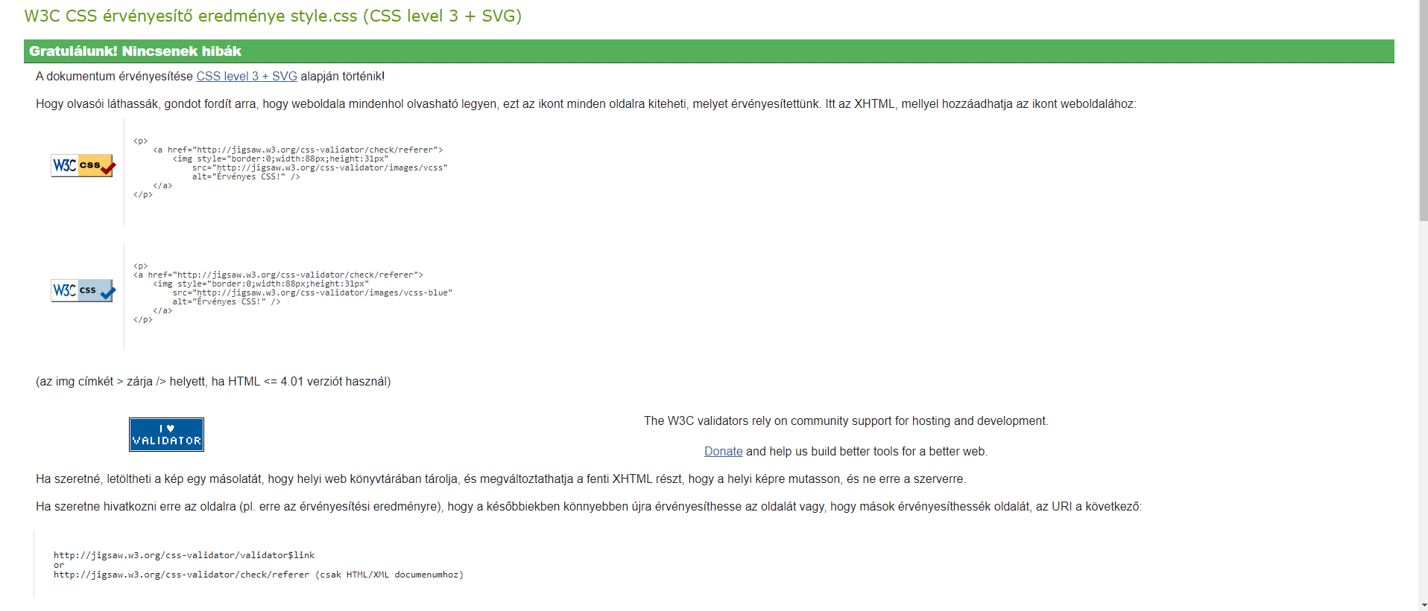
Validating - CSS
The purpose of HTML validation is to examine the structure of a Web page to see if it meets the requirements of the W3 Consortium. The HTML validation was successful.

Slide 5
Meet the crew
Name | Work
Városi Bendegúz | JavaScript developer-ish
Ónodi-Kiss Viktor Ákos | Project Leader
Koncz Ákos | website developer
Hézső Károly | Graphic designer

Slide 6
Meet the crew: Tasks
Városi Bendegúz
Ónodi-Kiss Viktor Ákos
Developing the English presentation
Responsible for game functionality (JavaScript)
Trello management
Git Repo management
Responsible for game functionality (JavaScript)
Blog

Slide 7
Meet the crew: Tasks
Koncz Ákos
Hézső Károly
HTML development
Developing the Hungarian presentation
Checking that the requirements are met
Collecting images
Encoding the game
CSS development

Slide 8
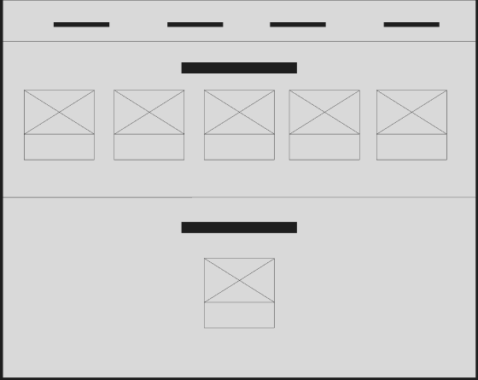
Design: wireframe
The wireframe shows the structure of the website.
The wireframe is used to build the structure of the website, at this point we have already taken into account the possibilities offered by Bootstrap.
The wireframe was accepted by the customer.

Slide 9
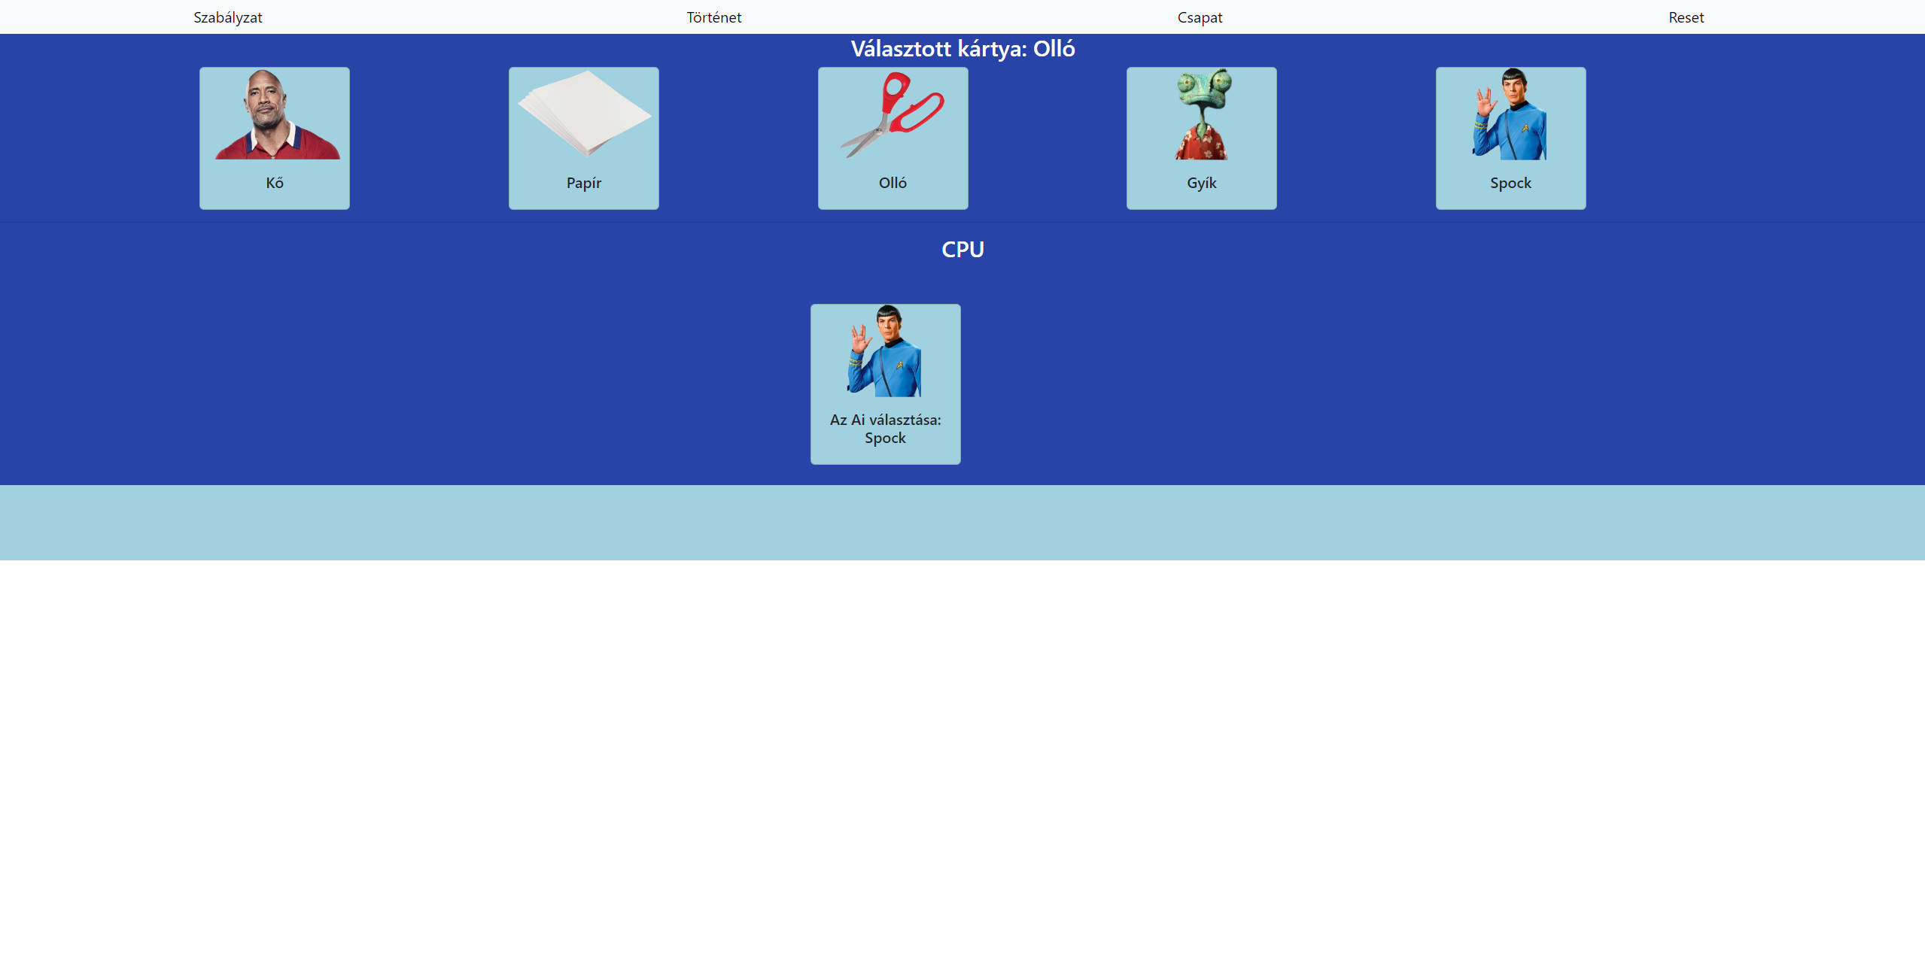
Design: prototype - Home
When creating the prototype of the website page, we separated the navigation menu in the header and the images.

Slide 10
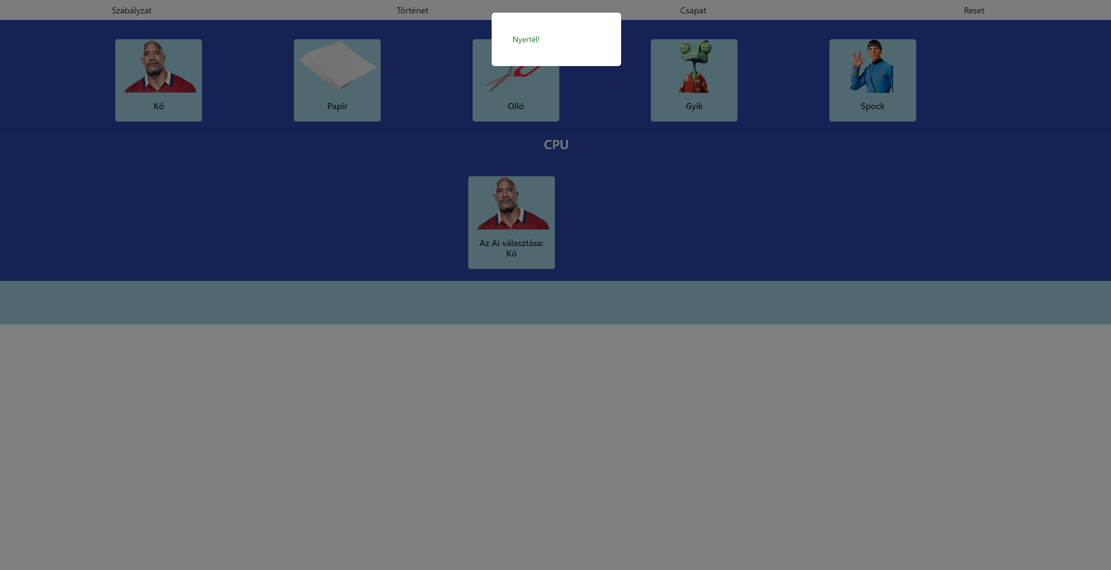
Design: prototype - Home
On the main page, we solved the problem of deciding in a form of a modal whether you won or not.

Slide 11
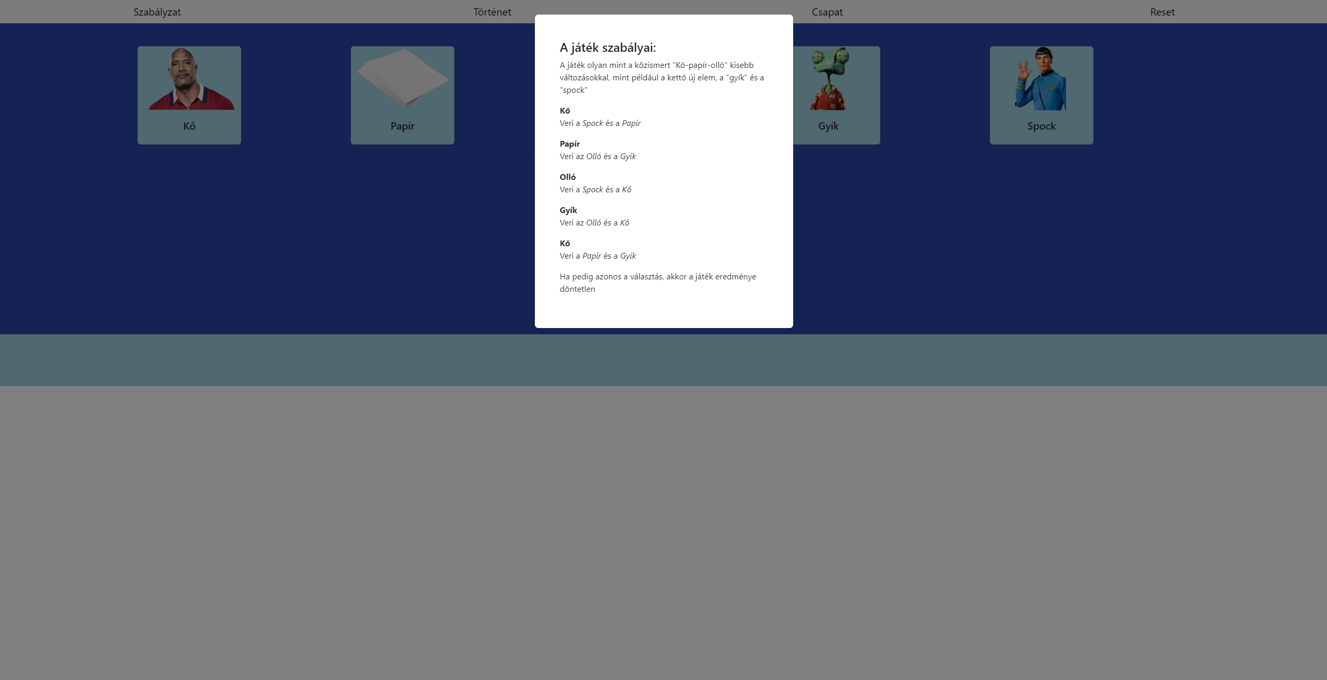
Tervezés: Prototípus – Főoldal
The Rules set out, point by point, what you can and cannot do.

Slide 12
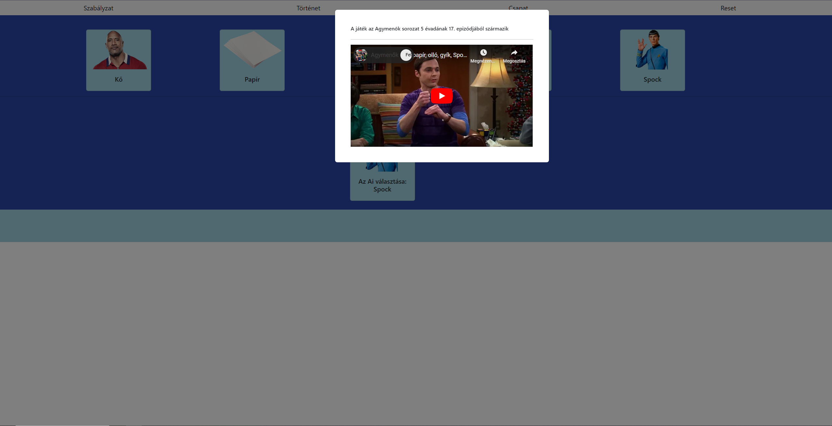
Design: prototype - Home
In the Story there is a very interesting video showing the origins of the game.

Slide 13
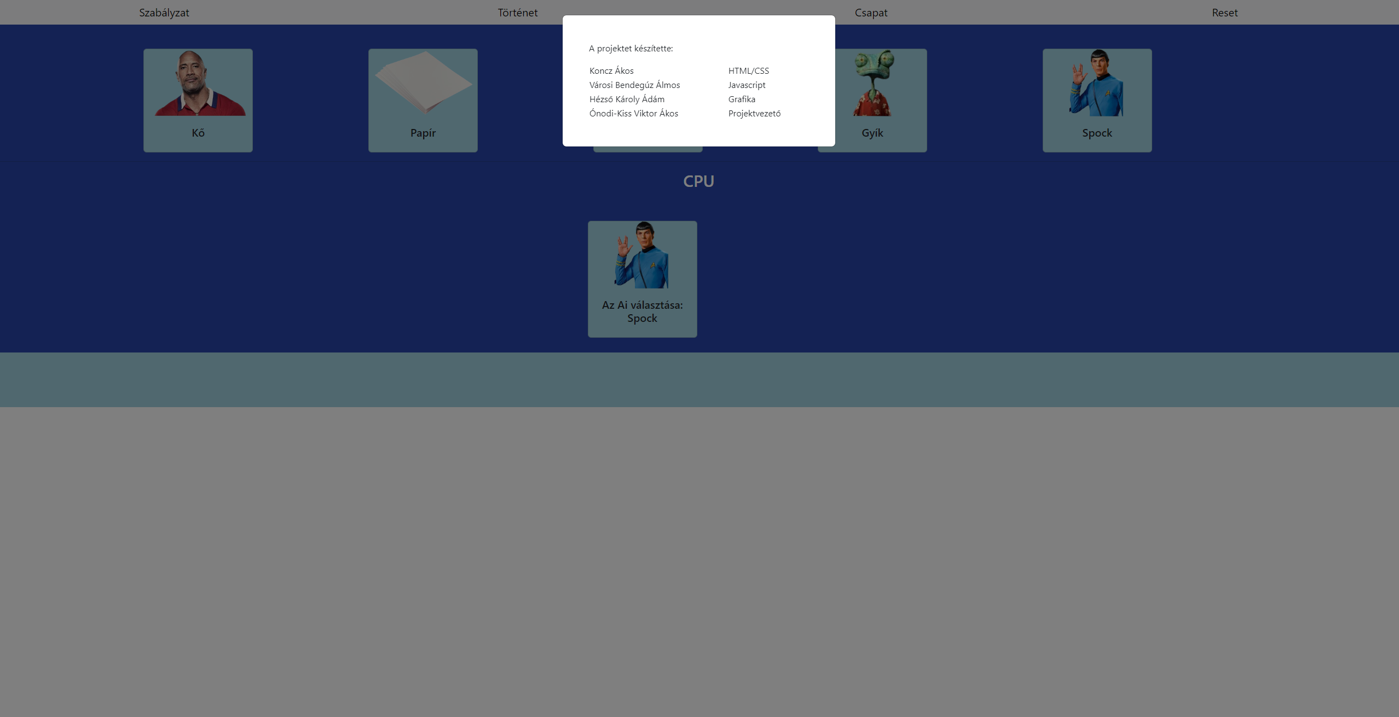
Design: prototype - Home
The Team includes what we have seen so far, who has done what.

Slide 14
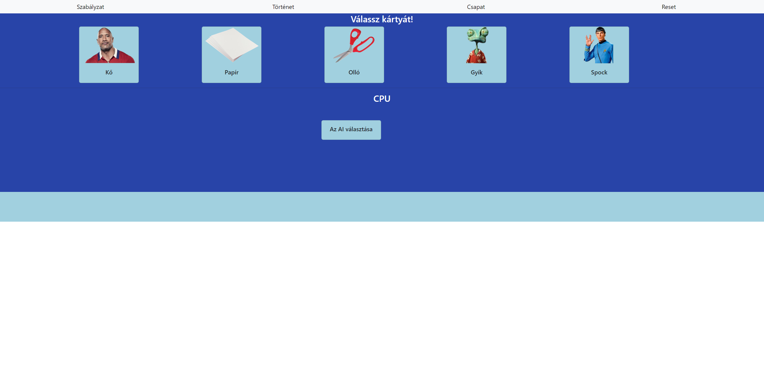
Design: prototype - Home
The Reset button resets everything to its default position.

Slide 15
Design: prototype - Home
The AI selection, when pressed, will start to toggle between images for a while and then select a persistent one.

Slide 16
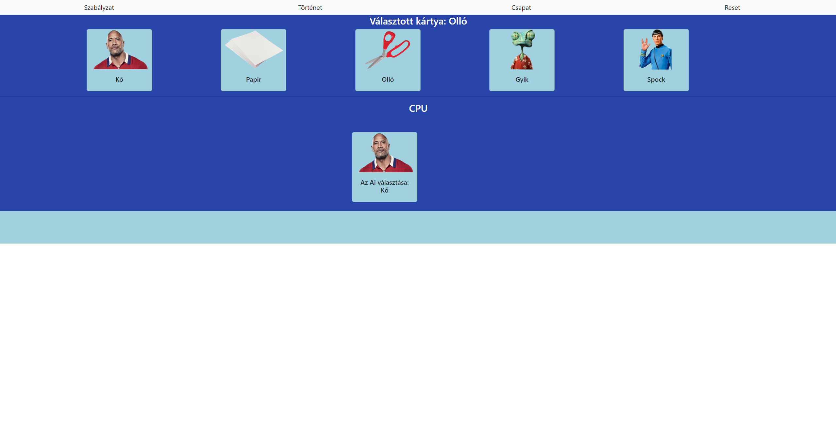
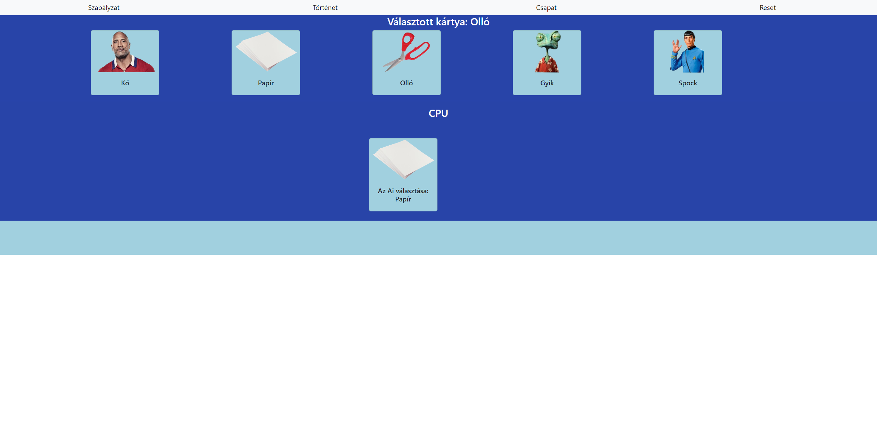
Functions: prototype - Home
How it changes
→

Slide 17
Tools/technologies used
Tools used to design the website:
Trello
Figma
For the implementation of the website:
HTML
CSS
Javascript
Visual Studio Code
GitHub
Bootstrap technologies

Slide 18
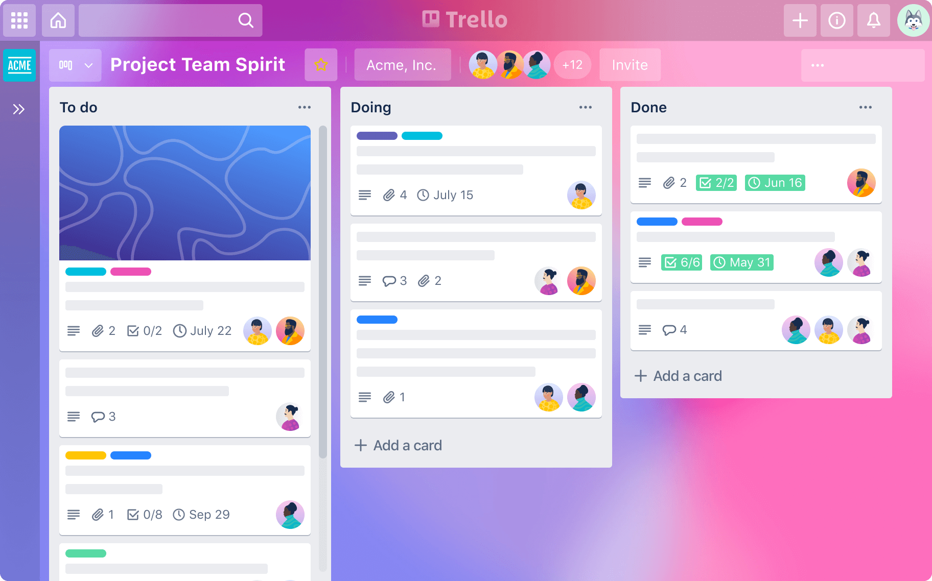
Trello
Using Trello, we were able to keep track of where we are in the project using lists and cards

Slide 19
Figma
We used Figma to create a prototype of the website

Slide 20
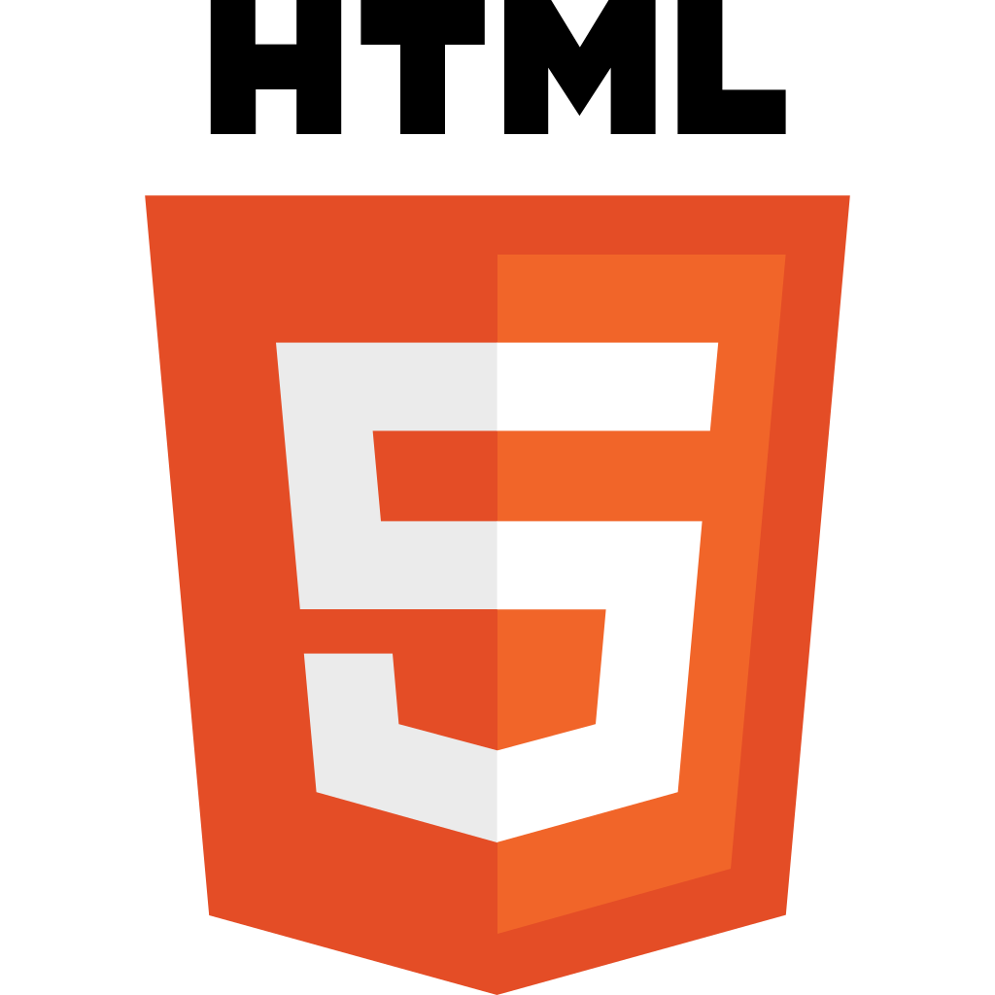
HTML
In building the website, we made great use of HTML5 (i.e. HyperText Markup Language), which allowed us to build the website using the built-in DOM (Document Object Model).

Slide 21
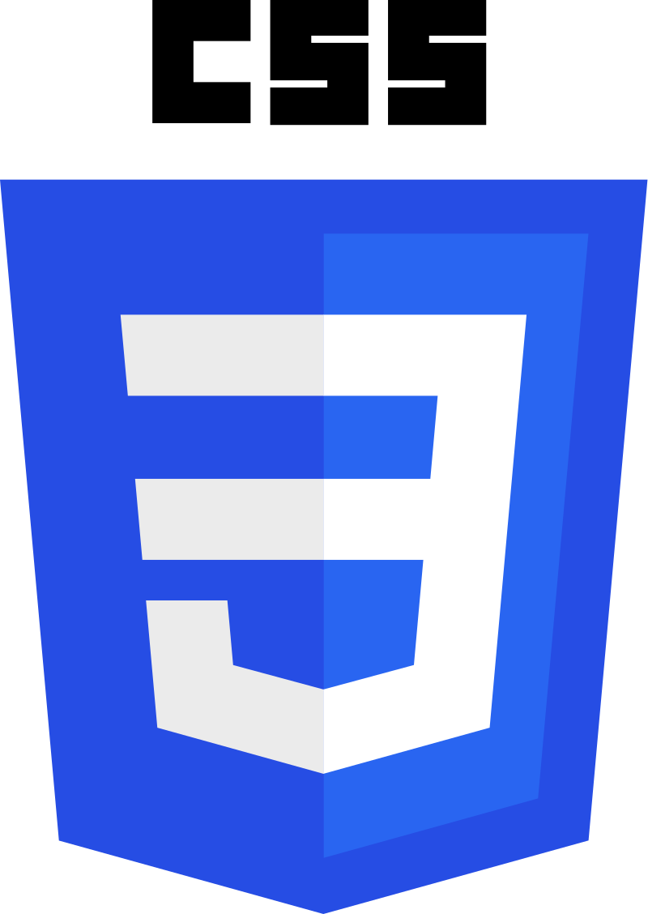
CSS
Using CSS (Cascading StyleSheets) we were able to apply stylistic formatting to the website. The CSS3 version was used to create the style sheets.

Slide 22
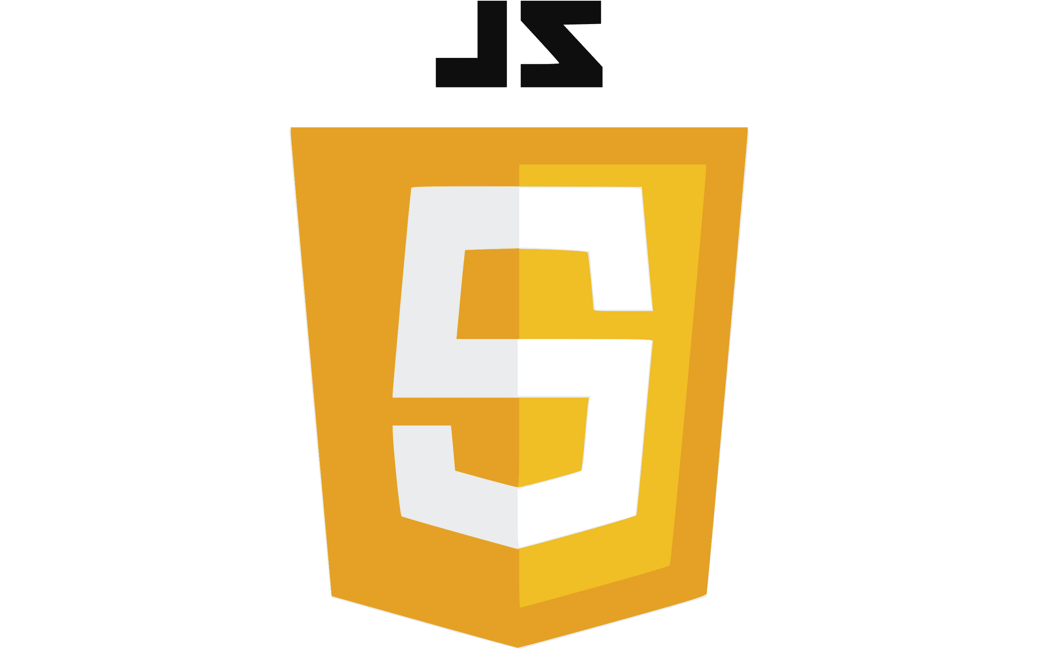
JavaScript
Using the JavaScript programming language, we were able to manipulate certain elements of the website DOM to take action on user input. This was primarily used to create the footer.

Slide 23

Visual Studio Code
Visual Studio Code (often abbreviated as VS Code) is a text editor that has become very useful for creating websites thanks to its built-in features.

Slide 24

Bootstrap
Bootstrap is a front-end framework that extends the functionality built into CSS/HTML. Bootstrap was used to implement both the pop-up window (modal) and the formatting of the web pages.

Slide 25

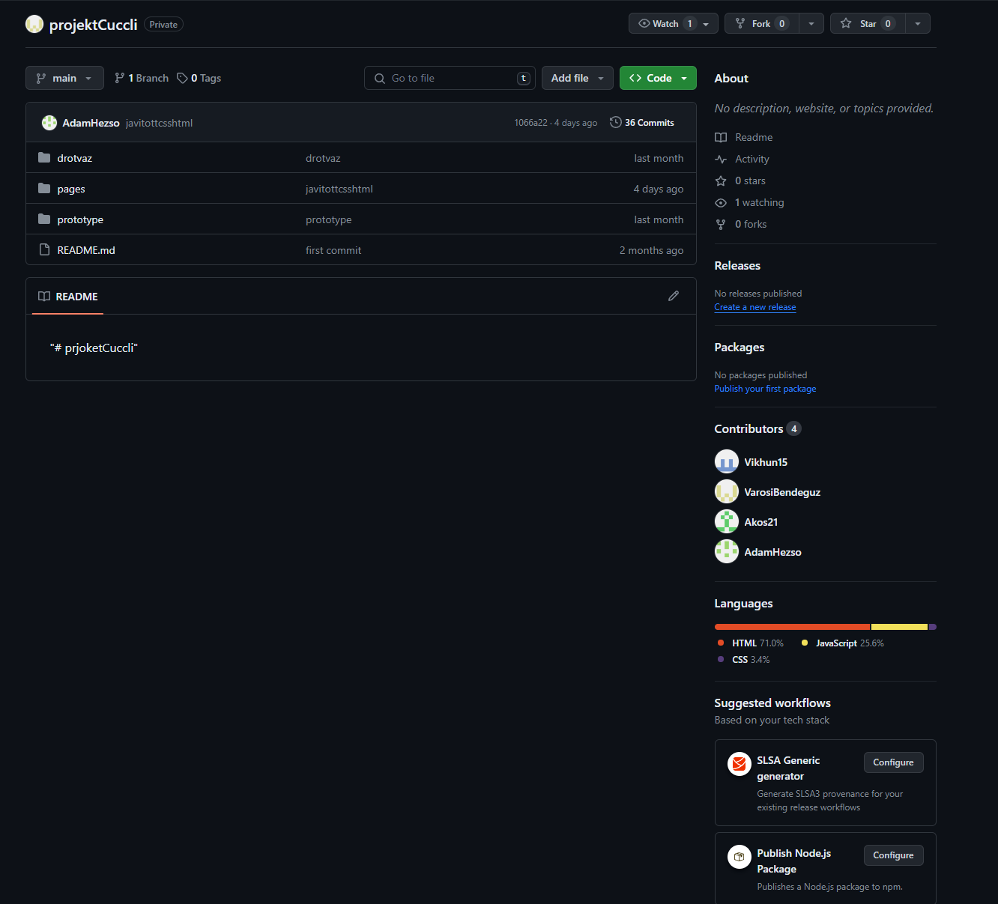
GitHub
GitHub is perhaps a programmer's closest friend. We used this version control program to share teamwork and store the files of the finished website.

Slide 26
ROSHAMBO II

Slide 27
Thank you for your attention!

