Slide 1

Angular 2
- The Big Picture

Slide 2
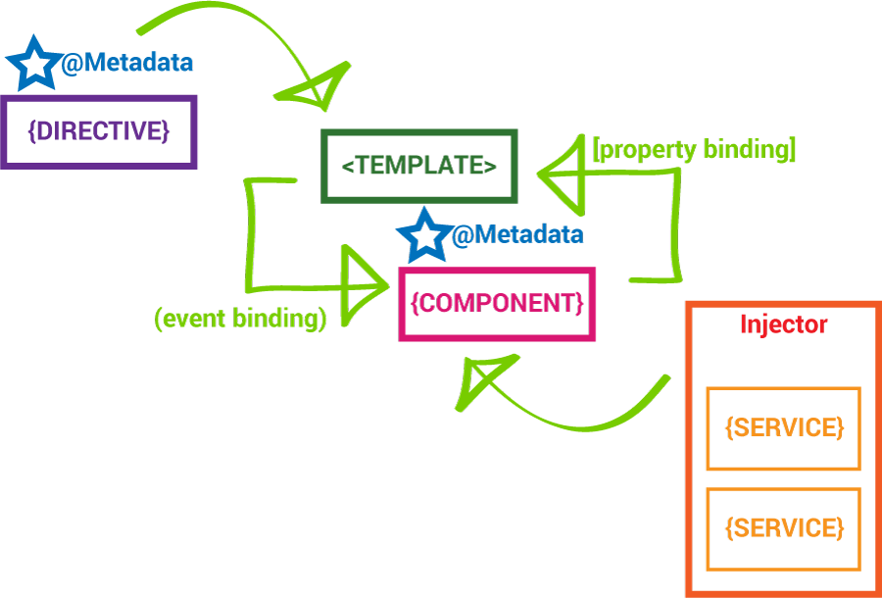
The Big Picture

Slide 3
The Main Building Blocks
Module
Component
Metadata
Template
Data Binding
Service
Directive
Dependency Injection

Slide 4
import
{Component} from 'angular2/core';
import
{Experiment} from '../common/experiment.model';
import
{ExperimentsService} from '../common/experiments.service';
import
{StateService} from '../common/state.service';
@Component({
selector: 'experiments',
templateUrl: 'app/experiments/experiments.component.html'
})
export class ExperimentsComponent { title: string = 'Experiments Page';
body: string = 'This is the about experiments body'; message: string;
experiments: Experiment[];
constructor(
private _StateService: StateService,
private _ExperimentsService: ExperimentsService) {}
updateMessage(m: string): void {
this._StateService.setMessage(m);
}
}

Slide 5
Bootstrapping the App
Import the bootstrap module
Import your top-level component
Import application dependencies
Call bootstrap and pass in your top-level component as the first parameter and an array of dependencies as the second

Slide 6
import
{bootstrap}
from
'angular2/platform/browser';
import
{ROUTER_PROVIDERS} from 'angular2/router';
import {AppComponent} from './app.component';
bootstrap(AppComponent, [ ROUTER_PROVIDERS
]);
Bootstrap

Slide 7
Module
Uses ES6 module syntax
Angular 2 applications use modules as the core mechanism for composition
Modules export things that other modules can import
Keep your modules fine-grained and self-documenting

Slide 8
// In
home.component.ts
export
class HomeComponent { }
// In
app.component.ts
import {HomeComponent}
from
'./home/home.component';
Module

Slide 9
Component
Components are just ES6 classes
Providers (Services) are injected in the constructor
Need to explicitly define providers and directives within the component decoration
Hook into the component lifecycle with hooks
Properties and methods of the component class are available to the template

Slide 10
export
class
HomeComponent
implements
OnInit{
title:
string = 'Home
Page';
body: string = 'This
is the about
home body';
message: string;
constructor(private
ngOnInit() {
_stateService:
StateService) { }
this.message =
this._stateService.getMessage();
}
updateMessage(m: string): void {
this._stateService.setMessage(m);
}
}
Component

Slide 11
Metadata
Metadata allows Angular to process a class
We can attach metadata with TypeScript using decorators
Decorators are just functions
Most common is the @Component() decorator
Takes a config option with the selector, template(Url), providers, directives, pipes and styles

Slide 12
@Component({ selector: 'home',
templateUrl:
'app/home/home.component.html'
})
export class
HomeComponent{ }
Metadata

Slide 13
Template
A template is HTML that tells Angular how to render a component
Templates include data bindings as well as other components and directives
Angular 2 leverages native DOM events and properties which dramatically reduces the need for a ton of built- in directives
Angular 2 leverages shadow DOM to do some really interesting things with view encapsulation

Slide 14
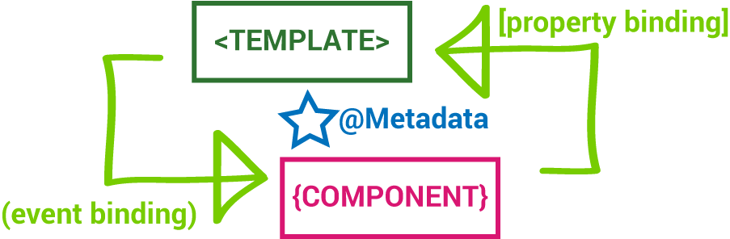
Template

Slide 15
@Component({
selector:
'experiment',
template: `
<div
class="experiment"
(click)="doExperiment()">
<h3>{{ experiment.name
}}</h3>
<p>{{ experiment.description }}</p>
<p><strong>{{experiment.completed}}</strong></p>
</div>
`,
styles: [`
.experiment {
cursor:
pointer;
outline:
1px lightgray
solid;
padding:
5px;
margin: 5px;
}
`]
})
Template

Slide 16
@Component({
selector:
'experiment',
templateUrl:
'./experiment.detail.component.html',
styles: ['./experiment.detail.component.css']
})
Template

Slide 17
Data Binding
Enables data to flow from the component to template and vice-versa
Includes interpolation, property binding, event binding, and two-way binding (property binding and event binding combined)
The binding syntax has expanded but the result is a much smaller framework footprint

Slide 18
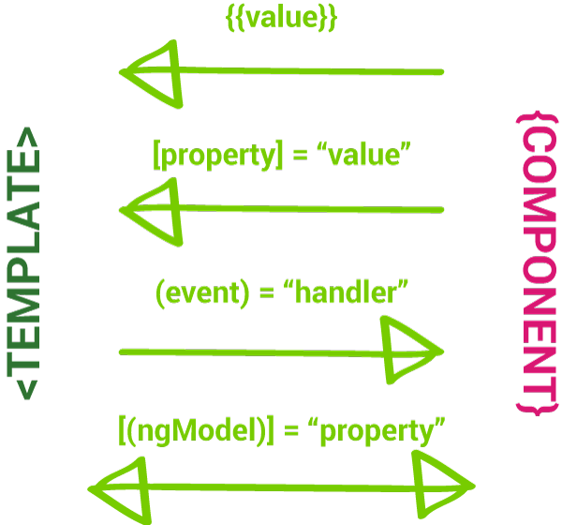
Data Binding

Slide 19
<h1>{{title}}</h1>
<p>{{body}}</p>
<hr/>
<experiment *ngFor="#experiment of experiments" [experiment]="experiment"></experiment>
<hr/>
<div>
<h2 class="text-error">Experiments:
{{message}}</h2>
<form class="form-inline">
<input type="text" required
[(ngModel)]="message"
placeholder="Message">
<button type="submit" class="btn" [disabled]="Message.invalid"
(click)="updateMessage(message)">Update Message
</button>
</form>
</div>
Data Binding

Slide 20
State | Class if true | Class if false
Control has been visited | ng-touched | ng-untouched
Control's value has changed | ng-dirty | ng-pristine
Control's value is valid | ng-valid | ng-invalid
Form validation

Slide 21
Service
A service is just a class
Should only do one specific thing
Take the burden of business logic out of components
Decorate with @Injectable when we need to inject dependencies into our service

Slide 22
import
{Injectable}
from
'angular2/core';
import {Experiment}
@Injectable()
from
'./experiment.model';
export class ExperimentsService {
= [];
private experiments: Experiment[]
getExperiments(): Experiment[] {
return this.experiments;
};
}
Service

Slide 23
Dependency Injection
Supplies instance of a class with fully-formed dependencies
Maintains a container of previously created service instances
To use DI for a service, we register it as a provider in one of two ways: when bootstrapping the application, or in the component metadata

Slide 24
// experiments.service.ts
import {Injectable} from
@Injectable()
'angular2/core';
export class ExperimentsService { }
// experiments.component.ts
import {ExperimentsService} from
experiments.service';
'../common/
import {StateService} from '../common/state.service';
export class ExperimentsComponent {
constructor(
private _stateService: StateService,
private _experimentsService: ExperimentsService) {}
}
Dependency Injection

Slide 25
Lifecycle Hooks
Allow us to perform custom logic at various stages of a component's life
Data isn't always immediately available in the constructor
Only available in TypeScript
The lifecycle interfaces are optional. We recommend adding them to benefit from TypeScript's strong typing and editor tooling
Implemented as class methods on the component class

Slide 26
Lifecycle Hooks (cont.)
ngOnChanges - called when an input or output binding value changes
ngOnInit - after the first ngOnChanges
ngDoCheck - developer's custom change detection
ngAfterContentInit - after component content initialized
ngAfterContentChecked - after every check of component content
ngAfterViewInit - after component's view(s) are initialized
ngAfterViewChecked - after every check of a component's view(s)
ngOnDestroy - just before the directive is destroyed.

Slide 27
import
{Component, OnInit}
from
'angular2/core';
export class
ExperimentsComponent
implements OnInit {
constructor(
private
_StateService:
StateService,
private
_ExperimentsService:
ExperimentsService) {}
ngOnInit() {
this.experiments
= this._ExperimentsService.getExperiments();
this.message =
this._StateService.getMessage();
}
}
Lifecycle Hooks

Slide 28
Service - Just a Class
Similarly to components, services are just a class
We define our service’s API by creating methods directly on the class
We can also expose public properties on our class if need be

Slide 29
export class
StateService {
private _message
= 'Hello
Message';
getMessage(): string {
return this._message;
};
setMessage(newMessage: string): this._message = newMessage;
};
void {
}
Just a Class

Slide 30
@Injectable
We decorate our service class with the @Injectable to mark our class as being available to the Injector for creation
Injector will throw NoAnnotationError when trying to instantiate a class that does not have @Injectable marker

Slide 31
import {Injectable}
@Injectable()
from
'angular2/core';
export class StateService {
private _message =
'Hello
Message';
getMessage(): string {
return this._message;
};
setMessage(newMessage: string): this._message = newMessage;
};
void {
}
@Injectable

Slide 32
Injecting a Service
Injecting a service is as simple as importing the service class and then defining it within the consumer’s constructor parameters
Just like components, we can inject dependencies into the constructor of a service
There can be only one instance of a service type in a particular injector but there can be multiple injectors operating at different levels of the application's component tree. Any of those injectors could have its own instance of the service.

Slide 33
import
{Component}
from
'angular2/core';
import
{StateService}
from
'../common/state.service';
@Component({ selector: 'home',
templateUrl:
'app/home/home.component.html'
})
export class
HomeComponent {
title: string
body: string
= 'Home
= 'This
Page'; is the
about
home
body';
message: string;
constructor(private
ngOnInit() {
_stateService:
StateService) { }
this.message =
this._stateService.getMessage();
}
updateMessage(m: string): void {
this._stateService.setMessage(m);
}
}
Injecting a Service

Slide 34
Testing
Angular wraps Jasmine methods
Import all necessary Jasmine methods from angular2/ testing
Import the classes to test
Include providers by importing beforeEachProviders and then calling it with a method that returns an array of imported providers
Inject providers by calling inject([arrayOfProviders], (providerAliases) => {}) inside a beforeEach or it block

Slide 35
import
{ describe,
it, expect } from
'angular2/testing';
import { AppComponent } from
'./app.component';
describe('AppComponent', () => {
it('should be a function', expect(typeof
() => {
AppComponent).toBe('function');
});
});
Tests!

Slide 36
Architectural Best Practices
Include all files pertinent to a component in the same folder
Remember CIDER for creating components: (Create class, Import dependencies, Decorate class, Enhance with composition, Repeat for sub-components
Keep templates small enough to put in the main component file directly
Delegate business logic from the component to a provider
Don’t be afraid to split a component up if it is growing too large
Constantly consider change detection implications as you develop an app

Slide 37
Happy Coding!

