Slide 1
Analysis of the utilization of nodes
2nd April 2025
Varshini Giri
Mid-Term Review

Slide 2
Objectives
To improve the discipline and productivity among the Team.


Node Utilization
Time prediction
To understand the various test run on a particular Node and plot a graph that gives the details about when and what test have run classified by the firmware and cluster data
Given a test plan, we need to predict the duration for executing all the test scripts and also help optimize the number of nodes needed.

Make a Dashboard
Make an interactive dashboard to display all the information to the customers and look for improvements

Slide 3
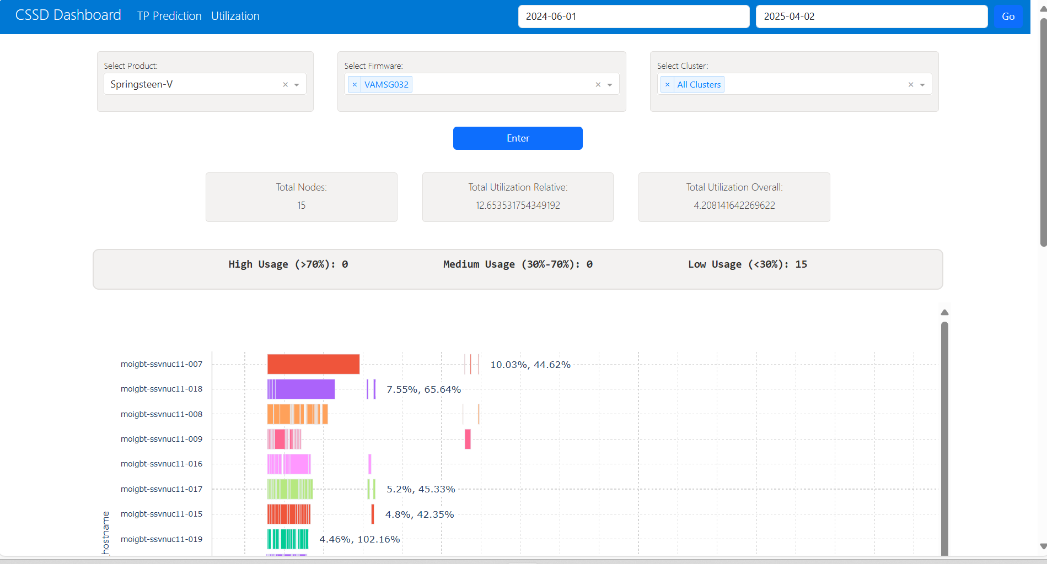
Node Utilization - Dashboard
Dashboard using Dash and Plotly libraries in python
Used the MTAP Database Server on PostGreSQL
Traverse through all data since the “START_DATE” from the System history and divide them according to firmware
Plot the data using a Gantt chart and visualize the drawback and area of improvements
Given options to choose Cluster and Firmware for the ease of the user
Data source: MTAP ( system history ), Cluster tree

Slide 4
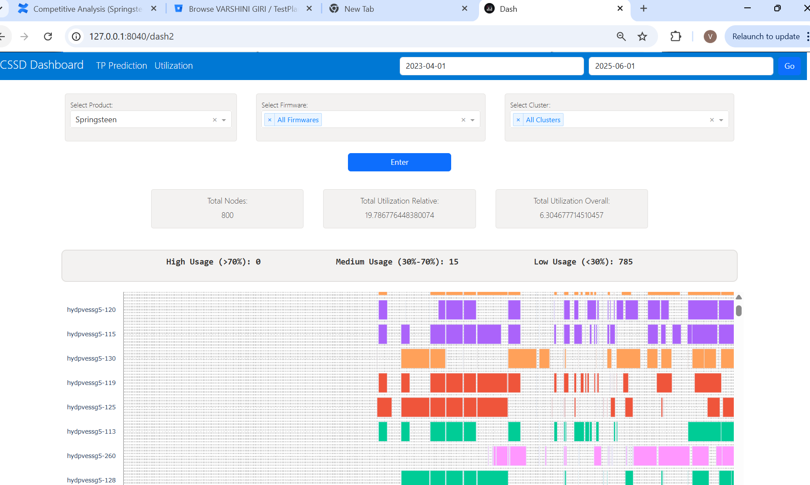
Node Utilization - Dashboard
Dashboard using Dash and Plotly libraries in python
This is a sample to find the total utilization of a single product – “SPRINGSTEEN” – choose all the firmwares and all the clusters under that.
Identifies the duration by itself and selects the required timeline
Elimates the scripts used to condition the drive and scripts that have been “ABORT”
Can also identify the utilization of the DUTs in the given period of time
1

Slide 5
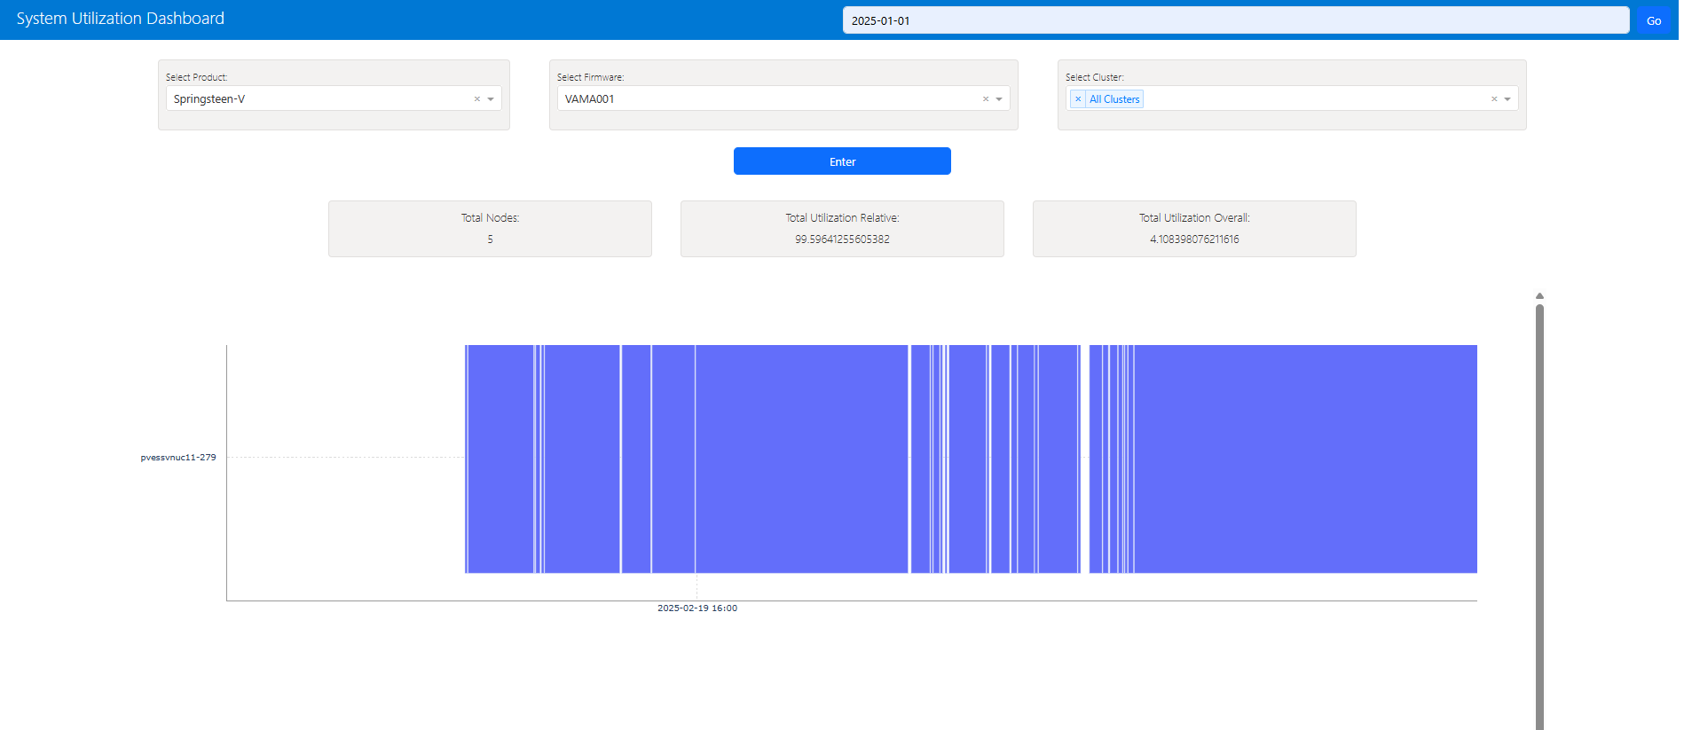
Node Utilization - Dashboard
Scope for improvement
Why are there gaps in between the tests that are run for the same firmware?
Provision to plot node by node to have closer look into the utilization
LOAD on the Database : The database is called 3 times for a single refresh.

Slide 6
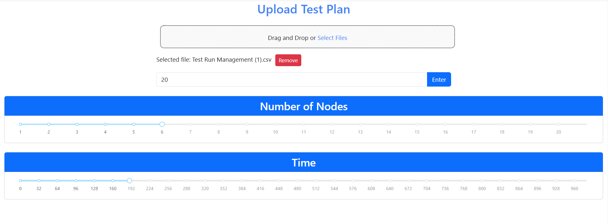
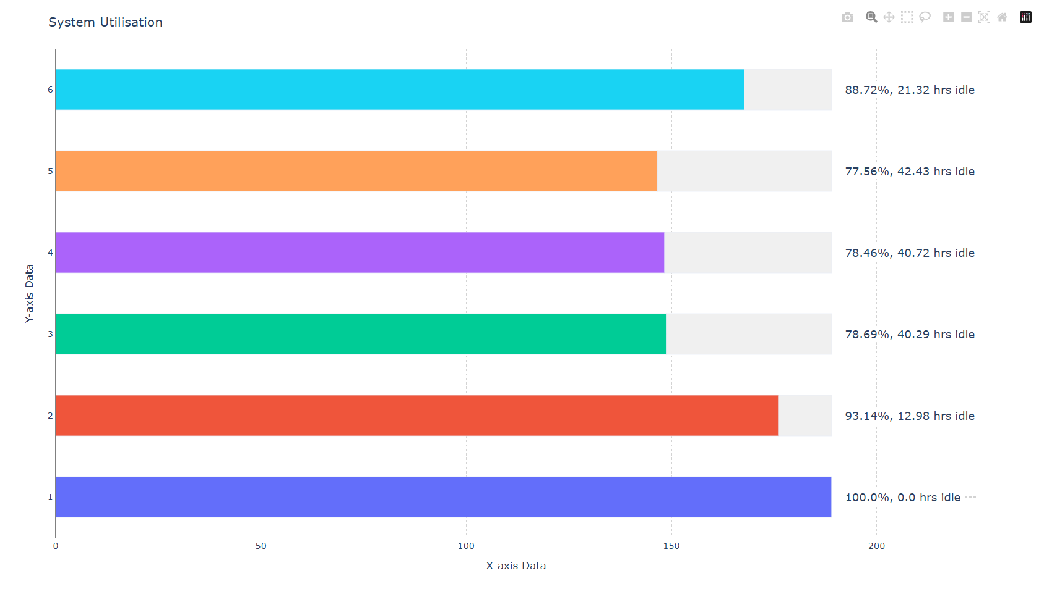
Time and Node Prediction
Contains a slider to adjust the time and nodes accordingly
Uses Longest-processing time first (LPTF) algorithm for finding the efficient distribution of tests
Also displays the script names
We can upload any CSV file containing a test plan to predict the allocation and time
Self-updates
Load on the MTAP server: Depends on the number of Tests in the Test plans (Number of API calls = Number of Testscripts)
Data source: MTAP script history – to collect the avg time
Considers weighted average time
To have a pre-knowledge and efficient scheduling of Tests

Slide 7
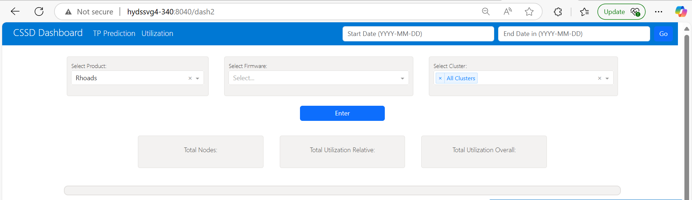
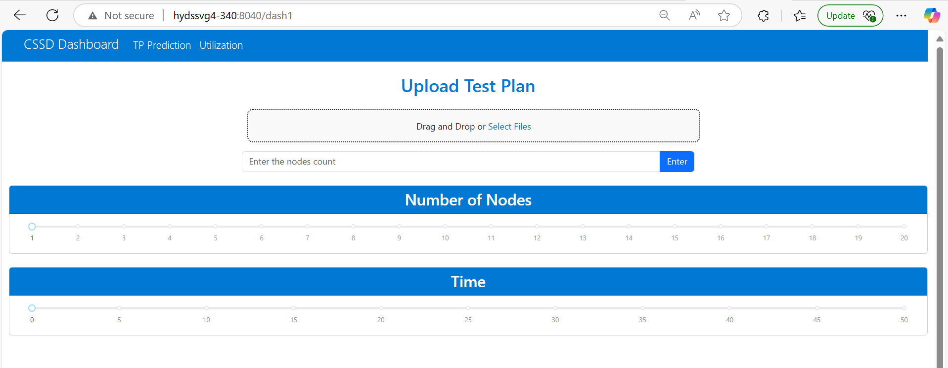
Dashboard
Including both the features in a single dash board
The header helps us navigate between the tabs
TP Prediction – Predicts the time required for the Test plan uploaded
Utilization – helps in understanding the Node Utilizations

Slide 8




Time and Node Prediction
Further works – Add more features
Time Left
ARRANGMENT
Make interactive set up where is shows much time is left for each node – idle state
Provide details about which tests comes under a particular nodes – color code or number codes
Common improvement
Flexibility
Allowing the user to change the allocation of the scripts to the nodes and edit the same

Slide 9
Training Progress
MAG and Interface
Have attended 6 Knowledge Transfer sessions – on MAG algorithms and Features
Getting to know the PVE repository – working the assignments in the New Hire Guide
Gaining more knowledge on the TestScripts
Finished the basics Trainings on RG Nand, PCIe and NVMe.
Exploring Internal and External JIRA

Slide 10
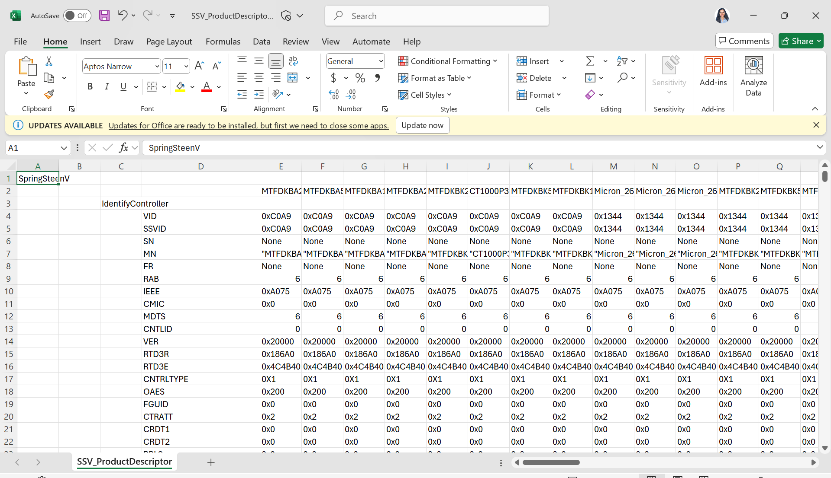
Product Descriptor Automation
Creating a CSV file from the product description for further use
NVMe Admin , TSM - Technical Specification Matrix of SS_V , LID – Location Id , FID – Feature Id
In exploring stage – almost 2600 parameters
A few parameters need to have a specify format – not present current
1. Identify those parameters
2. Set Format
3. Approval

