Slide 1
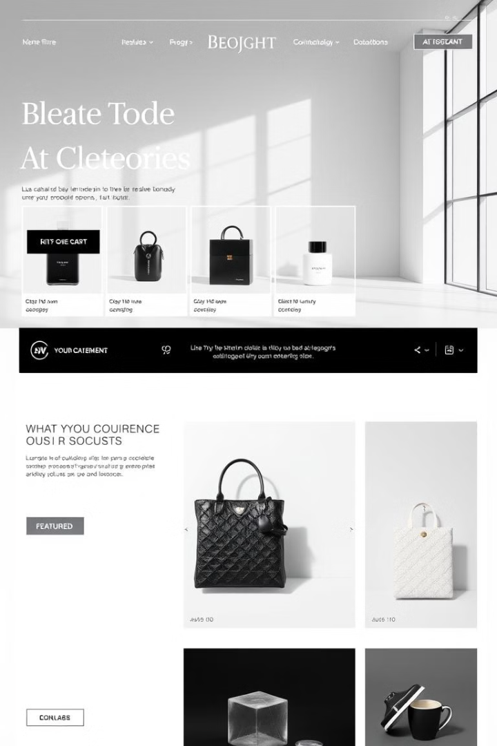
E-commerce Platform: A Functional Overview
This presentation outlines the development of a fully functional e-commerce website. We'll cover key features like product browsing, shopping cart, user authentication, and order checkout. Our aim is to create a seamless, user-friendly online shopping experience.
VU
by Varshith Uddanti

Slide 2




Interactive Shopping Cart
The shopping cart feature is crucial. Users can easily add, remove, and adjust quantities of items. Cart data is persistent, ensuring no lost items. Real-time updates provide immediate feedback.
Add to Cart
Remove Items
Quickly add items
Delete items
Update Quantities
Change the amount

Slide 3




Secure User Authentication
Security is paramount. Our system offers secure user registration and login. This allows for personalized shopping experiences.
User Account
Secure Login
Address

Slide 4




Simplified Checkout Process
A streamlined checkout ensures smooth purchases. Users navigate easily through shipping, billing, and order review. We also integrate secure payment options.
Shipping Details
Enter address
Billing Details
Payment info
Order Summary
Review everything

Slide 5
Admin Dashboard Overview
The admin dashboard provides comprehensive control. Admins can manage products, orders, and users.
Product Management
Order Management
User Management
Add, edit, delete products
View details, update status
Manage user accounts

Slide 6
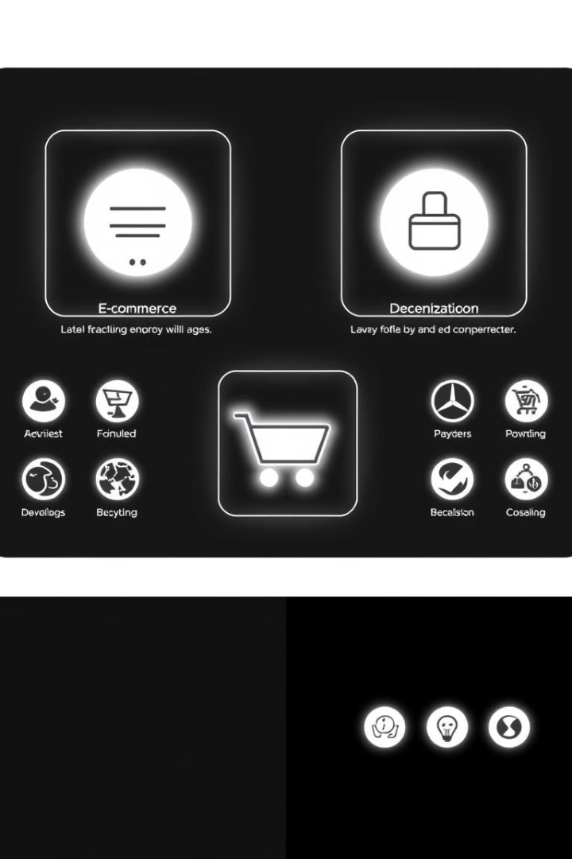
Future Enhancements
Future enhancements will enrich the platform. Wishlists, product reviews, personalized recommendations, advanced search and loyalty programs will be included.
Wishlist
Product Reviews
Save products
Submit opinions
Advanced Search
Find products

Slide 7

Summary and Next Steps
We have successfully developed a functional e-commerce platform. Next steps involve user testing, feedback collection, and implementing future enhancements. Contact us for support.
User Testing
Improvements
1
2
3
Feedback

