Slide 1
KNOWLEDGE DIVINE INFORMATION TACHNOLOGY, C-DAC ACTS (ATC), Pune
E- Rationing System
Project Guide
Mrs. Snehal Somvanshi
Submitted by
Group No-19
Group members :
Amar Ingale (210943020006)
Varsha Ghute (210943020025)
Aarti Karpe (210943020035)
Avishkar Katkar (210943020036)

Slide 2
Agenda
Project Introduction
Project Architecture
Technology-Platform used for Project
User Roles and Responsibilities
Details of contribution
Future extension
Conclusion

Slide 3
INTRODUCTION
E-Rationing System is a Web application for providing online ration facility to customers. The main objective of this project is to build a website which will help Customer to order available items in PDS and see the transactions.
Through this Website Government authority can register customers and retailers having valid id proof. Hence duplicate, bogus and ineligible beneficiaries can be avoided. This website will help to maintain the transparency between Customer and Retailer. The E-Rationing System will help us to avoid the Corruptions in PDS.

Slide 4
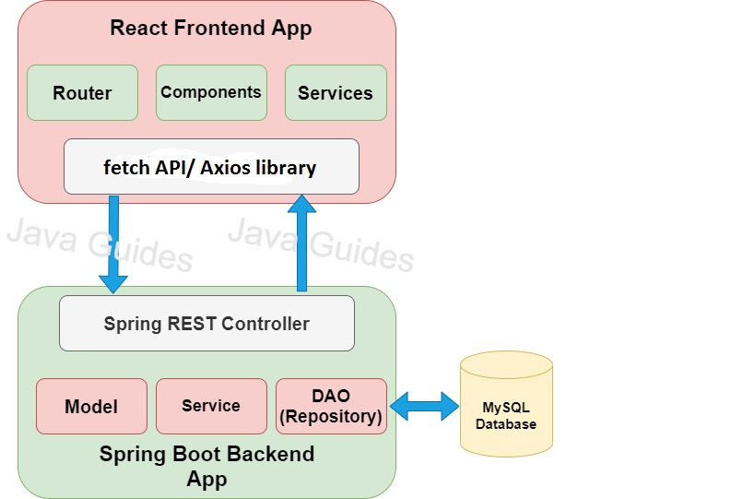
Architecture

Slide 5
Technology Used
Technology Used For Project :
Front End :
ReactJS
CSS, Bootstrap
Back End :
Java 8
Spring Boot framework
Database :
MySQL 8.0

Slide 6
Reason for selecting specific technologies
React JS :
The React basically allows developers to utilize individual parts of their application on both client-side and the server-side, which ultimately boosts the speed of the development process.
Compared to other frontend frameworks, the React code is easier to maintain and is flexible due to its modular structure.
The core of the framework offers a virtual DOM program and server-side rendering, which makes complex apps run extremely fast.
Spring boot :
Its main purpose is RAD(Rapid Application Development) i.e. reducing development time as much as possible.
It quickly releases the app in production environment and follows some development model ‘defaults opinionated approach’ i.e. spring boot will configure few things automatically.
Spring boot comes with embedded tomcat server so there is no any context root and hence application is deployed as self deployable unit.

Slide 7
MySQL :
MySQL is globally renowned for being the most secure and reliable database management system used in popular web applications like WordPress, Drupal, Joomla, Facebook and Twitter. The data security and support for transactional processing that accompany the recent version of MySQL, can greatly benefit any business especially if it is an eCommerce business that involves frequent money transfers.
MySQL offers unmatched scalability to facilitate the management of deeply embedded apps using a smaller footprint even in massive warehouses that stack terabytes of data. On-demand flexibility is the star feature of MySQL. This open source solution allows complete customization to eCommerce businesses with unique database server requirements.

Slide 8
User roles and responsibilities
E-Rationing System consists of four roles described as follows :
Customer
Retailer
Government Authority
Admin

Slide 9
Customer :
Customer will get Login credentials from Government Authority
Customer will be able to select product from product catalog.
Customer will be able to add selected items with quantity in the cart maintained by the system.
Customer can view transaction/order history.
Customer is allowed to change his/her mobile number and address.
Use cases:
Search Product, Place Order, View Order, Cancel Order
2. Retailer :
E-Rationing System provides the functionality which allows Retailer to display product catalogue and price (as per gov rule)
Retailer can update products and their stock.
Retailer will be able to update the individual customer’s stock (Customer will get notification.)
Use cases:
Publish Product, Update Stock, Accept Order, Cancel Order

Slide 10
3. Government Authority :
E-Rationing System provides the functionality which allows government authority to register a new customer or a new retailer.
Government authority can verify as well as update customer’s and retailers details.
Government authority can block the account of end user in case of fraudulent activity.
Use Cases:
Register Customers, Register Retailers, Block Customer/Retailer, Update details
3. Admin:
E-Rationing System should provide all functionality to admin how to handle the System.
Admin has control and see the Customer, retailer and government authority details.
If admin found any in-appropriate details, admin can delete those entries.
Admin can update the rates and quantity whenever required.
Use Cases:
Account Management, Product Management, Allocate Products, Give Notifications

Slide 11
Details of my contribution
We have developed by contributing equally a web application in which we have worked on both frontend and backend.
First of all we completed documentation part by making BRS and SRS document, ER diagram, zero level DFD and page navigation diagram.
After completing documentation we moved on for creating database and then further worked on server side and simultaneously on front end for registration and login purpose.
Further we worked on features which require to complete E-rationing system.

Slide 12
Future Extension
Mobile Notifications
Online Payment
Home delivery

Slide 13
Conclusion
E-Rationing system developed to dispense the correct quantity of ration to the card holders depending on type the number of members in the family, and also maintain the details of transactions in database.
Also this system will enable the government to keep track of the consumers and their transactions.
E-Rationing system will reduce the security issues and malpractices present in the current PDS.
This website will save a lot of time and avoid manual errors.
As Aadhar card is unique human identity and hence it is used in the FPS to make it fool proof. Hence duplicate, bogus and ineligible beneficiaries can be avoided

Slide 14
References

Slide 15
Thank You

