Slide 1

Music Store Analysis
SQL PROJECT
Name:Varsha

Slide 2

Customer
|
|--Invoice
|
|--InvoiceLine
|
|--Track
|
|--Album
| |
| |--Artist
|
|--Genre
|
|--MediaType
|
|--<PlaylistTrack
|
|--Playlist
Employee
|
|--(Self-referencing through ReportsTo)

Slide 3
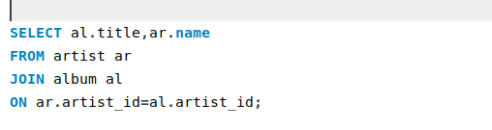
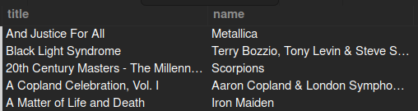
1.List all album titles and their respective artists.

Slide 4
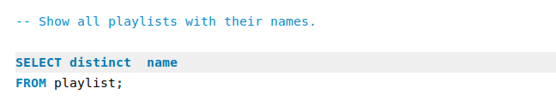
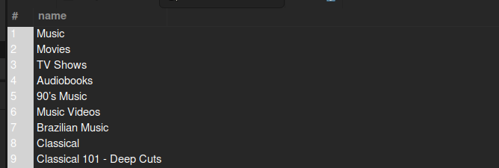
2) Show all playlists with their names.

Slide 5
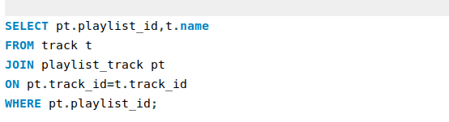
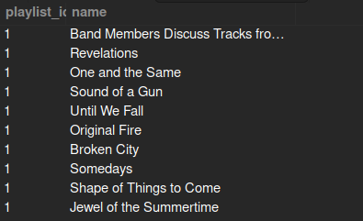
3) List the names of all tracks in a specific playlist (e.g., PlaylistId = 1)

Slide 6
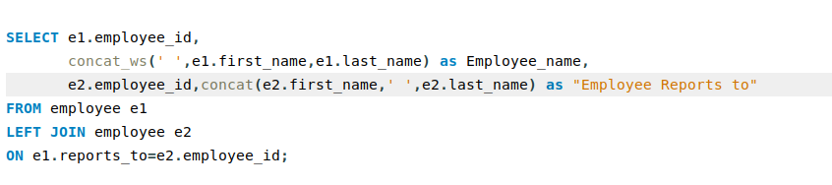
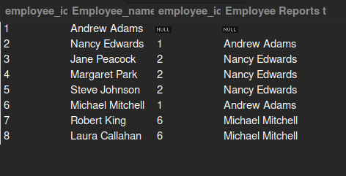
4) Retrieve all employees and the names of the employees they report to.

Slide 7
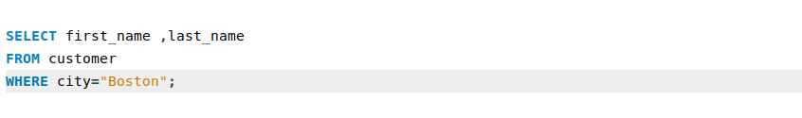
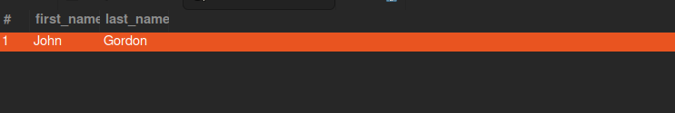
5) Find all customers in a specific city (e.g., 'Boston,Chicago...').

Slide 8
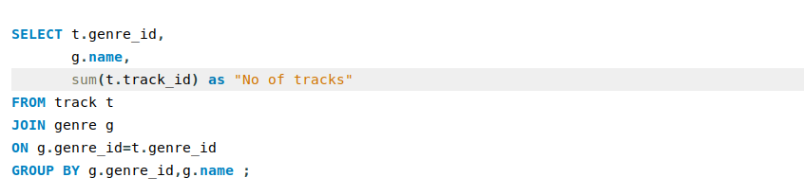
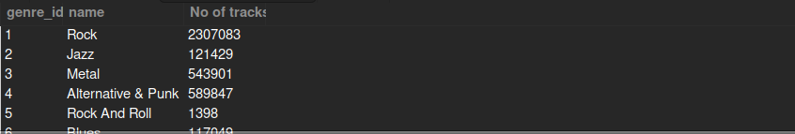
6) Calculate the total number of tracks in each genre.

Slide 9
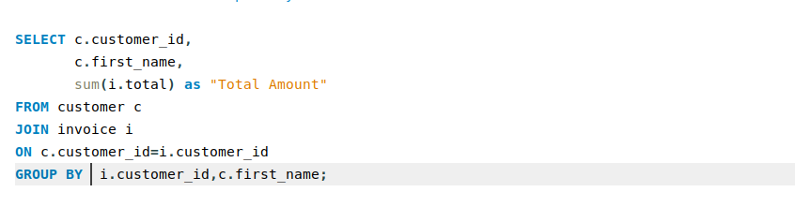
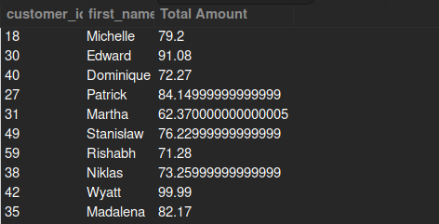
7) Find the total amount spent by each customer.

Slide 10
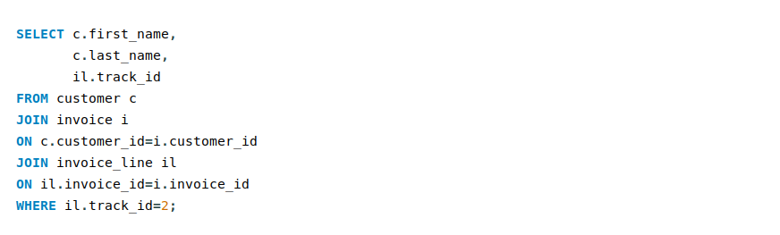
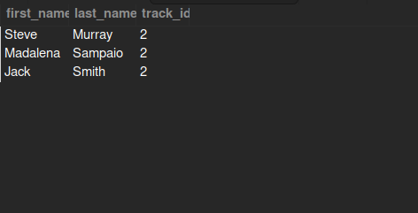
8)List the names of customers who have purchased a specific track
(e.g., TrackId = 1,2,3,4...).

Slide 11
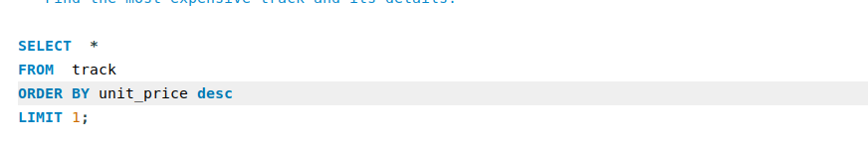
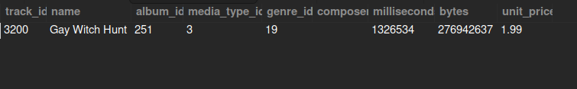
9) Find the most expensive track and its details.

Slide 12
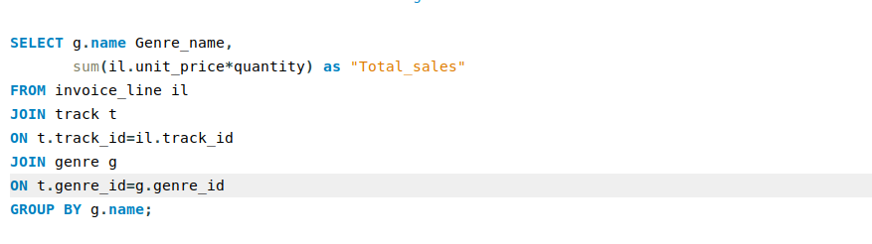
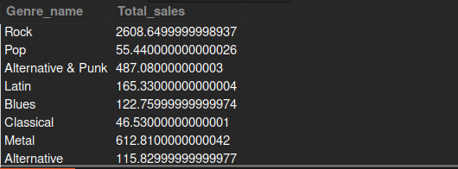
10) Calculate the total sales amount for each genre.

Slide 13
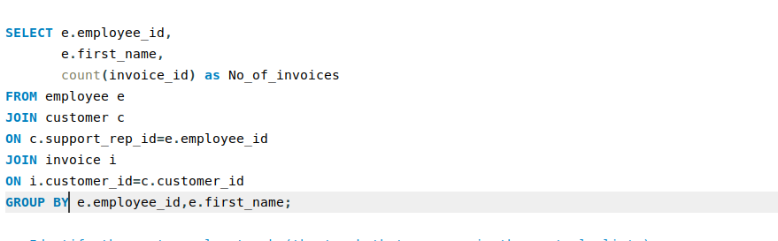
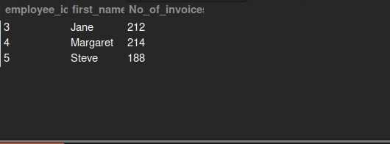
11) List the employees along with the total number of invoices they have processed.

Slide 14
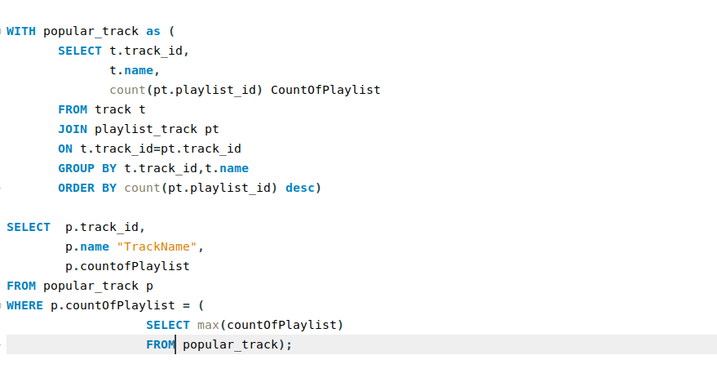
12) Identify the most popular track (the track that appears in the most playlists).

Slide 15
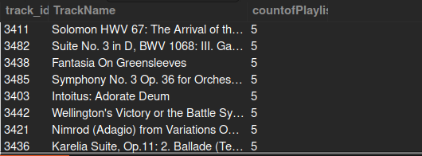

Slide 16
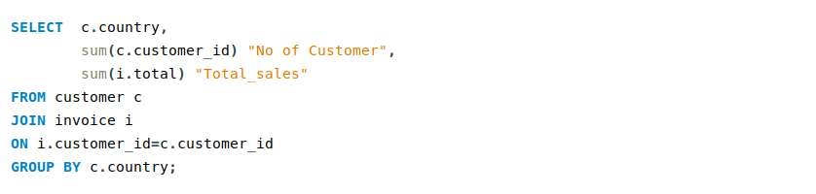
13) Get the total number of customers and the total sales for each country.

Slide 17
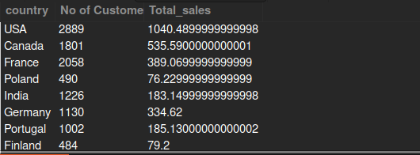

Slide 18
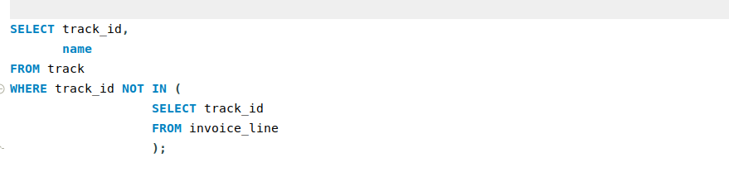
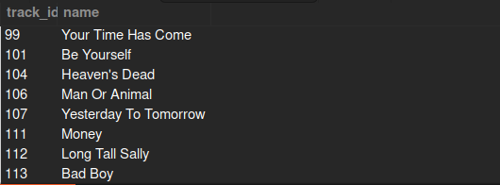
14) Identify tracks that have never been purchased.

Slide 19
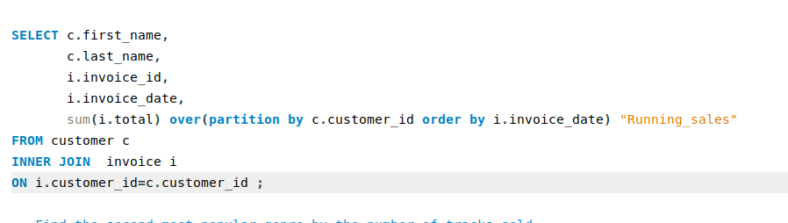
15) Calculate the running total of sales for each customer.

Slide 20
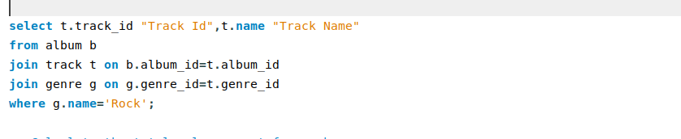
16) Retrieve the list of tracks that belong to the 'Rock' genre along with their album names.

Slide 21
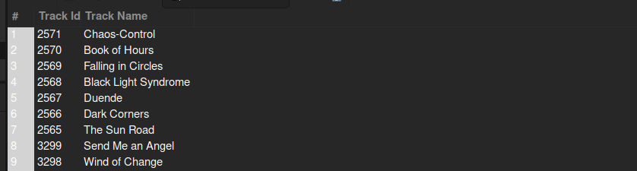

Slide 22
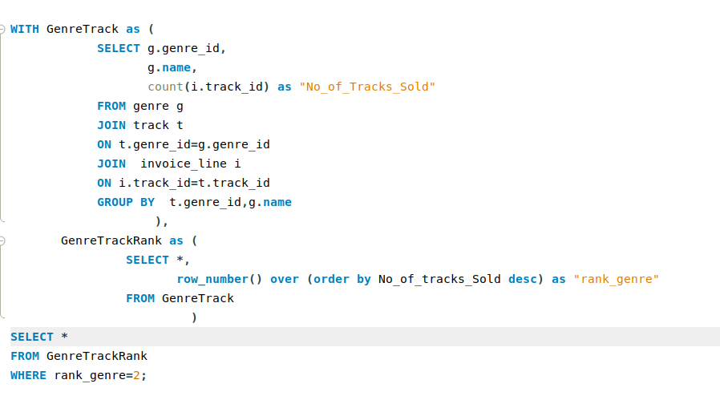
17) Find the second most popular genre by the number of tracks sold.

Slide 23
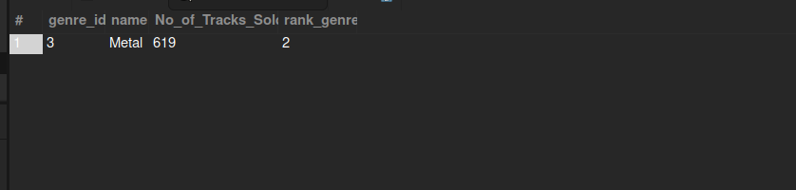

Slide 24
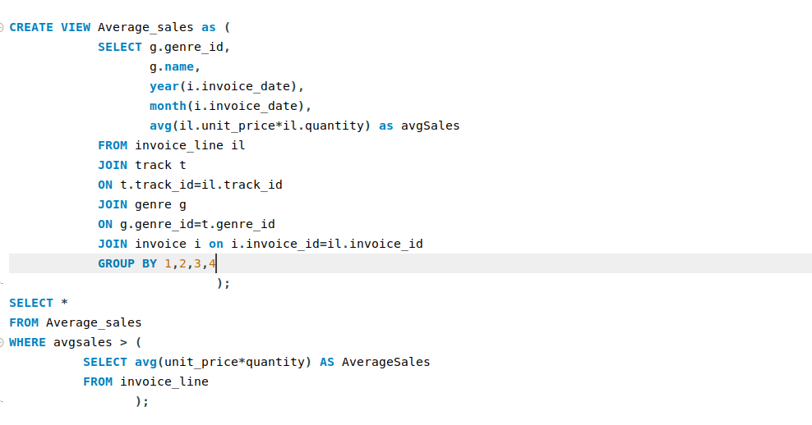
18) Average Sales per Genre by Month
-- The genres that had an average sales amount higher than the overall average sales
amount for any genre in any month

Slide 25
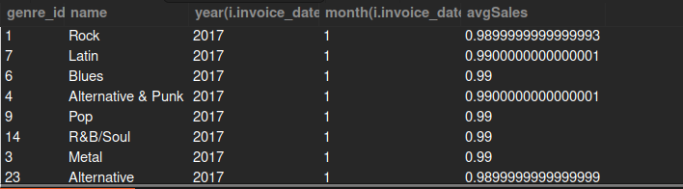

Slide 26
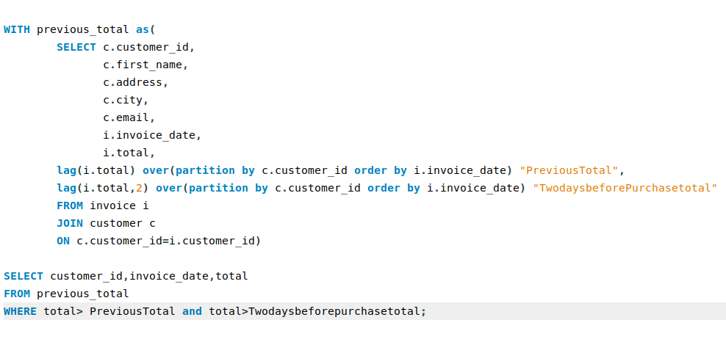
19) Customers with Increasing Purchase Amounts

Slide 27
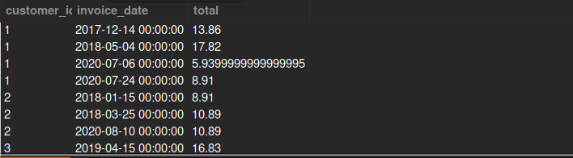

Slide 28
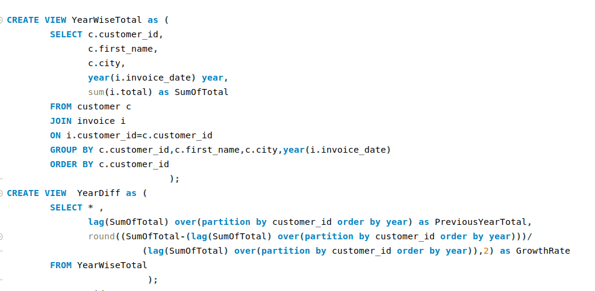
20) Top 5 Customers by Yearly Spending Growth

Slide 29
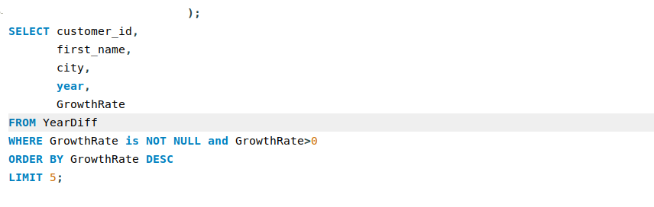
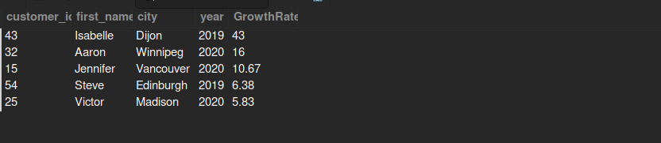

Slide 30
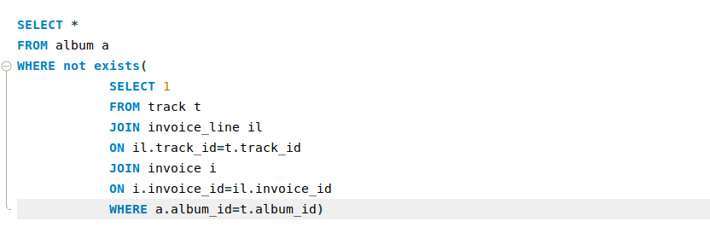
21) Find Albums with No Sales in the Last Year

Slide 31
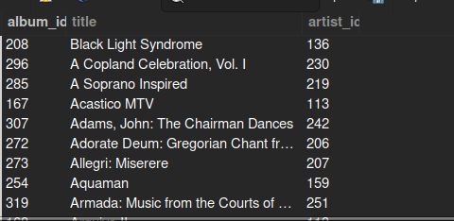

Slide 32
THANK YOU

