Slide 1

Department of Information Technology
A.P. Shah Institute of Technology
G.B.Road,Kasarvadavli, Thane(W), Mumbai-400615
UNIVERSITY OF MUMBAI
Academic Year 2019-2020

Slide 2
A Project Report on
Expeditious Banking using Blockchain Technology
Submitted in partial fulfillment of the degree of
Bachelor of Engineering(Sem-7)
in
INFORMATION TECHNOLOGY
By Varsha Naik(16104054) Riya Pejawar(16104040) Rishabh Singh(14104017)
Under the Guidance of Prof. Anagha Aher Prof. Sneha Kanchan

Slide 3
1.Project Conception and Initiation

Slide 4
1.1 Abstract
Blockchain is growing as a potentially Out of line force capable of changing the financial services industry by making the fund transfer immediate, cheaper and more secure.
Current existing system is not secure enough to give 100% fraud protection because of more manual work and lack of security of data.
Blockchain is nothing but a chain made of blocks (nodes).These process nodes do the all major work. These blocks are connected to each other using cryptography.
This system will be more expeditious, more efficient, and has user affectional interfaces in the banking and has zero probability of losing data while processing of the user data.
In integration to enabling trade, block chain is larceny-and tamper-resistant model.

Slide 5
1.2 Objectives
To decentralize the entire banking scenarios.
To make sure no one can manipulate or bypass the system.
To ensure all the rules laid down by RBI are strictly abided to and none supersided.
To protect the inter- block chain data from foreign entities through encryption techniques and checksum generation .

Slide 6
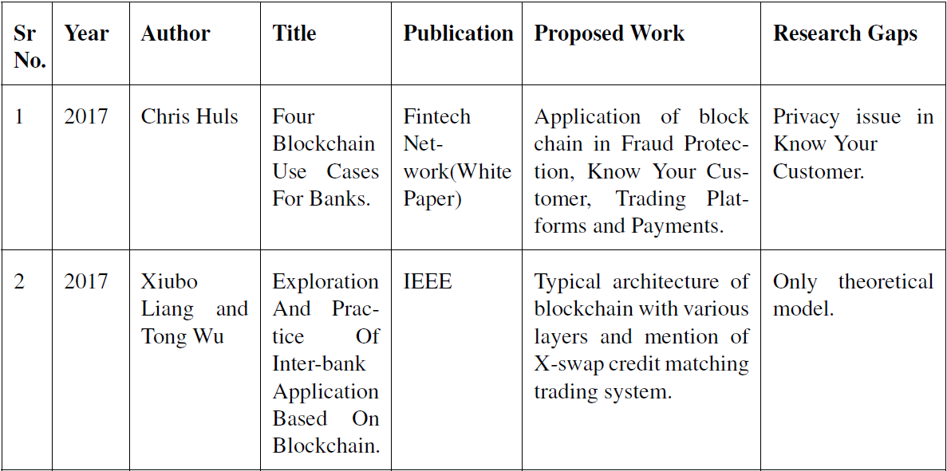
1.3 Literature Review

Slide 7
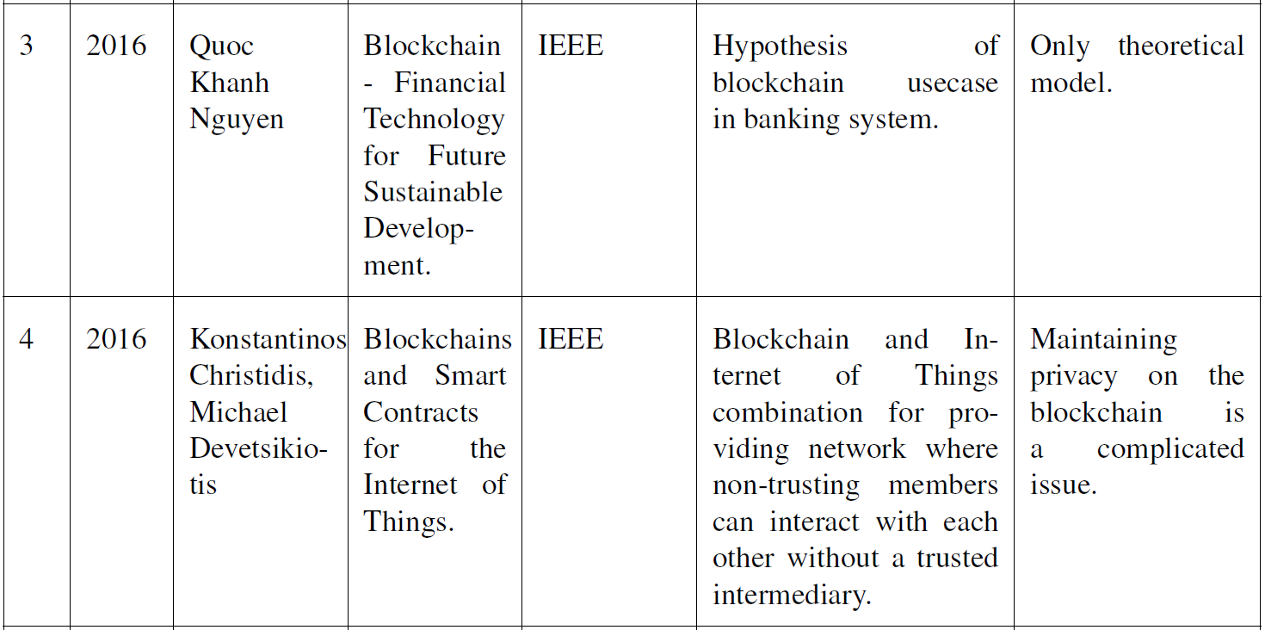
1.3 Literature Review

Slide 8
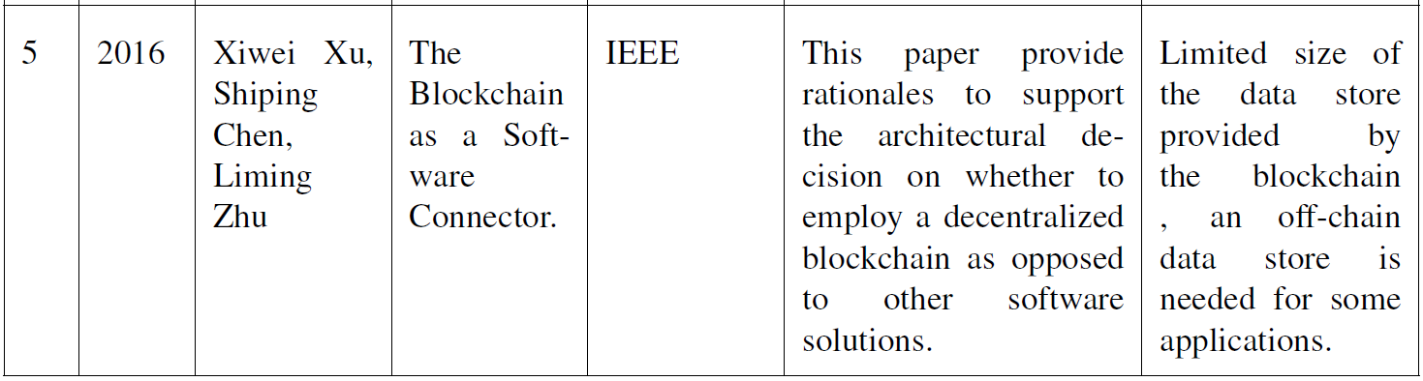
1.3 Literature Review

Slide 9
1.4 Problem Definition
To build an efficient and secure banking architecture using block-chain technology.
Current banking architecture is largely centralised and therefore vulnerable to loan defaults and frauds like the PNB scam, Videocon case , Kingfisher scam and many more.
Banking all over the world has adopted block chain technologies and it is the need of the hour for regulation and avoidance of such scams.
Thus, we are using block chain technology for the decentralized working of banks and the complete removal of authoritarian interception.
Software used: Java micro services, PKI , MAC hashing , Checksum generator for security module
Hardware used: Laptop, cable, USB, SQL database, network support.

Slide 10
1.5 Scope
To create an expeditious banking system .
To ensure a decentralized banking transaction for NEFT using block-chain technology.
Create a banking prototype for user interface for connecting the user to the backend processing.
To ensure protection of data in transit i.e. inter-block communication by hashing and cryptographic algorithm.
To ensure blocks are not bypassed by ensuring checksum matches by the majority in the pool of blocks.

Slide 11
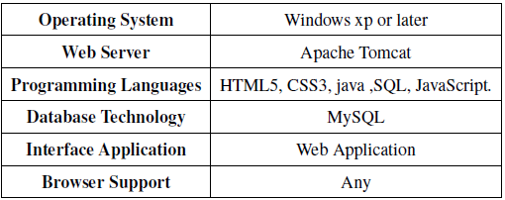
1.6 Technology stack
Software Requirement

Slide 12
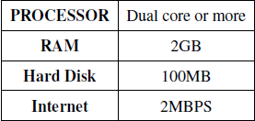
1.6 Technology stack
Hardware Requirement

Slide 13
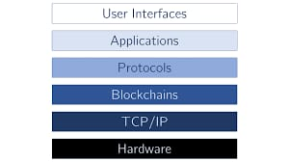
1.6 Technology stack

Slide 14
1.7 Benefits for environment & Society
Our project is an efficient solution for bypassing human intervention and control in banking sector to make it reliable and secure.
The project will ensure decentralized transfer of funds.
Frauds and huge loans sanction can be done away with our perception of a solution using Blockchain which makes it free of manual intervention.

Slide 15
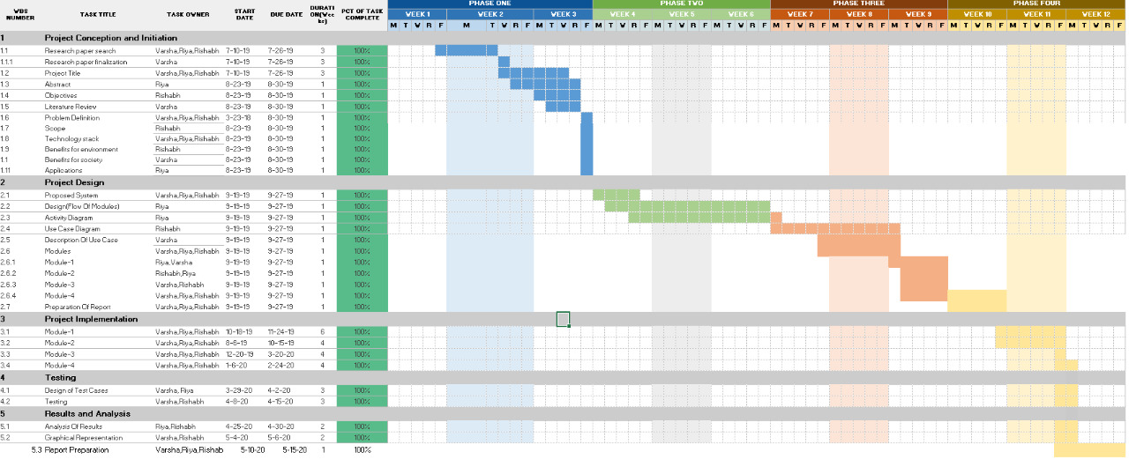
Gantt Chart & Project Timeline Chart

Slide 16
2. Project Design

Slide 17
2.1 Proposed System
The web application will help the bank users to perform the banking transaction more securely and with faster response by eliminating the third parties and the concept of blockchain technology is used which is very power full as compare to other modern world technology.
The system includes two main modules User, Admin.
User module contains sub-modules such as money transfer, OTP generation, My statement, Add beneficiary.
Admin module has viewing of all of the user request and add branch.

Slide 18
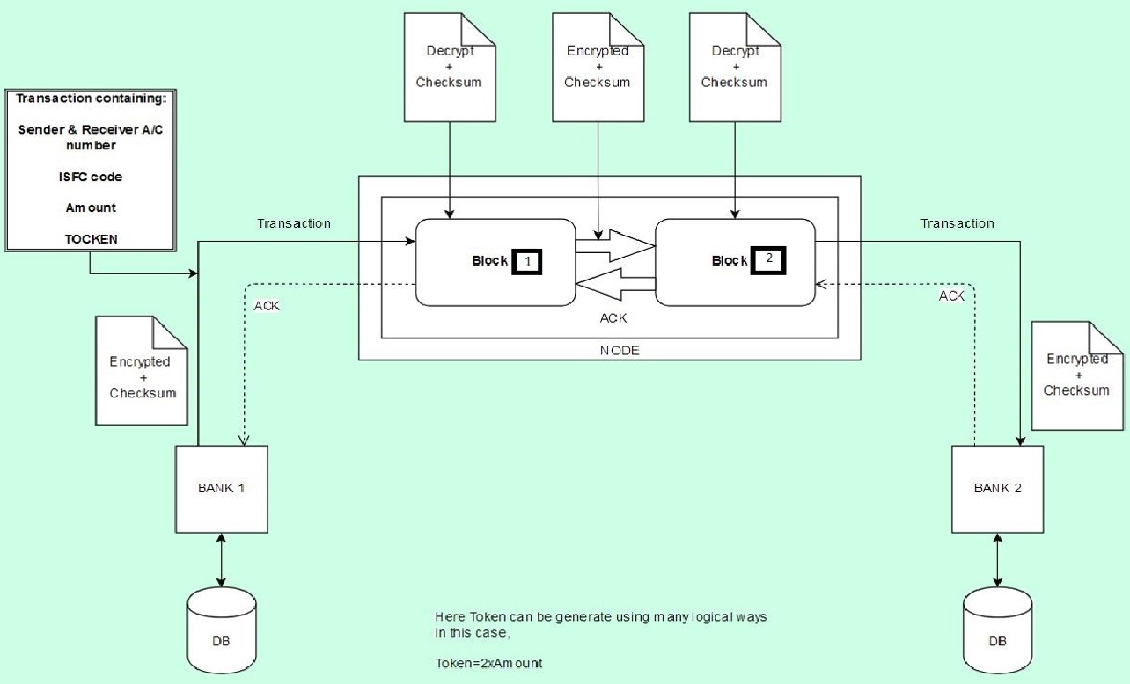

Slide 19
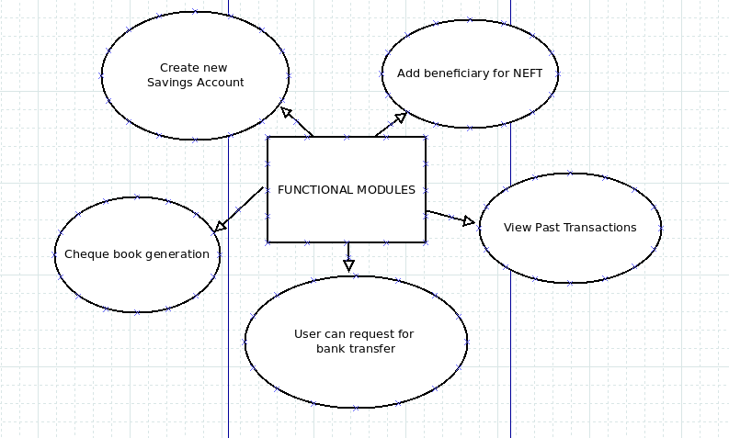
2.2 Design(Flow Of Modules)
User Module

Slide 20
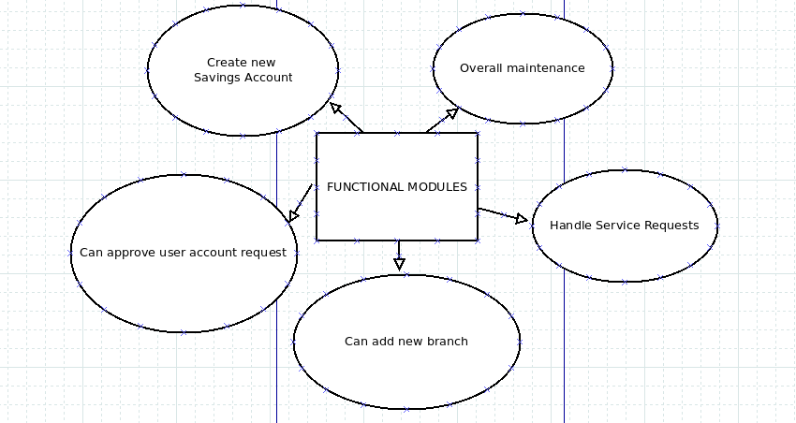
2.2 Design(Flow Of Modules)
Admin Module

Slide 21
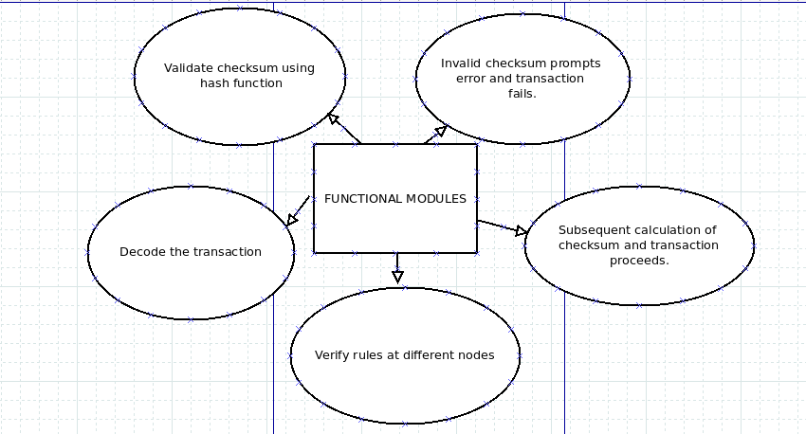
2.2 Design(Flow Of Modules)
Block-chain Module

Slide 22
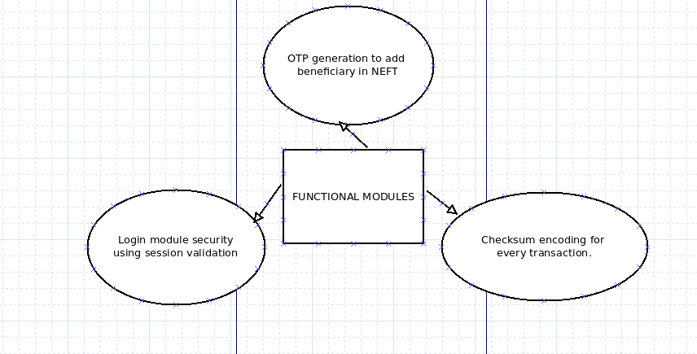
2.2 Design(Flow Of Modules)
Security Module

Slide 23
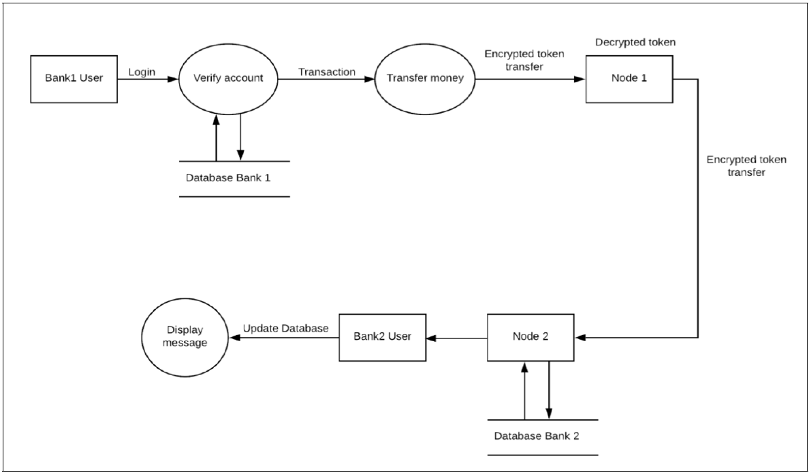
2.2 Design(Flow Of Modules)

Slide 24
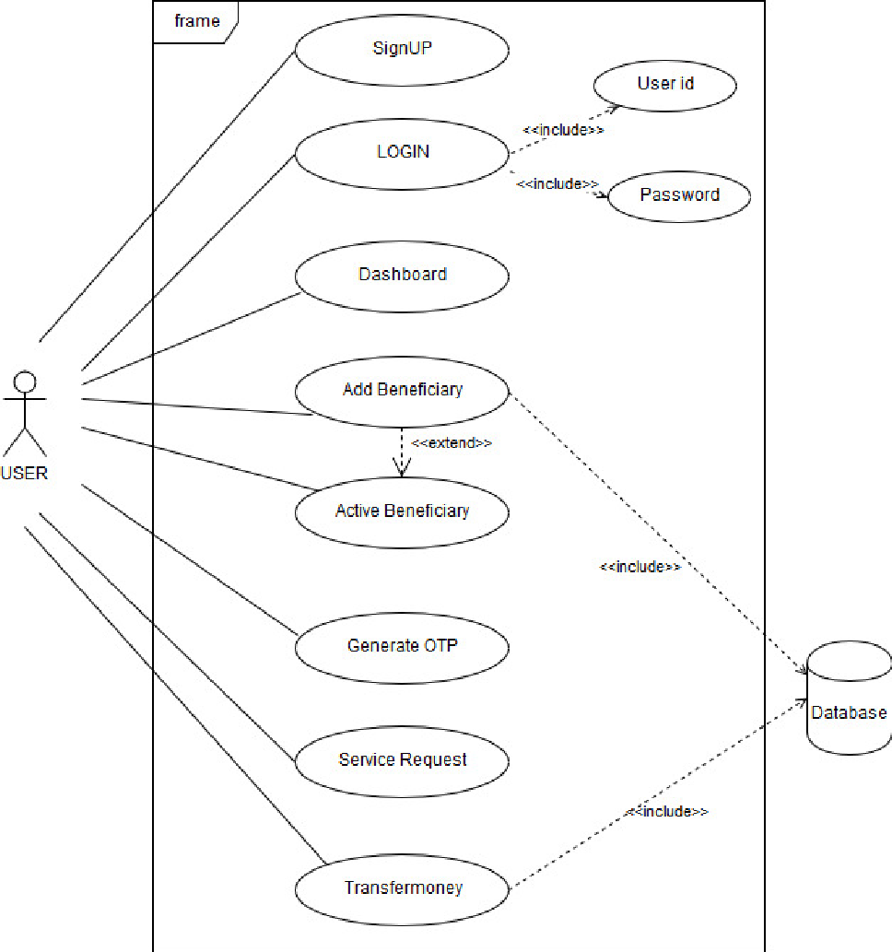
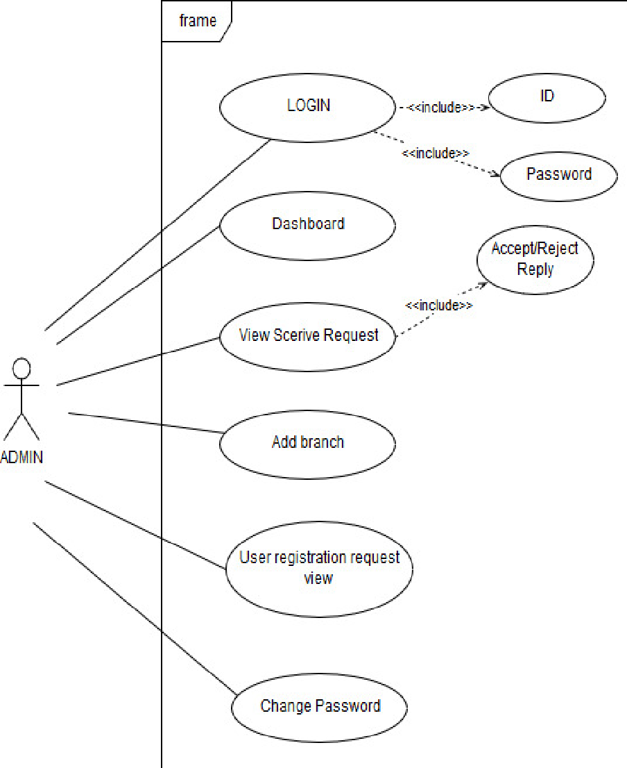
2.3 Description of Use-Case

Slide 25
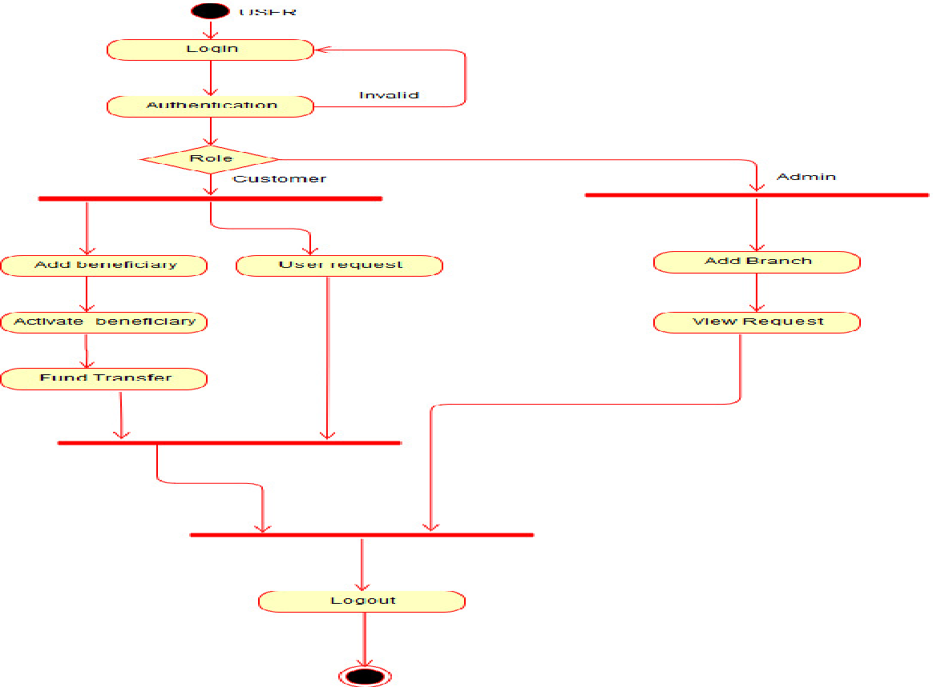
2.4 Activity Diagram

Slide 26
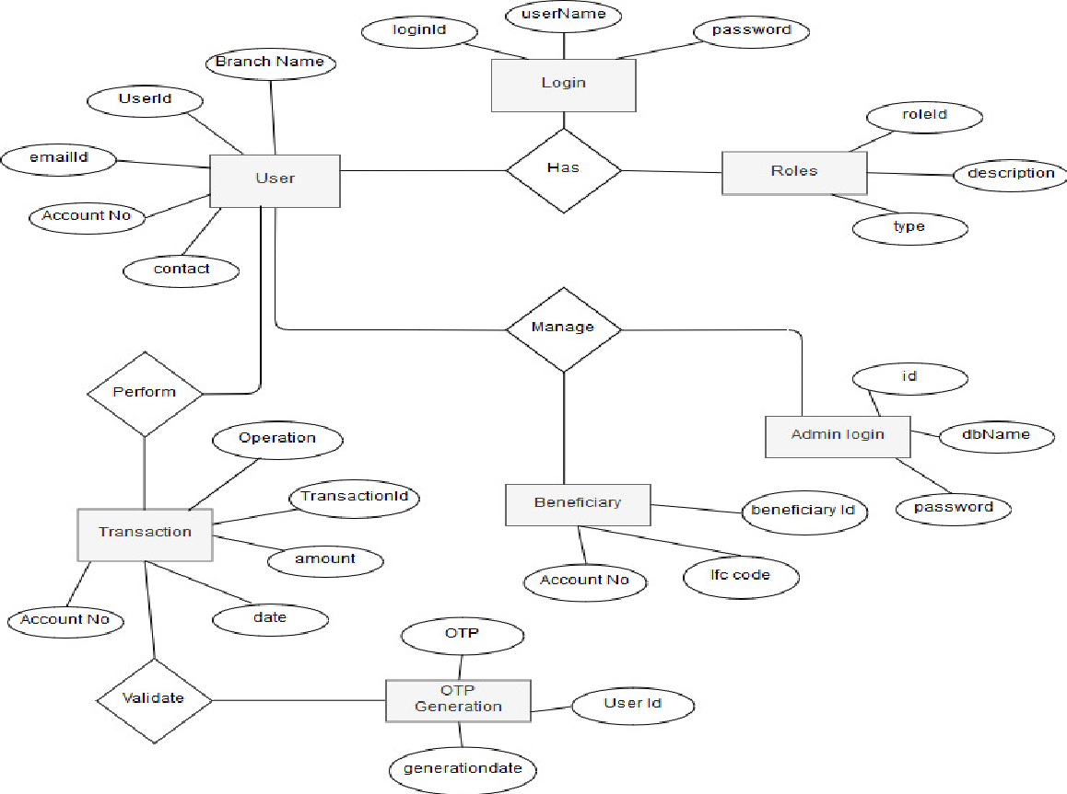
2.5 Class Diagram

Slide 27
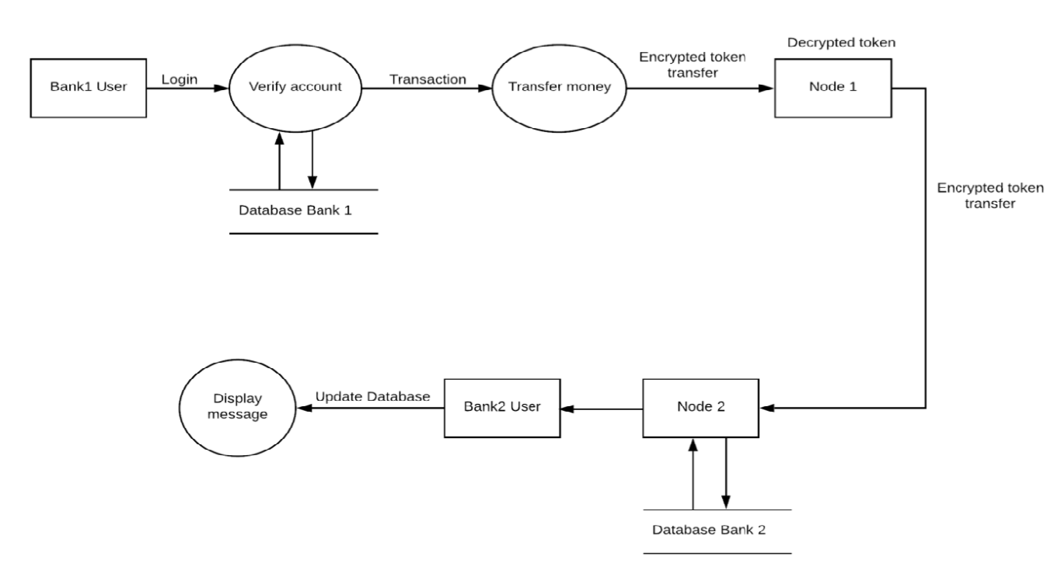
2.6 Data Flow Model

Slide 28
Module-1:BANK 1
Bank User
The application consists of the User interface with all the required links and buttons for navigating inside banking application.
For sign up user has to provide the personal details like Name, email, PAN.
After sign up the user will receive the mail containing the details like login id, login password.
Whenever user wants to do the transaction user has to enter transaction password the user can proceed with transaction.
Bank Admin
This part of an application also consists of the User interface with all the required links and buttons for navigating inside banking application.
Whenever new user register himself as new customer this request is received by admin, once admin approve this user gets mail of acceptance along with credentials in it.
The admin has the ability to accept or reject the service requests of users, he can also add the new branches of his bank into the system.

Slide 29
Module-2 : Processing NODE 1
A node is a device on a blockchain network, that is in essence the foundation of the technology,
allowing it to function and survive.
Nodes are distributed across a widespread network and carry out a variety of tasks.
The blocks of data are stored on nodes (compare it to small servers). Nodes can be any kind of device (mostly computers, laptops or even bigger servers). Nodes form the infrastructure of a blockchain.
All nodes on a blockchain are connected to each other this unit of an application is one of the main
processing component of the system which runs in background without having any user
interface.
The whole transaction process is divided into two different blocks.
NODE 1 is first block and the responsibility of it is validating the sender bank and the user by decrypting the token encrypted from the requested transaction.
Another responsibility is again encrypting the decrypted token to send it securely on network to next processing unit NODE 2. If this unit fails the system will not work.

Slide 30
Module-3 : Processing NODE 2
The nodes (blocks) are connected to each other forming a chain of blocks. The NODE 2 is the second processing unit of entire banking system which runs in background.
Transaction packet encrypted by NODE 1 is received by NODE 2.
Now NODE 2 decrypt this package then NODE 2 validates the receiver’s bank, receiver’s name also because money should not get sent to other user by mistakenly and Indian Financial System Code(ISFC).
After that updating the receiver’s bank database and giving the acknowledgement for the same to sending bank user. Nodes follows consensus algorithm.

Slide 31
Module-4 : BANK 2
Bank User
The application consists of the User interface with all the required links and buttons for navigating inside banking application.
For sign up user has to provide the personal details like Name, email, PAN.
After sign up the user will receive the mail containing the details like login id, login password.
Whenever user wants to do the transaction user has to enter transaction password theuser can proceed with transaction.
Bank Admin
This part of an application also consists of the User interface with all the required links and buttons for navigating inside banking application.
Whenever new user register himself as new customer this request is received by admin, once admin approve this user gets mail of acceptance along with credentials in it.
The admin has the ability to accept or reject the service requests of users, he can also add the new branches of his bank into the system.

Slide 32
3. Conclusion and Future Scope

Slide 33
3.1 Conclusion
As banks need to make numerous transactions every day, Blockchain technology could be of enormous significance by bringing in security and genuineness in transactions using our approach.
Currently, our system is for small scale environment we can extend the number of nodes in the future to provide higher level of security on large scale.
Endorsing an idea of trust economy, Blockchain can give financial institutions an opportunity to win the faith and confidence of their customers.
Not to ignore are the potential savings that it could bring in terms of cost and labour for the banking sector.

Slide 34
3.2 Future Scope
Our system could further scale up to accomodate more banks and their branches for a wider network of operation.
The system could also introduce more features in the user interface for a good experience for the customer altogether.
Also, the crypt algorithms used could be taken a notch up by introducing newer and more efficient algorithms.
Lastly, time complexity could be increased for efficient performance.

Slide 35
4.References

Slide 36
4. References
[1] Chris Huls, ''Four Blockchain Use Cases for Banks (white paper)'', Fintech network, Febuary 2017.
[2] Tong Wu, Xiubo Liang, ''Exploration and Practice of Inter-bank Application Based on Blockchain'', Institute of Electrical and Electronics Engineers, August 2017.
[3] Quoc Khanh Nguyen, ''Blockchain–A Financial Technology for Future Sustainable Development'', Institute of Electrical and Electronics Engineers, November 2016.
[4] Konstantinos Christidis, Michael Devetsikiotis ''Blockchains and Smart Contracts for the Internet of Things'', Institute of Electrical and Electronics Engineers, June 2016.
[5] Xiwei Xu, Liming Zhu, Shiping Chen, ''The Blockchain as a Software Connector'', Institute of Electrical and Electronics Engineers, April 2016.

Slide 37
Thank You

