Slide 1

SMART ENERGY METER
BY:
S.VARSHA -23011102082
SANJANA S – 23011102087
SANJANAA SHREE - 23011102088

Slide 2
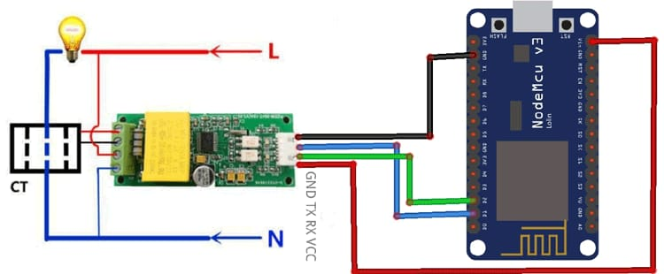
ABSTRACT :
The Smart Energy Conservation Meter IoT project aims to develop a system that effectively monitors and manages energy consumption in households or industrial settings. This system utilizes components such as the PZEM-004T current voltage multimeter module, CT sensor, and ESP8266 microcontroller. By integrating these components with IoT technology, users can remotely monitor energy usage, analyze consumption patterns, and implement conservation measures.

Slide 3
INTRODUCTION :
Energy conservation is becoming increasingly important in today's world due to rising energy costs and environmental concerns. Traditional energy meters lack the capability to provide real-time data and insights into consumption patterns. This project seeks to address these limitations by developing a smart energy metering system that leverages IoT technology for efficient monitoring and conservation of energy.
OVERVEIW
OBJECTIVE
MOTIVATION
The system consists of hardware components including the PZEM-004T module for measuring voltage and current, CT sensors for accurate current measurement, and the ESP8266 microcontroller for data processing and communication. Additionally, software components such as firmware for the microcontroller and a web-based interface for users to monitor energy usage are integral parts of the system.
Develop a smart energy metering system capable of real-time monitoring.
Provide users with insights into their energy consumption patterns.
Enable remote access and control of energy usage.
Facilitate energy conservation efforts through data-driven analysis.
Design a user-friendly interface for easy interaction with the system.
The motivation behind this project stems from the need for efficient energy management solutions. By empowering users with real-time data on their energy usage, they can make informed decisions to reduce wastage and promote sustainability. Moreover, remote monitoring capabilities allow for proactive conservation measures, leading to cost savings and environmental benefits.

Slide 4
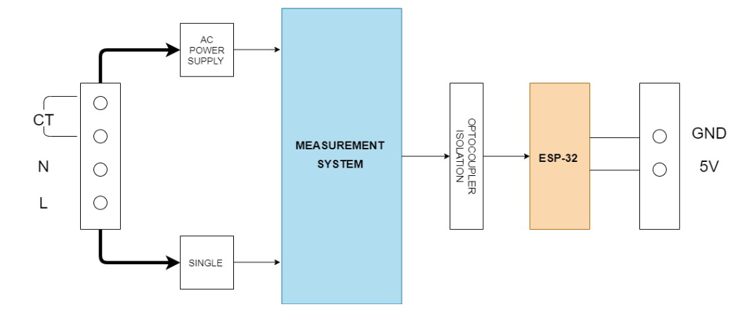
PROPOSED METHODOLOGY :
The proposed methodology involves the integration of hardware components to measure energy parameters, data processing and analysis using the ESP8266 microcontroller, and communication with a web-based interface for user interaction. Block diagrams illustrating the system architecture and flow of data will be used to illustrate the design.
BLOCK DIAGRAM:

Slide 5
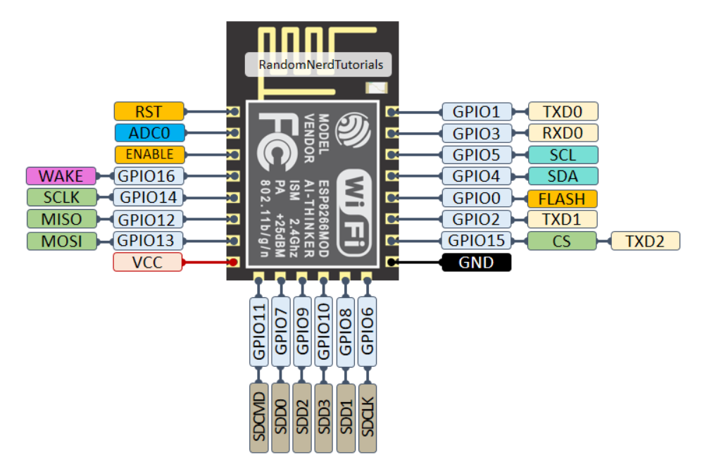
PIN DIAGRAMS :
ESP 8266

Slide 6
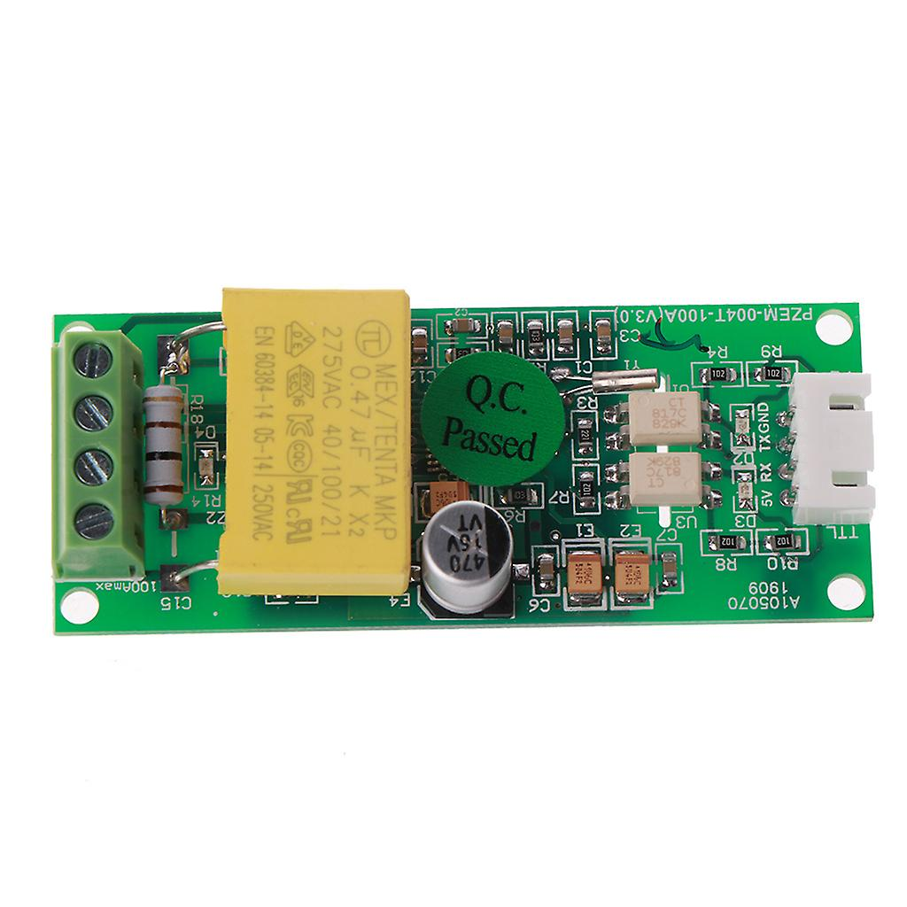
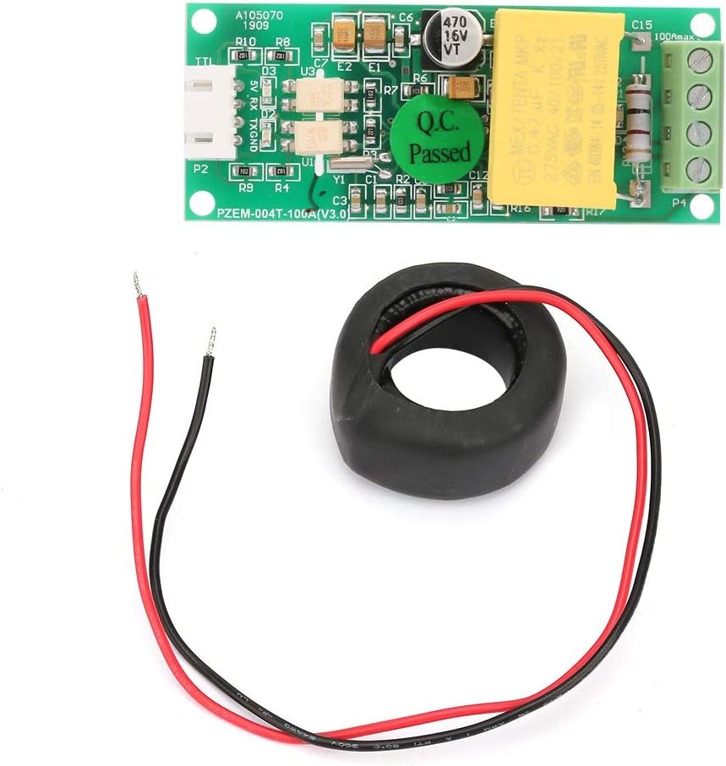
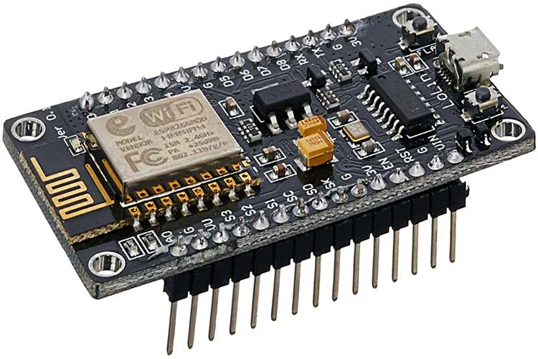
HARDWARE :
PZEM-004T current voltage multimeter module
CT Sensor
ESP8266 microcontroller

Slide 7
METHODOLOGY OF THE PROJECT :
Hardware Setup: Connect the PZEM-004T module and CT sensor to the ESP8266 microcontroller according to the circuit diagram.
Firmware Development: Develop firmware for the ESP8266 to read data from the PZEM-004T module and CT sensor, process the data, and transmit it to the web server.
Integration and Testing: Integrate the hardware and software components, and test the system for functionality, accuracy, and reliability.
Deployment: Deploy the smart energy metering system in the target environment, ensuring seamless operation and user accessibility.
Maintenance and Optimization: Continuously monitor and optimize the system for improved performance and efficiency, addressing any issues that may arise during operation.

Slide 8
APPLICATION OF THE PROJECT :
Home Energy Management: Individuals can monitor and optimize their energy usage in real-time, leading to cost savings and reduced environmental impact.
Industrial Energy Monitoring: Industries can track energy consumption in various processes, identify inefficiencies, and implement measures to improve energy efficiency.
Smart Grid Integration: The data collected from the smart energy meters can be utilized for better management of electricity distribution, load balancing, and peak demand reduction.
Renewable Energy Integration: Users can integrate renewable energy sources such as solar panels or wind turbines more effectively by understanding their energy consumption patterns and optimizing usage accordingly.
Building Automation Systems: Smart energy meters can be integrated into building automation systems to optimize HVAC (heating, ventilation, and air conditioning) and lighting systems for energy efficiency.
Demand Response Programs: Utilities can use data from smart energy meters to implement demand response programs, encouraging users to reduce energy consumption during peak periods through incentives.

Slide 9
INTERFERANCE OF MINI PROJECT :
Mini projects developed based on this Smart Energy Conservation Meter IoT project can focus on specific aspects or enhancements, leading to a diversified range of applications and innovations. Some examples of mini projects and their interference with the main project are:
Energy Forecasting: Develop a mini project to predict future energy consumption based on historical data and external factors such as weather forecasts. This can enhance the decision-making process for energy management.
Fault Detection and Diagnostics: Create a mini project to detect anomalies or faults in energy usage patterns and equipment operation. This can help identify inefficiencies or malfunctions for timely maintenance or repair.
User Behavior Analysis: Develop a mini project to analyze user behavior and preferences regarding energy consumption. Insights gained from this analysis can be used to personalize energy-saving recommendations or incentives.
Mobile Application Integration: Create a mini project to develop a mobile application for remote monitoring and control of energy usage. This enhances the accessibility and convenience of the system for users.
Integration with Smart Appliances: Develop a mini project to integrate smart appliances with the energy metering system, allowing for automated

Slide 10
CONCLUSION :
The Smart Energy Conservation Meter IoT project presents a comprehensive solution for efficient energy management and conservation. By leveraging IoT technology and integrating hardware components such as the PZEM-004T module, CT sensor, and ESP8266 microcontroller, the system enables real-time monitoring, analysis, and control of energy usage. The development of a user-friendly web interface enhances accessibility and usability, empowering users to make informed decisions to reduce wastage and promote sustainability. Through this project, we have demonstrated the potential of IoT in addressing the challenges of energy management and contributing to a more sustainable future.

Slide 11
FURTHER DEVLOPMENT:
Developing an user-friendly dashboard for the user the to monitor the power consumption pattern.
To obtain historic data of the device.

Slide 12
FUTURE WORK :
Enhanced Analytics: Develop advanced analytics algorithms to provide deeper insights into energy consumption patterns and trends, enabling more proactive conservation measures.
Integration with Smart Grids: Explore integration opportunities with smart grid technologies for better coordination of energy distribution and optimization of renewable energy integration.
Machine Learning Applications: Incorporate machine learning techniques to predict energy demand, optimize energy usage, and personalize recommendations based on user behavior and preferences.
Sensor Fusion: Investigate the fusion of data from multiple sensors, such as temperature and humidity sensors, to provide a more holistic view of energy usage and environmental conditions.
Energy Trading Platforms: Explore the development of energy trading platforms based on blockchain technology, enabling peer-to-peer energy transactions and incentivizing renewable energy production.

Slide 13
REFRENCES :
Kaur, H., Sharma, M., & Kumar, N. (2020). IoT-based energy management system: A review. Sustainable Energy Technologies and Assessments, 40, 100762.
Mahapatra, S., & Mishra, D. (2021). A Review on IoT Based Smart Energy Management System. 2021 International Conference on Intelligent Sustainable Systems (ICISS), 932-936.
Pankaj, B., Mittal, A., & Mathur, G. (2019). IoT based smart energy management system using renewable sources. 2019 2nd International Conference on Computing, Communication, and Automation (ICCCA), 1-5.
Singh, H., Raut, A., & Saxena, V. (2020). Review on Internet of Things Based Smart Energy Management System. 2020 International Conference on Communication and Electronics Systems (ICCES), 1637-1642.
Vishal, V., & Nayyar, A. (2020). Smart energy metering using IoT: A review. 2020 7th International Conference on Signal Processing and Integrated Networks (SPIN), 341-344.

