Slide 1
Predicting Customer Churn In Telecom Industry

Slide 2
Problem
What is Churn?
One customer switches from one service to another.
Big problem in any industry that offers subscription service or a recurring purchasable.
Why study Churn for telecom industry?
easy for subscriber to switch
large # of competitors in space

Slide 3
How do I solve for this?
Build a churn prediction model.
Uses historical data to provide a list of customers that are more likely to churn.
Targeted retention strategies on specific group of customers.

Slide 4
Approach
Build predictive models using different machine learning techniques.
Techniques used: Logistic Regression, Decision Tree, Random Forest and KNN.
Compare model performance metrics across different models.

Slide 5
Process
Data exploration
Data cleaning
Feature engineering
Apply different machine learning techniques
Compare model performance
Recommendations
Improvising/Fine tuning/Compatibility
DEPLOY!! ☺

Slide 6
Detective hats on! AKA Data Exploration
Shape of data : 3333, 21
Variables : state, acct length, area code, phone number, int plan, vm plan, #vmail messages, total min, total calls, total charge for day, eve, night and international, customer service calls, churn.
Target variable: Churn (True/False)

Slide 7
Data Cleaning
Drop missing/null values.
State values to keys.
International plan/VM plan/Churn to 0 and 1.

Slide 8
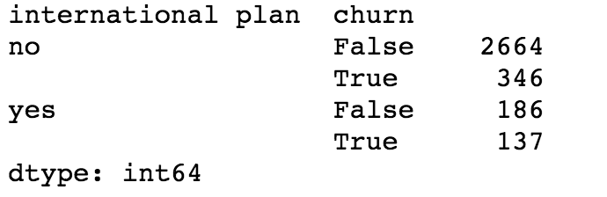
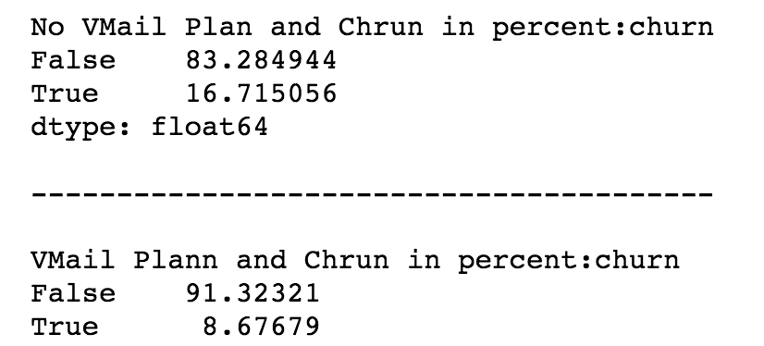
Feature Engineering
International plan
Voicemail plan

Slide 9
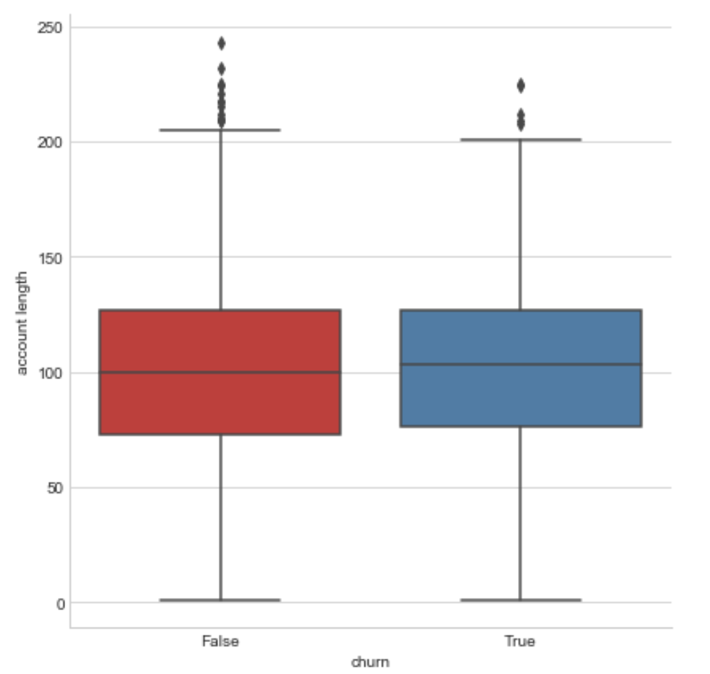
Feature Engineering
Account length

Slide 10
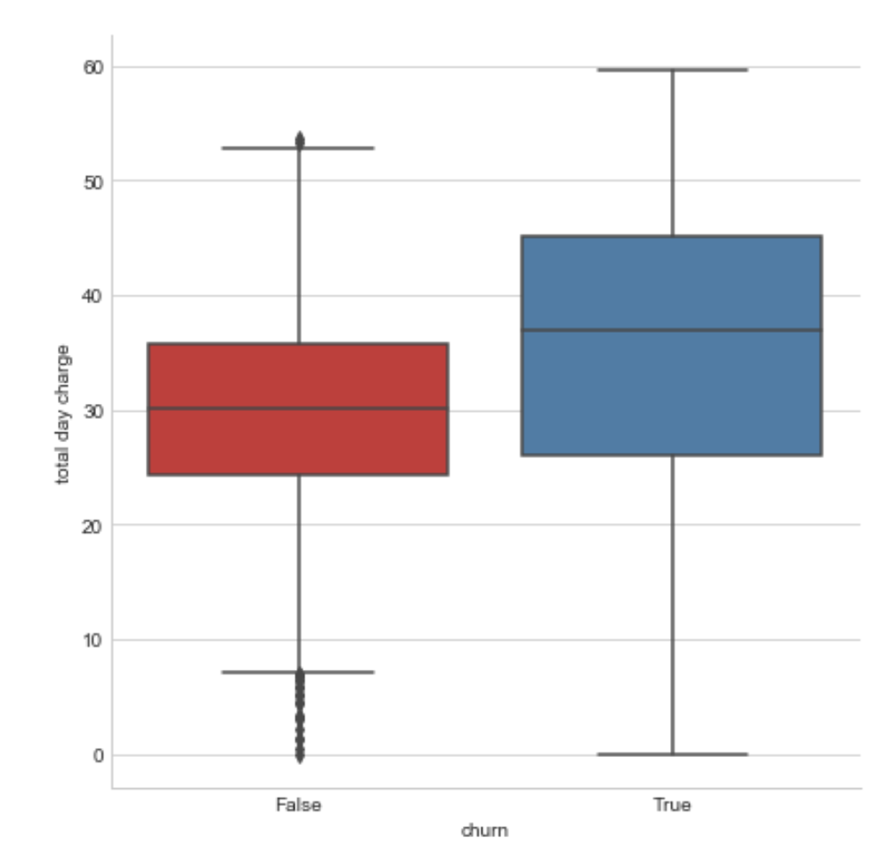
Feature Engineering
Total day charge

Slide 11
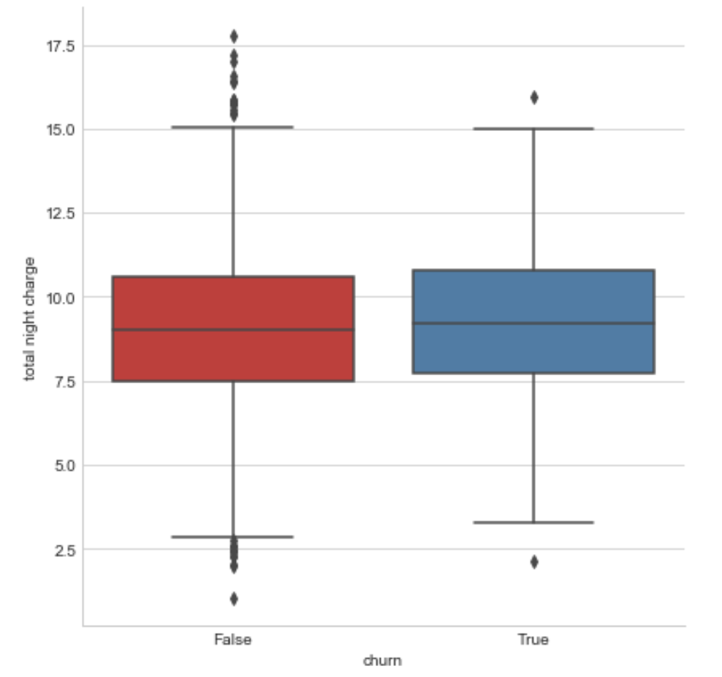
Feature Engineering
Total night charge

Slide 12
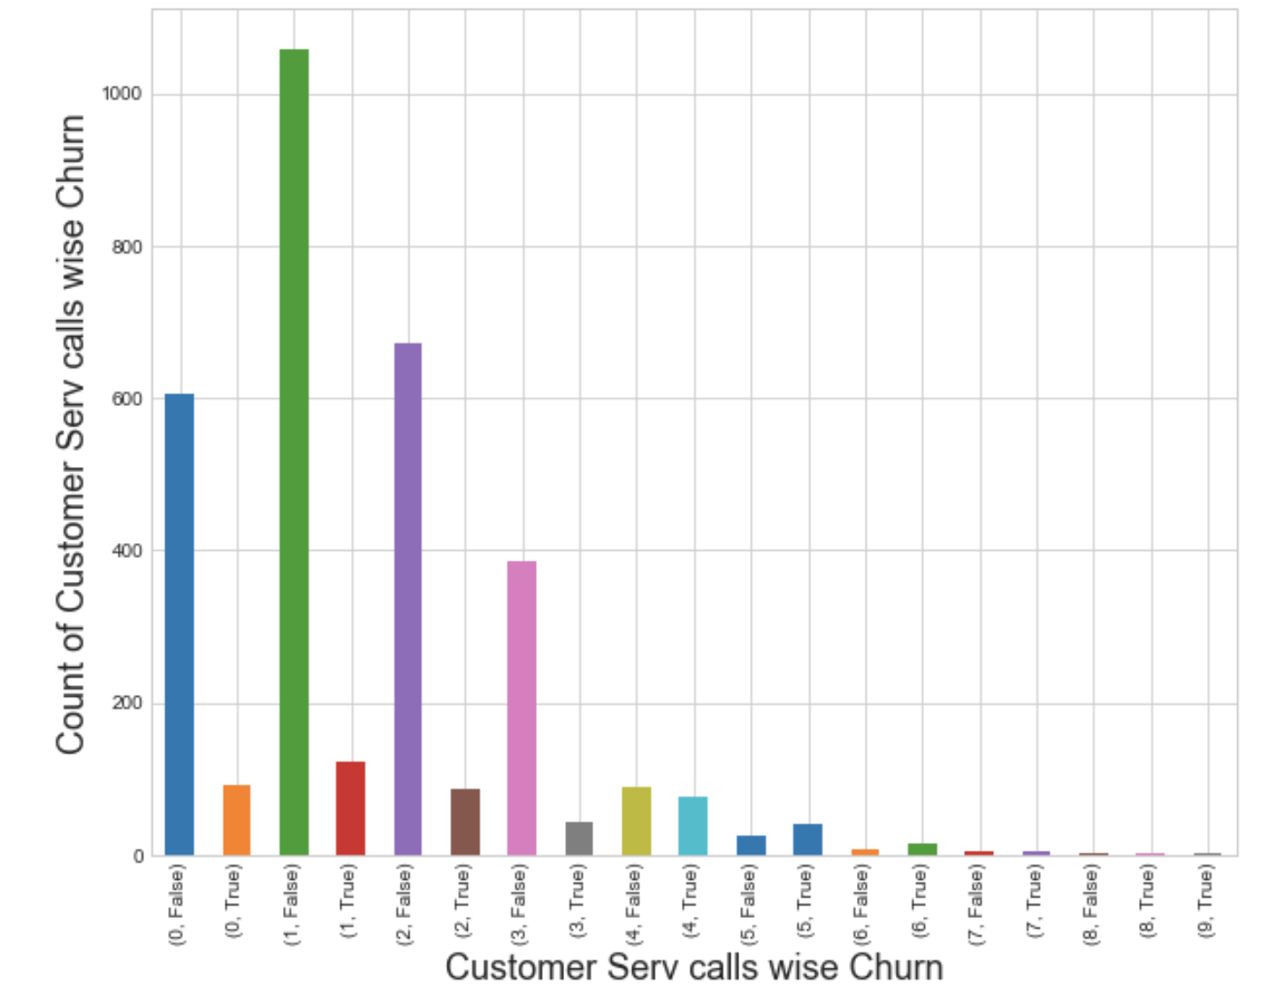
Feature Engineering
Customer service calls

Slide 13
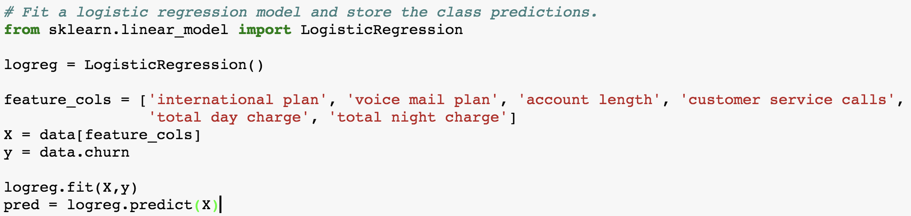
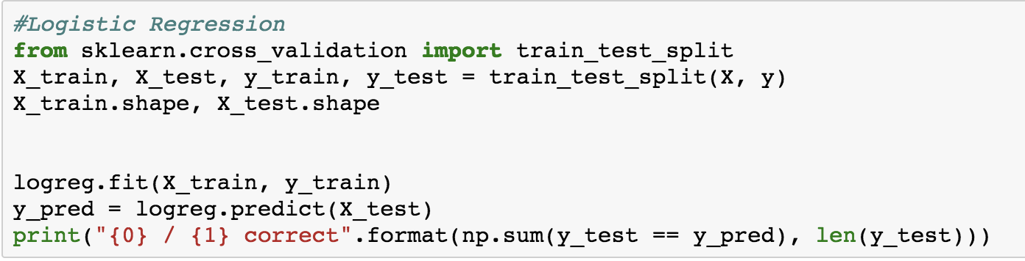
ML techniques – Logistic Regression

Slide 14
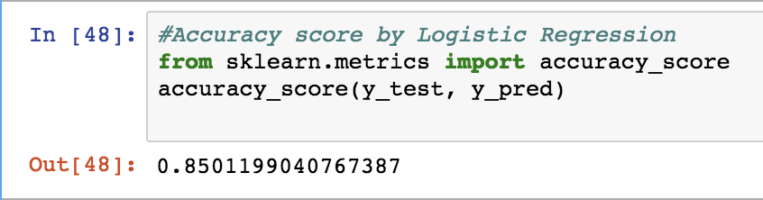
LR : Accuracy

Slide 15
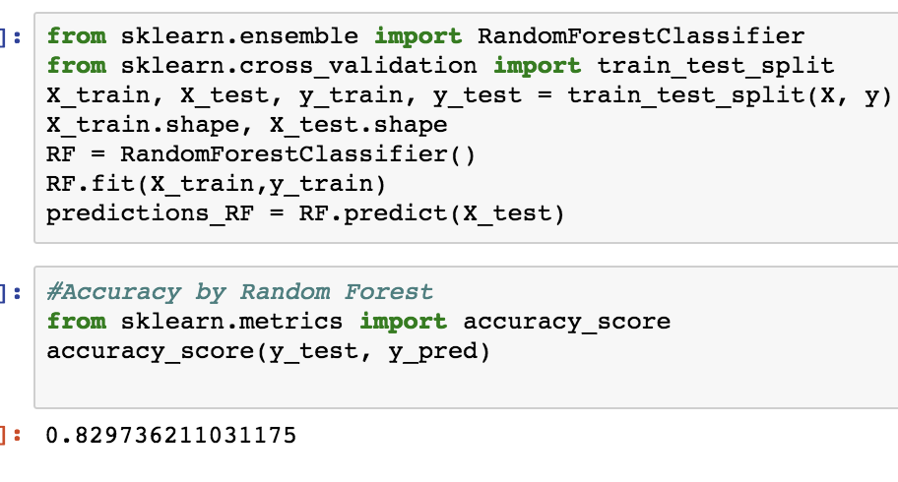
Random Forest

Slide 16
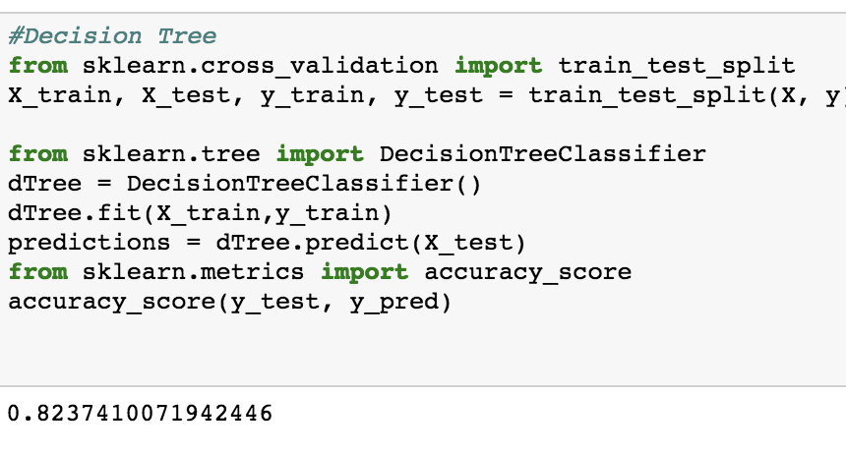
Decision Trees

Slide 17
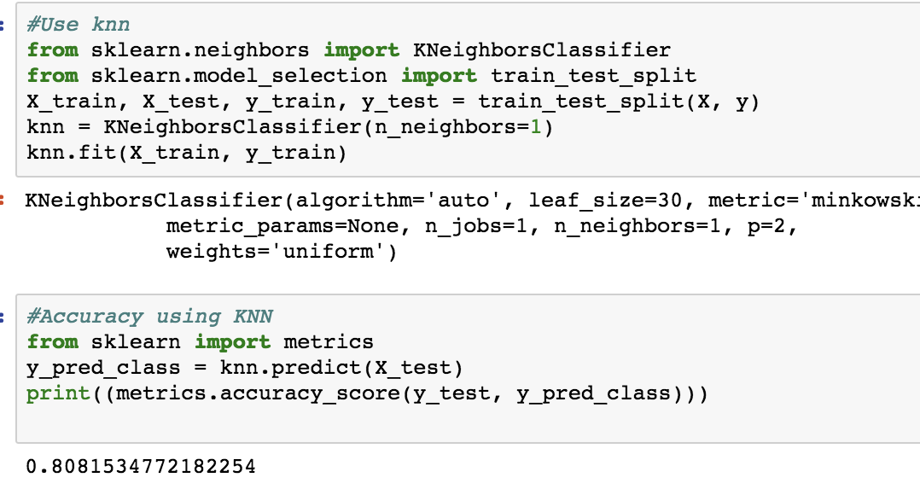
KNN

Slide 18
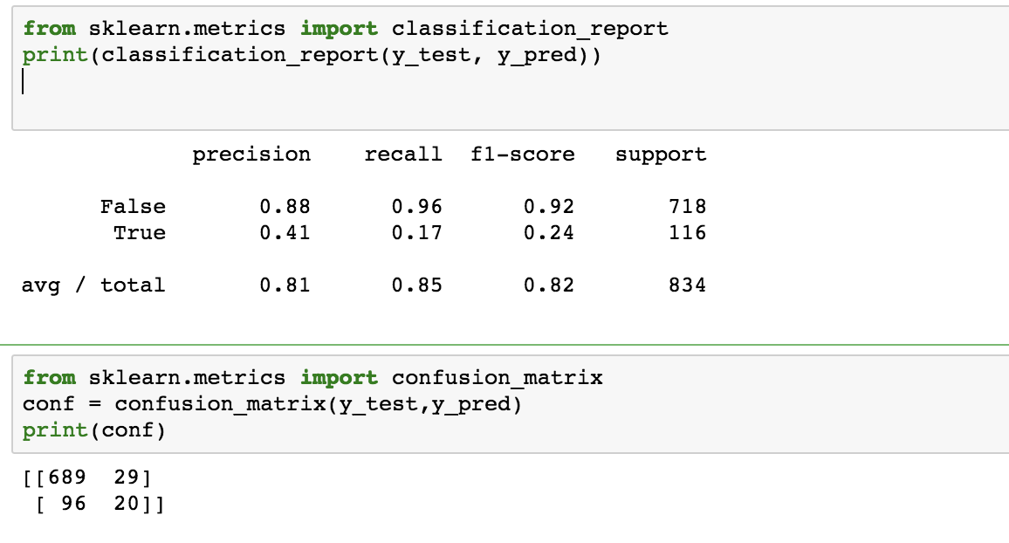
Model Performance Metrics

Slide 19
Recommendation
Logistic Regression has highest accuracy of 85% and very good precision and recall.
From the 718 data points with label = False, model was successful in identifying 689 of those correctly and 29 were incorrectly labeled.
From the 116 data points with label = True, model successful identifying 96 of those correctly.

Slide 20
Scope for Improvement
Add more data
Add more features
Do feature selection well
Regularization
Bagging
Boosting
Different kinds of model
Iterate to build a model that is less resource intensive, easy to deploy and debug.

Slide 21
THANK YOU!

