Slide 1

Project Title - Seasonal Agriculture Performance Analysis
Student Name: VARSHA SINGH
College Name: DR.HARISINGH GOUR VISHWAVIDYALAYA
AICTE STU ID : STU692b1deea9fb71764433390

Slide 2

PROBLEM STATEMENT
Agricultural activities are influenced by seasonal variations in environmental conditions, farming practices, resource availability and market conditions. As a result, agricultural performance may differ from one season to another. However, raw agricultural data does not clearly explain how agricultural performance changes across seasons or what patterns can be observed in different seasonal conditions. The problem is to analyze the given agricultural dataset and investigate seasonal differences in agricultural performance by identifying meaningful patterns, trends, relationships and variations within the available data.

Slide 3
Project Description
The project focuses on analyzing agricultural data across different seasons, crops and geographical regions.
The dataset contains information about:
Environmental conditions
Farming practices
Crop yield and production
Resource usage
Irrigation methods
Costs, revenue and profit
The data was cleaned and analyzed using statistical methods and visualizations to identify seasonal patterns, relationships and differences in agricultural performance.

Slide 4

WHO ARE THE END USERS?
Farmers and agricultural practitioners
Agricultural planners and policymakers
Agricultural researchers
Agribusiness and supply-chain professionals
Data analysts
Organizations involved in agricultural resource planning
Purpose:
The insights can support better seasonal planning, resource allocation and agricultural decision-making.

Slide 5

Technology Used
Python – Data analysis and visualization
Pandas – Data cleaning and manipulation
NumPy – Numerical analysis
Matplotlib – Data visualization
Seaborn – Statistical visualizations
Jupyter Notebook / Google Colab – Analysis environment
GitHub – Project and notebook repository

Slide 6
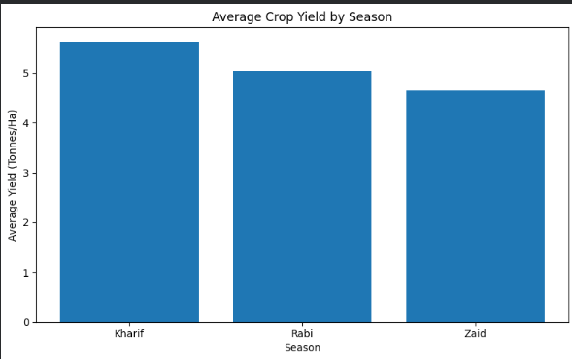
RESULTS
Finding:
Kharif shows the highest average crop yield, followed by Rabi and Zaid. This indicates variation in overall agricultural performance across seasons.

Slide 7
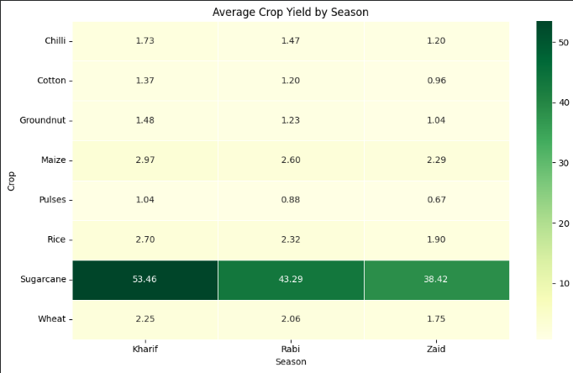
RESULTS
Finding:
Crop performance varies across seasons. Sugarcane has substantially higher average yield than the other crops, while most crops show their highest average yield in Kharif.

Slide 8
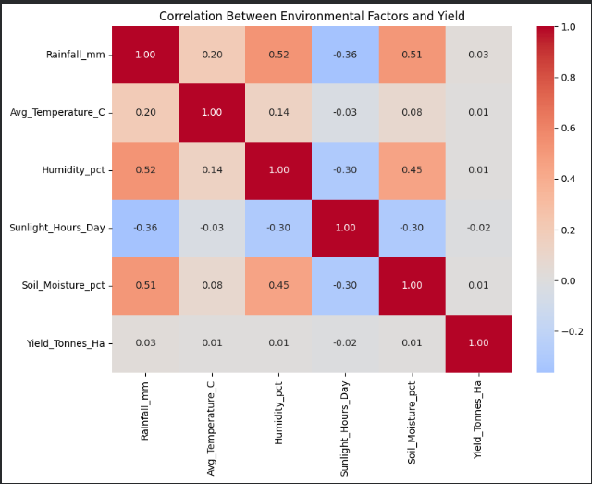
RESULTS
Finding:
The correlation heatmap shows the relationships between environmental factors and crop yield. It helps identify which conditions have stronger or weaker associations with agricultural performance.
Note: Correlation indicates association and does not establish causation.

Slide 9
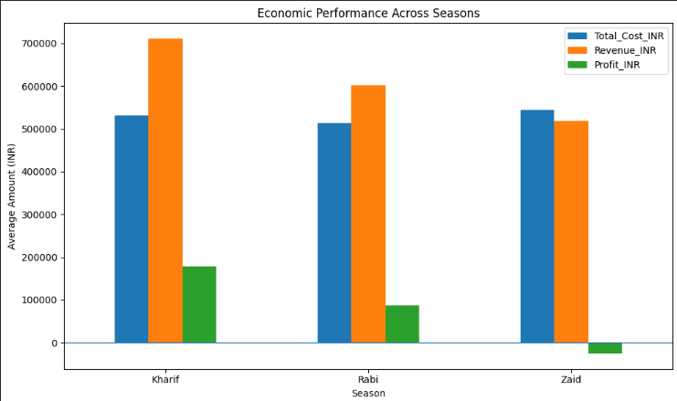
RESULTS
Finding:
Kharif has the highest average profit, while Zaid records a negative average profit. This shows that economic performance differs considerably across seasons.

Slide 10
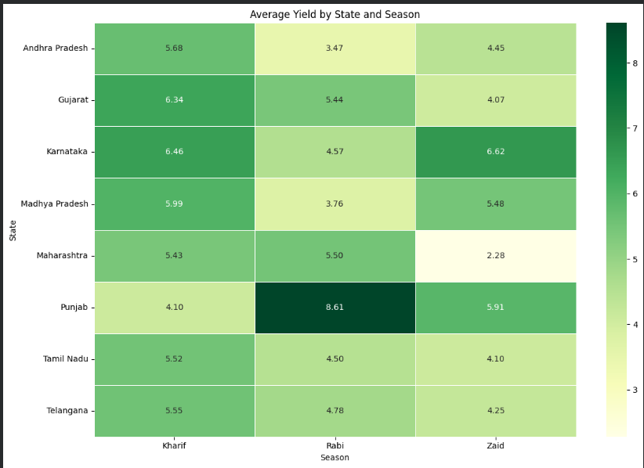
RESULTS
Finding:
Seasonal performance differs across states. For example, Punjab performs strongly in Rabi, while Karnataka performs strongly in Zaid, showing that seasonal patterns can vary by region.

Slide 11
Future scope
Build an interactive agricultural analytics dashboard.
Include more years of agricultural data for trend analysis.
Apply machine learning to predict crop yield and profitability.
Develop region-specific seasonal recommendations.
Analyze weather forecasts and real-time environmental data.
Improve resource and irrigation planning using predictive analytics.

Slide 12
GitHub Link
Varsha08-IT/Seasonal-Agriculture-Performance-Analysis: Data analytics project analyzing seasonal variations in agricultural performance, environmental conditions, resource usage, crop yield, and economic outcomes.

Slide 13

VOIS Course completion certificate -
Course name- Data Visualization

Slide 14
Thank you
.
.

