Slide 1



Employee Data Analysis using Excel
STUDENT NAME: VARSHA.K
REGISTER NO: 2213371036247
DEPARTMENT: B.COM(GENERAL)
COLLEGE: QUAID E MILLATH GOVT WOMEN’S COLLEGE
1

Slide 2

PROJECT TITLE
Employee Performance Analysis
using Excel
2

Slide 3


AGENDA
1.Problem Statement
2.Project Overview
3.End Users
4.Our Solution and Proposition
5.Dataset Description
6.Modelling Approach
7.Results and Discussion 8.Conclusion
3

Slide 4

PROBLEM STATEMENT
Wehavetotracktheperformanceofemployeesworkmotiveforthe organizationandSothatwecancompletelyfocusonthegrowthand structureoftheorganizationandalsotodeveloptheirpersonal
skillsandtalents.
Wehavetomotivatethebestandexecutiveemployeeswith increments,promotionandbonus
Wehavetotrainandmotivatetheunderdevelopedemployees andeffectivemannerwithproperspecifications.
4

Slide 5

PROJECT OVERVIEW
EMPLOYEEDATAANALYSIS
An a•lysingtheperformanceof the employees by considering the
Achievements, inorder toidentify the trends and patterns of
different
categoriesofemployees like high, medium and low.
various factorslikeGender,Performance score , Ratings and their
5

Slide 6


WHO ARE THE END USERS?
6

Slide 7


OUR SOLUTION AND ITS VALUE PROPOSITION
ONDITIONALFORMATTING–TOIDENTIFYTHEMISSING data
FILTER– FORTHEPURPOSEOFREMOVINGTHEUNWANTEDDATA.
FORMULA-FORIDENTIFYINGTHEPERFORMANCRETHEEMPLOYEES.
PIVOTTABLE-TOCONVERTTHEDATAINTOSHORTSUMMARY.GRAPH–
DATAVISUALIZATION
7

Slide 8
Dataset Description
EMPLOYEE=KAGGLE
26-FEATURES
9-FEATURES
EMPLOYEE– ID– NUMERICALVALUES.
NAME–TEXT
EMPLOYEETYPE
PERFORMANCELEVEL
GENDER– MALE,FEMALE
EMPLOYEERATING– NUMERICALVALUES

Slide 9

THE "WOW" IN OUR SOLUTION
PERFORMANCE LEVEL=IF(Z8>=5,
“VERY HIGH”, IF(Z8>=4, “HIGH”,
IF(Z8>=3, "MEDIUM", "LOW")))
3/21/2024 Annual Review
9

Slide 10
MODELLING
DATACOLLECTION
• DownloadedtheemployeedataperformancefromEDUNETDAS HBOARD
FEATURECOLLECTION
• IDENTIFIEDEACHFEATURE
DATACLEANING
• Identifiedthemissingvalues.
• Filteredthemissingvalues.
PERFORMANCELEVEL SUMMARY
• PIVOTTABLE
• PIECHART
• VISUALIZATION
• GRAPH
10

Slide 11

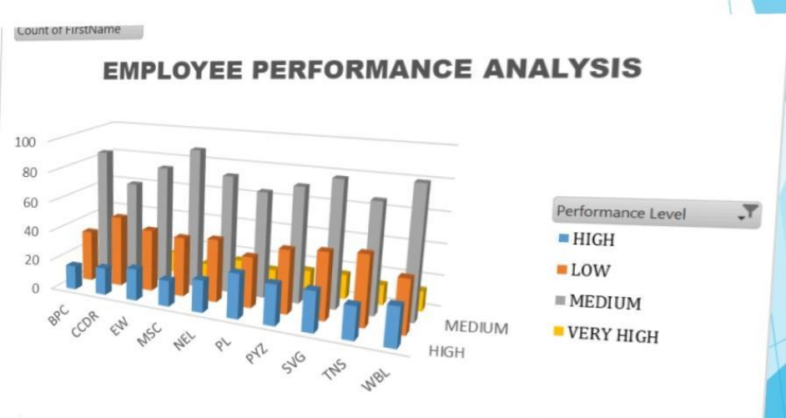
RESULTS
11

Slide 12


conclusion
EMPLOYEE PERFORMANCE ANALYSIS
BY COMPARINGTHE PERFORMANCE OF THE EMPLOYEES.THE EMPLOYEESARE
HIGHERIN NUMBER.THERE ARE MORE PEOPLE INAVERAGELEVEL EMPLOYEE
WE HAVE TO MOTIVAYE THE EMPLOYEES TO DEVELOP THEIR SKILLS AND TALENTS TO
ACHIEVE THE ORGANISATIONAL GOALS AND OBJECTIVES TO REACH THE PLACE
OF HIGH LEVEL PERFORMANCE TO SUSTAIN THE GOALS AND TARGETS.
WE HAVE TO TRAIN AND DEVELOP THE EMPLOYEES WITH BETTER OUT COME TO
REACH THE ORGANISATIONAL GOALS.

