Slide 1
A Nonlinear Regression Application via Machine Learning Techniques for Geomagnetic Data Reconstruction Processing
CSEMPBNUM_E09
Roll Number | Name
2210316548 | R.VARSHA
2210316565 | K.KEERTHANA
2210316557 | V.NEERAJ CHARY
2210316527 | K.SAI KIRAN REDDY

Slide 2
REQUIREMENTS
Anaconda - Jupyter Notebook
Knowledge in Python
Datasets

Slide 3
What are we doing ?
The integrity of geomagnetic data is a critical factor in understanding the evolutionary process of Earth’s magnetic field, as it provides useful information for near-surface exploration, unexploded explosive ordnance detection, and so on. Aimed to reconstruct undersampled geomagnetic data, this paper presents a geomagnetic data reconstruction approach based on machine learning techniques.
The traditional linear interpolation approaches are prone to time inefficiency and high labor cost, while the proposed approach has a significant improvement. In this paper, three classic machine learning models, support vector machine, random forests, and gradient boosting were built

Slide 4
Algorithms Used ->

Slide 5
Support Vector Machine
“Support Vector Machine” (SVM) is a supervised machine learning algorithm which can be used for both classification or regression challenges. However, it is mostly used in classification problems
In terms of its regression algorithm, it also contains all the main features that characterize the maximum margin algorithm

Slide 6
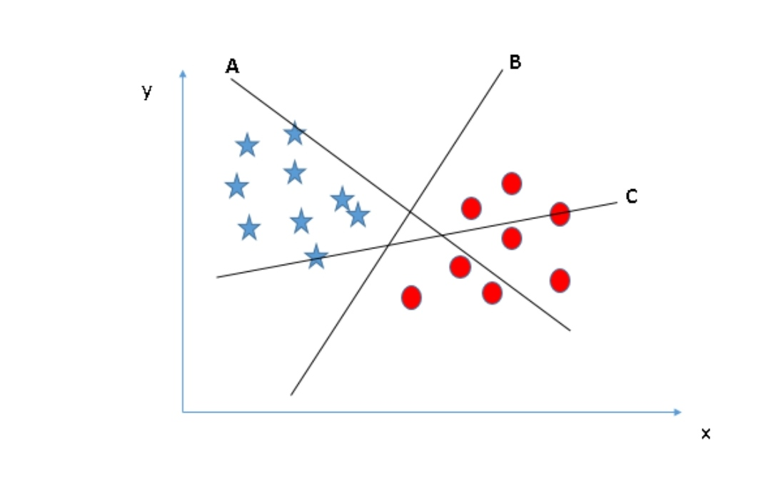
How does it work ?
Identify the right hyper-plane (Scenario-1):

Slide 7
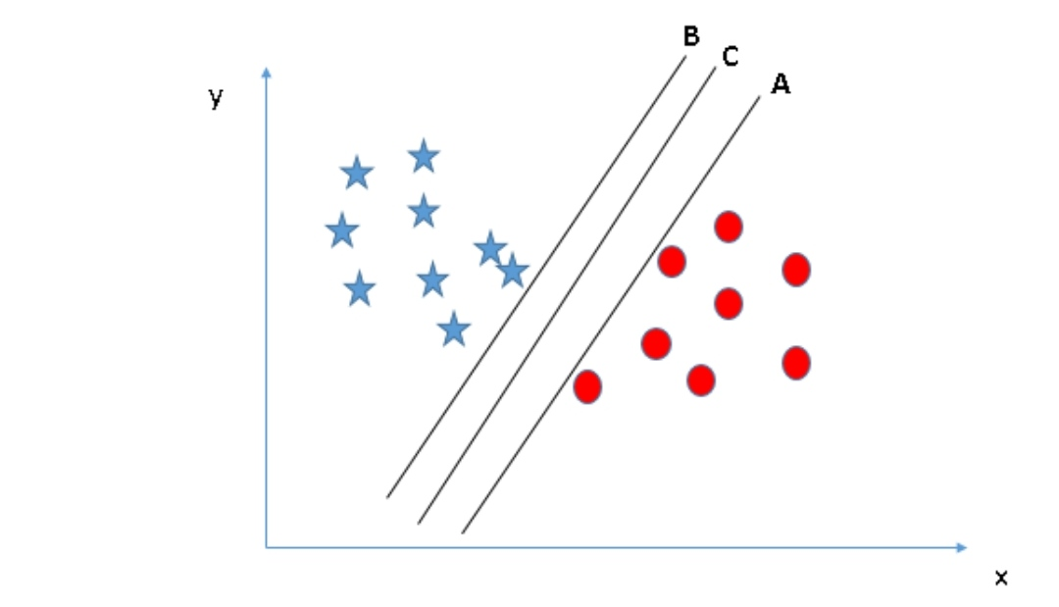
Continued...(1)
Identify the right hyper-plane (Scenario-2):

Slide 8
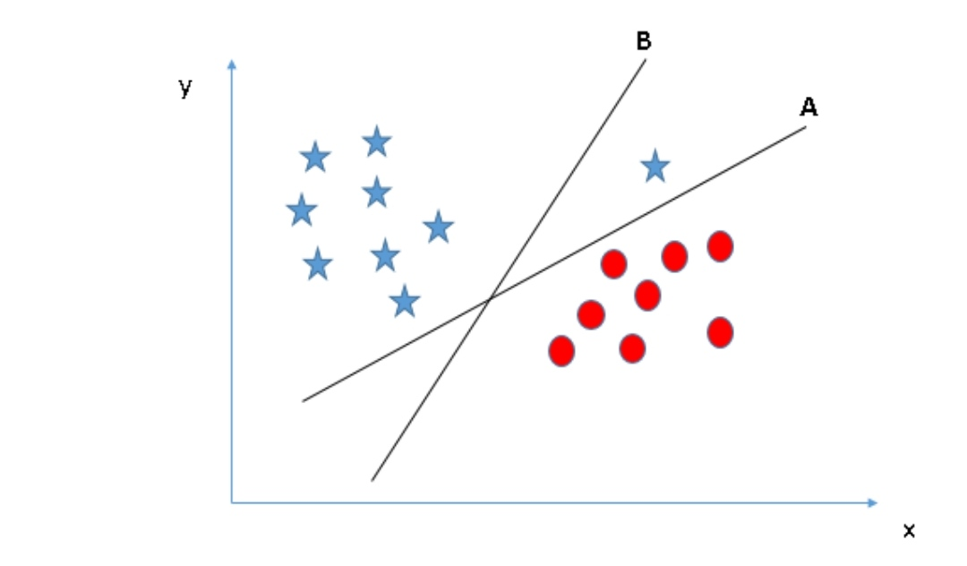
Continued...(2)
Identify the right hyper-plane (Scenario-3):

Slide 9
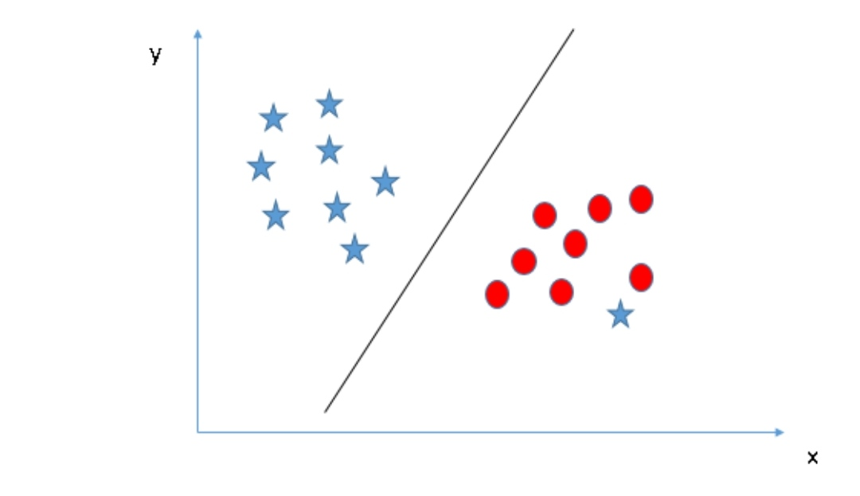
Continued...(3)
Can we classify two classes (Scenario-4)

Slide 10
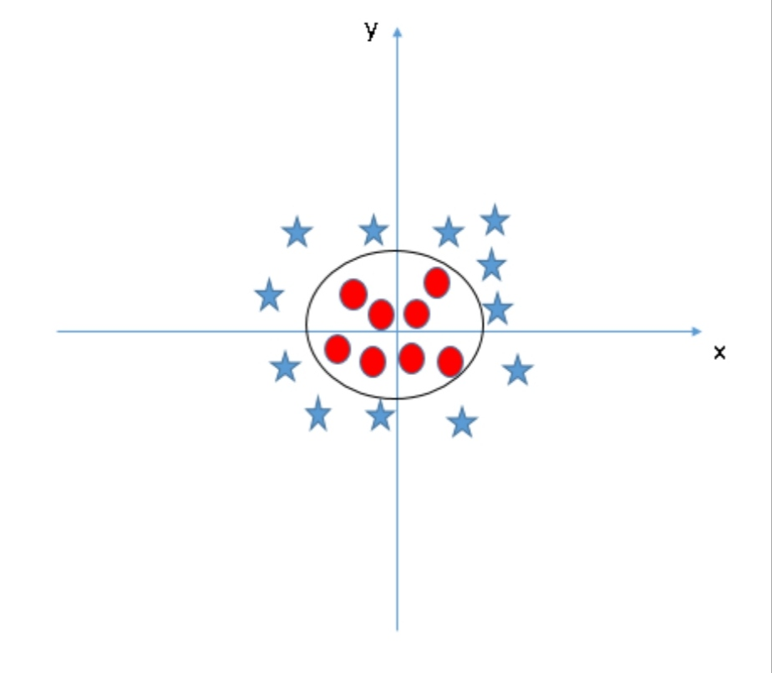
Continued...(4)
Find the hyper-plane to segregate to classes (Scenario-5):
kernel trick: It converts not separable problem to separable problem.

Slide 11
Random Forest Algorithm
Random forest is a supervised learning algorithm which is used for both classification as well as regression.
As we know that a forest is made up of trees and more trees means more robust forest. Similarly, random forest algorithm creates decision trees on data samples and then gets the prediction from each of them and finally selects the best solution by means of voting

Slide 12
How does it work ?
Step 1 − First, start with the selection of random samples from a given dataset.
Step 2 − Next, this algorithm will construct a decision tree for every sample. Then it will get the prediction result from every decision tree.
Step 3 − In this step, voting will be performed for every predicted result.
Step 4 − At last, select the most voted prediction result as the final prediction result.

Slide 13
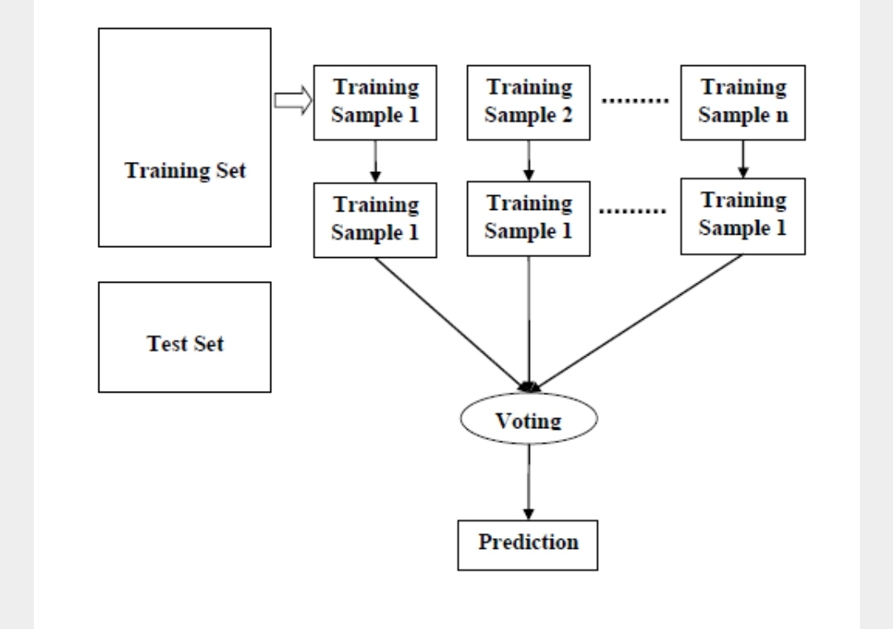

Slide 14
Gradient Boosting
The term ‘Boosting’ refers to a family of algorithms which converts weak learner to strong learners. Boosting is an ensemble method for improving the model predictions of any given learning algorithm. The idea of boosting is to train weak learners sequentially, each trying to correct its predecessor.
Gradient Boosting works by sequentially adding predictors to an ensemble, each one correcting its predecessor. However, instead of changing the weights for every incorrect classified observation at every iteration like AdaBoost, Gradient Boosting method tries to fit the new predictor to the residual errors made by the previous predictor.

Slide 15
Example scenario :
Assume, you are given a previous model M to improve on. Currently you observe that the model has an accuracy of 80% (any metric). How do you go further about it?
One simple way is to build an entirely different model using new set of input variables and trying better ensemble learners. On the contrary, I have a much simpler way to suggest. It goes like this:
Y = M(x) + error
error = G(x) + error2
error2 = H(x) + error3 //84%
Y = M(x) + G(x) + H(x) + error3
Y = alpha * M(x) + beta * G(x) + gamma * H(x) + error4 //above 84%

Slide 16
Linear interpolation
Linear interpolation is a form of interpolation, which involves the generation of new values based on an existing set of values. Linear interpolation is achieved by geometrically rendering a straight line between two adjacent points on a graph or plane. All points on the line other than the original two can be considered interpolated values.
Disadvantages:
Linear interpolation is quick and easy, but it is not very precise
The error is proportional to the square of the distance between the data points.

Slide 17
Up until next review:

Slide 18
THANK YOU

