Slide 1

HEALTHSCOPE: AN INTELLIGENT PUBLIC HEALTH
ANALYTICS AND RISK ASSESSMENT PLATFORM
Final Project Review | Department of CSE | KL University
TEAM MEMBERS
2420030331 – Varsha
2420030113 – Harshini
Guide: Dr.N.Sunanda | Academic Year: [2026–27]
Notes:
Title slide. Replace all bracketed text. Use the full project title, list every team member with registration number, and name your guide. Insert the institution logo in the dashed box.

Slide 2

Introduction & Problem Statement
Background
Public health datasets contain valuable information about health trends and population groups. Raw data often require cleaning, analysis and visualization before they become easy to interpret.
Problem Statement
Health information is spread across datasets and can be difficult for non-technical users to interpret. A connected workflow is needed to prepare, analyse and present population-level health insights.
Motivation / Need
Students, researchers and public-health stakeholders need accessible summaries and comparisons. HealthScope aims to make patterns easier to explore without presenting them as individual medical advice.
HEALTHSCOPE | CSE | FINAL PROJECT REVIEW
2

Slide 3
Objectives & Scope
01
Collect and prepare
02
Explore trends
Select documented public-health datasets and clean their records.
Summarize distributions, trends and differences across available groups.
03
Analyse relationships
04
Assess and present
Apply suitable statistical and correlation methods to selected health indicators.
Develop and evaluate a model only when the data support a defensible target; present findings in a dashboard.
Out of scope: individual diagnosis, treatment recommendations, and unsupported prediction claims.
HEALTHSCOPE | CSE | FINAL PROJECT REVIEW
3

Slide 4
Literature Survey
Author / Year | Method / System | Key finding | Limitation / Gap
Abhadiomhen et al. (2024) | Reviewed machine-learning approaches for health-risk assessment. | Reviewed 231 studies; highlighted reporting and validation concerns. | Concentrates on risk-assessment methods; HealthScope proposes combining risk assessment with broader data exploration and visualization.
Chandran & Roy (2024) | Reviewed GIS and spatial analysis applications in Indian health research. | Enables comparison of health indicators across local areas. | Concentrates on geographical analysis; HealthScope aims to connect it with data preparation and statistical analysis..
McClymont et al. (2024) | Reviewed internet-based infectious-disease surveillance, AI and early-warning systems. | Documents methods used to produce local estimates. | Focuses on infectious-disease surveillance rather than a wider range of public-health indicators.
Cuevas-Chávez et al. (2023) | Reviewed machine learning and IoT approaches for cardiovascular disease prediction and monitoring. | Shows application of ML to disease-specific risk prediction. | Focuses mainly on cardiovascular diseases rather than broader population-health analysis.
RESEARCH GAP
Rather than concentrating only on prediction, HealthScope connects data cleaning, analysis, comparison and visualization. It focuses on identifying patterns across regions and population groups, not diagnosing individual patients. It does not force machine learning into every dataset. It uses prediction only when a suitable target variable and sufficient data are available.
HEALTHSCOPE | CSE | FINAL PROJECT REVIEW
4

Slide 5
Proposed System & Methodology
1 DATA COLLECTION
2 PREPROCESSING
3 ANALYSIS
4 MODEL (IF SUITABLE)
5 DASHBOARD
Perform EDA, descriptive statistics and suitable correlation analysis.
Present summaries, comparisons, associations and model outputs where available.
Choose reliable, documented public datasets.
→
Inspect missing values, duplicates, formats and invalid entries.
→
→
Define target/features; train and evaluate only if data support prediction.
→
KEY CONTRIBUTION
Integration of multiple analytical stages in one reproducible workflow, with clear distinction between observed population data and model-generated estimates. The value must be assessed after implementation.
HEALTHSCOPE | CSE | FINAL PROJECT REVIEW
5

Slide 6
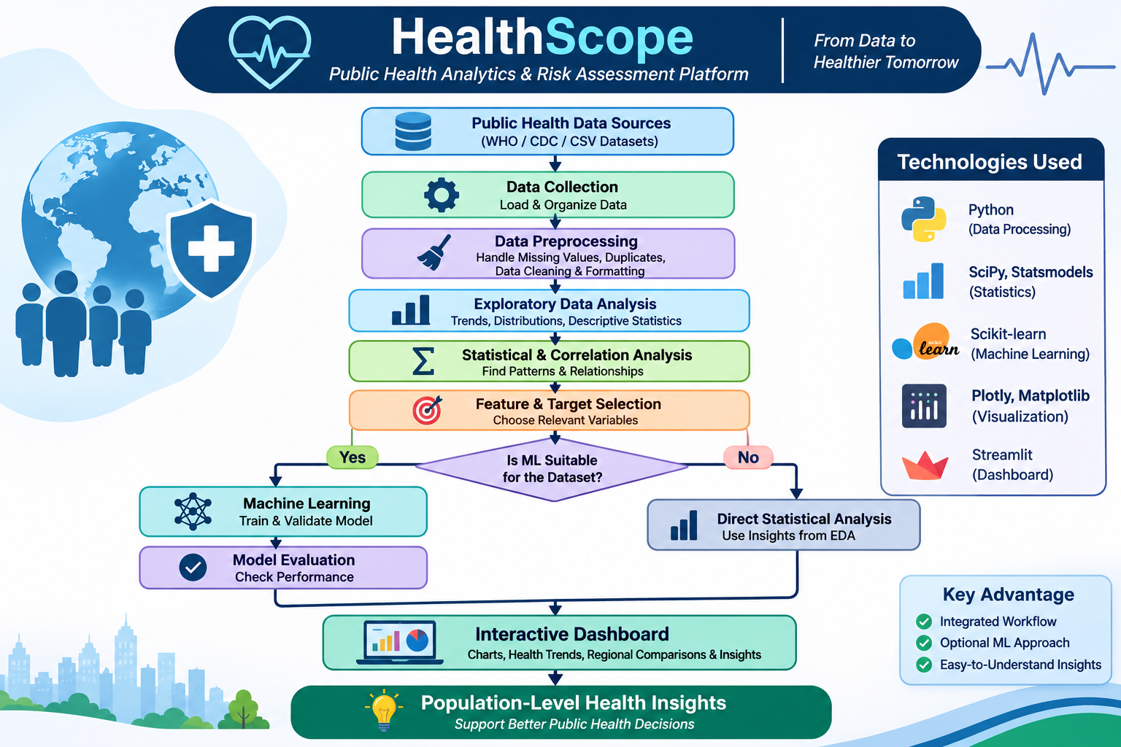
System Architecture
COMPONENTS
1. Data source: provides health indicators.
2. Preprocessing: improves data consistency.
3. Analysis: finds distributions and associations.
4. Dashboard: communicates outputs interactively.
Proposed stack: Python, Pandas, NumPy, SciPy / Statsmodels, Scikit-learn, Streamlit and Plotly / Matplotlib.
HEALTHSCOPE | CSE | FINAL PROJECT REVIEW
6

Slide 7
Hardware & Software Requirements
Hardware
Software & Tools
Libraries / Frameworks
• Computer / laptop
• Processor and RAM: to be recorded from actual system
• Storage: based on selected dataset
• Internet connection for public datasets
• Python
• IDE / notebook environment (actual choice to confirm)
• Git / GitHub, if used
• Operating system and versions to be recorded
Proposed tools in the paper:
• Pandas, NumPy
• SciPy or Statsmodels
• Scikit-learn
• Streamlit, Plotly or Matplotlib
Use only tools actually implemented.
HEALTHSCOPE | CSE | FINAL PROJECT REVIEW
7

Slide 8
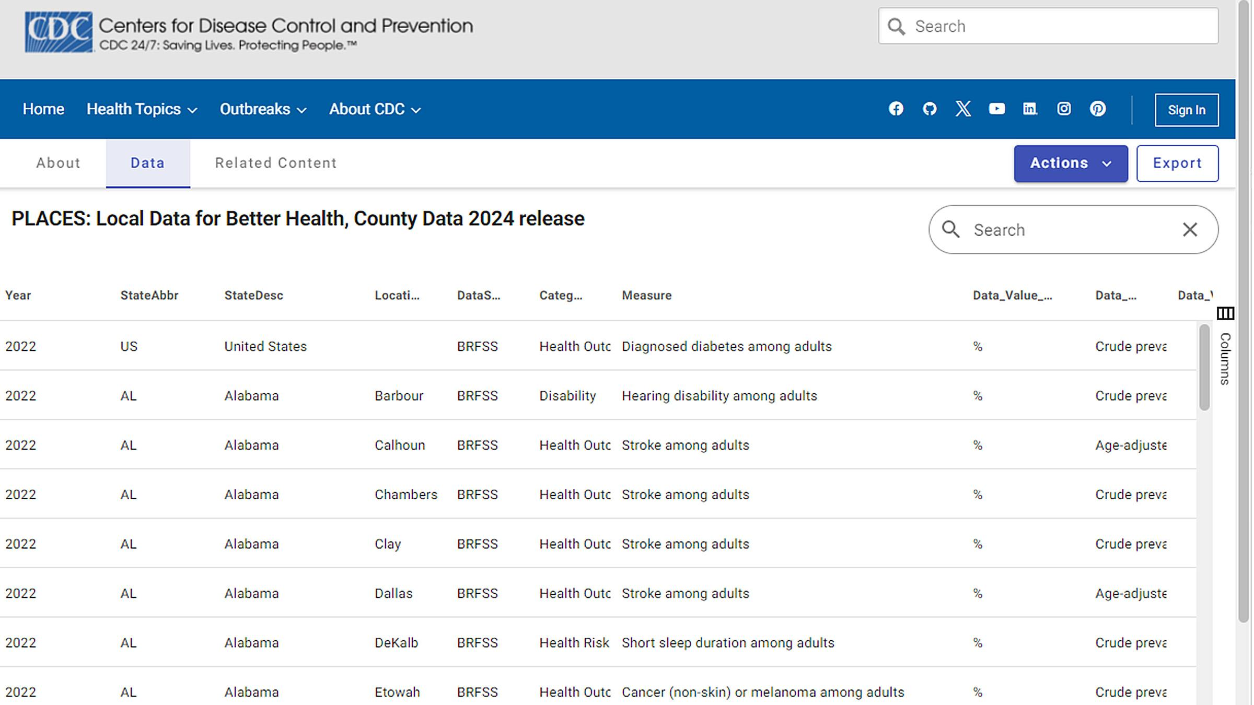
Dataset / Data Understanding
HEALTHSCOPE | CSE | FINAL PROJECT REVIEW
8

Slide 9
Data Preprocessing & Exploratory Analysis
Cleaning
Transformation
Feature Selection
Inspect missing values, duplicates, inconsistent formats, invalid entries and data types. Choose missing-value handling based on dataset characteristics.
Apply categorical encoding and numerical scaling only when required. Fit learned transformations on training data only during predictive modelling.
Choose relevant, non-redundant features. Define a defensible target and check for information leakage. If no target exists, use descriptive analysis.
Planned visualizations: histograms, bar charts, box plots, line charts and geographic comparisons. Actual plots are pending dataset analysis.
HEALTHSCOPE | CSE | FINAL PROJECT REVIEW
9

Slide 10
Module-wise Description
Data Collection & Validation
Preprocessing
Purpose: load documented public datasets.
Input → Output: raw data → selected dataset.
Owner: team allocation to confirm.
Purpose: inspect and clean data.
Input → Output: raw records → prepared dataset.
Owner: team allocation to confirm.
Analytics & Modelling
Dashboard & Evaluation
Purpose: EDA, statistics, correlations and optional ML.
Input → Output: prepared data → analytical results.
Owner: team allocation to confirm.
Purpose: present insights and test correctness.
Input → Output: results → interactive dashboard.
Owner: team allocation to confirm.
HEALTHSCOPE | CSE | FINAL PROJECT REVIEW
10

Slide 11
Algorithms & Technologies Used
Statistical Analysis
Machine Learning
Technology Stack
Pearson correlation: suitable for continuous variables with approximately linear relationships.
Spearman correlation: suitable for ranked data or monotonic relationships.
Classification candidates: Logistic Regression, Decision Tree and Random Forest.
Regression methods may be used for continuous targets.
Python; Pandas and NumPy; SciPy / Statsmodels; Scikit-learn; Streamlit; Plotly or Matplotlib.
Selection criteria: dataset suitability, target definition, validation design, interpretability and task-appropriate metrics.
HEALTHSCOPE | CSE | FINAL PROJECT REVIEW
11

Slide 12
Implementation / Model Building
• Feature selection: based on relevance, data quality and redundancy.
• Preprocessing: missing-value handling, encoding and scaling only as needed.
• Data splitting: train/test or cross-validation design to be selected for the final task.
• Configuration: model and hyperparameters depend on the chosen target and dataset.
• Leakage control: fit transformations and tune models using training data only.
PROPOSED PIPELINE (PSEUDOCODE)
load_public_health_data()
inspect_and_clean_data()
perform_eda_and_statistics()
if_valid_target_exists:
define_features_and_target()
train_and_validate_model()
build_interactive_dashboard()
HEALTHSCOPE | CSE | FINAL PROJECT REVIEW
12

Slide 13
Working Prototype / Output Screens
Dataset Overview
Health Trends
Analysis & Risk View
Planned screen: record counts, feature summary and data-quality indicators.
Planned screen: charts and filters for health indicators and population groups.
Planned screen: correlations and validated model output, only if supported by data.
SCREENSHOT TO ADD
SCREENSHOT TO ADD
SCREENSHOT TO ADD
The supplied paper describes a proposed dashboard; no prototype screenshots were included.
HEALTHSCOPE | CSE | FINAL PROJECT REVIEW
13

Slide 14
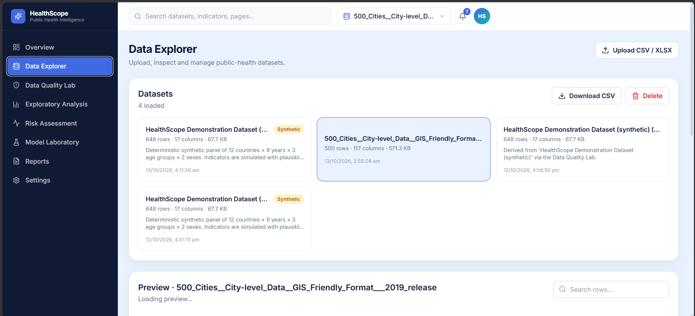
Working Prototype / Output Screens
HEALTHSCOPE | CSE | FINAL PROJECT REVIEW
13

Slide 15
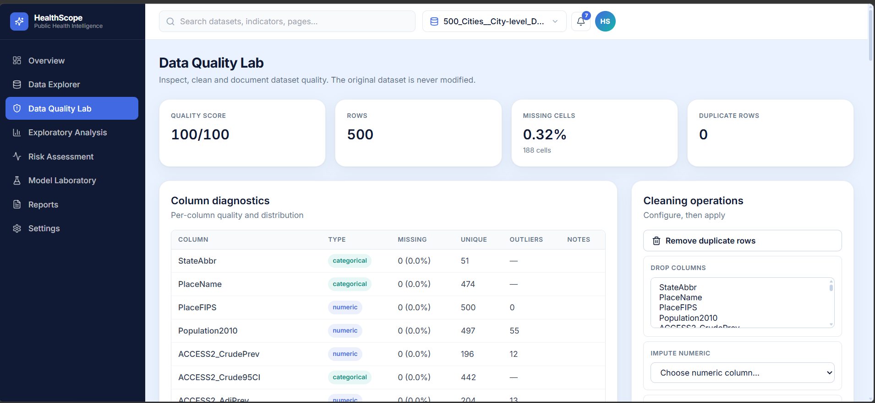
Working Prototype / Output Screens
HEALTHSCOPE | CSE | FINAL PROJECT REVIEW
13

Slide 16
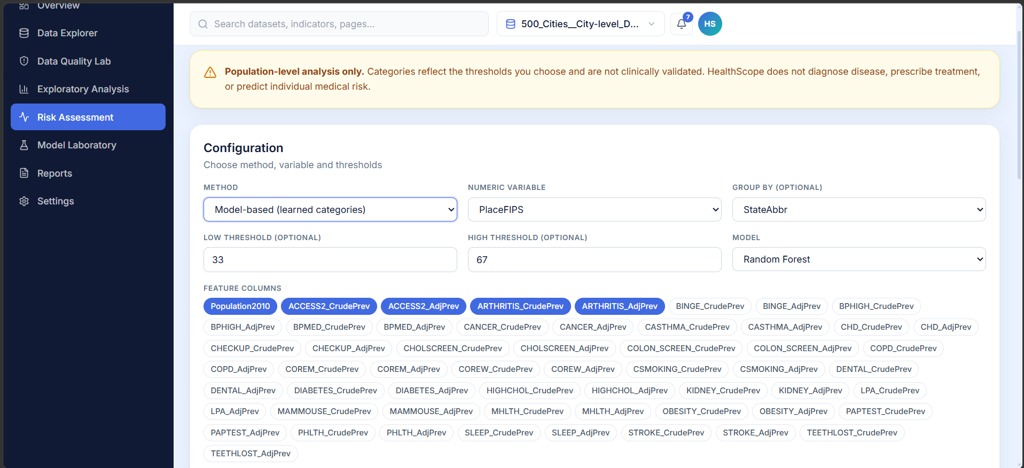
Working Prototype / Output Screens
HEALTHSCOPE | CSE | FINAL PROJECT REVIEW
13

Slide 17
Results & Performance Comparison
NO MEASURED RESULTS REPORTED IN THE SUPPLIED PAPER
Evaluation item | Status in current paper
Dataset size / features | 3,143 rows × 167 columns; 40 health measures
Model selected | Random Forest Classifier
Accuracy / Precision / Recall / F1 | Not available
ROC-AUC / Regression metrics | Not available
Baseline comparison | Not performed / not reported
HEALTHSCOPE | CSE | FINAL PROJECT REVIEW
14

Slide 18
Analysis & Key Findings
What can be analysed
Relationship analysis
Model interpretation
Distributions, unusual values, temporal patterns and differences between available population groups.
Pearson or Spearman correlation may identify associations. Correlation does not establish causation.
If a model is built, report task-appropriate metrics, calibration where relevant, and limitations.
HEALTHSCOPE | CSE | FINAL PROJECT REVIEW
15

Slide 19
Testing & Validation
Test ID | Test description | Expected result | Actual result | Status
TC-01 | Dataset loading | Selected dataset loads | Pending | Not run
TC-02 | Preprocessing | Documented cleaning is applied | Pending | Not run
TC-03 | Dashboard filters | Charts update consistently | Pending | Not run
TC-04 | Model evaluation (if applicable) | Metrics computed on held-out data | Pending | Not run
FUNCTIONAL TESTING
Planned: dataset loading, transformations, chart consistency and filter response.
VALIDATION
Use hold-out testing or cross-validation if supervised modelling is appropriate. Report actual results after tests.
HEALTHSCOPE | CSE | FINAL PROJECT REVIEW
16

Slide 20
Conclusion
Integrated workflow
HealthScope proposes data preparation, EDA, statistical analysis, optional ML and interactive visualization in one platform.
Responsible analytics
The methodology emphasizes transparent preprocessing, appropriate validation and clear communication of limitations.
Project value
Aims to make population-level health patterns easier to explore and communicate.
HEALTHSCOPE | CSE | FINAL PROJECT REVIEW
18

Slide 21
Future Scope & Applications
Improve Performance
Expand Data
Deploy & Scale
Tune suitable models, validate results and add calibration and explainability.
Add reliable health datasets and support time-series and geographic analysis.
Build dashboard deployment, automated refresh and stronger privacy and reliability controls.
POTENTIAL APPLICATIONS
• Exploring population health trends
• Comparing geographic and demographic groups
• Supporting research and public-health planning
Potential users: students, researchers and public-health stakeholders.
HEALTHSCOPE | CSE | FINAL PROJECT REVIEW
19

Slide 22
Team Contribution
Reg. No. | Name | Contribution / Role
2420030113 | Harshini S. R. | Research-paper co-author; specific module allocation not stated.
2420030331 | Varsha | Research-paper co-author; specific module allocation not stated.
— | Dr. N. Sunanda | Project Guide
HEALTHSCOPE | CSE | FINAL PROJECT REVIEW
20

Slide 23
References & Project Links
• [1] J. D. Morgenstern et al., “Predicting population health with machine learning: a scoping review,” BMJ Open, vol. 10, no. 10, e037860, 2020. doi: 10.1136/bmjopen-2020-037860.
• [2] Centers for Disease Control and Prevention, “About PLACES: Local Data for Better Health.” https://www.cdc.gov/places/about/
• [3] Centers for Disease Control and Prevention, “Methodology—PLACES: Local Data for Better Health.” https://www.cdc.gov/places/methodology/index.html
• [4] Z. Xie et al., “Building Risk Prediction Models for Type 2 Diabetes Using Machine Learning Techniques,” Preventing Chronic Disease, vol. 16, 2019. doi: 10.5888/pcd16.190109.
• [5] A. Rajkomar, J. Dean, and I. Kohane, “Machine Learning in Medicine,” New England Journal of Medicine, vol. 380, pp. 1347–1358, 2019. doi: 10.1056/NEJMra1814259.
• [6] World Health Organization, “Global Health Observatory.” https://www.who.int/data/gho
HEALTHSCOPE | CSE | FINAL PROJECT REVIEW
21

Slide 24
THANK YOU
2420030331 – Varsha
2420030113 – Harshini
Guide: Dr.N.Sunanda
Notes:
Leave this slide up during questions. Make sure every team member can answer questions about their own module.

