Slide 1

Environmental
Health Risk Assessment and Communication

Slide 2
Abstract
Background: Environment play major role in human life. In this assessment try to explain factors affect and how impact of air pollution in quality of life and public health. Further explained Chemical, physical hazard, environment, negative impacts on public health.
Location: Tennessee, Nashville, Davidson county. In which includes public health impacts, climate change considerations, real world issues and how deal with it. Additionally, health risk and ways climate change and policy and plan of government to cope with the air pollution, and communication plan.
Conclusion: Environment play crucial role in public health. There are many negative impacts of chemical, air, water, soil pollution on human health, but strategic communication policy and plan can reduce risk and improve quality of life.
Keywords: Climate change; air pollution, air quality, quality of life, ozone layer, county.

Slide 3
Definition:
Environmental health is the science and practice of preventing human illness and promoting well- being by identifying and evaluating environmental sources of hazardous agent and limiting exposures to hazardous physical, chemical, and biological agents in water, air, soil, food and other environmental aspects that may adversely affect human health. In other words, Environmental health consist of human health, including quality of life, that are determined by physical, social, biological and psychological factors in the environment. It also refers to the theory and practice of assessing, correcting, controlling, preventing, and evolving those factors in the environment that can potentially affect adversely the health of present and future generation.

Slide 4
Environmental factors and how it affects health:
Many aspects of the physical, social environment can affect
people’s health.
Physical environmental factors: The factors in the physical environment that are important to health includes harmful substances, such as air pollution or proximity to toxic sites access to various health-related resources for example, healthy or Unhealthy foods, recreational resources, medical care, community design and the build environment for instance, land use mix, stress connectivity, transportation system and so on.

Slide 5
The environment can affect health through physical exposures, such as air pollution in which solid and liquid droplets found in the air cause of cardiovascular and respiratory diseases. There are other negative impact on public health such as skin cancer, lung infection, and may contribute to the obesity and diabetes because for housing low-income community move into low-poverty areas experienced significant increasing weight and diabetes due to obesity may cause of high blood pressure.
In below figure, it clearly seen that health effects of pollution. Pollution has direct or indirect affect human health and cause of many health-related issues like cancer, infection, vascular diseases and many more.

Slide 6
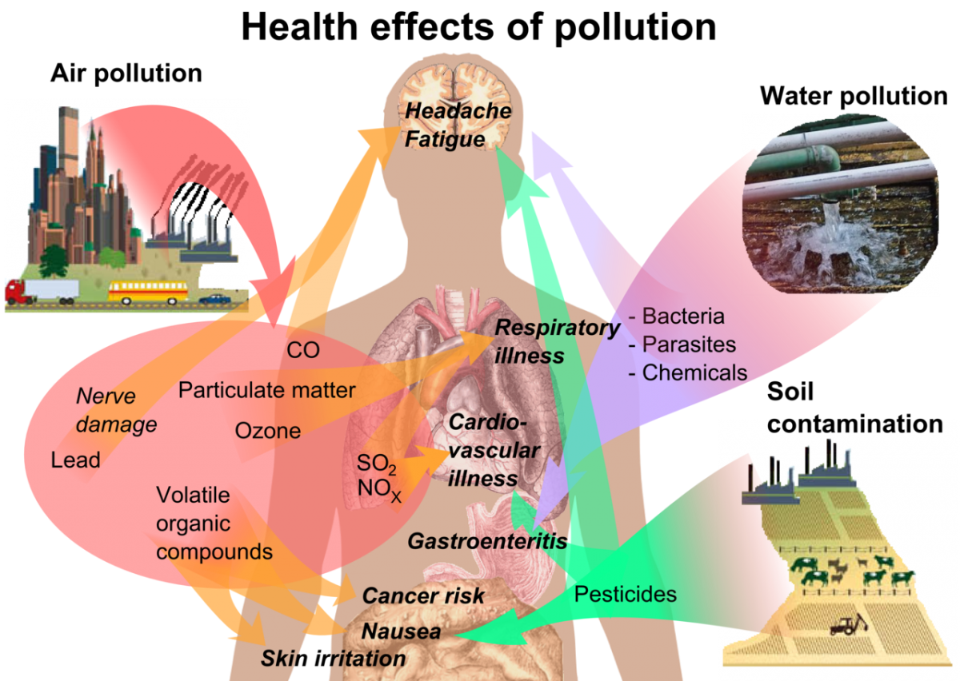

Slide 7
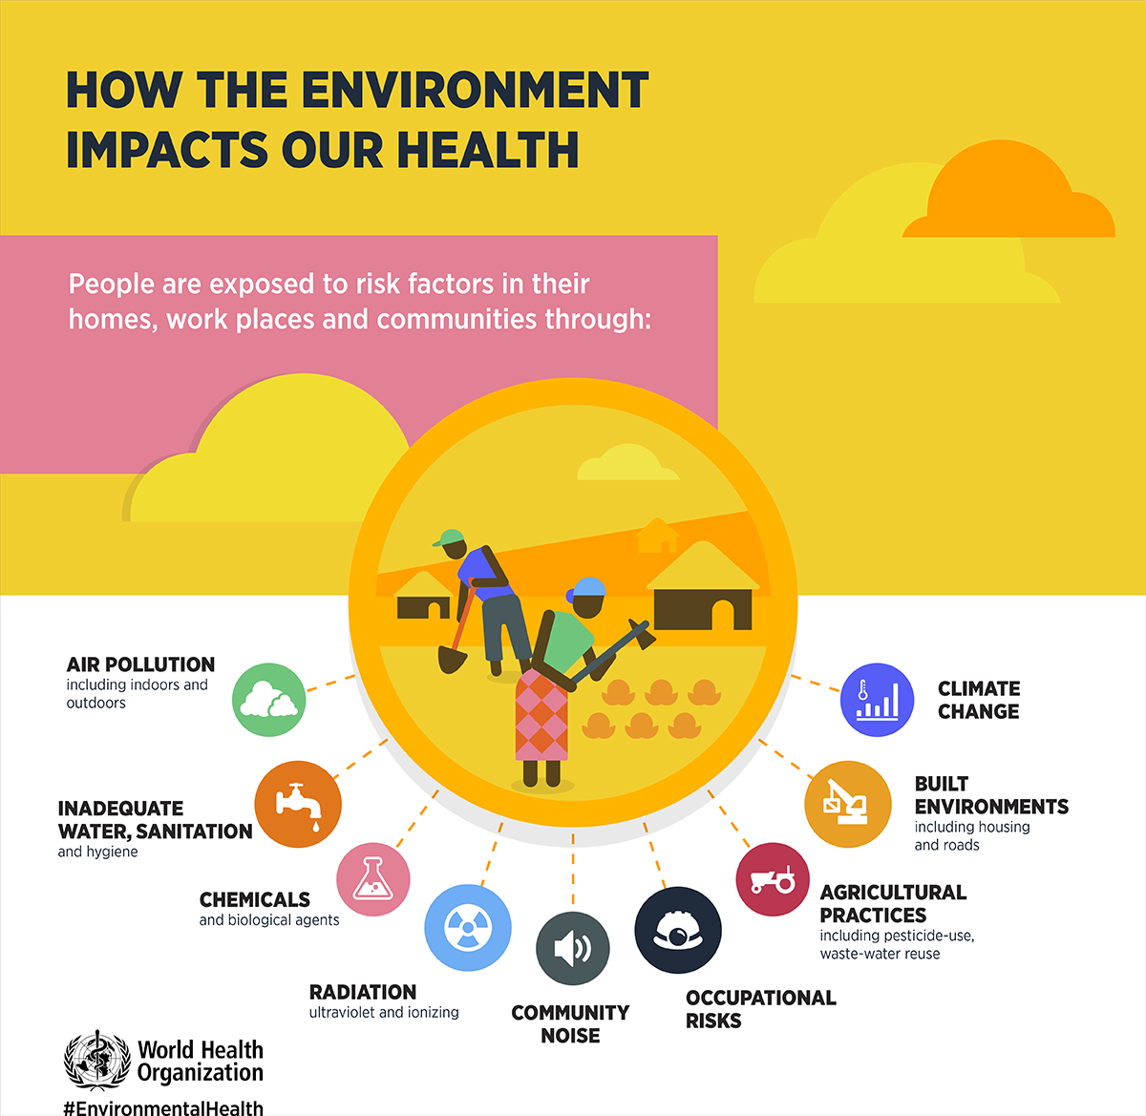
Social environmental factors: factors in social environment that are important to health includes safety, social disorder in general, and mainly related to the type, quality and stability of social connection and networks. A network of social relationships is an important source of support and appears to be an important influence on health issues for example neighborhood or work environmental conditions can create stress including safety and social disorder which leads to mental health and physical health.

Slide 8
Location: Tennessee (Nashville, davidson) Nashville is in attainment for the U.S. Environmental Protection Agency’s (EPA’s) most rigorous air pollution standards: short-term ozone, short-term PM2.5, and annual PM2.5. The capital city of Tennessee, however, has not always met these standards. It wasn’t until 2007 that Nashville finally met short-term and annual PM2.5 standards, and 2013 that Nashville met ozone standards. Moreover, during the most recent 2017 to 2019 monitoring period, levels for both annual PM2.5 and daily ozone remained near the governing threshold, indicating that increased emissions from population growth or climate-change derived wildfires could cause Nashville air quality to exceed federal standards in the future.

Slide 9
Nashville ranked as the 387th most polluted city in the United States (out of 1518 cities) in 2019, thus falling within the top 25 percentile of polluted U.S. cities. Still, the capital city is not the most polluted city in Tennessee; rather it falls 7th in the state behind:
Red Bank air quality: 13.5 μ g/m3 *
Farragut air quality:12.9 μ g/m3 *
Chattanooga air quality:12.4 μ g/m3 *
Goodlettsville air quality:12.0 μ g/m3 *
Knoxville air quality:10.2 μ g/m3 *
Athens air quality: 10.0 μ g/m3
* Above the World Health Organization target for average annual PM2.5 of 10 μg/m3

Slide 10
Nashville(Davidson county): Primary causes of air pollution, air quality is expected to improve or deteriorate and plan accordingly.
While air pollution trends are indicative, air quality can be difficult to predict. In the summer months, high temperatures and stagnant air combine to increase the prevalence and longevity of ambient air pollutants. Ozone is the primary threat during these months, often reaching “moderate” to “unhealthy” levels for hours at a time. In the Winter months wood burning, increased car idling, and cool air inversions, weather conditions that trap air pollutants in the lower atmosphere.

Slide 11
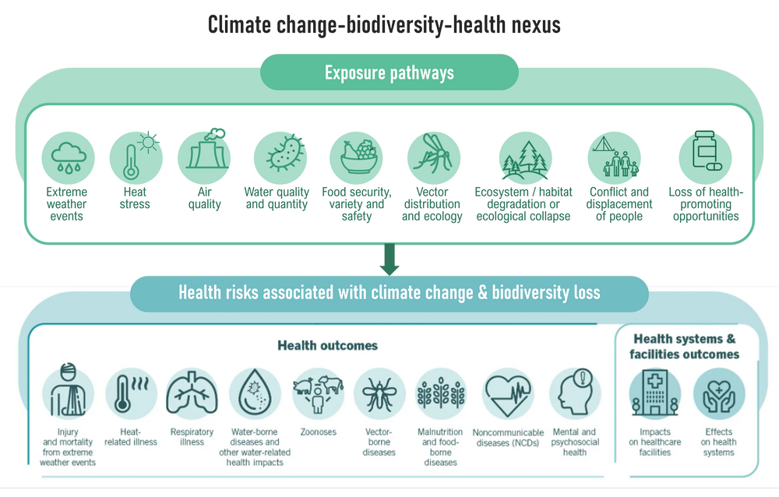
In this figure clearly shows that how climate change affects directly human health.

Slide 12
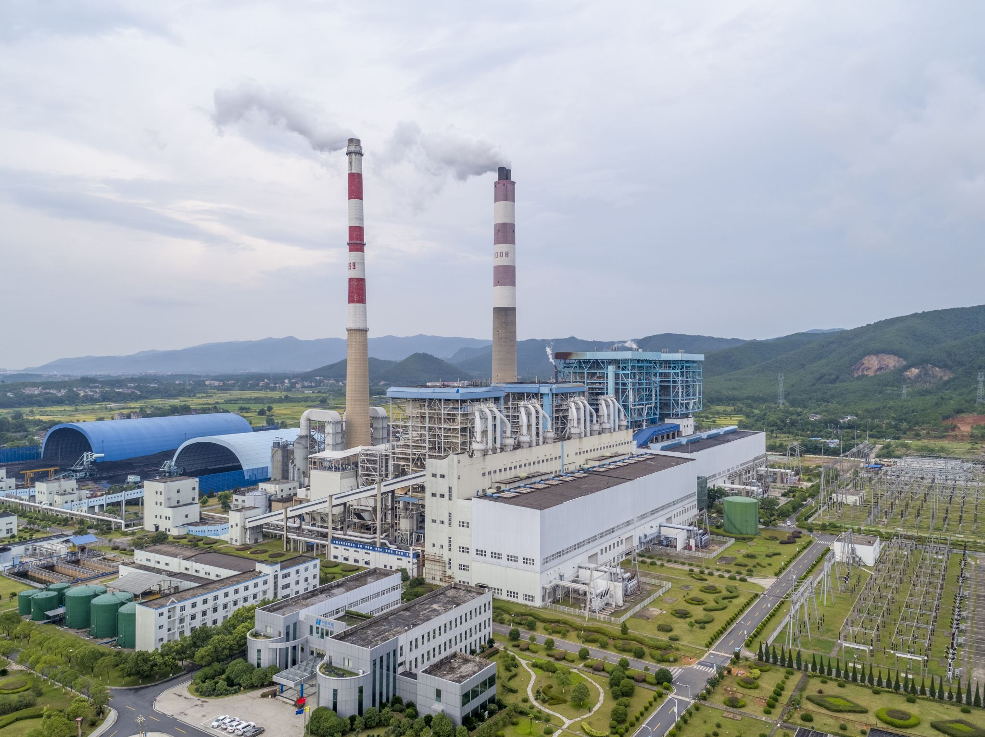
Factory farming can create a range of pollution problems, fragmenting and even destroying natural habitats. This can drive out or even kill the animals and plants that inhabit them. The range of wastes from factory farms can be particularly problematic, leaking into water courses and, in the worst cases, leaving vast "dead zones", where few species can survive. Some of the nitrogen will also become gaseous, turning into ammonia, for instance, which creates problems such as water acidification and ozone layer depletion. factory farming produces substantial greenhouse gas emissions - 14.5% of our total emissions in fact, which is more than the global transport sector. These emissions are intensifying climate change and making certain habitats increasingly hostile to live in. According to the Convention on Biological Diversity, climate change may affect plant growth and production by promoting the spread of pests and diseases, increasing exposure to heat stress and changing rainfall patterns, and encouraging soil erosion due to stronger winds.
Below there is table shows detail of county and comparison with different county of Tennessee, Nashville.

Slide 13
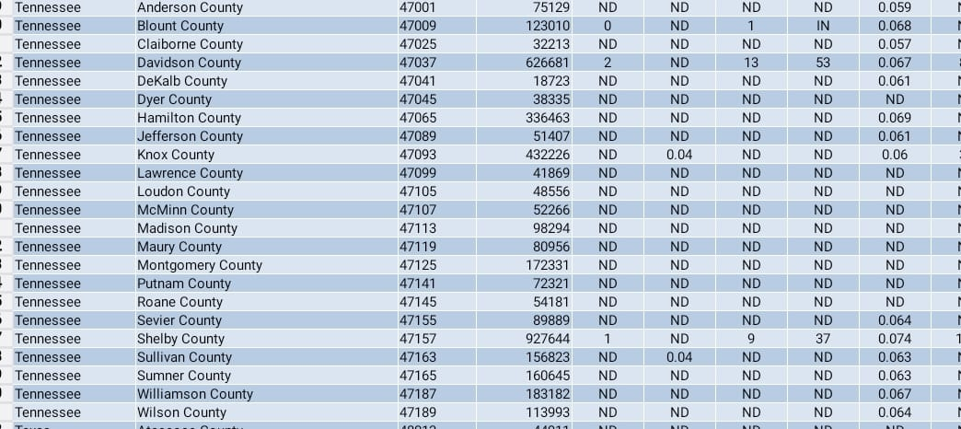

Slide 14
Environmental Scouts aims to inspire our youth to be leaders in their own communities by building a dynamic, real-life educational curriculum and spreading awareness. This type of knowledge is not gained solely through books. It is primarily from seeing what others have done, identifying what improvements can be made in your own current life situation, and finding ways to get involved. Environmental Scouts is a shared platform for environmental movements across various sectors. As we know it, life on Earth is interconnected, a delicate balance. We cannot separate out which environmental issue is more important than the other. Global Warming, Plastic Pollution, Extinction, threats to Biodiversity, Social Justice – like clean air, water, land/communities, energy, food, the wild – are all equally important components in our delicate ecosystem that are tightly interwoven.

Slide 15
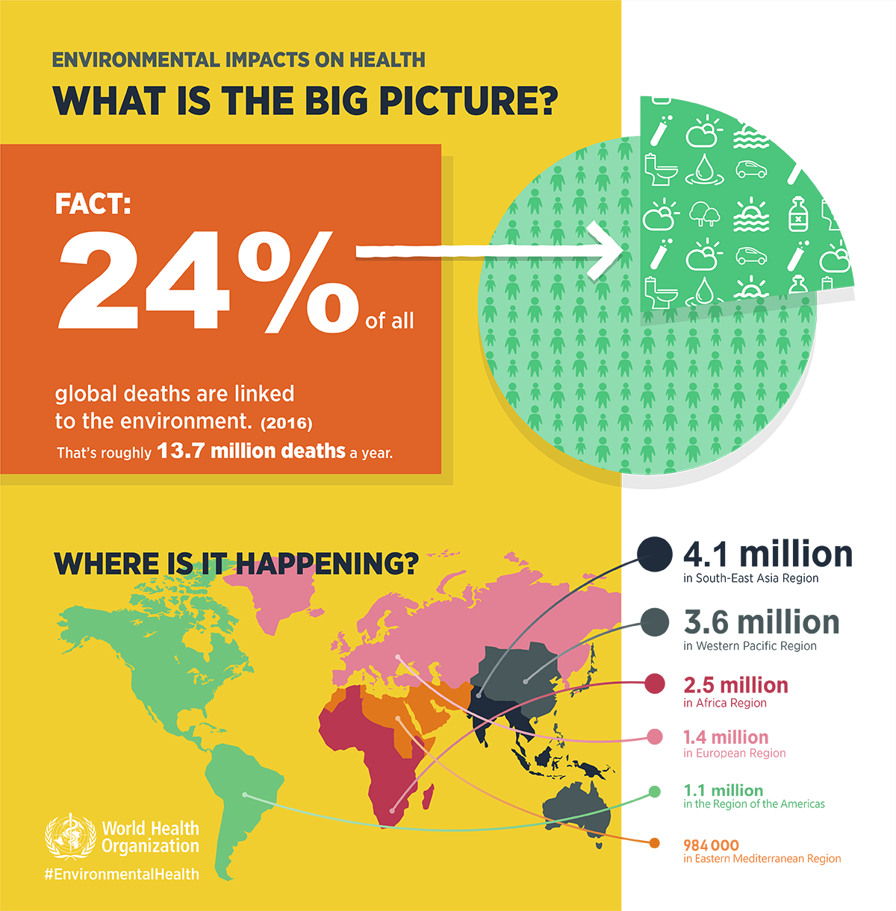

Slide 16
Air Pollution Control
The Division of Air Pollution Control is directed to maintain the purity of the air resources of the State of Tennessee consistent with the protection of normal health, general welfare, and physical property of the people while preserving maximum employment and enhancing the industrial development of the State.
The Division directly serves 91 counties within the state and oversees and assists in the actions of Davidson, Hamilton, Knox, and Shelby counties, which have their own local air pollution control programs.
The Division establishes emission standards and procedure requirements to monitor industries in the State through the issuance of construction and operating permits. Established to carry out control and abatement of air pollution, the Tennessee Air Pollution Control Board adopts regulations, holds hearings, and initiates court actions to enforce regulations. Division staff function as the administrative agency of the Board.

Slide 17
Office of Policy & Planning, department of environmental and conservation:
TDEC’s Office of Policy & Planning (OPP) provides research, analysis, and strategic support to further the Department’s purpose to enhance the quality of life for Tennessee citizens and the natural environment. OPP accomplishes this mission through:
Leading research into multi-disciplinary policy topics and developing deliverables for internal and external audiences;
Establishing and implementing departmental strategic planning initiatives;
Coordinating Departmental comments on proposed projects or policy actions that impact the Department and/or the State;
Supporting Environmental Justice efforts; and
Ensuring TDEC and its contractors and subrecipients are aware of the provisions of and responsibilities associated with the Title VI of the Civil Rights Act of 1964.

Slide 18
Environmental Policy:
The Department is continually preparing for and responding to a variety of complex issues and challenges when it comes to safeguarding human health, protecting the environment, conserving natural resources and managing an award-winning state park system for Tennessee. Our office assists in this endeavor by examining legacy, current and emerging issues that cut across environmental media, the Department's divisions and programs, geographic locations, and political jurisdictions. Through independent and comprehensive research and analysis, our office provides option alternatives and policy recommendations for the Department.

Slide 19
Air pollution control program:
This program is responsible for promoting the physical health and welfare of the public by protecting and enhancing the quality of the ambient air in Nashville (Davidson County), Tennessee. Specific responsibilities of the program include:
Inspecting potential sources of air pollution and evaluating that these sources are operating in compliance, or are brought into compliance, with all applicable air pollution regulations.
Evaluating air pollution permit applications and issuing construction permits to new and modified sources. Operating permits are issued to those sources that are operating in compliance with the applicable air pollution regulations or to those that are on an approved compliance schedule.
Preparing a comprehensive annual air pollution emissions inventory including criteria and toxic air pollutants emitted from permitted facilities as well as other significant area and mobile sources.
Responding to complaints from the public regarding ambient air pollution as well as indoor air quality.
Operating an ambient monitoring network across Davidson County monitoring for the following criteria air pollutants:
  PM10 (particulate matter less than 10 microns in diameter)
  PM2.5 (particulate matter less than 2.5 microns in diameter)
  Sulfur dioxide
  Nitrogen dioxide
  Carbon monoxide
  Ozone
The Air Quality Index is reported daily based on monitored levels of the criteria air pollutants. The Pollen Count is reported daily from March 1 until a killing frost in the fall.

Slide 20
References
Atkinson RWet al. (2012a). Systematic review and meta-analysis of epidemiological time-series studies on outdoor air pollution and health in Asia. Air Quality, Atmosphere & Health.
Atkinson RWet al. (2012b). Concentration–response function for ozone and daily mortality: results from five urban and five rural U.K. populations. Environmental Health Perspectives.
Atkinson RWet al. (2013). Long-term exposure to outdoor air pollution and incidence of cardiovascular diseases. Epidemiology.
Bahreini Ret al. (2012). Gasoline emissions dominate over diesel in formation of secondary organic aerosol mass. Geophysical Research Letters, 39(6):L06805:1-6 (http://www​.nserc.und​.edu/learning/Bahreini-2012.pdf, accessed 28 February 2013).

Slide 21
Baïz Net al. (2011). Maternal exposure to air pollution before and during pregnancy related to changes in newborn’s cord blood lymphocyte subpopulations. The EDEN study cohort. BMC Pregnancy and Childbirth.
Beckerman BSet al. (2012). The association between chronic exposure to traffic-related air pollution and ischemic heart disease. Journal of Toxicology and Environmental Health.
d’Ischia Met al. (2011). Secondary targets of nitrite-derived reactive nitrogen species: nitrosation/nitration pathways, antioxidant defense mechanisms and toxicological implications. Chemical Research in Toxicology.
Dimitrios Ket al. (2009).Exposure to multiple air contaminants in public buildings, schools and kindergartens – the European Indoor Air Monitoring and Exposure Assessment (AIRMEX) Study. Fresenius Environmental Bulletin.
d’Ischia Met al. (2011). Secondary targets of nitrite-derived reactive nitrogen species: nitrosation/nitration pathways, antioxidant defense mechanisms and toxicological implications. Chemical Research in Toxicology.

Slide 22
EPA (2006). Air Quality Criteria for Ozone and Related Photochemical Oxidants (2006 Final) [web site]. Washington, DC, United States Environmental Protection Agency (http://cfpub​.epa.gov​/ncea/cfm/recordisplay.cfm?deid=149923, accessed 5 April 2013).
Fischer PHet al. (2011). Trends in relative risk estimates for the association between air pollution and mortality in The Netherlands, 1992–2006. Environmental Research.
Gilbert NLet al. (2003). Ambient nitrogen dioxide and distance from a major highway. Science of the Total
Environment.
Wisthaler A, Weschler CJet al (2010). Reactions of ozone with human skin lipids: sources of carbonyls, dicarbonyls, and hydroxycarbonyls in indoor air. Proceedings of the National Academy of Sciences of the United States of America.
Witten Aet al. (2005). Effects of nitrogen dioxide on allergic airway responses in subjects with asthma. Journal of Occupational and Environmental Medicine.
Wolkoff Pet al. (2008). Acute airway effects of ozone-initiated d-limonene chemistry: importance of gaseous products.
Zuurbier Met al. (2010). Commuters’ exposure to particulate matter air pollution is affected by mode of transport, fuel type, and route. Environmental Health Perspectives.
Zuurbier Met al. (2011a). Respiratory effects of commuters’ exposure to air pollution in traffic. Epidemiology.

