Slide 1
UNIT-2

Slide 2
Introduction
Cryptology: science of encryption; combines cryptography and cryptanalysis.
Cryptography: process of making and using codes to secure transmission of information.
Cryptanalysis: process of obtaining original message from encrypted message without knowing algorithms.
Encryption: converting original message into a form unreadable by unauthorized individuals.
Decryption: the process of converting the ciphertext message back into plaintext.
Notes:
Cryptography and Encryption-Based Solutions
Although not a specific application or security tool, encryption represents a sophisticated approach to security that is implemented in many security systems.
In fact, many security-related tools use embedded encryption technologies to protect sensitive information handled by the application.
Encryption is the process of converting an original message into a form that is unreadable by unauthorized individuals, that is, anyone without the tools to convert the encrypted message back to its original format.
The science of encryption, known as cryptology, encompasses cryptography, from the Greek words kryptos, meaning hidden; graphein, meaning to write; and cryptanalysis, the process of obtaining the original message (or plaintext) from an encrypted message (or ciphertext), without the knowledge of the algorithms and keys used to perform the encryption.

Slide 3
Foundations of Cryptology
Cryptology has a long and multicultural history.
With emergence of technology, need for encryption in information technology environment greatly increased.
All popular Web browsers use built-in encryption features for secure e-commerce applications.
Notes:
Encryption Definitions
Algorithm: The mathematical formula used to convert an unencrypted message into an encrypted message.
Cipher: The transformation of the individual components (characters, bytes, or bits) of an unencrypted message into encrypted components.
Ciphertext or cryptogram: The unintelligible encrypted or encoded message resulting from an encryption.
Code: The transformation of the larger components (words or phrases) of an unencrypted message into encrypted components.
Cryptosystem: The set of transformations necessary to convert an unencrypted message into an encrypted message.
Decipher: To decrypt or convert ciphertext to plaintext.
Encipher: To encrypt or convert plaintext to ciphertext.
Key or cryptovariable: The information used in conjunction with the algorithm to create ciphertext from plaintext.
Keyspace: The entire range of values that can possibly be used to construct an individual key.
Link encryption: A series of encryptions and decryptions between a number of systems, whereby each node decrypts the message sent to it and then reencrypts it using different keys and sends it to the next neighbor, until it reaches the final destination.
Plaintext: The original unencrypted message that is encrypted and results from successful decryption.
Steganography: The process of hiding messages in a picture or graphic.
Work factor: The amount of effort (usually in hours) required to perform cryptanalysis on an encoded message.

Slide 4
Cryptography
Cryptography
  Original meaning: the art of secret writing.
  Send information in a way that prevents others from reading it.
  Other services:
    Integrity checking.
    Authentication.
  Process data into unintelligible form, reversible, without data loss.

Slide 5
Encryption/Decryption
encryption
decryption
plaintext
ciphertext
plaintext
Plaintext: a message in its original form.
Ciphertext: a message in the transformed, unrecognized form.
Encryption: the process for producing ciphertext from plaintext.
Decryption: the reverse of encryption.
Key: a secret value used to control encryption/decryption.

Slide 6
Terminology
Algorithm.
Cipher or cryptosystem.
Cipher text or cryptogram.
Code.
Decipher.
Encipher.
Key or crypto variable.
Key space.
Link encryption.
Plaintext or clear text.
Steganography.
work factor.

Slide 7
Cipher Methods
Plaintext can be encrypted through bit stream or block cipher method.
Bit stream: each plaintext bit transformed into cipher bit one bit at a time.
Block cipher: message divided into blocks (e.g., sets of 8- or 16-bit blocks) and each is transformed into encrypted block of cipher bits using algorithm and key.
Bit stream methods commonly use algorithm functions like the exclusive OR operation(XOR).
Block method can use substitution method, transposition, XOR or some combination of these operations.
Notes:
Cryptography and Encryption-Based Solutions
The notation used to describe the encryption process differs depending on the source.
The first uses the letters M to represent the original message, C to represent the ending ciphertext, and E to represent the encryption process: E(M) = C.
This formula represents the application of encryption to a message to create ciphertext. D represents the decryption or deciphering process, thus D[E(M)]=M.
K is used to represent the key, thus E(M, K) = C, or encrypting the message with the key results in the ciphertext.
Now look at a simple form of encryption based on two concepts: the block cipher and the exclusive OR operation.
With the block cipher method, the message is divided into blocks, i.e., 8- or 16-bit blocks, and then each block is transformed using the algorithm and key.
The exclusive OR operation (XOR) is a function of Boolean algebra whereby two bits are compared, and if the two bits are identical, the result is a binary 0. If the two bits are NOT the same, the result is a binary 1.

Slide 8
1.Substitution Cipher
Substitute one value for another.
Monoalphabetic substitution: uses only one alphabet.
Polyalphabetic substitution: more advanced; uses two or more alphabets.
Vigenère cipher: advanced cipher type that uses simple polyalphabetic code; made up of 26 distinct cipher alphabets.
Notes:
Encryption Operations
In encryption, the most commonly used algorithms include two functions: substitution and transposition.
In a substitution cipher, you substitute one value for another.
This is a simple enough method by itself but very powerful if combined with other operations. This type of substitution is based on a monoalphabetic substitution, since it only uses one alphabet.
More advanced substitution ciphers use two or more alphabets and are referred to as polyalphabetic substitutions.
Caesar reportedly used a three-value shift to the right, giving that particular substitution cipher his name–the “Caesar Cipher.”
Just like the substitution operation, the transposition cipher is simple to understand but can be complex to decipher if properly used.
Unlike the substitution cipher, the transposition cipher (or permutation cipher) simply rearranges the values within a block to create the ciphertext.
This can be done at the bit level or at the byte (character) level.
Transposition ciphers move these bits or bytes to another location in the block, so that bit 1 becomes bit 4, bit 2 becomes bit 7, etc.

Slide 9

Table 8-2 The Vigenère Square

Slide 10
2.Transposition Cipher
Easy to understand, but if properly used, produces ciphertext that is difficult to decipher.
Rearranges values within a block to create ciphertext.
Can be done at the bit level or at the byte (character) level.
To make the encryption even stronger, the keys and block sizes can be made much larger.
Simple transposition.
Rail fence cipher.
Route cipher.
Notes:
Transposition Cipher Method
The transposition cipher (or permutation cipher) simply rearranges the values within a block to create the ciphertext
This can be done at the bit level or at the byte (character) level. Transposition ciphers move these bits or bytes to another location in the block, so that bit 1 becomes bit 4, bit 2 becomes bit, 7 etc.

Slide 11
3.Exclusive OR (XOR)
Function of Boolean algebra; two bits are compared
  If two bits are identical, result is binary 0.
  If two bits not identical, result is binary 1.
A very simple symmetric cipher that is used in many applications where security is not a defined requirement.

Slide 12

Table 8-3 XOR Truth Table

Slide 13
4.Vernam Cipher
Developed at AT&T(American Telephone & Telegraph Company).
Uses set of characters once per encryption process.
To perform:
  The pad values are added to numeric values that represent the plaintext that needs to be encrypted.
  Each character of the plaintext is turned into a number and a pad value for that position is added.
  The resulting sum for that character is then converted back to a ciphertext letter for transmission.
  If the sum of the two values exceeds 26, then 26 is subtracted from the total.
Notes:
Vernam Cipher
Also known as the one-time pad, the Vernam cipher was developed at AT&T and uses a one-use set of characters, the value of which is added to the block of text.
The resulting sum is then converted to text.
When the two are added, if the values exceed 26, 26 is subtracted from the total (Modulo 26). The corresponding results are then converted back to text.

Slide 14
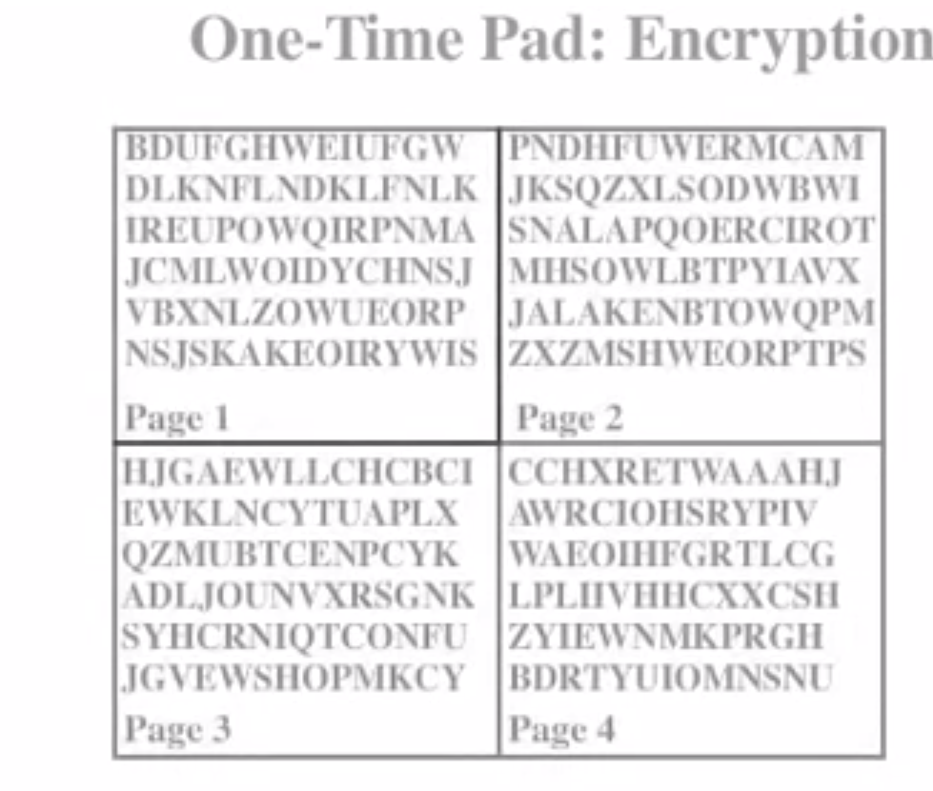

Slide 15
5.Book or Running Key Cipher
Uses text in book as key to decrypt a message.
Ciphertext contains codes representing page, line, and word numbers.
Algorithm is the mechanical process of:
  Looking up the references from the ciphertext.
  Converting each reference to a word by using the ciphertext’s value and the key.
Typical sources are dictionaries and thesauruses.

Slide 16
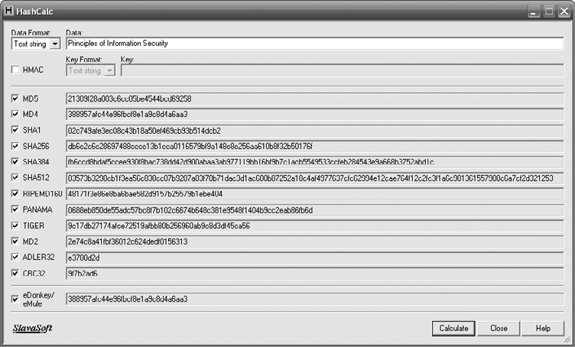
Figure 8-4 Various Hash Values

Slide 17
Cryptographic Algorithms
Often grouped into two broad categories, symmetric and asymmetric
  Today’s popular cryptosystems use hybrid combination of symmetric and asymmetric algorithms.
Symmetric and asymmetric algorithms distinguished by types of keys used for encryption and decryption operations.
Notes:
Cryptographic Algorithms
In general, cryptographic algorithms are often grouped into two broad categories—symmetric and asymmetric—but in practice, today’s popular cryptosystems use a hybrid combination of symmetric and asymmetric algorithms.
Symmetric and asymmetric algorithms can be distinguished by the types of keys they use for encryption and decryption operations.

Slide 18
Symmetric Encryption
Uses same “secret key” to encipher and decipher message.
  Encryption methods can be extremely efficient, requiring minimal processing.
  Both sender and receiver must possess encryption key.
  If either copy of key is compromised, an intermediate can decrypt and read messages.
Notes:
Symmetric Encryption
Symmetric encryption indicates that the same key, also known as a secret key, is used to conduct both the encryption and decryption of the message.
Symmetric encryption methods can be extremely efficient, requiring minimal processing to either encrypt or decrypt the message.
The problem is that both the sender and the receiver must own the encryption key.
If either copy of the key is compromised, an intermediate can decrypt and read the messages.
One of the challenges of symmetric key encryption is getting a copy of the key to the receiver, a process that must be conducted out-of-band to avoid interception.

Slide 19
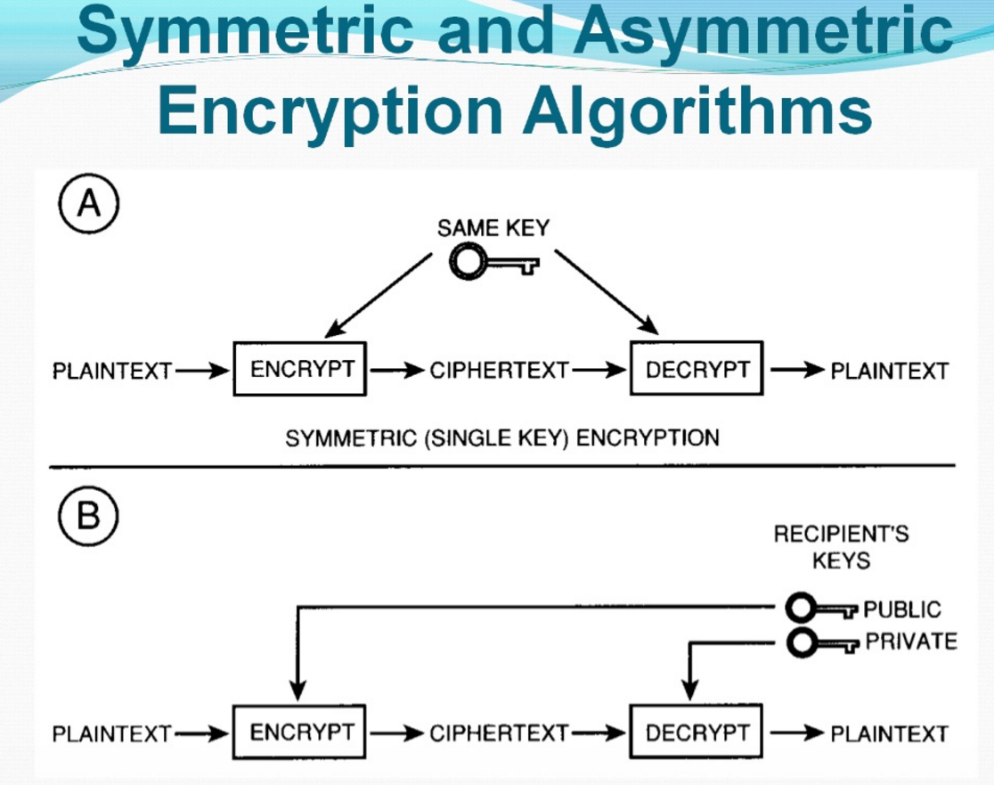

Slide 20
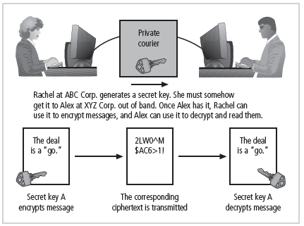
Figure 8-5 Example of Symmetric Encryption

Slide 21
Symmetric Encryption (cont’d.)
Data Encryption Standard (DES): one of most popular symmetric encryption cryptosystems
  64-bit block size; 56-bit key.
  Adopted by NIST in 1976 as federal standard for encrypting non-classified information.
Triple DES (3DES): created to provide security far beyond DES.
Advanced Encryption Standard (AES): developed to replace both DES and 3DES
Notes:
There are a number of popular symmetric encryption cryptosystems.
One of the most familiar is Data Encryption Standard (DES), developed in 1977 by IBM and based on the Data Encryption Algorithm (DEA).
DEA uses a 64-bit block size and a 56-bit key. The algorithm begins by adding parity bits to the key (resulting in 64 bits) and then apples the key in 16 rounds of XOR, substitution, and transposition operations.
With a 56-bit key, the algorithm has 256 possible keys to choose from (over 72 quadrillion).
DES is a federally approved standard for non-classified data. DES was cracked in 1997 when Rivest-Shamir-Aldeman (RSA) put a bounty on the algorithm.
RSA offered a $10,000 reward for the first person or team to crack the algorithm. Fourteen thousand users collaborated over the Internet to finally break the encryption.

Slide 22
Asymmetric Encryption
Also known as public-key encryption.
Uses two different but related keys
  Either key can encrypt or decrypt message.
  If Key A encrypts message, only Key B can decrypt.
  Highest value when one key serves as private key and the other serves as public key.
RSA algorithm.
Notes:
Asymmetric Encryption
Another category of encryption techniques is asymmetric encryption, also known as public-key encryption.
Whereas the symmetric encryption systems are based on a single key to both encrypt and decrypt a message, asymmetric encryption uses two different keys.
Either key can be used to encrypt or decrypt the message. However, if Key A is used to encrypt the message, only Key B can decrypt, and if Key B is used to encrypt a message, only Key A can decrypt it.
The public key is stored in a public location, where anyone can use it.
The private key, as its name suggests, is a secret known only to the owner of the key pair.
The problem with asymmetric encryption is that it requires four keys to hold a single conversation between two parties.
Asymmetric encryption is not as efficient as symmetric encryptions in terms of CPU computations.
As a result, the hybrid system described in the section on Public Key Infrastructure is more commonly used, instead of a pure asymmetric system.

Slide 23
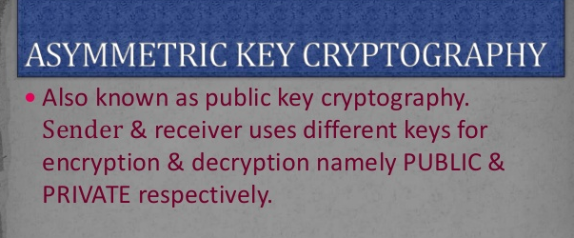

Slide 24
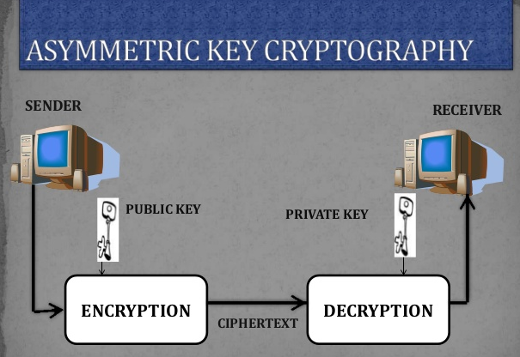

Slide 25
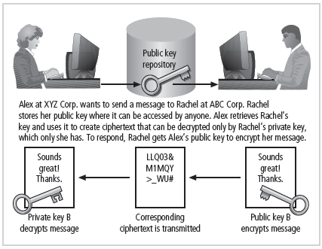
Figure 8-6 Example of Asymmetric Encryption

Slide 26
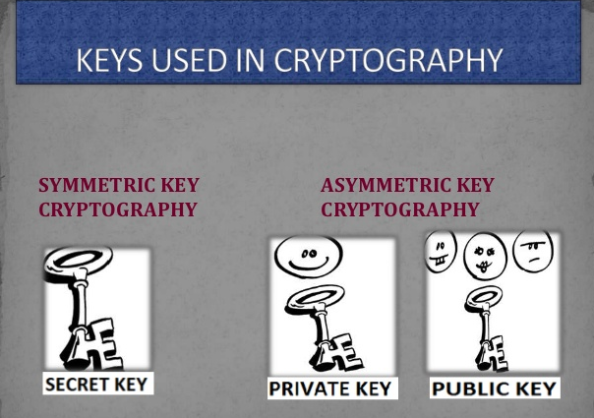

Slide 27
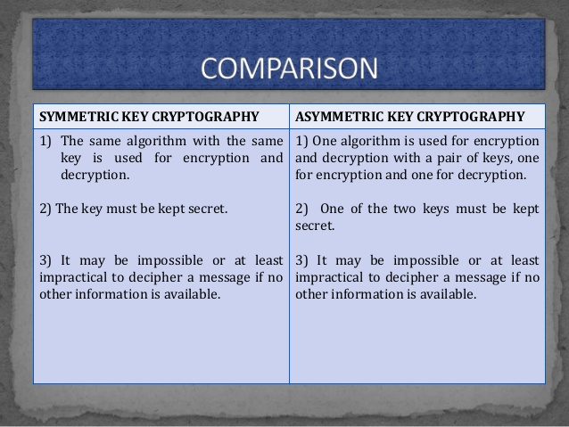

Slide 28
By using of encryption techniques a fair unit of confidentiality, authentication, integrity, access control and availability of data is maintained.

Slide 29
Encryption Key Size
When using ciphers, size of cryptvariable or key is very important.
Strength of many encryption applications and cryptosystems measured by key size.
For cryptosystems, security of encrypted data is not dependent on keeping encrypting algorithm secret.
Cryptosystem security depends on keeping some or all of elements of cryptovariable(s) or key(s) secret.
Notes:
Encryption Key Size
When using ciphers, one of the decisions that has to be made is the size of the cryptovariable or key. The strength of many encryption applications and cryptosystems is measured by key size.
When it comes to cryptosystems, the security of encrypted data is not dependent on keeping the encrypting algorithm secret; in fact, algorithms are often published, so that research to uncover their weaknesses can be done.
The security of any cryptosystem depends on keeping some or all of the elements of the cryptovariable(s) or key(s) secret.

Slide 30
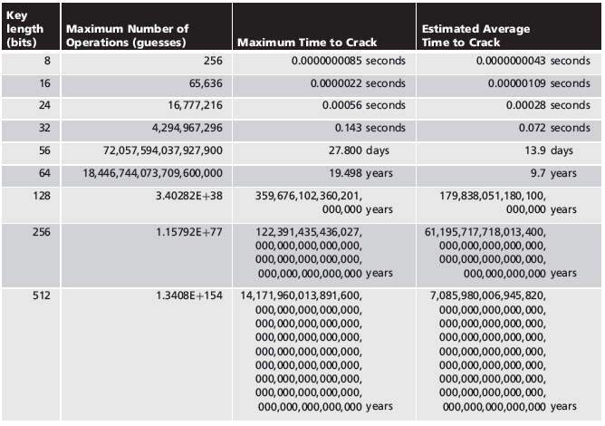
Table 8-7 Encryption Key Power

Slide 31
DES History
In 1971, IBM developed an algorithm, named LUCIFER which operates on a block of 64 bits, using a 128-bit key
Walter Tuchman, an IBM researcher, refined LUCIFER and reduced the key size to 56-bit, to fit on a chip.

Slide 32
History
In 1977, the results of Tuchman’s project of IBM was adopted as the Data Encryption Standard by NSA (NIST).

Slide 33
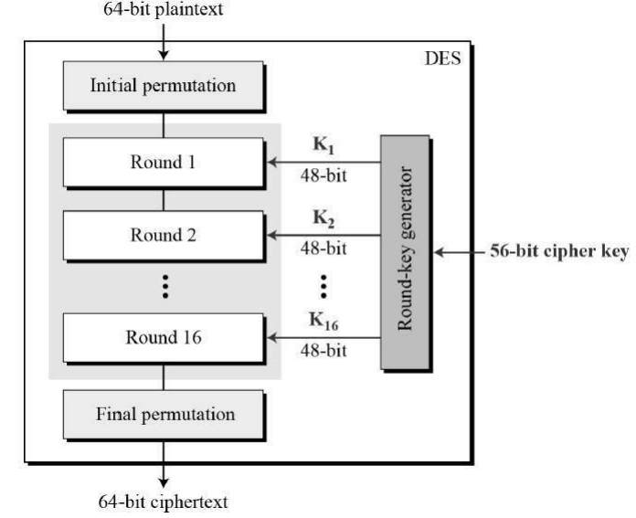

Slide 34
Encryption (IP, IP⁻¹)
IP
IP⁻¹
Bit | 0 | 1 | 2 | 3 | 4 | 5 | 6 | 7
1 | 58 | 50 | 42 | 34 | 26 | 18 | 10 | 2
9 | 60 | 52 | 44 | 36 | 28 | 20 | 12 | 4
17 | 62 | 54 | 46 | 38 | 30 | 22 | 14 | 6
25 | 64 | 56 | 48 | 40 | 32 | 24 | 16 | 8
33 | 57 | 49 | 41 | 33 | 25 | 17 | 9 | 1
41 | 59 | 51 | 43 | 35 | 27 | 19 | 11 | 3
49 | 61 | 53 | 45 | 37 | 29 | 21 | 13 | 5
57 | 63 | 55 | 47 | 39 | 31 | 23 | 15 | 7
Bit | 0 | 1 | 2 | 3 | 4 | 5 | 6 | 7
1 | 40 | 8 | 48 | 16 | 56 | 24 | 64 | 32
9 | 39 | 7 | 47 | 15 | 55 | 23 | 63 | 31
17 | 38 | 6 | 46 | 14 | 54 | 22 | 62 | 30
25 | 37 | 5 | 45 | 13 | 53 | 21 | 61 | 29
33 | 36 | 4 | 44 | 12 | 52 | 20 | 60 | 28
41 | 35 | 3 | 43 | 11 | 51 | 19 | 59 | 27
49 | 34 | 2 | 42 | 10 | 50 | 18 | 58 | 26
57 | 33 | 1 | 41 | 9 | 49 | 17 | 57 | 25
Note: IP(IP⁻¹) = IP⁻¹(IP) = I

Slide 35
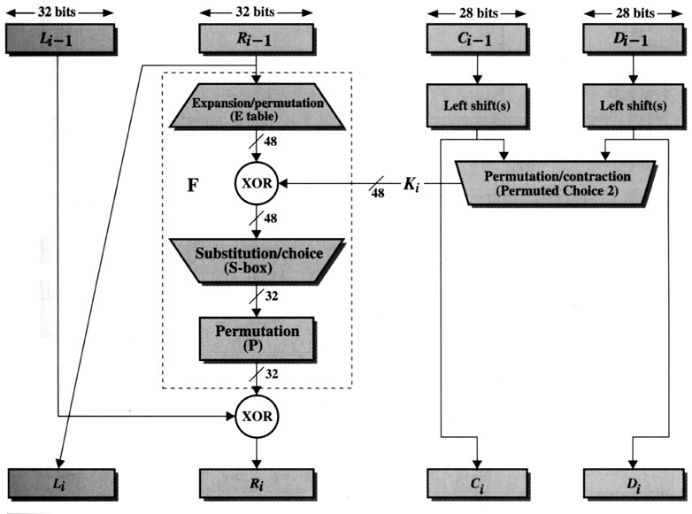
Encryption (Round)
(Key Generation)
[1]

Slide 36
Encryption (Round) (cont.)
L_{i-1}
R_{i-1}
Expansion/permutation (E_table)
XOR
K_{i}
F
Substitution/choice (S-box)
Permutation (P)
XOR
L_{i}
R_{i}

Slide 37
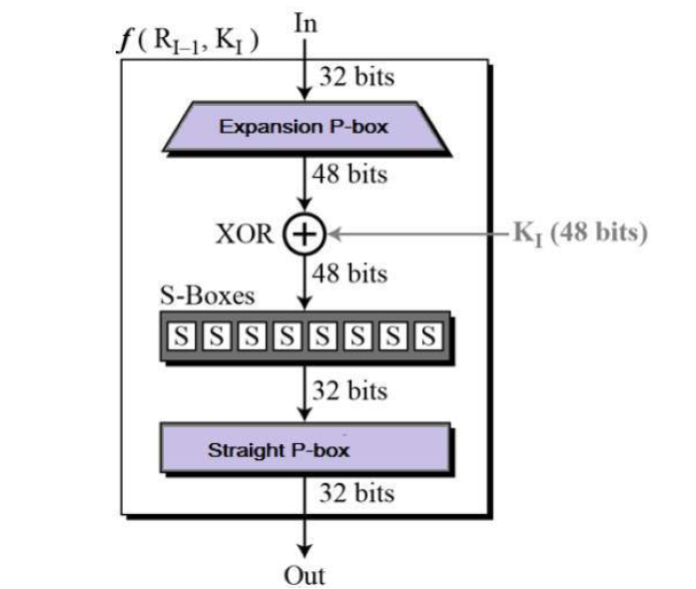
Round Function

Slide 38
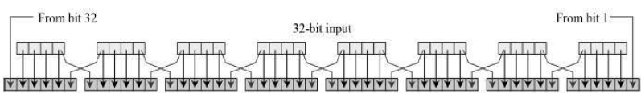
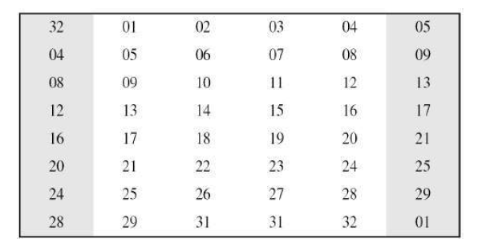
Expansion Permutation Box

Slide 39
Encryption (Round) (cont.)
E
P
32 | 1 | 2 | 3 | 4 | 5
4 | 5 | 6 | 7 | 8 | 9
8 | 9 | 10 | 11 | 12 | 13
12 | 13 | 14 | 45 | 16 | 17
16 | 17 | 18 | 19 | 20 | 21
20 | 21 | 22 | 23 | 24 | 25
24 | 25 | 26 | 27 | 28 | 29
28 | 29 | 30 | 31 | 32 | 1
16 | 7 | 20 | 21 | 29 | 12 | 28 | 17
1 | 15 | 23 | 26 | 5 | 18 | 31 | 10
2 | 8 | 24 | 14 | 32 | 27 | 3 | 9
9 | 13 | 30 | 6 | 22 | 11 | 4 | 25
Expansion
Expansion

Slide 40
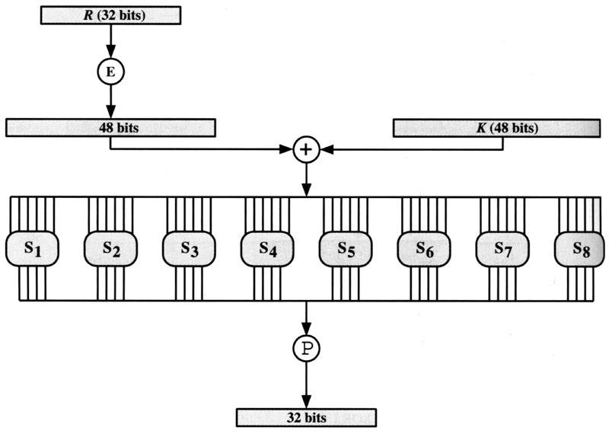
Encryption (Round) (cont.)
F
S-box
[1]

Slide 41
Encryption (Round) (cont.)
Separate plaintext as L₀R₀
  L₀: left half 32 bits of plaintext
  R₀: right half 32 bits of plaintext
Expansion/permutation: E( )
Substitution/choice: S-box( )
Permutation: P( )

Slide 42
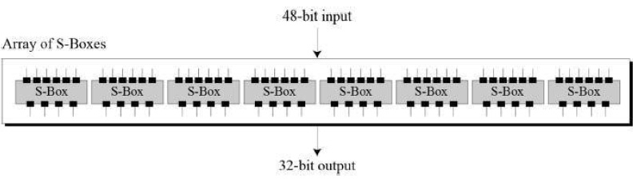
Substitution Boxes

Slide 43
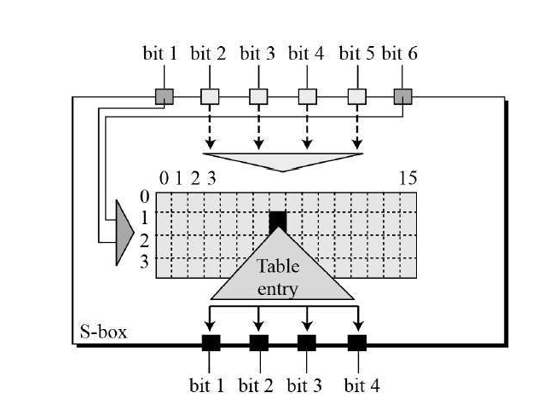

Slide 44
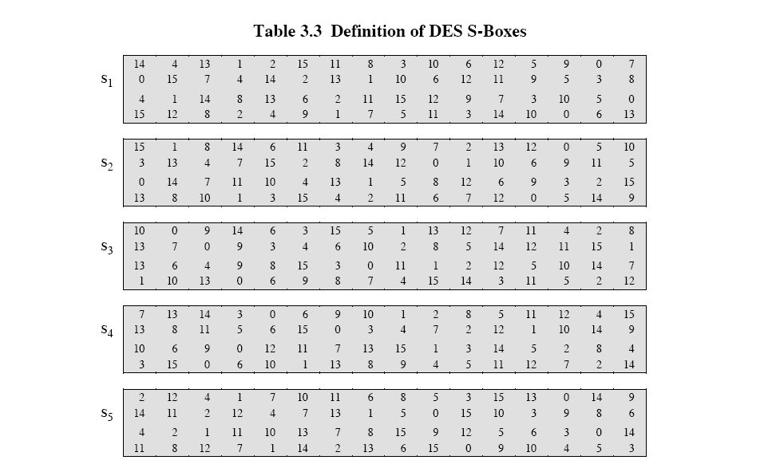
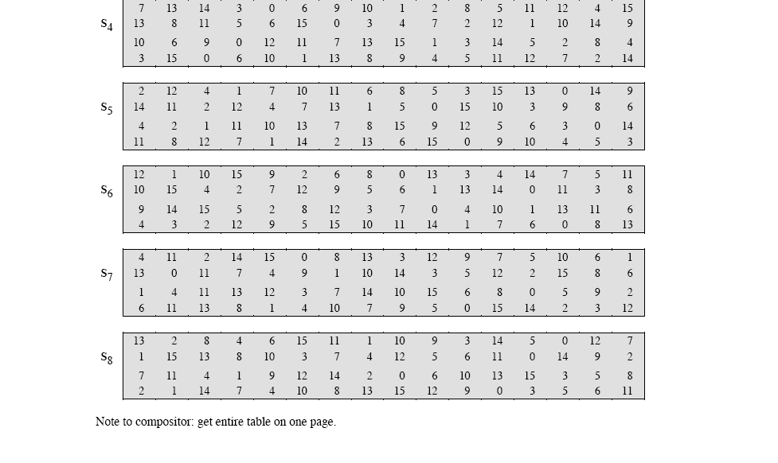
Encryption (Round) (cont.)
S-box
[1]

Slide 45
Key Generation
(Encryption)
[1]

Slide 46
Key Generation (cont.)
Input Key
Permuted Choice One (PC-1)
C₀
D₀
▪
▪
▪
▪
▪
▪
C_{i-1}
D_{i-1}
Permuted Choice Two (PC-2)
Key_{i}
Schedule of Left Shifts
C_{i}
D_{i}

Slide 47
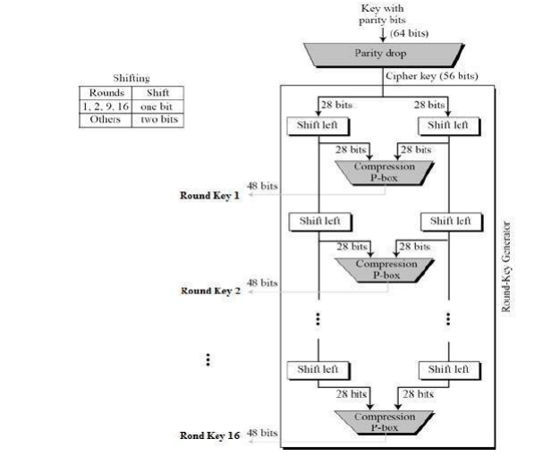
Key Generation

Slide 48
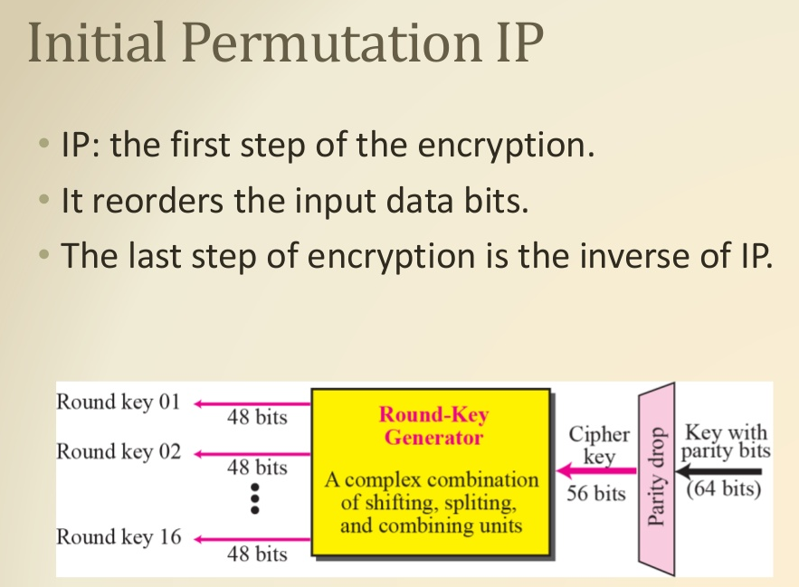

Slide 49
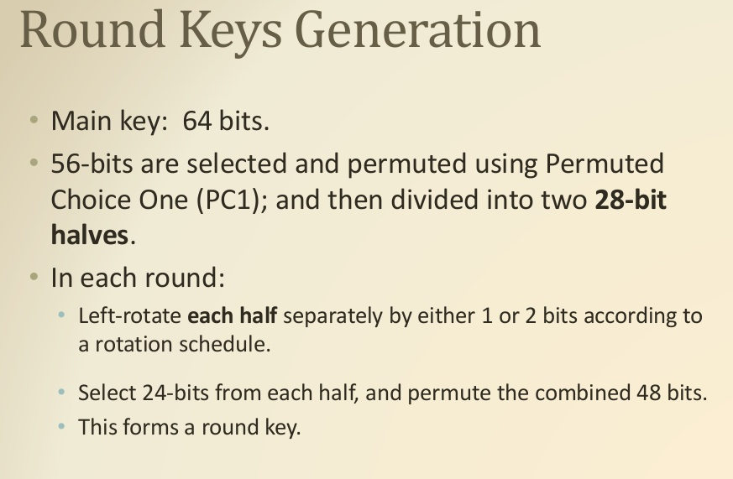

Slide 50
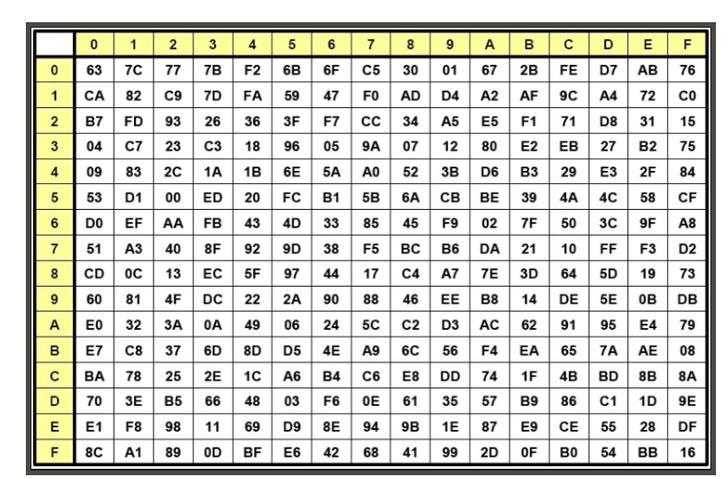

Slide 51
Cryptographic Tools
Potential areas of use include:
  Ability to conceal the contents of sensitive messages.
  Verify the contents of messages and the identities of their senders.
Tools must embody cryptographic capabilities so that they can be applied to the everyday world of computing.

Slide 52
Public key infrastructure (PKI)
A public key infrastructure (PKI) is a set of roles, policies, and procedures needed to create, manage, distribute, use, store, and revoke and manage public-key encryption.
The purpose of a PKI is to facilitate the secure electronic transfer of information for a range of network activities such as e-commerce, internet banking and confidential email.

Slide 53
PKI(contd…)
Integrated system of software, encryption methodologies, protocols, legal agreements, and third-party services enabling users to communicate securely.
PKI systems based on public-key cryptosystems.
PKI protects information assets in several ways:
  Authentication
  Integrity
  Privacy
  Authorization
  Nonrepudiation
Notes:
Cryptography Tools
Public Key Infrastructure (PKI) is an integrated system of software, encryption methodologies, protocols, legal agreements, and third-party services that enables users to communicate securely.
PKI systems are based on public-key cryptosystems and include digital certificates and certificate authorities (CAs).
PKI Protects Information Assets in Several Ways:
Authentication. Digital certificates in a PKI system permit parties to validate the identity of other parties in an Internet transaction.
Integrity. A digital certificate demonstrates that the content signed by the certificate has not been altered while being moved from server to client.
Privacy. Digital certificates keep information from being intercepted during transmission over the Internet.
Authorization. Digital certificates issued in a PKI environment can replace user IDs and passwords, enhance security, and reduce some of the overhead required for authorization processes and controlling access privileges.
Nonrepudiation. Digital certificates can validate actions, making it less likely that customers or partners can later repudiate a digitally signed transaction.

Slide 54
PKI(Contd…)
Typical PKI solution protects the transmission and reception of secure information by integrating:
  1.A certificate authority (CA)
  2.A registration authority (RA)
  3.Certificate directories
  4.Management protocols
  5.Policies and procedures

Slide 55
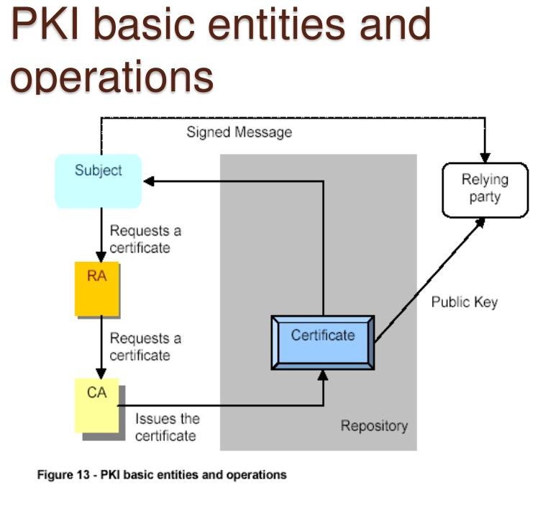

Slide 56
Digital Signature
To obtain a secure digital signature.
At first the message is hashed.
Creating a digital fingerprint which is encrypted using the receiver's public key.
Creating a digital signature. The clear message is combined with the digital signature.
The result (an authenticated message) is sent.
---------------------------------------------------------------------------------------------------------------
After the reception, the message is separated from the digital signature
which is decrypted using the receiver's private key.
The message is hashed into a "temporary" digital fingerprint.
which is used to validate the received fingerprint.
If the message has not been modified during the transfer process, it's authenticated.

Slide 57
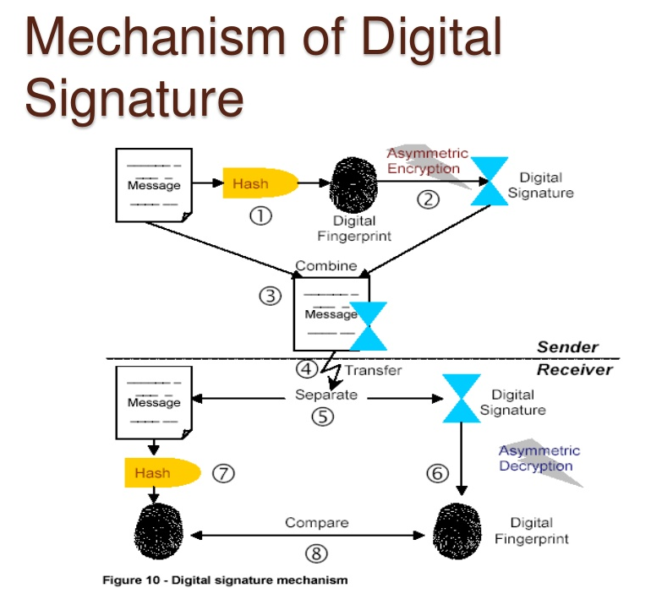

Slide 58
Digital Signatures(contd…)
Created in response to rising need to verify information transferred using electronic systems.
Asymmetric encryption processes used to create digital signatures.
Nonrepudiation: The process that verifies the message was sent by the sender and thus cannot be refuted.
Digital Signature Standard (DSS).
Notes:
Digital Signatures
An interesting thing happens when the asymmetric process is reversed, that is, the private key is used to encrypt a short message.
The public key can be used to decrypt it, and the fact that the message was sent by the organization that owns the private key cannot be refuted.
This is known as nonrepudiation, which is the foundation of digital signatures.
Digital signatures are encrypted messages that are independently verified by a central facility (registry) as authentic.

Slide 59
Digital Signatures(contd…)
Digital signatures can be permanently tied to the content of the message being signed. They cannot then be 'moved' from one document to another, for any attempt will be detectable.
RSA and DSA are two of the most popular digital signature schemes.

Slide 60
Digital Certificates
Electronic document containing key value and identifying information about entity that controls key.
Digital signature attached to certificate’s container file to certify file is from entity it claims to be from.
Different client-server applications use different types of digital certificates to accomplish their assigned functions.
Distinguished name (DN): uniquely identifies a certificate entity.
Notes:
Digital Certificates and Certificate Authorities
As alluded to earlier, a digital certificate is an electronic document, similar to a digital signature, attached to a file certifying that this file is from the organization it claims to be from and has not been modified from the originating format.
A certificate authority is an agency that manages the issuance of certificates and serves as the electronic notary public to verify their worth and integrity.

Slide 61
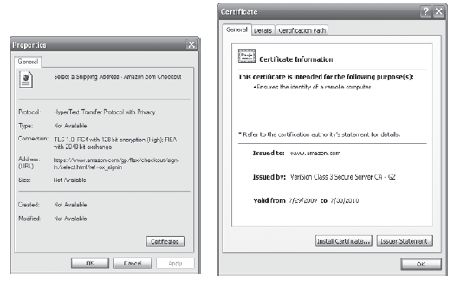
Figure 8-8 Digital Certificate

Slide 62
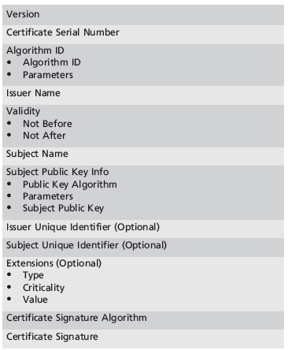
Table 8-8 X.509 v3 Certificate Structure¹¹

Slide 63
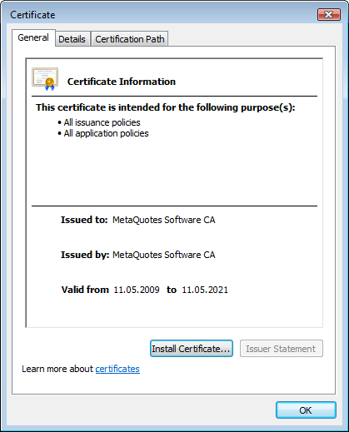
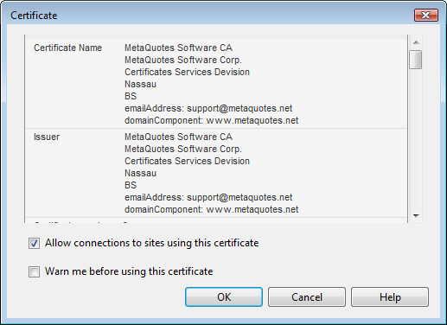
Elements of Digital Cert.
A Digital ID typically contains the following information:
  Your public key, Your name and email address.
  Expiration date of the public key, Name of the CA who issued your Digital ID.

Slide 64
What is a Certificate ?
The simplest certificate just contains:
  A public key
  Information about the entity that is being certified to own that public key
… and the whole is
  Digitally signed by someone trusted (like your friend or a CA)
2wsR46%frdEWWrswe(*^$G*^%#%#%DvtrsdFDfd3%.6,7
pub
This public key belongs to Charlotte
Can be a person or a computer or a device..
3kJfgf*£$&4dser4@358g6*gd7dT
Digital
Signature
Certificate

Slide 65
X.509 Certificate
X.500 Subject
Who is the owner, CN=Charlotte,O=CERN,C=CH
Public Key
The public key or info about it
X.500 issuer
Who is signing, O=CERN,C=CH
Expiration date
See later why expiration date is important
Serial Number
Extensions
Additional arbitrary information
Info
CA Digital Signature
… of the issuer, of course
Certificate

Slide 66
Certificate Validation
Essentially, this is just checking the digital signature.
But you may have to “walk the path” of all subordinate authorities until you reach the root.
  Unless you explicitly trust a subordinate CA.
“In BigRoot We Trust”
(installed root CA certificate)
Public key
Public key
Public key
This public key belongs to Charlotte
This public key belongs to CERN
This public key belongs to BigRoot
Check DS of
CERN
Check DS of
Foobar
Issued by: CERN
Issued by: BigRoot
Issued by: BigRoot
CERN Digital Signature
BigRoot Digital Signature`
BigRoot Digital Signature
Certificate
Certificate
Certificate

Slide 67
Hybrid Cryptography Systems
Except with digital certificates, pure asymmetric key encryption not widely used.
Asymmetric encryption more often used with symmetric key encryption, creating hybrid system.
Diffie-Hellman Key Exchange method:
  Most common hybrid system.
  Provided foundation for subsequent developments in public-key encryption.
Notes:
Hybrid Systems
In practice, asymmetric key encryption is not widely used except in the area of certificates. Instead, it is more often used in conjunction with symmetric key encryption creating a hybrid system.
The current process is based on the Diffie-Hellman Key Exchange method, which is a way to exchange private keys without exposure to any third parties using public key encryption.
With this method, asymmetric encryption is used as a method to exchange symmetric keys so that two organizations can conduct quick, efficient, secure communications based on symmetric encryption.
Diffie-Hellman provided the foundation for subsequent developments in public key encryption.

Slide 68
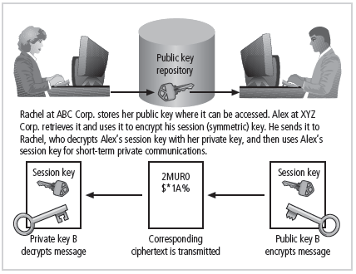
Figure 8-9 Example of Hybrid Encryption

Slide 69
Steganography
Process of hiding information.
Has been in use for a long time.
Most popular modern version hides information within files appearing to contain digital pictures or other images.
Some applications hide messages in .bmp, .wav, .mp3, and .au files, as well as in unused space on CDs and DVDs.
Notes:
Steganography
Steganography is a process of hiding information and has been in use for a long time.
The word “steganography” is derived from the Greek words steganos meaning “covered” and graphein meaning “to write.”
The most popular modern version of steganography involves hiding information within files that appear to contain digital pictures or other images.
Most computer graphics standards use a combination of three color values (red, blue, and green (RGB)) to represent a picture element, or pixel.
Each of the three color values usually requires an 8-bit code for that color’s intensity (e.g., 00000000 for no red and 11111111 for maximum red).
This inability to perceive difference on the part of humans provides the steganographer with one bit per color (or three bits per pixel) to use for encoding data into an image file.
Some applications are capable of hiding messages in .bmp, .wav, .mp3, and .au files, as well as in unused storage space on CDs and DVDs.

Slide 70
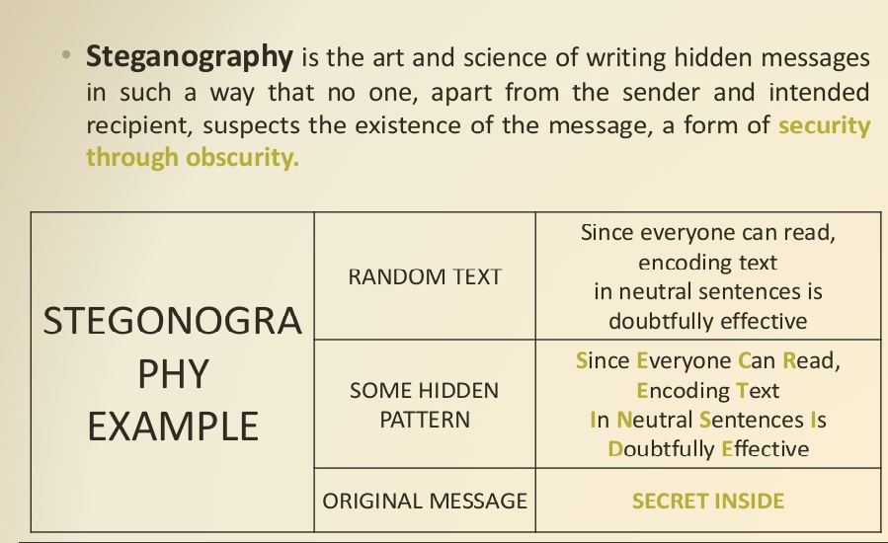

Slide 71
Attacks on Cryptosystems
Attempts to gain unauthorized access to secure communications have used brute force attacks (ciphertext attacks).
Attacker may alternatively conduct known-plaintext attack or selected-plaintext attach schemes.
Notes:
Attacks on Cryptosystems
Historically, attempts to gain unauthorized access to secure communications have used brute force attacks.
Ciphertext attacks involve a hacker searching for a common text structure, wording, or syntax in the encrypted message that can enable him or her to calculate the number of each type of letter used in the message.
Frequency analysis can be used along with published frequency of occurrence patterns of various languages and can allow an experienced attacker to crack almost any code quickly if the individual has a large enough sample of the encoded text.
To protect against this, modern algorithms attempt to remove the repetitive and predictable sequences of characters from the ciphertext.
Occasionally, an attacker may obtain duplicate texts, one in ciphertext and one in plaintext, which enable the individual to reverse-engineer the encryption algorithm in a known-plaintext attack scheme.
Alternatively, an attacker may conduct a selected-plaintext attack by sending the potential victim a specific text that they are sure the victim will forward on to others.

Slide 72
1.Man-in-the-Middle Attack
Designed to intercept transmission of public key or insert known key structure in place of requested public key.
From victim’s perspective, encrypted communication appears to be occurring normally, but in fact, attacker receives each encrypted message, decodes, encrypts, and sends to originally intended recipient.
Establishment of public keys with digital signatures can prevent traditional man-in-the-middle attack.
Notes:
Man-in-the-Middle Attack
A man-in-the-middle attack is designed to intercept the transmission of a public key or even to insert a known key structure in place of the requested public key.
From the perspective of the victims of such attacks, their encrypted communication appears to be occurring normally, but in fact the attacker is receiving each encrypted message and decoding it and then encrypting and sending it to the originally intended recipient.
Establishment of public keys with digital signatures can prevent the traditional man-in-the-middle attack, as the attacker cannot duplicate the signatures.

Slide 73
Man in Middle Attack (MIM)
The targets of this attack are mostly public key cryptosystems where key exchange is involved before communication takes place.
1.Host A wants to communicate to host B, hence requests public key of B.
2.An attacker intercepts this request and sends his public key instead.
3.Thus, whatever host A sends to host B, the attacker is able to read.
4.In order to maintain communication, the attacker re-encrypts the data after reading with his public key and sends to B.
5.The attacker sends his public key as A’s public key so that B takes it as if it is taking it from A.

Slide 74
2.Correlation Attacks
Collection of brute-force methods that attempt to deduce statistical relationships between structure of unknown key and cipher text.
Differential and linear cryptanalysis have been used to mount successful attacks.
Only defense is selection of strong cryptosystems, thorough key management, and strict adherence to best practices of cryptography in frequency of changing keys.
Brute Force Attack (BFA): In this method, the attacker tries to determine the key by attempting all possible keys. If the key is 8 bits long, then the number of possible keys is 2 pow 8 = 256. The attacker knows the ciphertext and the algorithm, now he attempts all the 256 keys one by one for decryption. The time to complete the attack would be very high if the key is long.
Notes:
Correlation Attacks
Correlation attacks are a collection of brute-force methods that attempt to deduce statistical relationships between the structure of the unknown key and the ciphertext that is the output of the cryptosystem.
Differential and linear cryptanalysis, both of which are advanced methods of breaking codes, have been used to mount successful attacks on block cipher encryptions such as DES.
The only defense against this kind of attack is the selection of strong cryptosystems that have stood the test of time, thorough key management, and strict adherence to the best practices of cryptography in the frequency of changing keys.

Slide 75
3.Dictionary Attacks
Attacker encrypts every word in a dictionary using same cryptosystem used by target.
Dictionary attacks can be successful when the cipher text consists of relatively few characters (e.g., usernames, passwords).
Dictionary Attack: This attack has many variants, all of which involve compiling a ‘dictionary’. In simplest method of this attack, attacker builds a dictionary of cipher texts and corresponding plaintexts that he has learnt over a period of time. In future, when an attacker gets the cipher text, he refers the dictionary to find the corresponding plaintext.
Notes:
Dictionary Attacks
In a dictionary attack, the attacker encrypts every word in a dictionary using the same cryptosystem as used by the target.
Dictionary attacks can be successful when the ciphertext consists of relatively few characters, as for example files that contain encrypted usernames and passwords.
After a match is located, the attacker has essentially identified a potential valid password for the system under attack.

Slide 76
4.Timing Attacks
Attacker eavesdrops during victim’s session
  Uses statistical analysis of user’s typing patterns and inter-keystroke timings to discern sensitive session information.
Can be used to gain information about encryption key and possibly cryptosystem in use.
Once encryption successfully broken, attacker may launch a replay attack (an attempt to resubmit recording of deciphered authentication to gain entry into secure source).
Timing Attacks: They exploit the fact that different computations take different times to compute on processor. By measuring such timings, it is be possible to know about a particular computation the processor is carrying out. For example, if the encryption takes a longer time, it indicates that the secret key is long.
Notes:
Timing Attacks
In a timing attack, the attacker eavesdrops during the victim’s session and uses statistical analysis of the user’s typing patterns and inter-keystroke timings to discern sensitive session information.
While timing analysis may not directly result in the decryption of sensitive data, it can be used to gain information about the encryption key and perhaps the cryptosystem in use.
Once the attacker has successfully broken an encryption, he or she may launch a replay attack, which is an attempt to resubmit a recording of the deciphered authentication to gain entry into a secure source.

Slide 77
Defending Against Attacks
No matter how sophisticated encryption and cryptosystems have become, if key is discovered, message can be determined.
Key management is not so much management of technology but rather management of people.
Birthday Attack.
Fault analysis Attacks.
Power Analysis Attacks.
Notes:
Defending From Attacks
No matter how sophisticated encryption and cryptosystems have become, however, they have retained the same flaw that the first systems contained thousands of years ago: if you discover the key, you can determine the message.
Thus, key management is not so much the management of technology but rather the management of people.

Slide 78
Birthday Attack:
As an example, consider the scenario in which a teacher with a class of 30 students (n = 30) asks for everybody's birthday to determine whether any two students have the same birthday. This chance may seem small If the teacher picked a specific day (say, 16 September), then the chance that at least one student was born on that specific day is
1-(364/365) power 30 about 7.9%.

Slide 79
Differential fault analysis (DFA):
It is a type of side channel attack in the field of cryptography. The principle is to induce faults—unexpected environmental conditions—into cryptographic implementations, to reveal their internal states.
For example, a smartcard containing an embedded processor might be subjected to high temperature, unsupported supply voltage or current, excessively high overclocking, strong electric or magnetic fields, or even ionizing radiation to influence the operation of the processor. The processor may begin to output incorrect results due to physical data corruption, which may help a cryptanalyst deduce the instructions that the processor is running, or what its internal data state is.

Slide 80
Power Analysis Attacks:
In cryptography, power analysis is a form of side channel attack in which the attacker studies the power consumption of a cryptographic hardware device (such as a smart card, tamper-resistant "black box", or integrated circuit). The attack can non-invasively extract cryptographic keys and other secret information from the device.

