Slide 1
Unit-3

Slide 2
Hash function
A hash function maps a variable-length message into a fixed-length hash value, or message digest. Virtually all cryptographic hash functions involve the iterative use of a compression function.
A hash function H accepts a variable-length block of data M as input and produces a fixed-size hash value h=H(M).

Slide 3
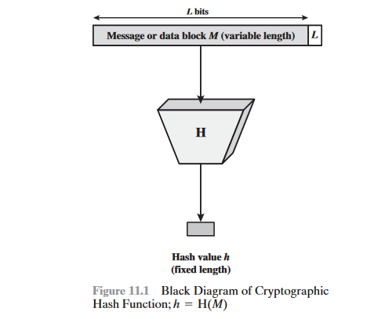

Slide 4
Message Authentication
Message authentication is a mechanism or service used to verify the integrity of a message. Message authentication assures that data received are exactly as sent (i.e., contain no modification, insertion, deletion, or replay). In many cases, there is a requirement that the authentication mechanism assures that purported identity of the sender is valid. When a hash function is used to provide message authentication, the hash function value is often referred to as a message digest

Slide 5
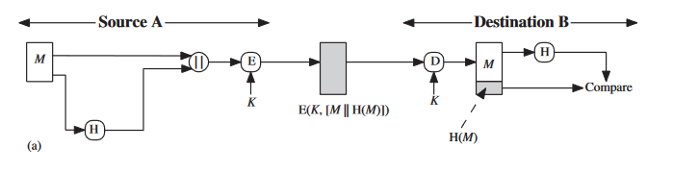
illustrates a variety of ways in which a hash code can be used to provide message authentication, as follows.
The message plus concatenated hash code is encrypted using symmetric encryption. Because only A and B share the secret key, the message must have come from A and has not been altered.
The hash code provides the structure or redundancy required to achieve authentication. Because encryption is applied to the entire message plus hash code, confidentiality is also provided.

Slide 6
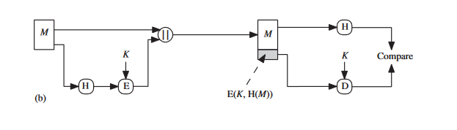
Only the hash code is encrypted, using symmetric encryption.
This reduces the processing burden for those applications that do not require confidentiality.

Slide 7
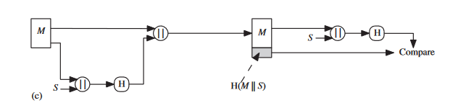
it is possible to use a hash function but no encryption for message authentication.
The technique assumes that the two communicating parties share a common secret value .A computes the hash value over the concatenation of M and S and appends the resulting hash value to M . Because B possesses S, it can recompute the hash value to verify. Because the secret value itself is not sent, an opponent cannot modify an intercepted message and cannot generate a false message.

Slide 8
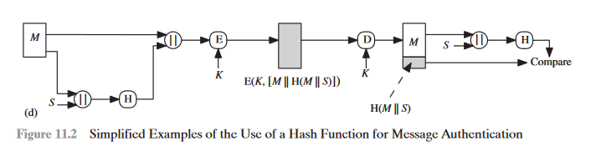
Confidentiality can be added to the approach of method (c) by encrypting the entire message plus the hash code.
More commonly, message authentication is achieved using a message authentication code (MAC), also known as a keyed hash function.

Slide 9
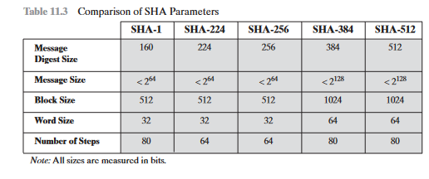
SHA
In recent years, the most widely used hash function has been the Secure Hash Algorithm (SHA). Indeed, because virtually every other widely used hash function had been found to have substantial cryptanalytic weaknesses, SHA was more or less the last remaining standardized hash algorithm by 2005.

Slide 10
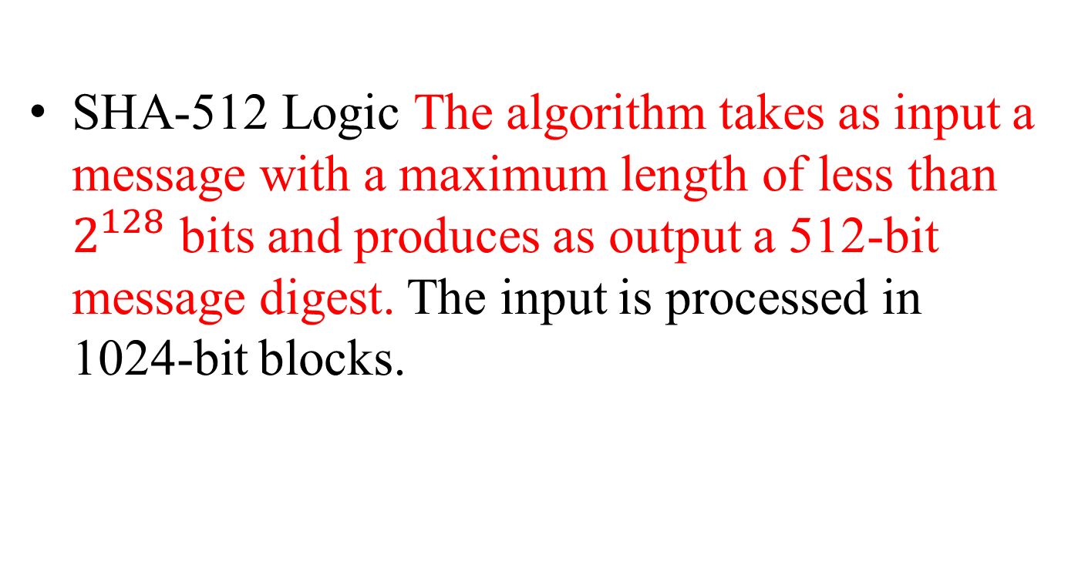
SHA-512 Logic The algorithm takes as input a message with a maximum length of less than $2^{128}$ bits and produces as output a 512-bit message digest. The input is processed in 1024-bit blocks.

Slide 11
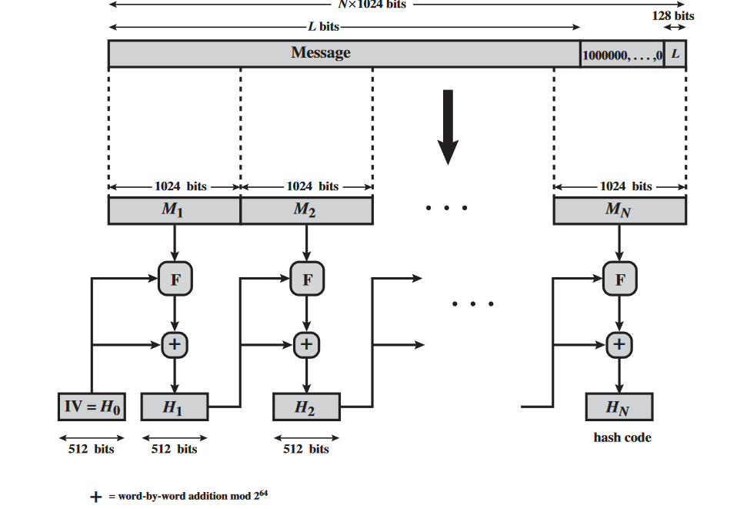
Fig:11.8 Message Digest Generation Using SHA-512

Slide 12
Step 1 Append padding bits. The message is padded so that its length is congruent to 896 modulo 1024[length=896(mod1024) . Padding is always added, even if the message is already of the desired length. Thus, the number of padding bits is in the range of 1 to 1024. The padding consists of a single 1 bit followed by the necessary number of 0 bits.

Slide 13
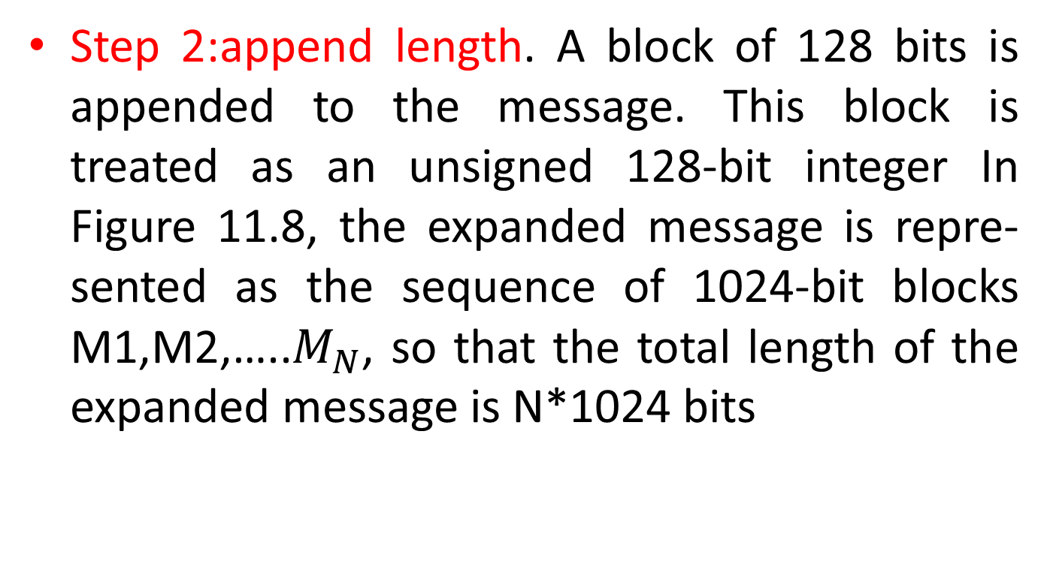
Step 2:append length. A block of 128 bits is appended to the message. This block is treated as an unsigned 128-bit integer In Figure 11.8, the expanded message is repre- sented as the sequence of 1024-bit blocks M1,M2,…..$M_{N}$, so that the total length of the expanded message is N*1024 bits

Slide 14
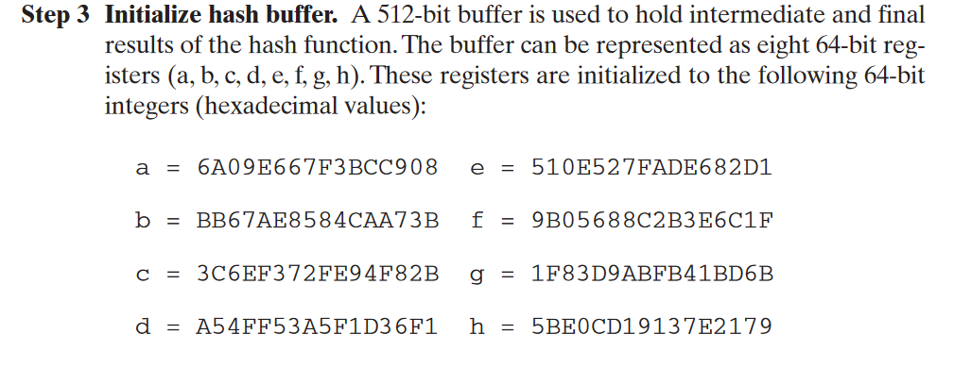

Slide 15
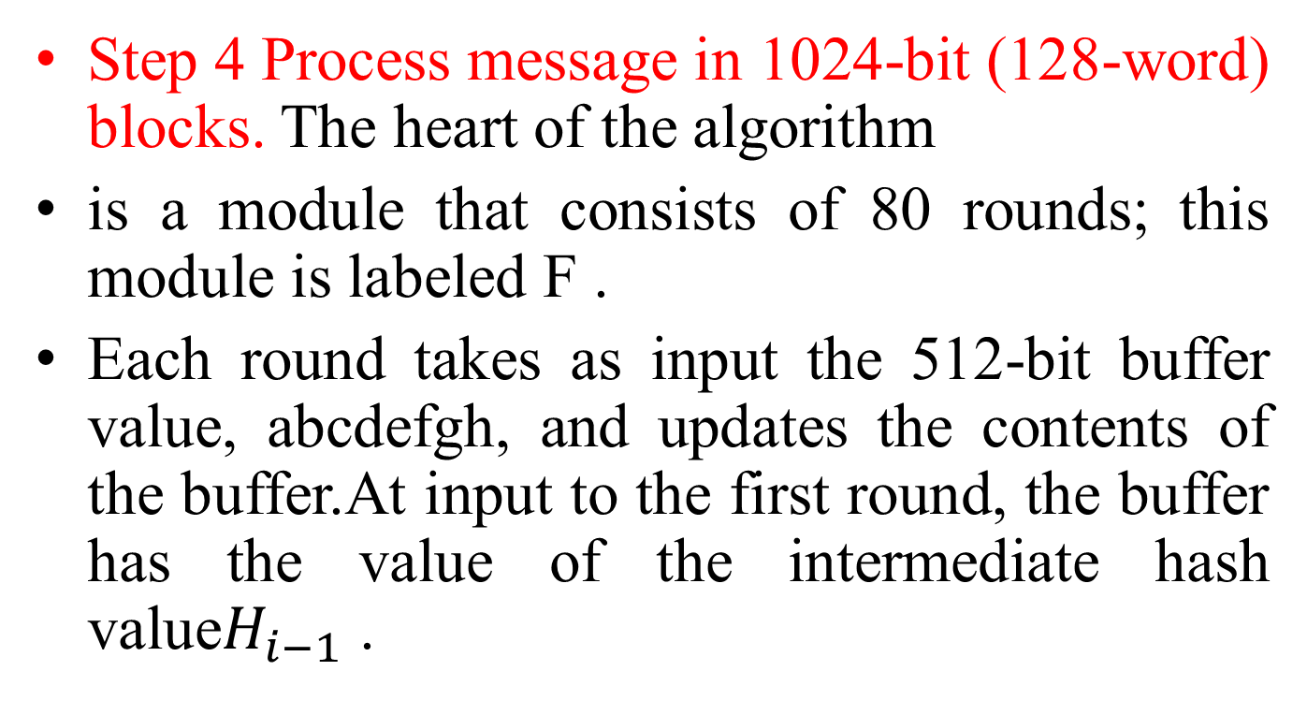
Step 4 Process message in 1024-bit (128-word) blocks. The heart of the algorithm
is a module that consists of 80 rounds; this module is labeled F .
Each round takes as input the 512-bit buffer value, abcdefgh, and updates the contents of the buffer.At input to the first round, the buffer has the value of the intermediate hash value$H_{i−1}$ .

Slide 16
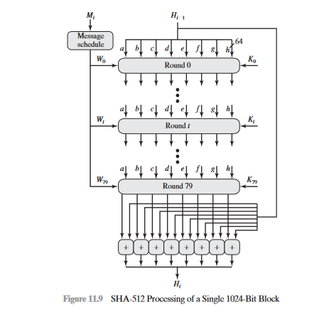

Slide 17
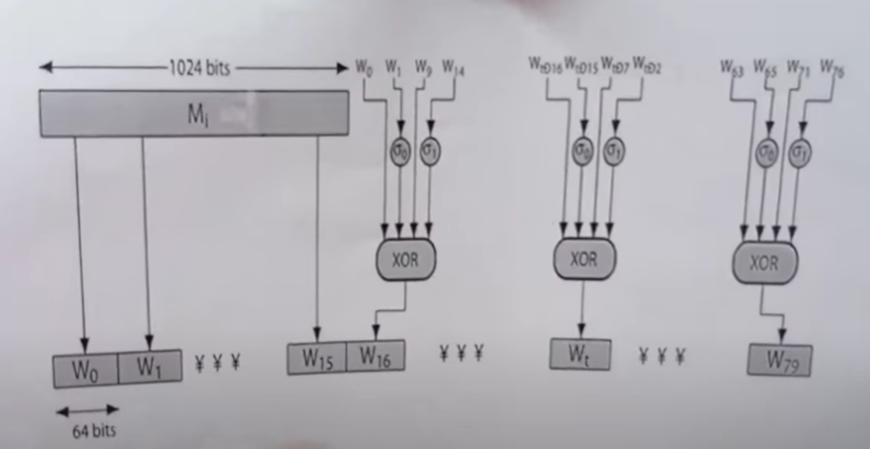

Slide 18
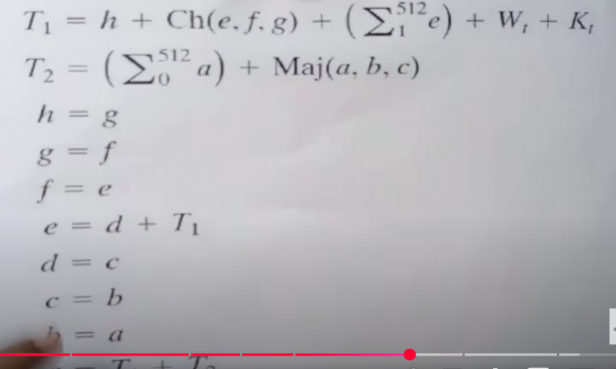

Slide 19
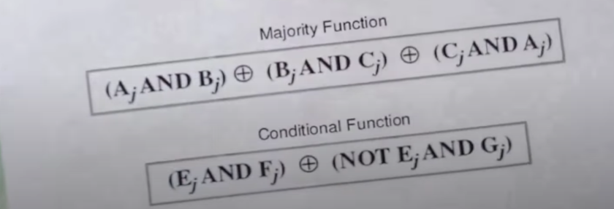

Slide 20
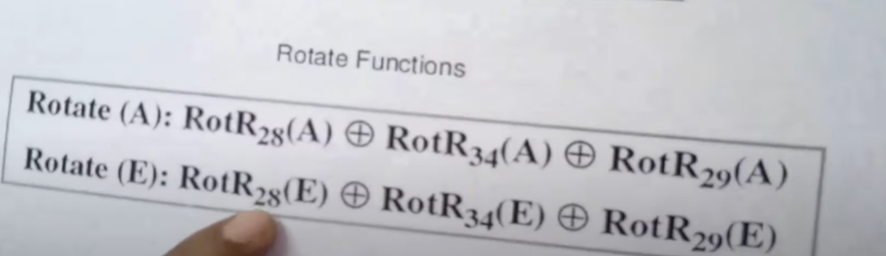

Slide 21
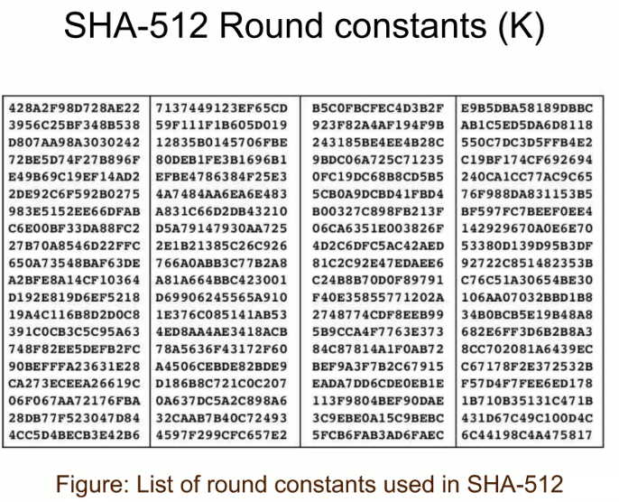

Slide 22
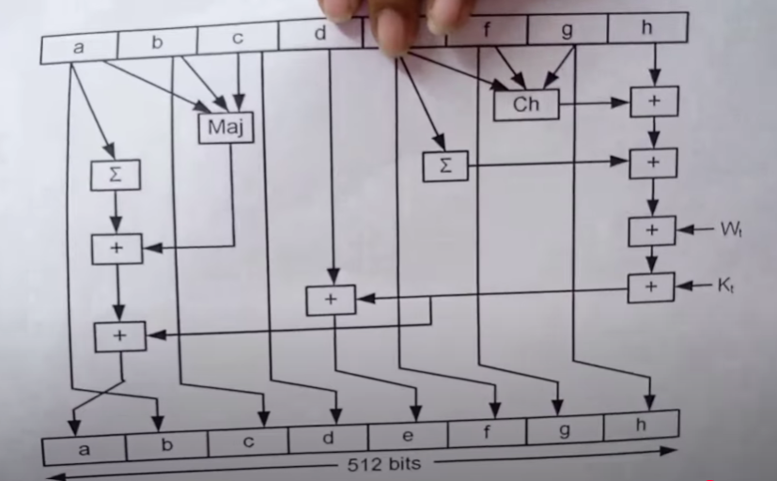

Slide 23
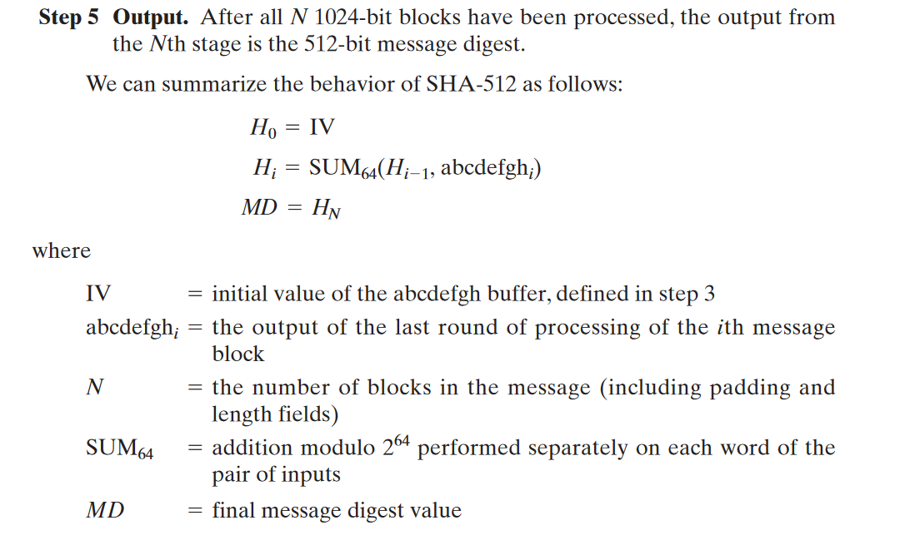

Slide 24
Message authentication requirements
In the context of communications across a network, the following attacks can be identified.
1. Disclosure: Release of message contents to any person or process not possessing the appropriate cryptographic key.
2. Traffic analysis: Discovery of the pattern of traffic between parties. In a connection-oriented application, the frequency and duration of connections could be determined.

Slide 25
3.Masquerade: Insertion of messages into the network from a fraudulent source.
4.Content modification: Changes to the contents of a message, including insertion, deletion, transposition, and modification.
5. Sequence modification: Any modification to a sequence of messages between parties, including insertion, deletion, and reordering.

Slide 26
6.Timing modification: Delay or replay of messages. In a connection-oriented application, an entire session or sequence of messages could be a replay of some previous valid session
7.Source repudiation: Denial of transmission of message by source.
8. Destination repudiation: Denial of receipt of message by destination

Slide 27
MAC based on Hash function:HMAC
HMAC Design Objective
To use, without modifications, available hash functions. In particular, to use
hash functions that perform well in software and for which code is freely and
widely available.
• To allow for easy replaceability of the embedded hash function in case faster
or more secure hash functions are found or required.
• To preserve the original performance of the hash function without incurring a
significant degradation.
• To use and handle keys in a simple way.
To have a well understood cryptographic analysis of the strength of the
authentication mechanism based on reasonable assumptions about the embedded hash function

Slide 28
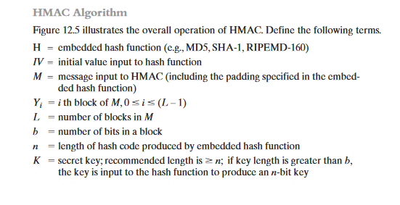

Slide 29
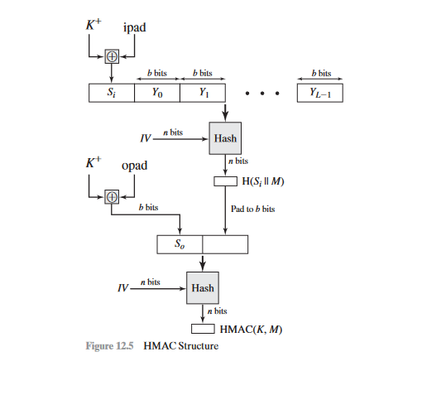

Slide 30
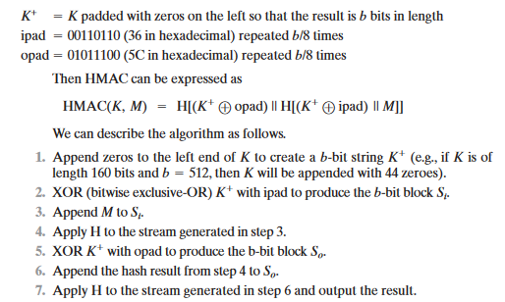

Slide 31
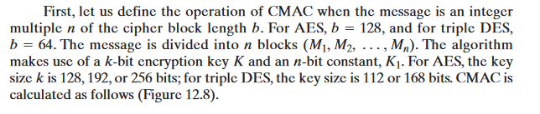
Cipher-Based Message Authentication Code (CMAC)
Cipher-based Message Authentication Code (CMAC) mode of operation for use with AES and triple DES.

Slide 32
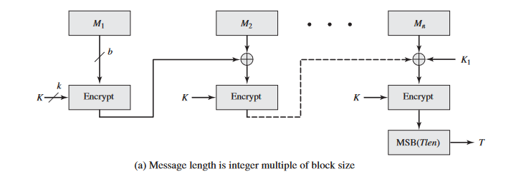

Slide 33
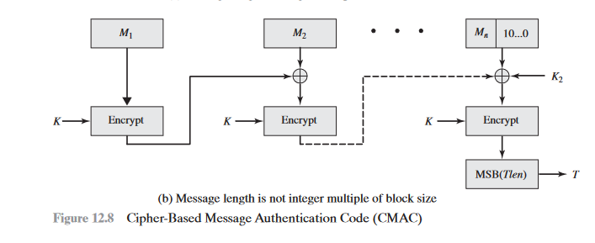

Slide 34
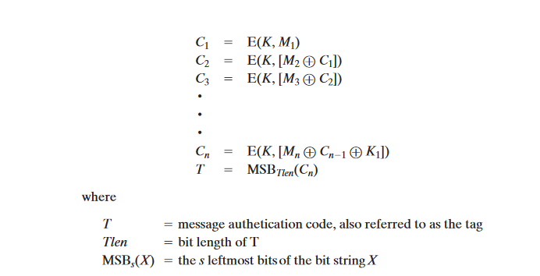
If the message is not an integer multiple of the cipher block length, then the final block is padded to the right (least significant bits) with a 1 and as many 0s as necessary so that the final block is also of length b .

Slide 35
Digital signatures
A digital signature is an authentication mechanism that enables the creator of a message to attach a code that acts as a signature.
Typically the signature is formed by taking the hash of the message and encrypting the message with the creator’s private key. The signature guarantees the source and integrity of the message.
The digital signature standard (DSS) is an NIST standard that uses the secure hash algorithm (SHA).

Slide 36
Properties
Message authentication protects two parties who exchange messages from any third party. However, it does not protect the two parties against each other. Several forms of dispute between the two are possible.

Slide 37
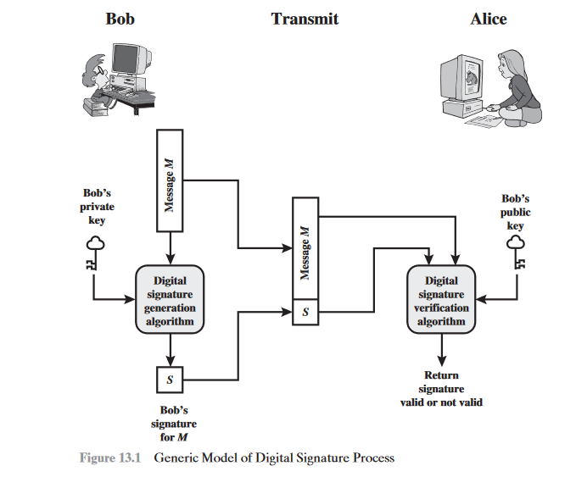

Slide 38
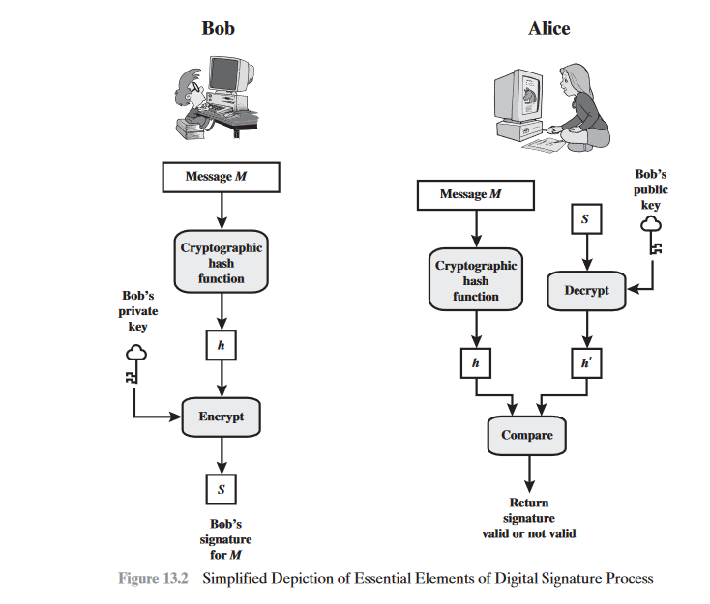

Slide 39
The most attractive solution to this problem is the digital signature. The digital signature must have the following properties:
• It must verify the author and the date and time of the signature.
• It must authenticate the contents at the time of the signature.
• It must be verifiable by third parties, to resolve disputes

Slide 40
Attacks and Forgeries:
Lists the following types of attacks(9), in order of increasing severity.
Here A denotes the user whose signature method is being attacked, and C denotes the attacker.
Key-only attack: C only knows A’s public key.
Known message attack: C is given access to a set of messages and their signatures.
Generic chosen message attack: C chooses a list of messages before attempting to breaks A’s signature scheme, independent of A’s public key.
Directed chosen message attack: Similar to the generic attack, except that the list of messages to be signed is chosen after C knows A’s public key but before any signatures are seen.

Slide 41
Adaptive chosen message attack: C is allowed to use A as an “oracle.” This means the A may request signatures of messages that depend on previously obtained message–signature pairs.
Total break: C determines A’s private key.
• Universal forgery: C finds an efficient signing algorithm that provides an equivalent way of constructing signatures on arbitrary messages.
• Selective forgery: C forges a signature for a particular message chosen by C.
• Existential forgery: C forges a signature for at least one message

Slide 42
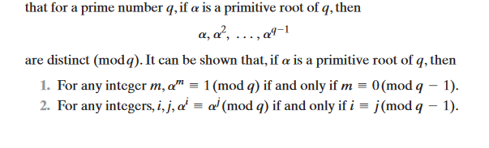
Elgamal digital signature scheme
ElGamal encryption scheme is designed to enable encryption by a user’s public key with decryption by the user’s private key.
The ElGamal signature scheme involves the use of the private key for encryption and the public key for decryption.

Slide 43
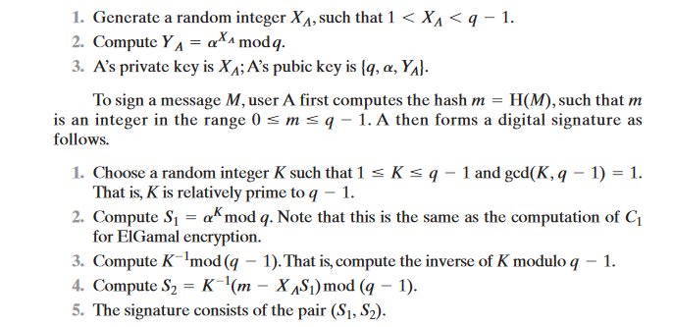
User A generates a private/public key pair as follows.

Slide 44
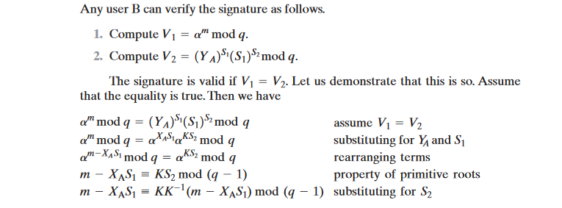

Slide 45
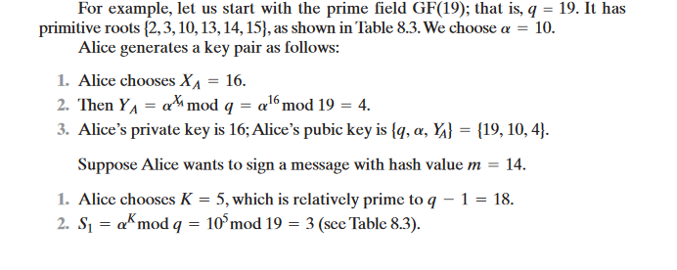

Slide 46
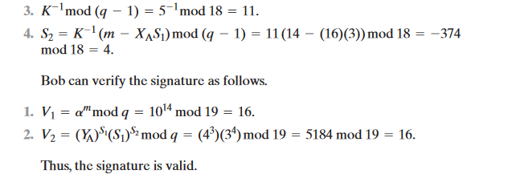

Slide 47
SYMMETRIC KEY DISTRIBUTION USING SYMMETRIC ENCRYPTION
Key distribution is the function that delivers a key to two parties who wish to exchange secure encrypted data. Some sort of mechanism or pro- tocol is needed to provide for the secure distribution of keys.
Key distribution often involves the use of master keys, which are infrequently used and are long lasting, and session keys, which are generated and distributed for temporary use between two parties.

Slide 48
SYMMETRIC KEY DISTRIBUTION USING SYMMETRIC ENCRYPTION
The strength of any cryptographic system rests with the key distribution technique, a term that refers to the means of delivering a key to two parties who wish to exchange data without allowing others to see the key. For two parties A and B, key distribution can be achieved in a number of ways, as follows:
1. A can select a key and physically deliver it to B.
2. A third party can select the key and physically deliver it to A and B.
3. If A and B have previously and recently used a key, one party can transmit the new key to the other, encrypted using the old key.
4. If A and B each has an encrypted connection to a third party C, C can deliver a key on the encrypted links to A and B.

Slide 49
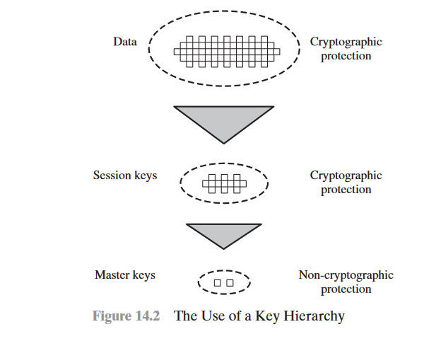

Slide 50
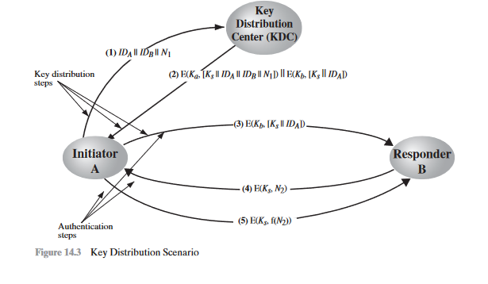
A Key Distribution Scenario
The key distribution concept can be deployed in a number of ways.

Slide 51
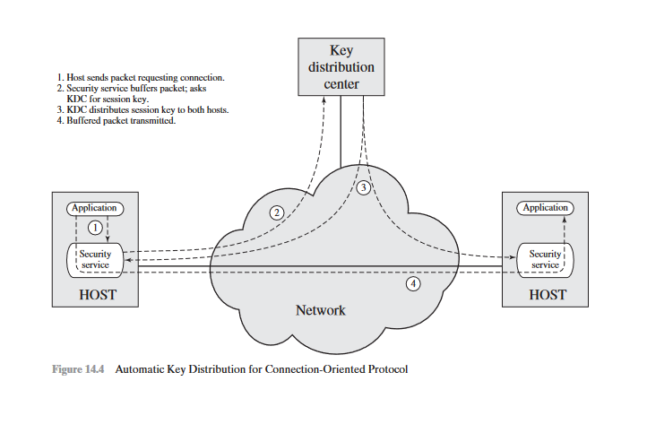

Slide 52
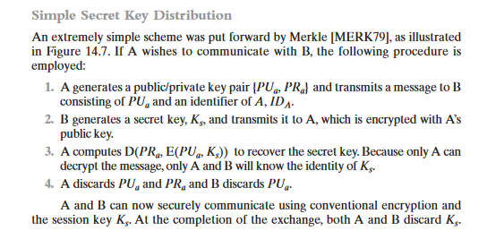
SYMMETRIC KEY DISTRIBUTION USING ASYMMETRIC ENCRYPTION
One of the most important uses of a publikey cryptosystem is to encrypt secret keys for distribution
.

Slide 53
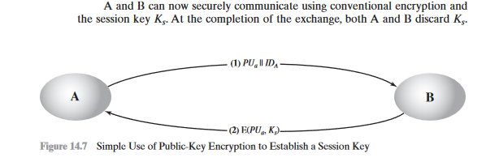
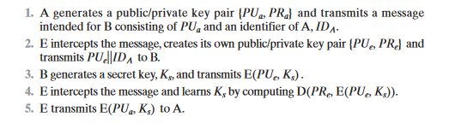

Slide 54
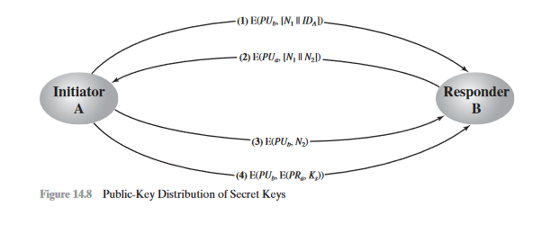
Secret Key Distribution with Confidentiality and Authentication

Slide 55
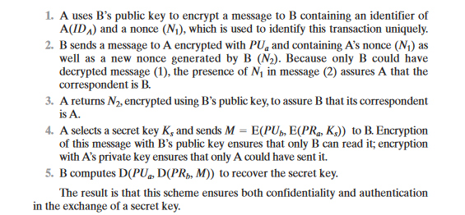

Slide 56
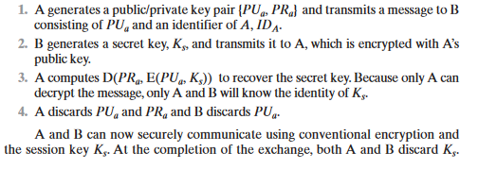
Symmetric Key Distribution using asymmetric encryption
One of the most important uses of a public-key cryptosystem is to encrypt secret keys for distribution. If A wishes to communicate with B, the following procedure is employed:

Slide 57
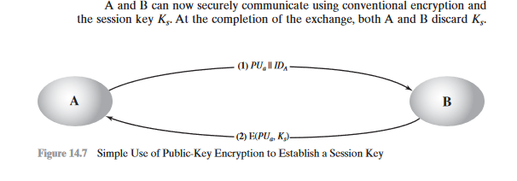

Slide 58
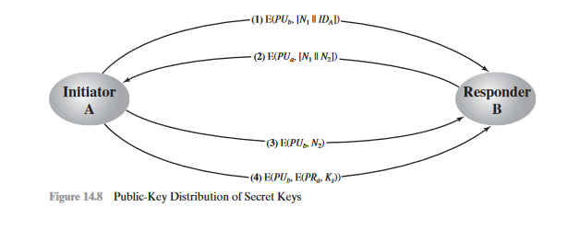
Secret Key Distribution with Confidentiality and Authentication

Slide 59
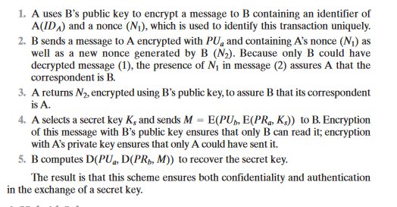

Slide 60
Distribution of public key
Several techniques have been proposed for the distribution of public keys. Virtually all these proposals can be grouped into the following general schemes:
• Public announcement
• Publicly available directory
• Public-key authority
• Public-key certificates

Slide 61
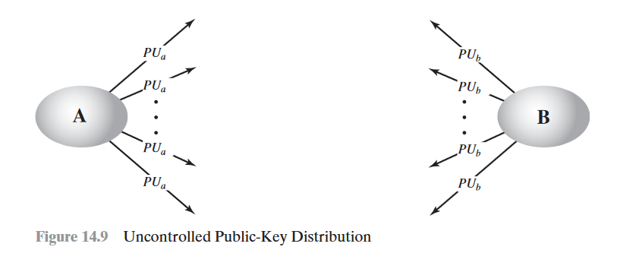
Public Announcement of Public Keys
the point of public-key encryption is that the public key is public. Thus, if there is some broadly accepted public-key algorithm, such as RSA, any par- ticipant can send his or her public key to any other participant or broadcast the key to the community at large .

Slide 62
Publicly Available Directory
A greater degree of security can be achieved by maintaining a publicly available dynamic directory of public keys
1.The authority maintains a directory with a {name, public key} entry for each participant.
2. Each participant registers a public key with the directory authority. Registration would have to be in person or by some form of secure authenti-cated communication.
3.A participant may replace the existing key with a new one at any time, either because of the desire to replace a public key that has already been used for a large amount of data

Slide 63
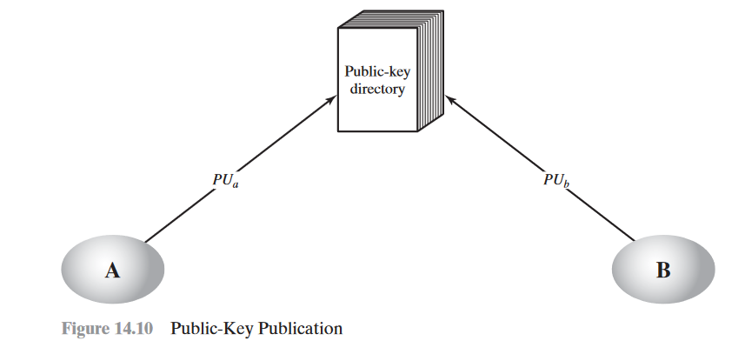
4.Participants could also access the directory electronically. For this purpose, secure, authenticated communication from the authority to the participant is mandatory.

Slide 64
Public-Key Authority
Stronger security for public-key distribution can be achieved by providing tighter control over the distribution of public keys from the directory.
1.A sends a timestamped message to the public-key authority containing a request for the current public key of B.
2.The authority responds with a message that is encrypted using the authority’s pri-vate key PR auth.

Slide 65
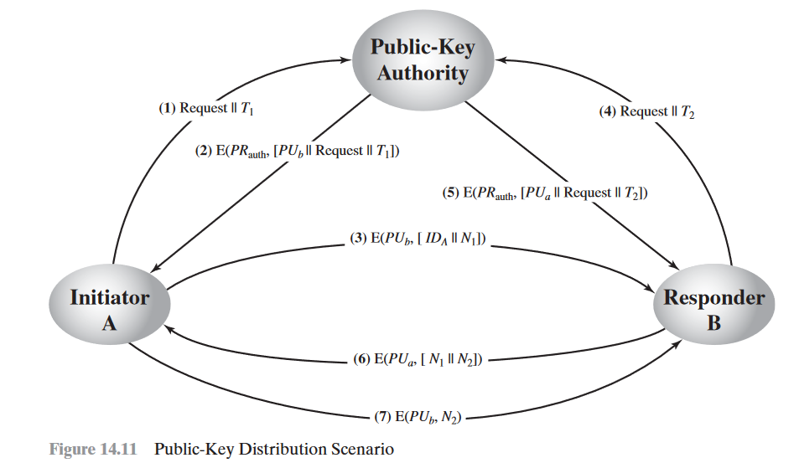

Slide 66
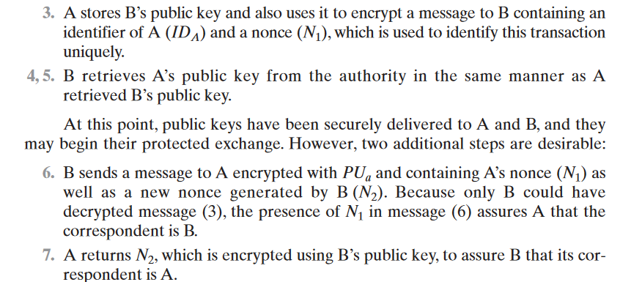

Slide 67
Public-Key Certificates
1. Any participant can read a certificate to determine the name and public key of the certificate’s owner.
2. Any participant can verify that the certificate originated from the certificate authority and is not counterfeit.
3. Only the certificate authority can create and update certificates.
4. Any participant can verify the currency of the certificate

Slide 68
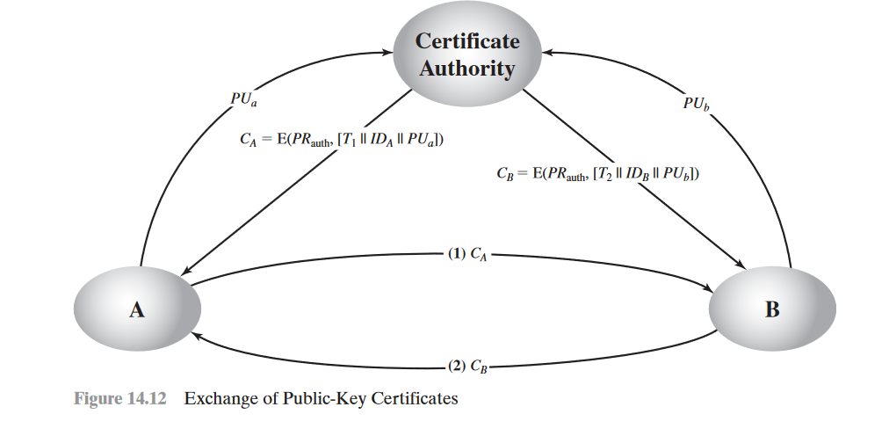

Slide 69
X.509 certificates
X.509 is part of the X.500 series of recommendations that define a directory service. The directory is, in effect, a server or distributed set of servers that maintains a database of information about users. The information includes a mapping from user name to network address, as well as other attributes and information about the users.
X.509 is an important standard because the certificate structure and authentication protocols defined in X.509 are used in a variety of contexts. For example, theX.509 certificate format is used in S/MIME , IP Security ,and SSL/TLS .

Slide 70
Certificates
The heart of the X.509 scheme is the public-key certificate associated with each user. These user certificates are assumed to be created by some trusted certifica- tion authority (CA) and placed in the directory by the CA or by the user.

Slide 71


Slide 72


Slide 73
public-key infrastructure (PKI)
public-key infrastructure (PKI) as the set of hardware, software, people, policies, and procedures needed to create, manage, store, distribute, and revoke digital certificates based on asymmetric cryptography.
The principal objective for developing a PKI is to enable secure, convenient, and efficient acquisition of public keys.

Slide 74
End entity: A generic term used to denote end users, devices (e.g., servers, routers), or any other entity that can be identified in the subject field of a public key certificate.
Certification authority (CA): The issuer of certificates and (usually) certificate revocation lists (CRLs). It may also support a variety of administrative functions, although these are often delegated to one or more Registration Authorities.

Slide 75
Registration authority (RA): The RA is often associated with the end entity registration process but can assist in a number of other areas as well.
• CRL issuer: An optional component that a CA can delegate to publish CRLs.
• Repository: A generic term used to denote any method for storing certificates and CRLs so that they can be retrieved by end entities.

Slide 76


Slide 77
PKIX Management Functions
Registration:
Initialization:
Certification:
Key pair recovery
Key pair update:
Revocation request:
Cross certification

