Slide 1
Kerberos
1.Kerberos is an authentication service designed for use in a distributed environment.
2.Kerberos provides a trusted third-party authentication service that enables clients and servers to establish authenticated communication

Slide 2
Kerberos4 is an authentication service developed as part of Project Athena at MIT.
The problem that Kerberos addresses is this: Assume an open distributed environment in which users at workstations wish to access services on servers distributed throughout the network.

Slide 3
We would like for servers to be able to restrict access to authorized users and to be able to authenticate requests for service.
In this environment, a workstation cannot be trusted to identify its users correctly to network services. In particular, the following three threats exist

Slide 4
1. A user may gain access to a particular workstation and pretend to be another user operating from that workstation.
2. A user may alter the network address of a workstation so that the requests sent from the altered workstation appear to come from the impersonated workstation.
3. A user may eavesdrop on exchanges and use a replay attack to gain entrance to a server or to disrupt operations.

Slide 5
this environment,three approaches to security can be envisioned.
1. Rely on each individual client workstation to assure the identity of its user or users and rely on each server to enforce a security policy based on user identification (ID).
2. Require that client systems authenticate themselves to servers,but trust the client system concerning the identity of its user.
3. Require the user to prove his or her identity for each service invoked.Also require that servers prove their identity to clients.

Slide 6
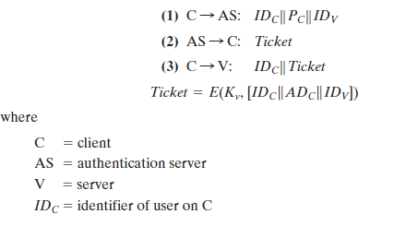
A SIMPLE AUTHENTICATION DIALOGUE

Slide 7
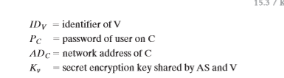

Slide 8
The first published report on Kerberos [S
TEI88] listed the following requirements.
1.Secure
2.Reliable
3.Transparent:
4. Scalable:

Slide 9
KERBEROS REALMS AND MULTIPLE KERBERI
A full-service Kerberos environment consisting of a Kerberos server, a number of clients, and a number of application servers requires the following:
1. The Kerberos server must have the user ID and hashed passwords of all participating users in its database. All users are registered with the Kerberos server.
2. The Kerberos server must share a secret key with each server. All servers are registered with the Kerberos server.

Slide 10
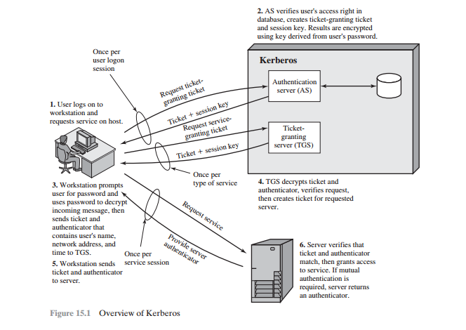

Slide 11
Such an environment is referred to as a Kerberos realm.
The concept of realm can be explained as follows. A Kerberos realm is a set of managed nodes that share the same Kerberos database. The Kerberos database resides on the Kerberos master computer system, which should be kept in a physically secure room.

Slide 12
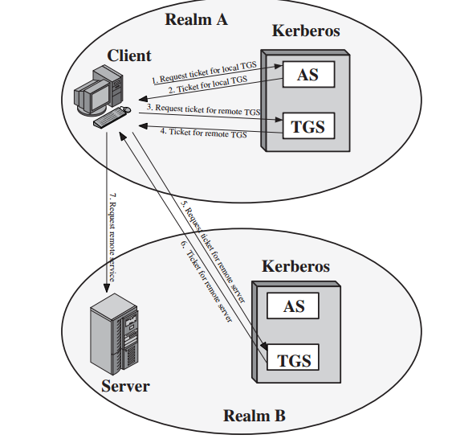


Slide 13
Kerberos version 4 was developed for use within the Project Athena environment and, accordingly, did not fully address the need to be of general purpose. This led to the following environmental shortcomings.
1. Encryption system dependence:
2. Internet protocol dependence:
3. Message byte ordering:

Slide 14
4. Ticket lifetime:
5. Authentication forwarding:
6. Inter realm authentication:

