Slide 1
Customer Churn Prediction Project
(Enhancing Retention Strategies through Data Analysis)
Team: 1.Raghavendra Reddy Pemmireddy(U01073510) 2.Varsha Kaipa(U01099158) 3.Rajeswari Yanamaddi(U01103527)

Slide 2
Introduction
- Background: "Customer churn significantly impacts revenue; retaining existing customers is more cost-effective than acquiring new ones."
- Problem Statement: "Churn rates in the banking sector are increasing due to factors like service dissatisfaction and competitive offers."
- Significance: "Effective churn prediction can save millions in revenue and enhance customer satisfaction."
- Objectives:
1. "Develop a predictive model to accurately identify potential churners."
2. "Compare various machine learning techniques to find the most effective one for churn prediction."
3. "Provide insights into the key factors contributing to customer churn."

Slide 3
Data Description
- Overview: "Analyzing data from 10,000 bank customers to predict churn."
- Key Features Include:
- Identifiers: "CustomerId, Surname (removed in preprocessing)"
- Customer Attributes:
- "CreditScore: Customer's credit score"
- "Geography: Customer's location"
- "Gender: Customer's gender"
- "Age: Customer's age"
- "Tenure: Number of years the customer has been with the bank"
- "Balance: Customer's account balance"

Slide 4
Data Description
- "NumOfProducts: Number of bank products used by the customer"
- "HasCrCard: Whether the customer has a credit card (Yes/No)"
- "IsActiveMember: Whether the customer is an active member (Yes/No)"
- "EstimatedSalary: Customer's estimated salary"
- Target Variable:
- "Exited: Whether the customer left the bank (Churned) or not (1/0)"

Slide 5
Data Preprocessing
- Introduction: "Critical steps taken to clean and prepare data for modeling:"
- Data Cleaning:
- "Handled missing values by replacing them with the median (continuous variables) or mode (categorical variables)."
- "Removed non-predictive identifiers such as CustomerId and Surname."
- Feature Engineering:
- "Transformed features like Credit Score and Balance using logarithmic scaling to normalize distribution."
- "Created new features, such as a binary indicator for above-average balance and total products used, to enhance model inputs."

Slide 6
Data Preprocessing
- Feature Encoding:
- "Applied One-Hot Encoding to categorical variables like Geography and Gender to convert them into a machine-readable form."
- "Used Label Encoding for ordinal data where appropriate."
- Feature Scaling:
- "Standardized all numeric features to have zero mean and unit variance using StandardScaler."
- "This standardization helps in removing bias due to differing scales of data measurements."
- Dataset Splitting:
- "Split the data into training (80%) and testing (20%) sets to validate model performance on unseen data."
- "Randomized split to ensure the distribution is consistent across both datasets."

Slide 7
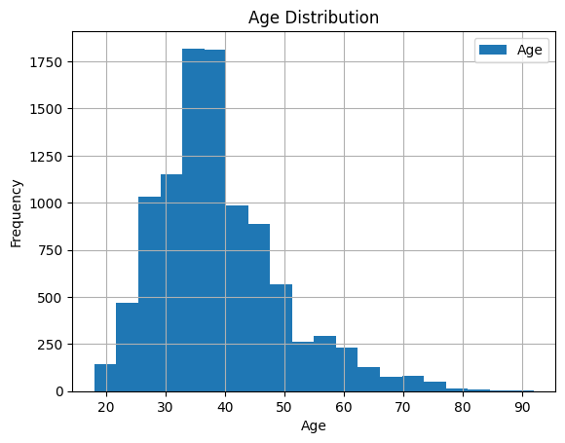
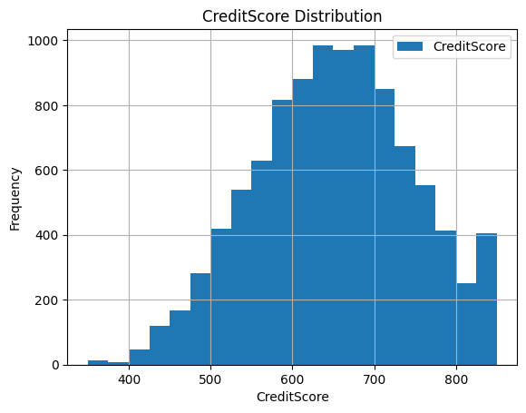
Distribution Analysis Using Histograms
- Key Visuals:
- Histogram for `Age`
- Histogram for `CreditScore`
- Insights:
- Age: The histogram shows that the age distribution is approximately normal, which suggests that no transformation is necessary for this variable in the data preprocessing stage. This normal distribution is ideal for many statistical tests and models that assume normality.
- Credit Score: The distribution exhibits a slight right skew. To address this and potentially improve model performance, a logarithmic transformation of the `CreditScore` could be considered. Normalizing the distribution can help in reducing the influence of extreme values and make the data more symmetrical which is particularly useful for models that assume normality in feature distributions.

Slide 8
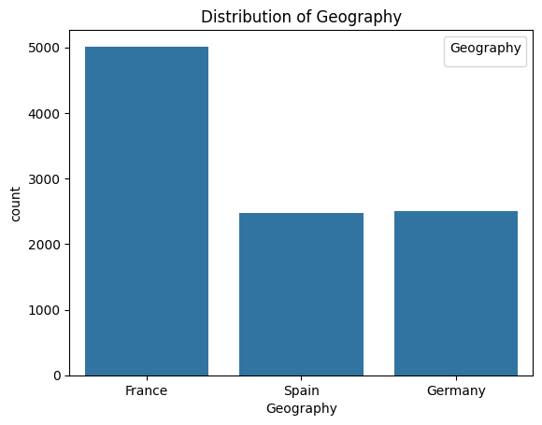
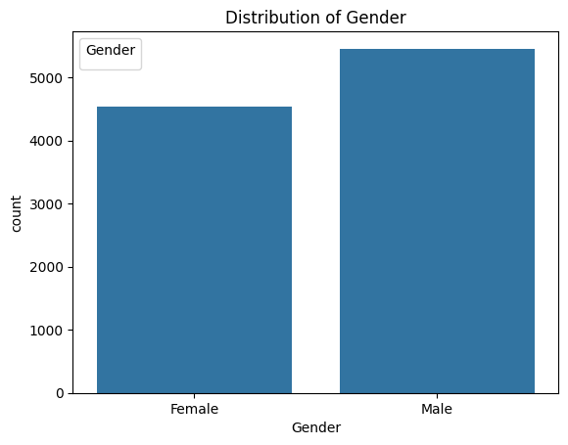
Understanding Categorical Data with Bar Charts
- Key Visuals:
- Bar chart for `Geography`
- Bar chart for `Gender`
- Insights:
- Geography:
- The bar chart reveals significant regional differences in churn rates. Notably, customers from Germany have a higher churn rate compared to those from France and Spain. This insight could suggest a regional variability in service satisfaction or market competition.
- Gender:
- The churn rate among genders shows slight variations, with females showing a marginally higher churn rate than males. This difference points to possible gender-specific factors affecting customer satisfaction or expectations that could be addressed in targeted marketing strategies.

Slide 9
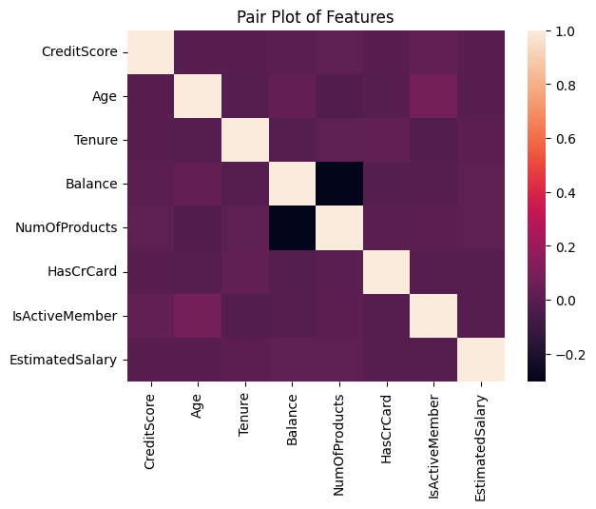
Exploring Data Relationships with a Correlation Heatmap
- Key Visual:
- Correlation heatmap of all numerical features in the dataset.
- Specific observations include:
- CreditScore and Age: There is a slightly negative correlation,
suggesting that younger customers tend to have higher credit scores.
- Balance and NumOfProducts: There is a minor negative correlation indicating that customers with higher balances tend to use fewer bank products, which might suggest different service usage patterns among wealthier customers.
- Geography (encoded as dummy variables): Shows varying degrees of correlation with product usage and balance, potentially highlighting regional differences in banking behavior.

Slide 10
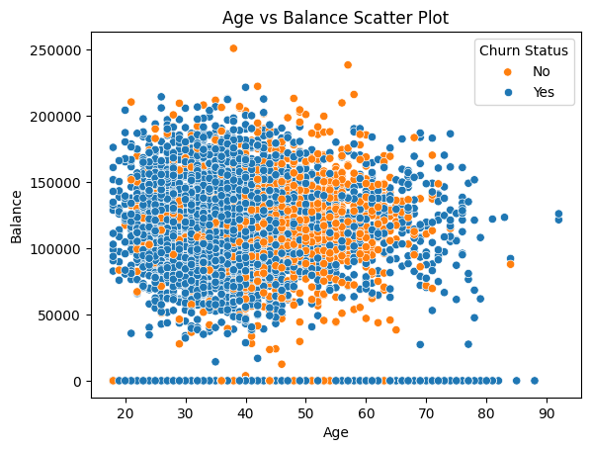
Investigating Variable Relationships Using Scatter Plots
- Key Visuals:
- Scatter plot comparing `Age` and `Balance` with churn indicated
(e.g., different colors for churned vs. non-churned customers).
- Insights: - The scatter plot reveals that older customers with higher balances tend to churn less frequently, which might indicate that more established customers feel more satisfied with or loyal to the bank.
- There is a noticeable cluster of younger customers with lower balances who have churned, suggesting that this demographic might be at a higher risk of leaving and could potentially benefit from targeted retention strategies.
- No clear linear relationship between `Age` and `Balance` in terms of churn, indicating the complexity of factors influencing the churn decision.

Slide 11
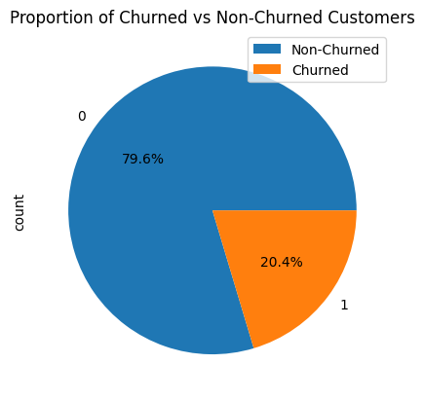
Analyzing Customer Segments with Pie Charts
- Key Visuals:
- Pie chart displaying the proportion of
churned vs. non-churned customers.
- Additional pie chart(s) might include the breakdown of customers by gender or geography if these categories are relevant to churn.
- Insights:
- The first pie chart shows that a significant portion of the bank’s customer base has churned, highlighting the importance of implementing effective retention strategies.

Slide 12
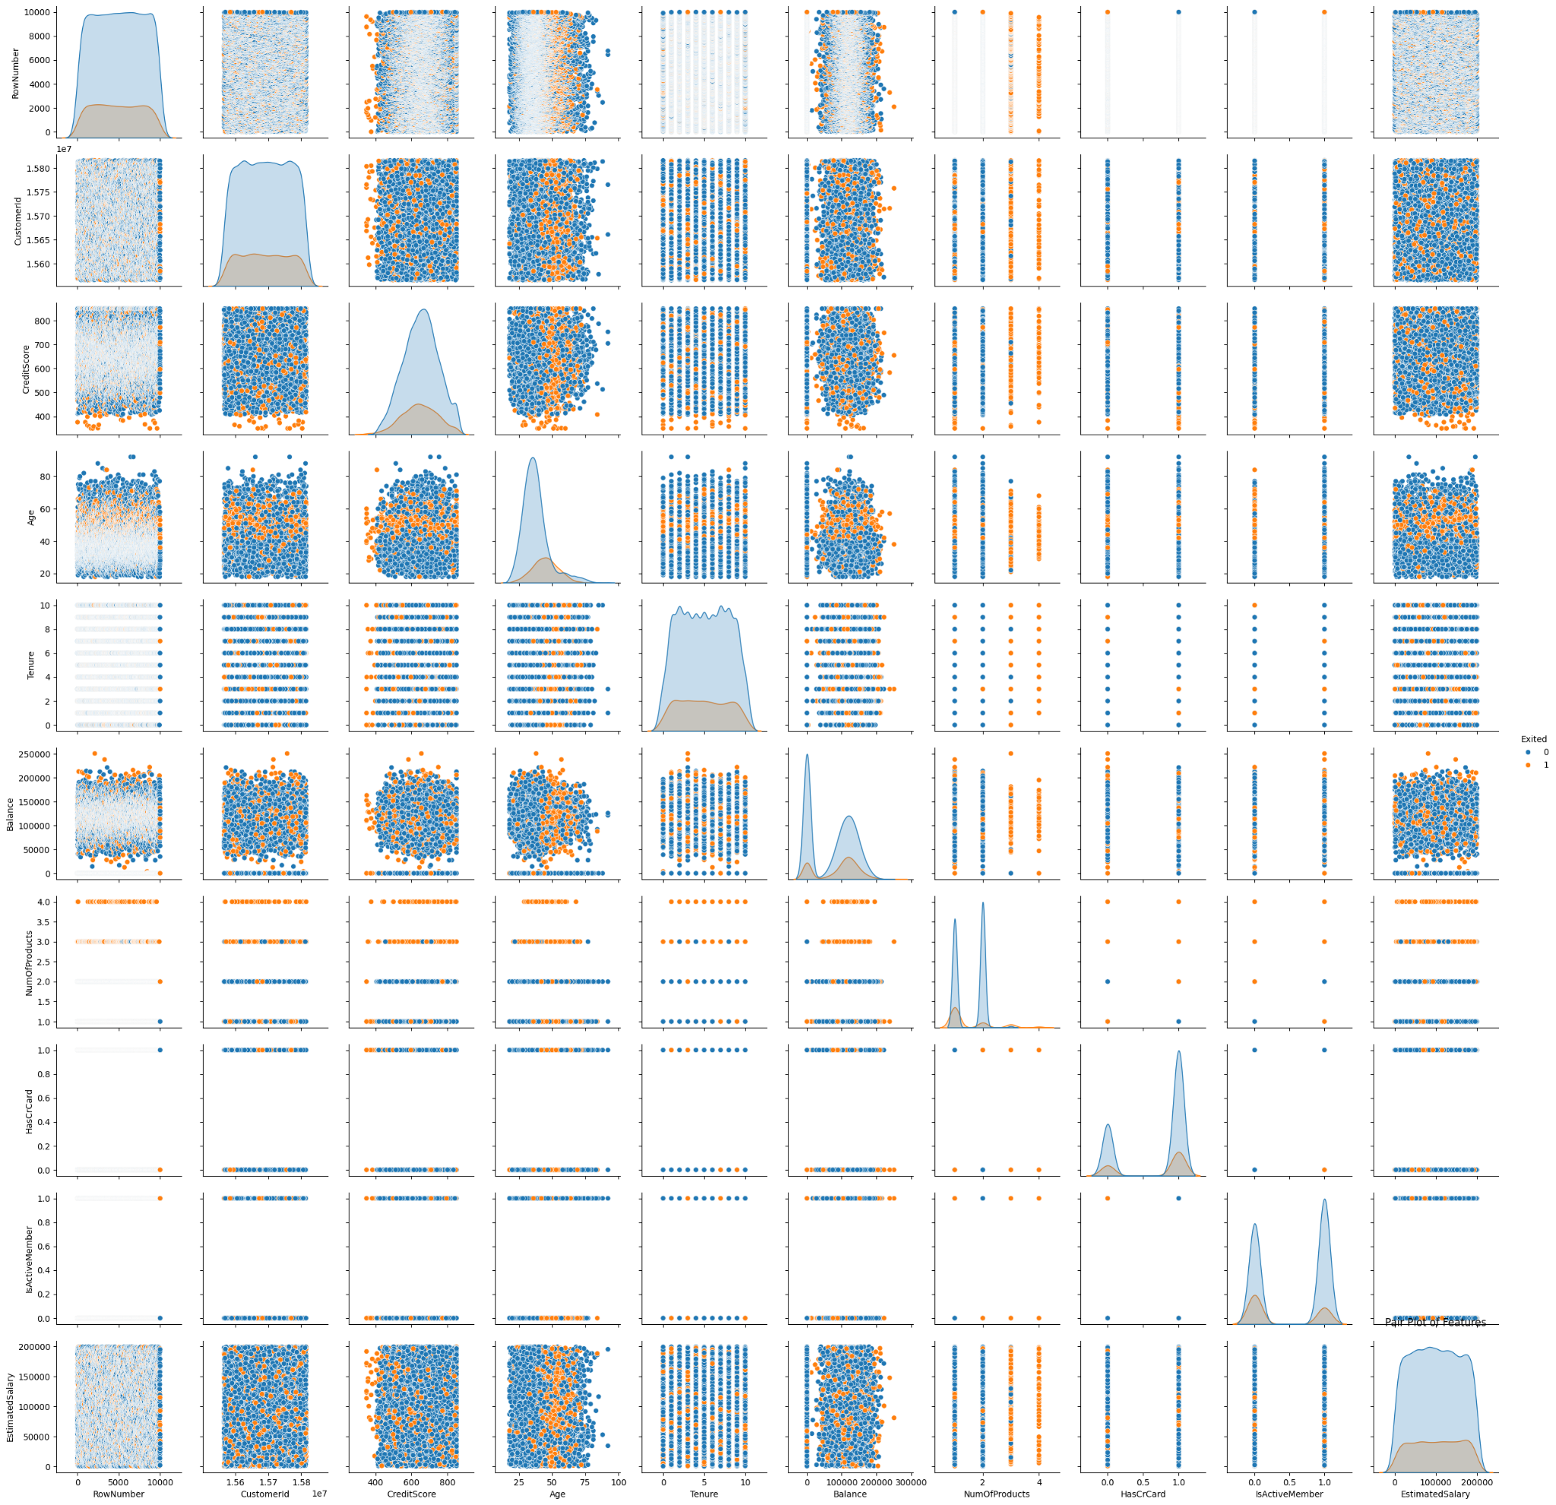
Advanced Data Distribution Analysis
- Pair Plots
- Visual: A matrix of scatter plots for multiple variable pairs
like Age, Balance, CreditScore, etc., with points colored by churn status.
- Insights:
- Clear clustering can be observed, which may indicate distinct customer segments defined by similar characteristics.

Slide 13
Strategic Insights and Actionable Recommendations
- Key Insights:
- Model Performance: The ensemble models, particularly XGBoost, have shown superior performance in predicting customer churn. These models are robust against various types of data and complex relationships.
- Customer Segmentation: Analysis has identified key segments more prone to churn, such as younger customers with lower balances and customers from specific regions (e.g., Germany).
- Feature Importance: Certain features like `NumOfProducts`, `Balance`, and regional indicators have been pivotal in predicting churn, suggesting targeted areas for intervention.
- Recommendations:
- Enhance Customer Engagement:
- Develop customized engagement plans for high-risk segments identified through the analysis. For example, introducing loyalty programs or tailored financial advice for younger customers with fewer products.

Slide 14
- Regional Focus:
- Implement region-specific strategies to improve customer satisfaction and retention, especially in high-churn areas like Germany.
- Optimize Marketing Spend:
- Use insights from feature importance to optimize marketing efforts, focusing more on retaining customers likely to churn rather than blanket campaigns.
- Continuous Model Tuning:
- Regularly update and tune the churn prediction models to adapt to changing customer behaviors and market conditions. Incorporate new data and feedback loops into the modeling process to refine predictions.

Slide 15
- Future Directions:
- Integration with Real-time Data:
- Explore opportunities to integrate the churn prediction model with real-time customer data streams for dynamic risk assessment.
- Expand Data Collection:
- Consider incorporating additional data points such as customer service interactions or social media activity to enrich the analysis and improve model accuracy.

Slide 16
Conclusion
Through rigorous analysis and application of machine learning models such as Logistic Regression, Random Forest, XGBoost, Gradient Boosting, and SVM, this project successfully achieved its goal of identifying potential churners with high accuracy and provided comprehensive insights into the drivers of customer churn. Among these, XGBoost and Gradient Boosting were standout performers, demonstrating superior ability to handle complex datasets with robust accuracy and F1-scores. Furthermore, critical factors such as geographical location, number of bank products used, and credit scores were identified as significant predictors of churn. These insights offer actionable intelligence for targeted customer retention strategies, particularly in high-churn regions like Germany where specific interventions could include enhanced customer support and tailored financial products.

Slide 17
Conclusion
Looking forward, it is recommended that continuous refinement and testing of predictive models be carried out to adapt to evolving customer behaviors and market conditions. Integrating real-time data analytics into these models could also provide more dynamic insights, allowing for immediate remedial actions to enhance customer satisfaction and retention. Additionally, expanding the data set to include variables such as social media activity and more detailed demographic information could further refine the models' accuracy. By advancing these strategies, businesses can not only decrease churn rates but also significantly improve overall operational efficiency and profitability, thereby maintaining a competitive edge in the highly volatile banking sector.

Slide 18
References
- Amin, A., Anwar, S., Adnan, A., Nawaz, M., Howard, N., Qader, I., Hawalah, A., & Hussain, A. (2019). Customer churn prediction in the telecommunication industry using data certainty. Journal of Business Research, 94, 290-301. https://doi.org/10.1016/j.jbusres.2018.10.012
- Burez, J., & Van den Poel, D. (2009). Handling class imbalance in customer churn prediction. Expert Systems with Applications, 36(3), 4626-4636. https://doi.org/10.1016/j.eswa.2008.05.043
- Chen, T., & Guestrin, C. (2016). XGBoost: A Scalable Tree Boosting System. Retrieved April 21, 2024, from https://xgboost.ai/
- Friedman, J., Hastie, T., & Tibshirani, R. (2001). The elements of statistical learning. New York: Springer series in statistics.
- Garcia, S., Luengo, J., & Herrera, F. (2015). Data Preprocessing in Data Mining. Springer International Publishing. https://doi.org/10.1007/978-3-319-10247-4
- Haenlein, M., & Kaplan, A. (2019). A brief history of artificial intelligence: On the past, present, and future of artificial intelligence. California Management Review, 61(4), 5-14. https://doi.org/10.1177/0008125619864925
- James, G., Witten, D., Hastie, T., & Tibshirani, R. (2021). An Introduction to Statistical Learning: with Applications in R (2nd ed.). Springer. https://www.statlearning.com/
- Kuhn, M., & Johnson, K. (2013). Applied Predictive Modeling. Springer.
- Pedregosa, F., Varoquaux, G., Gramfort, A., Michel, V., Thirion, B., Grisel, O., ... & Duchesnay, E. (2011). Scikit-learn: Machine learning in Python. Retrieved April 21, 2024, from https://scikit-learn.org
- Provost, F., & Fawcett, T. (2013). Data Science for Business: What you need to know about data mining and data-analytic thinking. O'Reilly Media, Inc.
- R Core Team. (2023). R: A language and environment for statistical computing. R Foundation for Statistical Computing, Vienna, Austria. URL https://www.R-project.org/.

