Slide 1

Heart Disease Analysis And Prediction
K537Z453
Varsha Nagaraj

Slide 2
Abstract
Cardiovascular disease is the most common type of heart disease, killing over 370,000 people annually.
About 610,000 people die of heart disease in the United States every year–that’s 1 in every 4 deaths.
Preventing heart disease is important. Good data-driven systems for predicting heart disease can improve the entire research and prevention process, making sure that more people can live healthy lives.

Slide 3
Problem Statement & Objective
The goal is to predict the binary class i.e; heart_disease_present, which represents whether or not a patient has heart disease.
Implementing few machine learning algorithms to analyse the data and predict the heart disease in a patient thereby finding which approach is effective to predict heart diseases in patients based on the attributes found in the dataset.

Slide 4
Methodology
Data Collection (Kaggle)
Data Cleaning
Exploring the Data
Feature scaling
Train and test Model
Calculate accuracy of the model.

Slide 5
Algorithms Used to Predict the Heart Disease
Logistic Regression
Naive Bayes Algorithm
K-Nearest Neighbour (KNN) Classification
Support Vector Machine Algorithm
Random Forest Classifier
Decision Tree Classifier

Slide 6
Libraries Used
pandas
matplotlib.pyplot
numpy
seaborn
sklearn

Slide 7
Data Analysis
Attributes : Age, sex, chest pain, Resting Blood Pressure, cholesterol, Fasting Blood sugar, ECG, exercise induced angina, Maximum heart rate achieved, target , slope, oldpeak.
target = 1 implies that the person is suffering from heart disease.
target = 0 implies the person is not suffering from heart disease.

Slide 8
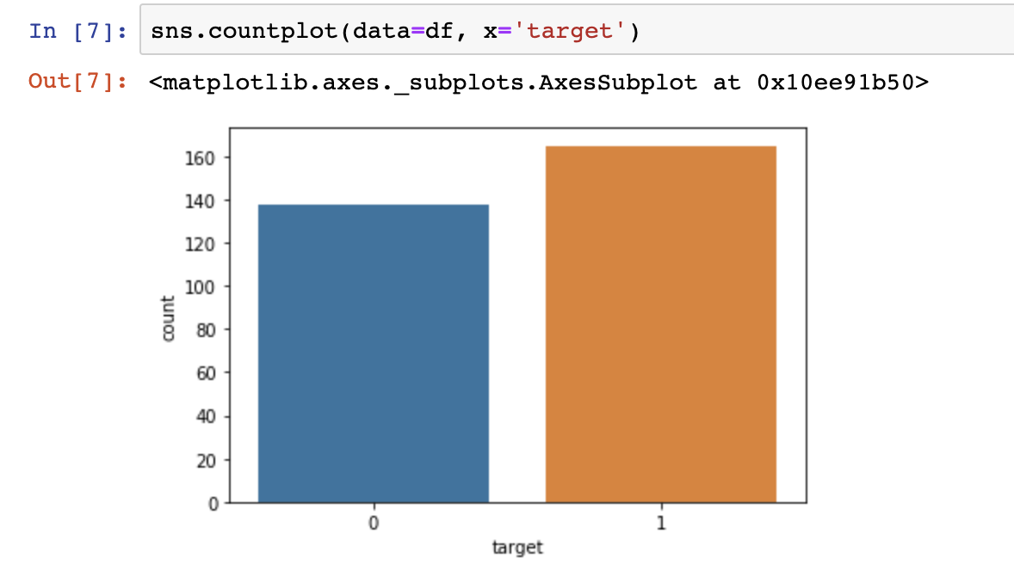
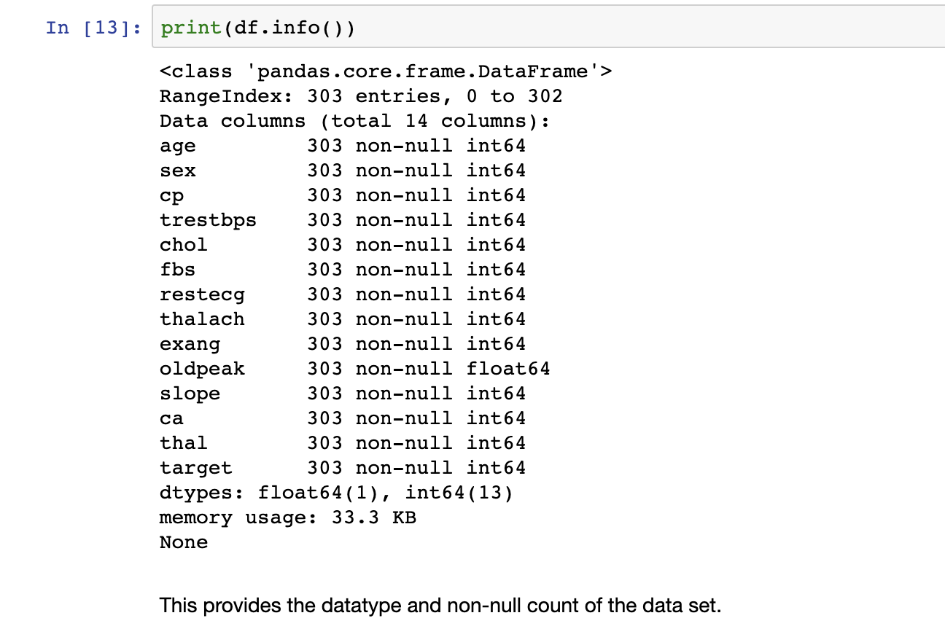

Slide 9
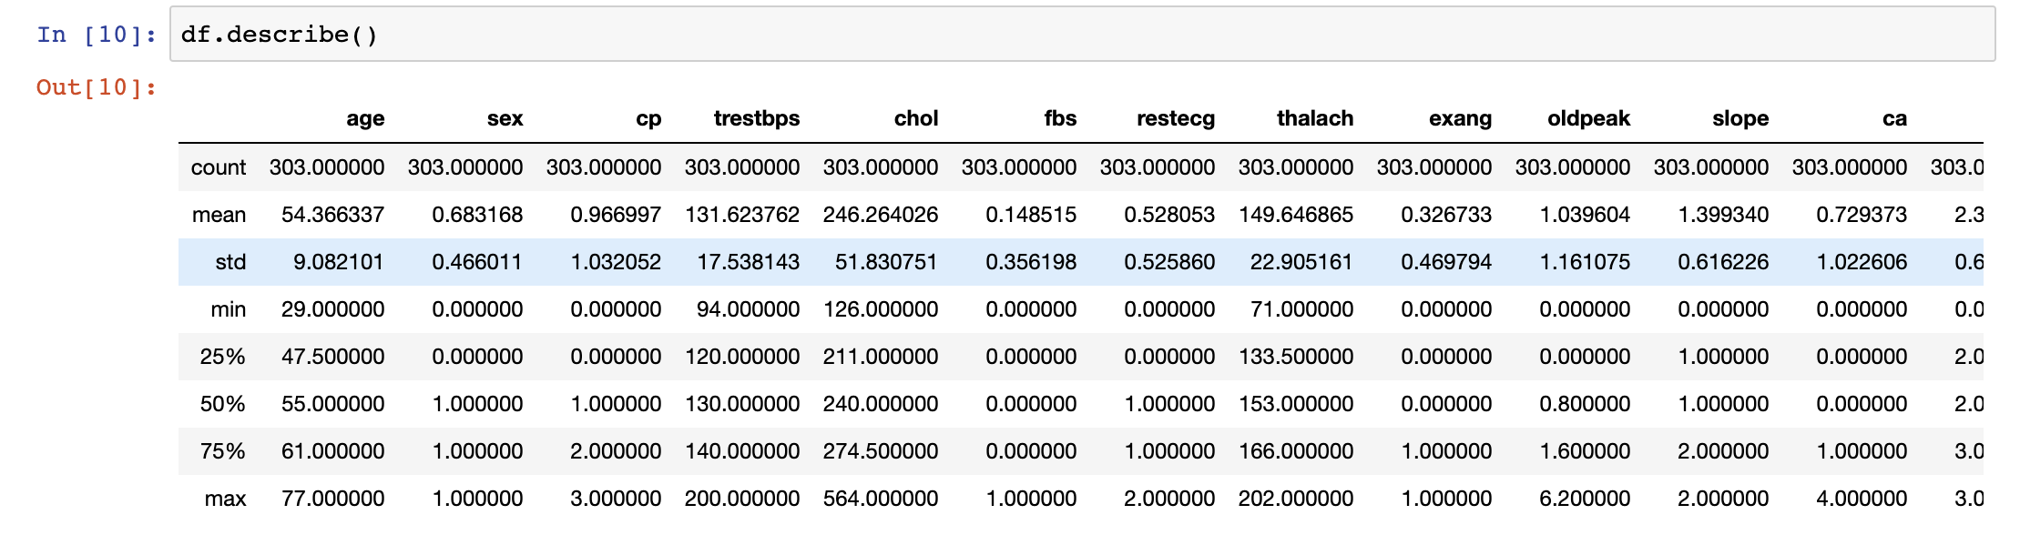

Slide 10
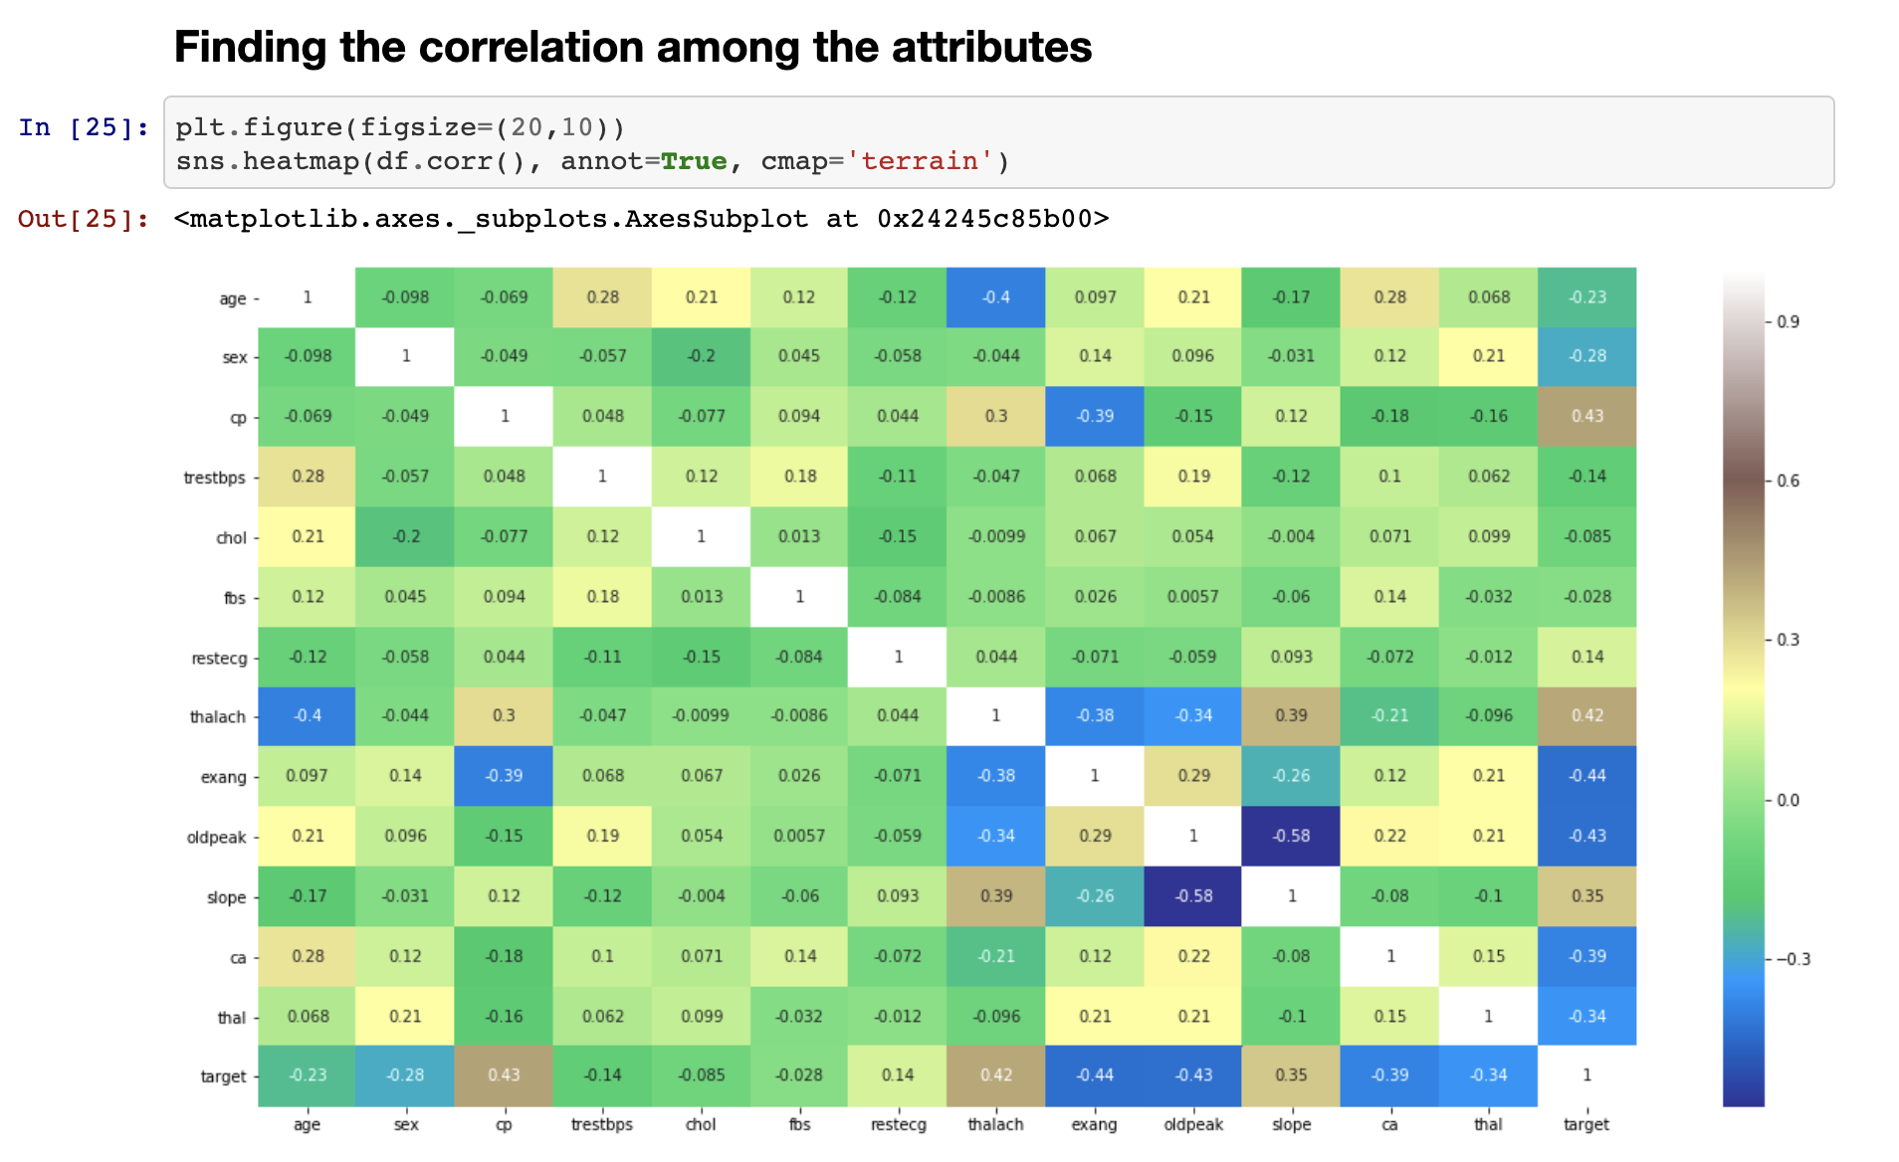

Slide 11
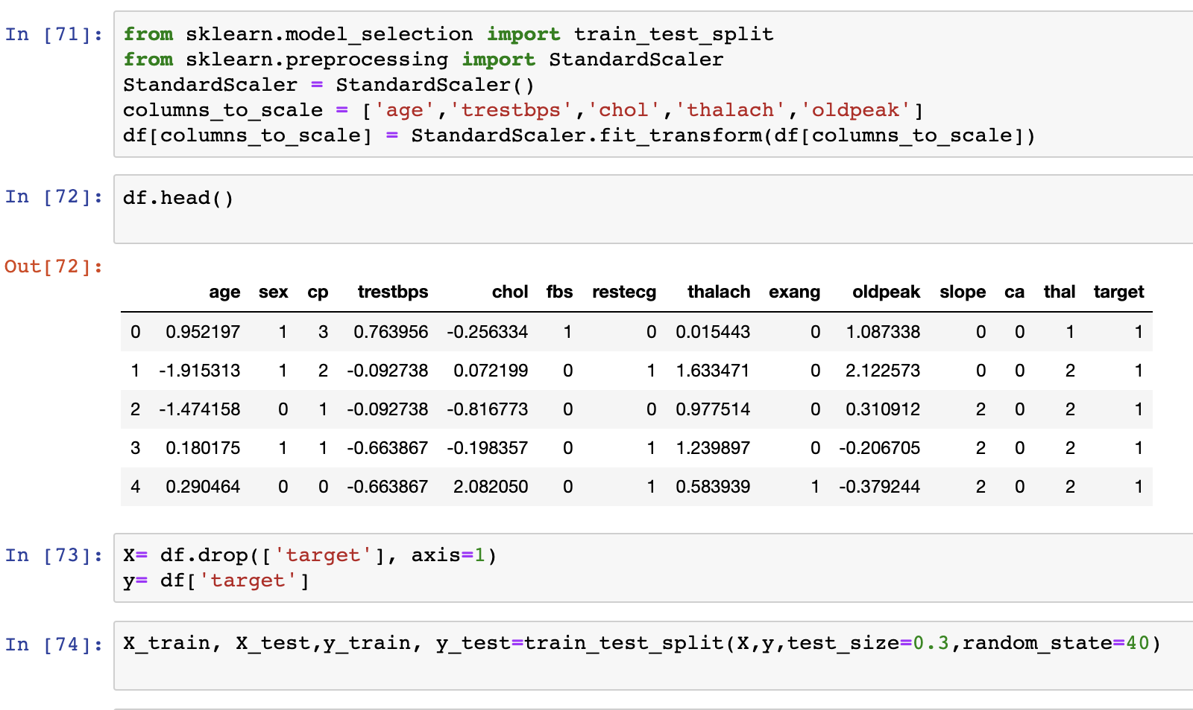
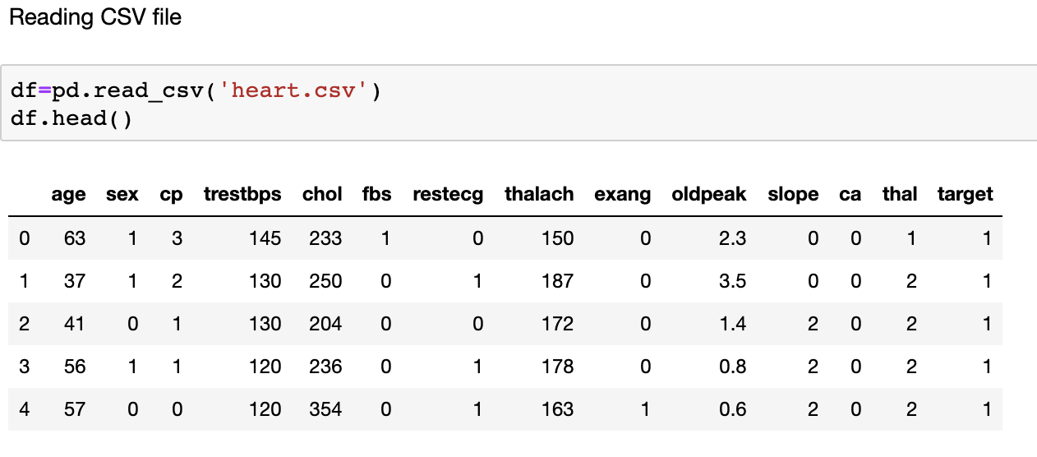
Preparing Data for Model

Slide 12
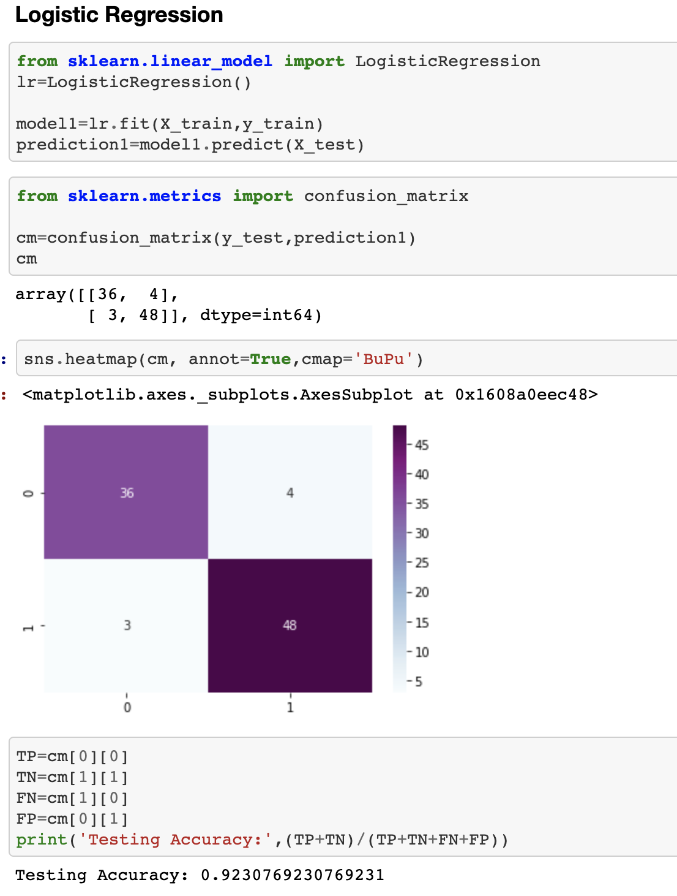
Logistic Regression

Slide 13
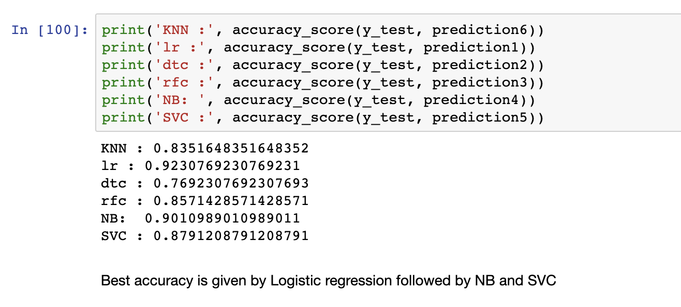
Accuracy of other Algorithms

Slide 14
References
https://www.researchgate.net/publication/319393368_Heart_Disease_Diagnosis_and_Prediction_Using _Machine_Learning_and_Data_Mining_Techniques_A_Review.
Predicting and Diagnosing of Heart Disease Using Machine Learning Algorithms Sanjay Kumar Sen Asst. Professor, Computer Science & Engg. Orissa Engineering College, Bhubaneswar, Odisha – India.
Heart disease prediction using machine learning techniques: a survey V.V. Ramalingam*, Ayantan Dandapath, M Karthik Raja

Slide 15
THANK YOU

