Slide 1
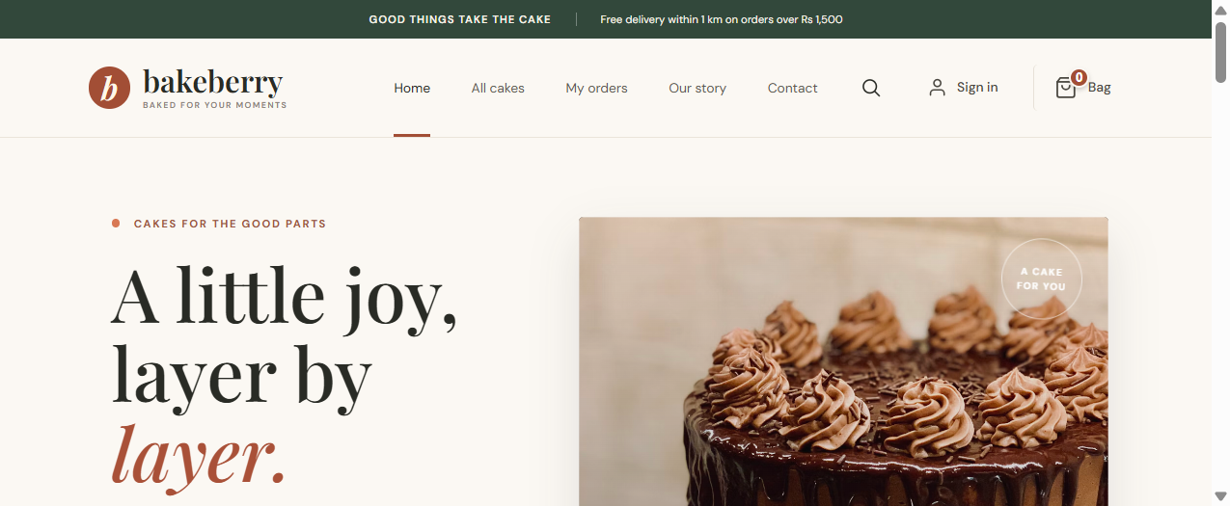
BAKEBERRY
A little joy,
layer by layer.
Artisanal cake storefront & ordering platform
PROJECT OVERVIEW • 2026

Slide 2
THE IDEA
One bakery. Two ways to celebrate.
A single-shop experience that connects everyday cake discovery with planned celebrations.
Browse a curated cake collection with clear stock and flavour details.
CUSTOMER PROMISE
Order ready cakes for pickup or local delivery.
Thoughtful,
small-batch cakes
for the moments
that matter.
Book made-to-order cakes with date and kitchen-capacity checks.
Follow orders from checkout through pickup or delivery.

Slide 3
PRODUCT EXPERIENCE
A storefront built around discovery
Real screenshot from the running Vite application.
SHOPPING HIGHLIGHTS
Category browsing
Stock-aware product cards
Quick-add cart
Advance celebration booking

Slide 4
HOW IT WORKS
From cake choice to confirmed order
Key customer and kitchen steps are coordinated through the API.
01
02
03
04
Discover
Schedule
Checkout
Complete
→
→
→
Browse cakes and
choose a variant
Select pickup date
and available slot
Server validates price
and reserves capacity
Verify payment and
track order status
Made-to-order bookings require at least 3 days' notice; availability is checked against daily capacity.

Slide 5
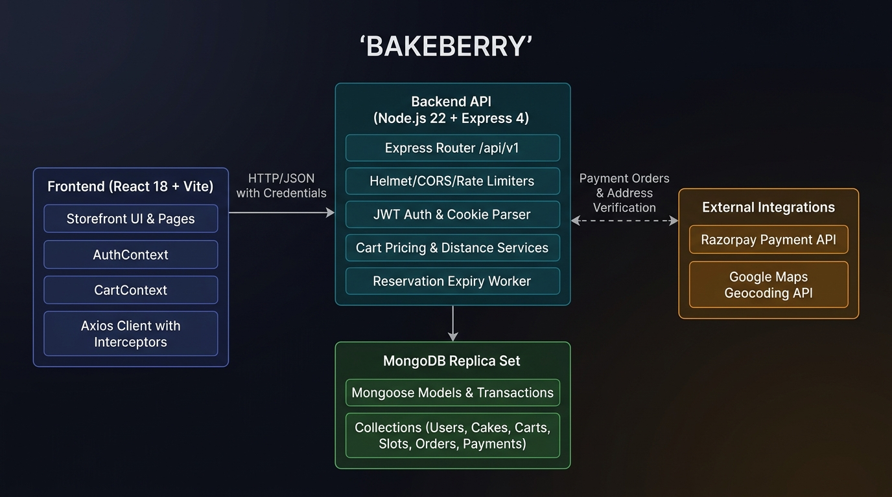
SYSTEM ARCHITECTURE
A modern web app with a transaction-aware API
React storefront, Express services, and MongoDB replica-set transactions.
React 18 + Vite
Node.js + Express REST API
MongoDB / Mongoose
Razorpay payments + geocoding

Slide 6
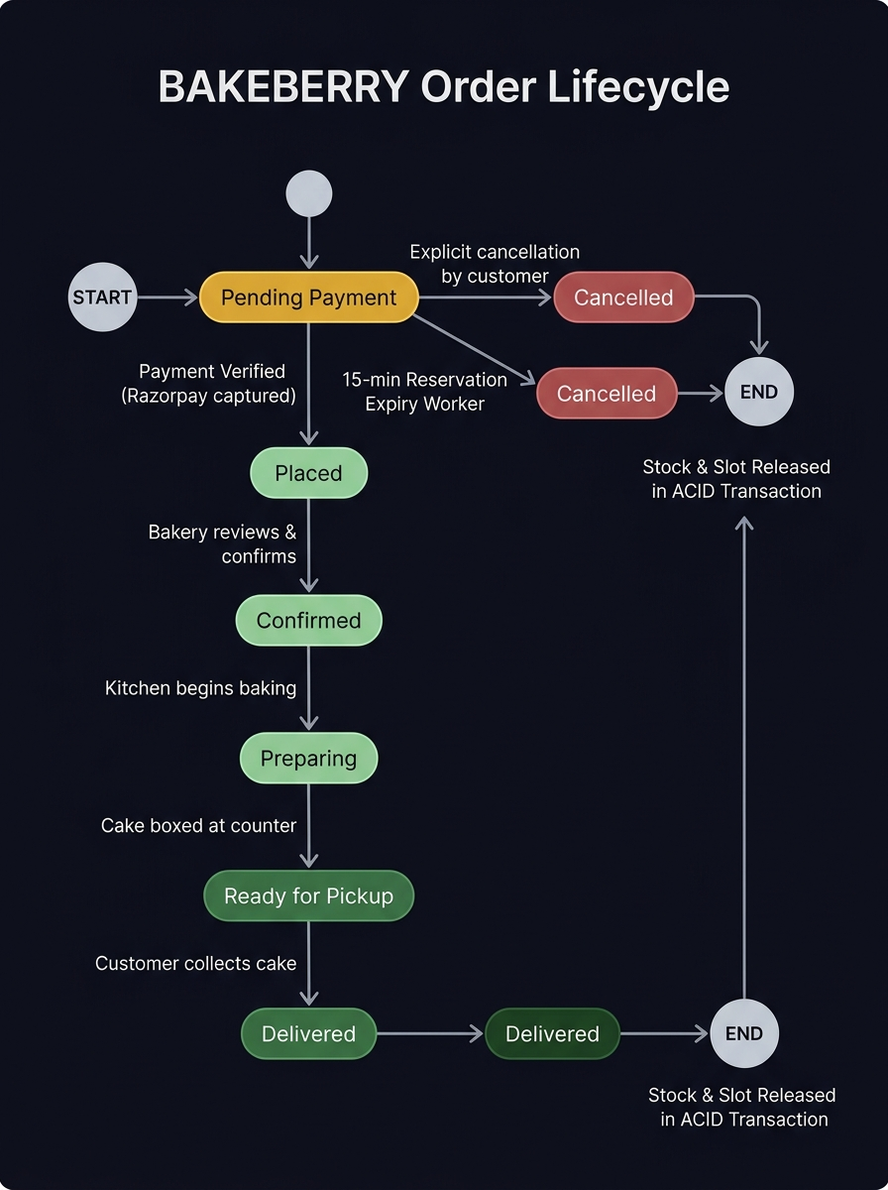
RELIABILITY & NEXT STEPS
Orders designed for trust
The core flows are implemented; production launch depends on live service configuration.
Atomic stock and booking-slot reservations.
Idempotent checkout prevents duplicate orders.
Unpaid reservations expire and release capacity.
Tests cover booking rules, commerce and ownership.
Next: configure production database, payment and delivery credentials.

