Slide 1
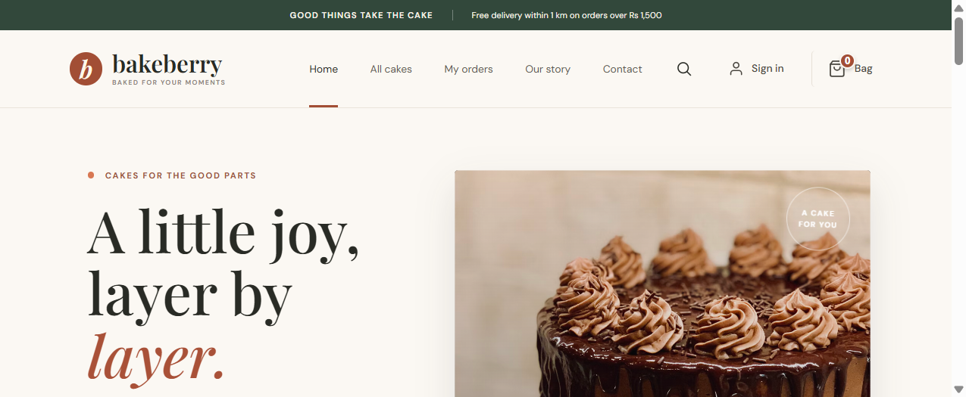
SINGLE-BAKERY E-COMMERCE WEB APPLICATION
BAKEBERRY
Cake ordering • Advance booking • Shop inventory
Project overview, user journey, architecture,
features and implementation highlights
PROJECT VERSION 1.0 | OCTOBER 2026

Slide 2
01 / THE IDEA
Project overview
BAKEBERRY is a dedicated online storefront for one bakery. Customers can browse cakes, order available stock, or book celebration cakes in advance.
One shop
Two order modes
Not a marketplace. All products, orders and inventory belong to BAKEBERRY.
Ready-today stock and made-to-order advance bookings.
Customer-first
Owner control
Business goals
• Make cake discovery simple
• Reduce booking and stock conflicts
• Support a clear, secure checkout
• Help the shop plan daily production
Responsive catalogue, cart, checkout and order tracking.
Admin overview for orders, inventory and booking capacity.
BAKEBERRY • PROJECT PRESENTATION
02

Slide 3
02 / WHAT USERS CAN DO
Main features
Browse cakes
Account access
Cart management
Explore cake categories, search products and open cake details.
Sign up, log in, manage profile and saved addresses.
Add/remove items, update quantities and sync guest cart after login.
Advance booking
Checkout & payment
Order tracking
Choose a date and time slot; minimum three calendar days’ notice.
Server-calculated totals, pickup scheduling and Razorpay payment handoff.
Review order history, status updates and cancellation options where supported.
BAKEBERRY • PROJECT PRESENTATION
03

Slide 4
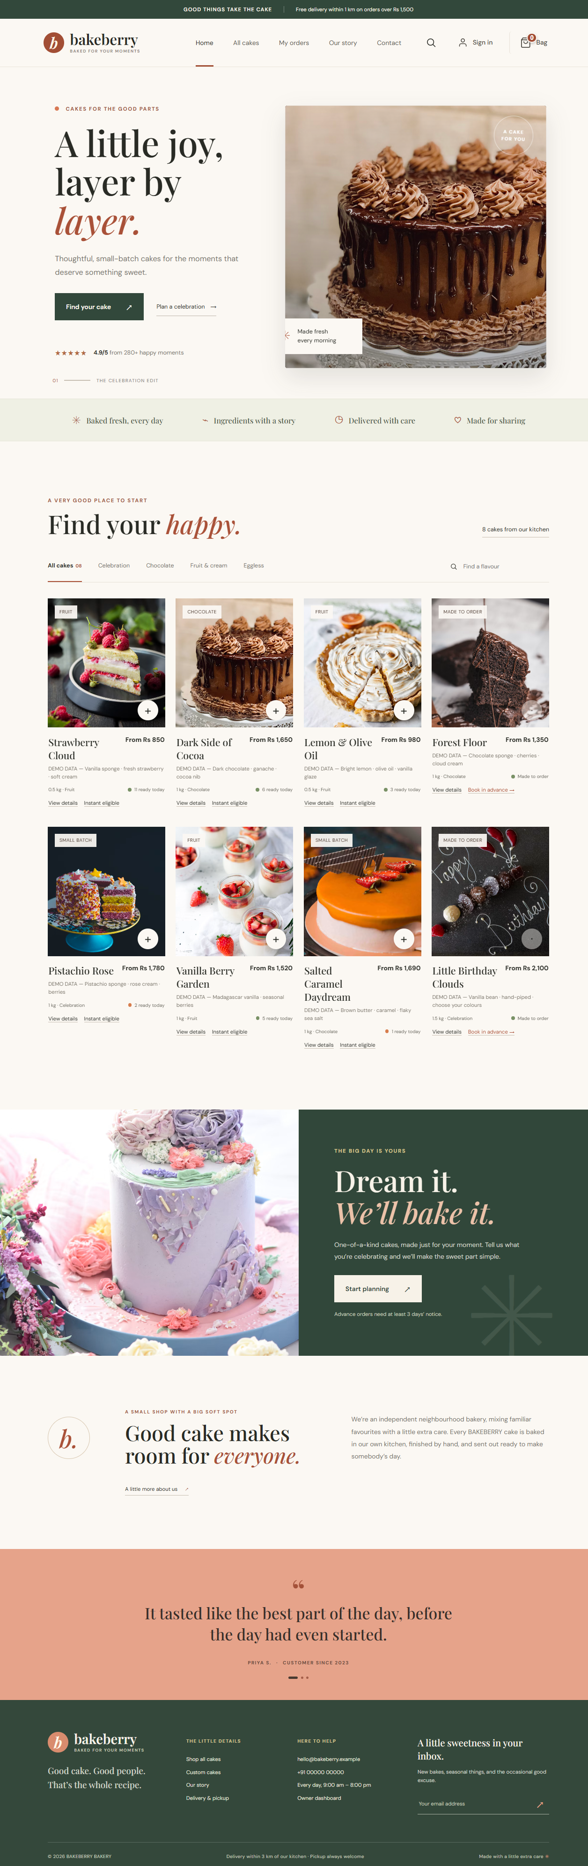
03 / INTERFACE PREVIEW
Storefront screenshots
Homepage — brand introduction and featured cake experience
Full storefront page capture
BAKEBERRY • PROJECT PRESENTATION
04

Slide 5
04 / FROM DISCOVERY TO ORDER
Customer journey
01
02
03
04
05
06
Browse
→
Choose
→
Cart
→
Schedule
→
Checkout
→
Track
Explore cake catalogue
Select size, flavour and quantity
Review items and subtotal
Select pickup date and slot
Sign in and confirm order
View order and payment status
Important rule: advance orders are validated on the server and must meet the three-day lead time and available slot/capacity rules.
BAKEBERRY • PROJECT PRESENTATION
05

Slide 6
05 / IMPLEMENTATION
Technology stack
Frontend
Backend
Database
React 18 • Vite • JavaScript/JSX
React Router • Axios • CSS
Node.js • Express 4
REST API • Middleware and services
MongoDB • Mongoose
Users, cakes, carts, slots, orders
Authentication
Payments
External services
JWT access token in memory
HttpOnly refresh cookie • bcrypt
Razorpay order creation
Backend payment verification
Geocoding API for delivery checks
Environment-based configuration
Frontend API base path: /api/v1 • Development frontend: port 5500 • Backend: port 4000
BAKEBERRY • PROJECT PRESENTATION
06

Slide 7
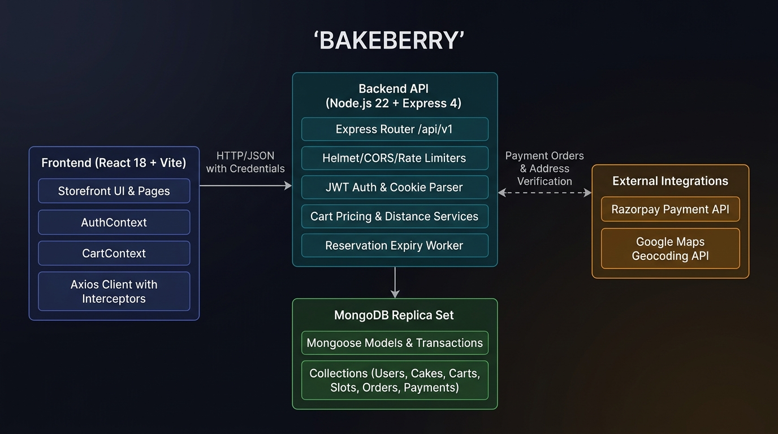
06 / HOW THE PARTS CONNECT
System architecture
React app
Pages, contexts and API client.
Express API
Auth, catalogue, cart, booking and orders.
MongoDB
Persistent records and transaction-safe reservations.
BAKEBERRY • PROJECT PRESENTATION
07

Slide 8
07 / KEY ENGINEERING CHOICES
Backend and reliability
• Modular REST API for authentication, cakes, cart, bookings, orders, payments and admin.
• Server-owned pricing prevents the browser from deciding final checkout totals.
• MongoDB transactions protect stock and booking-capacity reservations.
• Idempotency keys help avoid duplicate order creation.
• Expired unpaid reservations can be released automatically.
• JWT-based access with role and ownership checks.
• Refresh token stored in an HttpOnly cookie.
• Validation, security middleware and centralized error handling.
• Delivery checks require real shop coordinates and configured geocoding.
• Secrets and environment values should be configured outside source control.
BAKEBERRY • PROJECT PRESENTATION
08

Slide 9
08 / CURRENT PROJECT RECORD
Testing and implementation status
Frontend tests
Backend tests
Build
Recorded result: 3 service tests passed.
Recorded result: 13 tests passed, including checkout and ownership scenarios.
Recorded Vite production build passed.
Next steps before production
Known gaps to finish
• Configure persistent MongoDB and production secrets.
• Set real shop hours, inventory, delivery radius and payment keys.
• Deploy frontend and API; run end-to-end tests.
• Complete refund and delivery operations.
• Finish admin management and password-reset user experience.
• Use a reliable scheduler/queue for reservation expiry at scale.
BAKEBERRY • PROJECT PRESENTATION
09

Slide 10
BAKEBERRY
A smoother way to order
and plan celebration cakes.
A single-shop platform combining a polished storefront with booking rules, stock control, secure checkout and order visibility.
THANK YOU • PROJECT PRESENTATION

