Slide 1

Airbnb Price Prediction

Slide 2
Business Understanding:
Airbnb, inc. is an American company operating an online marketplace for short- and long-term homestays and experiences. The company acts as a broker and charges a commission from each booking. The company was founded in 2008 by Brian Chesky, Nathan Blecharczyk, and Joe Gebbia. Airbnb is a shortened version of its original name, AirBedandBreakfast.com.
Area of study- Antwerp (Belgium)
Objective:
Aims to provide property owners with a tool to suggest appropriate listing prices. This tool can help property owners optimize their rental income while remaining competitive in the market..
Optimize Rental Income: The primary objective is to assist property owners in Antwerp, Belgium, in optimizing their rental income by suggesting appropriate listing prices based on market dynamics and property characteristics.
The goal is to create a predictive model that takes into account these property attributes, historical rental data to recommend optimal rental prices.

Slide 3
Data Understanding
The Airbnb dataset has the following tables:
Calendar Table included the information of listings in Chronological Order which has columns like Listing id, Date, Available, Price, Minimum nights and Maximum nights.
Listings Table contains the details of a particular listings including Listing id, URL, Name, Description, Latitude, Longitude, Property type, Room type, Accommodates, Number of Bathrooms, Bedrooms, Beds, Amenities, Host id.
Hosts Table provides the details of hosts who have posted their listings such as Host id, Host name, Host since, Host location, Host about.
Review Table includes review details like Listing id, Review id, Date, Reviewer id, Reviewer name, Comments.

Slide 4
Software/Tools
Programming Languages: Python
Jupyter Notebook
Data Analysis and Manipulation Libraries:
Pandas
NumPy
Data Visualization Libraries:
Matplotlib
Seaborn
Machine Learning Libraries:
Scikit-learn

Slide 5
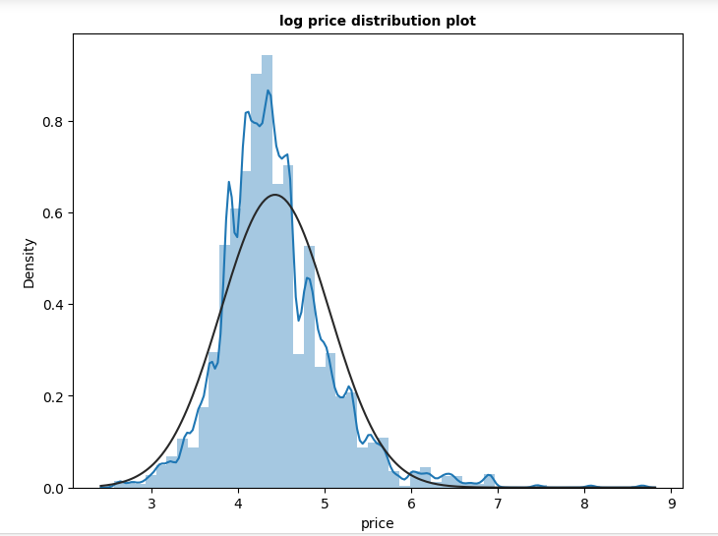
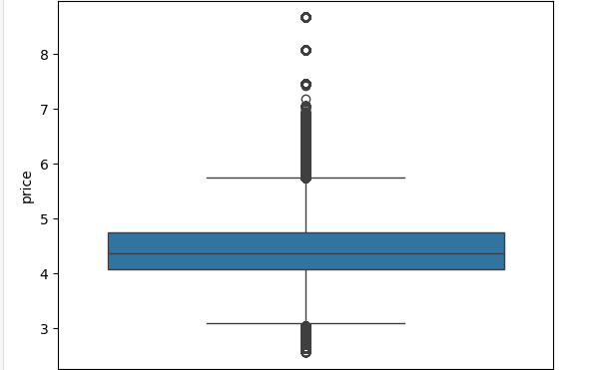
Data Understanding and Feature Creation
Identified rows and unique listing ids present in Calendar table.
Total number of rows in calendar table are 319192 & Total Unique listing_ids are 1749.
And what does it implies?
A maximum number of bookings relative to the total number of listings could indicate a large proportion of the available listings or properties are currently booked or occupied by guests. This could be a positive sign for hosts or property managers as it suggests a strong demand for accommodation in the area. It also indicates a strong demand for accommodations in the area. This might have different reasons such as tourism, events, or business travel.
Price column as target variable need some transformations.
Datatypes checked
Outlier detection & removal
Percentage of missing values checked.
With only 0.023% of missing values
in the price column we applied
data imputation technique rather
than dropping null values as price
column is Target variable.

Slide 6
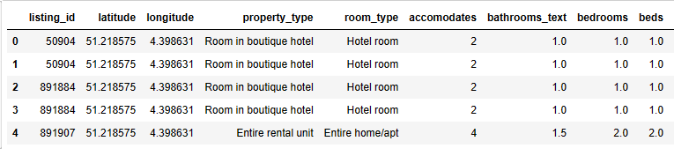
Potential transformations needed in Listings, Hosts and Reviews tables in order to fetch the features.
Datatypes checked
Null Values checked
Missing values in beds & bedrooms columns.
Imputed ‘beds’ column denoting number of beds with 1 for null values and ‘bedrooms’ column with 1 as there cannot be any Airbnb listing without any beds or bedrooms. The assumption is that any property listing will definitely have at least one bed and room for the customer to stay.
Bathroom text column converted into float dtypes because it contains the info. in both number & text format.
descriptions, host_about, host_location, comments which were dropped before further analysis
Selected Features from Listings Hosts & Review table

Slide 7
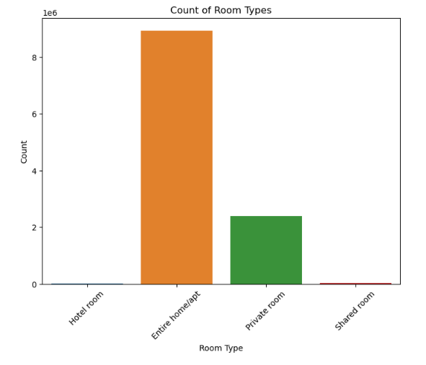
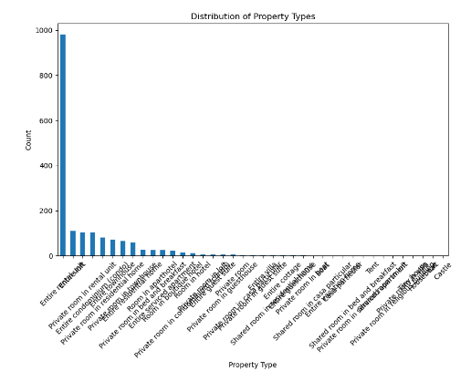
Room Type & Property Type Distribution

Slide 8
Data Quality and checks
Data Quality Report
After merging the tables containing predictors as well as target variable the data quality report has been created which mainly contains:
Summary Statistics(for Continuous Variable)
Percentage Missing values (for Continuous & Categorical Variable)
Unique Values (for continuous & categorical variable)
Data Anomaly
Missing Values in bedrooms, beds & price column, data imputation method used.
Outlier in price column, checked and removed.

Slide 9
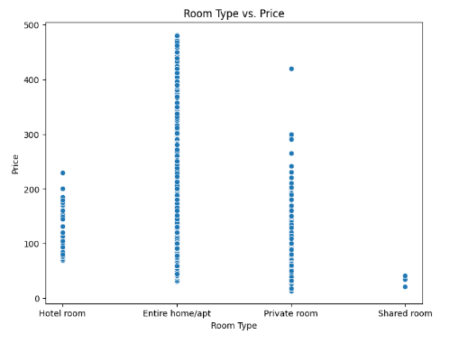
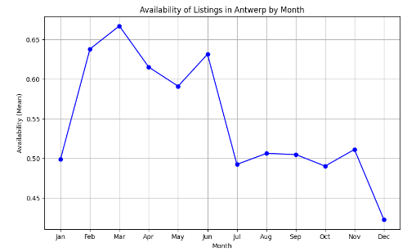
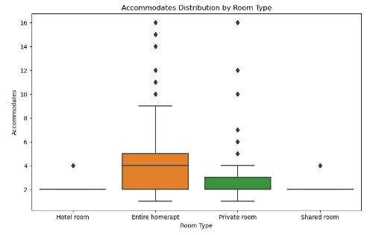
Variable profiling and checking relationships between variables
Bivariate Analysis

Slide 10
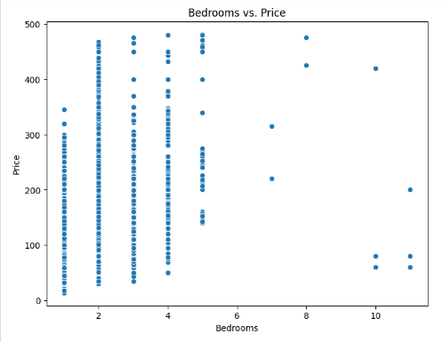
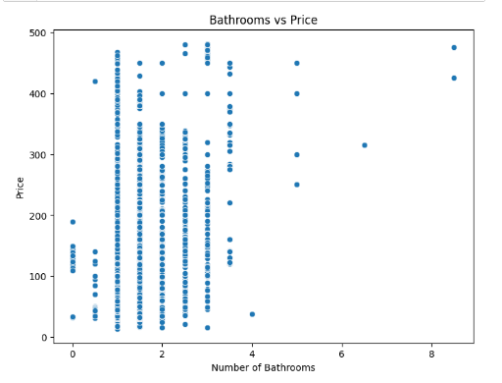
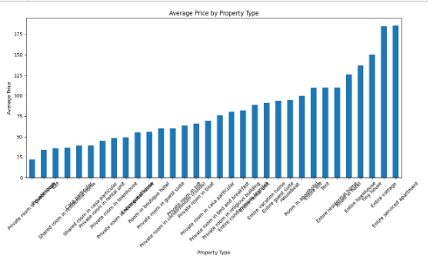

Slide 11
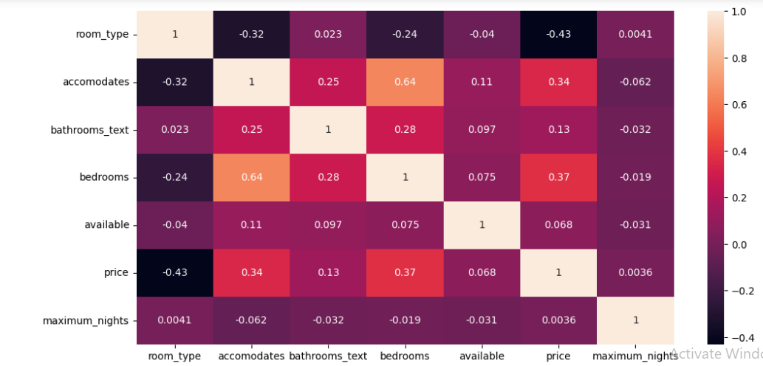
Correlation/Heat Map

Slide 12
Findings based on the above analysis and which columns need transformations:
Availability of listings varies by season, with the highest availability in March and lowest in January. Summer months tend to have lower availability due to increased tourist activity.
Entire homes command higher prices compared to Private rooms and Hotel rooms.
Certain property types such as Castles and Entire villas tend to have higher prices.
Listings with more bathrooms tend to be more expensive.
Entire homes have the highest capacity to accommodate guests, followed by Private rooms.
There is a positive correlation between the number of bedrooms and the price of listings.
Based on these findings, the column that need transformation for modeling purposes include:
Room Type: Encoded into numerical values.

Slide 13

Modeling & Insights
Explain your approach on creating train/test/validation splits.
70% data has been put in the training set and 30% in the testing set.
Experiment with Linear Regression, Decision Tree, Random Forest ,Gradient Boosting.
Model Performance
Final Model selection
Random Forest Regressor : Final Model Selection Based on the comparison matrix, the model with the lowest RMSE will be selected as the final model. From above Comparison Metrics it is observed that the accuracy score(R2 Score) is high for Random Forest Regressor Model. So that this model is considered as final model for price prediction of Airbnb listings.

Slide 14
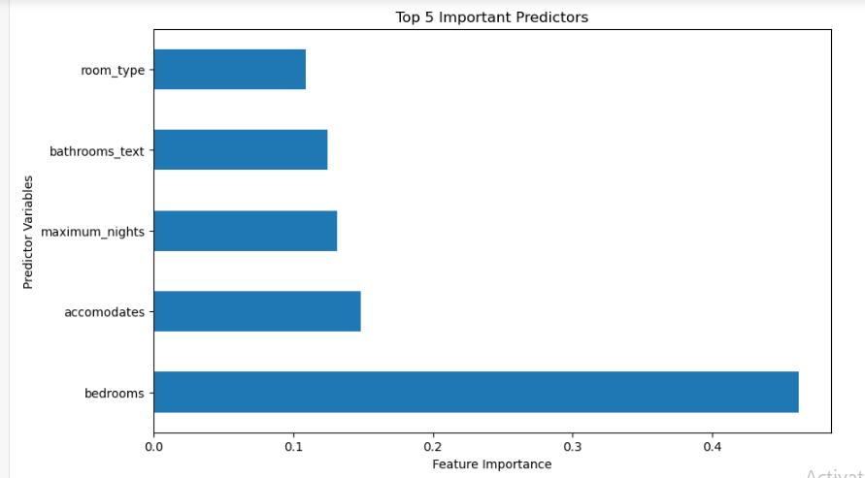
Top 5 most important predictors & direction of impact of these top 5 predictors on the Response variable.
These predictors have the most significant impact on the listing price. Interpretation of direction of impact can be derived from the coefficients in case of linear models or from the feature importance values. This completes the implementation and interpretation of the tasks. Topmost Predictor is bedrooms followed by accomodates.

Slide 15
Direction of impact
Bedrooms
Positive: Generally, a larger number of bedrooms in a property could lead to higher prices or occupancy rates. Larger properties with more bedrooms may be able to accommodate larger groups or families, making them more desirable and potentially commanding higher prices.
Negative: In some cases, having too many bedrooms relative to other amenities or features could lead to higher costs for maintenance or utilities, which might negatively impact the profitability of the property.
Accommodates
Positive: The capacity to accommodate more guests in a property could lead to higher prices or occupancy rates. Properties that can accommodate larger groups may be in higher demand, especially for group travel or special events.
Negative: If a property is designed to accommodate a larger number of guests but lacks adequate amenities or space, it could lead to negative guest experiences and impact the property's reputation or occupancy rates.
Maximum Nights
Positive: A longer maximum nights stay allowed in a property could attract guests looking for extended stays or longer-term rentals, potentially leading to higher occupancy rates or consistent bookings.
Negative: Allowing longer maximum nights stays may limit the property's flexibility in terms of availability and may not be suitable for hosts looking for short-term or transient guests.
Bathroom Text
Positive: Properties with more desirable bathroom amenities may command higher prices or attract more guests. Features such as Jacuzzi tubs, rainfall showers, or luxury toiletries could enhance the overall guest experience.
Negative: Properties with outdated or poorly maintained bathrooms may receive negative reviews or lower demand, leading to lower prices or occupancy rates.
Room Type
Positive: Certain room types, such as entire homes or private rooms, may be more desirable to guests seeking privacy, exclusivity, or a home-like experience. These room types may command higher prices or occupancy rates.
Negative: Room types that are less desirable or offer less privacy (e.g., hotel rooms, shared rooms) may have lower demand and command lower prices.

Slide 16
Thank You!

