Slide 1
Project: FDA Analysis Using SQL & Power BI

Slide 2
Business Understanding:
The FDA is a federal agency responsible for safeguarding public health in the United States, overseeing various areas including food safety, pharmaceuticals, medical devices, cosmetics, tobacco, and veterinary products. The FDA evaluates the safety and efficacy of drugs, biological products, and medical devices, conducts inspections, enforces regulations, regulates food production and distribution, conducts research, provides public health education, and monitors and responds to emerging health risks.

Slide 3
Business Objective
The U.S. Food and Drug Administration (FDA) aims to conduct a thourough data analysis on the FDA's dataset.

Slide 4
Data Understanding

Slide 5
Data Dictionary
ReviewClass_Lookup: Contains lookup values for different review classes.
ChemTypeLookup: Contains lookup values for different chemical types.
Application: Stores information about FDA applications, including details such as application number, applicant information, and various flags related to the application.
Product: Contains details about products associated with FDA applications, including product number, form, dosage, marketing status, and references to TE codes.
AppDocType_Lookup: Lookup table for different types of application documents.
DocType_lookup: Lookup table for different document types.
Product_tecode: Stores information about TE codes associated with products.
RegActionDate: Contains information about regulatory actions associated with applications, including action types, dates, and document types.
AppDoc: Stores details about application documents, including document titles, URLs, dates, and references to related application information.

Slide 6
Software/Tools:
MySQL
Power BI

Slide 7
Key Insights Overview
Bullet points summarizing the main insights derived from the analysis:
Increasing trend in drug approvals over the years.
Top three years with highest and lowest number of approvals.
Analysis of approval trends by sponsor applicants.
Segmentation of products based on market status.
Trends in dosage form distribution and successful forms.
Therapeutic classes with highest number of approvals.

Slide 8
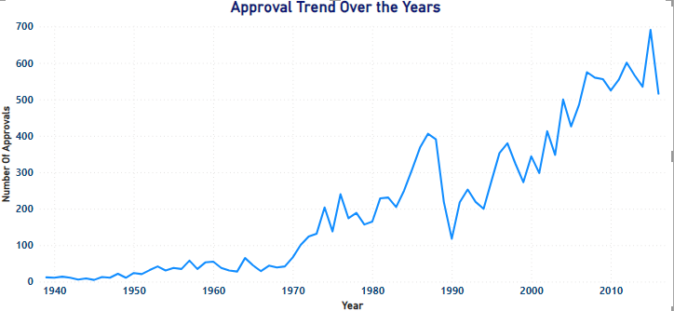
1.Visualize the yearly approval trends of drugs. Highlight any significant patterns and/or fluctuations, if any.
From the analysis it can be inferred that the number of drugs approved each year are in increasing order.
Rising number of drug approvals indicates ongoing innovation and advancements within the pharmaceutical industry. The FDA's regulatory processes may be becoming more efficient, leading to faster approval times for new drugs.
2015, 2012, and 2007 are the top three years with the highest number of drug approvals.
The high number of approvals in these years suggests periods of significant innovation,
investment, and regulatory efficiency in the pharmaceutical industry.
1943, 1944, and 1945 are the top three years with the lowest number of drug approvals.
The low number of approvals during these years could be attributed to various factors,
including wartime constraints, resource limitations, and regulatory challenges.

Slide 9
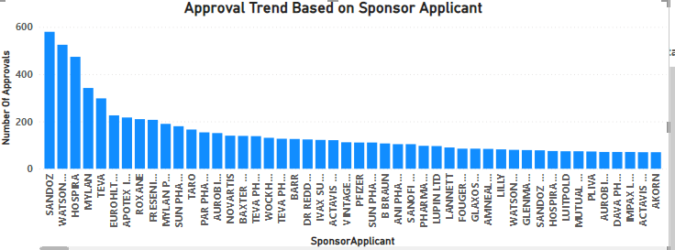
2. Explore approval trends over the years based on different sponsors. Uncover patterns and changes in approval rates among sponsors.
Analysis of approval trends based on different sponsors can provide insights into the level of engagement and investment by pharmaceutical companies in drug development over the years.
Total Sponsor applicants are 1589.
“SANDOZ”, “WATSON LABS” , “HOSPIRA” are the Sponsors with consistently high approval rates.

Slide 10
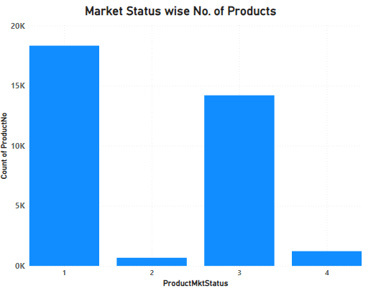
3. Visualize the segmentation of products based on Marketing Status
Segmentation of products based on market status provides valuable insights into the distribution and status of products within the FDA dataset. By visualizing the segmentation, we can observe the following:
Market status 1 has the maximum number of products, indicating that a significant portion of the product portfolio falls under this category.
Market status 1 likely represents products that are readily available in the market, approved for sale, and actively marketed to consumers.

Slide 11
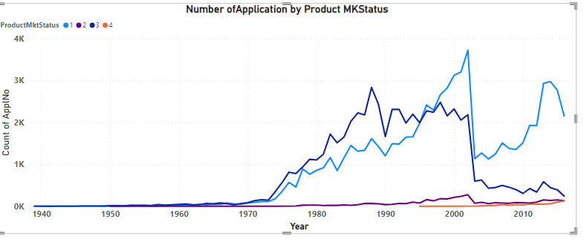
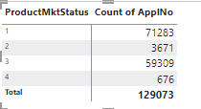
4. Show the total number of applications for each MarketingStatus. Enable users to filter by years and MarketingStatus for detailed analysis.
By analyzing the total number of applications for each MarketingStatus category, we can see the application trends over time.
It can be identified that Product MarketingStatus category 1 has the highest number of applications
Till 1995 Product MKStatus 3 had maximum number of application but afterwards it tends to decline and Product MKStatus 1 shows the increasing trend.
But in 2003 there was a sharp decrease in applications for all the Product MKStatus then from 2004 it started to increase gradually.

Slide 12
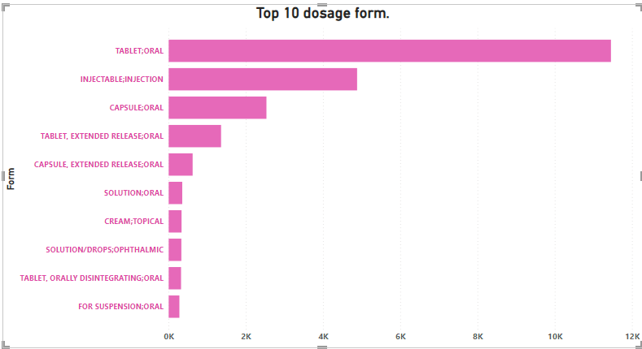
5. Analyze the grouping of drugs by dosage form. Visualize the distribution of approvals across different forms. Identify the most successful dosage form.
The analysis reveals the distribution of drug approvals across different dosage forms.
Tablet Oral followed by Capsule Oral emerge as the most successful dosage forms based on the analysis. These forms likely have the highest number of approvals compared to other dosage forms, indicating their popularity and effectiveness in delivering medications. The popularity of Tablet Oral and Capsule Oral forms may be attributed to factors such as patient preference, ease of administration, and convenience.
Here I tried to showcase the top 10 dosage form.
The high number of approvals for Tablet Oral and Capsule Oral forms may also reflect prescribing practices among healthcare providers. Physicians often prefer these dosage forms for their patients due to their reliability, dosage accuracy.

Slide 13
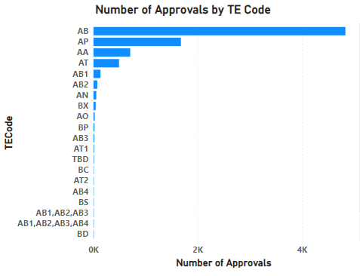
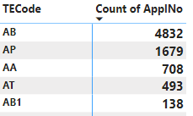
6. Visualize drug approvals based on therapeutic classes. Identify classes with the highest number of approvals.
Therapeutic classes with the highest number of approvals indicate areas of significant pharmaceutical activity and research focus. These classes likely represent diseases or conditions that are prevalent or have high unmet medical needs.
Below table shows the top 5 Therapeutic classes which have the highest number of approvals.
TE Code ‘AB’ shows the highest number of drugs approval.
High approval counts in certain therapeutic classes may reflect market demand for medications targeting specific diseases or medical conditions. Pharmaceutical companies may prioritize research and development efforts in these areas to address patient needs and capitalize on market opportunities.

Slide 14
Recommendations
2015, 2012, and 2007 are the top three years with the highest number of drug approvals. Successful strategies implemented by pharmaceutical companies, regulatory agencies, and other stakeholders during these years.
1943, 1944, and 1945 are the top three years with the lowest number of drug approvals. historical events, regulatory challenges, economic conditions, or external factors that may have impacted drug development and approval processes.
Sponsors should continuously evaluate and improve their research and development processes, regulatory strategies, and product pipelines to maintain or enhance approval rates.
Building strong relationships with regulators can lead to expedited reviews, favorable outcomes, and enhanced regulatory compliance.
Given that market status 1 has the maximum number of products, it is essential to prioritize resources and efforts towards optimizing the performance and market penetration of these products. Market status 1 likely represents products that are readily available in the market, approved for sale, and actively marketed to consumers.
Evaluate the reasons behind the lower counts of products in market status categories 2, 3, and 4.
Given the success of Tablet Oral and Capsule Oral dosage forms, pharmaceutical companies should prioritize the development and marketing of medications in these forms. Investing in research and development efforts to innovate and improve formulations for Tablet Oral and Capsule Oral products can help maintain their market dominance.
Pharmaceutical companies can allocate resources strategically based on therapeutic classes with the highest number of approvals. Investing in research, development, and marketing efforts for drugs within these classes can yield favorable returns and support business growth.
Companies can leverage their expertise and capabilities to develop and commercialize drugs within high-demand therapeutic areas.
High approval counts in certain therapeutic classes may present partnership opportunities for collaboration with academic institutions, research organizations, or other industry players. Collaborative efforts can accelerate drug development and enhance the competitive position of companies within targeted therapeutic areas.

