Slide 1

DenguScope: Identification of Transcriptomic Biomarkers for Dengue Infection
M.Sc., Dissertation 2026
Date: 20th July 2026 Venue: SLSM, Mysuru
S Varsha (24L10930)
MSc. Bioinformatics
Department of Biotechnology & Bioinformatics
JSS Academy of Higher Education & Research, Mysuru, India
Dr. Kiran Kumar M N
Associate Professor
Department of Biotechnology & Bioinformatics
JSS Academy of Higher Education & Research, Mysuru, India

Slide 2
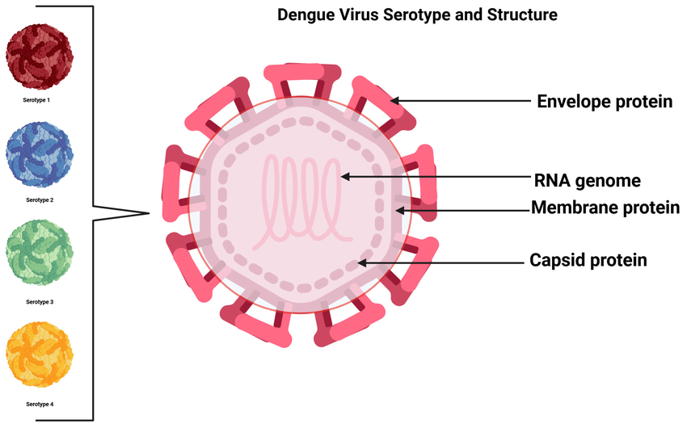

Dengue Infection
Structure and serotype of the dengue virus

Slide 3
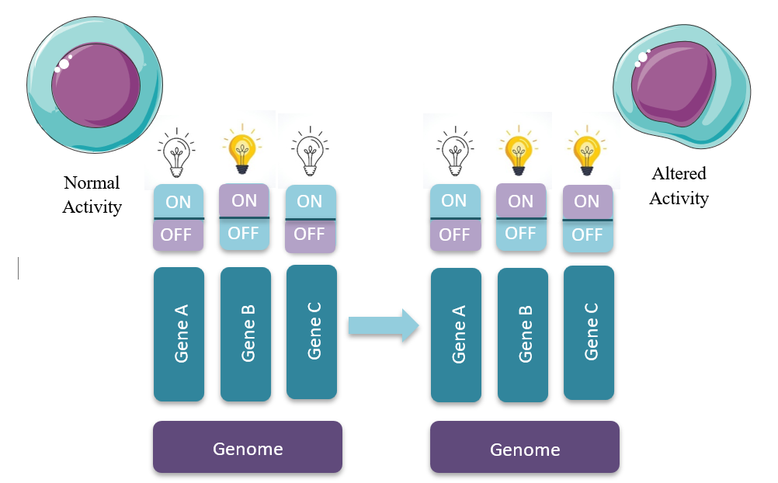
Why Transcriptomic Biomarkers?

Slide 4
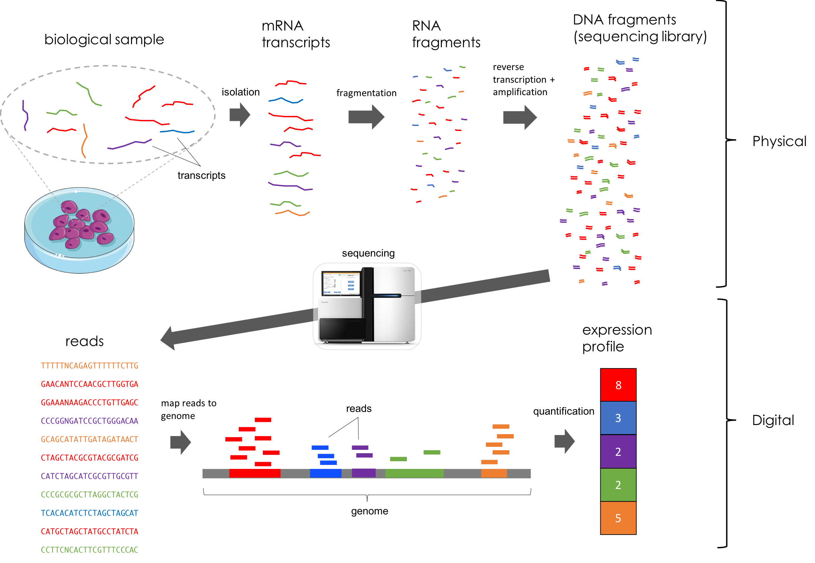
RNA-Seq Workflow
20-07-2026

Slide 5
Objectives
To identify differentially expressed genes (DEGs) associated with dengue infection.
To identify key biological pathways involved in dengue infection.
To identify candidate biomarker genes for future validation and development of targeted molecular diagnostic assays.

Slide 6
Methodology
Step 1: Data Collection and Quality Control
Step 2: Genome Indexing
NCBI Database (PRJNA1279769)
NCBI Database
60 Positive Patients
20 Negative Patients
Homo Sapiens genome (.fna)
Homo Sapiens gene annotation (.gtf)
Raw fastq files Download
STAR Indexer
Homo Sapiens Genome Index Directory
fastp Tool
Clean fastq files
FastQC Tool

Slide 7
Methodology
Step 3: Alignment and Quantification
Step 4: Normalization and Differential Expression modelling
Clean fastq files
Gene Count Matrix
Sample Metadata
Homo Sapiens Genome Index Directory
STAR Aligner
R Studio (DESeq2 Package)
SAM (Sequence Alignment Map) files
Result Matrix (log2FC, p-value, padj)
Sorted BAM (BinaryAlignment Map) files
Homo Sapiens gene annotation (.gtf)
featureCounts Tool

Slide 8
Methodology
Step 5: GO and Pathway Analysis
Significant DESeq Genes
Significant DESeq Genes
R Studio
R Studio
clusterProfiler Package
clusterProfiler Package
KEGG Enriched Pathways
GO Enriched Terms
Filtering
Filtering
GO Terms related to Dengue and Immune Response
KEGG Pathways related to Dengue and Immune Response

Slide 9
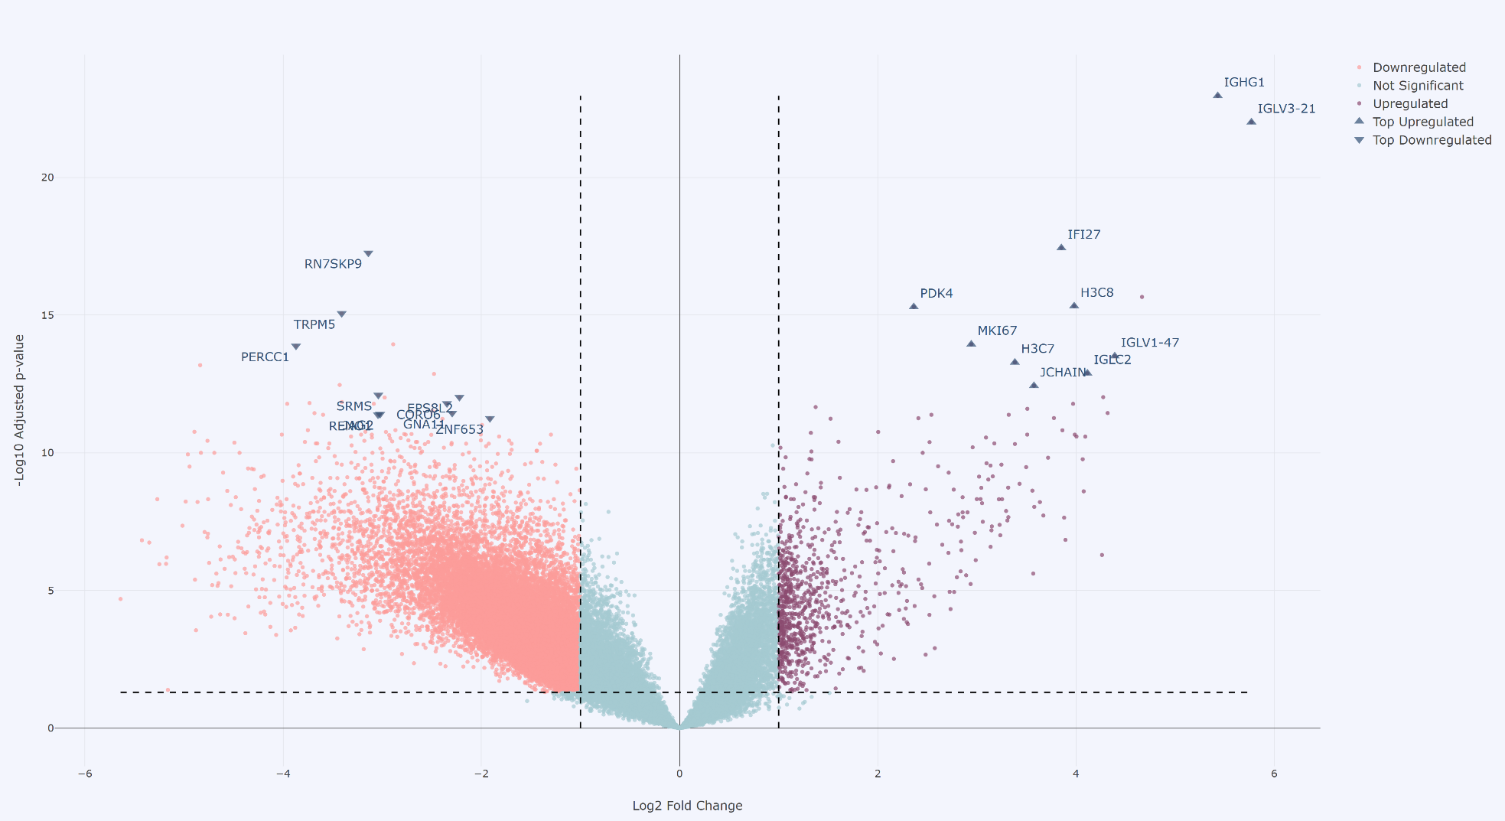
Results
Volcano Plot of Differentially Expressed Genes

Slide 10
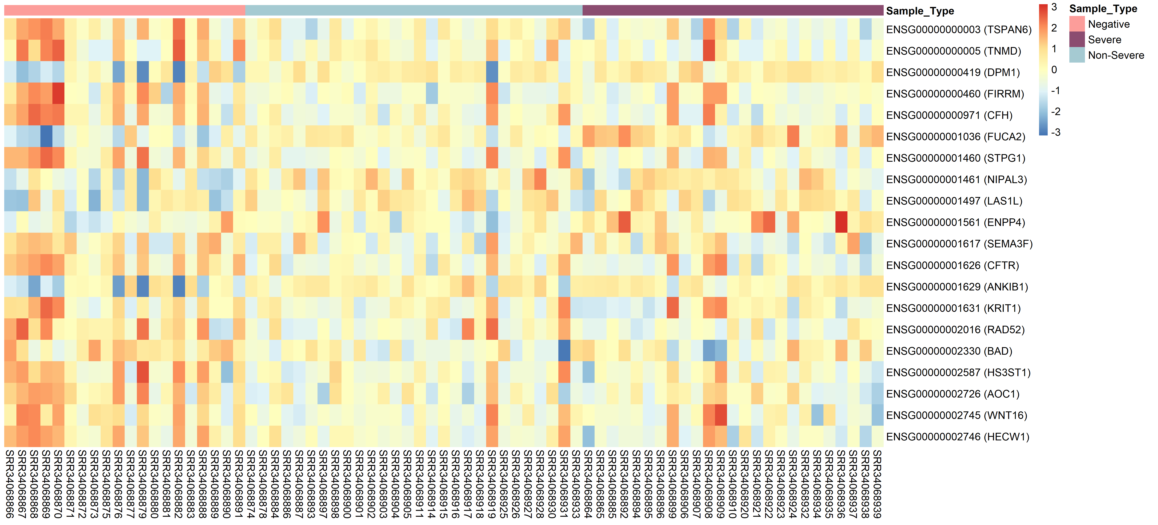
Results
Heatmap of Top Differentially Expressed Genes

Slide 11
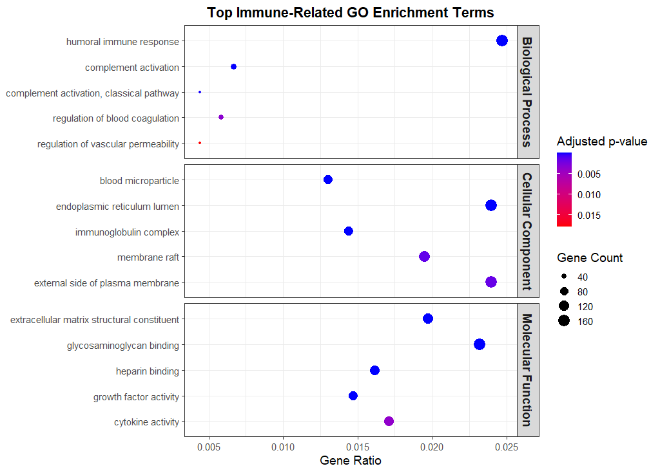
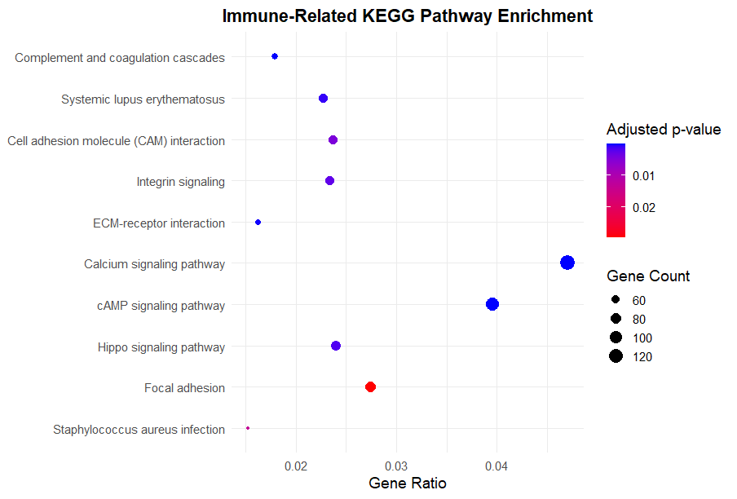
Results
Dot Plot of Top GO terms
Dot Plot of Top KEGG Pathways

Slide 12
Summary
Major Upregulated Genes
IGHG1, IGLV3-21, IGLC2, JCHAIN: Enhanced antibody production (humoral immunity)
IFI27: Activated antiviral (interferon) response
MKI67, MYBL2: Increased immune cell proliferation
Major Downregulated Genes
LAMA5: Reduced cell adhesion/ECM organization
JAG2: Altered cell signaling and vascular function
GNA11, CAMSAP3: Impaired cellular signaling and structure
Top GO Terms
Humoral immune response
Complement activation
Blood coagulation
Vascular permeability
Top KEGG Pathways
Complement & coagulation
Cell adhesion molecules
ECM–receptor interaction
Integrin & Calcium signaling

Slide 13
Conclusion
Candidate Biomarkers
Antiviral: IFI27
Humoral immunity: IGHG1, IGLV3-21, IGLC2, JCHAIN
Cell proliferation: MKI67, MYBL2
Vascular function: LAMA5, JAG2
Selected based on significant differential expression and functional enrichment.
Conclusion
Dengue causes major transcriptomic changes.
Key pathways affected: immunity, antiviral defense, coagulation, and vascular function.
IFI27, IGHG1, IGLV3-21, IGLC2, JCHAIN, MKI67, MYBL2, LAMA5, and JAG2 are promising candidate biomarkers for future validation.

Slide 14
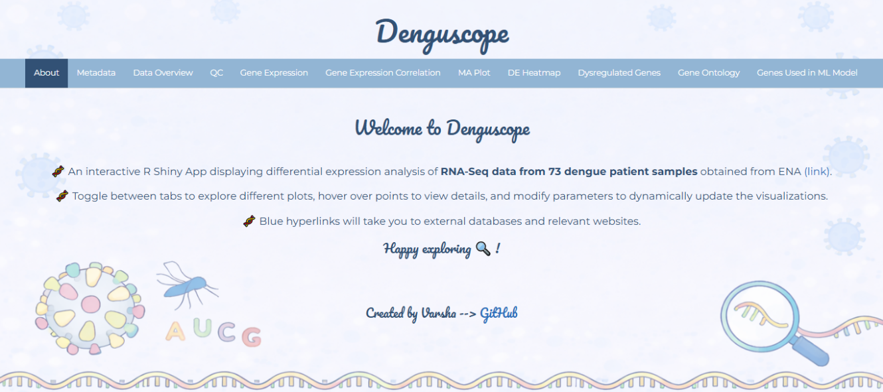
R Shiny Web App
https://varshas.shinyapps.io/Denguscope/

Slide 15




Acknowledgement
Dr. Kiran Kumar M N Guide
IISER Bhopal
Prof. Himanshu Kumar
A huge thanks to all!!
Laboratory of Immunology and Infectious Disease Biology
Dr. Pandikannan Krishnamoorthy

Slide 16
References
Dhole P, Zaidi A, Nariya HK, Sinha S, Jinesh S, Srivastava S. Host immune response to dengue virus infection: Friend or foe? Immuno. 2024;4:549-577. doi:10.3390/immuno4040033.
Krishnamoorthy P, Raj AS, Kumar P, Das N, Kumar H. Host and viral non-coding RNAs in dengue pathogenesis. Rev Med Virol. 2022;32(6):e2360. doi:10.1002/rmv.2360.
Paz-Bailey G, Adams LE, Deen J, Anderson KB, Katzelnick LC. Dengue. Lancet. 2024;403(10427):667-682. doi:10.1016/S0140-6736(23)02592-4.
Stark R, Grzelak M, Hadfield J. RNA sequencing: The teenage years. Nat Rev Genet. 2019;20:631-656. doi:10.1038/s41576-019-0150-2.
Falconi-Agapito F, Kerkhof K, Merino X, Bakokimi D, Torres F, Van Esbroeck M, et al. Peptide biomarkers for the diagnosis of dengue infection. Front Immunol. 2022;13:793882. doi:10.3389/fimmu.2022.793882.
Thach TQ, Eisa HG, Ben Hmeda A, Faraj H, Thuan TM, Abdelrahman MM, et al. Predictive markers for the early prognosis of dengue severity: A systematic review and meta-analysis. PLoS Negl Trop Dis. 2021;15(10):e0009808. doi:10.1371/journal.pntd.0009808.
Thank You

Slide 17
Thank You

