Slide 1

DEPARTMENT OF ARTIFICIAL INTELLIGENCE AND DATA SCIENCE
Project Review
“ IMAGE CLASSIFICATION-BASED RANSOMWARE ATTACK DETECTION USING A DEEP-LEARNING ALGORITHM ”
Project Team Members
Name USN
P N PAVITHRA 1SJ22AD031
SHIRISHA C 1SJ22AD042
VARSHA S V 1SJ22AD057
Project Guide
Ms. Sandhya R
Assistant Professor

Slide 2

ABSTRACT
Ransomware is a significant cybersecurity threat that encrypts data and disrupts systems, making early detection essential. The project introduces a ransomware detection system that utilizes Convolutional Neural Networks (CNNs) to analyze files. Built with PyTorch, it provides predictions via a Flask web API linked to a MySQL database. At the same time, additional features ensure secure detection without executing files.

Slide 3
INTRODUCTION
Ransomware is a highly destructive type of malware that leads to substantial financial losses and operational disruptions for individuals and organizations worldwide. Many attacks go undetected until after files are encrypted, complicating recovery efforts. Traditional detection methods often fail against new ransomware variants and may require executing suspicious files, introducing security risks. A safer approach is static analysis, but manual inspection of binary data is complex and time-consuming. By converting executable files into grayscale images, it's possible to extract meaningful patterns. Convolutional Neural Networks (CNNs) can learn these patterns, allowing them to differentiate between ransomware and legitimate software. The project proposes a CNN-based detection system that analyzes executables without execution, providing an efficient and accurate method for modern ransomware defense.

Slide 4
PROBLEM STATEMENT
Ransomware attacks are increasing and can easily bypass traditional antivirus systems.
Attackers frequently modify ransomware code, making detection ineffective.
Users remain at high risk of data loss and system disruption due to undetected ransomware
Lack of real‑time alert systems that notify users instantly during ransomware detection.

Slide 5
OBJECTIVES
To study ransomware behavior and design a CNN-based deep learning model for accurate classification of ransomware and legitimate files.
To integrate the trained model with a Flask-based web system and MySQL database, including secure user authentication and session management.
To evaluate the model using performance metrics such as accuracy, precision, recall, F1-score, and confusion matrix analysis.
To deploy a complete, user-friendly ransomware detection system that supports real-time prediction and assists users and researchers in identifying threats effectively.

Slide 6

SOFTWARE AND HARDWARE REQUIREMENTS
Sl. No | Software Requirements | Hardware Requirements
1 | Operating System: Windows 10 / 11 | System: Intel i5 or higher
2 | Coding Language: Python 3.9 / 3.10 | Processor: Minimum 4-core CPU
3 | Frontend Language: HTML, CSS, JavaScript | RAM: Minimum 8 GB
4 | Backend Framework: Flask | GPU: Optional (NVIDIA GPU with 4 GB VRAM recommended for training)
5 | Database: MySQL / SQLite | Storage: Minimum 50 GB free disk space
6 | Deep Learning Libraries: PyTorch, NumPy | Input Devices: Any modern computer with keyboard and mouse

Slide 7

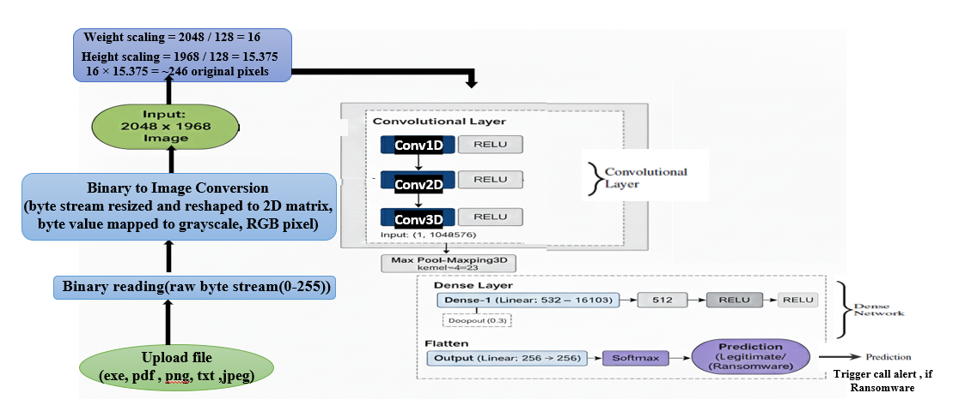
DESIGN AND ARCHITECTURE
Model Architecture

Slide 8
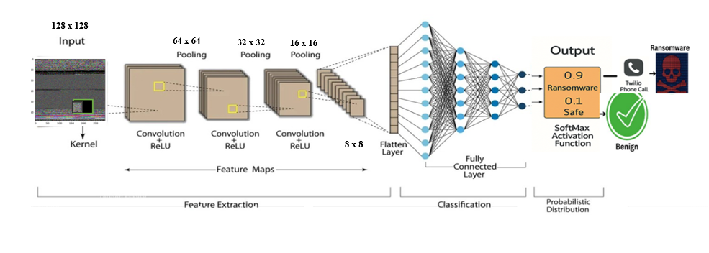
CNN ARCHITECTURE

Slide 9
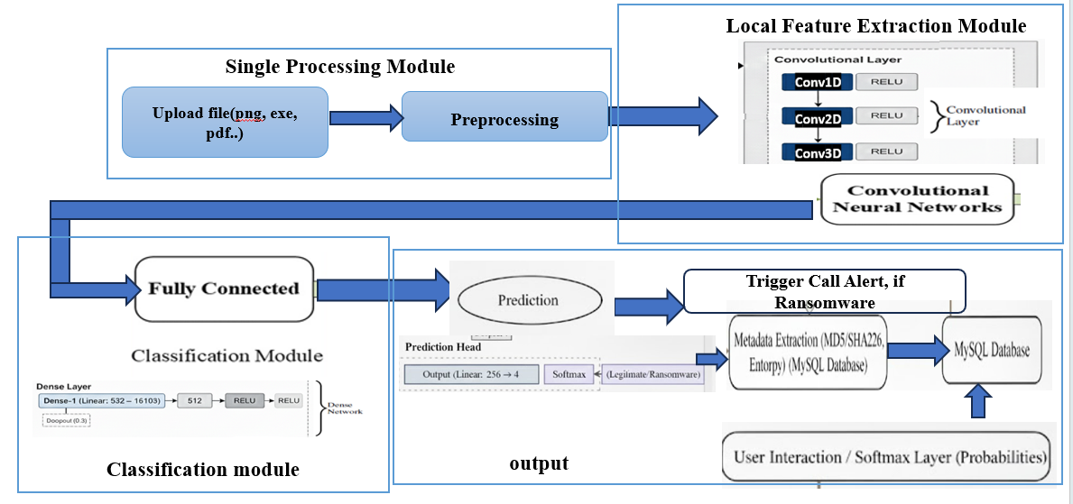
FLOW CHART

Slide 10
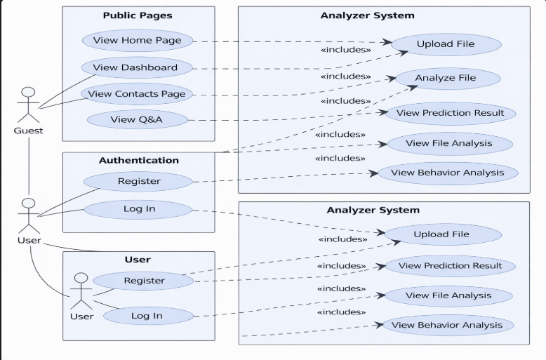
USE CASE DIAGRAM

Slide 11
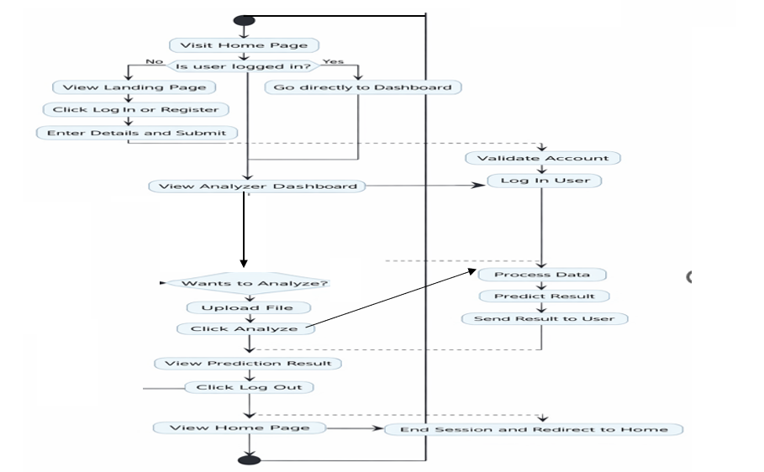
ACTIVITY DIAGRAM

Slide 12
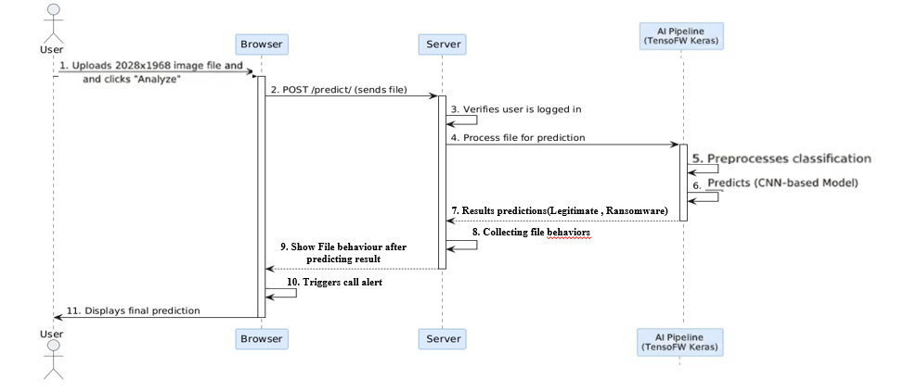
SEQUENCE DIAGRAM

Slide 13
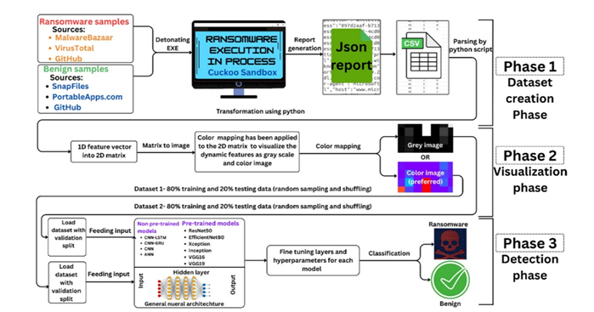
PROPOSED METHODOLOGY ARCHITECTURE

Slide 14
IMPLEMENTATION
Data Collection: Collected ransomware executable samples from Malware-Bazaar, Virus-Total, and GitHub. Collected benign executable samples from Snap-Files, Portable-Apps, and GitHub.
Data Preprocessing: Read raw binary bytes from executable files using Python, convert byte streams into fixed-length sequences.
Reshaped 1D byte data into 2D matrices. Mapped matrices to grayscale images using byte-to-pixel intensity mapping.
Split the dataset into 80% training and 20% testing data with random shuffling.

Slide 15

Model Development: Designed a CNN-based deep learning model using PyTorch.
CNN (Convolutional neural network)
Input Layer: Takes an uploaded image (PNG/JPG/exe/pdf) and converts it into a standardized format (grayscale, resized to 128×128).
Convolution Layers: Extract key spatial features such as edges, texture patterns, and malicious artefacts present in ransomware-infected files.
Activation (ReLU): Highlights important patterns.
Pooling Layer: Reduces dimensionality/size while preserving essential feature patterns.
Fully Connected Layer: Converts extracted features into class scores:{Ransomware, Legitimate}.
Soft-max Probability: Produces final confidence score and class label.

Slide 16

Deployment and Detection: Deployed the trained model using a Flask web
API. Integrated MySQL database for user authentication and prediction history. Uses the Twilio API to send voice call alerts when ransomware is detected.
Twilio Alert
Event Trigger: When the CNN classifier detects Ransomware.
TwilioClient Initialization: Uses secure credentials (ACCOUNT_SID, AUTH_TOKEN).
Alert Mechanism: Initiates an automated phone call to the registered user.
Voice Message: Plays a spoken alert: “Ransomware detected. Please take immediate action”.
Notification Delivery: User receives a real-time phone call alert for critical threat detection.

Slide 17
CNN Implementation
# Load image and preprocess
img = Image.open(io.BytesIO(file.read())).convert("L")
img = transform(img).unsqueeze(0).to(device)
# Predict using the DeepCNN model
with torch.no_grad():
output = model(img)
prob = torch.softmax(output, dim=1)[0]
pred = torch.argmax(prob).item()
# Final label
label = "Ransomware" if pred == 1 else "Legitimate"
Twilio Alert Implementation
# Twilio client
client = Client(ACCOUNT_SID, AUTH_TOKEN)
# Make alert call when ransomware is detected
def make_alert_call():
client.calls.create(twiml='<Response><Say>Alert! Ransomware detected.</Say></Response>', from_=TWILIO_NUMBER, to=USER_PHONE)
# Trigger alert
if label == "Ransomware":
make_alert_call()

Slide 18
TESTING
1. UNIT TESTING:
Test Name | Test Description | Input | Expected Output | Actual Output | Test Result
Image file validation | Validate supported image formats | .png, .jpg, .jpeg, .pdf, .exe | File accepted | File accepted | Pass
Image preprocessing Model prediction | Check resizing, grayscale conversion &normalization Validate Softmax probability output | Uploaded image Preprocessed tensor | Tensor(1x1x128x128) Two-class probability (Ransomware /Legitimate) | Correct tensor generated Correct probabilities returned | Pass Pass

Slide 19
2. INTEGRATED TESTING:
Test Name | Test Description | Input | Expected output | Actual output | Results
Full pipeline execution | Test upload-> preprocess -> predict flow | Normal image | Legitimate file | Legitimate file | Pass
Ransomware detection | Check if CNN detects malicious image | Ransomware image | Ransomware detected | Successfully detected | Pass
Alert function trigger | Validate Twilio call after detection | Prediction = ransomware | Phone call initiated | Call triggered successfully | Pass

Slide 20
3. SYSTEM TESTING:
Test name | Test Description | Input | Expected output | Actual output | Results
End –to-end workflow | Validate entire system performance | Image uploaded via web UI | Full workflow completes | Work correctly | Pass
Response time check | Measure system speed | Multiple test images | < 2 sec response time | 1.2-1.5 sec observed | Pass
Error handling | Validate behaviour for invalid inputs | .apk, .doc, corrupt image | “Invalid file format “ error | Error displayed correctly | Pass

Slide 21
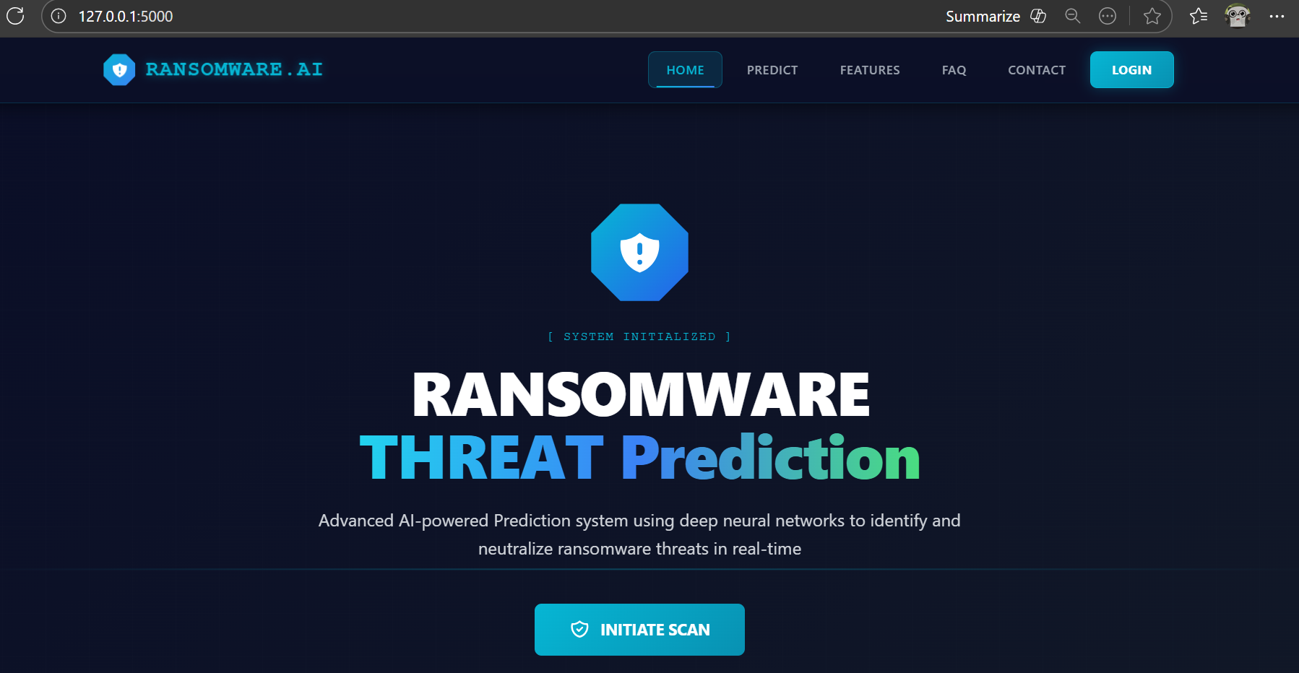
SCREENSHOTS OF OUTPUTS
Home Page: Introduces the ransomware detection system and allows users to start scanning using the ‘Initiate Scan’ button.
System FAQ: Explains how predictions work, supported file formats, and how user data is kept secure.
Defense Mechanisms: Shows key security features like neural network analysis, real-time detection, and zero-trust processing.
Contact Operations: Provides contact details for support and confirms system ownership and authenticity.

Slide 22
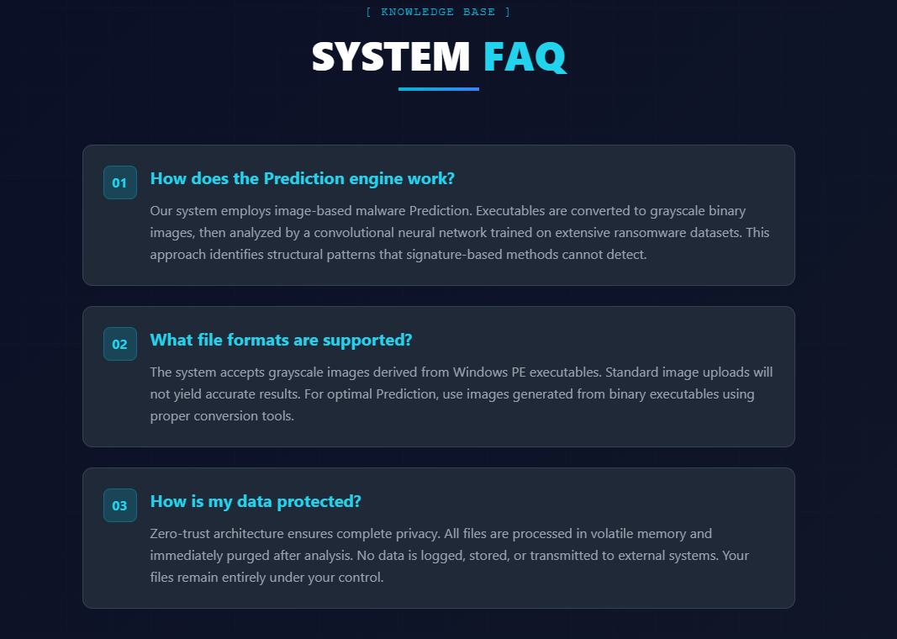
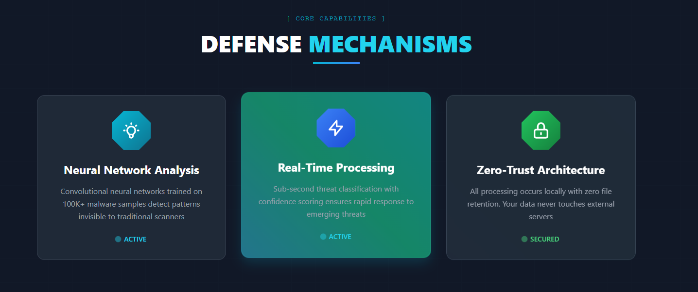
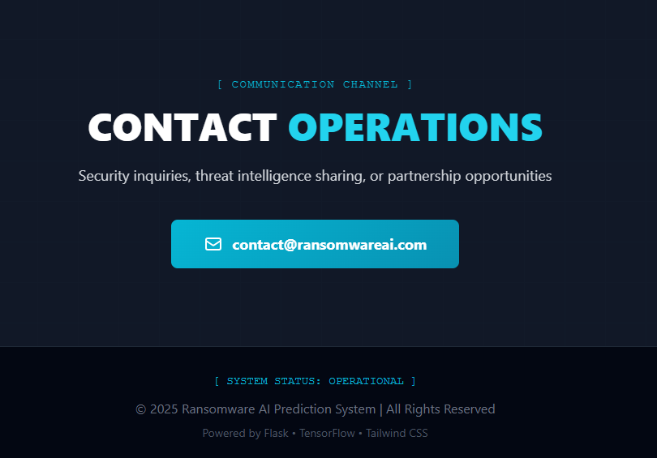

Slide 23
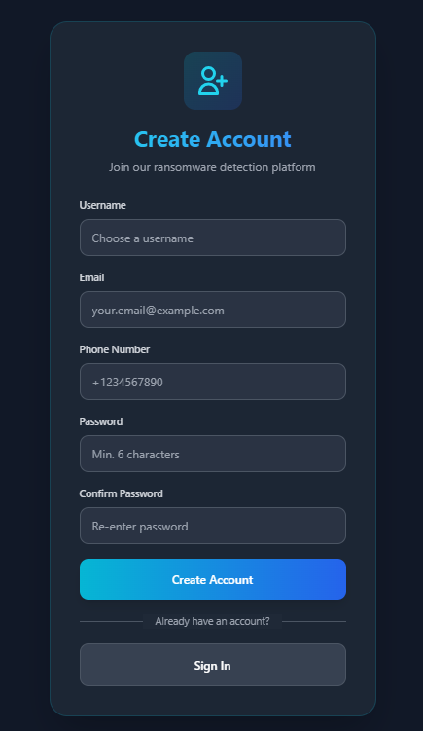
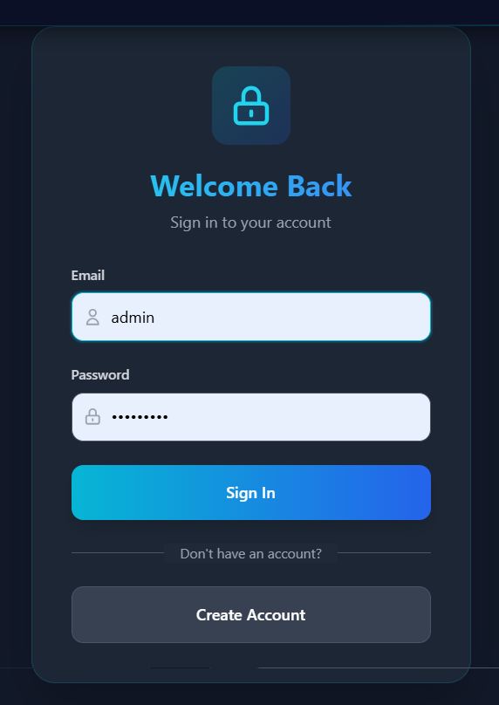
Create Account Page:
Allows new users to register by entering a username, email, phone number, and password. This enables secure access to the ransomware detection platform.
Login Page:
Allows registered users to sign in using their email and password. After login, users can upload files, view predictions, and access system features securely.

Slide 24
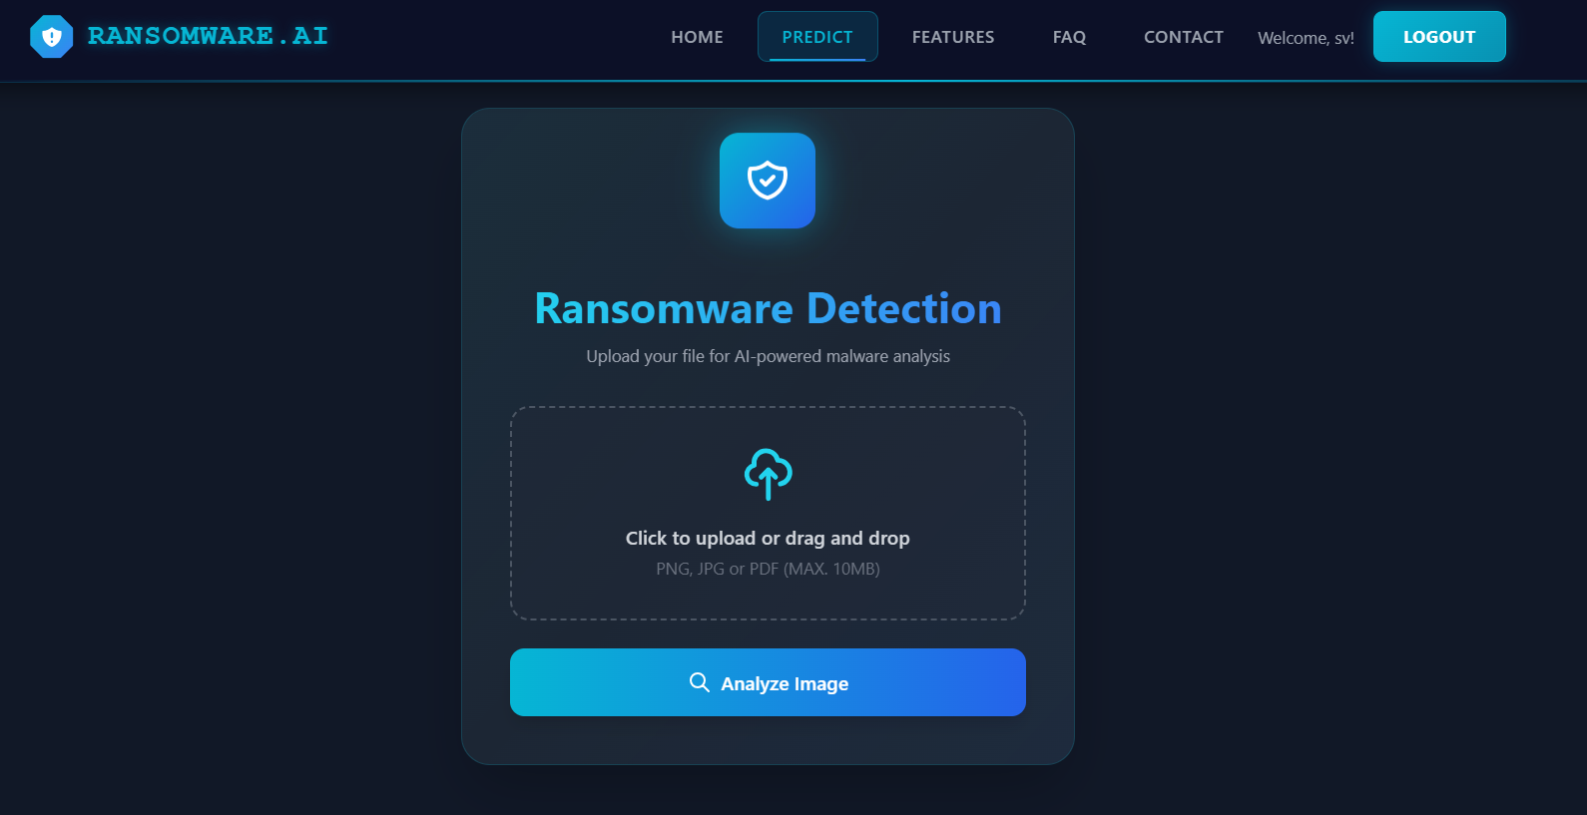
Predict Page (Upload Screen):
Allows logged-in users to upload or drag-and-drop files for ransomware analysis and start scanning using the ‘Analyze Image’ button.
Legitimate File Result:
Displays detailed file analysis and behavioral indicators, confirming the file is safe with a confidence score.
Ransomware Detected Result:
Shows file and behavioral analysis along with a clear Ransomware Detected alert and confidence percentage.
Alert Notification (Call):
When ransomware is detected, the system can trigger an alert notification (call) to immediately warn the user or administrator.

Slide 25
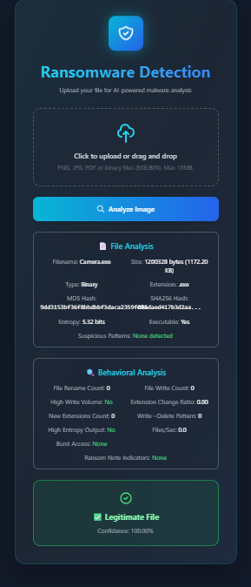
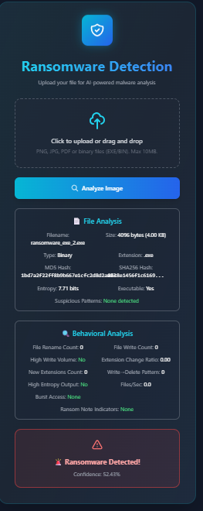
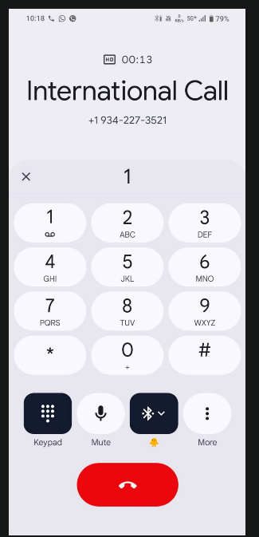

Slide 26
CONCLUSION
The project successfully detects ransomware with CNN. The system gives fast and accurate results through a user-friendly web application. Real-time Call alerts make the system more reliable and useful for early warning. Overall, the project proves that deep learning can detect ransomware effectively before it causes damage.
FUTURE ENHANCEMENTS
Add support for more ransomware families to improve accuracy. Build a real-time monitoring system that scans files automatically without user upload. Create a desktop or mobile app version for easier use. Add cloud storage protection and automatic file isolation when a threat is detected. Improve alert features by sending email alerts and logging to the dashboard.

Slide 27
REFERENCES
Alraizza, A., & Algarni, A. (2023). Ransomware detection using machine learning: A survey. Big Data and Cognitive Computing, 7(3), 143.
Kok, S., Abdullah, A., Jhanjhi, N., & Supramaniam, M. (2019). Ransomware threat and detection techniques: A review. Int. J. Comput. Sci. Netw. Secur, 19(2), 136.
Musonda, M., Zimba, A., & Sinyinda, M. (2023). Machine learning-based crypto ransomware detection model on Windows platforms. ICICT-Zambia, 5(1), 141-147.
Ganfure, G. O., Wu, C.-F., Chang, Y.-H., & Shih, W.-K. (2022). Deepware: Imaging performance counters with deep learning to detect ransomware. IEEE Transactions on Computers, 72(3), 600-613.
Almomani, I., et al. (2021). Android ransomware detection using a hybrid evolutionary approach. IEEE Access, 9, 57674-57691.

