Slide 1

Azure Data Engineering Project
Tokyo_Olympic_Data
-Varsha Sri Madhusudhanan

Slide 2
Project Overview
This project demonstrates an end-to-end data engineering solution using Microsoft Azure tools to transform raw data into valuable insights. The solution employs:
Azure Data Factory for orchestrating and automating data pipelines,
Azure Databricks with PySpark for data ingestion, transformation, and aggregation,
Azure Synapse Analytics for serverless data querying and analysis,
Tableau for creating interactive visualizations and dashboards.
The goal is to build a seamless, scalable architecture that efficiently processes and refines raw data into actionable insights, enabling data-driven decision-making.

Slide 3
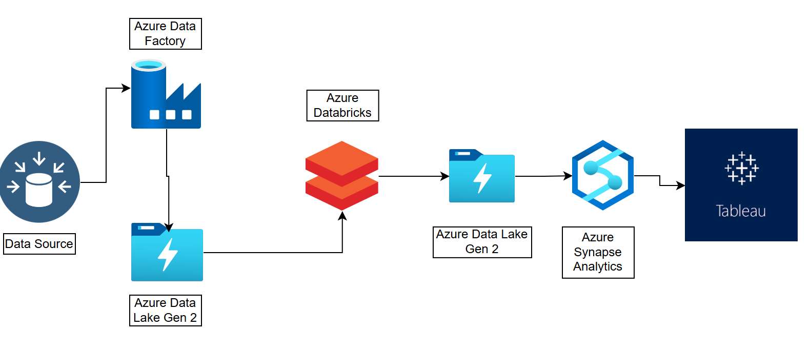
Solution Architecture
The solution follows a layered approach with raw and transformed data stages. Azure services work together for data ingestion, transformation, and visualization.

Slide 4
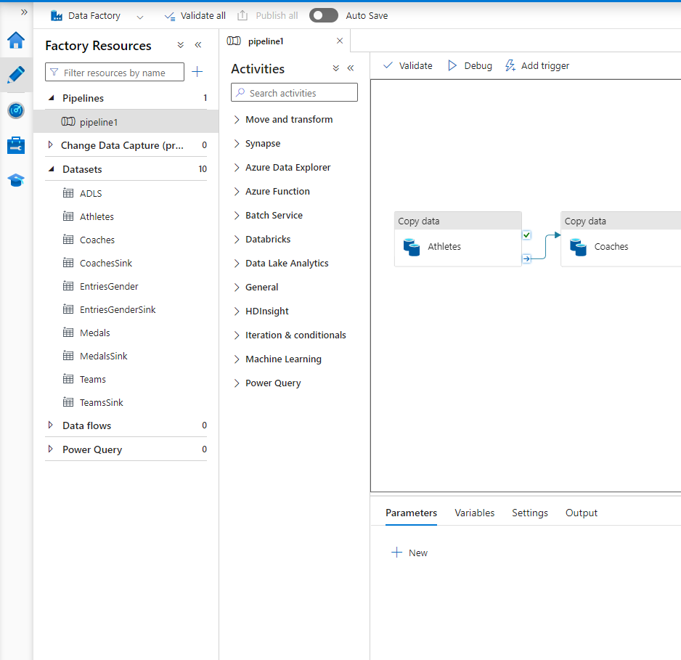
Azure Data Factory
Azure Data Factory automates data pipelines, managing seamless data flow.
It connects to multiple services, orchestrating the entire data journey.

Slide 5
Azure Databricks
Databricks uses PySpark to ingest, clean, and process data efficiently.
Data moves between layers, transforming from raw to refined insights.

Slide 6
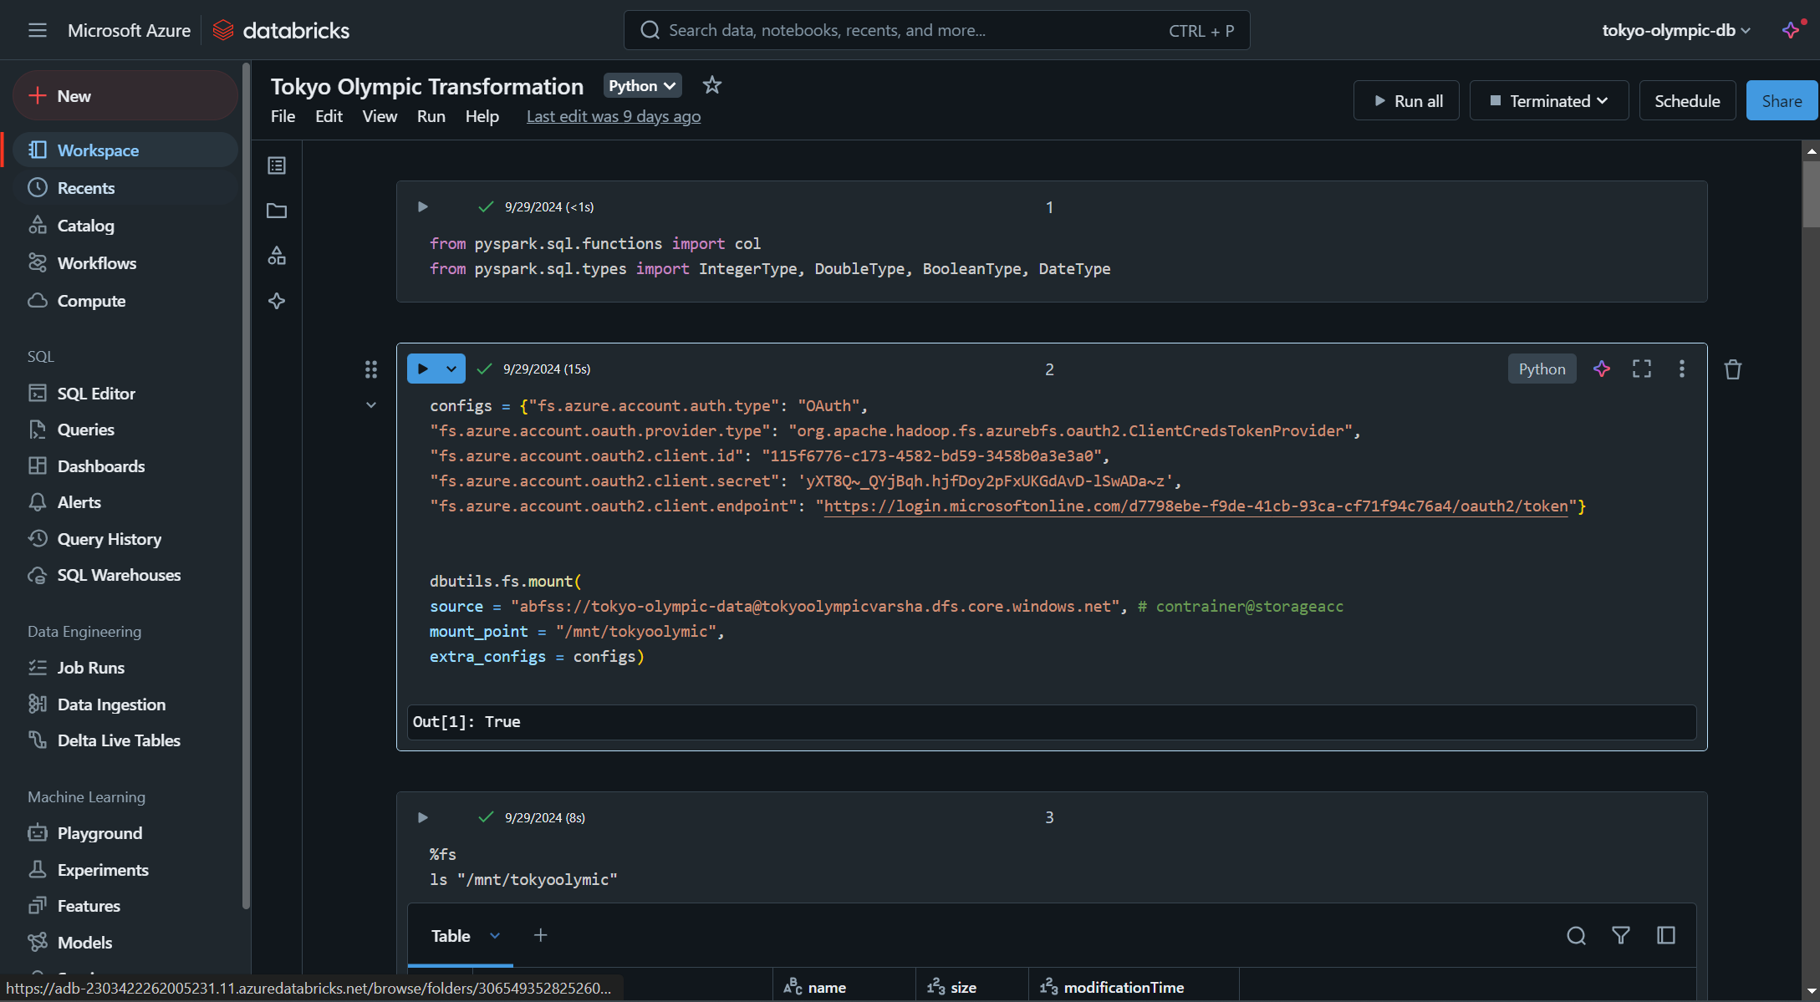
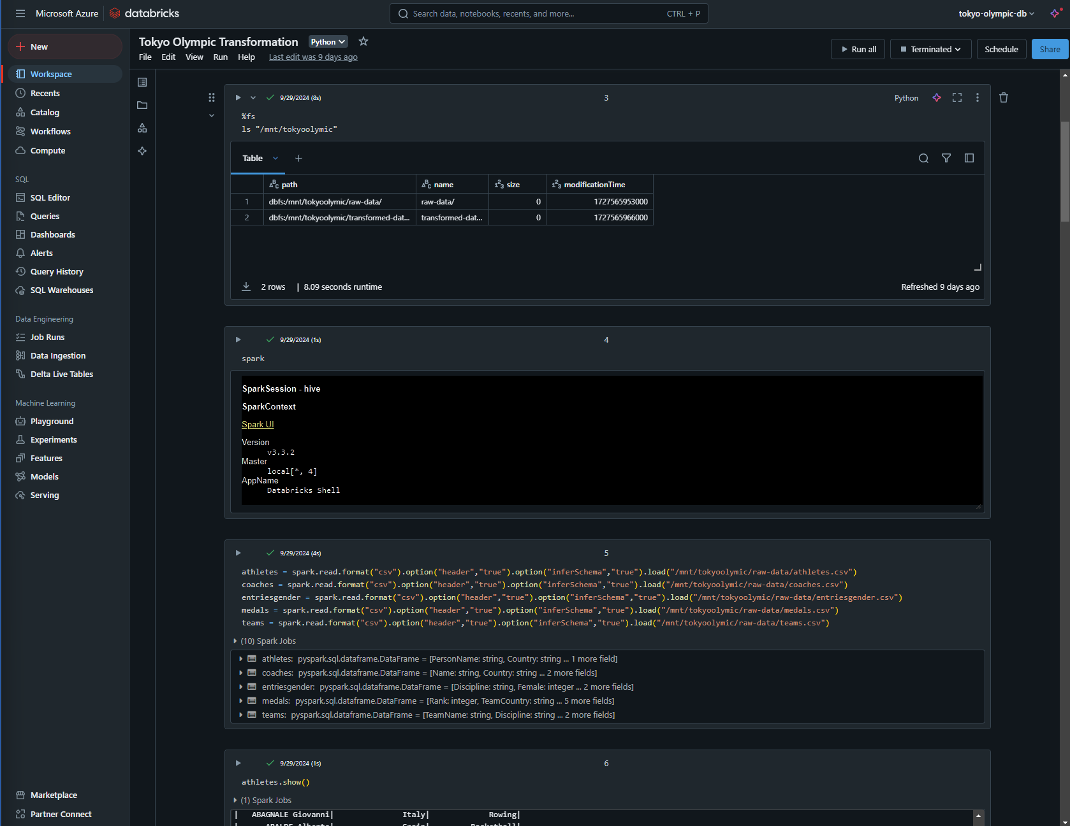
Cont.

Slide 7
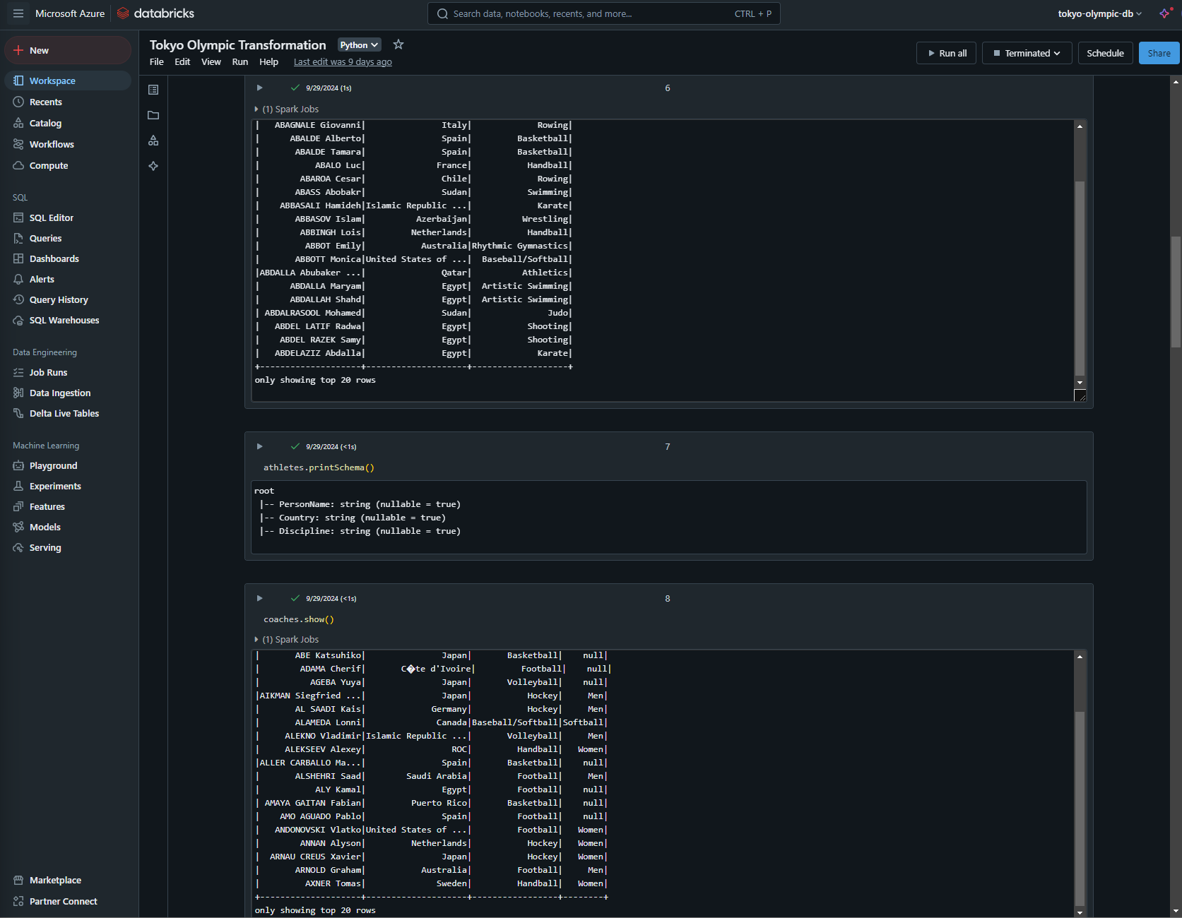
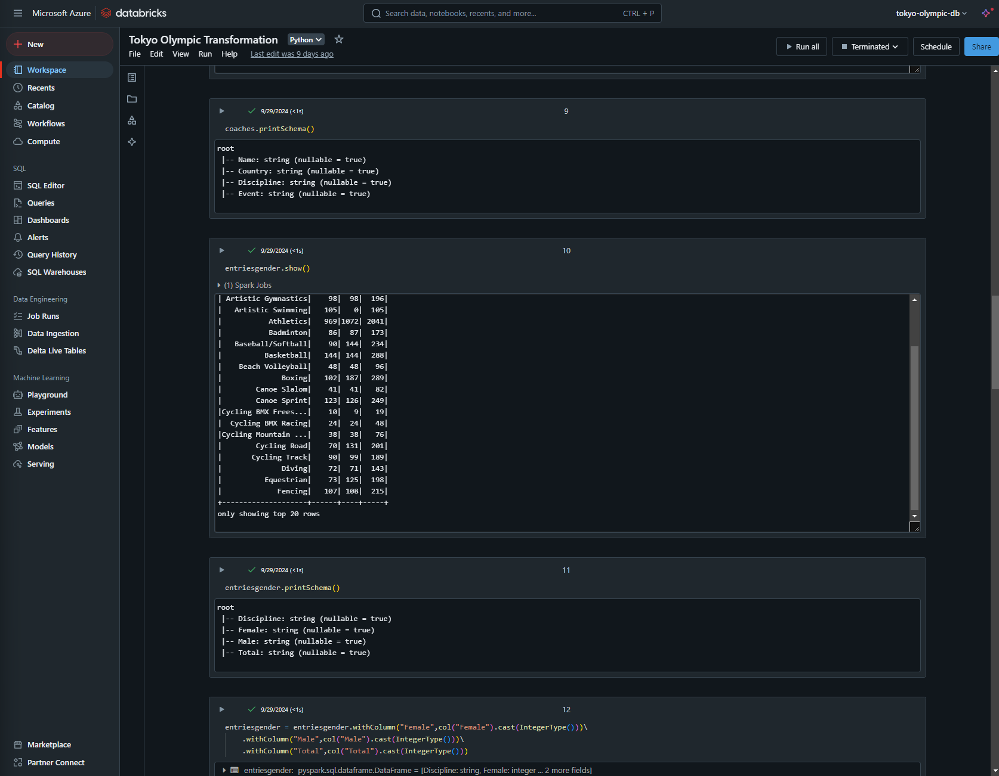
Cont.

Slide 8
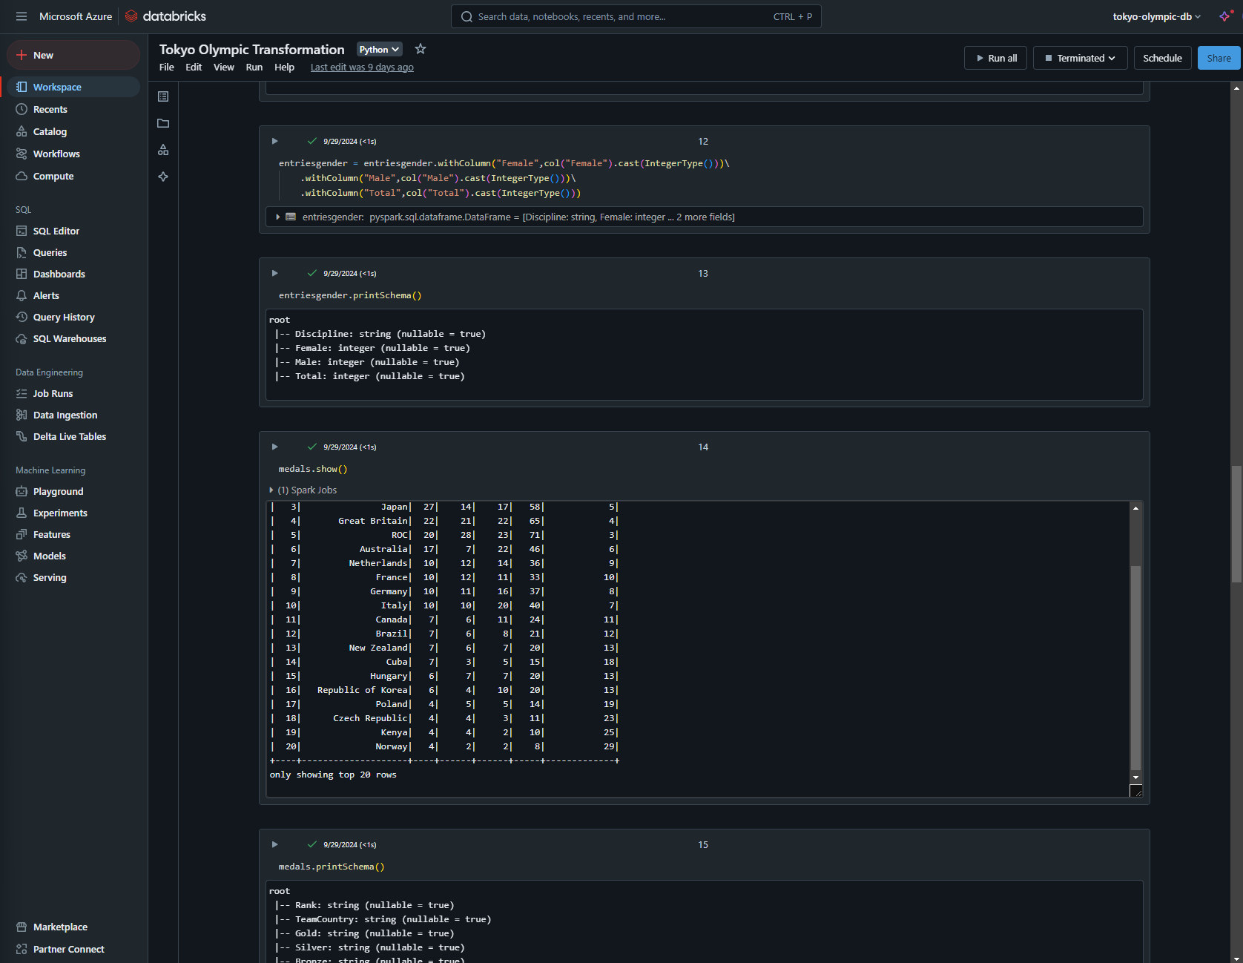
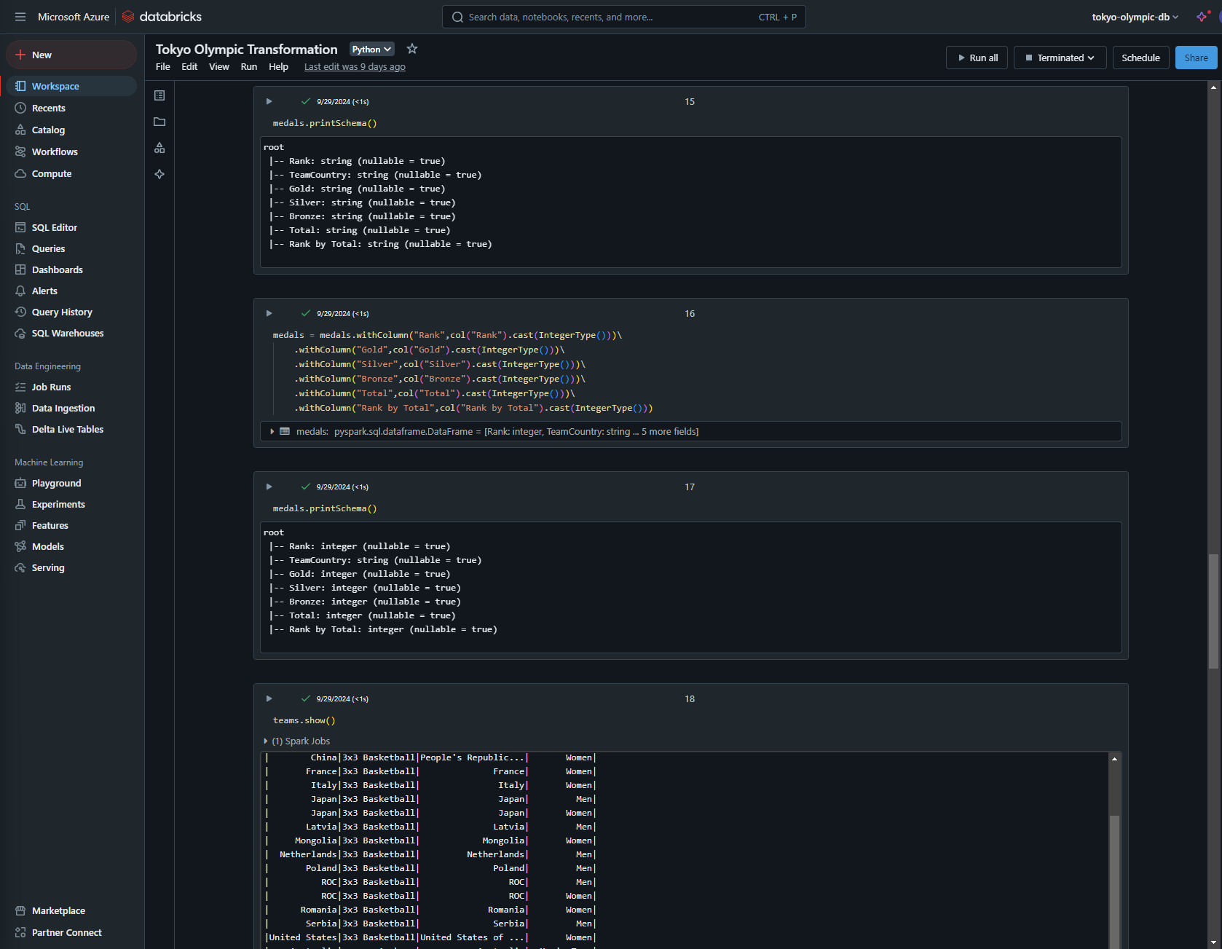
Cont.

Slide 9
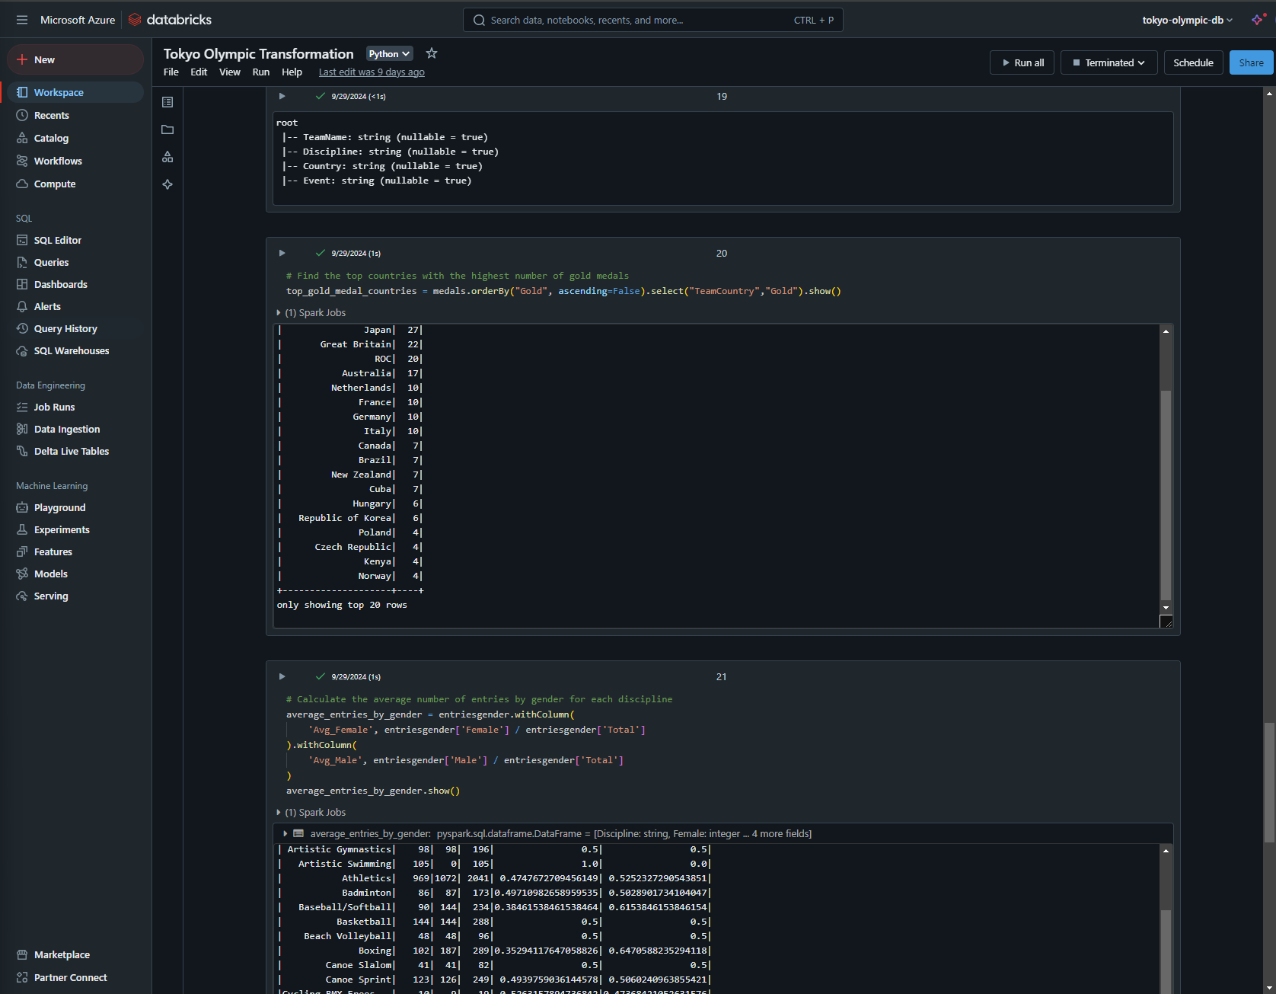
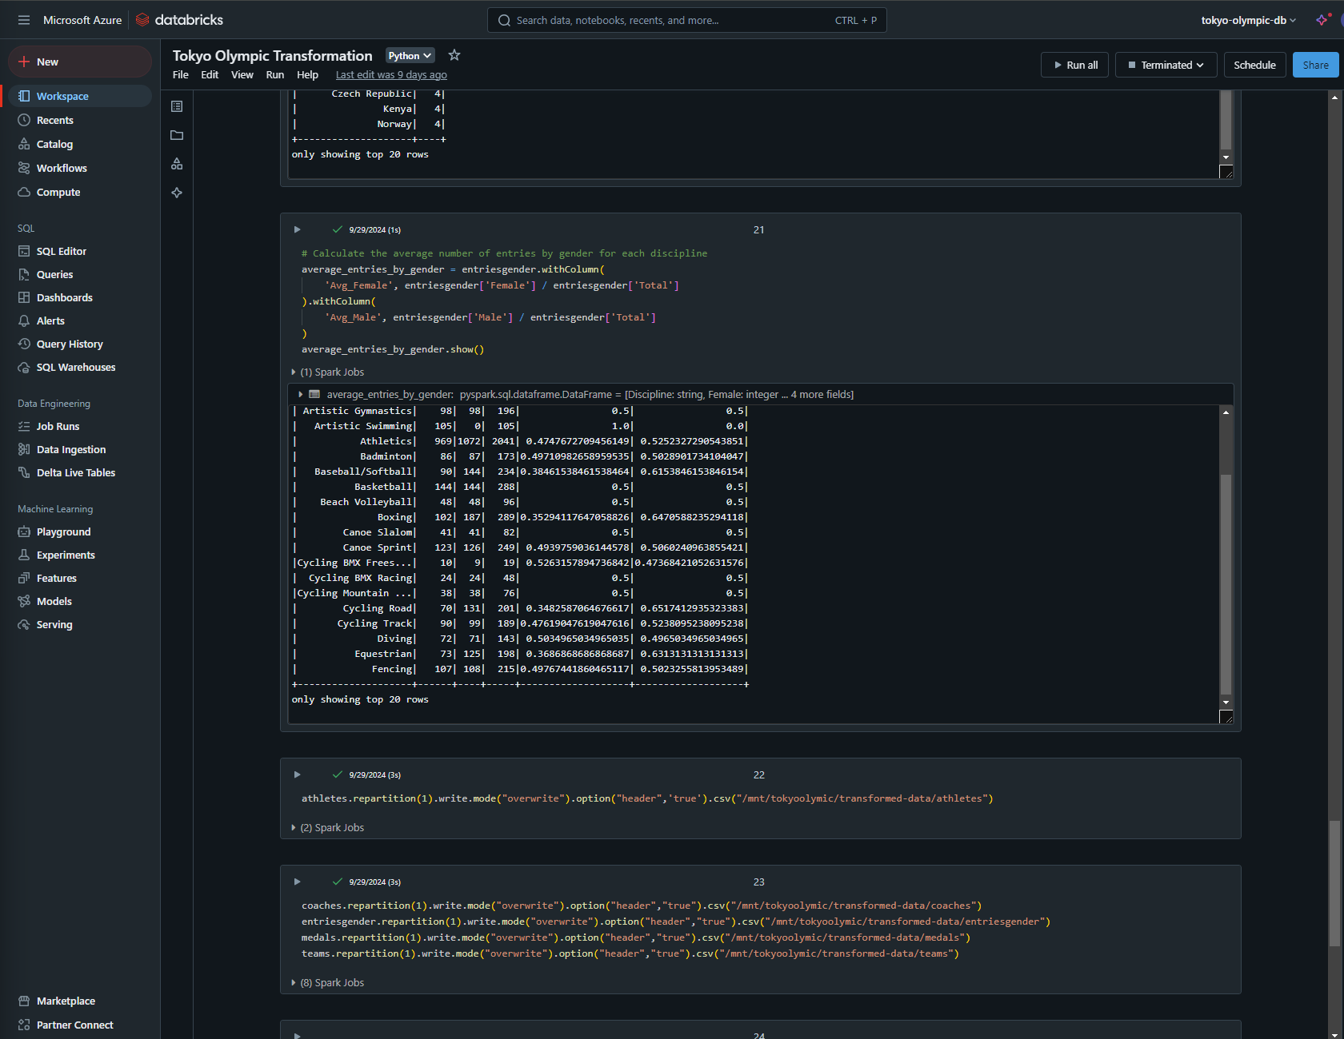
Cont.

Slide 10
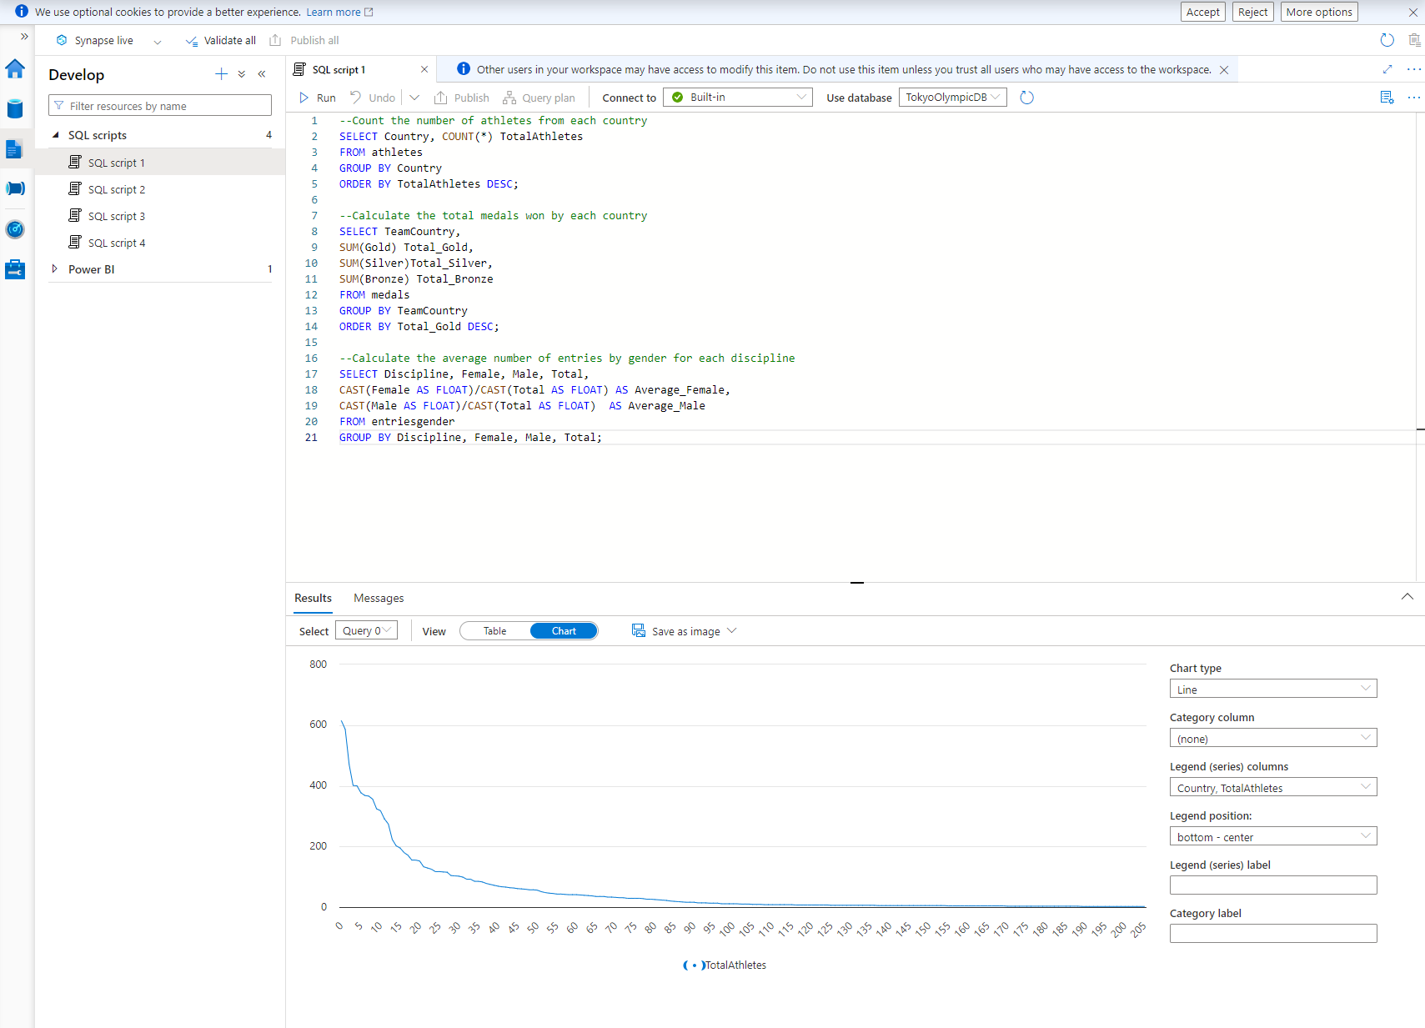
Azure Synapse Analytics
Synapse Analytics provides serverless querying for real-time data analysis.
External tables in Synapse allow scalable querying without data duplication.

Slide 11
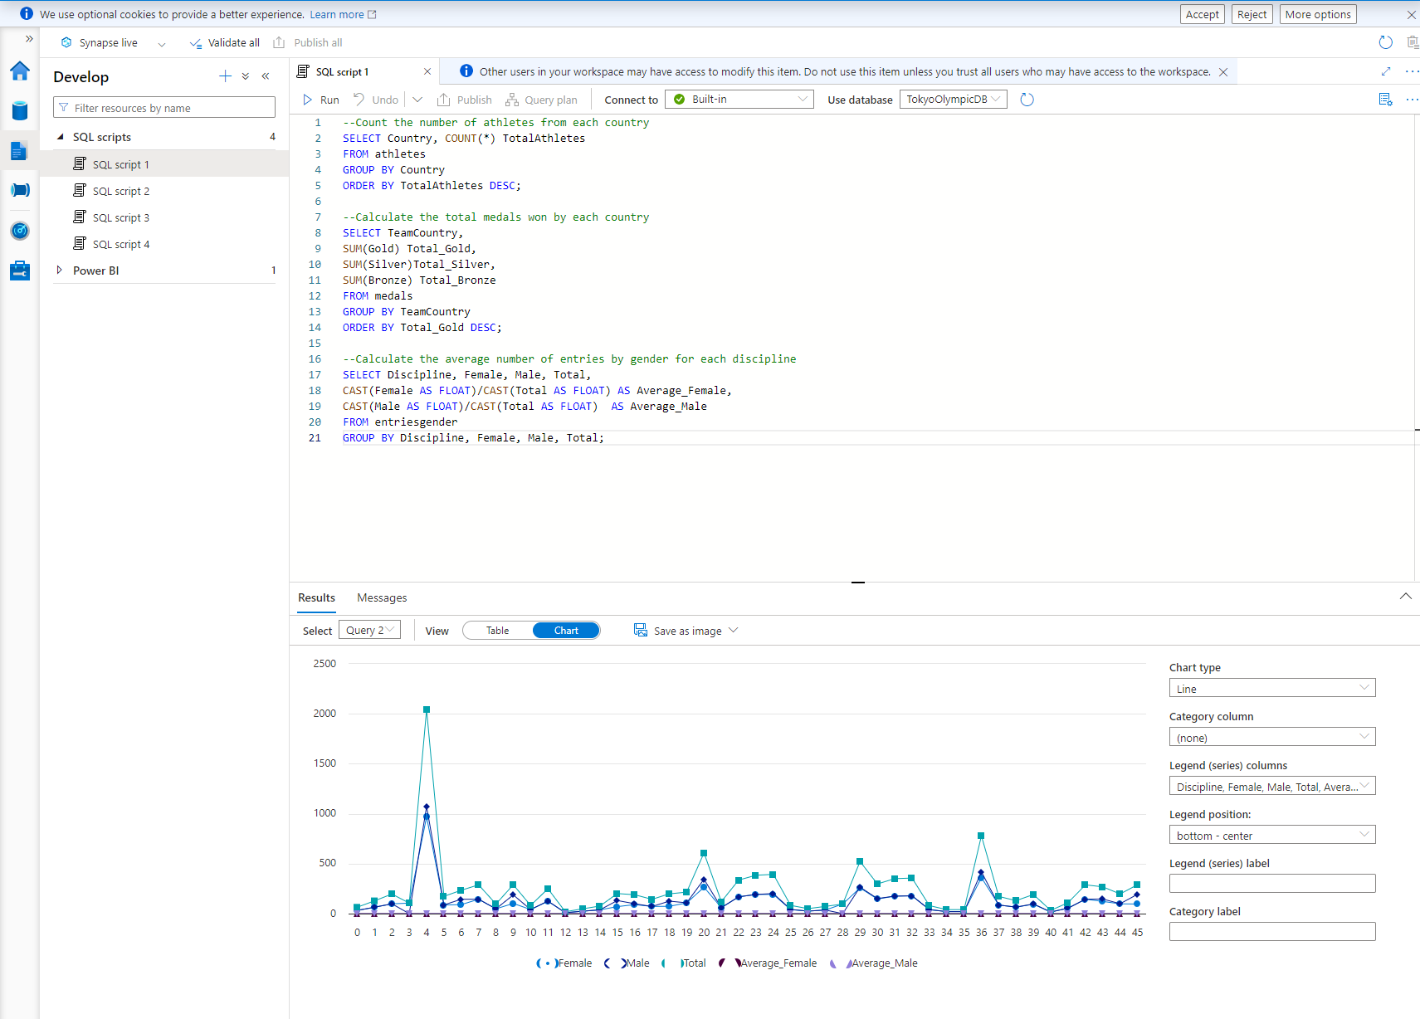
Cont.

Slide 12
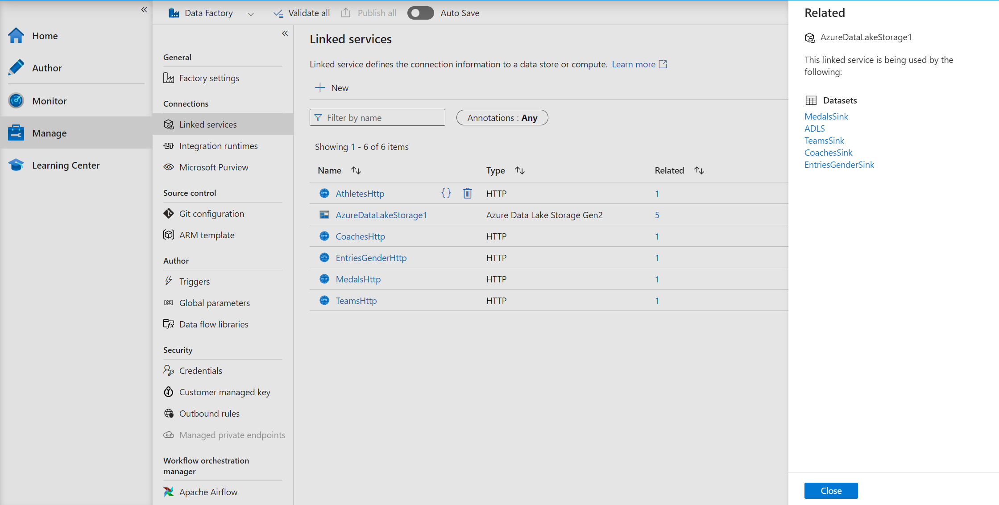
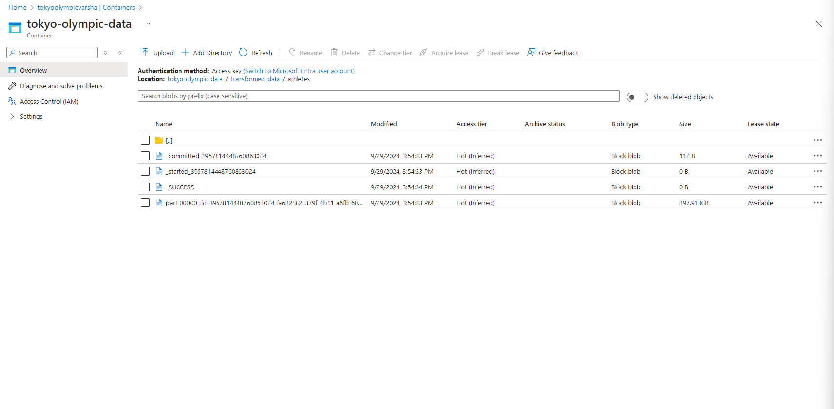
Azure Data Lake Storage Gen2 ADLS Gen2 stores data at different stages, supporting scalable data storage. It provides the foundation for both raw and transformed data layers.

Slide 13
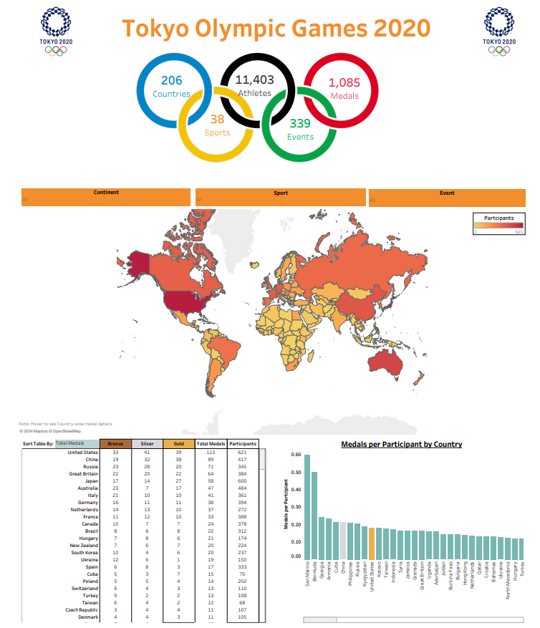
Tableau
Tableau connects to Synapse for creating interactive data visualizations.
Dashboards offer insights that enable data-driven decision-making.

Slide 14
Key Highlights
Automated Data Pipelines: Utilized Azure Data Factory to orchestrate seamless, automated data flows across services.
Efficient Data Transformation: Leveraged Databricks and PySpark for optimized data ingestion, cleaning, and processing, enhancing data quality.
Real-Time Analytics: Synapse Analytics enabled serverless querying for timely data insights without the need for data duplication.
Comprehensive Visualization: Tableau provided powerful, interactive dashboards, allowing stakeholders to easily interpret and act on data insights.

Slide 15
Conclusion and Future Steps
Proven Scalability with Azure: Demonstrated how Azure services can handle data engineering tasks at scale, from ingestion to visualization.
Potential for Advanced Analytics: Future steps could include implementing machine learning models in Synapse or Databricks to gain predictive insights.
Expansion of Data Sources: Plan to incorporate additional data sources, enriching the analysis and making the solution more versatile.
Enhanced Visualization: Opportunities to further develop Tableau dashboards with more interactive and user-focused features for stakeholders.

Slide 16

THANK YOU

