Slide 1
BiasBuster: AI Agent for Detecting Gender Bias in Recruitment Texts
VAGMinds
Team Members:
Varsha Thomas
Aishwarya RN
Gopika Radhakrishnan
Midhuna P Prakash
UN SDG 5: Gender Equality

Slide 2
Introduction
Gender bias in job recruitment is a major barrier to equality.
Job descriptions often contain gender-coded language.
This project supports UN Sustainable Development Goal 5: Gender Equality.

Slide 3
Problem Statement
Recruitment texts often contain subtle gender-biased language that discourages certain groups, particularly women and non-binary individuals, from applying. This unintentional bias reduces diversity, limits talent acquisition, and reinforces workplace inequality.

Slide 4
Objective
To develop an AI agent that detects gender-biased language in job descriptions.
To classify texts as 'Biased' or 'Unbiased' using machine learning.

Slide 5
Dataset Description
5000 job descriptions collected and labeled.
Features: Job_Title, Department, Experience_Level, Job_Description.
Label: 1 = Biased, 0 = Unbiased.

Slide 6
Tools & Technologies
Python, Pandas, Scikit-learn
NLP: NLTK, SpaCy
Model: Logistic Regression, SVM
Google Colab

Slide 7
Methodology
1. Data Preprocessing (cleaning, vectorization)
2. Feature Engineering (TF-IDF, Label Encoding)
3. Model Training and Testing
4. Performance Evaluation

Slide 8
Input and Output
Input: Job description text
Output: Bias classification (Biased/Unbiased)
Optional: Highlight biased terms

Slide 9
Results
Model accuracy: ~92%
Successfully detects biased patterns in unseen texts.
Can be integrated into HR tools.

Slide 10
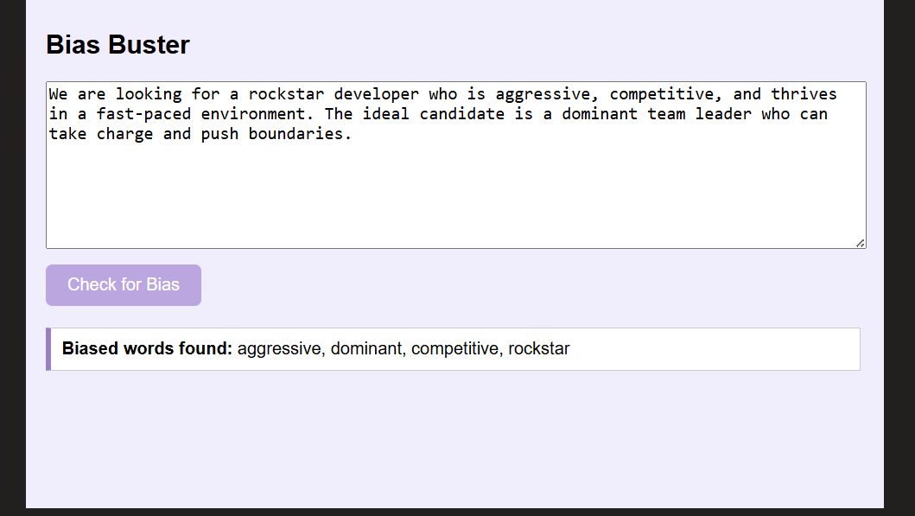
APPLICATION INTERFACE

Slide 11
Conclusion
The AI agent promotes inclusive and fair hiring.
Reduces unconscious bias in recruitment texts.
Supports ethical AI and social good.

Slide 12
Future Scope
Integrate with resume filtering tools.
Support multilingual bias detection.
Add feedback learning from user corrections.

Slide 13
References
UN Sustainable Development Goals - sdgs.un.org
Kaggle Datasets: Gender Bias in Job Descriptions
Scikit-learn, NLTK, SpaCy Documentation
A Machine Learning Approach to Recognize Bias in Job Ads
Authors: Desrosiers, C. et al.
Journal: AI & Society (Springer)
Volume: 38, Pages 561–576 (2023)
🔗 https://doi.org/10.1007/s00146-022-01574-0

Slide 14
Project link:
Github repository
https://github.com/VarshaThomas/BiasBuster

Slide 15
Contact Info
Team VAGMinds
Team Members
Aishwarya RN – aishwaryarn2@gmail.com
Gopika Radhakrishnan – gopikaradhakrishnan2003@gmail.com
Miduna P Prakash – midhunapprakash66@gmail.com
Team Leader:Varsha Thomas – varsha.mca24@mbits.ac.in

Slide 16
THANKYOU

