Slide 1
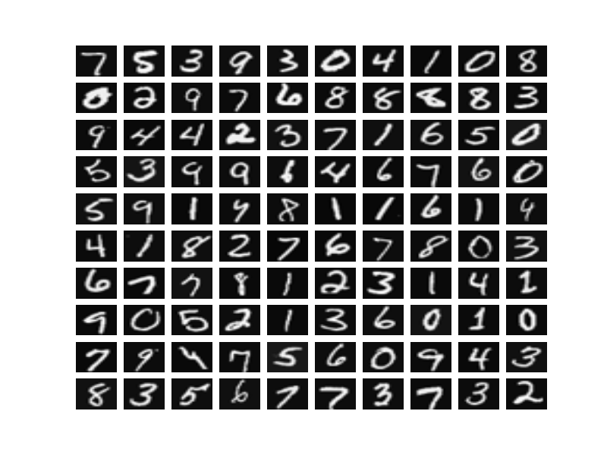
Optical Recognition of Handwritten Digits
Presented By: Varsha Tekale
Business Analytics
5th August 2016

Slide 2
Index
Training Dataset
Validation Dataset
Model Building
Model Comparison: % Accuracy
Model Comparison: Actual vs Predicted
Summary

Slide 3
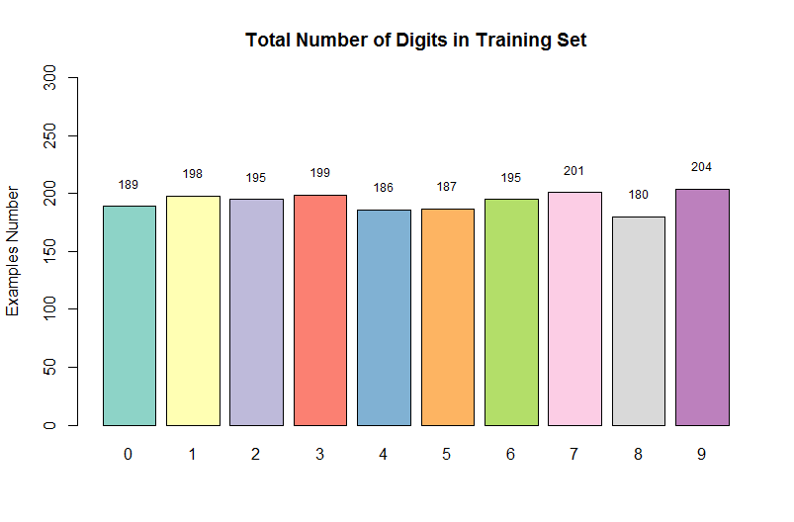
Training Dataset
1934 rows and 1025 columns
Class distribution in training dataset

Slide 4
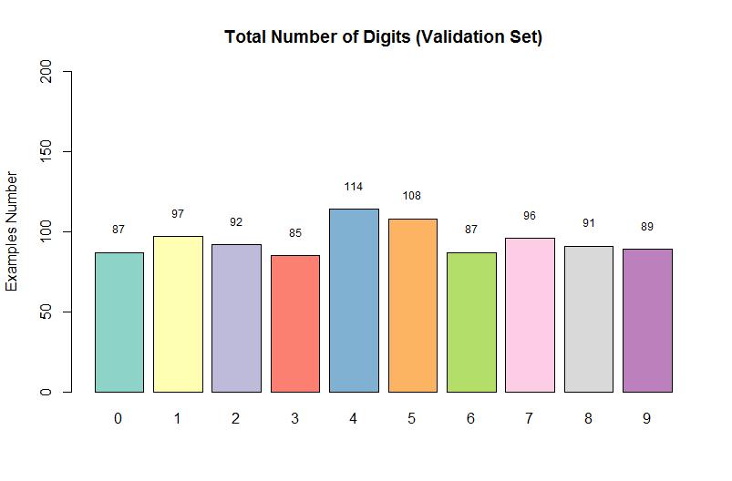
Validation Dataset
946 rows and 1025 columns
Class distribution in validation dataset

Slide 5
Models Used for Handwritten Digits Recognition
Recursive Partitioning and Regression Trees
Naïve Bays Algorithm
Support Vector Machine
Fast Nearest Neighbor Search Algorithm
Random Forest
K Nearest Neighbor Algorithm
https://github.com/VarshaVT/Handwritten-Digits-Recognition

Slide 6
Model 1: Recursive Partitioning and Regression Trees
It is a statistical method for multivariate analysis.
It creates a decision tree to classify the data by splitting it into sub data based on several dichotomous independent variables.
The process is called recursive because each sub data may in turn be split an indefinite number of times until the stopping criteria is reached.

Slide 7
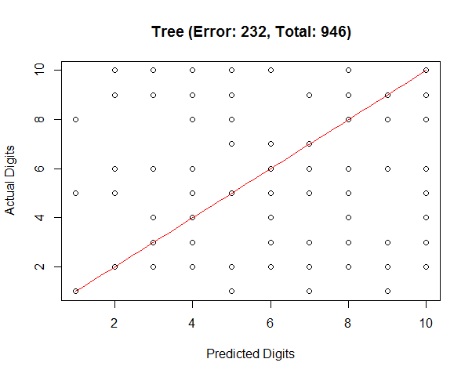
Model 1: Recursive Partitioning and Regression Trees
Generated the classification model through RPART package in R.
Accuracy of this model is 75%.
Time required to train the model
on 1934 observations is 3.72 Sec.
Time required to predict the model
on 946 observations is 0.21 Sec.
This model incorrectly classifies
232 handwritten digits out of total
946 digits.

Slide 8
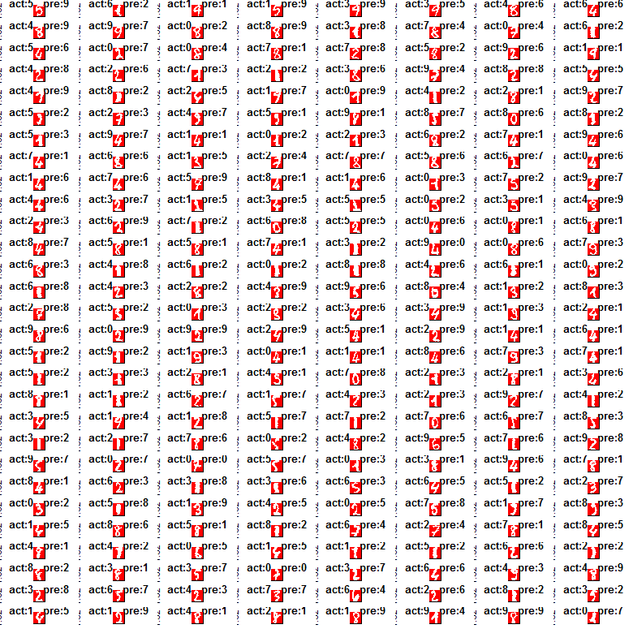
Incorrectly Classified Digits (errors): 232

Slide 9
Model 2: Naïve Bayes Algorithm
It’s a family of simple probabilistic classifiers.
It is based on applying Bays’ theorem with conditional independence assumptions between the predictors.
It is simple to understand, gives good results and is fast to build a model and make predictions.

Slide 10
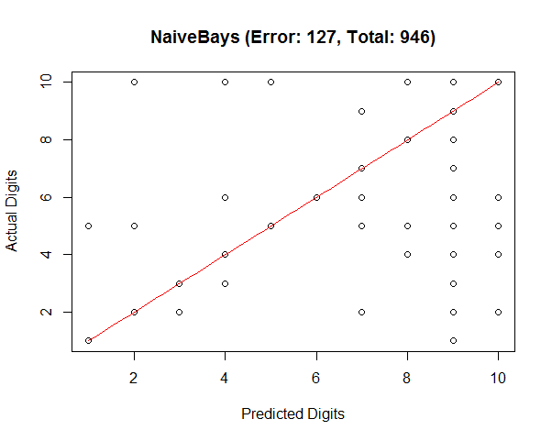
Model 2: Naïve Bayes Algorithm
Generated the classification model through e1071 package in R.
Accuracy of this model is 86.58 %.
Time required to train the model
on 1934 observations is 1.06 Sec.
Time required to predict the model
on 946 observations is 23.95 Sec.
This model incorrectly classifies
127 handwritten digits out of total
946 digits.

Slide 11
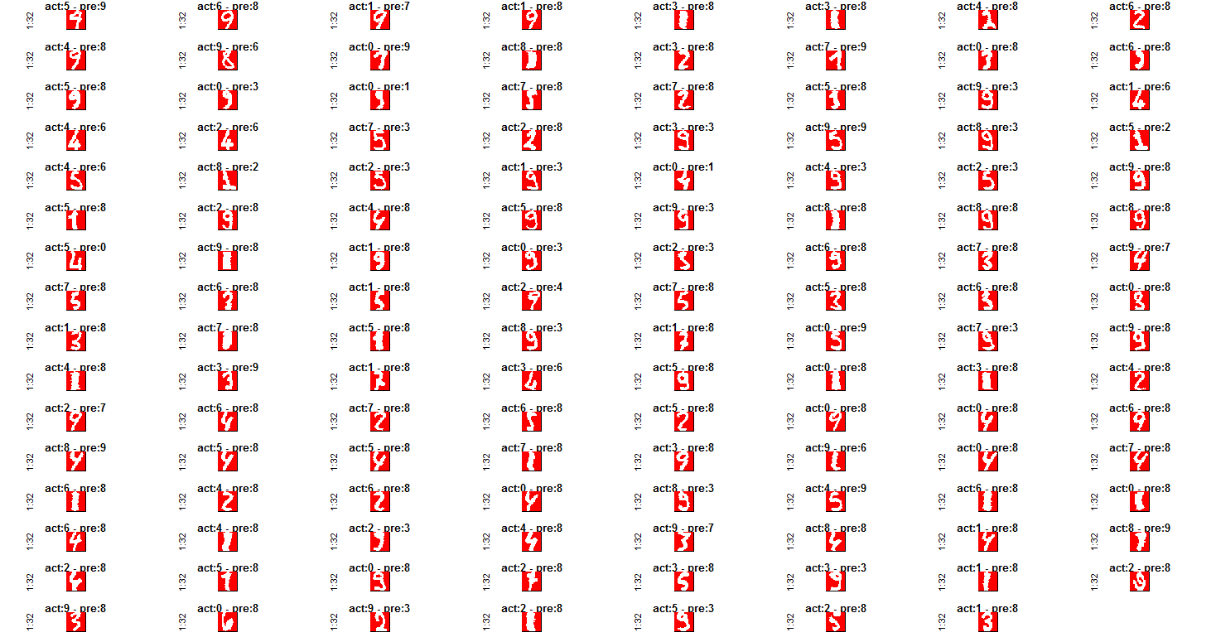
Incorrectly Classified Digits (errors): 127

Slide 12
Model 3: Support Vector Machine (SVM)
SVM constructs a hyperplane or set of hyperplanes in a high dimensional space, which is used for classification.
It is a representation of observations as points in a space.
These points are mapped so that the observations of a separate categories are divided by a clear gap that is as wide as possible.
New observations are then classified based on which side of the gap they fall on.

Slide 13
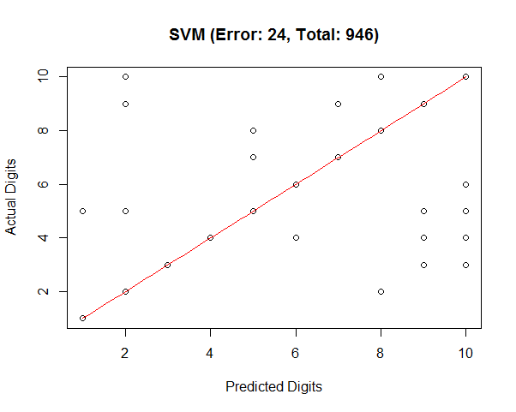
Model 3: Support Vector Machine
Generated the classification model through e1071 package in R.
Accuracy of this model is 97.46 %.
Time required to train the model
on 1934 observations is 10.87 Sec.
Time required to predict the model
on 946 observations is 2.08 Sec.
This model incorrectly classifies
24 handwritten digits out of total
946 digits.

Slide 14
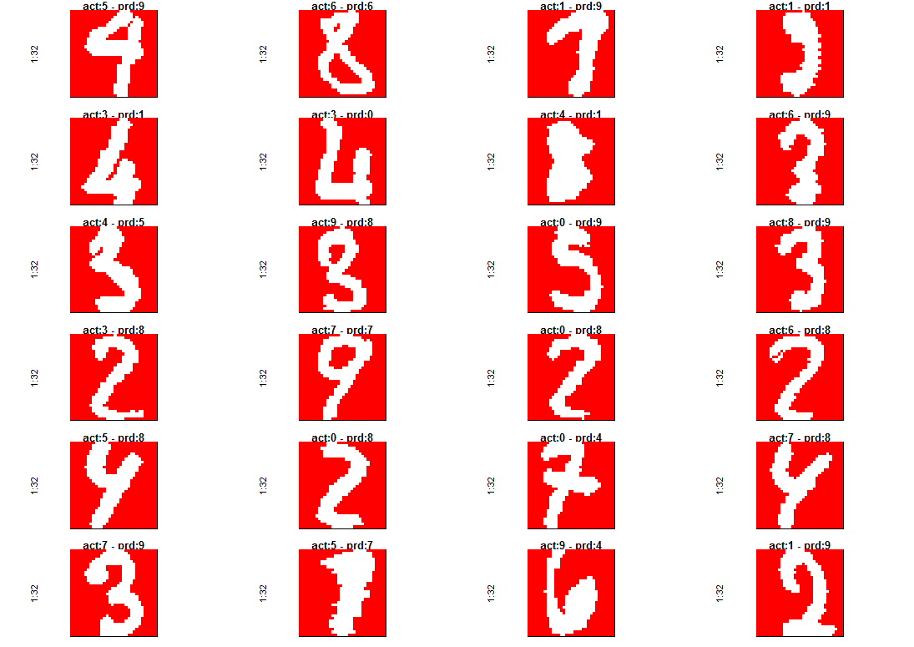
Incorrectly Classified Digits (errors): 24

Slide 15
Model 4: Fast Nearest Neighbor (FNN)
FNN implements K nearest neighbor classifier using cover tree algorithm
Cover tree is a type of data structure in a computer science that is designed to speed up the nearest neighbor search.
In KNN classification an object is classified by a majority vote of its neighbors based on a similarity criteria (distance).

Slide 16
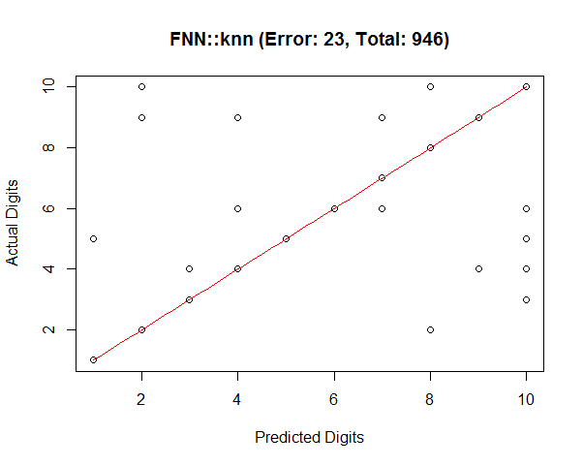
Model 4: Fast Nearest Neighbor
Classification model of FNN package in R uses Cover Tree algorithm.
Accuracy of this model is 97.57 %.
Time required to train the model
on 1934 observations is 6.51 Sec.
Time required to predict the model
on 946 observations is 6.51 Sec.
This model incorrectly classifies
23 handwritten digits out of total
946 digits.

Slide 17
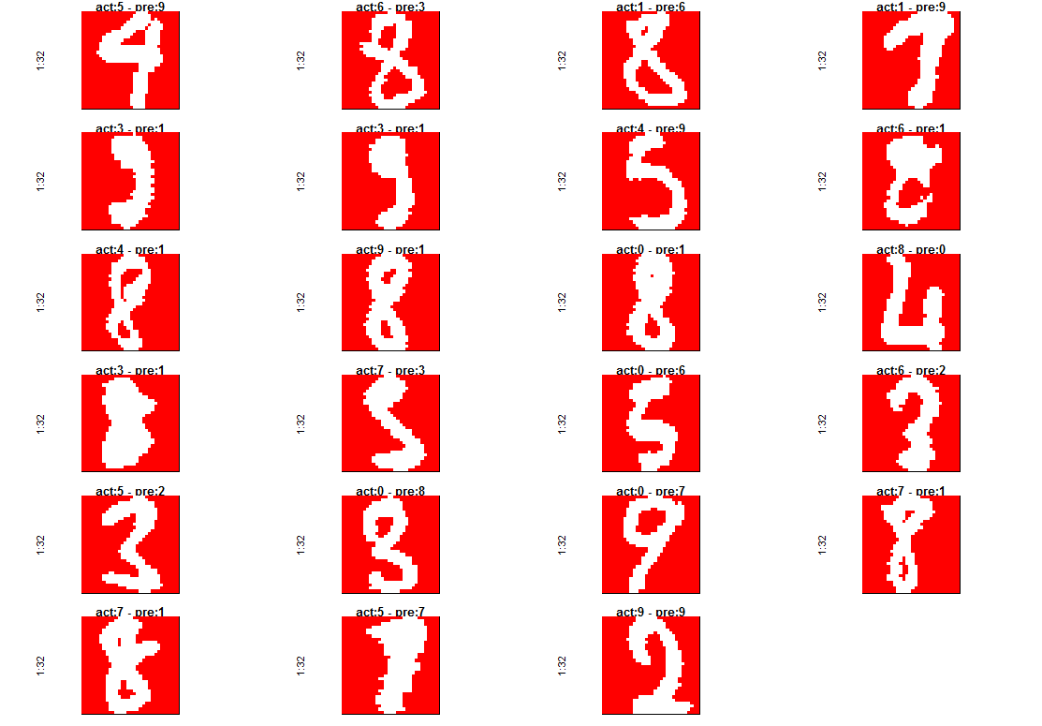
Incorrectly Classified Digits (errors): 23

Slide 18
Model 5: Random Forest
It grows many classification trees.
It takes random sample of data and identifies a key set of features to grow each classification tree.
It classifies a new object from an input by putting it down each trees in the forest. Then each tree votes for that class and the forest chooses the classification having most votes over all the trees.

Slide 19
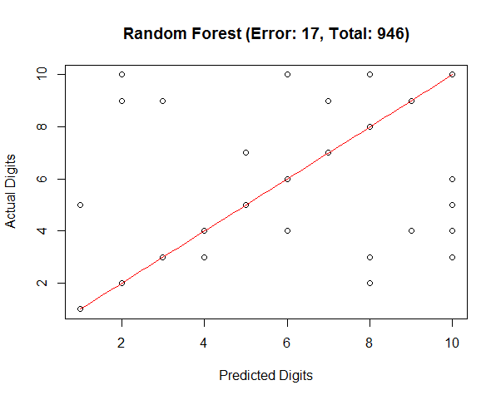
Model 5: Random Forest
Generated the classification model through randomForest package in R.
Accuracy of this model is 98.2 %.
Time required to train the model
on 1934 observations is 56.55 Sec.
Time required to predict the model
on 946 observations is 0.22 Sec.
This model incorrectly classifies
17 handwritten digits out of total
946 digits.

Slide 20
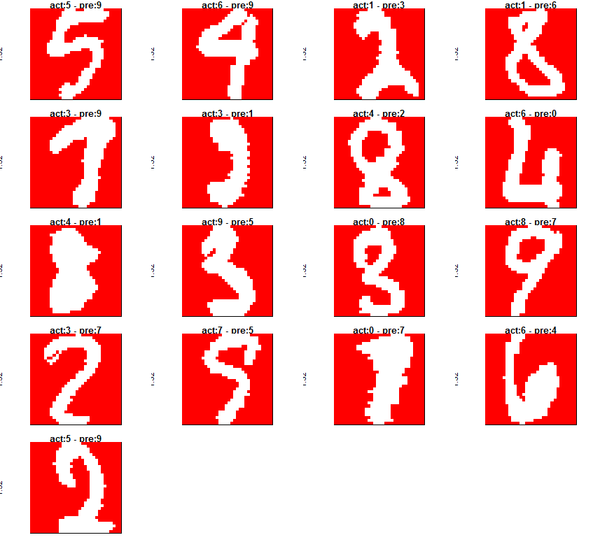
Incorrectly Classified Digits (errors): 17

Slide 21
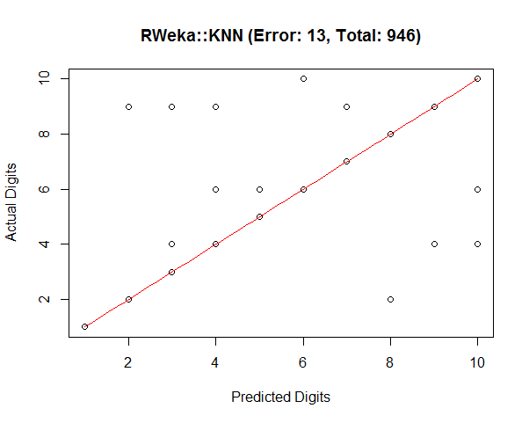
Model 6: K Nearest Neighbor Algorithm
RWeka is a R interface to weka. It has a Ibk (instance based learning) class which provides K nearest neighbor classifier.
Accuracy of this model is 98.63 %.
Time required to train the model
on 1934 observations is 13.89 Sec.
Time required to predict the model
on 946 observations is 11.14 Sec.
This model incorrectly classifies
13 handwritten digits out of total
946 digits.

Slide 22
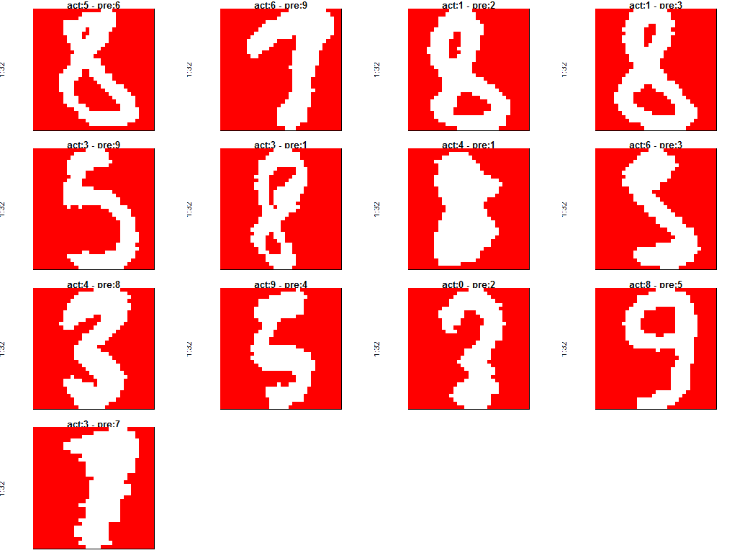
Incorrectly Classified Digits (errors): 13

Slide 23
Model Comparison: Accuracy

Slide 24
Model Comparison: Actual vs Predicted

Slide 25
Summary of Models Used
Models Used for Digits Recognition | R Package | % Accuracy of a Model | % Error of a Model | Misclassified Digits Out of Total 946 | Time to Train the Model in Sec. | Model Prediction Time in Sec.
Recursive Partitioning and Regression Trees | rpart | 75.48 % | 24.52 % | 232 | 3.72 | 0.21
Naïve Bays Algorithm | e1071 | 86.58 % | 13.42 % | 127 | 1.06 | 23.95
Support Vector Machine | e1071 | 97.46 % | 2.54 % | 24 | 10.87 | 2.08
Fast Nearest Neighbor Search Algorithm | FNN | 97.57 % | 2.43 % | 23 | 6.51 | 6.51
Random Forest | randomForest | 98.20 % | 1.8 % | 17 | 56.55 | 0.22
K Nearest Neighbor Algorithm | RWeka | 98.63 % | 1.37 % | 13 | 13.89 | 11.14

Slide 26


