Slide 1
Payroll App – Capstone Project
Varsha Medukonduru

Slide 2
Agenda
Project Overview
System Architecture Flow
Detailed Components
PDF Generation
Challenges
Future Enhancements
Conclusion
Takeaways

Slide 3
Project Overview
What the system does?
Employee timesheet logging
Manager approvals
HR salary calculations
What is the Goal?
Simplify, automate, reduce errors

Slide 4
System Architecture flow
User action
FastAPI receives request
Python processes logic
DB stores/returns data
FastAPI sends response
Swagger UI for testing

Slide 5
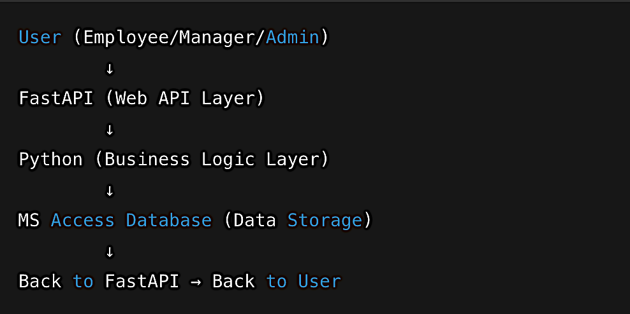

Slide 6
Detailed Components

Slide 7
Database (MS Access)
The DB has 5 Tables:
Employee
Timesheet
Payroll
Deductions
Payrate
The main Purpose of Database is it acts as Central vault for records

Slide 8
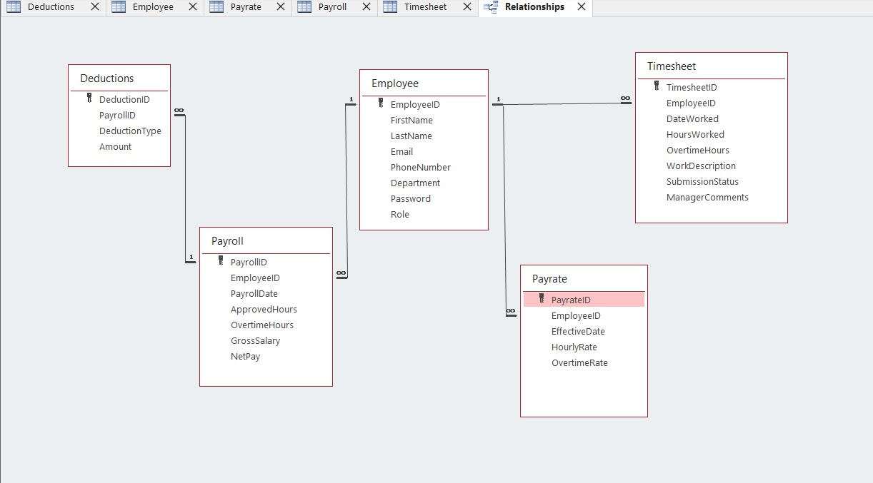

Slide 9
FastAPI and RBAC
API layer between user & backend
Handles routes: login, timesheet, payroll
JWT authentication with roles: Emp – 0, Manager -1 and Admin - 2
End point for Employees(CRUD)
Validates input, manages roles

Slide 10
Python
Business logic: authentication, validation, payroll calculations
Libraries: pyodbc
Key functions: hash_password(), get_db()

Slide 11
Frontend UI
Swagger UI + ReDoc
Live API testing
Auto-docs for developers
Docs = interactive
ReDoc = readable

Slide 12
PDF Generation
Python generates pdf using weasyprint library
Export payslip content (timesheet summary, payroll, deductions) to PDF

Slide 13
Challenges and Solutions:
Challenge | Solution
FastAPI + MS Access | Used pyodbc
Secure login | SHA-256 hashing
Role management | Role-based access
Early testing | Swagger UI

Slide 14
Future Enhancements
Email notifications
Full web/mobile frontend
Analytics dashboards
Move to cloud database

Slide 15
Thank you!

