Slide 1
Customer Reviews Analysis
An analysis of customer reviews for British Airways

Slide 2
Data Cleaning
The reviews were cleaned to remove unnecessary characters and standardized to lowercase for analysis.

Slide 3
Sentiment Analysis
Sentiment analysis was performed to classify the reviews into positive, negative, and neutral sentiments.

Slide 4
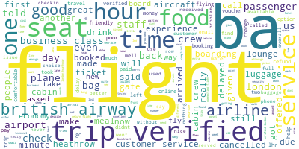
Word Cloud for All Reviews

Slide 5
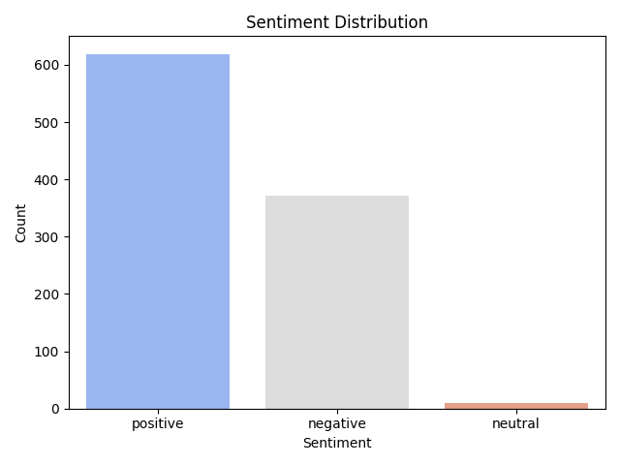
Sentiment Distribution

Slide 6
Rating Analysis
Verified Reviews: 754
Non-Verified Reviews: 246

Slide 7
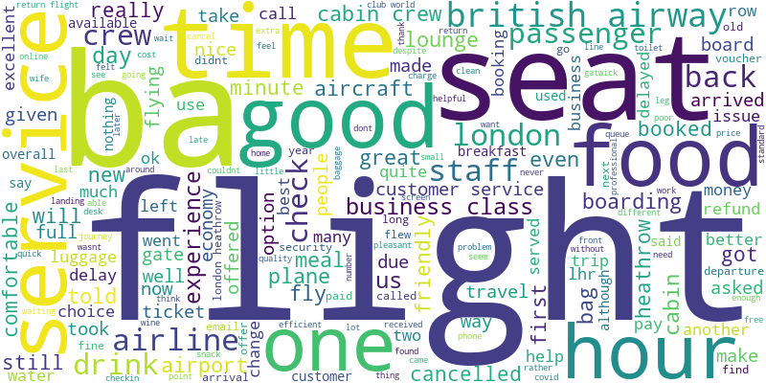
Word Cloud for Positive Reviews

Slide 8
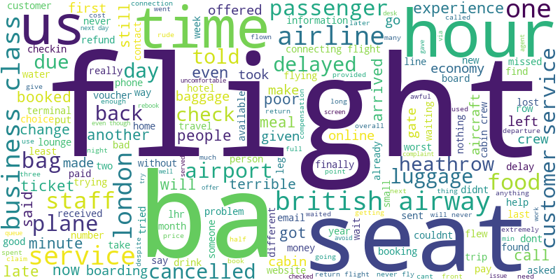
Word Cloud for Negative Reviews

