Slide 1
Sales_insights
File created on: 8/31/2024 3:24:35 PM

Slide 2
Total revenue represents the total income generated from sales of goods or services. It's a key indicator of business performance and growth which is 986.63 M

Slide 3
State the purpose of the analysis, such as understanding trends in sales quantity, identifying key drivers of sales, or highlighting areas for improvement. Sales Quantity is 2431539

Slide 4
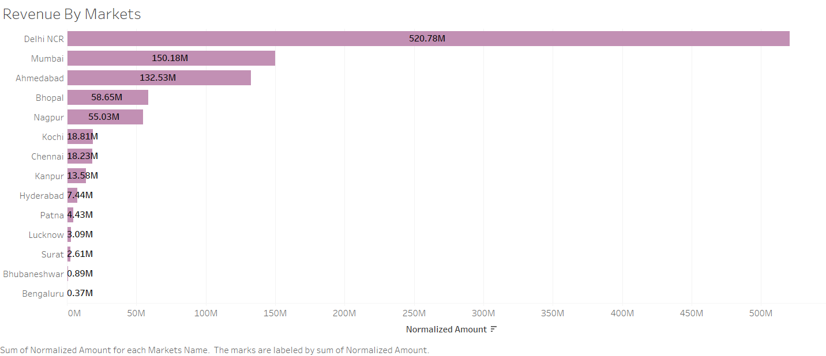

Slide 5
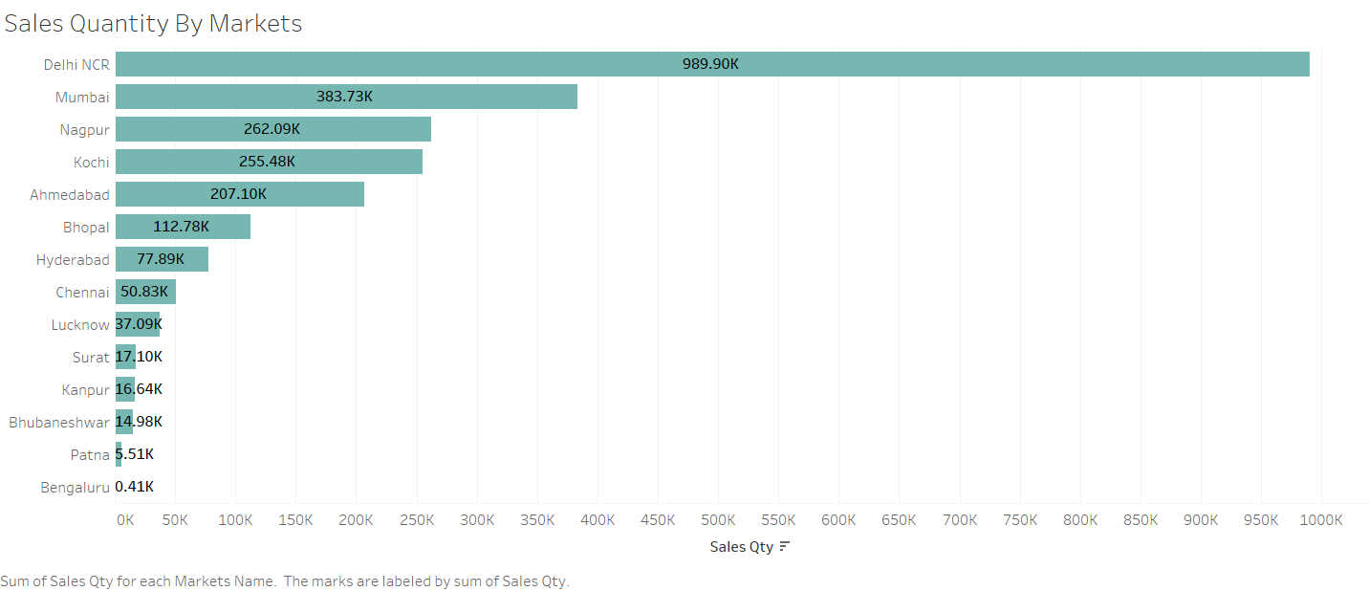

Slide 6
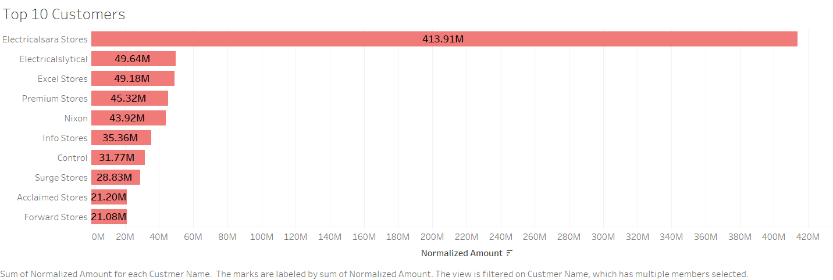

Slide 7
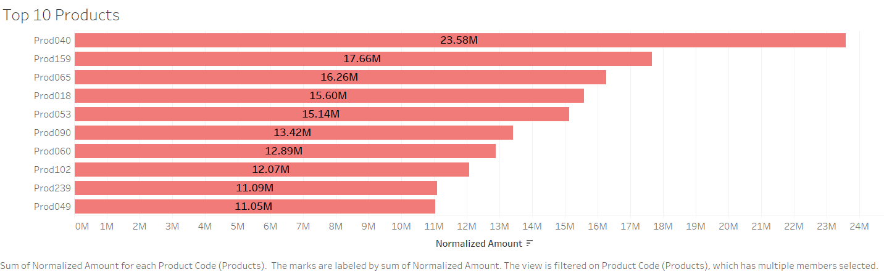

Slide 8
