Slide 1
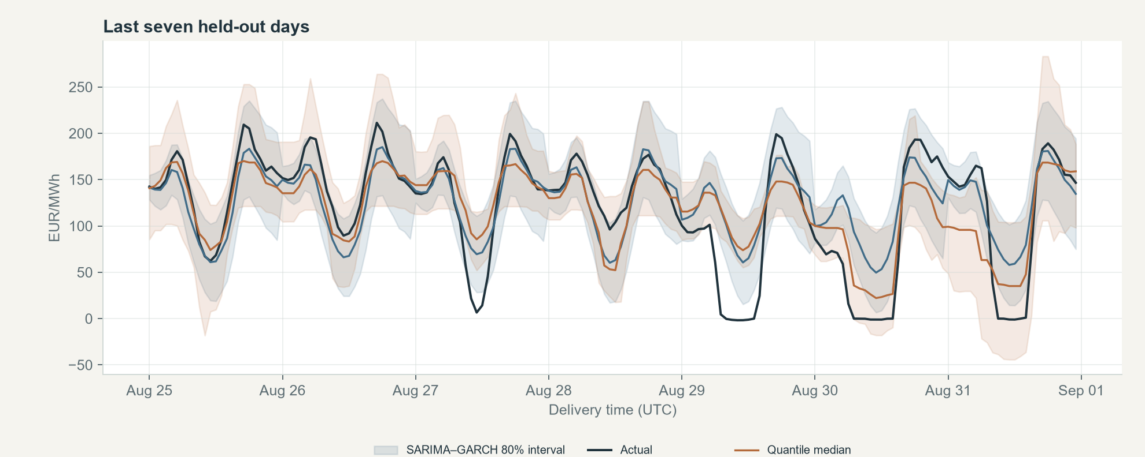
TIME SERIES ANALYSIS / LAB AAT
Day-ahead electricity
price forecasting
Volatility and prediction intervals using SARIMA–GARCH and quantile gradient boosting
Germany–Luxembourg (DE-LU) · Hourly prices in UTC
520-day chronological holdout | 12,480 hourly forecasts
PRESENTED BY [STUDENT NAME] · USN [USN]
B. M. S. College of Engineering | Department of Machine Learning
DAY-AHEAD FORECASTING • PROJECT PRESENTATION
01

Slide 2
PROBLEM AND OBJECTIVE
A day-ahead forecast must describe both price and uncertainty
The question
01
Estimate
Before delivery begins, what might each hour cost tomorrow?
Produce 24 hourly point forecasts for one selected test day.
02
Quantify
Show an 80% prediction interval, not just a single price.
03
Evaluate
Compare forecasts with held-out prices after the day is complete.
Application context: procurement, flexible demand and storage planning. The dashboard is an evaluation tool, not a trading system.
DAY-AHEAD FORECASTING • TSA LAB AAT
02

Slide 3
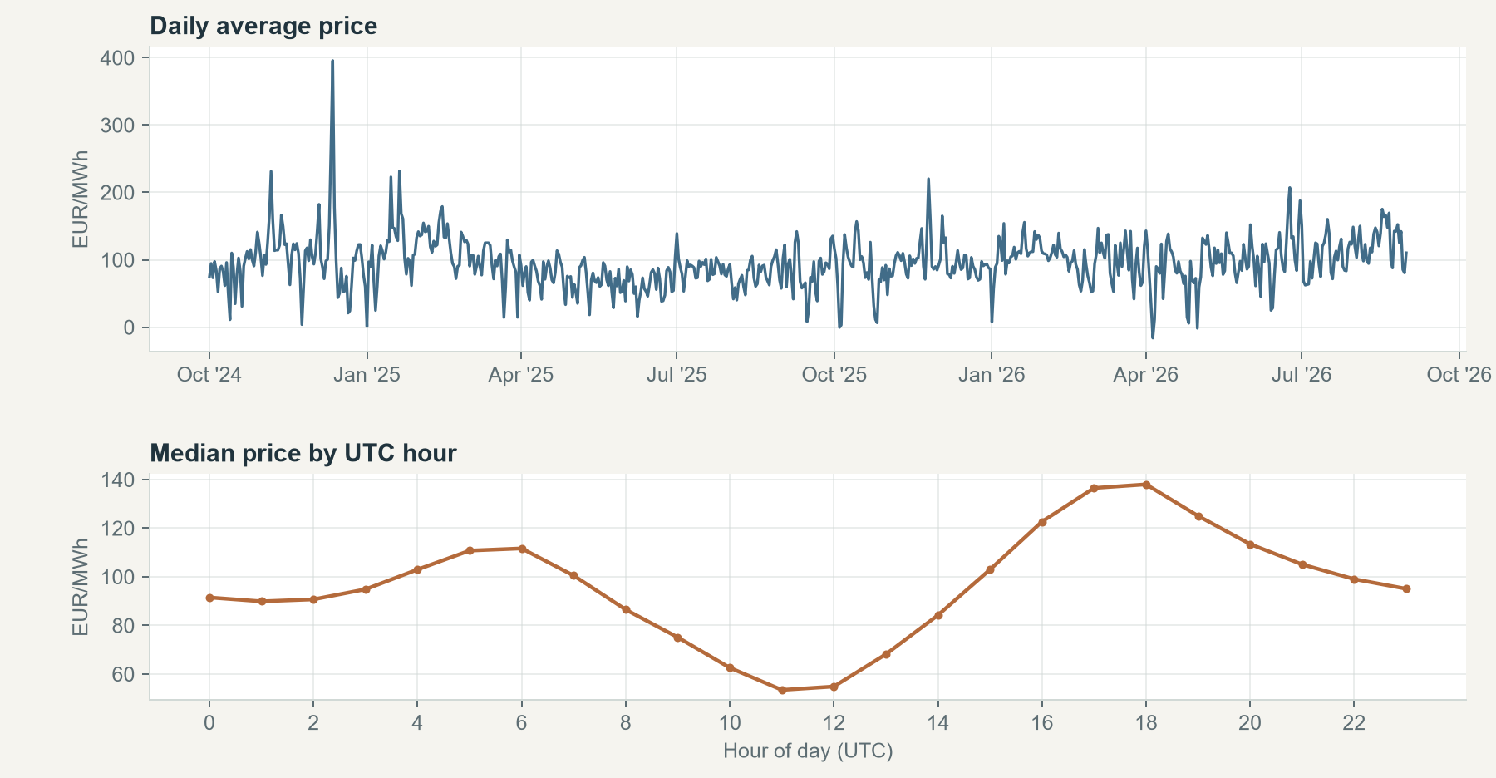
DATA
The study uses hourly DE-LU prices from a public market source
OBSERVATIONS
16,800
Hourly prices; timestamps stored in UTC.
COVERAGE
Oct 2024 – Aug 2026
The full series spans the training and test periods.
15-minute API observations are averaged to the hour. Negative prices are retained. Data: Energy-Charts price API; attribution to Bundesnetzagentur / SMARD, CC BY 4.0.
SOURCE: ENERGY-CHARTS PRICE API • DE-LU BIDDING ZONE
03

Slide 4
LITERATURE AND RESEARCH GAP
Prior work motivates the model choices and the comparison
PRICE DEPENDENCE
CHANGING VARIANCE
REPRODUCIBLE EVALUATION
Autoregressive models capture useful intraday price structure. [1, 2]
Volatility and probabilistic forecasts matter alongside point error. [1, 3, 4]
Benchmarking requires common test dates and consistent measures. [5]
Research question
On the same long chronological DE-LU holdout, how do a seasonal SARIMA–GARCH interval and a direct quantile interval compare?
This is a focused classroom comparison, not a claim that the model combination is new or universally superior.
RELATED WORK: GARCIA ET AL. (2005); ZIEL (2016); NOWOTARSKI & WERON (2018); UNIEJEWSKI ET AL. (2018); LAGO ET AL. (2021)
04

Slide 5
EVALUATION DESIGN
Both models are tested on the same future-only dates
Chronological split · no random shuffle
INITIAL TRAINING
ROLLING HOLDOUT
180 days · 4,320 hourly observations
520 days · 12,480 hourly forecasts
01 Oct 2024 – 29 Mar 2025
30 Mar 2025 – 31 Aug 2026 · 24 hours per forecast origin
01
Forecast first
02
Update second
03
Score together
Use information available before each delivery day.
Add that day's actuals only after forecasting.
Evaluate both models on the same 520 days.
DAY-AHEAD FORECASTING • TSA LAB AAT
05

Slide 6
MODEL 1 · BASELINE
SARIMA models the daily pattern; GARCH tracks residual volatility
SEASONAL MEAN
CONDITIONAL VARIANCE
SARIMA(1,0,1) × (1,0,1,24)
σ²ₜ = ω + αε²ₜ₋₁ + βσ²ₜ₋₁
An autoregressive and moving-average baseline with a 24-hour seasonal cycle, fit on the most recent 180 training days.
GARCH(1,1) updates uncertainty from recent residuals. The nominal 80% interval uses forecast mean ± 1.645 standard deviations.
Assumption to check
Standardized innovations are treated as approximately normal for interval construction. Held-out coverage tests how well this assumption works.
SARIMAX ORDER: (1,0,1) × (1,0,1,24) • GARCH(1,1)
06

Slide 7
MODEL 2 · PROPOSED COMPARISON
Quantile boosting estimates the centre and both sides directly
τ = 0.10
τ = 0.50
τ = 0.90
LOWER QUANTILE
MEDIAN FORECAST
UPPER QUANTILE
10th–90th percentiles form the nominal 80% prediction interval.
INPUT FEATURES
WHY QUANTILES?
Past prices at 24, 48 and 168 hours; recent 24- and 168-hour summaries; hour, weekday and month.
Quantile loss allows an asymmetric interval without assuming normal forecast errors. Models use 150 shallow boosting trees.
GRADIENT BOOSTING • QUANTILE LOSS AT τ = 0.10, 0.50 AND 0.90
07

Slide 8
EVALUATION MEASURES
Accuracy and interval quality answer different questions
POINT ERROR
LARGE ERRORS
CALIBRATION
SHARPNESS
MAE
RMSE
Coverage
Width
Typical absolute miss; reported in EUR/MWh.
Penalizes larger misses more strongly.
Share inside a nominal 80% interval.
Average interval size; smaller is not useful alone.
Additional checks
sMAPE is reported instead of MAPE because prices may be zero or negative. Pinball loss scores the lower and upper quantile forecasts.
Coverage is interpreted against 80%; it does not measure interval width or point accuracy.
DAY-AHEAD FORECASTING • TSA LAB AAT
08

Slide 9
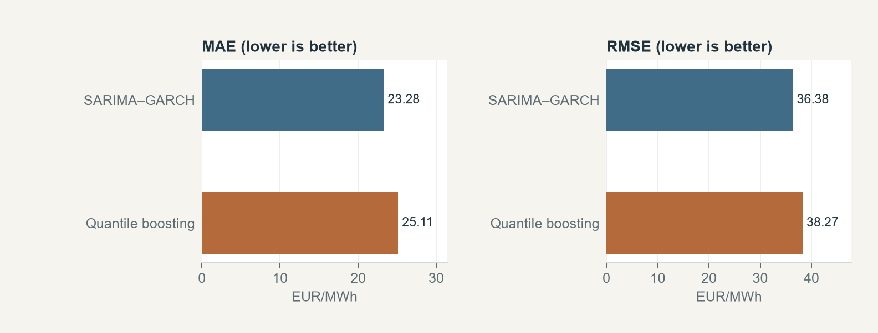
RESULTS · FULL HELD-OUT TEST
On this holdout, SARIMA–GARCH has lower point error
MODEL | MAE | RMSE | sMAPE | 80% COVERAGE | MEAN WIDTH | PINBALL 10 | PINBALL 90
SARIMA–GARCH | 23.28 | 36.38 | 83.3% | 82.9% | 83.25 | 6.43 | 6.30
Quantile boosting | 25.11 | 38.27 | 86.5% | 79.8% | 81.90 | 6.77 | 6.09
SARIMA–GARCH: lower MAE and RMSE.
Quantile boosting: coverage nearer 80% and slightly narrower intervals.
The preferred model depends on whether point error or interval behaviour matters more.
PRICE ERRORS / WIDTH / LOSS: EUR/MWh • sMAPE / COVERAGE: % • SAME 520-DAY HOLDOUT
09

Slide 10
FORECAST EXAMPLE
The final test week shows where point forecasts and intervals differ
Actual prices are shown only for retrospective evaluation. Shaded regions are nominal 80% intervals; sharp price moves remain difficult for both models.
HELD-OUT PERIOD • UTC DELIVERY HOURS
10

Slide 11
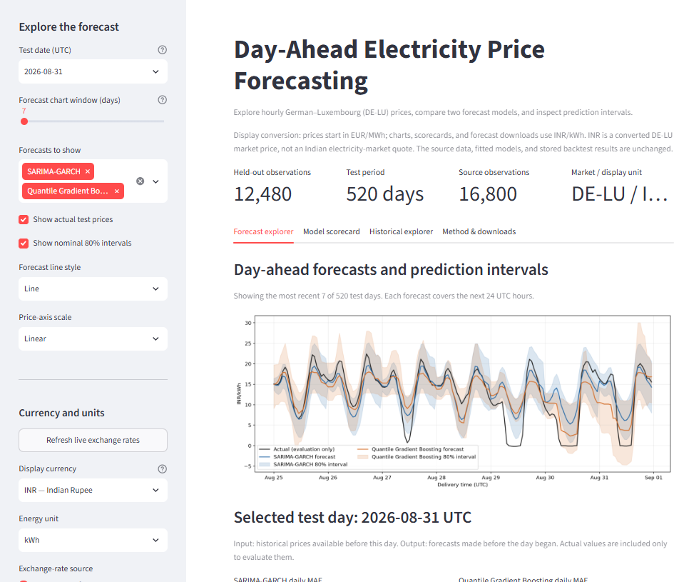
INTERACTIVE DASHBOARD · INPUT AND OUTPUT
The forecast explorer turns a test date into 24 hourly outputs
01
Choose a test date
The selector covers the 520 stored holdout dates, not arbitrary future dates.
02
Inspect next-day estimates
View 24 hourly forecasts, optional 80% bounds and the selected-day table.
03
Compare with actuals
Held-out prices appear for evaluation only; they are not forecast inputs.
You can also show either model, hide actuals or intervals, choose line/step style, and use a linear or symmetric-log price axis.
LIVE DEMO: python -m streamlit run app.py
11

Slide 12
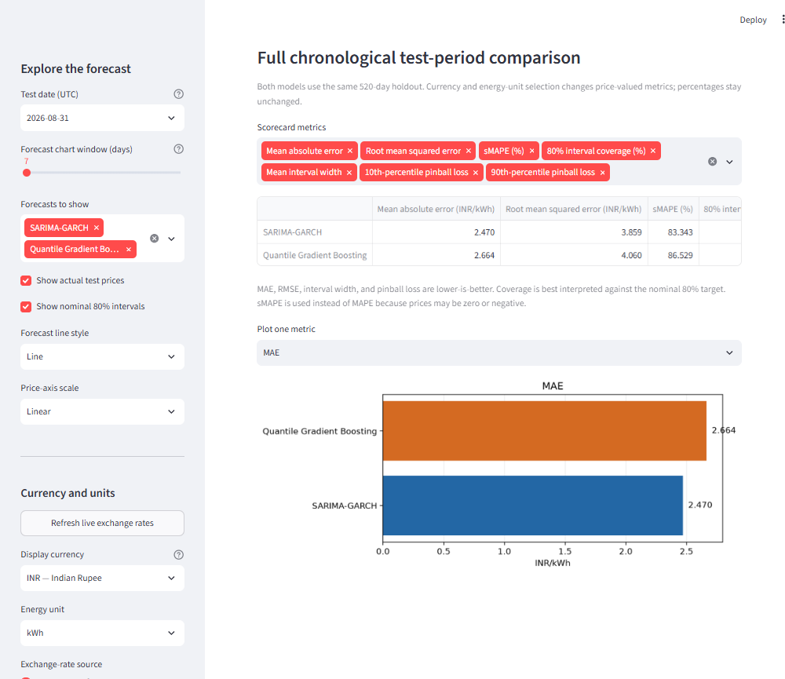
INTERACTIVE DASHBOARD · DISPLAY AND EXPLORATION
Currency and chart controls change the display, not the forecast
CURRENCY AND UNITS
Choose listed currencies or enter a three-letter code. INR/kWh is the default when live rates are available; EUR/MWh remains the source unit.
Rates are published ECB reference rates via Frankfurter. A positive manual rate is available; if rates are offline, EUR remains usable.
HISTORY AND DOWNLOADS
Explore hourly, daily or weekly prices, rolling averages, typical UTC-hour prices and price distributions. Download the visible history or selected-day forecasts as CSV.
INR is a display conversion of DE-LU prices—not an Indian electricity-market quote. Model inputs and stored results remain unchanged.
PRICE-VALUED DISPLAYS CAN BE CONVERTED • PERCENTAGES ARE UNCHANGED
12

Slide 13
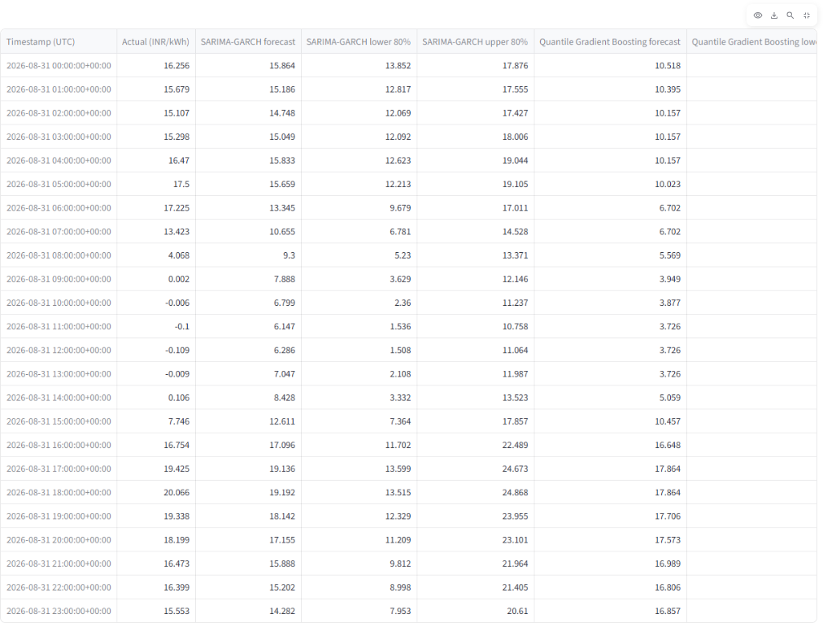
INTERACTIVE DASHBOARD · OUTPUT DETAIL
A selected day can be checked row by row
24 HOURLY ROWS
Each row reports one UTC delivery hour. The selected display currency and unit appear in price-valued columns.
EVALUATION ONLY
Actual prices are included to measure the forecast after delivery. They are never used to build that same day's input features.
The daily CSV is downloadable in the selected display unit.
EXAMPLE OUTPUT: 31 AUG 2026 UTC • INR/KWH DISPLAY
13

Slide 14
CONCLUSION AND LIMITATIONS
The result is useful within a clearly defined scope
WHAT THE TEST SHOWS
LIMITS TO KEEP IN VIEW
01
Point accuracy
One bidding zone and one historical period; no weather, demand or generation inputs; UTC days do not resolve local daylight-saving delivery days.
SARIMA–GARCH has lower MAE and RMSE in this holdout.
02
Interval behaviour
Quantile boosting is closer to 80% coverage and slightly narrower.
The dashboard's currency controls are for readability. An INR value is converted DE-LU data and should not be interpreted as an Indian market forecast.
Next: add external drivers, test more zones and seasons, calibrate intervals, and evaluate decision value.
DAY-AHEAD FORECASTING • TSA LAB AAT
14

Slide 15
SOURCES
References and data attribution
[1] Garcia, R. C. et al. (2005). A GARCH forecasting model to predict day-ahead electricity prices. IEEE Transactions on Power Systems. doi:10.1109/TPWRS.2005.846044
[2] Ziel, F. (2016). Forecasting electricity spot prices using Lasso. IEEE Transactions on Power Systems. doi:10.1109/TPWRS.2016.2521545
[3] Nowotarski, J. & Weron, R. (2018). Recent advances in electricity price forecasting: probabilistic forecasting. Renewable & Sustainable Energy Reviews. doi:10.1016/j.rser.2017.05.234
[4] Uniejewski, B., Weron, R. & Ziel, F. (2018). Variance stabilizing transformations for electricity spot price forecasting. IEEE Transactions on Power Systems. doi:10.1109/TPWRS.2017.2734563
[5] Lago, J. et al. (2021). Forecasting day-ahead electricity prices: algorithms, best practices and open-access benchmark. Applied Energy. doi:10.1016/j.apenergy.2021.116983
Data: Energy-Charts price API, DE-LU zone; attribution to Bundesnetzagentur / SMARD; CC BY 4.0. Exchange-rate service: Frankfurter, which distributes ECB reference rates.
All reported model results are computed from the original EUR/MWh backtest. Dashboard currency conversion affects presentation only.
END
15

