Slide 1
TruthLens AI
Explainable Fake News Detection using NLP
AAT: Topic Exploration, Implementation, Validation and Presentation
[Student 1 / USN] | [Student 2 / USN]
Department of Machine Learning, B.M.S. College of Engineering

Slide 2
1. Problem Statement
Why this is an NLP problem
Online news creates a large volume of text that can be difficult to review manually.
The project studies whether article wording and contextual patterns can be used for supervised text classification.
The target is a screening signal that can support human review, not an automatic truth verdict.

Slide 3
2. Objectives
What we implement
Clean and validate a labelled news corpus.
Build a TF-IDF + Logistic Regression reference model.
Fine-tune DistilBERT for the same binary task.
Evaluate accuracy, precision, recall and F1 on the same held-out test set.
Use LIME for local explanations and expose the result through a simple application.

Slide 4
3. Literature Review
Research basis
BERT (Devlin et al., 2019): contextual transformer language representations.
DistilBERT (Sanh et al., 2019): compact transformer with lower computational cost.
Fake-news detection literature: content and contextual signals can be used in classification systems.
LIME (Ribeiro et al., 2016): local, model-agnostic explanations for individual predictions.

Slide 5
4. Dataset and Pre-processing
ISOT Fake News Dataset
Two source files: True.csv and Fake.csv.
Primary experiment: 5,000 examples per class, sampled with seed 42.
Cleaning: missing values, URLs, obvious source-prefix artifacts, whitespace and duplicates.
Split: 70% train, 15% validation and 15% test, stratified by label.

Slide 6
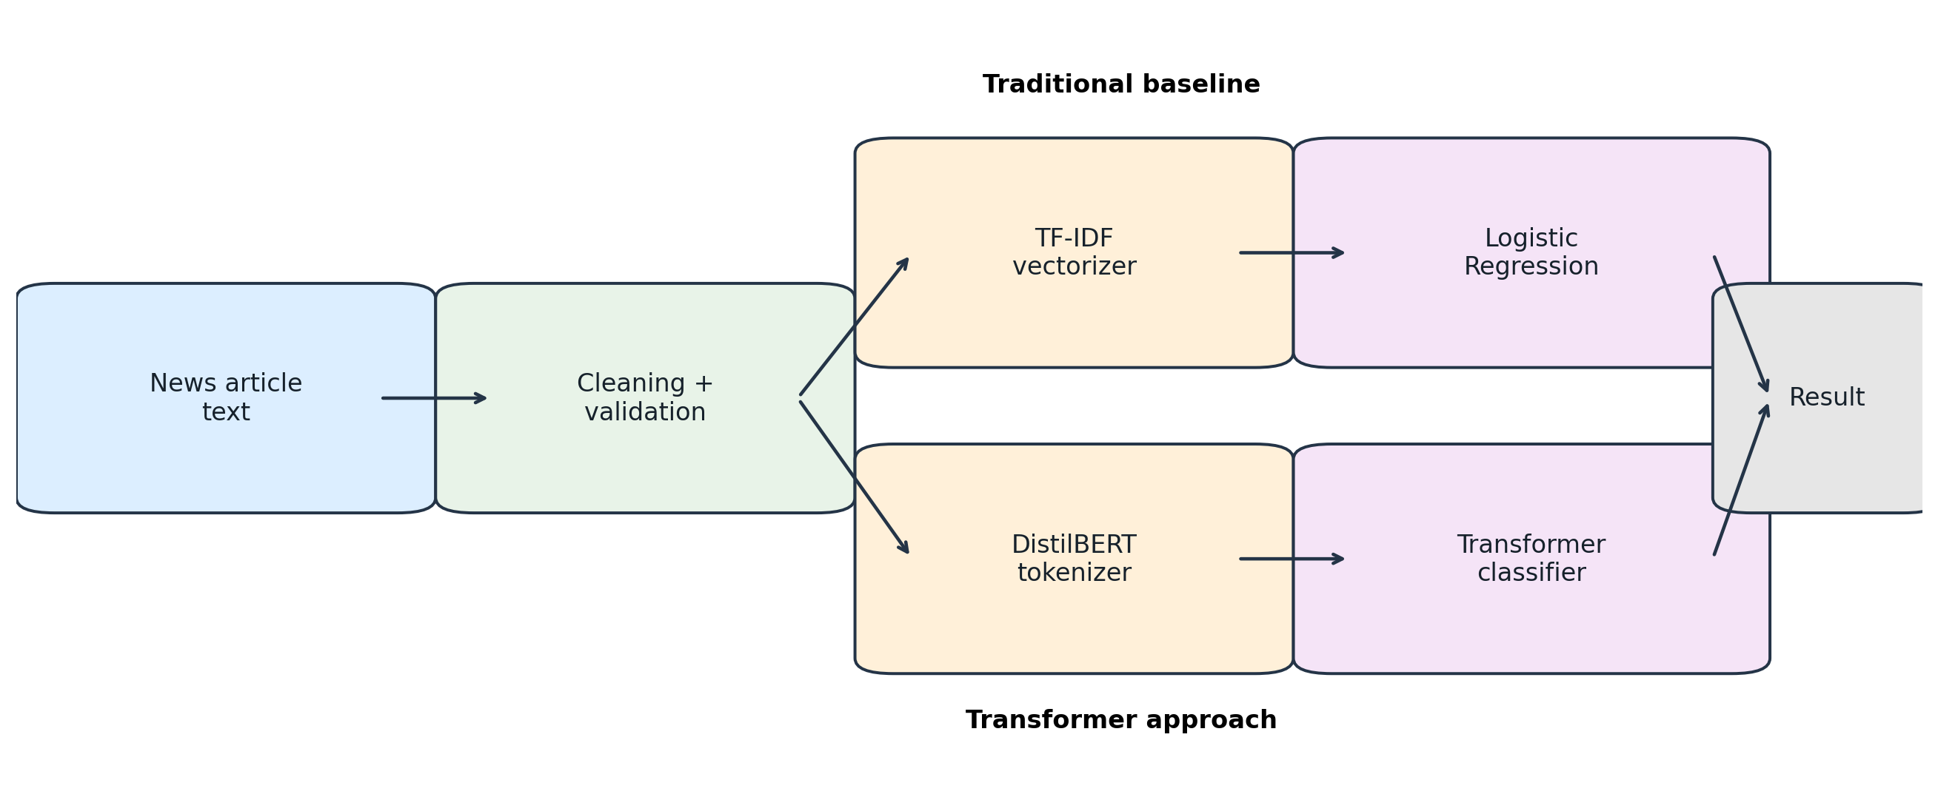
5. System Architecture
Two modelling branches from the same cleaned text

Slide 7
6. Baseline: TF-IDF + Logistic Regression
Fast and interpretable reference
TF-IDF converts words and bigrams into weighted sparse features.
Vocabulary capped at 20,000 features with sublinear term-frequency scaling.
Logistic Regression learns a binary decision boundary over the TF-IDF vectors.
This model helps separate genuine transformer gains from gains caused simply by preprocessing.

Slide 8
7. Transformer: DistilBERT
Contextual language representation
Tokenizer converts text to subword IDs and attention masks.
DistilBERT encoder builds contextual representations.
A two-class classification head produces FAKE and REAL logits.
Training uses AdamW, learning rate 2e-5, maximum length 256, batch size 8 and 2 epochs.

Slide 9
8. Experimental Setup
Fair comparison
Same cleaned text and same stratified test set for both models.
Fixed random seed: 42.
Primary evaluation: accuracy, precision, recall and F1.
Validation is used during transformer development; test data is held back until final evaluation.

Slide 10
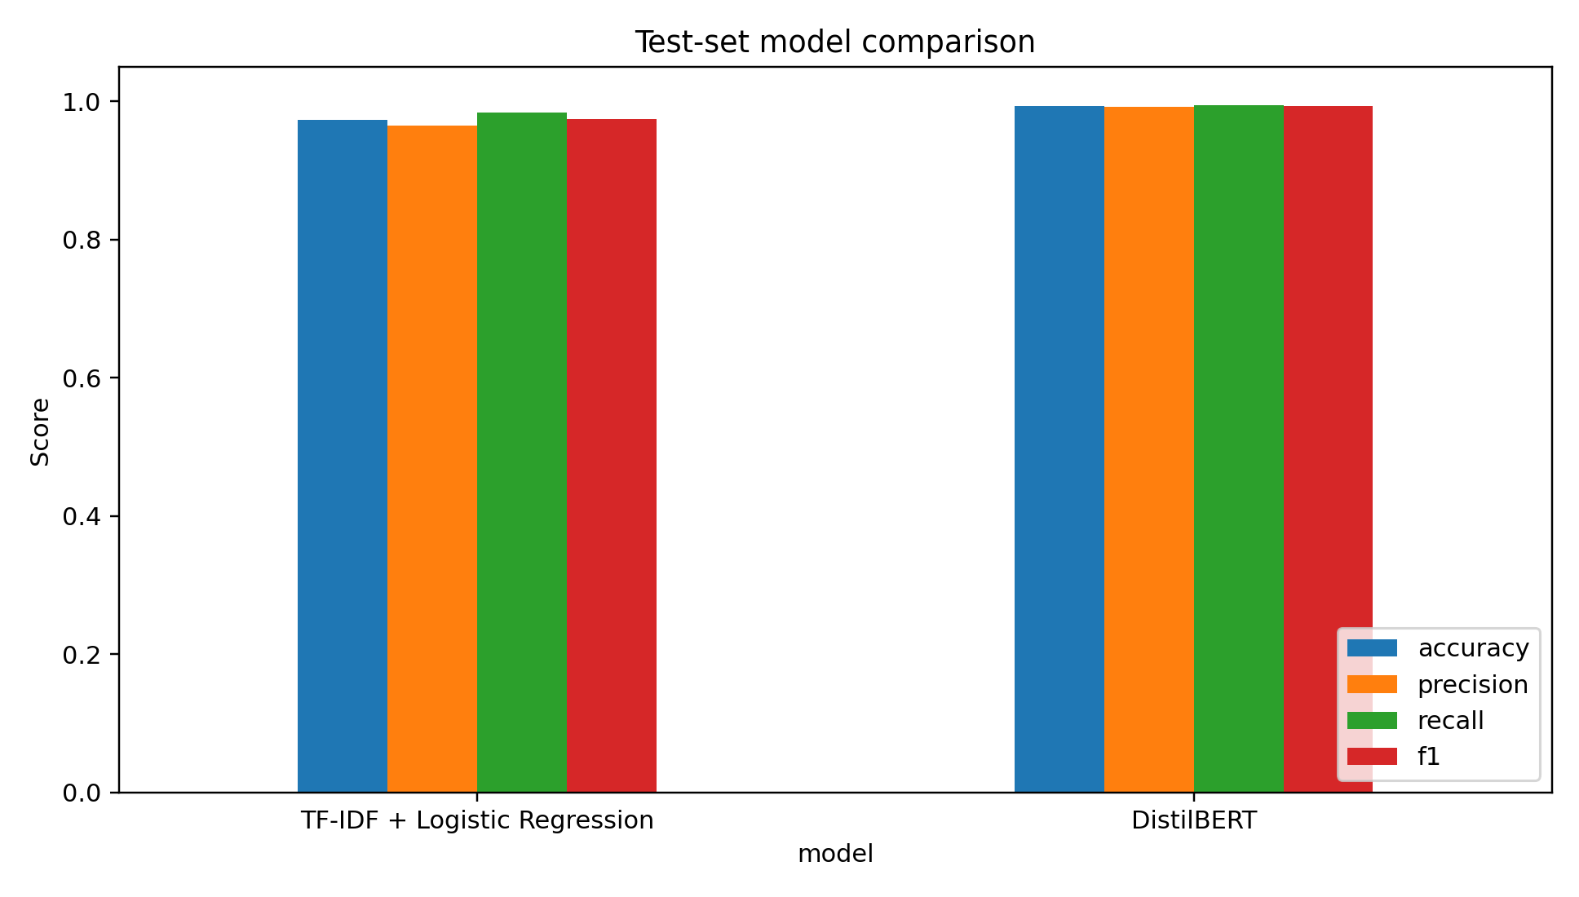
9. Results
Measured on the held-out test split after the final run
Model | Accuracy | Precision | Recall | F1
TF-IDF + LR | [[LR_ACC]] | [[LR_PREC]] | [[LR_REC]] | [[LR_F1]]
DistilBERT | [[BERT_ACC]] | [[BERT_PREC]] | [[BERT_REC]] | [[BERT_F1]]

Slide 11
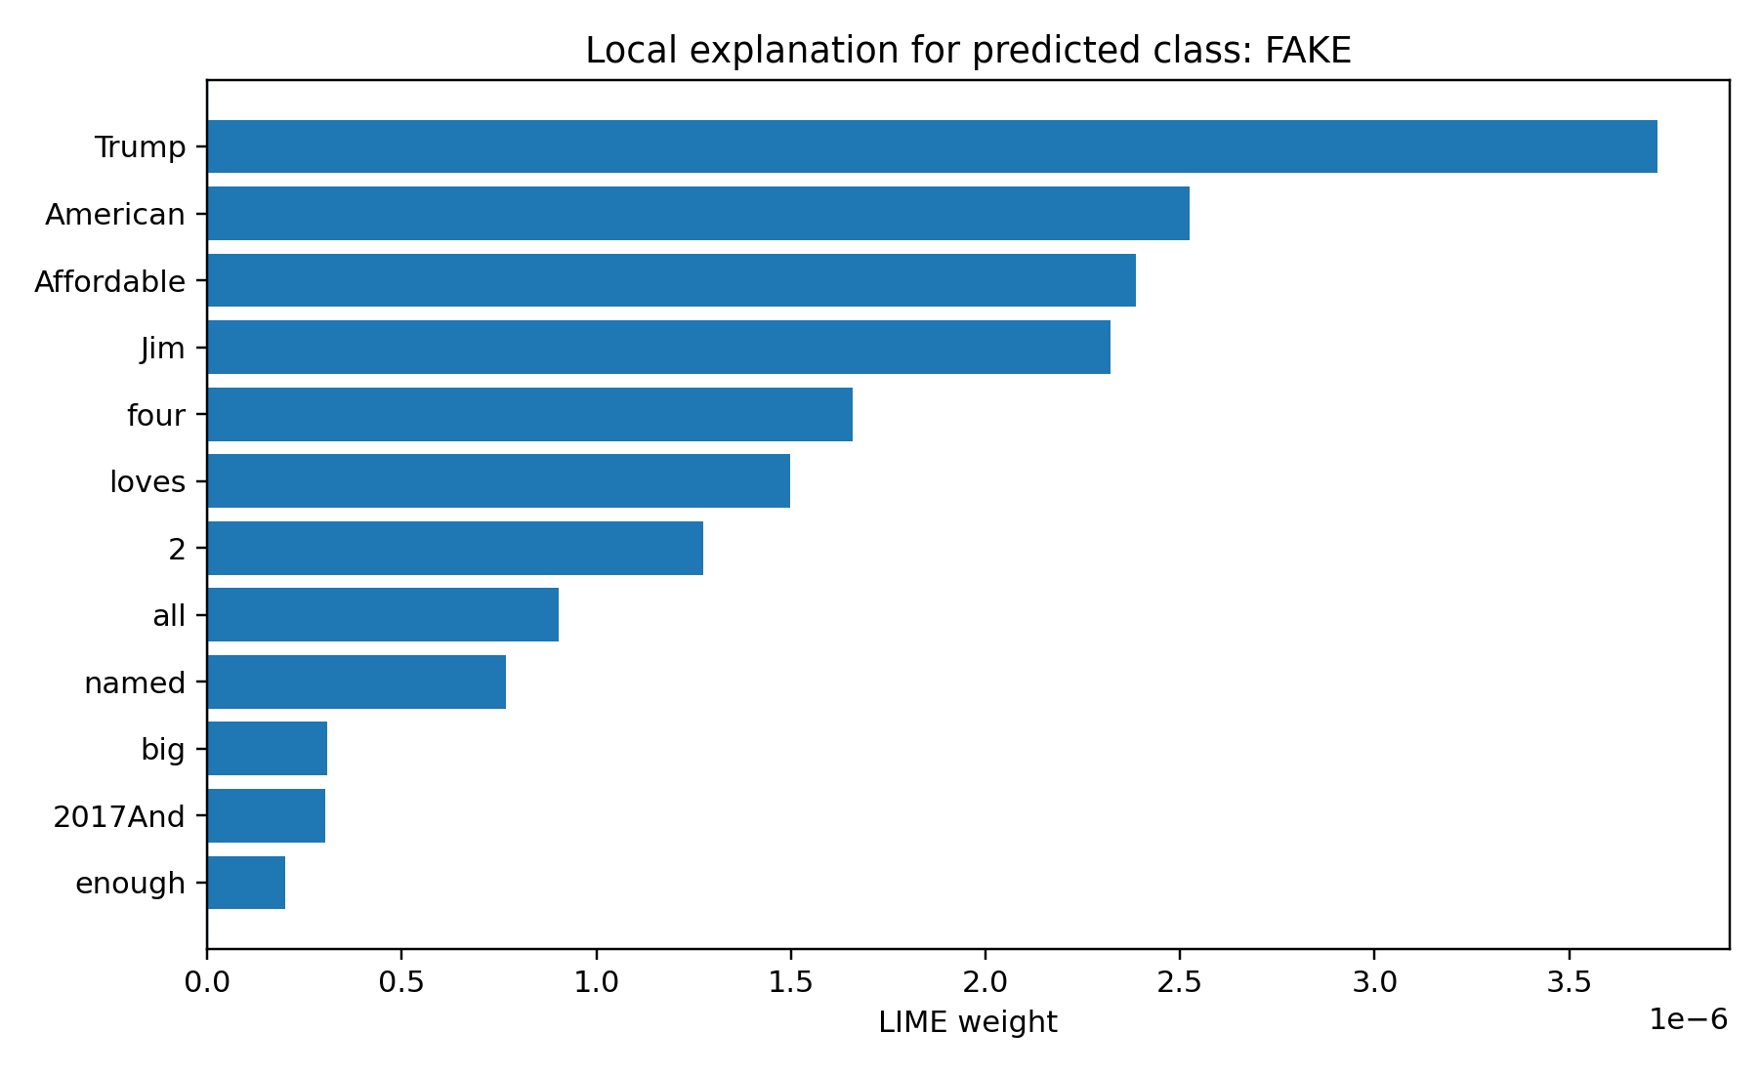
10. Explainability + Application
From model output to a usable prototype
LIME creates a local explanation for an individual prediction.
Streamlit provides a simple article-analysis UI.
FastAPI exposes POST /predict for programmatic use.
The interface explicitly warns that the output is a learned classification signal, not independent fact verification.

Slide 12
11. Limitations and Conclusion
What the project demonstrates
Dataset source and publisher effects may create shortcuts that do not generalize to new sources.
Long articles are truncated to the first 256 tokens in the transformer experiment.
LIME is local and approximate.
The completed pipeline satisfies the AAT requirements: topic study, application, architecture, implementation, evaluation, comparison, interpretation, report and presentation.

