Slide 1
CAPSTONE PROJECT movie recommendation system
Presented By
Student Name: varsha yellaram
College Name: mallareddy engineering college for women
Department: cse
Email ID: 23rh1a05tj@mrecw.in
AICTE Student ID: 23rh1a05tj

Slide 2
OUTLINE
Problem Statement Proposed Solution System Development Approach Algorithm & Deployment Result Conclusion Future Scope References
Problem Statement Proposed Solution System Development Approach Algorithm & Deployment Result Conclusion Future Scope References
Problem Statement Proposed Solution System Development Approach Algorithm & Deployment Result Conclusion Future Scope References

Slide 3
Problem Statement
People often struggle to decide what movie to watch next. With countless options available, it becomes overwhelming to find films that align with personal preferences. This project addresses the need for a personalized movie recommendation system that simplifies movie discovery based on user taste.
People often struggle to decide what movie to watch next. With countless options available, it becomes overwhelming to find films that align with personal preferences. This project addresses the need for a personalized movie recommendation system that simplifies movie discovery based on user taste.

Slide 4
Proposed Solution
To help users discover relevant movies based on what they already like, we propose a content-based recommendation system using: - Movie metadata such as genres, plot summaries, cast, crew, and keywords. - Feature engineering to convert text-based features into vectors. - Cosine similarity for finding similar movies. - A search-based interface for querying favorite movies.
To help users discover relevant movies based on what they already like, we propose a content-based recommendation system using: - Movie metadata such as genres, plot summaries, cast, crew, and keywords. - Feature engineering to convert text-based features into vectors. - Cosine similarity for finding similar movies. - A search-based interface for querying favorite movies.

Slide 5
System Development Approach
Technology Used: - Language: Python - Libraries: Pandas, NumPy, scikit-learn, NLTK, ast, matplotlib - Dataset: TMDB 5000 Movies and Credits datasets - Tools: Jupyter Notebook System Requirements: - Python 3.x - 8 GB RAM minimum - Jupyter Notebook environment
Technology Used: - Language: Python - Libraries: Pandas, NumPy, scikit-learn, NLTK, ast, matplotlib - Dataset: TMDB 5000 Movies and Credits datasets - Tools: Jupyter Notebook System Requirements: - Python 3.x - 8 GB RAM minimum - Jupyter Notebook environment

Slide 6
Algorithm & Deployment
Algorithm: - Content-Based Filtering using cosine similarity. Steps: 1. Merge TMDB movies and credits datasets on title. 2. Extract and clean relevant features: genres, keywords, cast, crew, overview. 3. Apply text preprocessing using NLTK. 4. Convert features into a 'tags' column. 5. Use CountVectorizer to create feature vectors. 6. Calculate cosine similarity matrix. Deployment: - Currently in notebook phase; can be deployed using Flask or Streamlit for a web interface.
ithm:
Algorithm: - Content-Based Filtering using cosine similarity. Steps: 1. Merge TMDB movies and credits datasets on title. 2. Extract and clean relevant features: genres, keywords, cast, crew, overview. 3. Apply text preprocessing using NLTK. 4. Convert features into a 'tags' column. 5. Use CountVectorizer to create feature vectors. 6. Calculate cosine similarity matrix. Deployment: - Currently in notebook phase; can be deployed using Flask or Streamlit for a web interface.

Slide 7
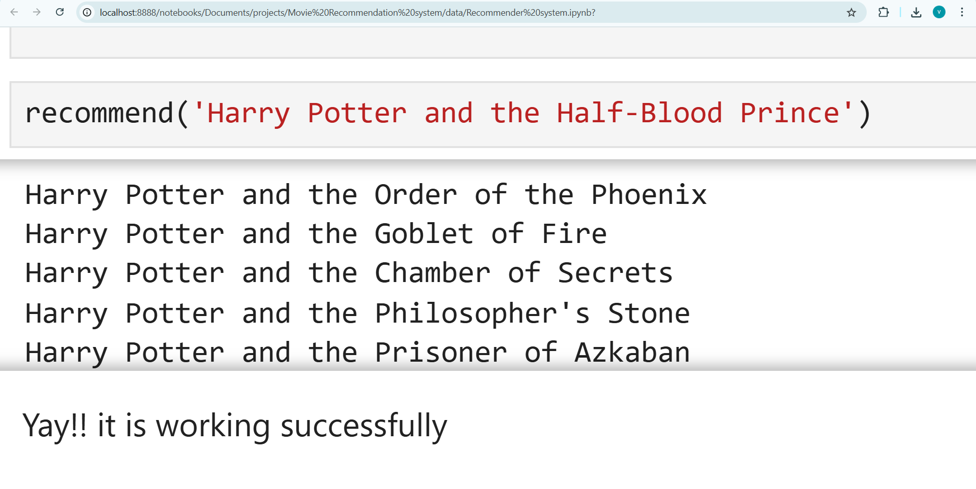
Result
Example Output: Enter movie: 'Avatar' Top 5 Recommended Movies: 1. Guardians of the Galaxy 2. John Carter 3. 2012 4. The Avengers 5. The Helix... (Insert screenshot of output table or similarity results)
Example Output: Enter movie: 'Avatar' Top 5 Recommended Movies: 1. Guardians of the Galaxy 2. John Carter 3. 2012 4. The Avengers 5. The Helix... (Insert screenshot of output table or similarity results)

Slide 8
Conclusion
- The project successfully implements a content-based movie recommendation system. - It helps users quickly find similar movies using textual metadata. - Shows strong potential for user engagement in OTT or entertainment platforms. - Simple and effective use of NLP and machine learning techniques.
- The project successfully implements a content-based movie recommendation system. - It helps users quickly find similar movies using textual metadata. - Shows strong potential for user engagement in OTT or entertainment platforms. - Simple and effective use of NLP and machine learning techniques.

Slide 9
Future Scope
- Integrate user ratings and collaborative filtering for hybrid recommendations. - Include real-time user feedback for dynamic suggestions. - Build a web/mobile app interface for broader access. - Use deep learning (e.g., transformers) for better semantic understanding.
- Integrate user ratings and collaborative filtering for hybrid recommendations. - Include real-time user feedback for dynamic suggestions. - Build a web/mobile app interface for broader access. - Use deep learning (e.g., transformers) for better semantic understanding.

Slide 10
References
- [1] TMDB 5000 Dataset - [2] Scikit-learn Documentation - [3] NLTK Documentation - [4] https://www.kaggle.com/tmdb-5000-movie-dataset - GitHub Repository: (Insert your project GitHub link)
- [1] TMDB 5000 Dataset - [2] Scikit-learn Documentation - [3] NLTK Documentation - [4] https://www.kaggle.com/datasets/tmdb/tmdb-movie-metadata - GitHub Repository: https://github.com/Varshayellaram/MovieRecommendationSystem

Slide 11
Thank you

