Slide 1

DEPARTMENT OF COMPUTER ENGINEERING
CLOUD COMPUTING
Employee Leave Management System
Student name: Avishkar Dalvi Roll no: 06
Student name: Kanchi Patil Roll no: 45
Student name: Varshil Shah Roll no: 63
Student name: Jainam Zaveri Roll no:77

Slide 2
Problem Statement
In the existing paperwork related to leaving management. Leaves are maintained using the attendance register for the staff. An employee needs to submit their leaves manually to their respective authorities or department, this increases paperwork and maintaining the paperwork becomes a tedious exercise. Employees find it difficult to apply for leaves and vacations, especially those that have tasks that require a specific number of people to operate which is a very complicated process. First of all, there should be a way to determine if a specific employee has legitimate leave days to use. Second, leaves should be scheduled in a way that the normal operations of the business are not impaired. Finally, the personal views and emotions of the employee that is taking the leave as well as the atmosphere in the department he or she is leaving should be considered to foster cooperation and goodwill instead of anger and conflicts.
Employee Leave Management System

Slide 3
Introduction
The "Employee Leave Management System" has been developed to override the problems prevailing in the practicing manual system. This software is supported to eliminate and, in some cases, reduce the hardships faced by this existing system. Moreover, this system is designed for the particular need of the company to carry out operations in a smooth and effective manner. The application is reduced as much as possible to avoid errors while entering the data. It also provides error message while entering invalid data. No formal knowledge is needed for the user to use this system. Thus, by this all it proves it is user-friendly
This software project was mostly built utilizing the powerful coding tools of HTML, CSS, and PHP on the front end, and Microsoft SQL Server on the back end. The software is extremely user-friendly, which is a big feature. Some AWS features and tools are used in the development of this project, which is rather significant
.
Employee Leave Management System

Slide 4
Software Requirements:
Notepad ++: Notepad++ is a text and source code editor for use with Microsoft Windows.
Visual Studio Code: Visual Studio Code, also commonly referred to as VS Code, is a source-code editor made by Microsoft for Windows, Linux and macOS.
Xampp: XAMPP is a free and open-source cross-platform web server solution stack package developed by Apache Friends, consisting mainly of the Apache HTTP Server,
MariaDB database, and interpreters for scripts written in the PHP and Perl programming languages.
Aws Services: Amazon Web Services, Inc. is a subsidiary of Amazon providing ondemand cloud computing platforms and APIs to individuals, companies, and governments, on a metered pay-as-you-go basis
Employee Leave Management System

Slide 5
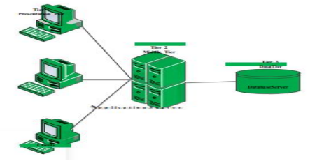
Description
Employee leave management system is designed using three tier architecture model. The three-tier architecture runs on client/server model and the web server.

Slide 6
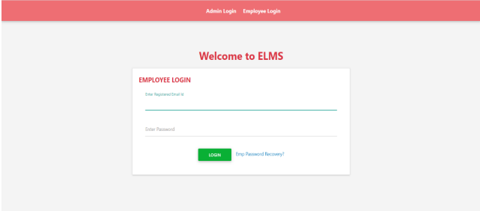
Implementation
EMPLOYEE SIDE LOGIN-
Employee login allows employee to update profile , apply leave ,check leave history and logout to the system.

Slide 7
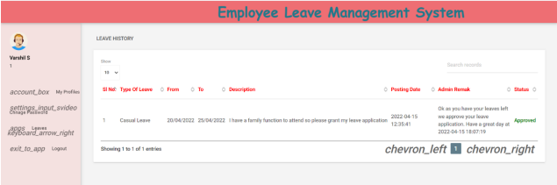
EMPLOYEE SIDE-

Slide 8
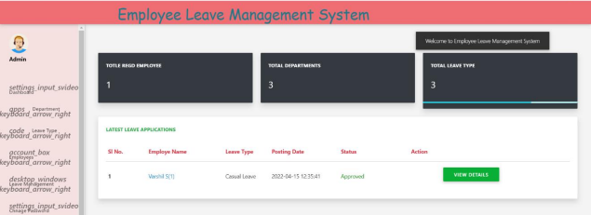
ADMIN SIDE LOGIN:
Admin login allows admin to manage employees information, can accept or reject leave , allows to manage employees department wise, leave management , logout and so on.

Slide 9
References
[1] Manish, S., Prachi, S., Rohil, Shubham, S. and Shiwani, S. (2015). Leave and Payroll Management System. International Conference on Computing and Virtualization, Thakur, India.
[2] Hridita, A. (2018). Employee leave Management System in Metlife Bangladesh. An Intenship Report on Meltlife.
[3]342815048_EMPLOYEE_LEAVE_MANAGEMENT_SYSTEM/link/617dd2703c987366c3094c7a
Employee Leave Management System

