Slide 1

Quantum Computing: A Leap into the Future
Welcome to a journey into the fascinating world of quantum computing! This presentation explores its groundbreaking concepts and potential to revolutionize technology.
Prepare to delve into the intricacies of qubits, algorithms, and the hardware driving this next generation of computation. Discover its vast potential and impact on society.

Slide 2
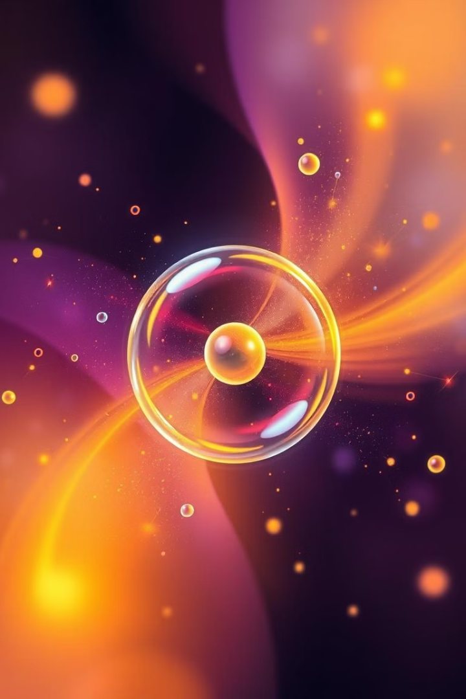
Introduction to Quantum Mechanics
Superposition
Entanglement
Quantum systems can exist in multiple states at once.
Linked particles share a fate, regardless of distance.
Uncertainty Principle
Wave-Particle Duality
We can't know both position and momentum precisely.
Quantum objects behave as both waves and particles.

Slide 3
Qubits and Quantum States
Qubit Types
Quantum States
Superconducting circuits
Superposition: Qubit exists in multiple states simultaneously.
Trapped ions
Photonic qubits
Entanglement: Linked qubits share a fate, regardless of distance.
Neutral atoms
Measurement: Collapses superposition into a definite state.
Each type has unique properties affecting performance and scalability.
These states allow for powerful quantum computations.

Slide 4
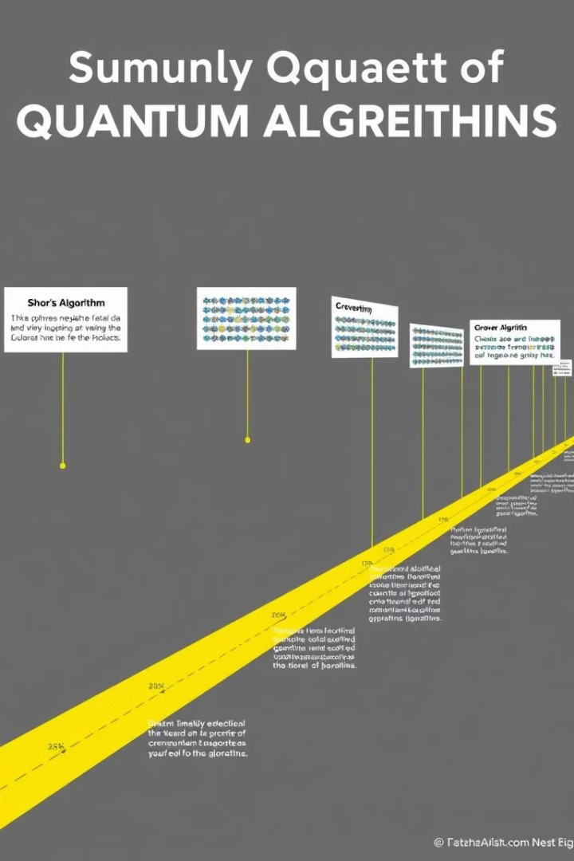
Quantum Algorithms and Computational Complexity
1
Shor's Algorithm
Efficiently factors large numbers, posing a threat to RSA cryptography.
2
Grover's Algorithm
Provides a quadratic speedup for unstructured search problems.
3
Quantum Simulation
Simulates quantum systems, enabling drug discovery and materials science breakthroughs.
4
Quantum Machine Learning
Develops novel algorithms for faster and more efficient machine learning.

Slide 5
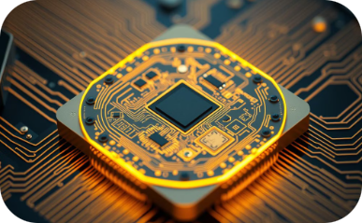
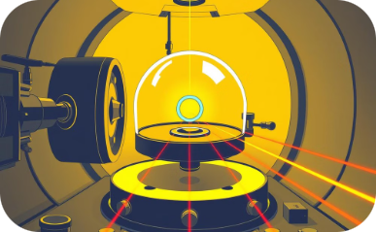
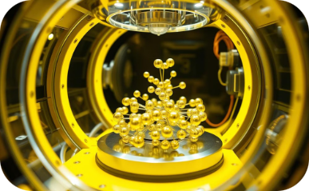
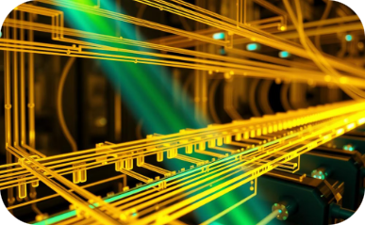
Quantum Hardware: Superconducting Circuits and Ion Traps
Superconducting Circuits
Ion Traps
Neutral Atoms
Photonic Qubits
Confine and manipulate individual ions using electromagnetic fields.
Control individual neutral atoms with lasers for quantum computation.
Encode qubits in photons, leveraging their properties for computation.
Utilize superconducting materials to maintain quantum coherence.

Slide 6
Quantum Error Correction and Fault Tolerance
Qubit Errors
1
Noise and decoherence affect qubits.
Error Detection
2
Codes detect errors in qubits.
Error Correction
3
Techniques correct errors, enhancing reliability.
Fault Tolerance
4
Protecting against errors for robust computation.
Quantum error correction is crucial for building large-scale, fault-tolerant quantum computers. Protecting qubits from errors enables complex computations.

Slide 7
Practical Applications of Quantum Computing
Drug Discovery
Materials Science
Financial Modeling
Quantum simulation accelerates drug design. It models molecular interactions accurately.
New materials with improved properties are designed. This leads to advancements in various fields.
Quantum algorithms optimize financial models. Risk assessment and portfolio management improve.
Cryptography
Optimization Problems
Quantum-resistant cryptography is developed. It protects data from future quantum attacks.
Complex logistics and supply chain issues are solved. Efficiency and resource allocation are improved.

Slide 8





The Future of Quantum Computing and Its Impact on Society
Transformative Technology
1
Revolutionizing multiple sectors.
2
Scientific Advancements
Accelerating drug discovery and materials science.
3
Economic Growth
Creating new industries and jobs.
4
Enhanced Security
Improving cybersecurity and data protection.
5
Ethical Considerations
Addressing potential societal impacts responsibly.
Quantum computing's potential is vast. It promises breakthroughs in various fields. Ethical considerations are crucial for responsible development.

