Slide 1
HOTPOT - ONLINE FOOD DELIVERY APPLICATION
DEVELOPED BY:VARSHINEE VK
TRAINER NAME:JAVEED MOHAMMED HUSNUDDIN

Slide 2
TECHNOLOGIES USED:
FRONT END : React.js
BACKEND-Spring BOOT, Java
DATABSE- MYSQL
TOOLS USED:
VISUAL STUDIO CODE
ECLIPSE
MYSQL WORKBENCK

Slide 3
PROJECT INTRODUCTION
Problem statement:
A popular restaurant chain sought to capitalize on the growing trend of online food ordering by developing a state-of-the-art full stack web application. The goal was to provide customers with a seamless and user-friendly platform for ordering food online, enhancing their overall dining experience.
Scope
1. User Registration and Authentication: Allow users to register, log in, and securely manage their accounts.
2. Menu Management: Restaurant staff/admin manage menu listings, track menu, and update menu availability. menu with detailed item descriptions, prices, and images. Implement menu categorization for breakfast, lunch, and dinner, Appetizer, Main Course, Dessert, burger, pizza, Italian, Arabian etc items.
3. Efficient Order Placement: Develop user-friendly interface for customers to place food orders efficiently and should be notified by email.
4. Cart Management: Enable users to add, remove, and manage items in their carts before checkout.
5. Order Tracking and Notifications: Integrate real-time order tracking [order confirmations, dispatch, and estimated delivery times to keep customers informed about the status of their orders through email.
6. Restaurant Management: Restaurant can add menu and fix the discount price for the menu. Restaurant can view the orders, update the order status

Slide 4
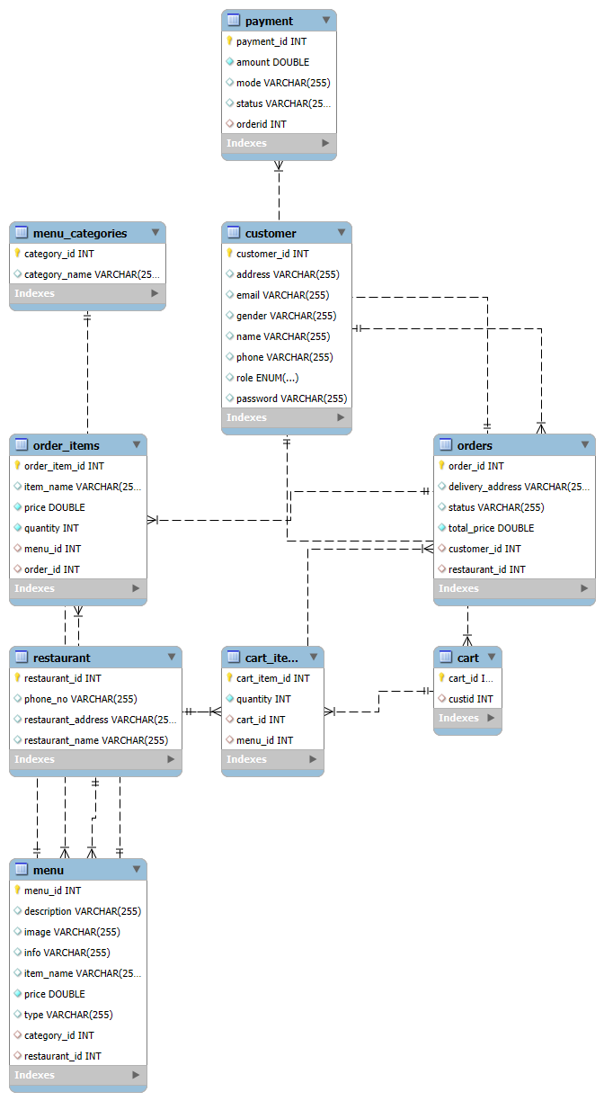
ER DIAGRAM

Slide 5
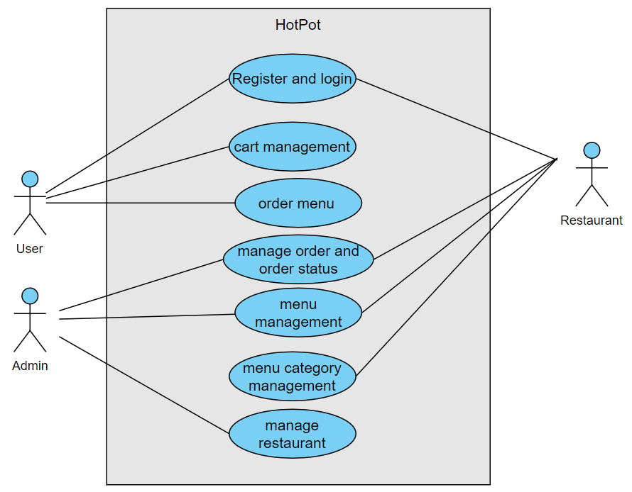
USE CASE DIAGRAM

Slide 6
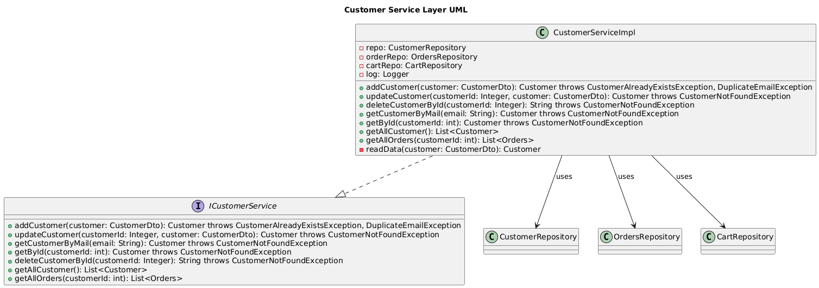
CLASS UML DIAGRAM

Slide 7
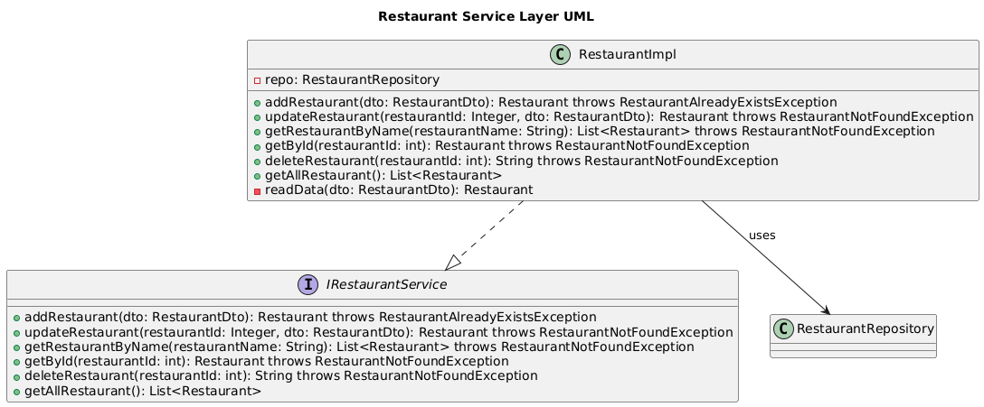
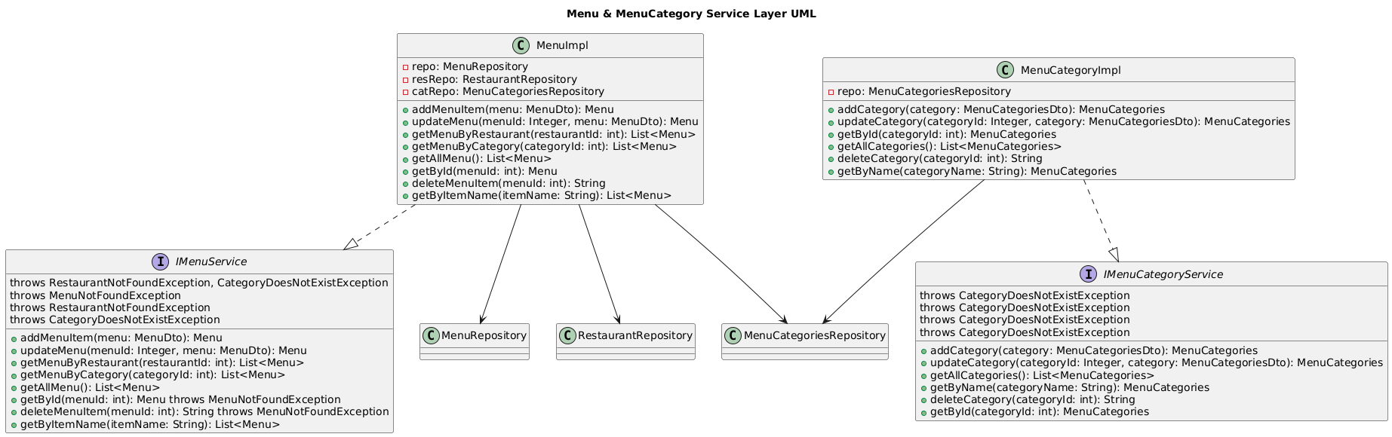
RESTAURANT SERVICE DIAGRAM
MENU SERVICE DIAGRAM

Slide 8
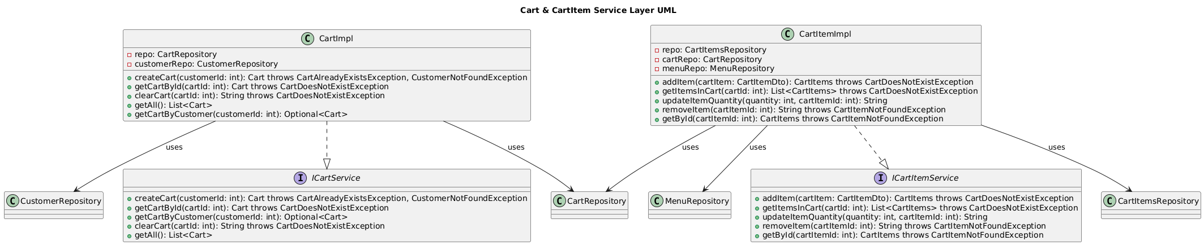
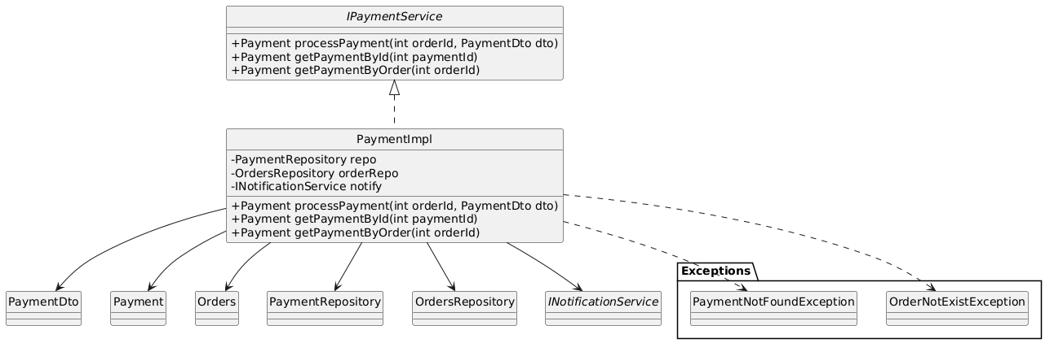
CART SERVICE
PAYMENT SERVICE

Slide 9
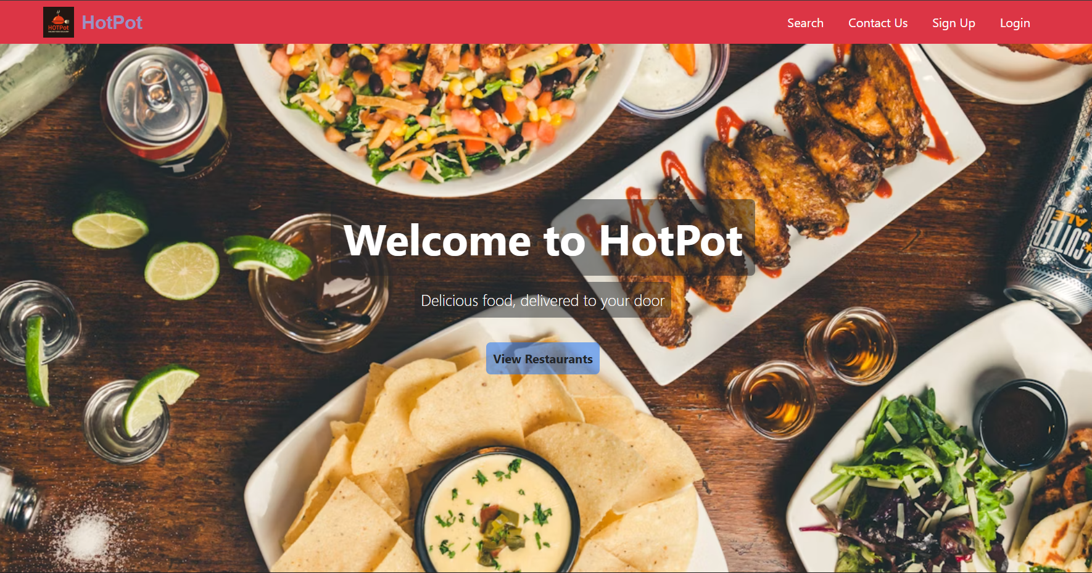
OUTPUTS
LANDING HOME PAGE

Slide 10
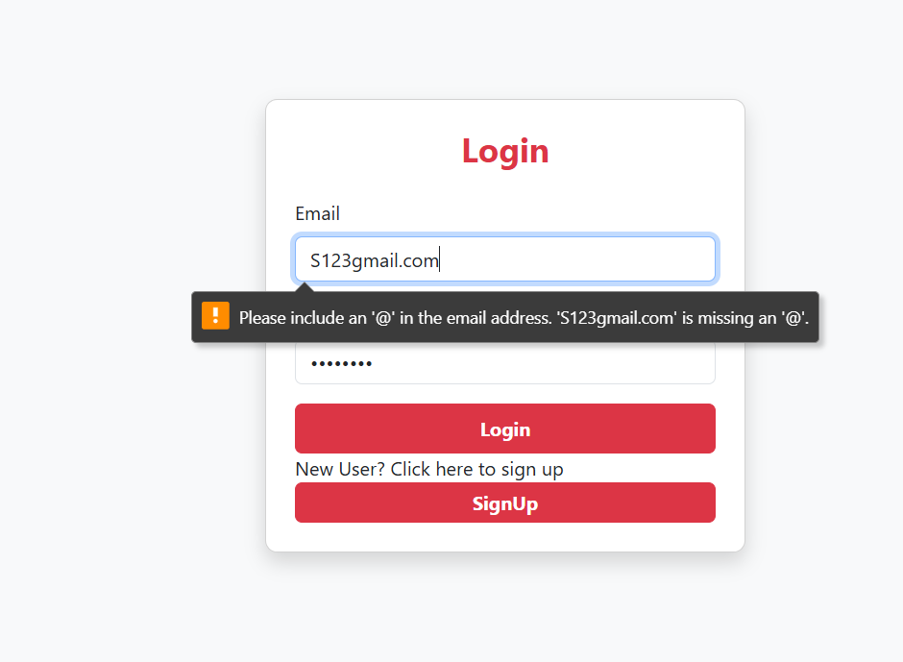
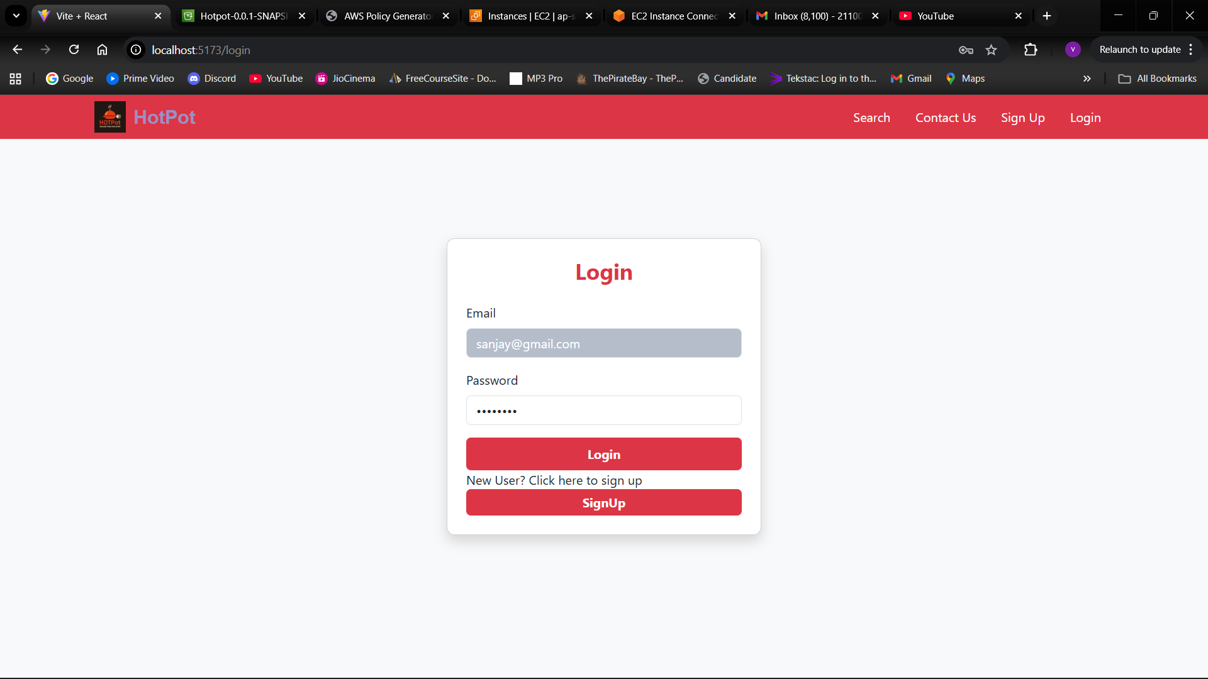
LOGIN WITH BAD CREDENTIALS
PROPER LOGIN

Slide 11
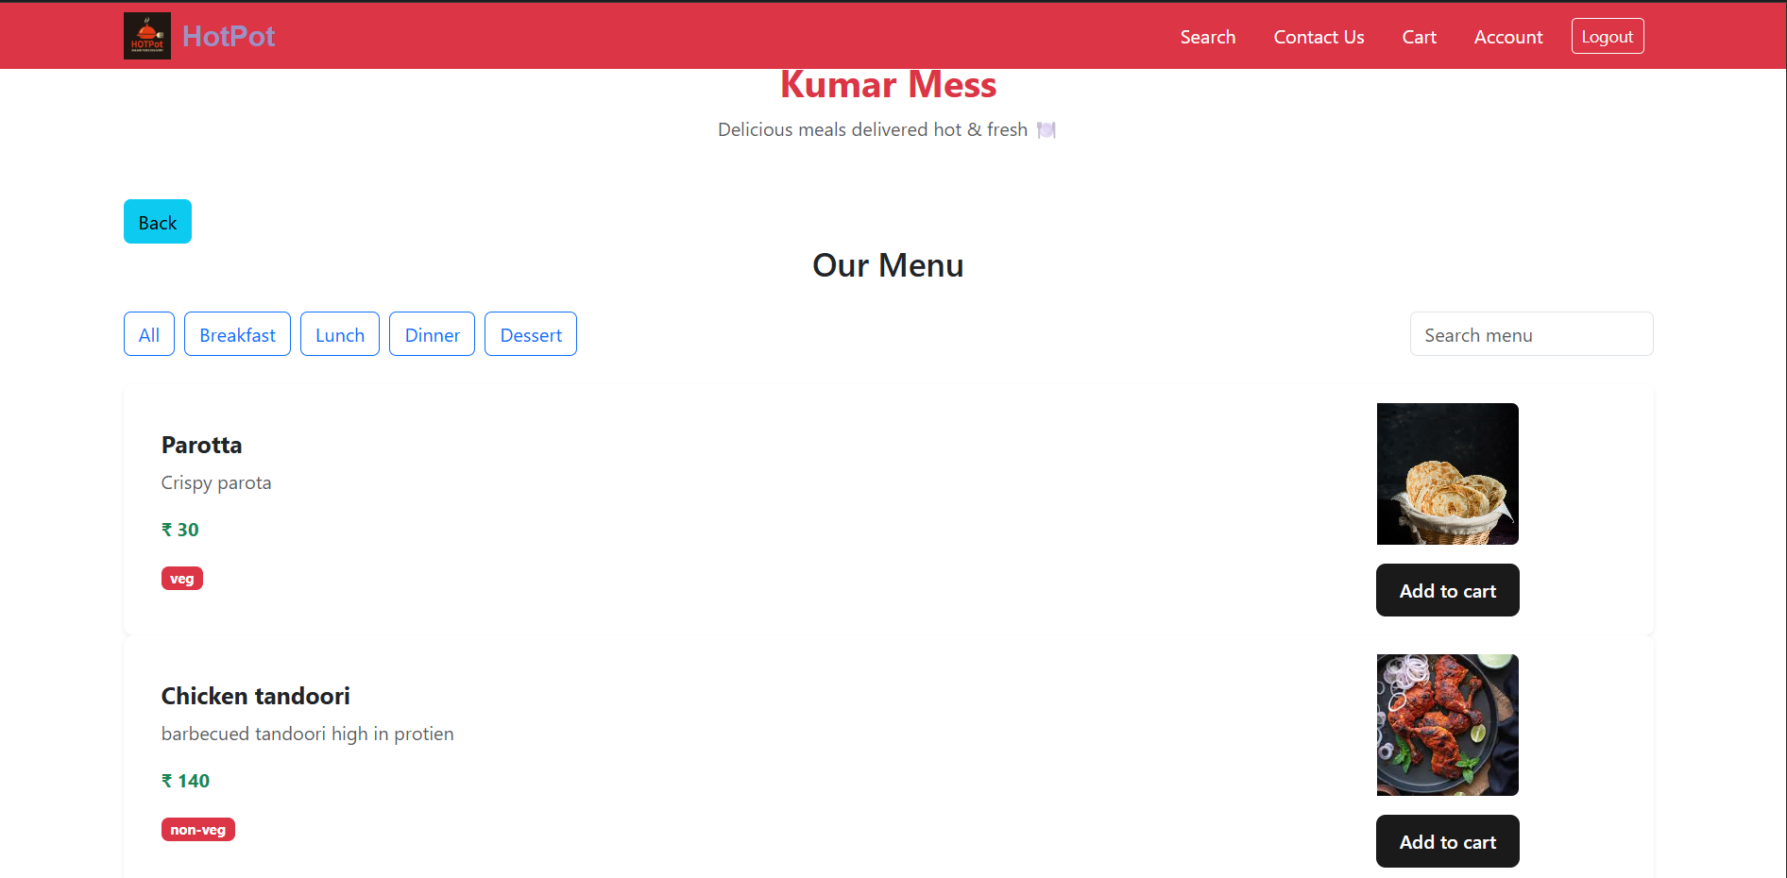
RESTAURANT WITH MENU ITEMS

Slide 12
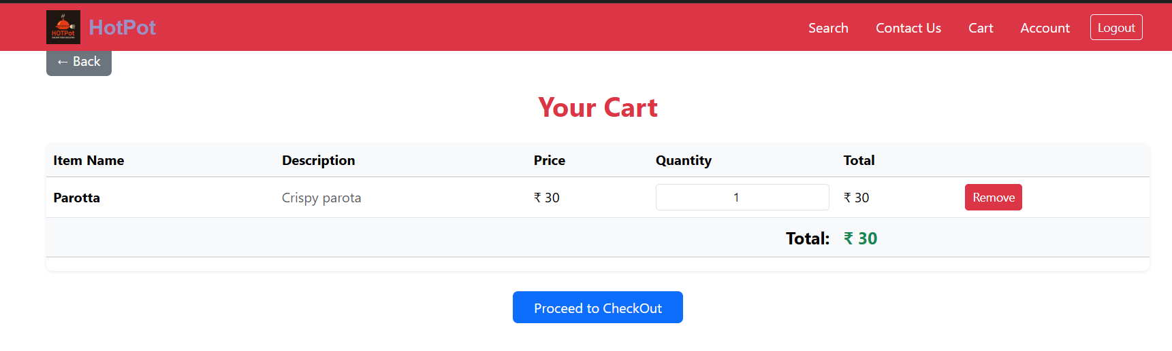
CART WITH ITEM ADDED

Slide 13
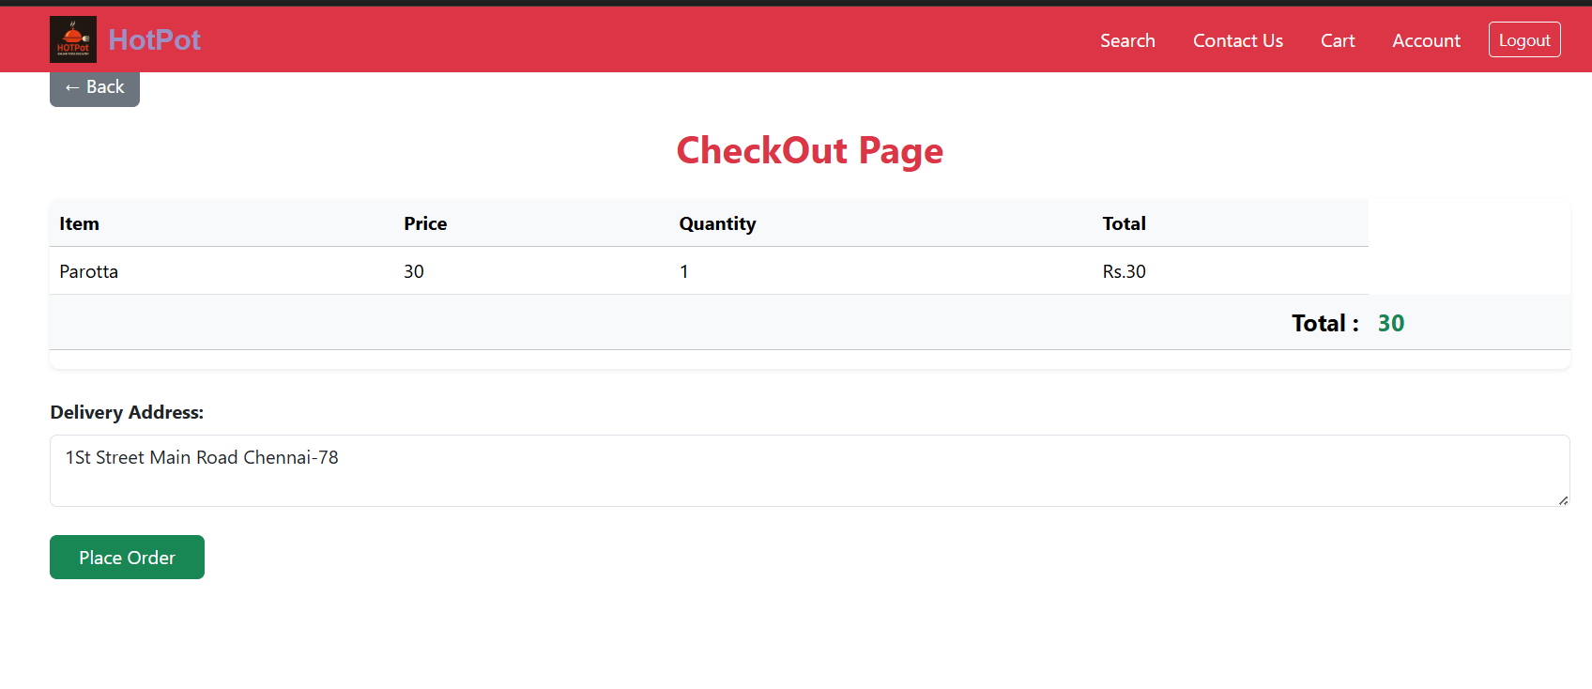
ORDER CHECKOUT

Slide 14
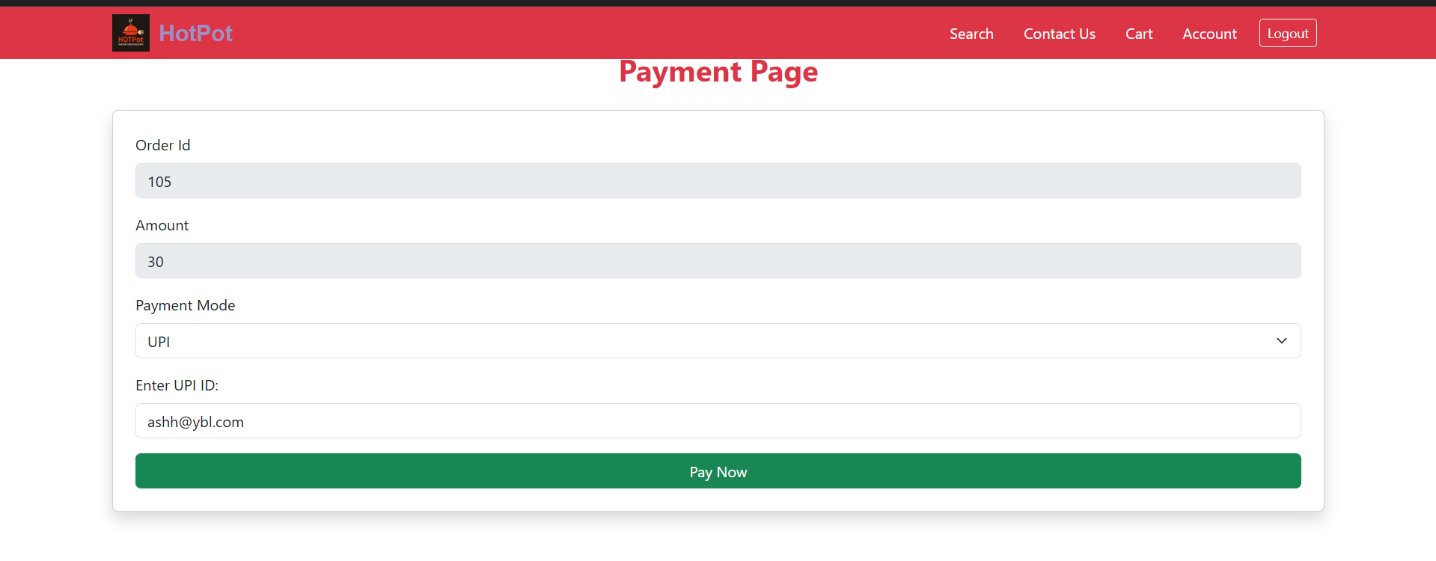
PAYMENT PAGE

Slide 15
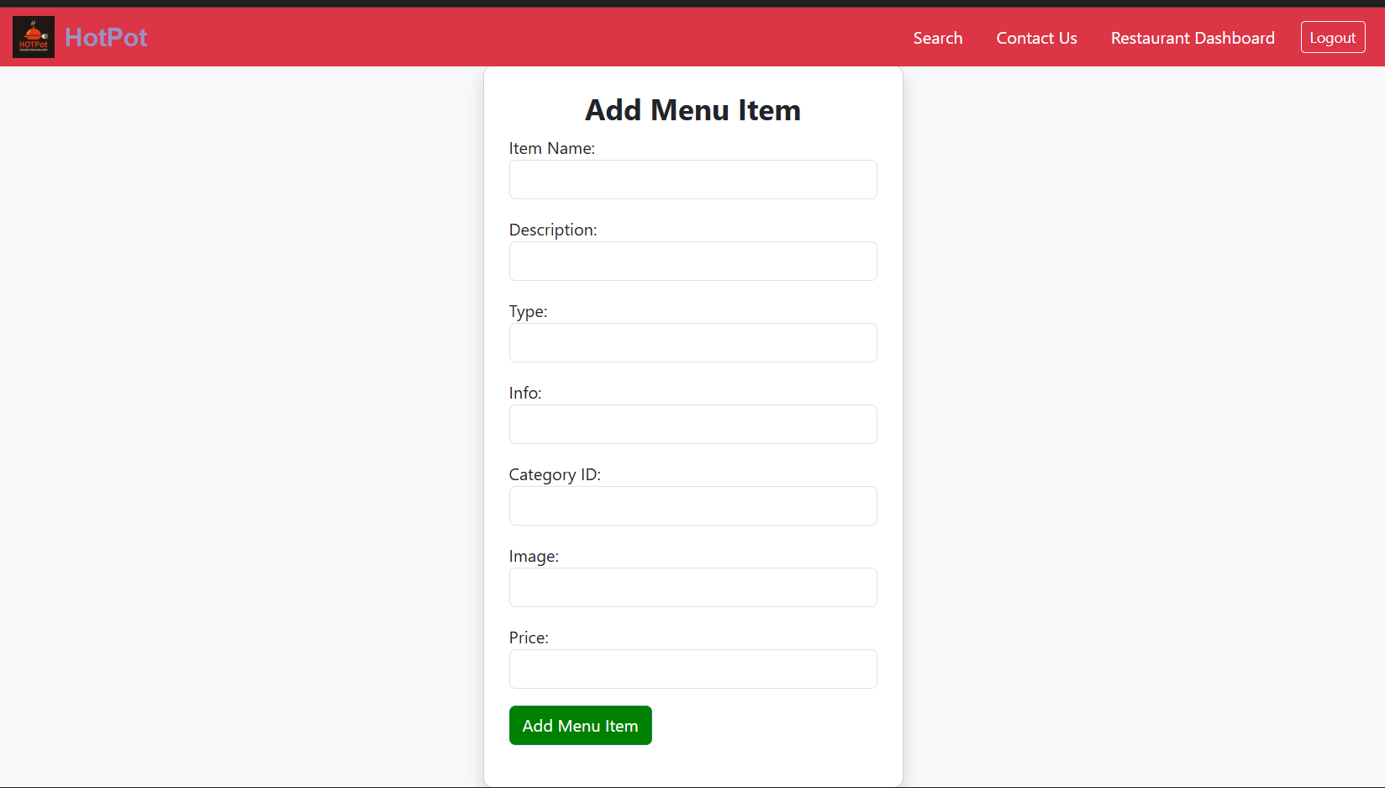
ADD MENU ITEM

Slide 16
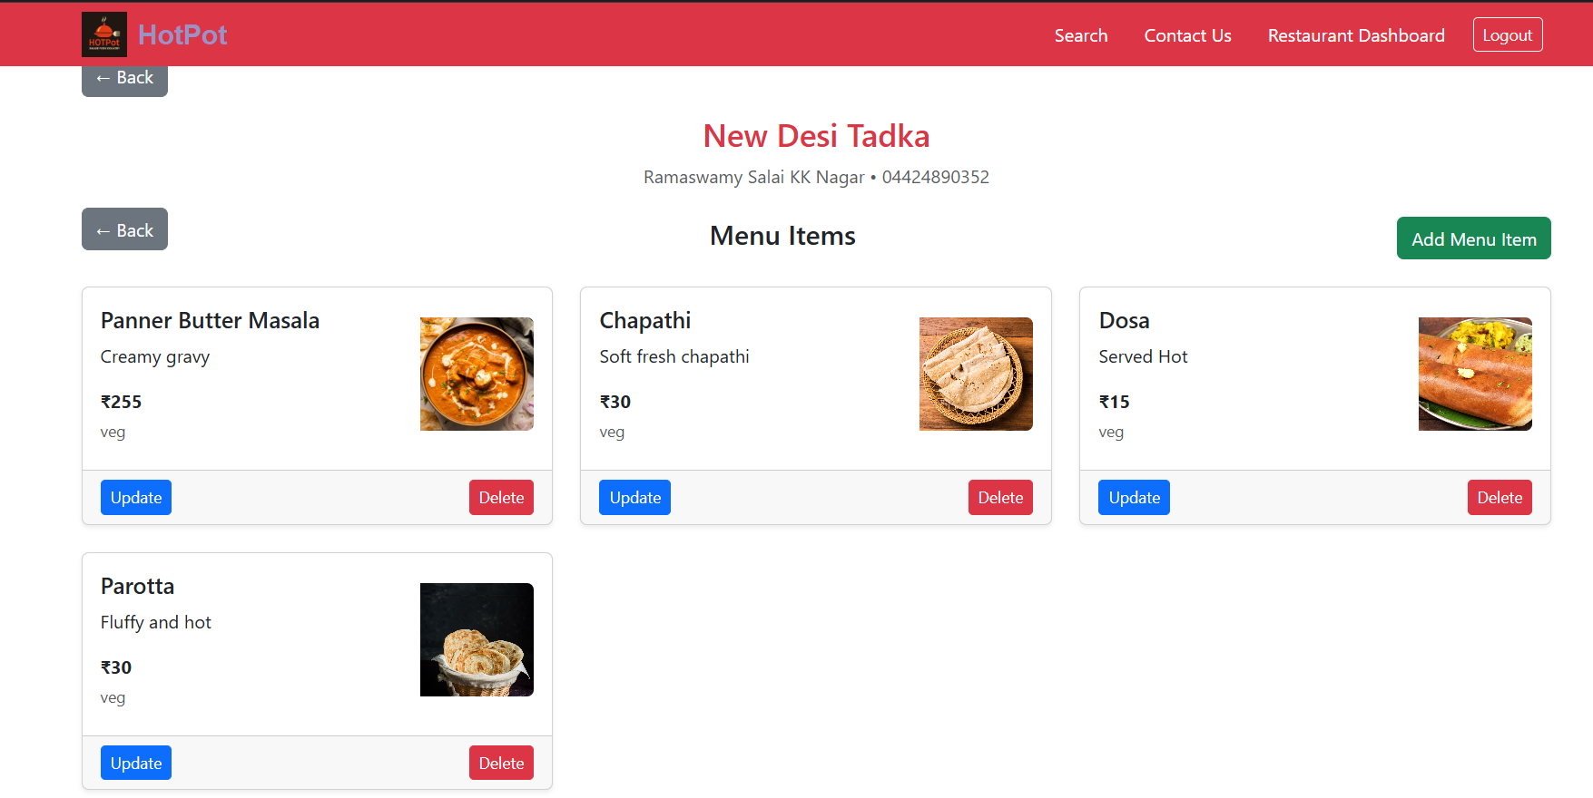
MANAGE MENU

Slide 17
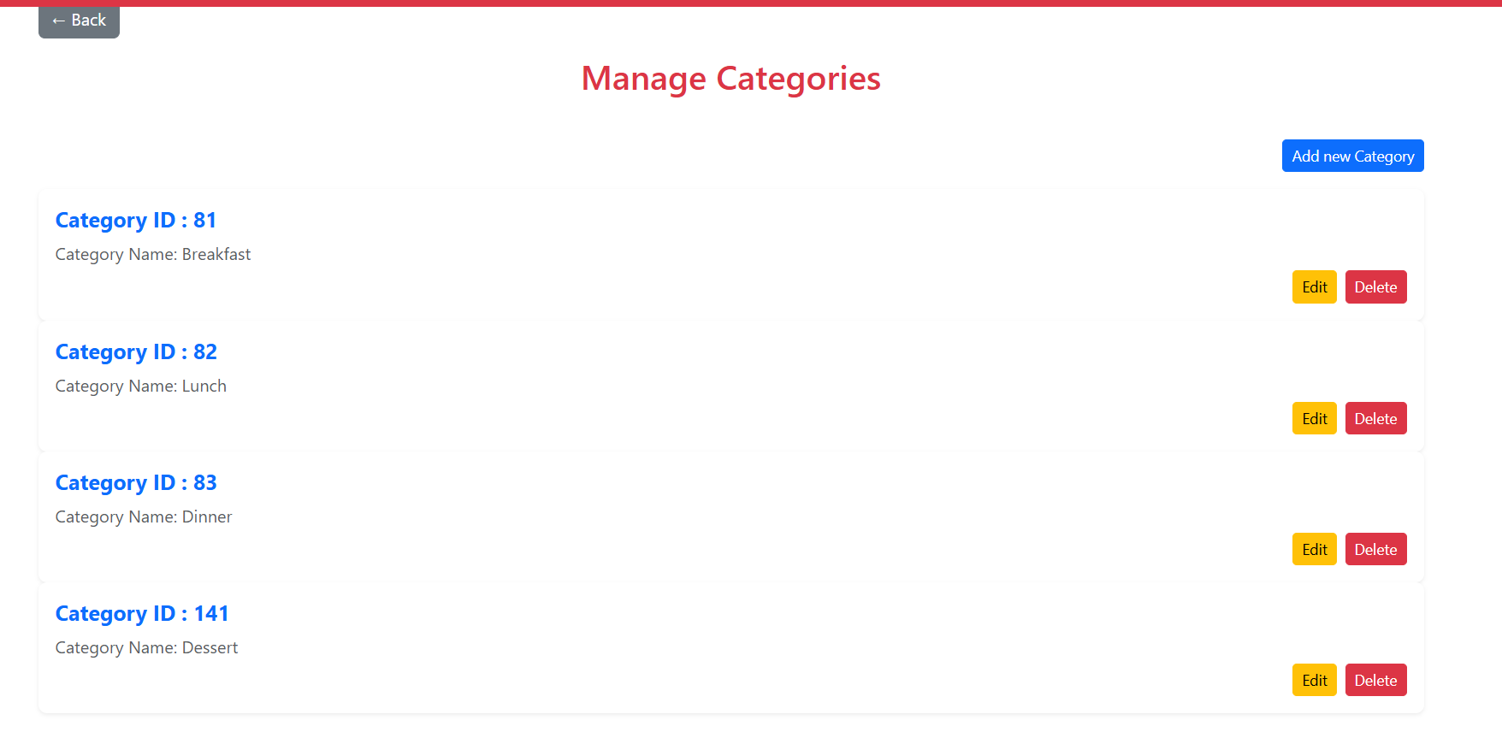
CATEGORIES MANAGEMENT

Slide 18
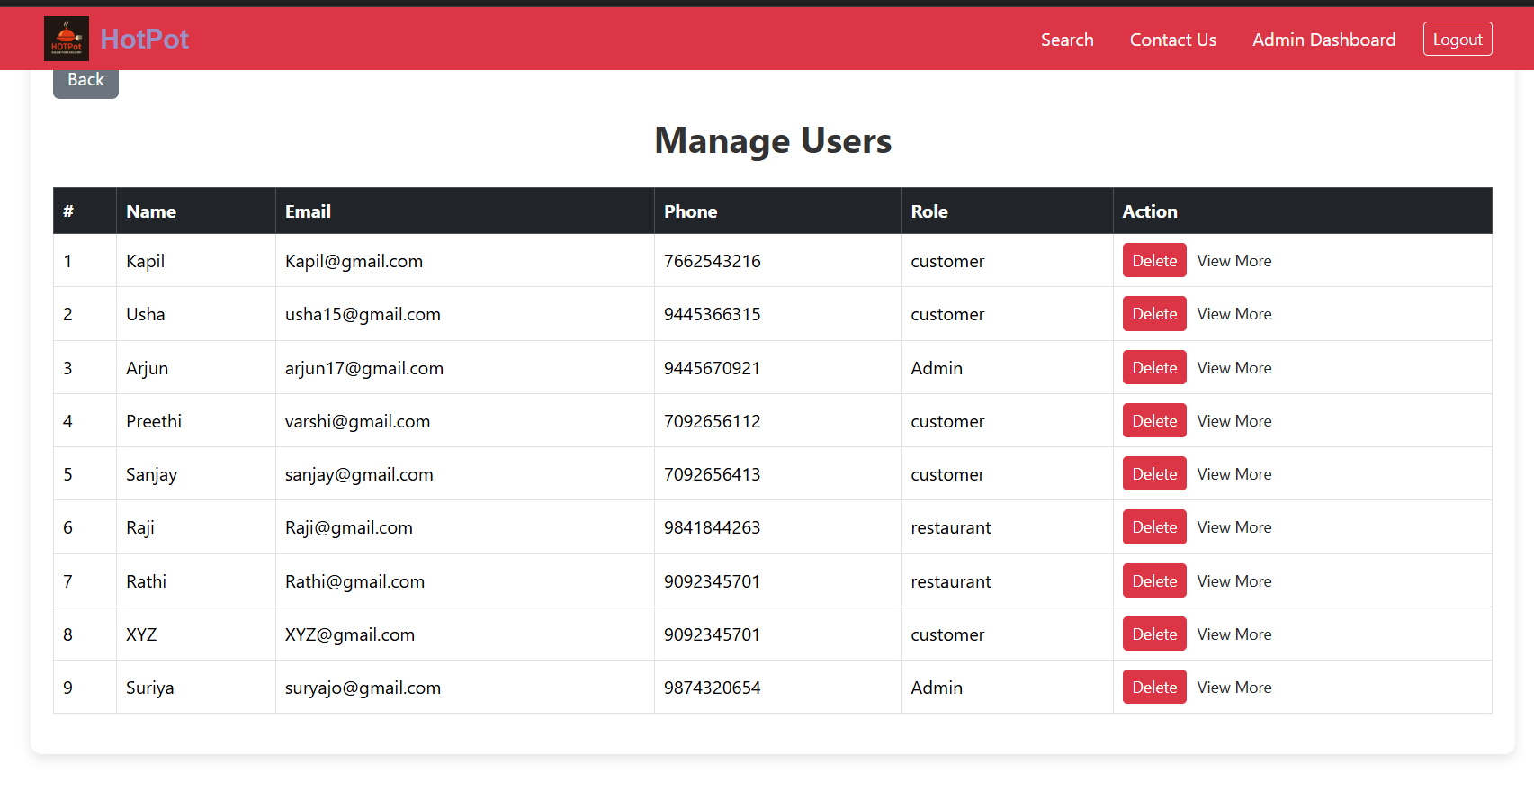
USER MANAGEMENT

Slide 19
THANK YOU

