Slide 1


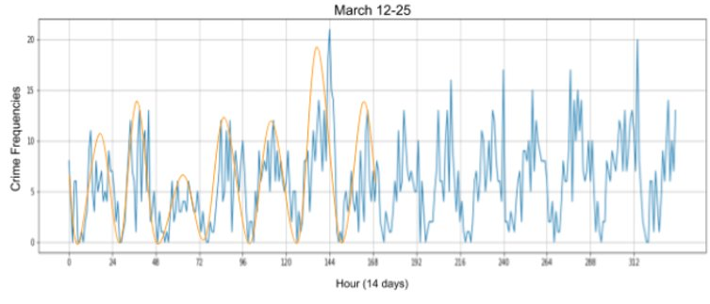
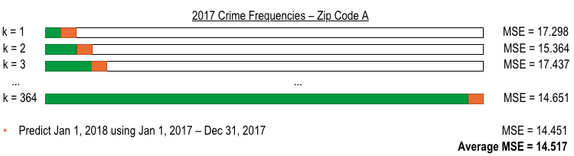
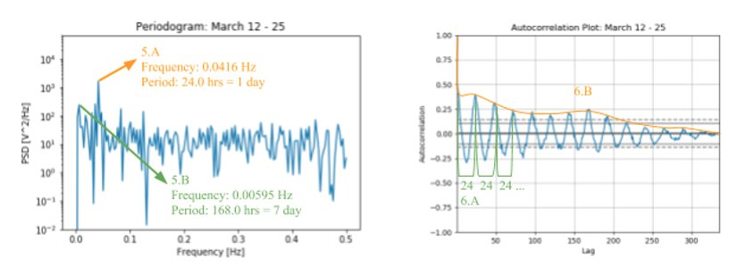
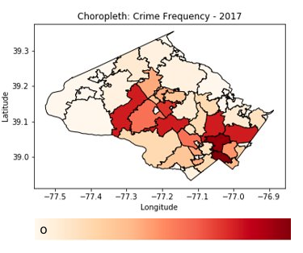
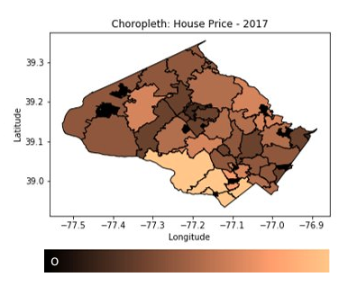
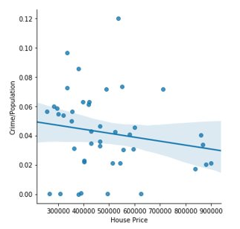
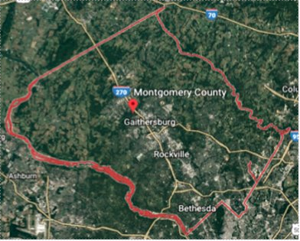
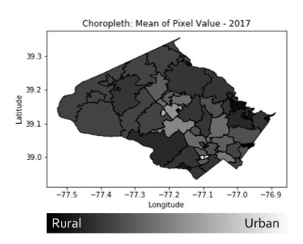
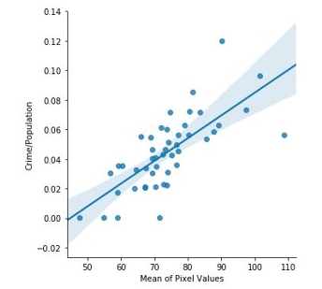

Analyzing Crime Statistics for Smart City Applications
ABSTRACT
Varshini Selvadurai
MACHINE LEARNING
Modern cities and communities are not as effective as they could be with their services. Although a vast amount of data is collected, it isn’t utilized to distribute resources effectively. A smart community is capable of managing its resources and services solely based on data collected by sensors throughout the community. Montgomery County, MD is one of the richest counties in the United States, but it is not currently a smart community. However, data collected within the community can help make Montgomery County smarter without the use of sensors. This project presents an analysis of possible predictors of crime based on Montgomery County’s recorded crime incident database. The crime data was expected to have both daily and weekly temporal trends and high positive correlations with spatial quantities such as average house prices and urbanity. Additionally, it was hypothesized that a relationship between crime in multiple zip codes could be used to predict future crime frequencies in those zip codes. Using evidence from various data analysis methods and machine learning techniques, it was found that the crime data in Montgomery County has a weekly and daily seasonality, is correlated to the level of urbanity, and that crime in certain zip codes can help predict crime in others. This project opens an avenue for further research regarding the crime patterns. In the future, these patterns can be exploited to create a safer county.
Spatiotemporal Relationships
Retrieve Data & Data Wrangling
Interested In:
Combing spatial and temporal qualities to assess trends regarding crime over time for different zip codes
Expected:
The number of crime incidents in one zip code can be used to predict crime incidents in another zip code
Identify pertinent data and unify data types
Quantitative Data → Excel
Geometric Data → Shapefile
Uploaded into Python as a dataframe
Data | Source | Downloaded As
Crime | Montgomery County Database | Excel
Zip Code Boundary | Montgomery County Database | Shapefile
Temperature | National Center for Environmental Information | Excel
Montgomery County Satellite Image | Google Maps | Shapefile
House Price | Zillow | Excel
Population | Census | Excel
Granger Causality: A statistical test that is used to determine whether one time series can forecast another
60 zip codes → 33 zip codes after removing ones that can’t be used
Conducted the Granger Causality test for every combination of the 33 zip codes
Autoregression(AR): Forecasts data using previous data from the time series
Vector Autoregression(VAR): Forecasts data using previous data from other time series
Cross-Validation: Validates the stability of the first 2 models
Mean Squared Error(MSE): Used to compare the forecasted data with the actual data
Visualization & Relationship Analysis
Investigate data to find qualitative trends then quantify the found trends
Example: For some zip code A, where the Granger Causality passed with a significance of below .05 for zip codes B, C and D
Autoregression & Cross-Validation:
Where in step k = 1 Jan 2, 2017 is being predicted using data from Jan 1, 2017 and in step k =2 Jan 3, 2017 is being predicted using data from Jan 1, 2017 – Jan 2, 2017
Vector Autoregression & Cross-Validation:
Interested in:
Crime trends over time
Expected:
Daily & Weekly trends
Confirmed:
Daily and Weekly seasonality
Apparent seasonal daily trend: fall and rise in crime
[2]
INTRODUCTION
Apparent seasonal weekly trend: spike near end of the week
Temporal Relationships
[2]
Smart Communities
Montgomery County
Technological advancements lead to a safer and smarter world. The Internet of Things (IoT) is a network of devices such as sensors and software that share information with each other to create a dynamic system that can be used in smart cities. Smart cities are urban areas that use electronically collected data to interpret and analyze similarities in data that can be used to improve city resources, services and predict future patterns. This data can range from energy usage, traffic to environmental data.
An effective community should know how resources should be spread throughout the community. For this reason unconventionally researched data such as crime should be looked at to determine the spread of police stations and officers. Effectively distributing resources will save money and time for the county.
Montgomery County is the most populated and economically well-off county in Maryland. Although Montgomery County is not a smart community with sensors to collect and store data, the county has public records of data that could be used to analyze county statistics. Using machine learning techniques to analyze the crime data, relationships can be found between crime and zip codes. These relationships can help determine future crime patterns and trends found can help allocate the necessary resources in zip codes with higher crimes rates and prevent crime. With such information Montgomery county can
become a smarter community.
The periodogram shows a the highest peak at 24 hours, meaning it is the more prevalent period. The next highest period is at 168 hours confirming a period of 7 days.
[2]
Rise in the plot occurs after 7 peaks → confirms periodogram and confirms a weekly seasonality
[2]
The autocorrelation plot confirms the periodogram
A peak occurs every 24 lags (hours) → confirms the periodogram and confirms a daily seasonality
After Cross-Validation Using | Average MSE​
B | 19.490
C | 15.977
D | 13.269
B &C | Can not be calculated
B &D | 17.844
C &D | 20.313
B, C &D | Can not be calculated
The best forecaster for zip code A is Vector Autoregression & Cross-Validation using zip code D because it resulted in the least MSE.
Interested in:
Crime trends based on demographics of different zip codes
Expected:
Urban/Rural Ratio, Avg. House Price
Confirmed:
Urban/Rural Ratio
[2]
[2]
y = -2.71e-08x + 0.06
r = -0.17
[2]
Spatial Relationships
This process was conducted on all 33 zip codes, although there were results, nothing is conclusive because of the lack of data
ZC | ML Alg | Using | MSE | ZC | ML Alg | Using | MSE | ZC | ML Alg | Using | MSE
20910 | VAR | 20874 | 36.22 | 20886 | VAR | 20872 | 8.83 | 20895 | AR |  | 3.61
20902 | AR |  | 46.24 | 20876 | AR |  | 16.94 | 20851 | AR |  | 4.81
20906 | AR |  | 33.07 | 20912 | AR |  | 7.28 | 20866 | VAR | 20974 | 3.44
20874 | VAR | 20814 | 37.04 | 20817 | AR |  | 8.43 | 20855 | AR |  | 34.14
20904 | VAR | 20902 | 14.92 | 20879 | VAR | 20910 | 12.67 | 20905 | AR |  | 2.72
20850 | VAR | 20902 | 39.64 | 20903 | VAR | 20886 | 8.62 | 20871 | AR |  | 3.93
20877 | VAR | 20886 | 13.80 | 20853 | VAR | 20906 | 20.37 | 20872 | AR |  | 1.90
20878 | AR |  | 384.49 | 20837 | AR |  | 0.43 | 20816 | VAR | 20876 | 8.29
20852 | VAR | 20902 | 12.28 | 20854 | AR |  | 4.38 | 20841 | VAR | 20878 | 1.56
20901 | AR |  | 66.03 | 20815 | AR |  | 4.25 | 20882 | AR |  | 16.84
20814 | AR |  | 10.72 | 20832 | AR |  | 4.19 | 20833 | AR |  | 0.75
Pixel Values → Brightness of the pixel
Urban = White = Bright
Rural = Green = Dark
The mean of the pixels in a zip codeshould help quantify how urban or rural a zip code is
[3]
[2]
y = 1.54e-03x + -0.07
r = 0.73
[2]
The r-values for Crime Frequency/Population verses House Price and Mean Pixel Value shows that crime has no correlation with house price and a strong correlation with the level or urbanity.
[1]
CONCLUSION
 | Temporal | Spatial | Spatiotemporal
Predictors | Daily ✓ Weekly ✓ | Urban vs. Rural ✓ House Price ✗ | There exists a possibility to predict crime
Future Work | Monthly Seasonal Yearly | Population Density Urban vs. Rural: different method of creating the value | Need more data to make a conclusive statement
METHODS
REFERENCES
ACKNOWLEDGEMENTS
Retrieve Data
Data Wrangling
Visualization
Relationship Analysis
Machine Learning
[1] Montgomery County Database [2] Self made [3] Google Maps [4] Sun, M., Wang, Y., Strbac, G., & Kang, C. (n.d.). Probabilistic Peak Load Estimation in Smart Cities Using Smart Meter Data. Retrieved from IEEE website: http://ieeexplore.ieee.org/stamp/stamp.jsp?tp=&arnumber=8304659 [5] Sun, Y., Song, H., Jara, A. J., & Bie, R. (2016, February). Internet of Things and Big Data Analytics for Smart and Connected Communities. Retrieved from iEE Xplore website: http://ieeexplore.ieee.org/stamp/stamp.jsp ?arnumber=7406686 [6] U.S. Census Bureau (2016,June) QuickFacts: Montgomery County, Maryland Retrieved June 10, 2018, from https://census.gov/quickfacts/geo/chart/
Thank you to Dr. Aaron Gilad Kusne along with the Materials Measurements Laboratory at the National Institute of Standards and Technology for assistance throughout the project. Similarly thank you to Mrs.Aunpama Sekhsaria, Mr.Kevin Lee, Mr.Zachary Kingman, Mr.Mark Curran and all the teachers at Poolesville High School for their continued support. Finally thank you to my parents, friends and other family members.

