Slide 1

Web Scraping Project on
Ev Market Analysis Quantifying Consumer Value across Segments
Presented by:
Narla Yaswanth Simha Reddy
Boddu Varshini
Tulluri Venkata Vinay Kumar
Batch No: 474

Slide 2
About
Linkedin profile1 : https://www.linkedin.com/in/yaswanth-simha-reddy-narla-1a943a280/
Linkedin profile2 : https://linkedin.com/in/tulluri-venkata-vinay-kumar-15484a227
Linkedin profile3 : https://www.linkedin.com/in/varshini-boddu-1b8913264
Github profile1 : https://github.com/YaswanthNarla
Github profile2 : https://github.com/Vinaytulluri
Github profile3 : https://github.com/Varshini-Boddu151

Slide 3
Data Source: ev-database.org
10 pages scraped in ~45 seconds | 18 raw features extracted per EV | Saved as EV_Market_Analysis.csv
Dataset Description
12,330
Total Records
Website: https://ev-database.org
Website Name : Electric Vehicle DataBase
Unique EV configurations
ev-database.org is one of Europe's most comprehensive EV specification databases, providing real-world performance data across all major manufacturers.
The dataset scraped from ev-database.org contains 12,330 records and 11 columns. Covering vehicle specifications such as range, battery capacity, charging speed, efficiency, price and vehicle segment across all major global manufacturers.
11
Total Features
Raw columns after scraping
8
Vehicle Segments
A-Mini to F-Luxury + Sports
Tools Used:
EUR
Market Coverage
Python · Beautiful Soup · Requests · Pandas · Matplotlib · Seaborn
Germany pricing (€)

Slide 4
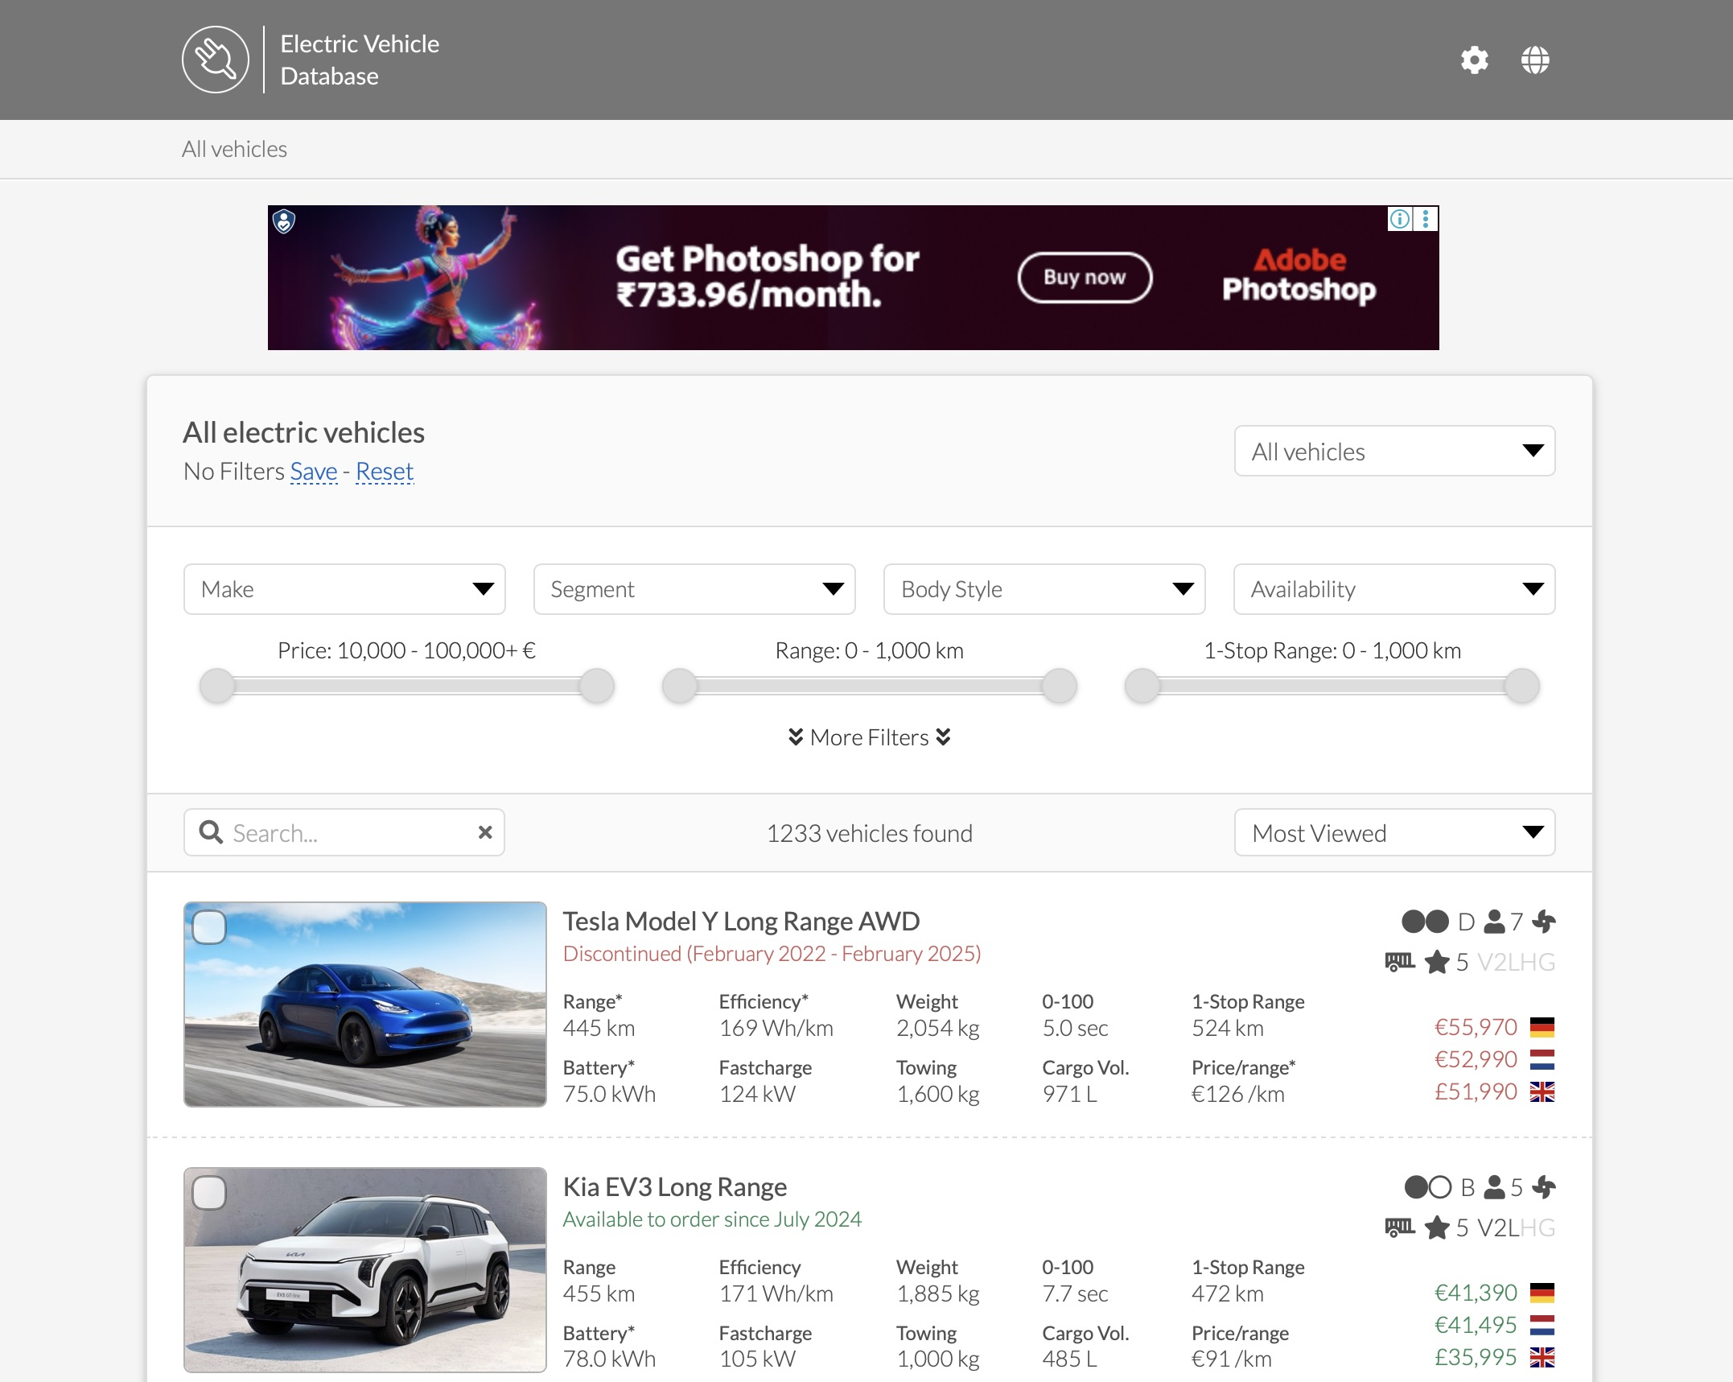
Website UI

Slide 5
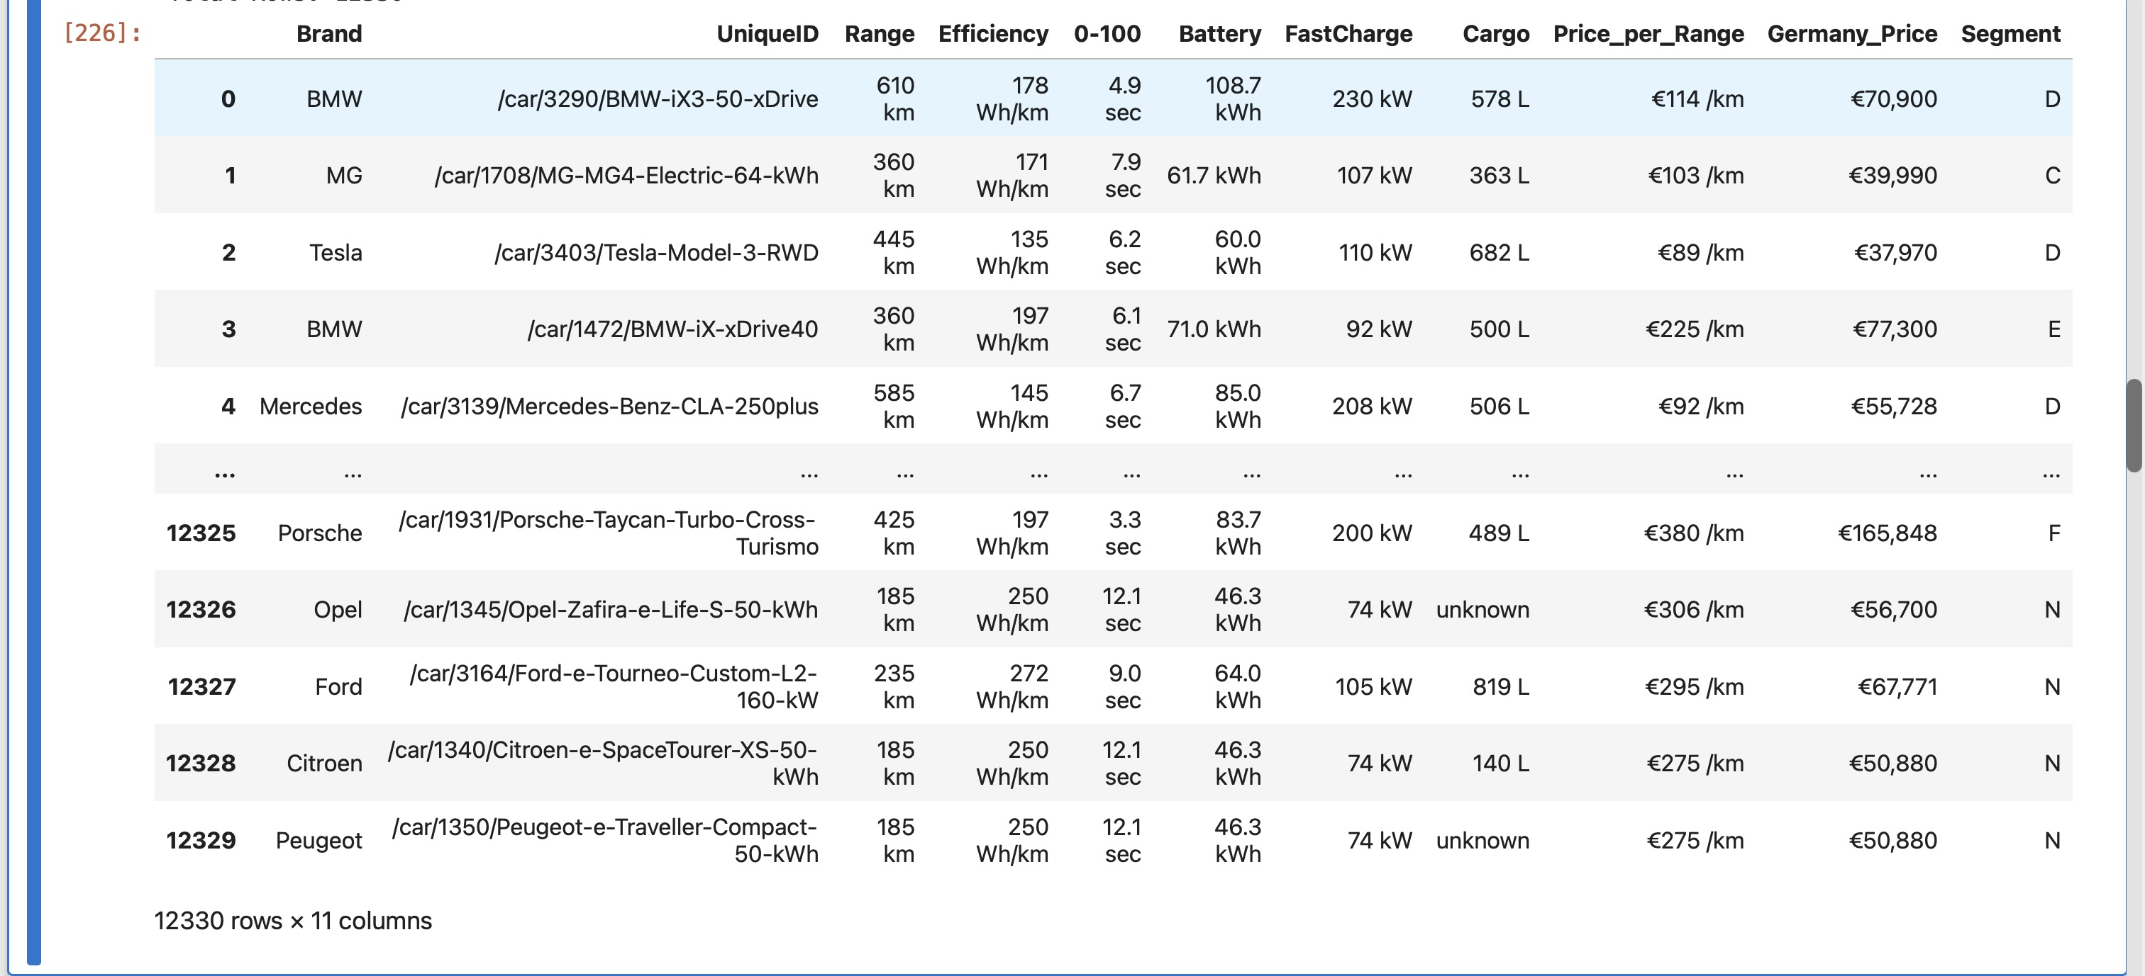
Web Scraped —> Raw Data.

Slide 6
Column Transformation
germany price eur
Germany_Price(€) — String to Float Conversion
price_per_range_km our
Price_per_Range(/km) — Remove Units and Convert
segment
range_km
Segment — Single Letter to Descriptive Label (A→A-Mini, B→B-Compact, etc.)
battery_kwh
fast_charge_kw
A→A-Mini | B→B-Compact | C→C-Medium | D→D-Large | E→E-Executive | F→F-Luxury | N→Passenger Van | S→Sports
All 3 transformations: Currency/unit regex extraction for numeric conversion; Segment letter codes mapped to readable descriptive labels for visualizations.

Slide 7
Column Transformation
germany_price_eur
range_km — Extract Numeric from '620km'
price_per_range_km_eur
segment
battery_kwh — Extract Numeric from '100kWh'
range_km
battery_kwh
fast_charge_kw — Extract Numeric from '250kW'
fast_charge_kw
Scraped HTML text contains units like '620 km' or '100kWh' — regex r'(\d+)' extracts only the numeric portion. Converted to int64 for range, float64 for battery and charge speed.

Slide 8
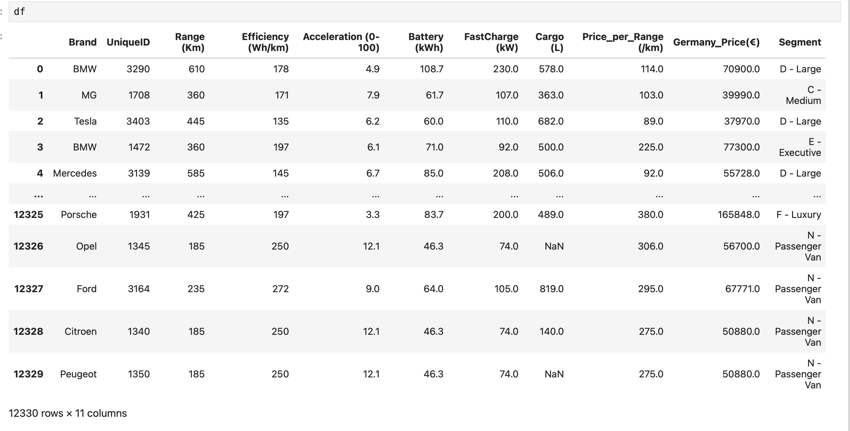
Web Scraping — Final DataFrame Output
Data Collection Summary
Source: ev-database.org 10 pages scraped in 45 seconds
12,330 EV records | 11 raw features extracted per vehicle
Fields include: Range, Battery, FastCharge, Price (3 countries), Segment, Seats.
Goal
Quantify true consumer value across EV segments using data science
Move beyond price then compare segments on range, efficiency, and cost-per-km

Slide 9
Column Description
Column | Type | Description
brand | Object | EV manufacturer name (e.g., Tesla, BMW, Hyundai, Porsche)
unique_id | Integer | Unique identifier extracted from the vehicle URL
range_km | Integer | Real-world driving range on a full charge (km)
Efficiency wh km | Integer | Energy consumed per km (Wh/km) — lower = more efficient
acceleration | Float | Time to accelerate 0–100 km/h (seconds)
Battery kwh | Float | Total usable battery capacity (kWh)
fast_charge_kw | Float | Maximum DC fast charging power (kW)
Cargo capacity_l | Float | Cargo/boot space in litres
germany_price_eur | Float | New vehicle price in Germany (EUR)
segment | Object | Vehicle market segment (A-Mini to F-Luxury, S-Sports)

Slide 10
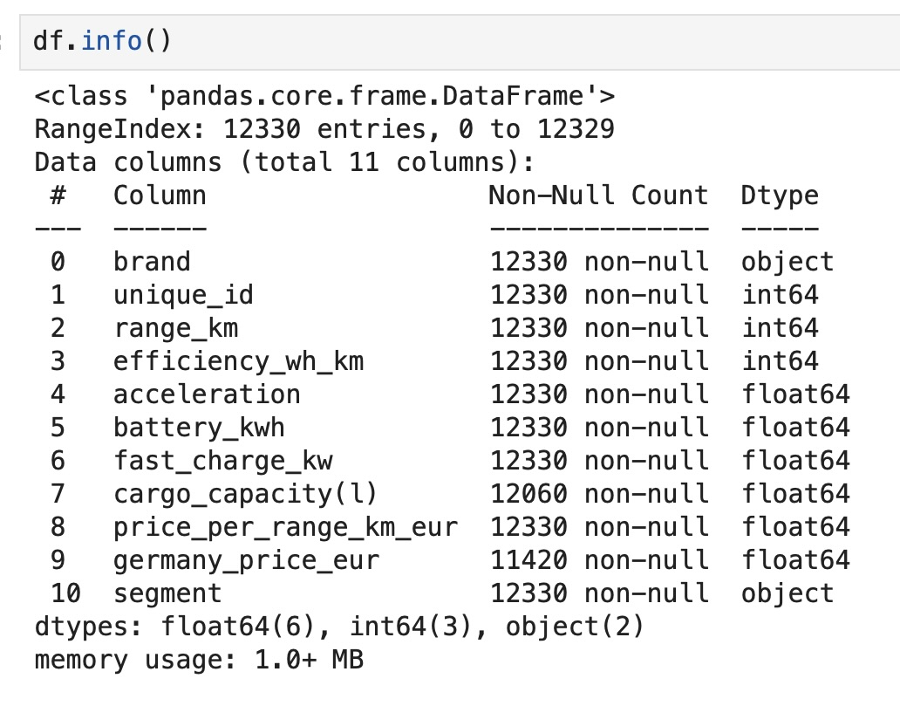
Info about the data.
Observations:
Output shows dataset AFTER column transformation but BEFORE handling missing values.
cargo_capacity_l: 270 missing (2.2%) germany_price_eur: 910 missing (7.4%)
Duplicates not yet removed.

Slide 11
Data Cleaning Process
What & Why
Columns renamed to snake_case for consistent Python-style access across all downstream code
price_per_range_km_eur had "euro" and "/km" string suffixes — must be numeric for analysis
Scraped HTML text contains units like "620 km" or "100kWh" — regex extracts only the number
Segment letters (A/B/C/D/F/S) are mapped to descriptive labels for readable charts
Outcome
All 13 columns are properly typed: int64, float64, object (categorical)
Dataset is clean, consistent and ready for feature engineering
# Step 1: Column Renaming — snake case standardization
# Step 2: Data Type Fix
# Step 3: Numeric Extraction
# Step 4: Segment Label Mapping
# Step 5: Remove Duplicates

Slide 12
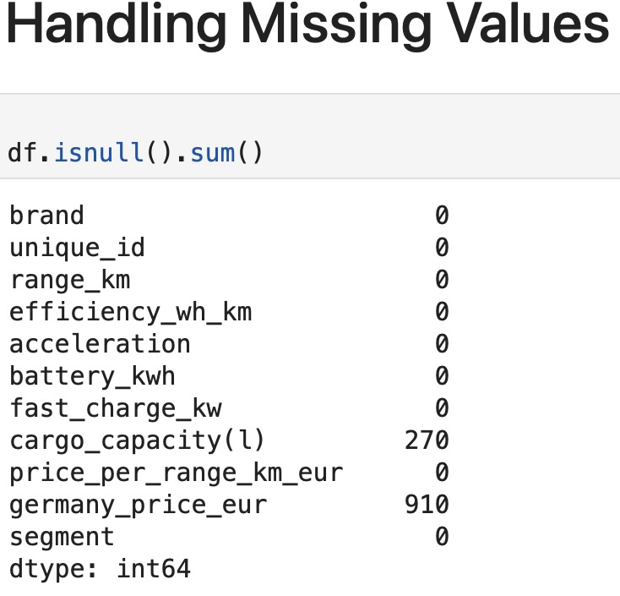
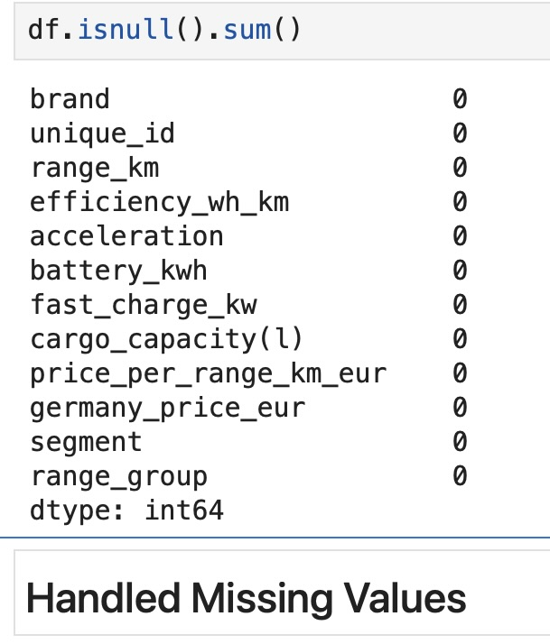
Missing Value Handling
Detecting : df.isnull().sum()
# Strategy 1: Domain Knowledge
# Strategy 2: Range Group Buckets for imputation
# Strategy 3: Segment-wise median imputation
Imputation Rationale
germany_price_eur: 7.4% missing is significant. Segment-wise median preserves market-level price characteristics instead of using a global average
Cargo_capacity_l: Missing varies by body style. Segment-wise median fills realistically based on similar vehicles
price: Group-wise fill ensures we do not mix ultra-cheap city EVs with premium long-range when imputing
Why groupby().transform()?
transform() preserves the original DataFrame index, enabling in-place conditional fill without merge complexity
Result: 0 missing values across all 11 columns after imputation

Slide 13
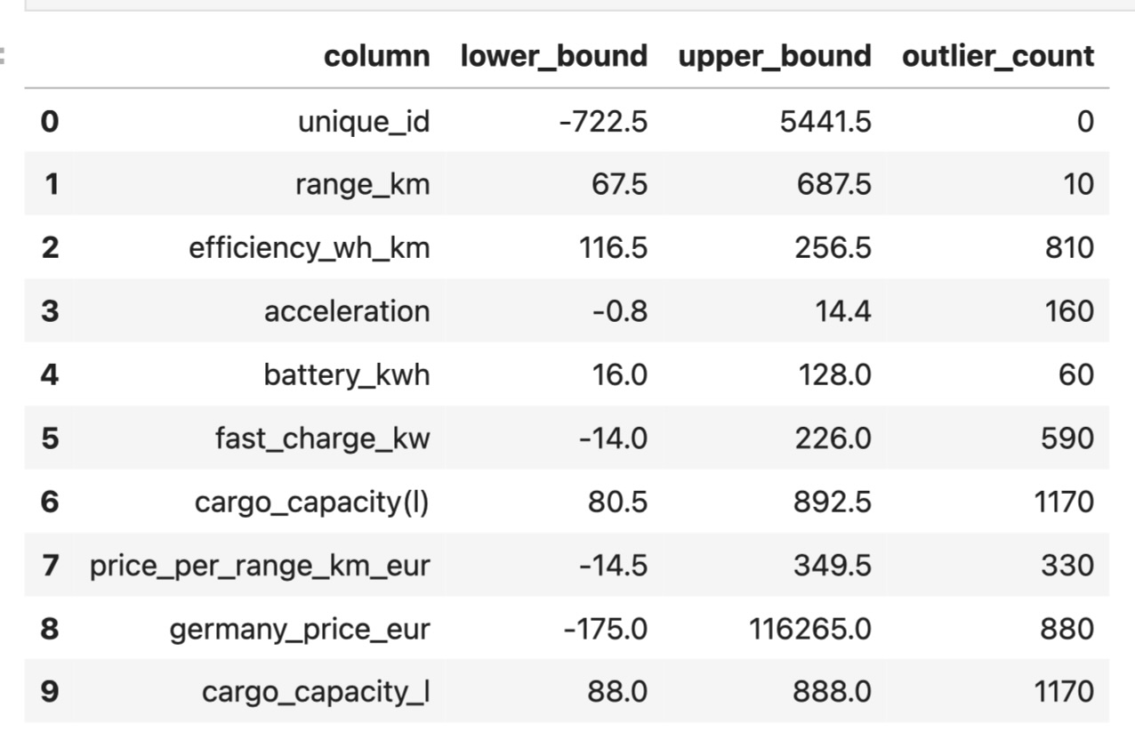
Outlier Detection
def detect_outliers(data, column):
Q1 = data[column].quantile(0.25)
Q3 = data[column].quantile(0.75)
IQR = Q3 - Q1
lower = Q1 - 1.5 * IQR
upper = Q3 + 1.5 * IQR
return {‘col':column,'lower':lower,'upper':upper}
def cap_outliers(data, column):
Q1 = data[column].quantile(0.25)
Q3 = data[column].quantile(0.75)
IQR = Q3 - Q1
data[column] = data[column].clip(
Q1 - 1.5*IQR, Q3 + 1.5*IQR)
return data
for col in numeric_cols:
df = cap_outliers(df, col)

Slide 14
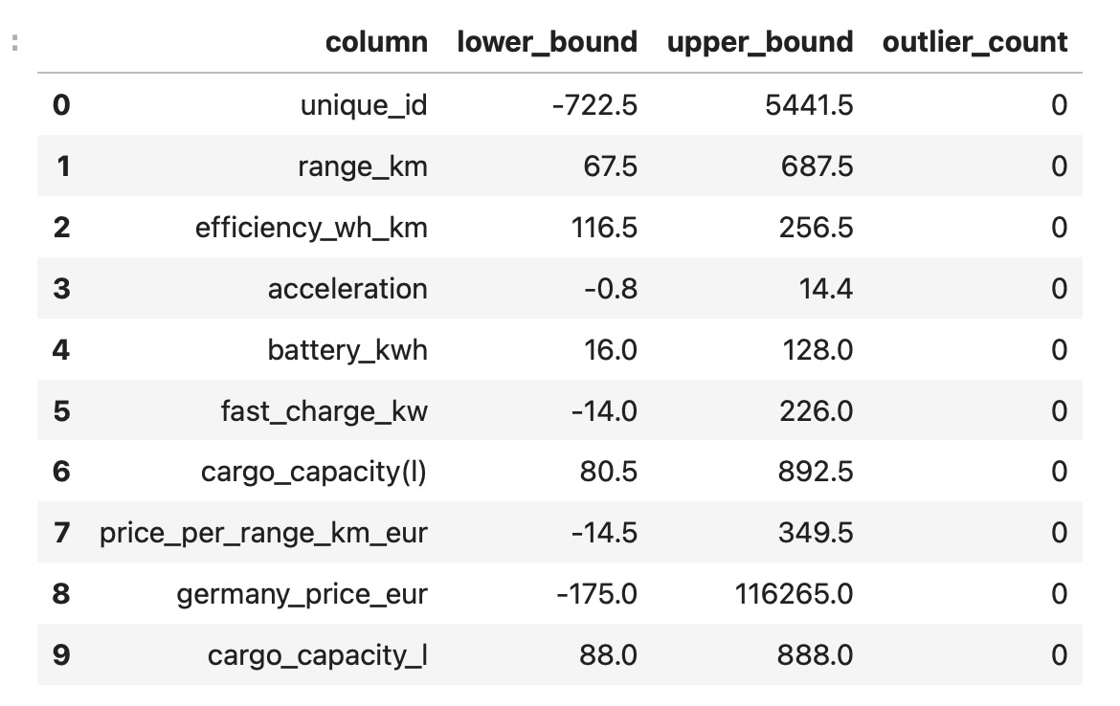
Outlier Handling
Why Not Deletion?
Deleting outliers loses valid data (ultra-premium models have legitimately extreme prices)
Capping retains these records while preventing them from distorting statistical measures

Slide 15
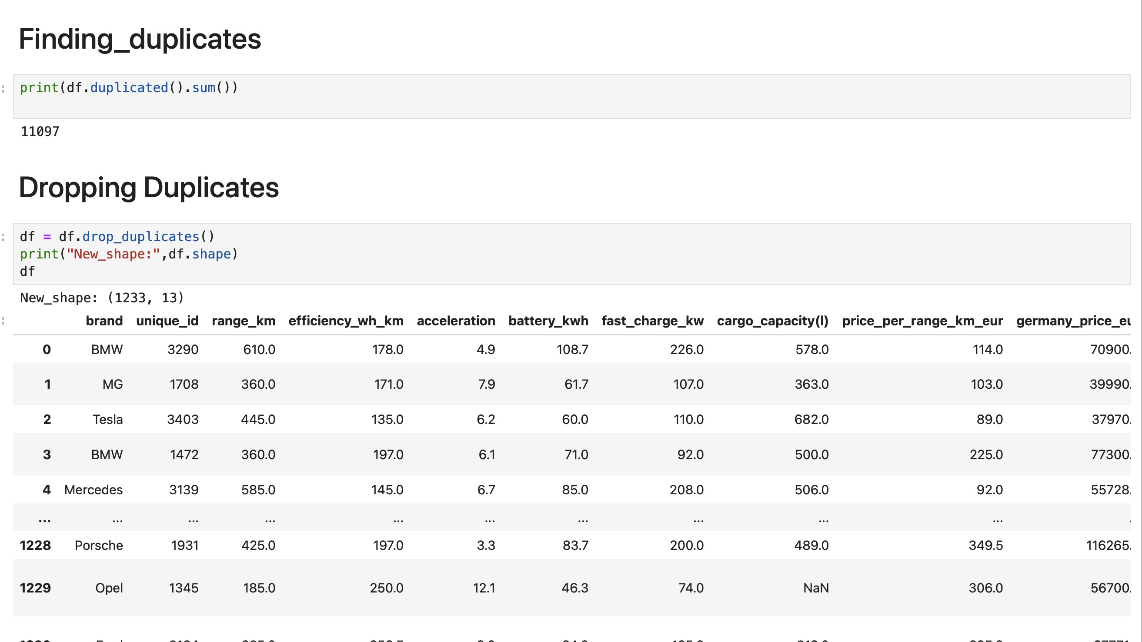
Duplicate values

Slide 16
Feature Engineering
Why Engineer These Features?
Raw features alone (price, range, battery) do not answer the key question: "Which segment gives best VALUE?”
range_per_kwh exposes EFFICIENCY — two vehicles with the same battery can differ by 20% in km delivered
price_per_km is the single most consumer-relevant metric — it directly answers "what am I paying per km?”
charge_speed_per_kwh normalizes charging speed by battery size — a 250kW charger means less on a 100kWh battery than on a 60kWh one
Business Insight These Enable
With these 3 features, we can rank every segment on value, efficiency, and convenience in one pivot table
The analysis becomes segment-comparative, not just descriptive — driving actionable recommendations
What Makes This Unique?
We do not just describe the data — we build engineered value metrics that consumers can directly use for decisions
Key Engineered Metrics
Price_per_km: How much money you spend per km of range
range_per_kwh: How efficiently the battery delivers distance
Charge_speed_per_kwh: How fast the vehicle charges relative to its battery size.

Slide 17
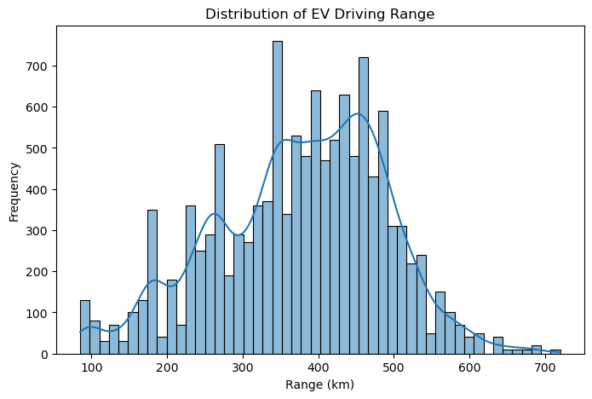
Univariate Analysis — Range Distribution
Insight
Distribution is right-skewed; peak at 350–450 km
Market optimizing for balanced usable range, not extreme long-range
Short-range A/B vehicles (under 250 km) target urban-only use cases

Slide 18
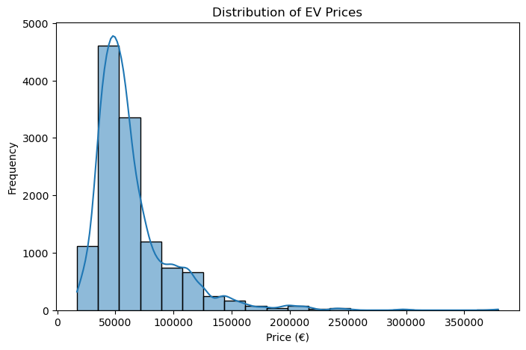
Univariate Analysis — Price Distribution
Insight
Strong price clustering in the EUR 40k–70k competitive band
Right-skewed — few ultra-premium models pull the mean upward
EUR 40k–70k is the primary battleground for mainstream EV buyers

Slide 19
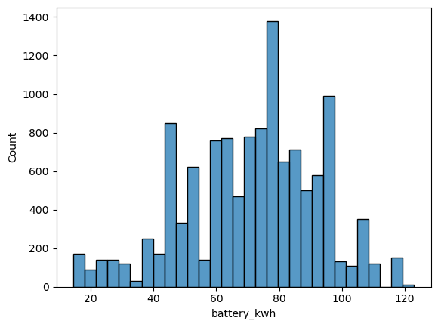
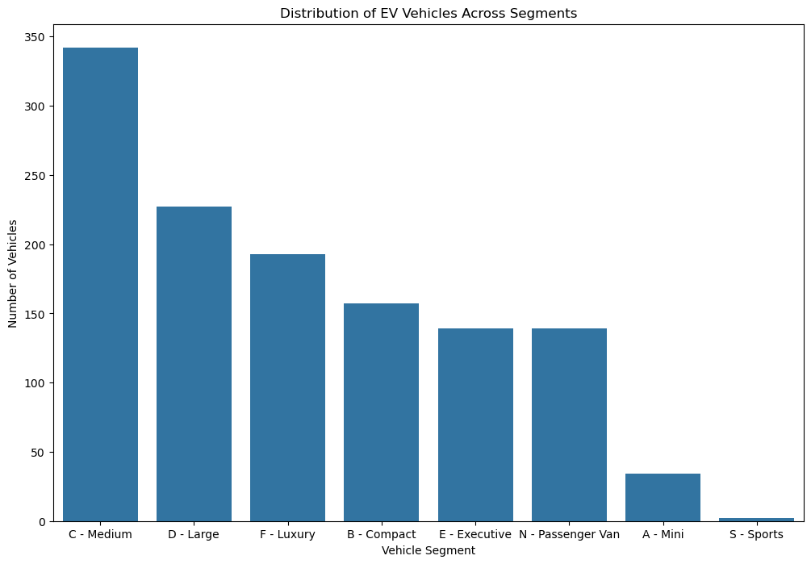
Univariate Analysis — Battery & Segment Distribution
Battery kWh Insight
~70 kWh is the industry sweet spot: balances cost, weight, and range
Range spans 20 kWh (city EVs) to 130+ kWh (premium long-range)
Segment Count Insight
D-Large and SUV segments dominate, targeting mainstream family buyers
A-Mini and B-Compact segments are niche and urban commuter focus.

Slide 20
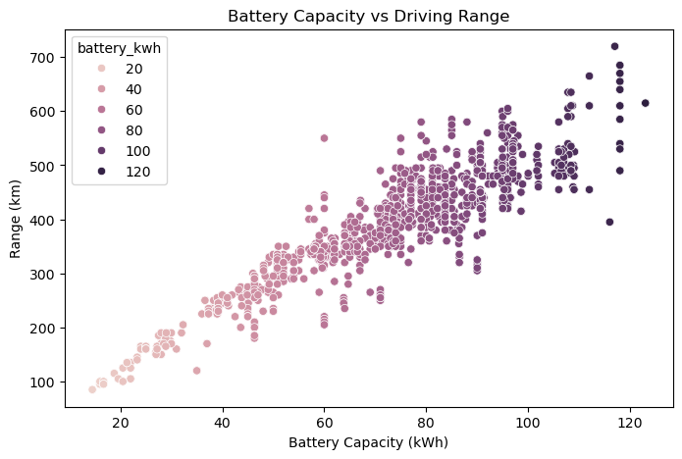
Bivariate Analysis — Battery Capacity vs Driving Range
Insight
Strong positive correlation (r ~ 0.85) — battery is primary range driver
Confirms battery size as the central engineering variable

Slide 21
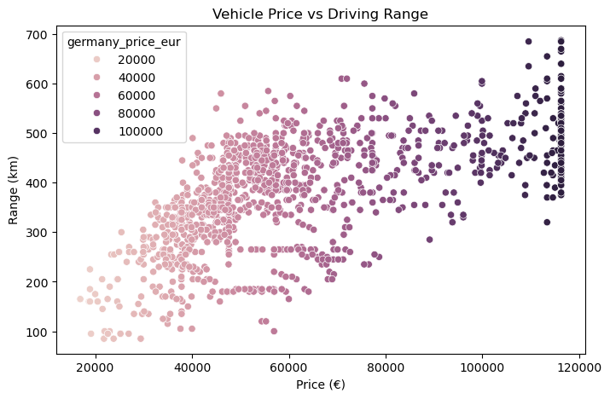
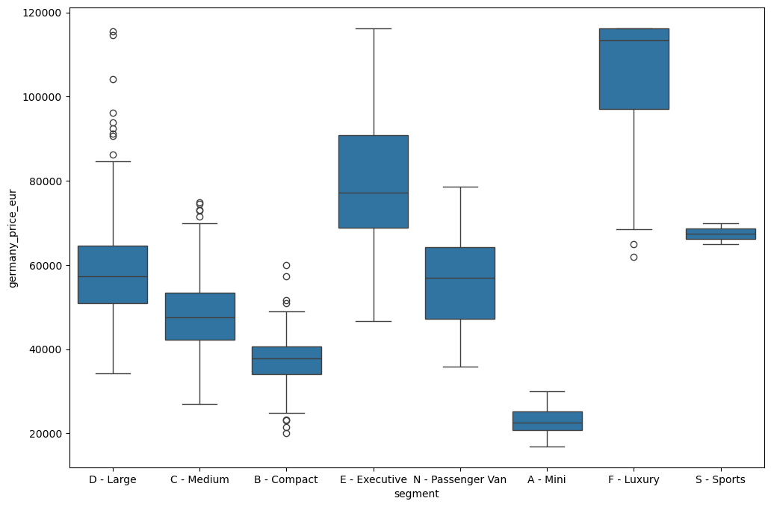
Bivariate Analysis — Price vs Range & Segment vs Price
Price vs Range Insight
Moderate positive correlation; some mid-range vehicles match premium range at lower price
Technology differences between brands create efficiency gaps
Segment vs Price Insight
Luxury segments show significantly wider and higher price distributions (box plot)
Price premium in luxury reflects brand positioning, not just engineering specs

Slide 22
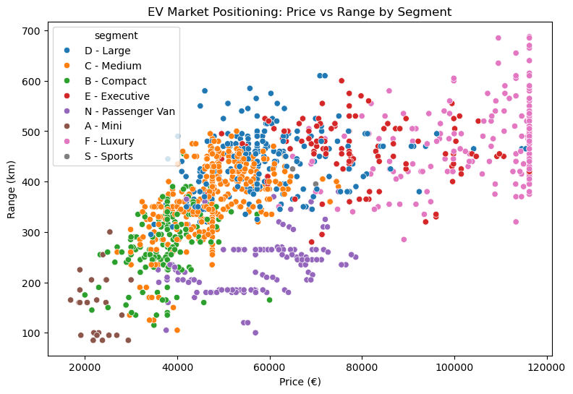
Multivariate Analysis — EV Market Positioning by Segment
Insight
Clear segment clustering visible across price-range spectrum
C-segment: moderate price, moderate range — best value positioning
D-segment: higher range, moderate premium — family-oriented value
Luxury segments: highest price but NOT proportionally higher range

Slide 23
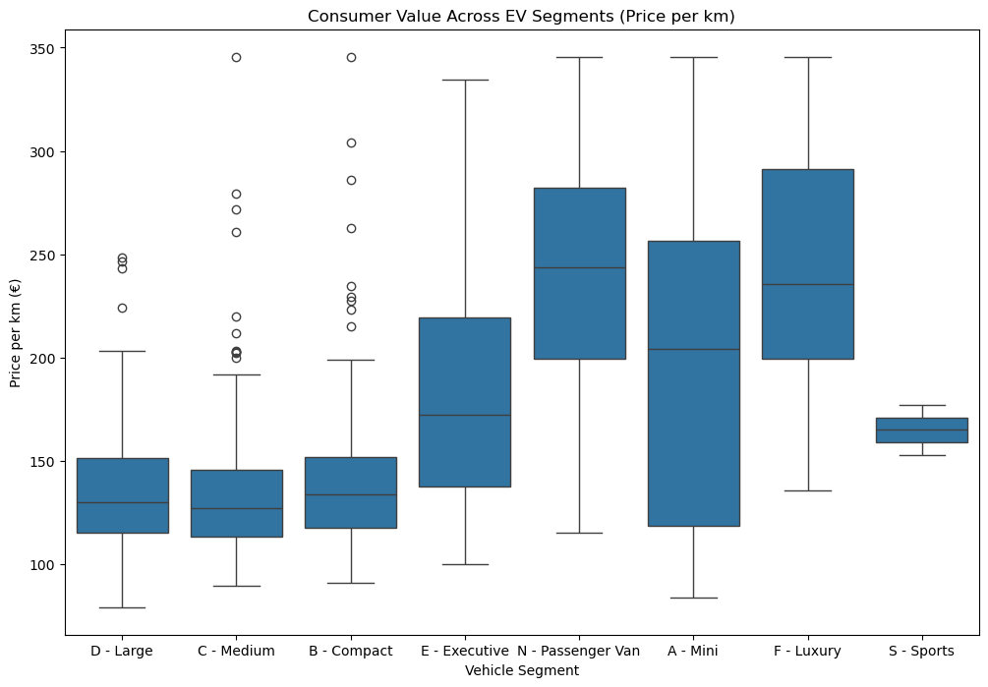
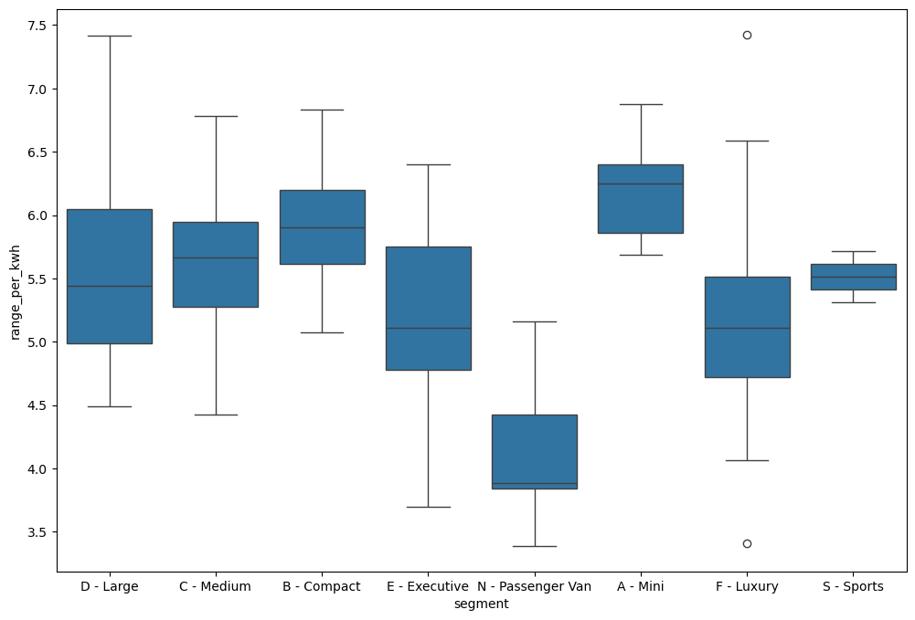
Multivariate Analysis — Consumer Value & Efficiency by Segment
Price per km Insight (Consumer Value)
C-segment consistently delivers lowest cost per km that means best consumer value
Luxury segments show highest and most variable price per km ratios
Range per kWh Insight (Efficiency)
Compact segments achieve best range that means lighter vehicles = more efficient
Larger luxury vehicles sacrifice efficiency due to increased weight

Slide 24
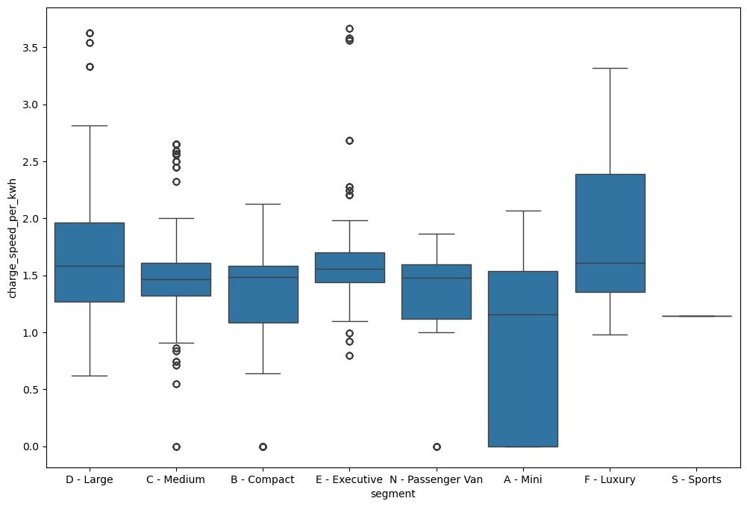
Multivariate Analysis — Charging Speed & Correlation Analysis
Charging Speed Insight
Higher segments generally support faster charging (kW/kWh)
Improves long-distance usability for premium segment buyers

Slide 25
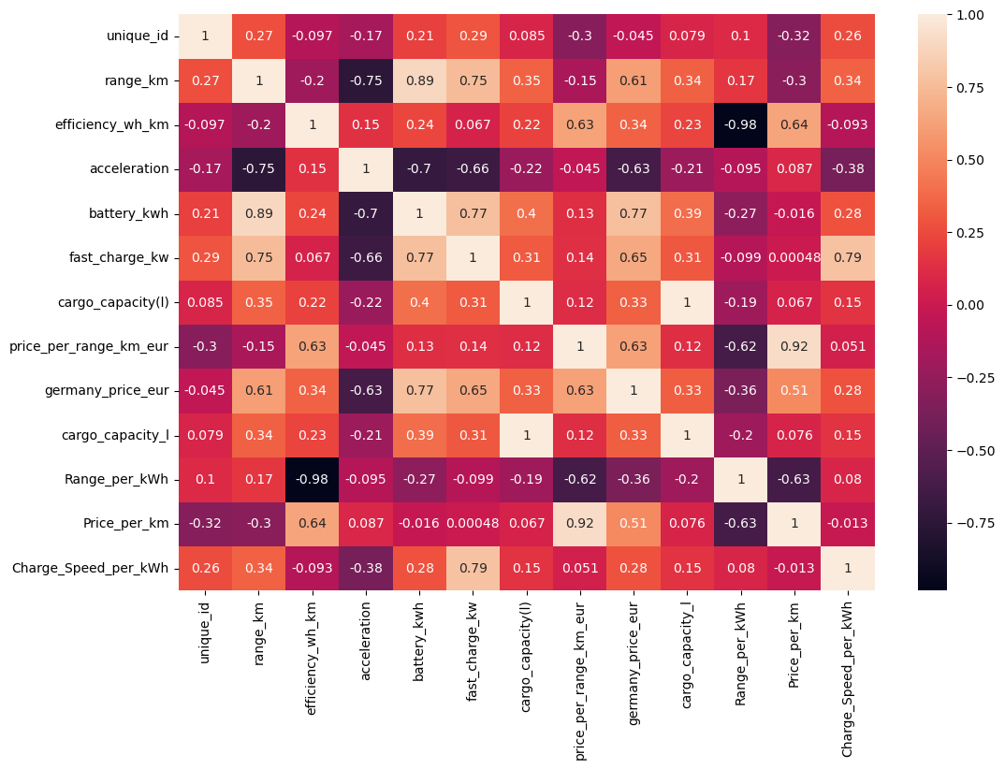
Correlation Heatmap Insight
battery_kwh ↔ range_km: r ~ 0.85 | germany_price_eur ↔ battery_kwh: r ~ 0.80
Battery capacity is the central variable driving both range and price

Slide 26
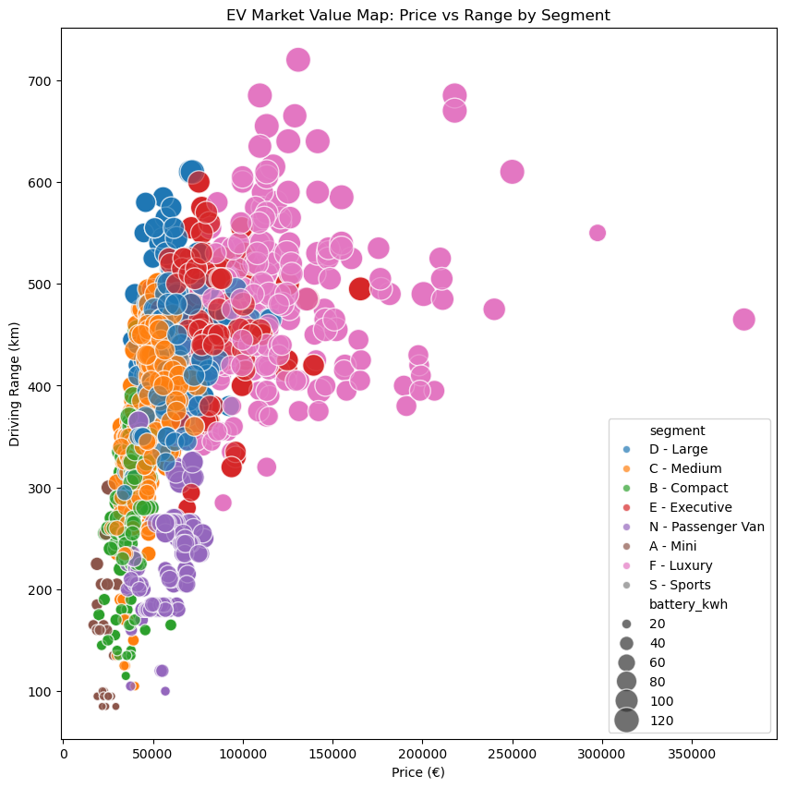
Visualization Insights — EV Market Value Map
Strategic Insight
Market equilibrium: EUR 40k–70k with 350–450 km is the dominant zone
Entry-level EVs target price-sensitive consumers but sacrifice range
Luxury EVs charge 2–3x premium vs mid-range, delivering only 20–30% more range

Slide 27
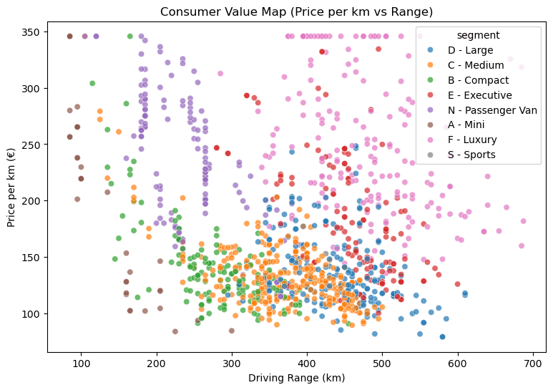
Visualization Insights — Consumer Value Frontier
Consumer Value Frontier Insight
Mid-size segments (C/D) deliver strongest value: competitive range at lower price/km
Premium segments command significant cost-per-km premiums without proportional range gains

Slide 28
Final Insights & Conclusion
1. Market Structure
EV market is dominated by mid-size (C/D) and large segments — greatest volume opportunity
2. Value Leadership
C-segment EVs consistently lead on consumer value metrics
3. Efficiency Gap
Premium EVs sacrifice energy efficiency for vehicle weight and performance tuning
Compact segments achieve best range— physics and aerodynamics advantage
4. Price Premium Reality
Luxury price premiums are primarily brand-driven, not engineering-driven
2–3x price premium delivers only 20–30% additional driving range
5. Battery Optimization
~70 kWh is the market-optimal battery — efficiency and cost balanced beyond this is diminishing

Slide 29
Recommendations
For Consumers
Best value: Choose C or D segment EVs in the EUR 45k–65k range for optimal price-per-km
Urban buyers: A/B segment EVs are cost-efficient for daily commutes under 200 km
Prioritize range over battery size — efficiency matters more than raw capacity
For Manufacturers
Invest in range R&D — efficiency improvements create sustainable competitive advantage
Price strategically in C/D segment: value transparency builds consumer trust
Expand fast-charging compatibility across all segments to improve adoption rates
For Policymakers
Incentivize C/D segment EV purchases to maximize consumer adoption and market growth
Support charging infrastructure expansion — critical enabler for higher-segment EV adoption

Slide 30

THANK YOU

